Slide 1
Kit

Slide 2
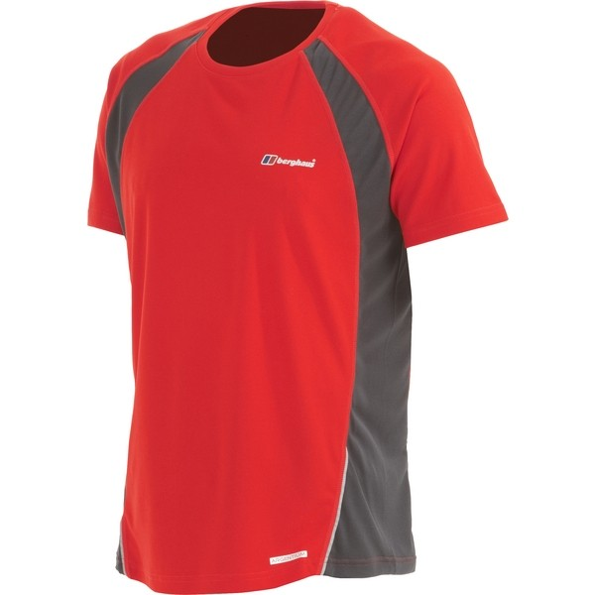
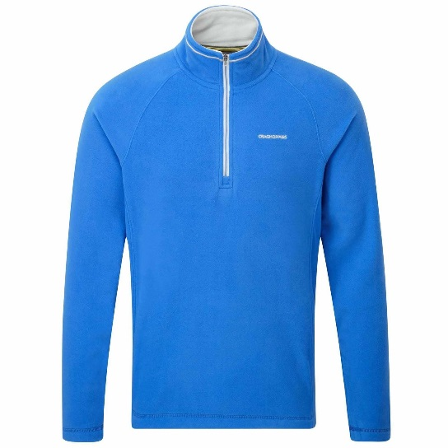
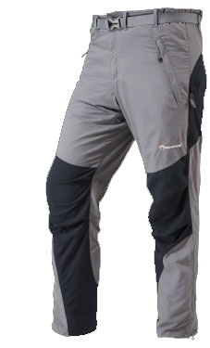
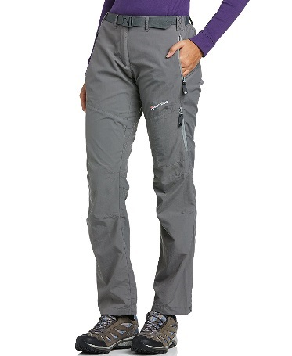
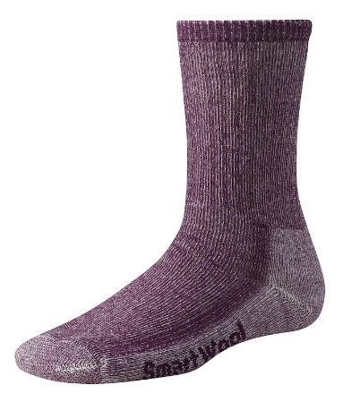
What to wear
Base layer
Quick-drying
Light weight
Warm tops
Fleece
Light weight
Trousers
Light weight
Comfortable
Quick-drying
Socks
Thick and comfortable
Higher than boot
Made from wool

Slide 3
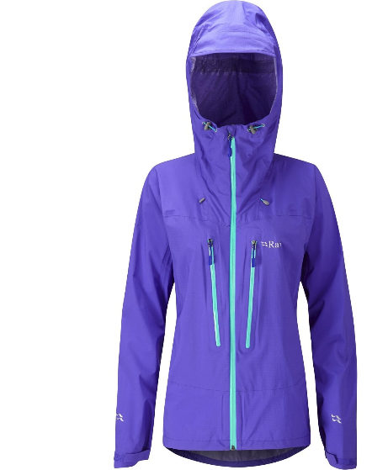
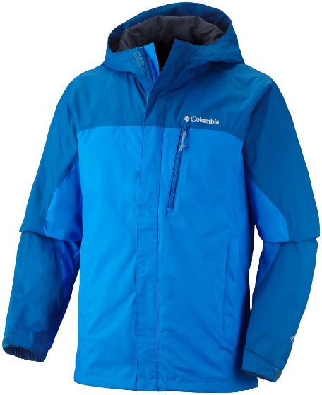
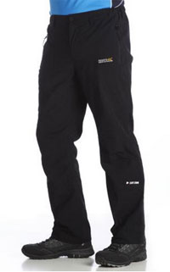
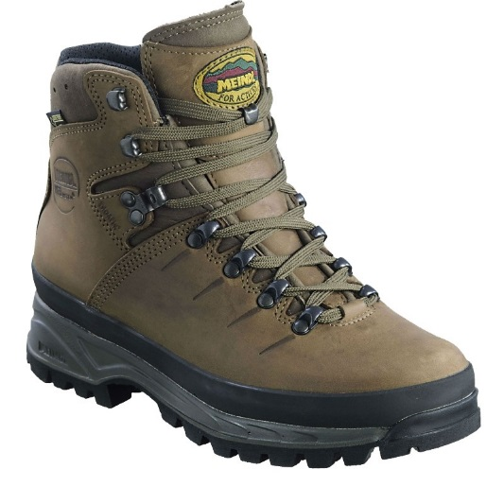
What to wear
Waterproof jacket
Waterproof fabric (Gortex, E-vent)
Light weight
Breathable
Boots
Sit and laced above the ankle
Waterproof fabric
Hard wearing
A good grip sole (Vibram)
Waterproof trousers
Waterproof fabric (Gortex, E-vent)
Light weight
Breathable

Slide 4
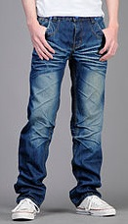
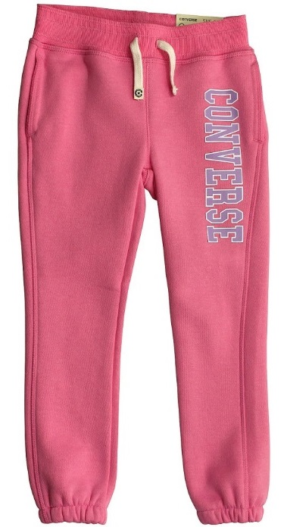
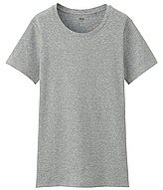
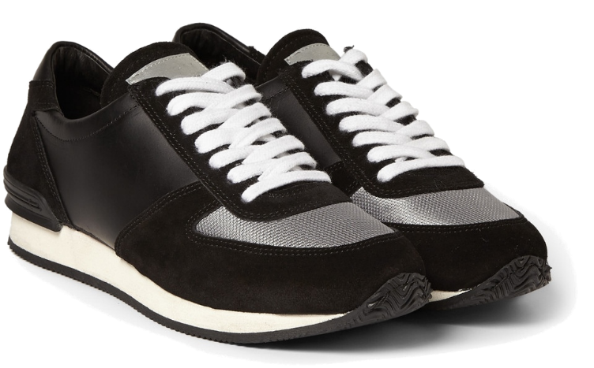
What NOT to wear
NO JEANS
No cotton
Heavy
Does not dry quickly
Stays cold
No trainers
No ankle support
Poor grip
Not waterproof

Slide 5
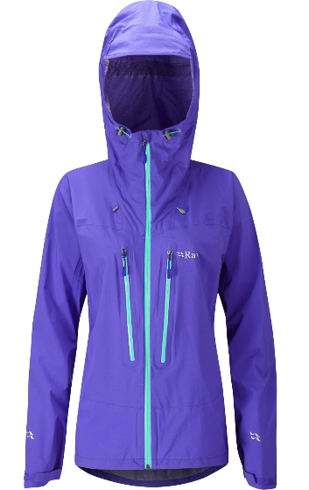
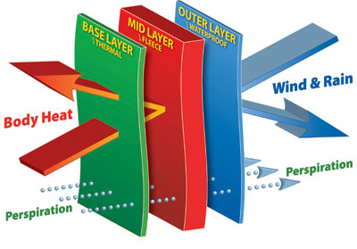
Layering system
Base Layer
Helps to regulate your body temperature and wick away moisture from your skin.
Mid-layer
Used to trap the warmth your body generates
Outer-layer
Protects you from wind and rain

Slide 6
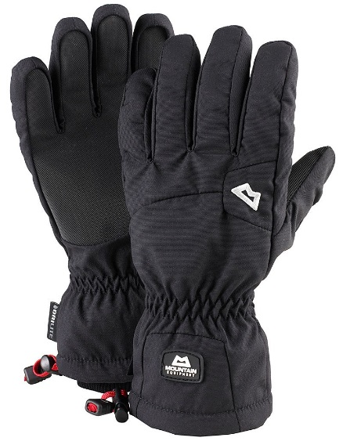
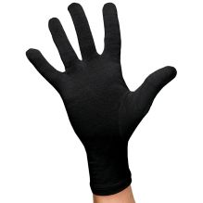
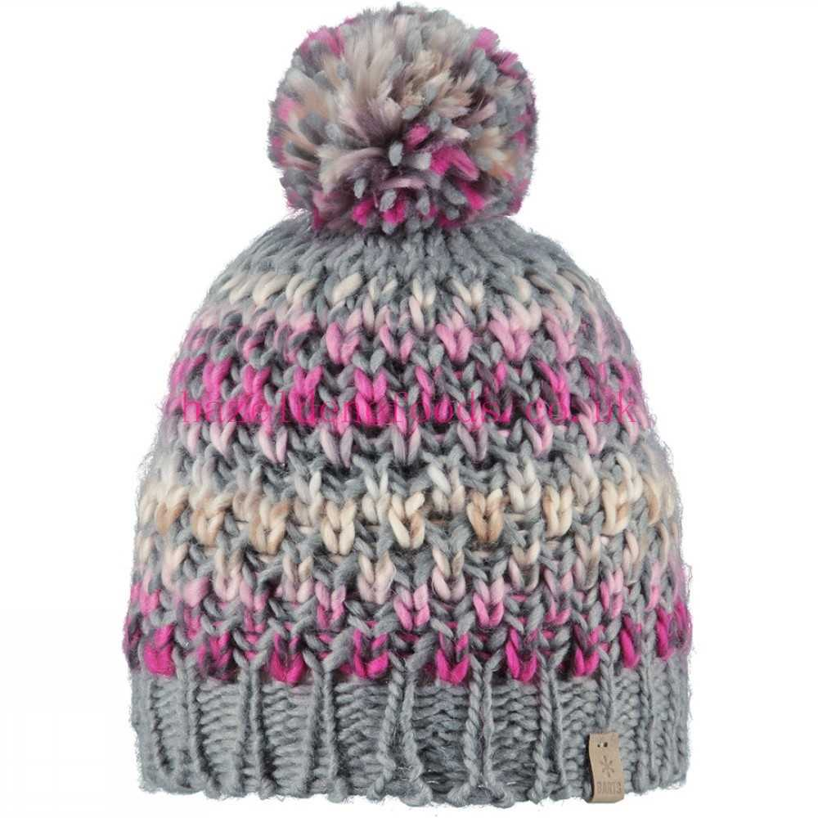
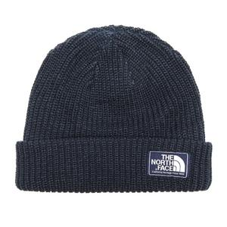
What else do you need?
Gloves
Your hands will be the first things to get cold. Cold hands can make simple tasks like getting into your rucksack or tying your boot laces difficult. Have multiple pairs.
Hats
You loose a huge amount of heat out of your head. Have multiple hats.

Slide 7
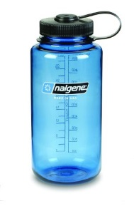
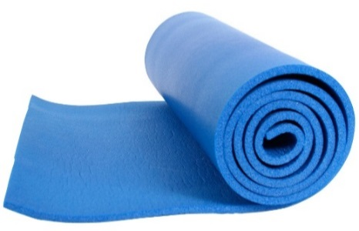
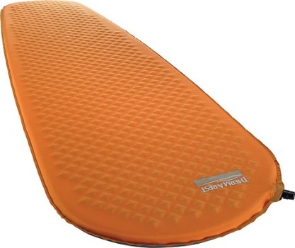
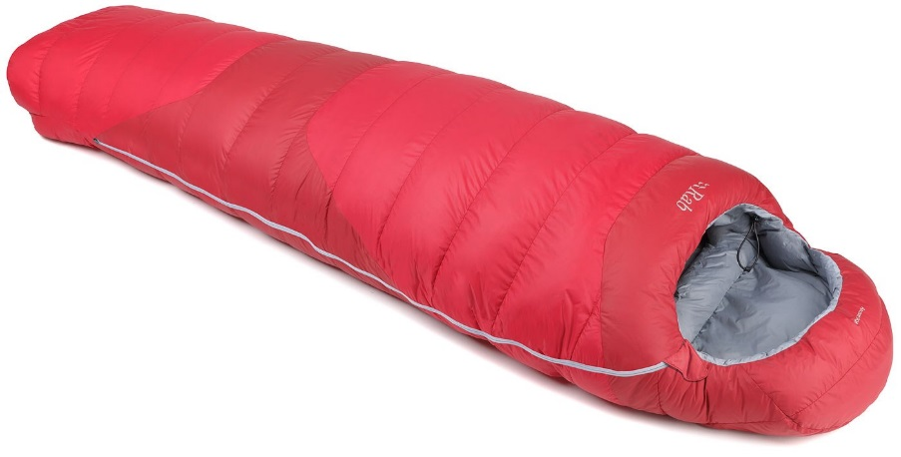
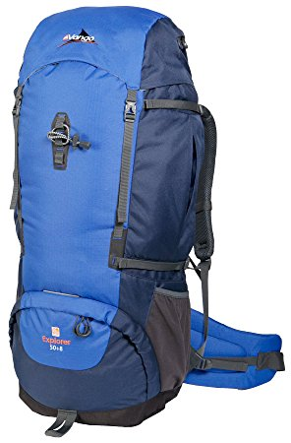
What else do you need?
Roll Mat
To sleep on
Protects you from the cold ground
Water bottle
Minimum 1 Litre
Rucksack
50-60 Litres
Comfortable waist and shoulder straps
Sleeping bag
Keeps you warm
At least 2 season
Pack down to a small size

Slide 8
Pack your rucksack

Slide 9
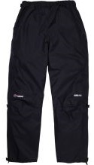
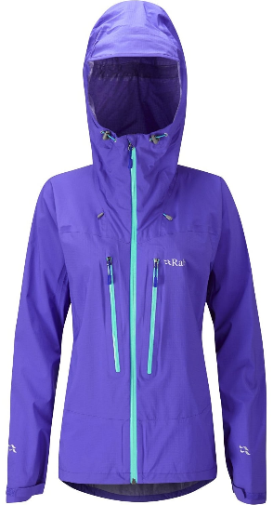
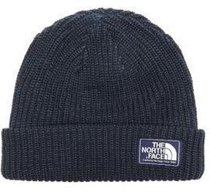
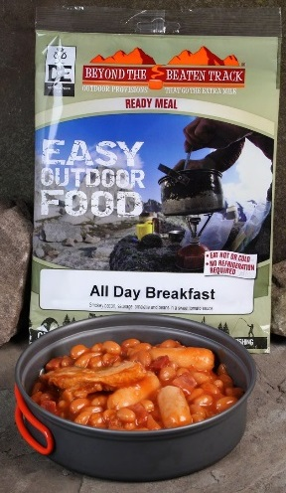
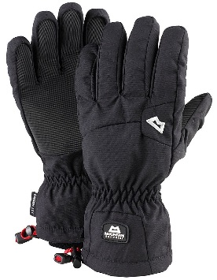
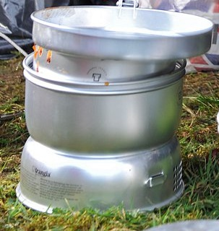
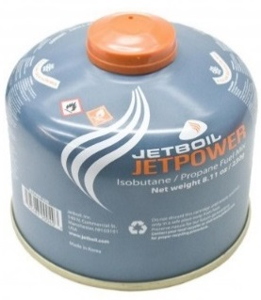
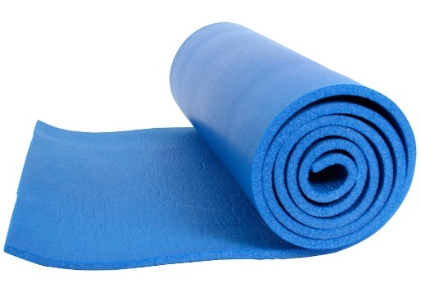
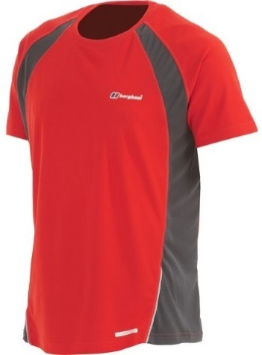
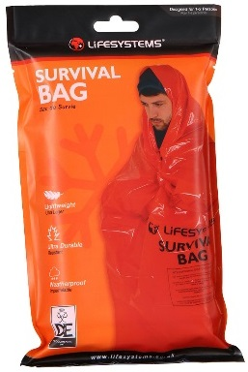
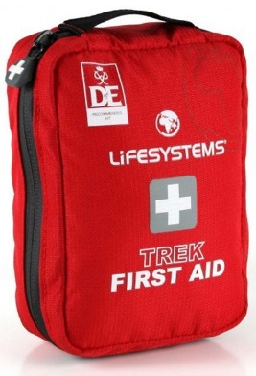
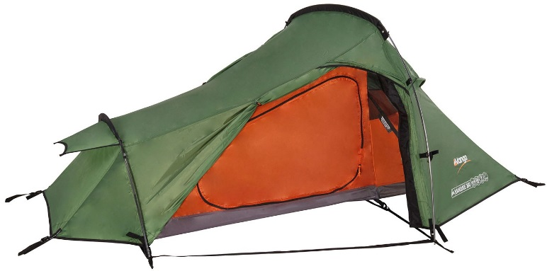
What are you carrying?

Slide 10
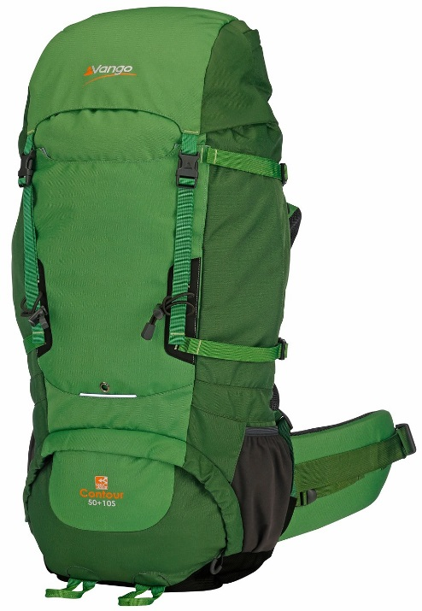
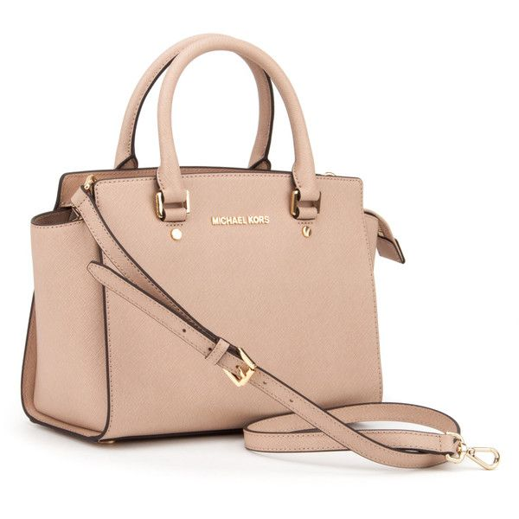
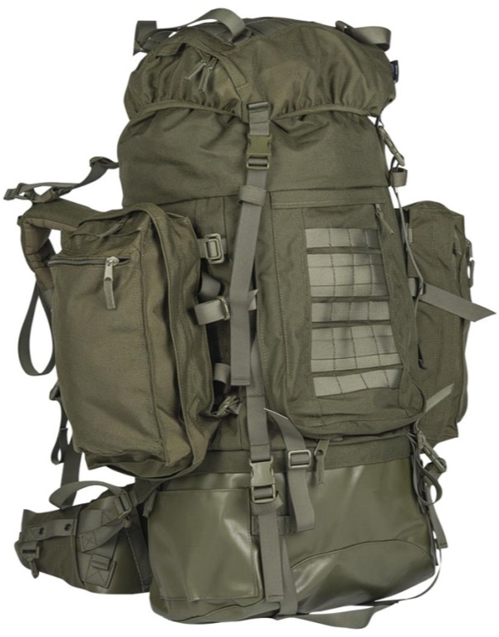
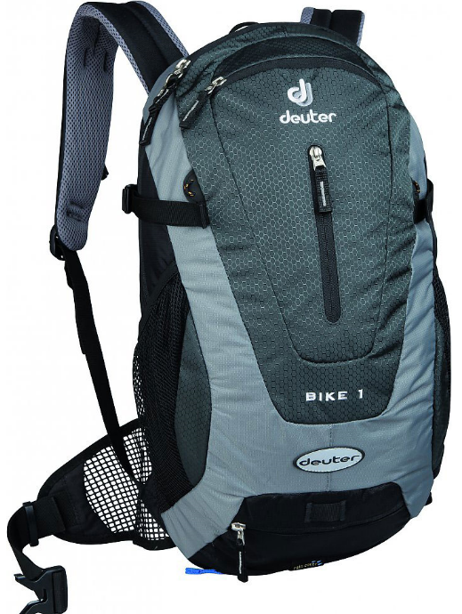
Type of bag

Slide 11
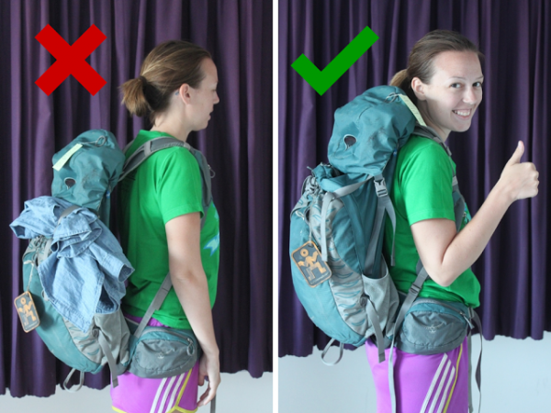
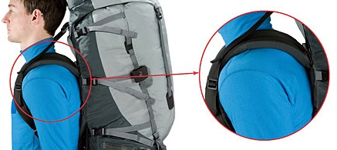
Fitting my rucksack
Loosen all straps before putting on.
Tighten the waist strap to fit snugly on your hips. Remember this is where most of the weight will be supported.
Adjust shoulder straps. You may need to raise or lower the shoulder straps according to your height. The straps should fit close to your shoulders.

Slide 12
How to pack
Items you need quick access to at the top.
Items you will need at the end of the day at the bottom.
Heavy items close to your back.
Approx. weight 10kg – 14kg.

Slide 13
Tents

Slide 14
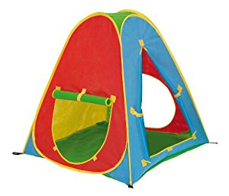
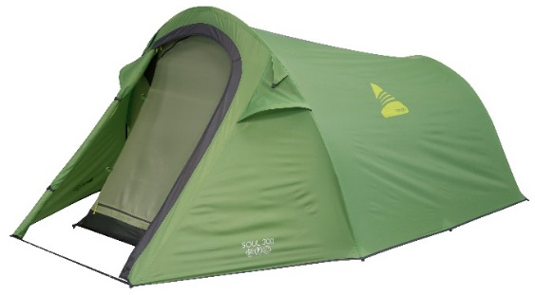
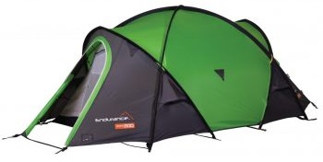
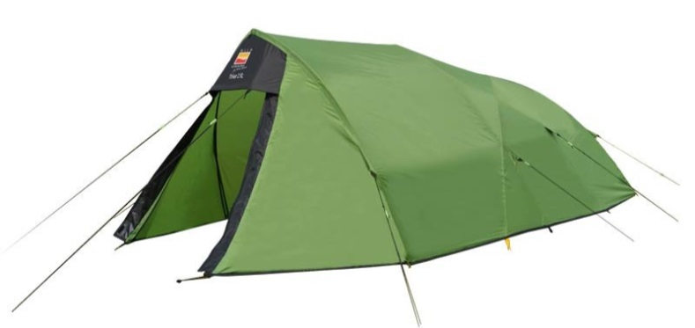
Pop up tent
Just NO!
1 Person tent
Light
Not a lot of space
Easy to pitch
2 Person tent
Light
Bigger porch area
Simple to pitch
3 Person tent
Heavy
More space
Harder to pitch

Slide 15
Pitching your tent
Select a suitable place to pitch your tent.
Clear away any stones and sticks.
Work together.
Be careful when putting the polls through the sleeves.
Make sure all the guy-ropes are pegged down tightly.

Slide 16
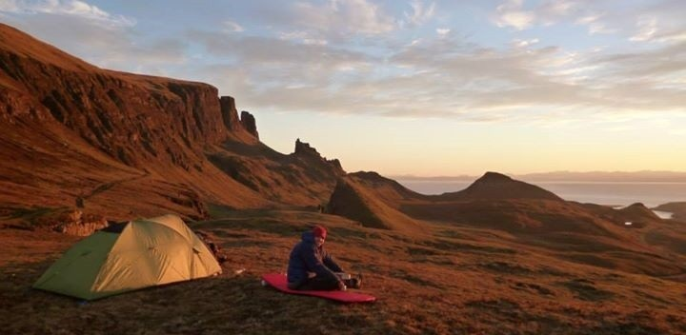
Looking after your tent
Be careful when pitching your tent. Avoid forcing pols into place, this can result in damage to the tent.
Same goes for taking it down.
After each trip it is essential that you dry out and air your tent. Do this by putting it up in a cool and dry environment. Example - garage.
Make sure you pack it away dry and clean. This prevents the tent becoming mouldy.

