Slide 1
Navigation and route planning

Slide 2
Types of maps
Orienteering
Very detailed
Come in a variety of scales
Great for learning Navigation

Slide 3
Types of maps
1:25 Ordinance Survey
Lots of detail.
Show all rights of way and open access land.
1 Square = 1 Kilometre

Slide 4
Types of maps
1:50 Ordinance Survey
Less detailed than 1:25.
Great for planning a long distance route.
Contours are every 10m.

Slide 5
Map symbols
Campsite
Nature reserve
School
Trees
View point

Slide 6
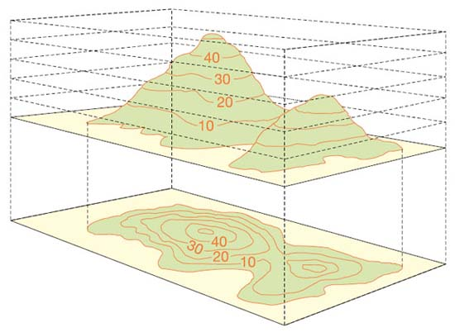
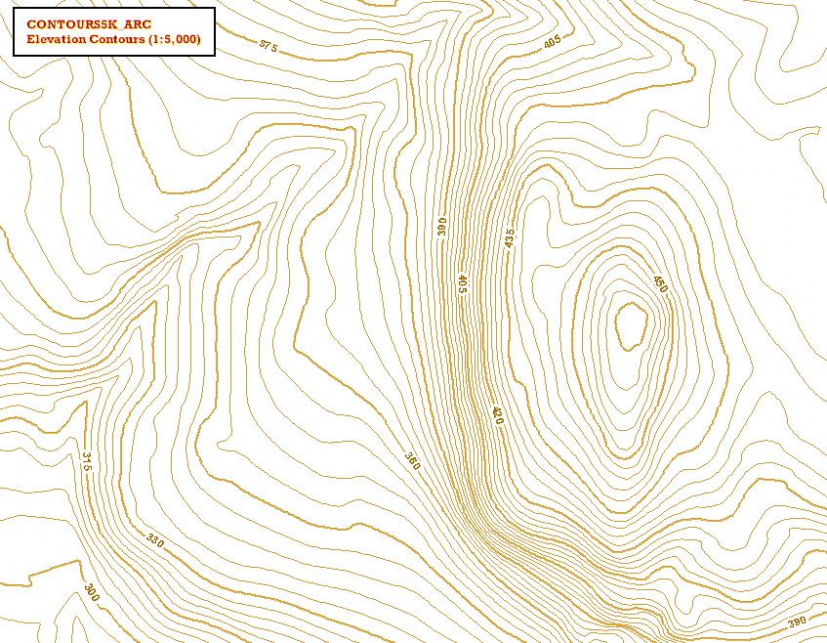
Contours
A contour line joins points of equal height and they do this at intervals usually of 10m above sea level.
Contours are the most reliable information on our maps.
Shallow Slope
Top
Ridge
Re-entrant
Steep slope

Slide 7
The 5 Ds
Destination – “Where am I going?”
Direction – “Which way am I going?”
Distance – “How far is it?”
Duration - “How long is it going to take me?”
Details – “What am I going to see along the way?”
Remembering and using these questions can help you plan your route and prevent you from getting lost on your expedition.

Slide 8
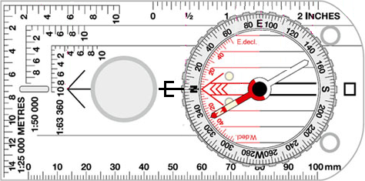
Compass
Orienting lines
Orienting arrow
Compass needle
Romer scales
Compass housing
Direction of travel arrow
Magnifier
Baseplate

Slide 9
Taking a bearing
From the map to the real world
Line up the edge of the base plate from your start point to the end point.
Turn the compass housing so that the orientating arrow lines up with the grid lines running north.
Take the compass off the map and turn the compass so that the red needle lines up with the red arrow.

Slide 10
Taking a bearing
From the real world to the map
Point the direction of travel arrow to the target.
Turn the compass housing so the red arrow lines up with the red end of the needle.
Place the compass on the map with the red arrow pointing north and is parallel to the grid lines.

Slide 11
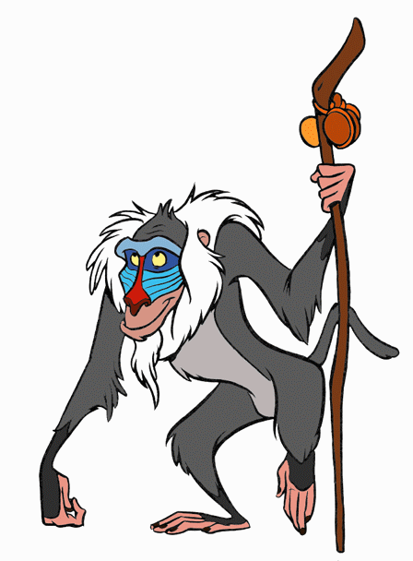
Grid reference
07
Allows you to communicate a location to another person.
The rule for a grid references is: “Along the corridor and up the stairs.”
This means quoting the easting number first and then the northing number.
For example Aladdin’s grid reference is 03 02.
Northings
06
05
04
03
02
01
00
01
02
03
04
05
06
07
Eastings

Slide 12
6 Figure Grid Reference
07
A 6 figure grid reference is a more accurate way of communicating a position on the map.
You must split the grid square in to 100 smaller squares to get your extra number.
Example; Grumpy’s 6 figure grid reference is 027 064
Northings
06
02
03
Eastings

Slide 13
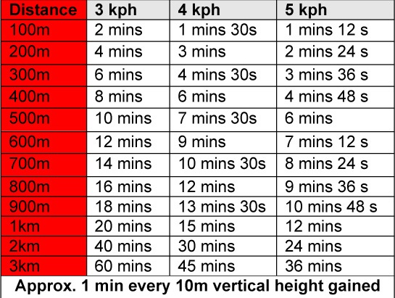
Timing and pacing
Timing and pacing is very useful to help you plan your route and for keeping track of where you are when you are out on your expedition.
Naismith's rule
This is used as a rule of thumb to calculate how long it will take you to walk up a step section of your walk.

Slide 14
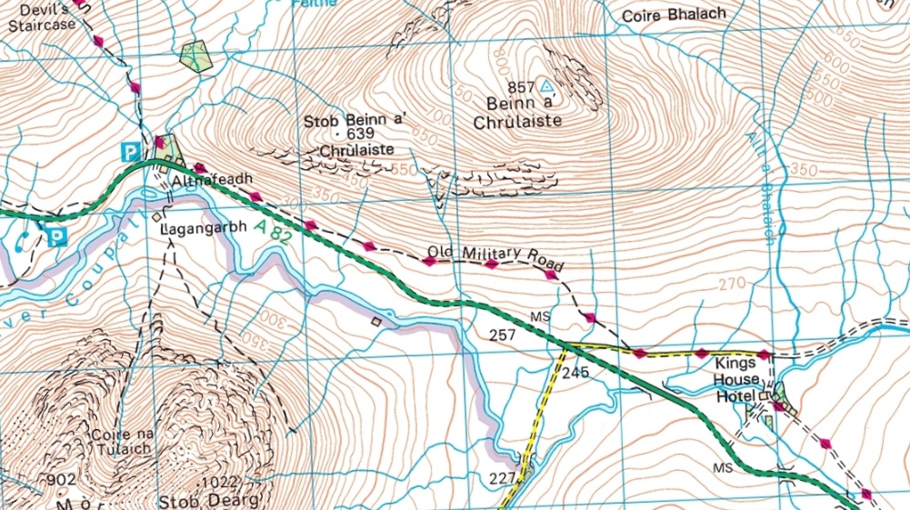
Plan a leg
To figure out how long it will take you to travel a certain distance you need to know: the speed you are traveling, distance travelled and the height gained.
Speed: 3km/h Distance: 4km Height gained: 70m
It will take you 1 hour and 20 minutes + 7 minutes for the height gain =
1 hour and 27 minutes

Slide 15
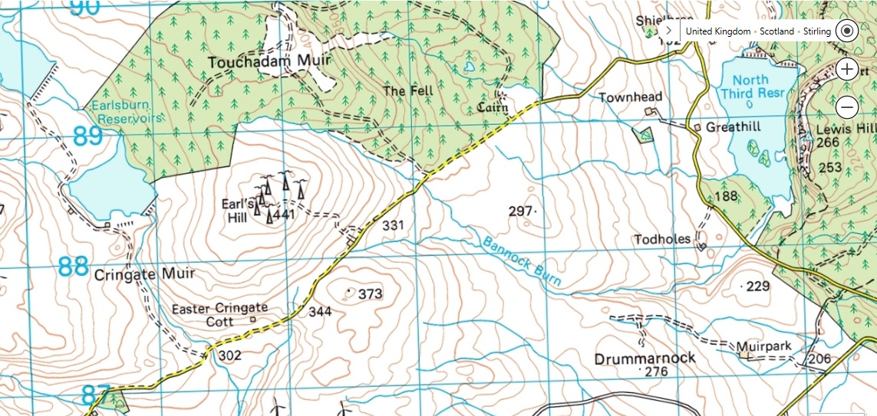
Hand rail
Following a linear feature: path, river, fence line

Slide 16
Catching future
An obvious feature or landmark that if you get to you know you have gone to far.

Slide 17
Aiming off
Reduces the chance of missing your intended point.

