Slide 1
Food & Cooking

Slide 2
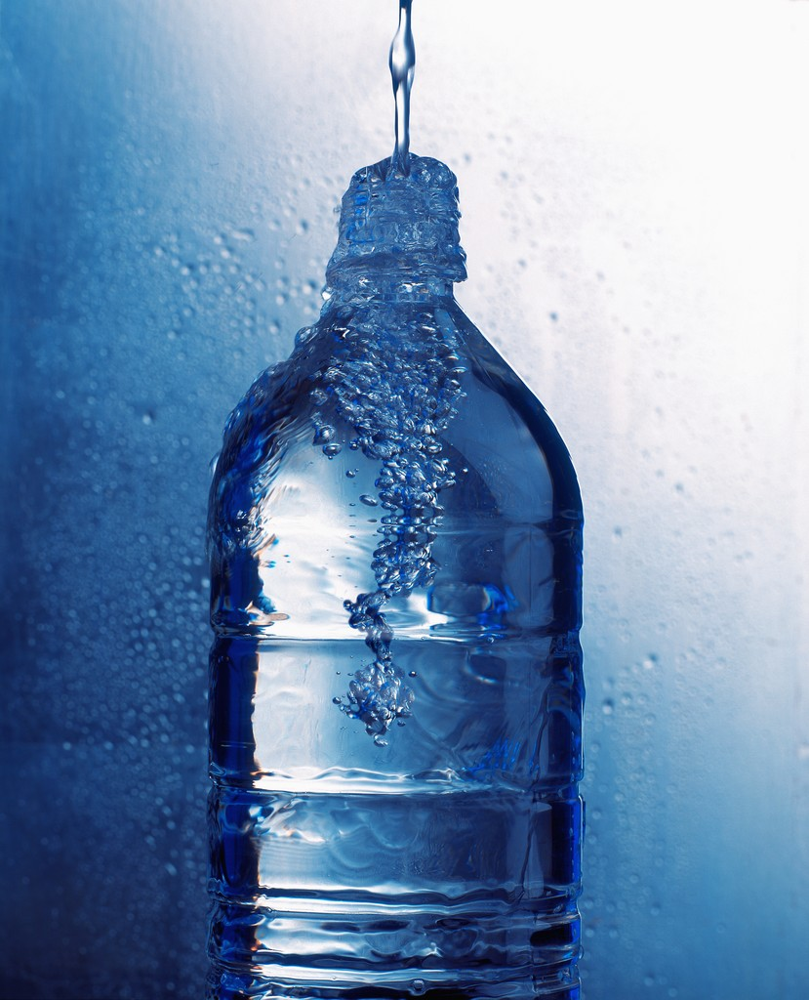
Food is fuel!!!
Food and drink are extremely important to the success of your expedition.
During your expedition you may burn up to 5000 calories a day! This means you need lots of high energy foods to keep you going.
Staying hydrated is also extremely important. You should be drinking at least 2 litres of water through out the day.

Slide 3
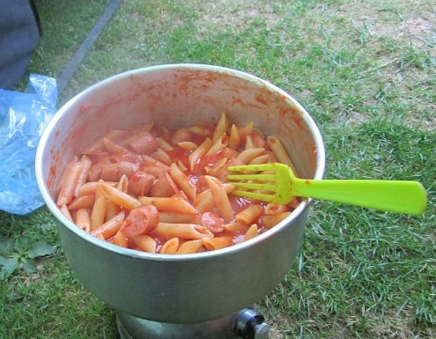
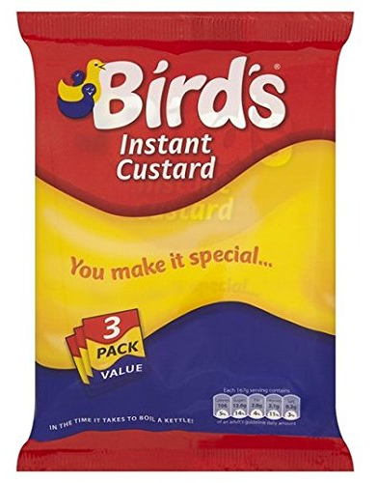
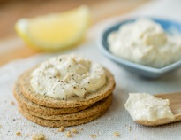
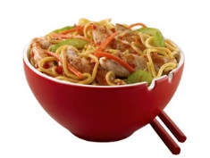
What food should I take?
Breakfast
Portage
Beans & Bacon
Tea or Coffee
Dinner
Pasta and sauce
Couscous
Chicken and sweet chilli stir-fry
Chocolate cake and custard
Lunch
Sandwiches
Pizza
Oatcakes and Hummus
Wraps

Slide 4
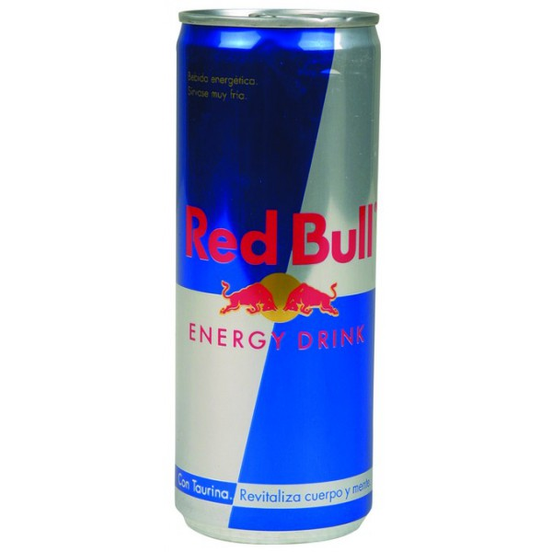
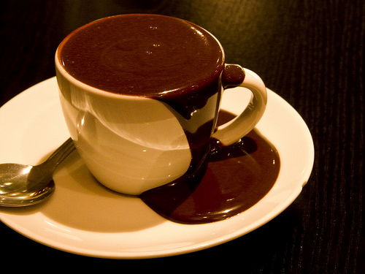
Things to avoid
Tinned food
Crisps
Chocolate (in hot weather)
Fresh meat and veg
Energy drinks (Red Bull, Monster Lucozade)

Slide 5
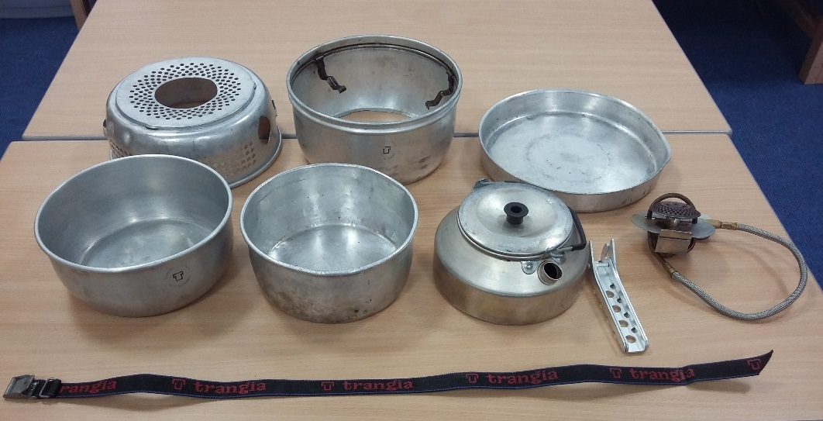
Stove safety
Find a flat area preferably not in woodland or near long grass.
Minimum 2 metres away from your tents.
Do not leave a lit stove unattended.
Always use the handle to move pots.
Allow the stove to cool before dismantling.
Wind stopper & pot stand
Frying pan & lid
Base
Gas connecter
Large pot
Handel
Strap
Small pot
Kettle

Slide 6
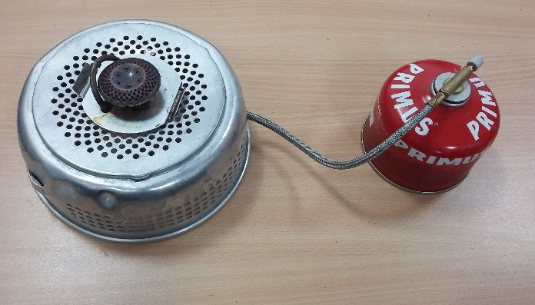
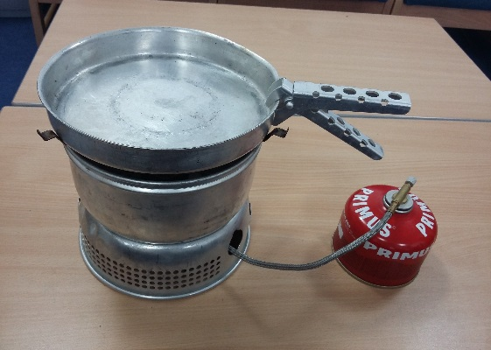
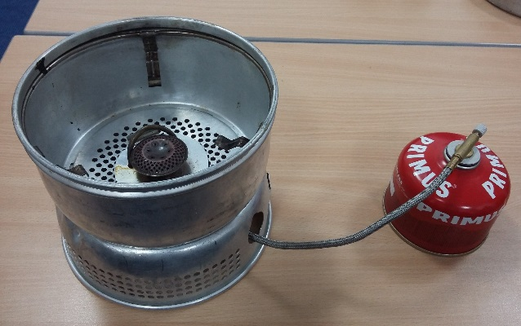
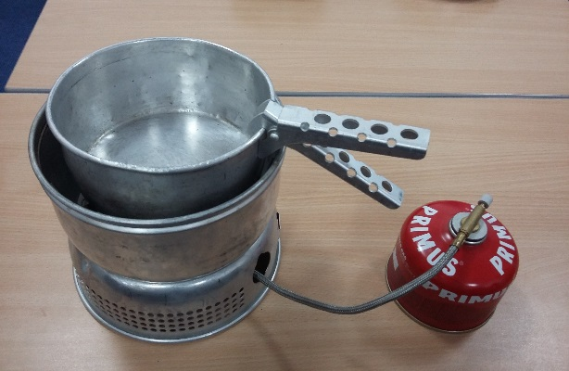
Stove safety
Position gas connector & attach to gas canister.
Using the handle place pan in position.
Fix wind stopper using the slots.
Using handle place pot in position.

