Slide 1
20 Conditions & Aim

Slide 2

20 Conditions
Your expedition must be by your own physical effort, without any motorised or outside assistance.
Your expedition must be unaccompanied and self-sufficient.
Your expeditions must be supervised by an adult who is able to accept responsibility for the safety of you and your team.
Your expedition must have an aim.
You must be properly equipped for your expedition.

Slide 3
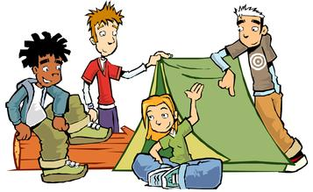
20 Conditions
You must have completed the required training and practice expeditions.
At least one practice expedition must be undertaken at each level of the programme, in the same mode of travel in a similar environment to the qualifying expedition.
You and your team must plan and organise your expedition.
You must be assessed by an approved accredited Assessor to the DofE.
There must be between four and seven people in your team

Slide 4

20 Conditions
You must be within the qualifying age of the DofE programme level.
Participants must be at the same level of assessment.
Your team must not include anyone who has completed the same or higher level DofE expedition.
Your overnight accommodation should be camping.
Your expedition must be the minimum number of days required for your DofE level.

Slide 5

20 Conditions
Your expedition should normally take place between the end of March and the end of October.
Your expedition should be in the recommended environment for your DofE level.
You must do the minimum hours of planned daily activity for your DofE level.
You should cook and eat a substantial meal each day.
You must create and deliver a presentation after your expedition to complete the section.

Slide 6
Expedition Aim
Gives a purpose to the expedition
Can be expressed as a single sentence
Is compatible with a self-sufficient and unaccompanied expedition
Is suitable for the appropriate expedition environment
Is suitable for the chosen expedition destination
Is suitable for the chosen mode of travel
Involves the team actively doing something during the expedition
Involves every member of the team at some point
Is something the team are interested in
Has results that can be presented

Slide 7

Presentation
A written report
A verbal presentation performed as interpretive dance/theatre/a skit/poetry/song
Delivery of a DofE session or educational
Any other appropriate way you can come up with to present the results of your work

