Slide 1
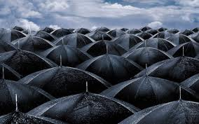
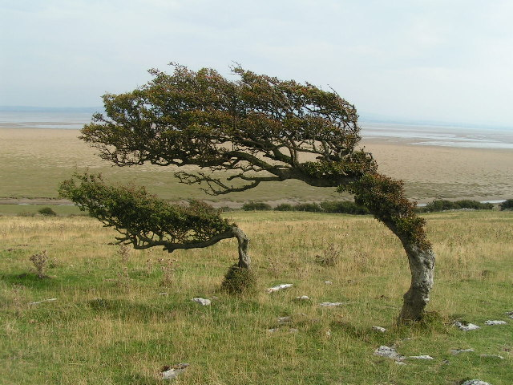
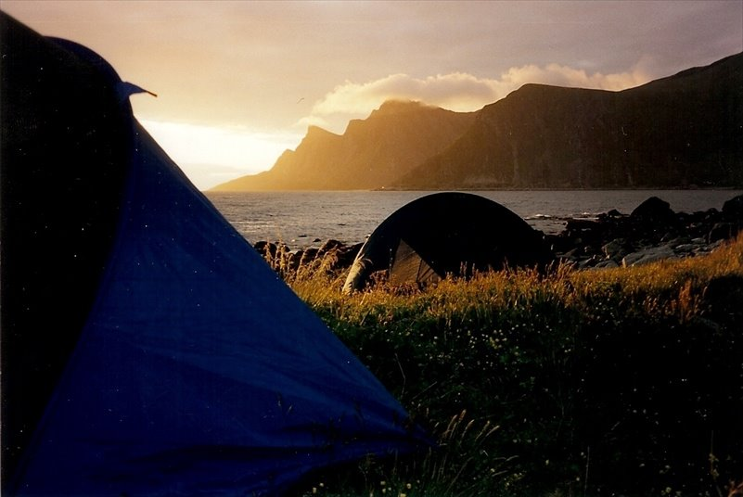
The Weather
d

Slide 2
What makes the weather?
All of earths many kinds of weather depend on two things…water and the sun.
Water moves between
seas, skies and
land, forming clouds
and all other types
of wet weather
The sun heats the
earth and causes air
to move from place
to place. We feel
this air movement
as winds.
Without these different types of weather, no life could exist on Earth.

Slide 3
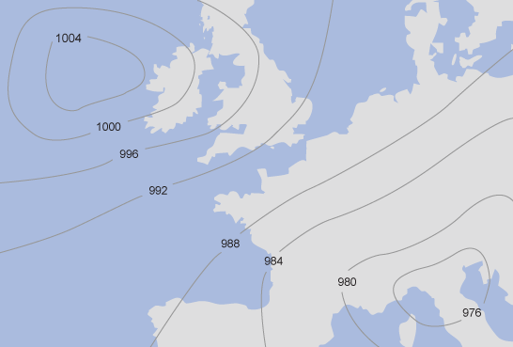
Isobars are lines on a weather map joining together places of equal atmospheric pressure. On the map the isobar marked 1004 represents an area of high pressure, while the isobar marked 976 represents an area of low pressure.

Slide 4
The numbers measure the atmospheric pressure in millibars.
Usually isobars are drawn at intervals of two or four millibars
The closer the isobars are together the windier it is.
If the lowest number is in the middle circle this is a low pressure or depression. Often low pressures mean wet and windy weather.
If the highest number is in the middle circle, this is a high pressure or anticyclone. Often high pressures mean dry, sunny weather.
Air pressure tends to range from 890 mb (a hurricane) to 1060 mb (an anticyclone).

Slide 5
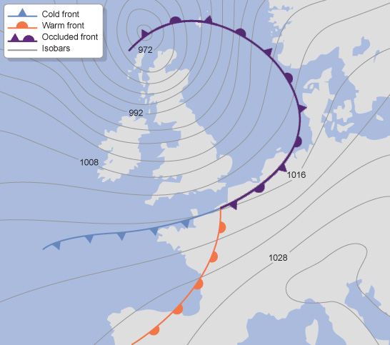
The weather map below shows a low pressure, centred to the north of Scotland. As we move away from the centre the isobars increase in atmospheric pressure and become wider apart. There is a zone of high pressure over Italy in the southeast corner of the map.

Slide 6
Fronts
Fronts occur where two different air masses meet.
Warm fronts are formed when warm air rises over a mass of cold air. As the air lifts into regions of lower pressure, it expands, cools and condenses the water vapour as wide, flat sheets of cloud.
Cold fronts are usually associated with depressions. A cold front is the transition zone where a cold air mass is replacing the warmer air mass. The cold air is following the warm air and gradually moves underneath the warmer air. When the warm air is pushed upwards it will rain heavily. Often more rain will fall in the few minutes the cold front passes than it will during the whole passage of a warm front. As the cold front passes, the clouds roll by and the air temperature is cooler.
Occluded fronts occur at the point where a cold front takes over a warm front or the other way around. If a cold front undercuts a warm front it is known as a cold occlusion and if the cold front rises over the warm front it is called a warm occlusion. Occluded fronts bring changeable weather conditions.

Slide 7
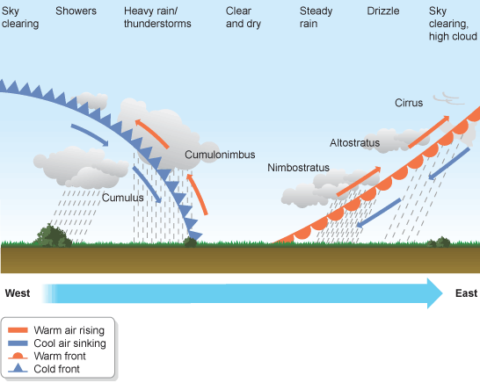
Depressions
Depressions are areas of low atmospheric pressure which produce cloudy, rainy and windy weather. These low-pressure systems often begin in the Atlantic, moving eastwards towards the UK. They are responsible for the UK's changeable weather.
The diagram shows a depression with a leading warm front and a trailing cold front moving from west to east across Britain.

Slide 8
At the warm front, lighter, warmer air from the south (tropical maritime air) meets cooler air from the north (polar maritime air) and rises gradually over it.
As the warm air slowly rises it cools, its water content condenses and clouds form (nimbostratus then altostratus). The result is steady rain, later giving way to drizzle and finally clearer skies with high cirrus clouds.
Behind the warm front is an area of warm, rising air and low pressure - the centre of the low-pressure system. As this part of the depression passes over, there may be a short period of clear, dry weather. However, at the trailing cold front, heavier, cooler air meets the warm air at the centre of the depression, undercutting it and forcing it steeply upwards. Quickly moving air masses produce high winds and cooler temperatures.
As the rapidly rising warm air cools, its water condenses and clouds form (cumulonimbus, then cumulus). The result is heavy rain or thunderstorms, giving way to showers and finally to clear skies as the cold front moves away eastwards.

Slide 9
Anticyclones
Anticyclones are the opposite of depressions - they are an area of high atmospheric pressure where the air is sinking.
As the air is sinking, not rising, no clouds or rain are formed. This is because as the air sinks it warms, meaning it can hold more water.
The absence of fronts means winds may be very light.
Consequently, high-pressure areas are often associated with settled, dry and bright conditions.
In summer, anticyclones bring dry, hot weather. In winter, clear skies may bring cold nights and frost.
In cold conditions, anticyclones may also bring fog and mist. This is because the cold forces moisture in the air to condense at low altitudes.

Slide 10
Clouds
There are four main families of cloud, based on the height at which they form.
There are many other types of cloud within these families.
We will have a look at the most common.

Slide 11
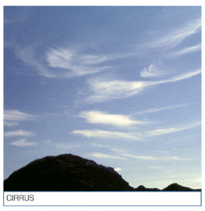
Cirrus
Cirrus show that there is a lot of wind high in the atmosphere which means that the weather is probably about to change. Often seen before a warm front.

Slide 12
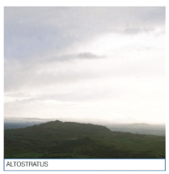
Altostratus
Altostratus forms when large areas of air are moving slowly upwards. Can be seen before a warm or occluded front.

Slide 13
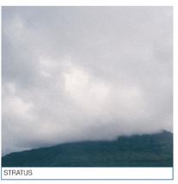
Stratus
Stratus formed when the air is very humid and often produces drizzle. Usually found in the warm sector.

Slide 14
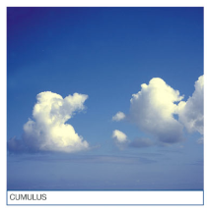
Cumulus
Cumulus is a fair weather cloud. Found when there us a ridge of high pressure in the warm sector or near the coast during an anticyclone where they show that there is a sea breeze.They are fluffy and white and you usually see them on warm summers days. If they start to pile on top of each other they create cumulonimbus clouds which will signify a storm.

Slide 15
Forecasting
There are many ways to check the whether forecast, however it is a good idea to have a knowledge of how weather is changing.
How can you do this?

Slide 16
Weather
What sources of information can we use to find out the weather?

Slide 17
Weather Forecasts
Radio- Both national and local stations give good forecasts. Shipping forecasts can be very accurate.
Newspapers put their forecast in print but they work 12-24 hours beforehand and tend to be less accurate because of this.
Weathercall is a 24hr recorded forecast. There are specific numbers for each area but. For UK 09068 500 400.
Fax- the MET office has a very good fax service giving good detail and maps of weather systems. Fax for Scottish Weather (5 day forecast); 09060 100 418
Internet websites such as ????

Slide 18
Websites
http://www.mwis.org.uk/
http://www.metoffice.gov.uk/
http://www.biber.fsnet.co.uk/weather.html
What other good websites can you find? Try and find one new one each

Slide 19
Weather Activity
You have been given a small map. You have planned the following qualifying expedition. You have a mini bus and two qualified expedition leaders for 12 young people:
Start Artgarten GR 269037 pass through 301070
Camp GR 287089
End GR 265097 pass through 309075
It has been raining non stop for several days and when you get there you realise that this has had a big effect on the water that is coming off of Beinn Narnain.
Discuss the following:
Do you still try to run the expedition?
If so do you need to make any route adjustment?
Can you still camp at the original camp site?
If not where will you camp?
Will your young people still get three hours of walking in?

Slide 20
Weather Activity
If you had planned a completely alternative route in a different location. Where would be a good place?
Why?

Slide 21
Remember
There is no such thing as bad weather, just bad clothing, make sure you bring warm clothes with you and most importantly lots of layers. But we will cover this more in depth when we talk about equipment.

Slide 22
Weather quiz
www.cotf.edu/ete/modules/k4/online/Wonline1.html

