Slide 1
The Scottish Outdoor Access Codes

Slide 3
Key Principles
Respect the interests of others. Respect the needs of other people enjoying or working in the outdoors and follow any reasonable advice form land owners. Respect other’s privacy and peace of mind. Avoid causing alarm to people, especially at night, by keeping a reasonable distance from houses and gardens or by using paths or tracks.
Take Responsibility for your own actions. The outdoors is a great place to enjoy but it’s also a working environment and natural hazards exist. Make sure that you are aware of this, take care of yourself and others with you including your dog.
Care for the Environment. Do not do any damage to nature, pulling branches of trees for example or littering. Leave things as you find them and do not disturb animals.

Slide 7
Discussion: Is there anywhere that you think that your access rights don’t apply?

Slide 8
Access codes do not apply in
Houses, gardens, non residential buildings
Crop land
School land
Sport and playing fields
Golf courses (but you can cross)
Airfields, Railways, telecommunication sites, military bases, quarries
Visitor attractions that charge
Access rights do not extend if:
committing an offense, breaching peace, allowing dog to worry livestock, dropping litter, polluting water
hunting, shooting and fishing
motorised recreation or passage (unless by person with disability)
anyone responsible for dog not properly under control
taking anything away from land for commercial use
If you are breaking the law.

Slide 9
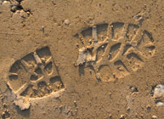
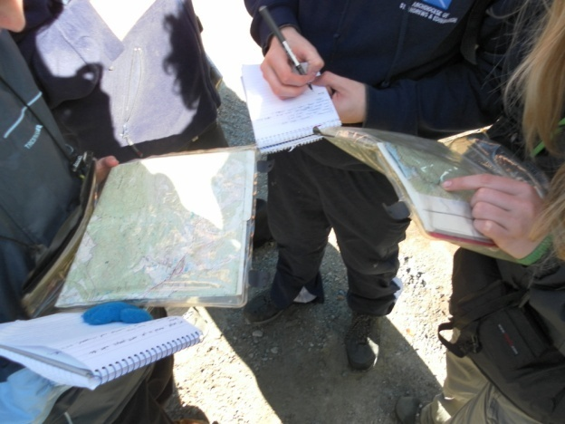
Taking nothing but pictures, Leave nothing but footprints, Kill nothing but time.

