Slide 1
Duke of Edinburgh’s Award
Bronze First Aid Training

Slide 2
Purposes of First Aid
Preserve life
Prevent further injury
Promote recovery

Slide 3
Principles of First Aid
Stay calm
Assess the situation
Carry out a primary survey – D R A B
Identify the injury or illness

Slide 4
Principles of First Aid cont
Give easy, appropriate and adequate treatment in a sensible order of priority -
Breathing, Bleeding, Burns, Bones
If casualty is not breathing & you need to commence CPR, call for help before you start
Organise removal of casualty to secondary care where appropriate
Make and pass on a report

Slide 5
Most Common Expedition Injuries
Blisters
Cuts & abrasions
Burns & scalds
Sprains

Slide 6
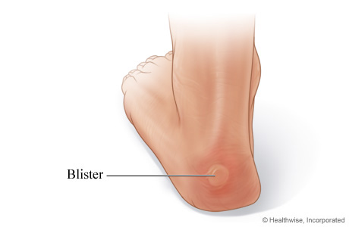
Blisters
Prevention:
Ensure footwear is broken in
Wear good walking socks, clean & dry
Change into dry socks & different footwear at campsite
STOP IMMEDIATELY if you begin to feel discomfort
Treatment:
If friction but no blister – cover affected & surrounding area with plaster, moleskin or other thin adhesive tape
If blister has developed, pad it & apply clean dressing

Slide 7
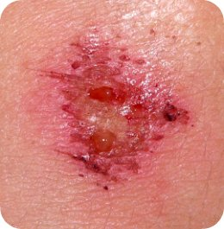
Minor Cuts & Abrasions
Treatment:
Clean with fresh water, ideally running and cold
Do not use cotton wool as this can leave traces in the wound
Use a plaster or bandage depending on size of wound

Slide 8
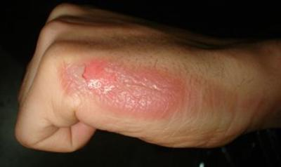
Minor Burns & Scalds
Prevention:
Always take care when cooking
Always place the stove on the ground, never on a picnic table or other elevated surface
Ensure the whole group is aware of hot pans and boiling water
Avoid spillages
Always take burns seriously and report to a supervisor
Treatment:
Immerse in cold, running water for at least 10 mins
Remove any rings from fingers, watches or bracelets from wrists
Cover with a sterile, non-fluffy dressing, clear cling film or small plastic bag
DO NOT apply creams, lotions or fat to the injury

Slide 9
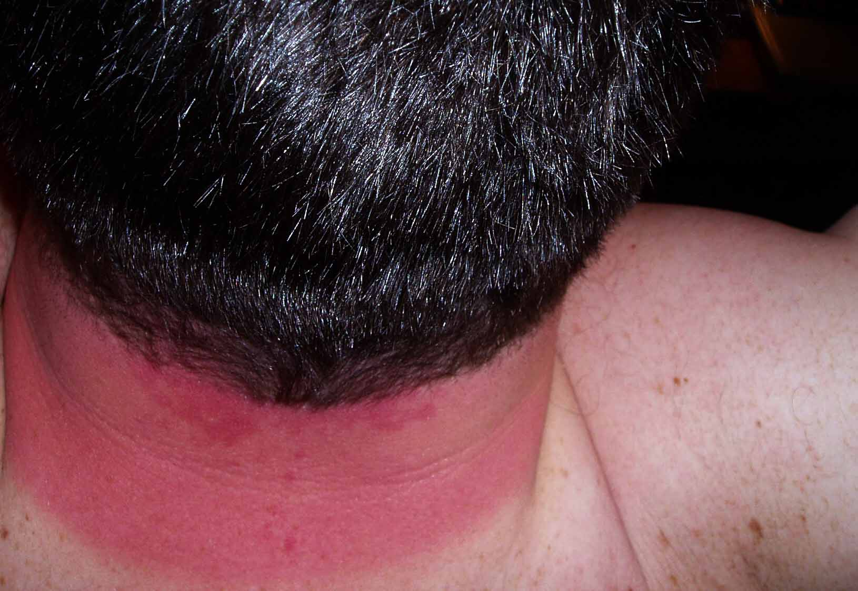
Sunburn
Prevention:
Cover up
Apply water-resistant sun block every few hours
Treatment:
Treat as a minor burn and inform your supervisor

Slide 10
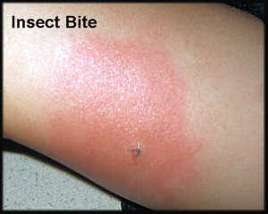
Insect Bites
Prevention:
Use insect repellent
Treatment:
Keep clean and treat as minor abrasion
Some people suffer a reaction to bites – report this to your supervisor
If known to suffer a reaction, keep anti-histamine cream or tablets in your personal first aid kit and use as necessary

Slide 11
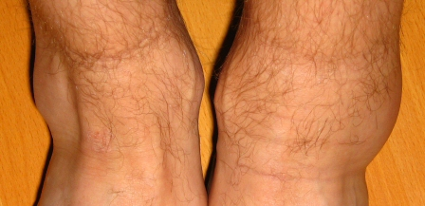
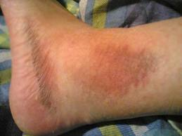
Sprains
Treatment:
R
I
C
E
est
ce
ompression
levation
Stop and rest
Apply a damp towel or t-shirt to help reduce swelling
Elevate injured limb to reduce swelling
If the pain does not ease, treat as a more serious sprain or fracture

Slide 12
Other Common Issues
Ticks and Asthma

Slide 13
Asthma
What to look for:
Difficulty breathing
Wheezy breath
Pale, clammy skin
Grey or blue lips
Difficulty breathing

Slide 14
Asthma
Keep calm
Sit patient upright
Help patient use inhaler
If attack is severe or lasts a long time call 999

Slide 15
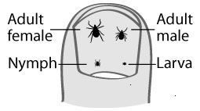
Ticks
Ticks are small blood sucking insects that can carry infectious diseases such as Lyme’s disease.
Found in open countryside, especially in long grass and bracken.
Can be very small and difficult to see. Keep an eye out on your clothing and your team’s for ticks.

Slide 16
Ticks
At the end of the day check for ticks, especially in areas such as armpits, belly button and back of the knees.
A shower will remove any that are not yet attached.
You can cut down the risk of picking up ticks by applying insect repellent and wearing long trousers, tucked into your socks.

Slide 17
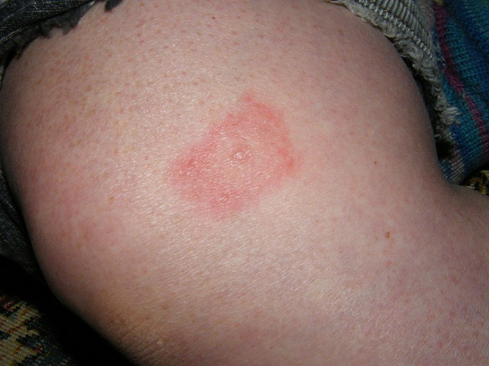
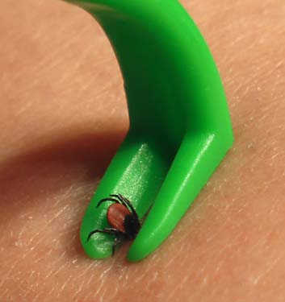
Ticks
If you get a tick bite remove the tick using a special tick removal tool. Ensure the head is removed.
If you get a swelling or a rash or feel unwell see your doctor.
Symptoms may develop up to
2 weeks after being bitten.

