Slide 1
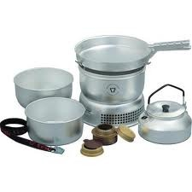
Use of Stoves

Slide 2
Safety
Stoves are potentially very dangerous and need to be used with care.
Key things to remember
Never cook in your tent, set up at least 3m away from tents.
Make sure the stove is stable and will not fall over when you put a pan on it.
Always use the correct meths bottle.
Do not mess around where people are cooking.

Slide 3
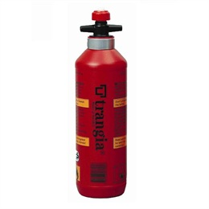
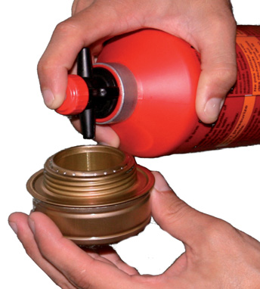
Fuel
Always use the correct fuel bottle.
Keep the bottle away from the cooking area.
Ensure the burner is cold before adding fuel. Meths burns with a transparent flame so even if you do not see a flame treat it with care.
Screw the fuel bottle cap back down immediately.

Slide 4
Lighting The Burner
Put the burner into the base.
Use long matches to light the meths. (A lighter is a good backup in wet weather)
Remember you might not see the flame so carefully feel for heat.
Put the windshield on.

Slide 5
Cooking
Remember to get food ready before you light the stove. Do not waste fuel.
Use the handle to steady the pan when stirring.
Make sure the people around you are aware of you cooking.
If you run out of fuel before you have finished make sure the burner is cold before you refill it.

Slide 6
Packing Up
When you have finished cooking put out the flame using the simmer ring.
Never attempt to blow out a Trangia, you will finish up blowing flaming meths around!
When the burner is cold put the screw cap on and pack the burner into its plastic bag.

Slide 7
Enjoy your meal

