Slide 1
Expedition Food
A substantial meal should be cooked and eaten by participants each day.
- D of E handbook

Slide 2
What Do You Need?
High energy intake – you will use 2-3000 calories each day on expedition.
To keep the weight down as you will be carrying the food. Use dried foods and avoid tins. Remove as much packaging as possible.
To work as groups.

Slide 3
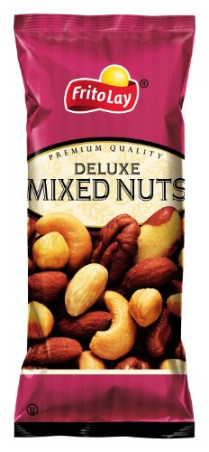
Planning a menu
Fats – Highest energy content per 100g but not fun to eat on their own (think block of butter)
Include items such as cheese, nuts and meat

Slide 4
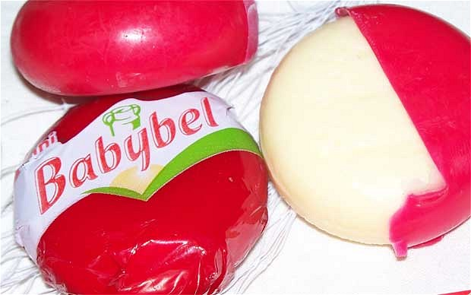
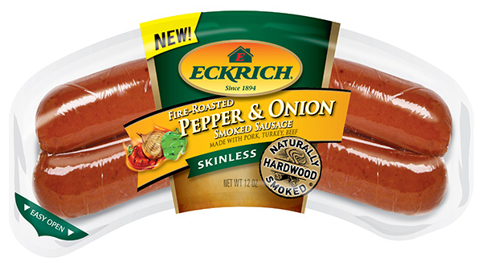
Planning a menu
Protein – about half as much energy as fats, but can fill you up. Eggs and cheese are examples

Slide 5
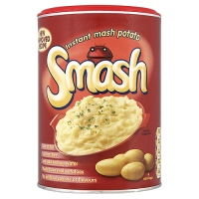
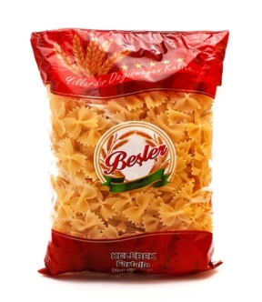
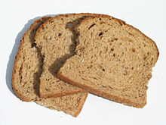
Planning a menu
Carbohydrates – will provide the bulk of your energy requirements. Will release energy into your system faster than fats and proteins especially if they have a high sugar content.
Include pasta, rice, bread, chocolate.

Slide 6
Breakfast
Porridge – buy instant porridge, put into a bag with some raisins to add interest, then make it in your cup.
Cereal – look for high energy content, put a portion in bag with some milk powder, then just add water.
Beans – weighty but can be very enjoyable on a cold wet morning!
Hard Boiled Eggs – Cook at home and bring with you, should be OK for 24hrs.

Slide 7
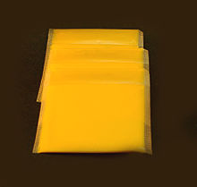
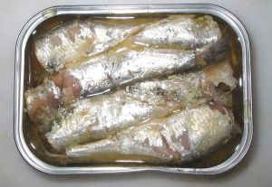
Lunch
Sandwiches – good for first day but will get squashed and go soggy for later on. Try croissants and pain au chocolat, they have high fat levels so provide lots of energy.
Try taking a bread product such as pitta, naan, oat cakes or thins then adding fillings such as tuna, mackerel, cold meat, cheese slices or wedges.

Slide 8
Dinner (2 courses)
Do not bring things that take a long time to cook, eg plain rice and pasta.
Use quick cook varieties with their own sauces.
Try instant potato or couscous.
Add variety and protein with tuna or smoked meats.
Cup of Soups are good starters and things like swiss roll or chocolate cake and custard are nice treats at the end.

Slide 9
Snacks
It is important to keep your energy levels up during the day by snacking.
Nuts and trail mixes – lots of fats and energy.
Chocolate, except on the hottest of days.
Sweets – high sugar content will keep you going
Snack bars – look for high energy content.
Pepperami – or any other dried meat that does not need to be kept in a fridge.

Slide 10
Drinks
It is important to keep your fluid intake high to avoid dehydration.
Carry water with you, but not too much as it is very heavy and you will be able to top up at the campsite. Use squash to add flavour.
Take hot chocolate for warm drinks in the evening.

Slide 11
Things to Avoid
Bacon & Sausages – make a mess of your pans and you will need to take cooking oil as well.
Pot noodles – take up a lot of space for little return.
Crisps – contain very little energy for the space they need, will get crushed.
Fresh fruit – OK on first day but easily damaged in rucsac.
Tinned food – extra weight and rubbish to dispose of.

Slide 12
Finally
Make sure everyone in the group likes the food you are taking, try it out before you go.
Pack your food so it does not get damaged and crushed.
Remember you will need all those calories, eat proper meals.
.

