Slide 1
World of Work Week
Parent Information Session
5th May 2017

Slide 2
Why?
Scottish Curriculum aims to support child development to develop adults who contribute to their community.
Developing skills for learning, life and work is a key focus in school.
The world is changing quickly and we need to help them cope with these changes
Gives our children an idea of the work some people do and what jobs people in Cumnock do.

Slide 3
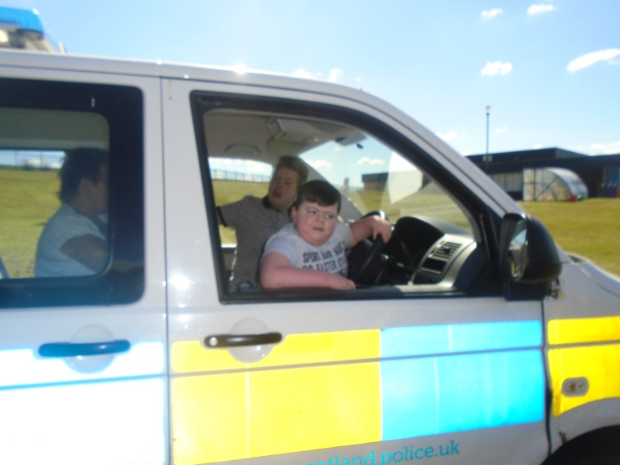
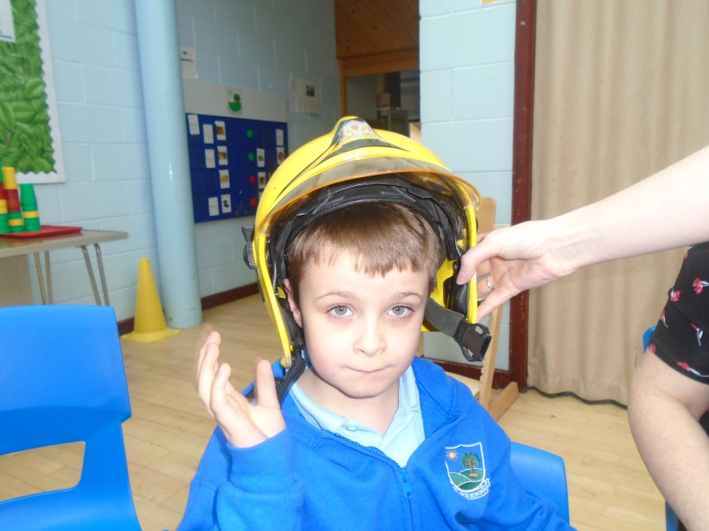
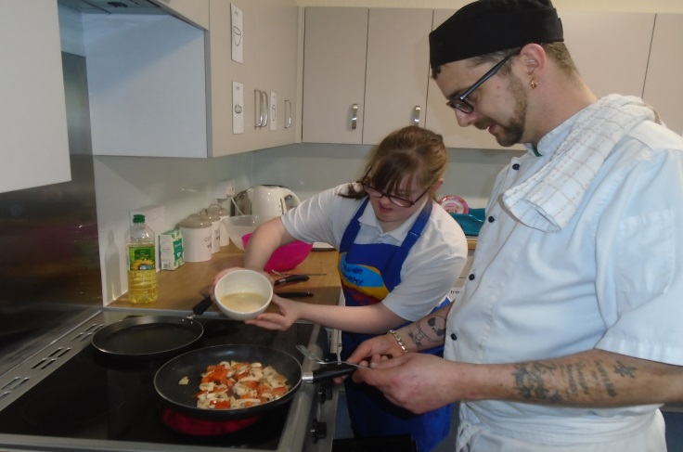
What’s been happening this week?
Local people have been coming in to tell us about their job.

Slide 4
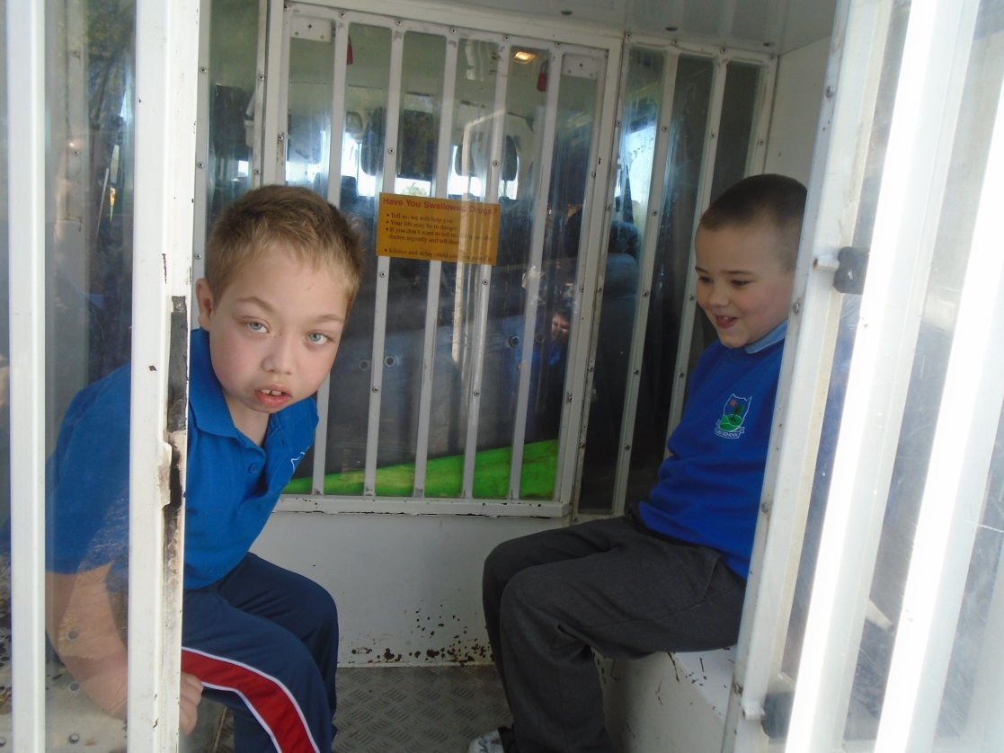
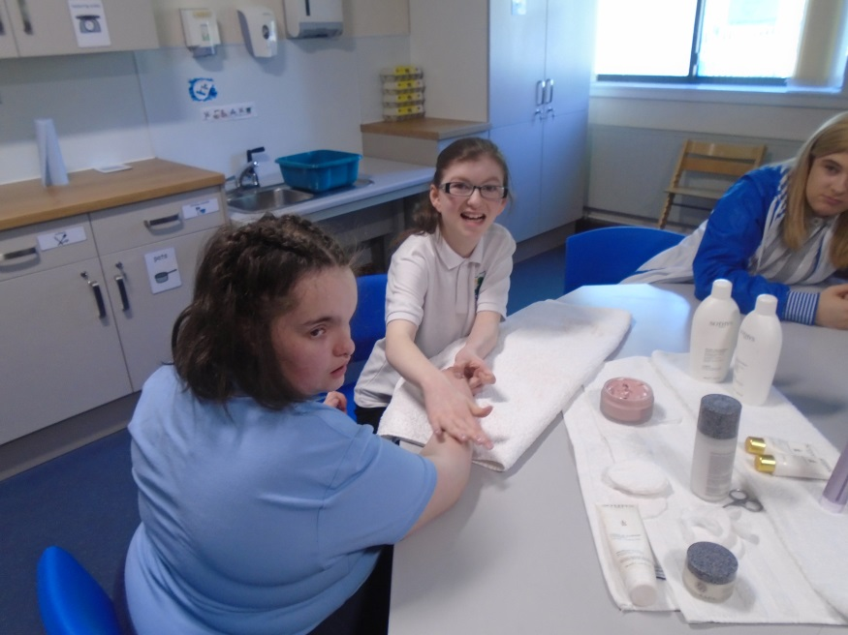
What’s been happening this week?
Local people have been coming in to tell us about their job.

Slide 5
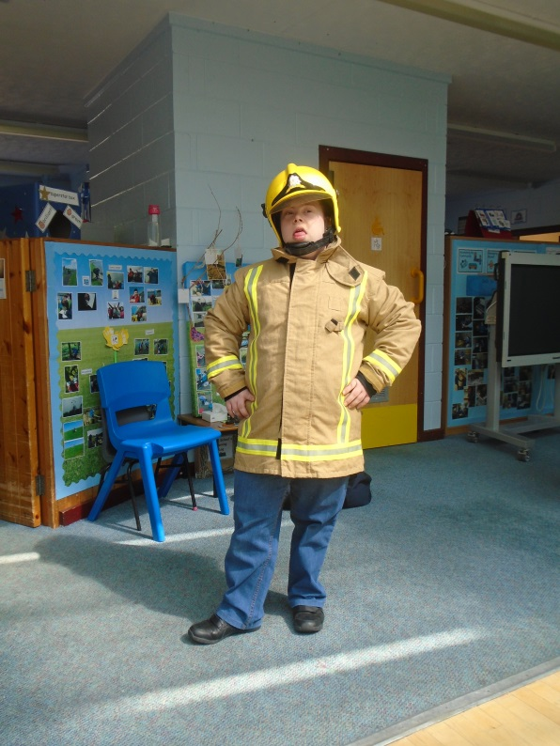
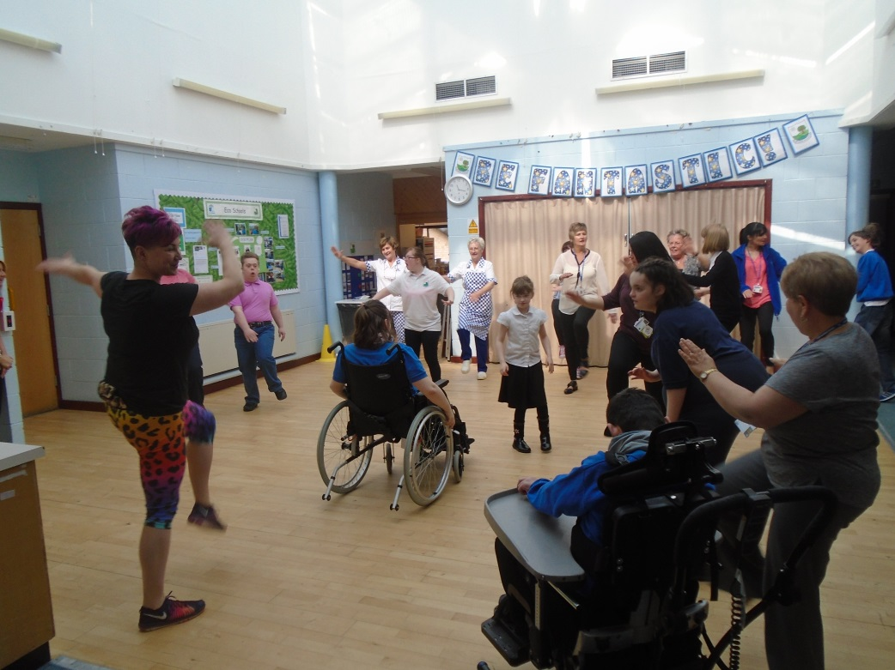
What’s been happening this week?
Local people have been coming in to tell us about their job.

Slide 6
What do we do every week?
Children have responsibilities in class from Primary 1 to Secondary 6 : collecting milk, washing dishes, tidying up, updating timetables and more
Children and young people have regular times in the ‘flat’ to develop cookery skills.
Children and young people have a regular visit into the community to practice skills like communication, shopping, ordering in a café, social skills.

Slide 7
What do all classes do?
Plan and host a charity event.
Plan and present an assembly.
Take part in our Christmas show and Fayre
Support children to think about their learning to prepare for their annual review.
Support children to work and play with each other.
Encourage children and young people to take responsibility for their belongings and actions.
Nominate a child/ young person to attend Pupil Council, held termly.

Slide 8
What do the primary classes do?
Children in the primary classes learn about the world of work through topics like ‘People who help us’, ‘Famous Artists and Musicians’ and ‘Incredible Inventors’
They attend the weekly ‘Snack Shack’ hosted by the secondary class.
Attend informal learning through Scouts & Guides

Slide 9
What does the S1-3 class do?
Host Snack Shack most Tuesday snack times
Learn about world of work through topics linked to their ASDAN ‘Transition Challenge Award’.
Go sailing at Lochwinnoch – develops confidence, opportunities for outdoor learning and adventure.
Take responsibility for the class registers across the school.
Some young people start volunteering awards

Slide 10
What does the S4-6 class do?
Learn about the world of work and achieve SQA National Qualifications through this.
Take part in work experience in or out of school
Help Janet lead our Eco Schools programme
Go to College or work with our College Outreach Lecturer
Start transition planning with social work – talking about and visiting places that might suit after school

Slide 11
How you can help….
Give your child opportunities to make decisions. (food/ clothes/ toys/ places to go)
Encourage your child to take part in chores about the house. (tidy up / washing dishes/ hoovering / putting washing in the machine)
Help your child to prepare food (spreading butter & jam, pouring cereal, mixing ingredients, cutting fruit/veg, mixing pasta & sauce – depending on your child!!!)
Help your child pay for things in shops.
Talk about the jobs people are doing when you are out and about.
Talk about the work you do, whether it is about the house or a job.

Slide 12
How can we help you?

