Slide 1
to Primary 6!
7th Sep 2023

Slide 2
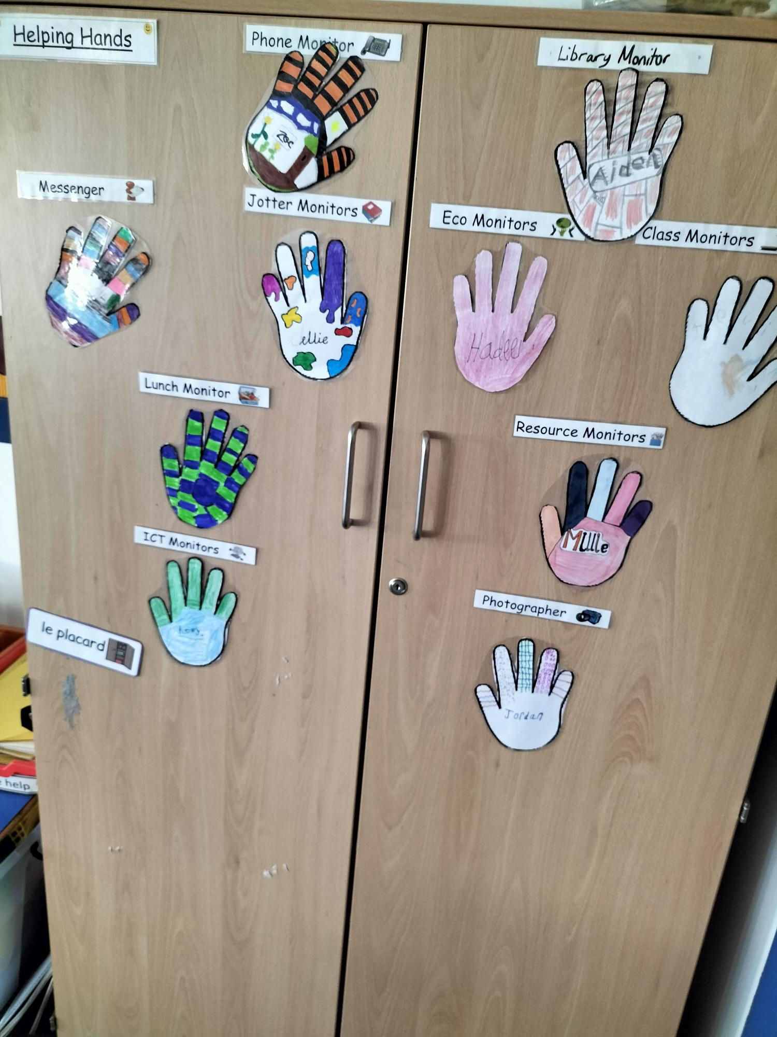
Our Classroom
Welcome to the Primary 6 classroom.
We take PRIDE in our classroom and have a number of class jobs to ensure everyone respects our learning environment.

Slide 3
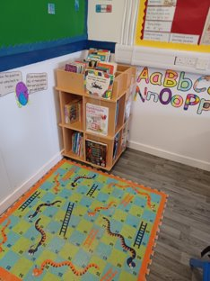
Our Library Area
Our library area is a cosy spot filled with great fiction and non-fiction books.
We have a library monitor who is in charge of keeping it looking great!
photo

Slide 4
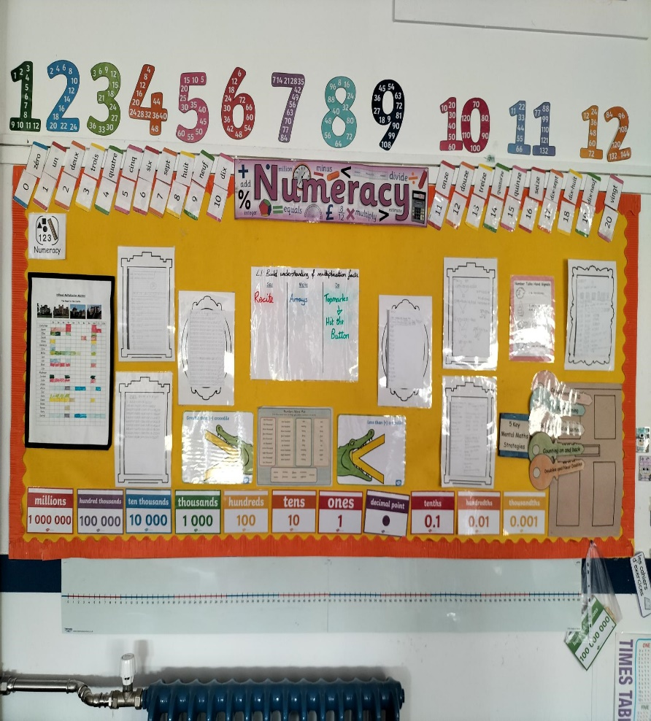
Numeracy Working Wall
Our Numeracy working wall adapts with our current learning.
We are currently working on place value up to 5 digit numbers.
We are building up a bank of Numeracy resources to help us with our learning.
photo

Slide 5
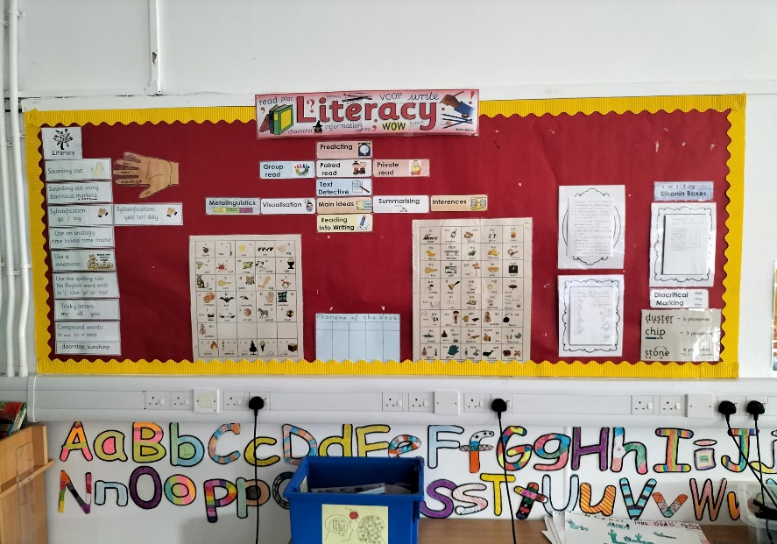
Literacy Working Wall
Our Literacy working wall displays lots of helpful aids that we can use to help us in our Literacy work.
Why not have a go at some diacritical marking or spell using Elkonin boxes!

Slide 6
Divided City
Our class novel this term is ‘Divided City’ by Theresa Breslin.
The novel is set in the city of Glasgow.
Check out our jotters to see some of our Literacy work.

Slide 7
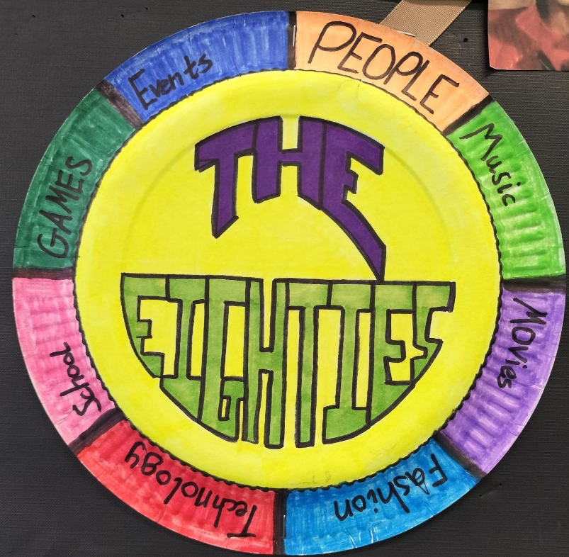
The Eighties
We have chosen ‘The 80’s’ as our Term 1 topic.
We are investigating different aspects of the past and will be comparing them to modern times.

Slide 8
PE days
Gym days are Tuesday and Thursday. Please bring in a change of clothing.

Slide 9
Homework
Homework will be a mixture of Literacy (Spelling and Reading), Numeracy and the occasional IDL related task.
Homework will be accessed via the school blog.
*Search ‘Hillhead Blog’*

