Slide 1
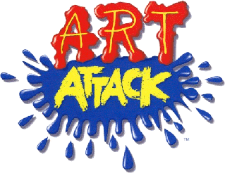
Express Yourself

Slide 2
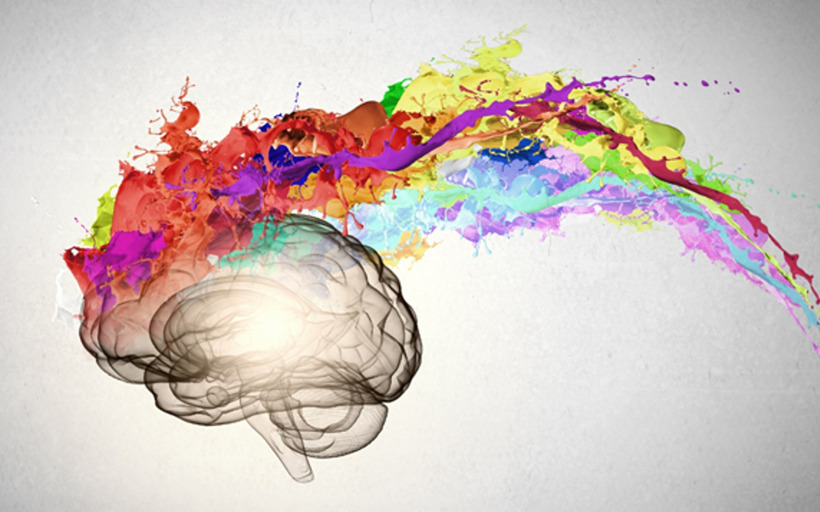
Why Art?
Art is fun
Art allows us to be creative
Art is relaxing and enjoyable
Art is good for the brain

Slide 3
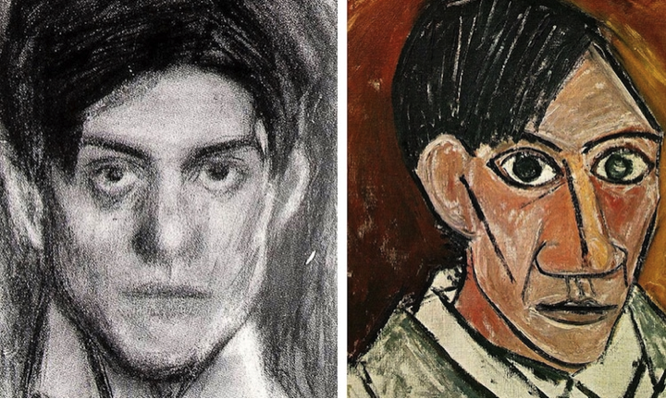
PABLO PICASSO
Portraits are a great way to explore express yourself.
Exploring them–through the use of paper collage inspired by Picasso’s work just makes it even more fun.

Slide 4
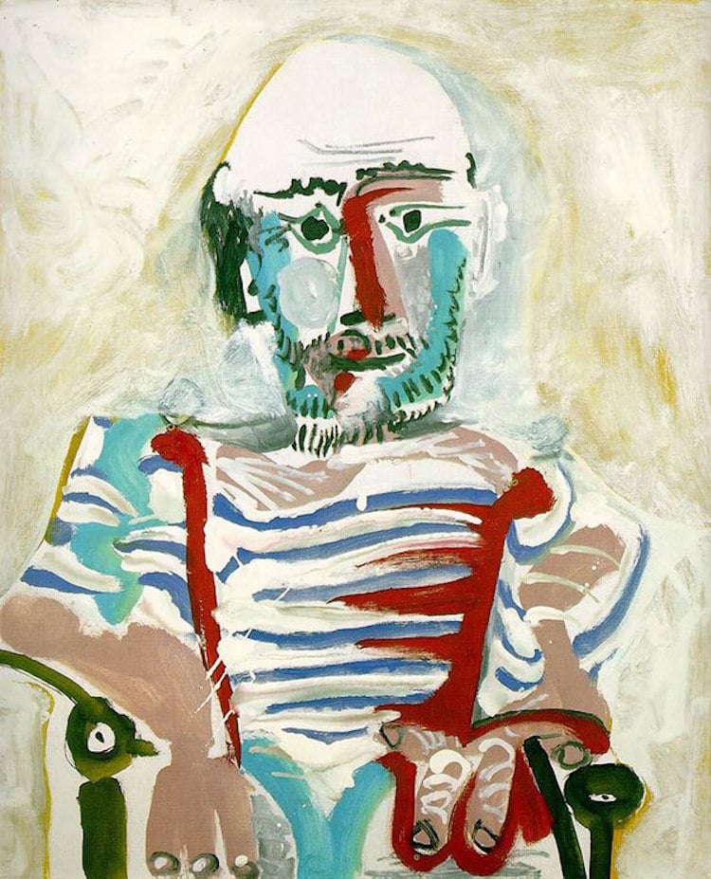
https://www.bbc.co.uk/bitesize/clips/zdfgkqt
Click this link to
learn about
Pablo Picasso!

Slide 5
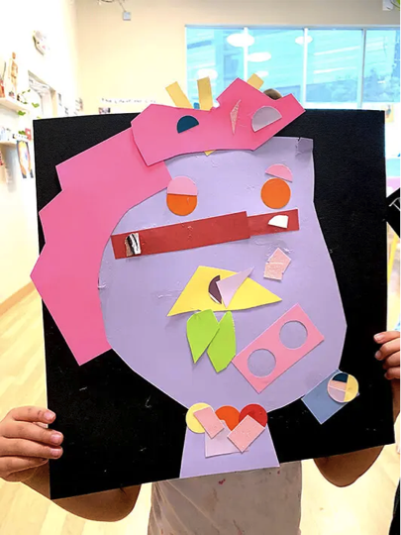
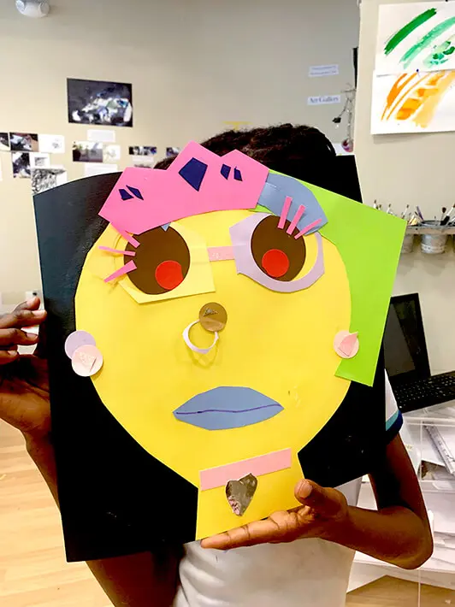
Activity
Picasso Collage Inspired Self Portrait
Imagine YOU are Picasso and have been asked to do a portrait of yourself.
What would it look like?
Create your own Picasso collages.

Slide 6
Materials
Paper any size large or small
Paint/colured pens or pencils
Colored paper
Any other fun paper you may have around
Circle hole punchers/stencils/
Glue sticks/sticky tape/blue tac
Scissors

Slide 7
If you want to, you can share your self-portraits and explain a little of what is going on and why you made certain choices for your artwork.
Good Luck

