Slide 2
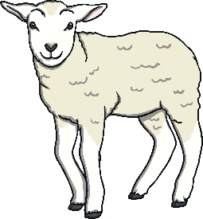
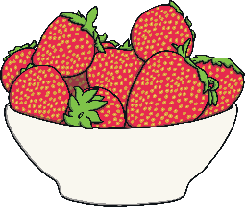
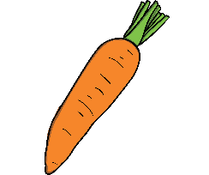
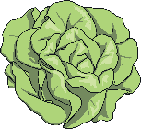
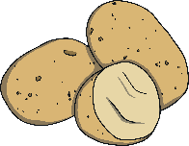
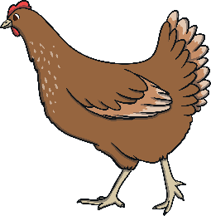
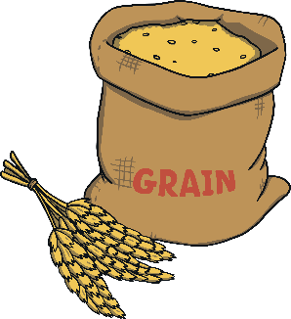
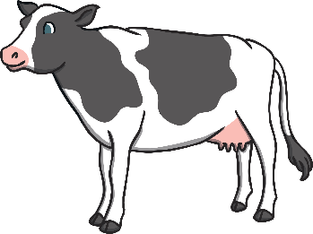
Scottish Food and Drink
Many parts of Scotland are covered in farmland. Those farms produce lots of ingredients that make some famous Scottish foods and drinks. Some of the farms keep animals.
Click on each animal to reveal text box.
Sheep are used for meat and wool.
Lots of different fruits and vegetables are grown on Scottish farms.
Wheat, which is used in many cereals is also grown in Scotland.
Chickens are used for meat and eggs.
Cows are used for meat and milk.

Slide 3
Menu
Breakfast
Sweet Treats
Porridge
Shortbread
Tablet
Clootie dumpling
Lunch
Oatcakes
Cock-a-leekie soup
Cullen skink
To Drink
Irn Bru
Dinner
Haggis, neeps and tatties
Stovies
Scotch pie

Slide 4
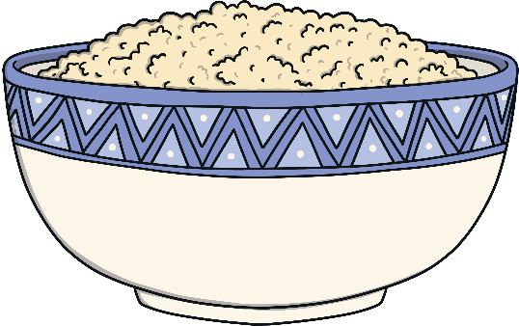
Breakfast
<
Menu
Porridge
Porridge is made from oats grown on farms in Scotland. People mix the oats with hot water or warm milk to make porridge. Sometimes people add toppings to their porridge.
Have you tried porridge?
Yes
No
What did you think?
Do you like it?
Would you like to try it?

Slide 5
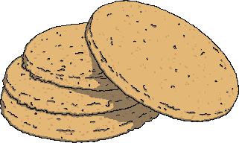
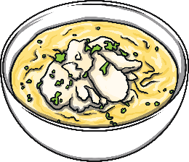
Lunch
<
Menu
Oatcakes
Oatcakes are savoury biscuits made from oats. People often enjoy them with different types of cheese.
Cock-a-Leekie Soup
Cock-a-leekie soup is a soup made from leeks, chicken stock and rice or barley to make it nice and thick.
Cullen Skink
Cullen skink is another Scottish soup made with haddock, potatoes and onions. It is a thick, creamy soup.
Which food would you choose for lunch?

Slide 6
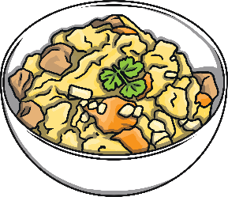
Dinner
<
Menu
Haggis, Neeps and Tatties
Haggis is a traditional Scottish dish made from sheep, oats, onions and some seasoning. It is often served with mashed turnip and potatoes.
Stovies
Stovies is a dish made from beef and potatoes. Sometimes people add other ingredients and vegetables to their stovies.
Have you tried either of these dishes?
Yes
No
Would you like to try
any of them?
What did you think?
Do you like them?

Slide 7
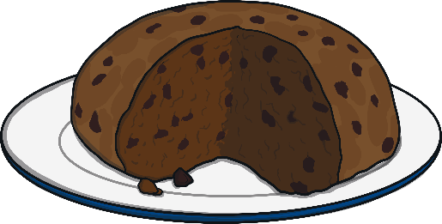
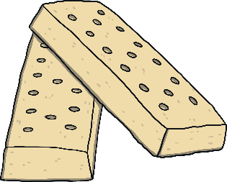
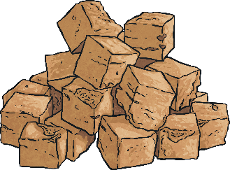
Sweet Treats
<
Menu
Shortbread
Shortbread is a sweet biscuit made with sugar, flour and butter.
Clootie Dumpling
Clootie dumpling is pudding made with dried fruit. Clootie is the word for cloth in Scots. Clootie dumpling is wrapped in a piece of cloth to cook it.
Tablet
Tablet is very sweet. It is made with lots of sugar, milk and butter.
Which dessert would you choose?

Slide 8
To Drink
<
Menu
Irn Bru
Irn Bru is a fizzy drink made in Scotland. It is bright orange in colour.
Have you tried Irn Bru?
Yes
No
What did you think?
Do you like it?
Would you like to try it?

