Slide 2
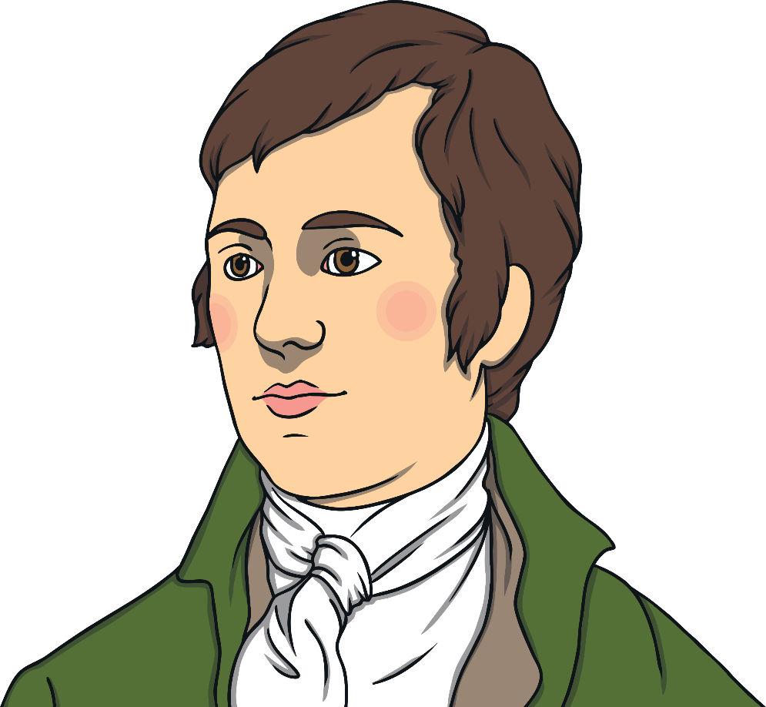


All about Robert Burns
My name is Robert Burns. I am a Scottish poet.
I lived in Ayrshire, Scotland over 250 years ago.
Most of my poems were written in Scots and standard English.
My most famous poem, ‘Auld Lang Syne’,
is sung all over the world on Hogmanay.
Have you heard the song ‘Auld Lang Syne’?

Slide 3
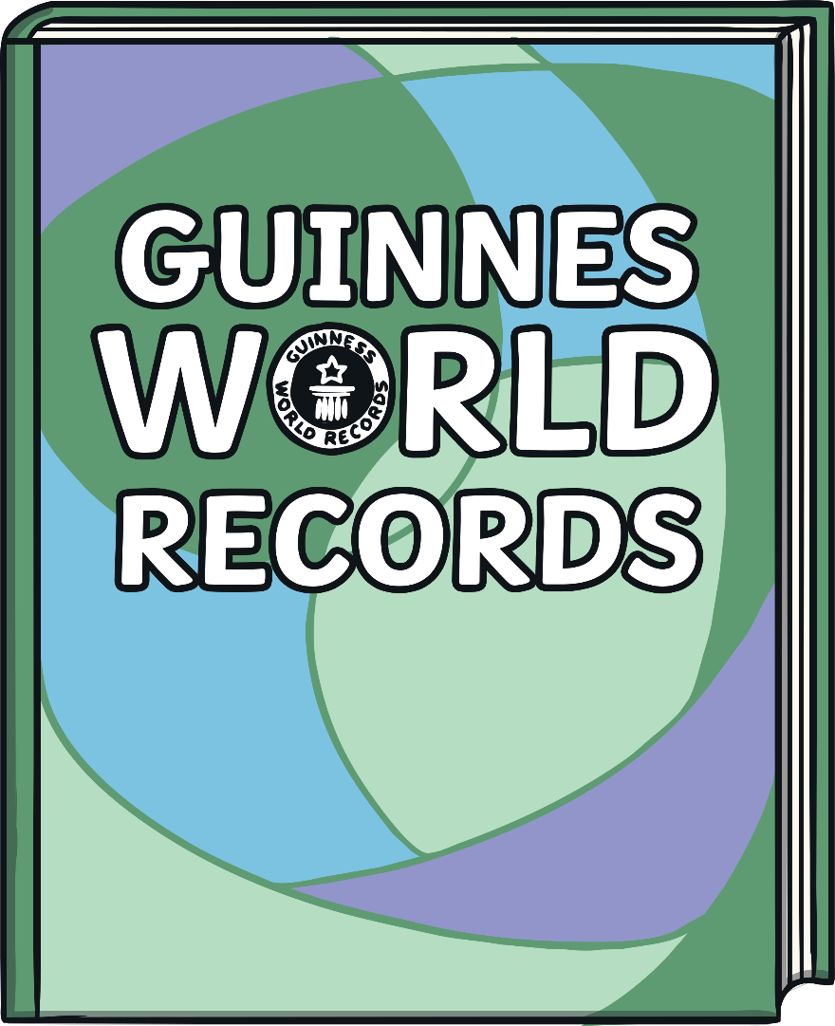
Did You Know?
Auld Lang Syne is in the Guinness Book of World Records.
It is one of the three most popular songs sang in the
English language.
Can you guess which
song is first?
Click to reveal answer
Happy Birthday

Slide 4
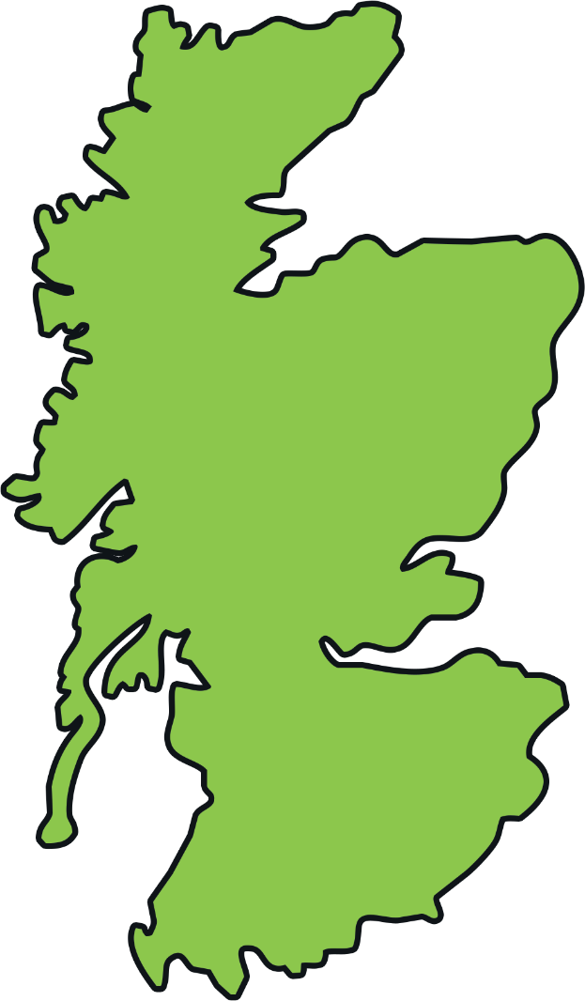
Robert Burns’ Early Life
I was a born in Alloway, Ayrshire in 1759.
My parents were called William and Agnes.
I was the eldest of seven children.
My family were poor, but my father taught
us how to read and write.
Alloway

Slide 5
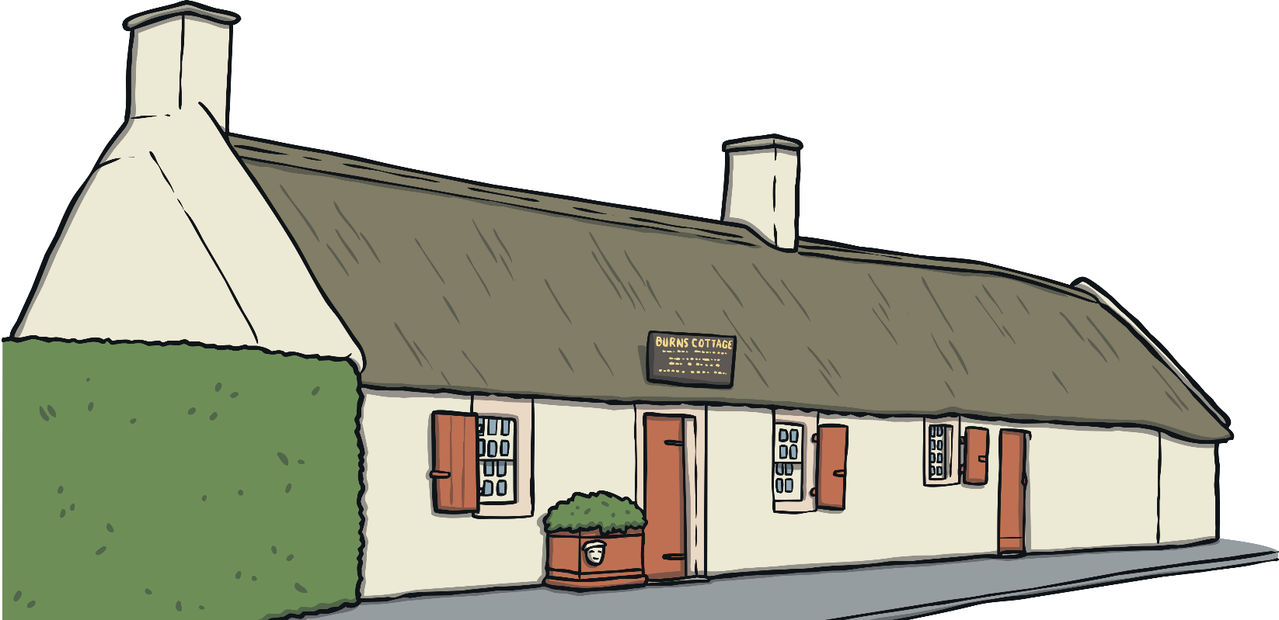
Did You Know?
The house I was born in is now the Robert Burns Birthplace Museum. It is visited by over 100,000 people every year!
In the museum, there are hundreds of objects that belonged to me, such as the quills I used to write my famous poems.

Slide 6
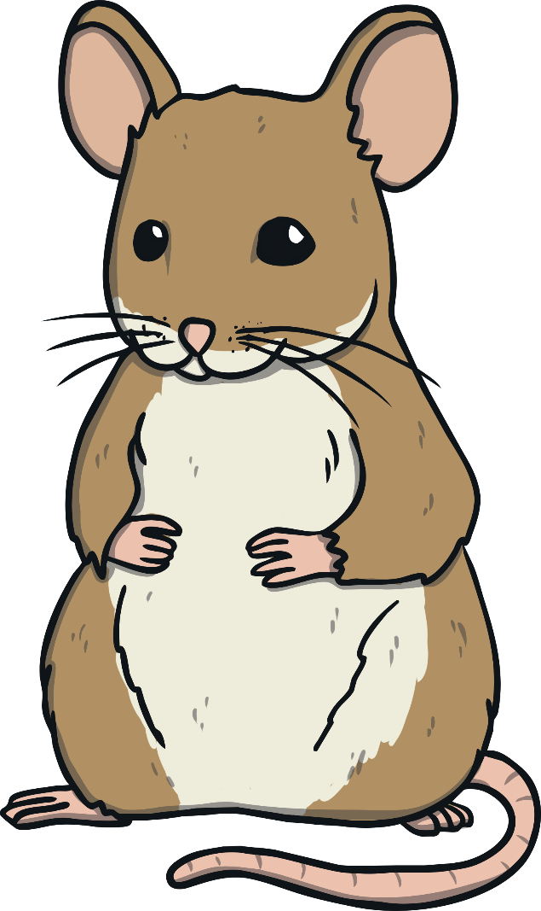
Robert Burns’ Early Life
My father was a tenant farmer and I had
to help him on the farm from a young age.
This inspired me to write poems about the different things I saw.
During this time, I wrote my famous
poems about a mouse and a woodlouse!

Slide 7

To a Mouse
In 1785, I wrote ‘To a Mouse’ after I turned over a tiny field mouse’s nest with my plough.
Can you guess what the first two
lines of the poem mean?
Wee, sleekit, cowrin, tim’rous beastie,
O, what a panic’s in thy breastie!
Who is the beastie?

Slide 8


A Red, Red Rose
The inspiration for many of my poems and ballads was about falling in love.
O my Luve is like a red, red rose
That’s newly sprung in
O my Luve is like the melody
That’s sweetly played in
A ballad is a type of poem, often a story set to music.
Usually the second and fourth lines
in each stanza rhyme.
June;
Is ‘A Red, Red Rose’ a ballad?
tune.

Slide 9
Robert Burns’ Life
In 1788 I married Jean Armour.
That year, I also travelled around Scotland collecting local songs and writing about my travels.
Inverness
Aberdeen
Here are just some of the places I
travelled to.
Dundee
Can you name them?
Perth
Click on the red dot to reveal the place name!
Glasgow
Edinburgh

Slide 10
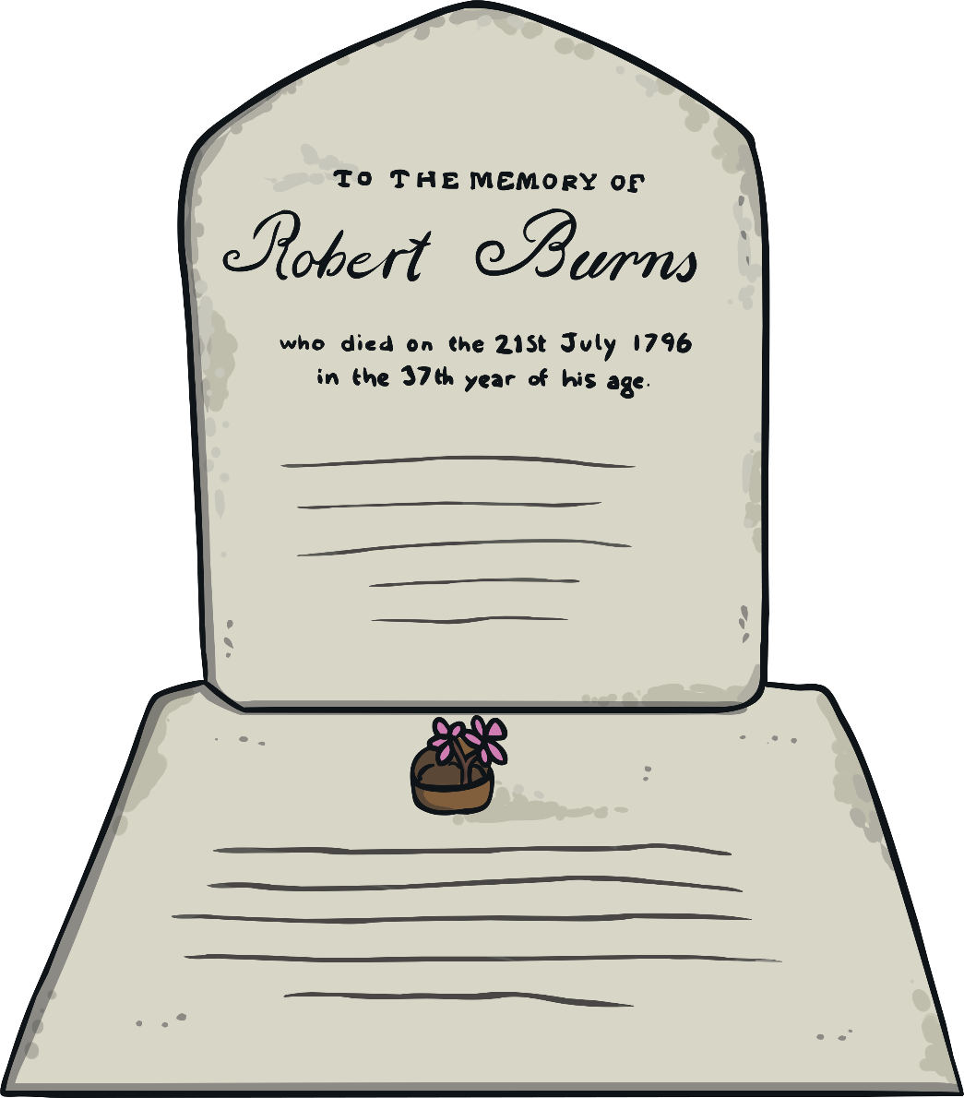
Robert Burns’ Death
I died on 21st July 1796,
at the age of 37.
My funeral took place on the 25th of
July, the same day my twelfth child,
Maxwell, was born.

Slide 11
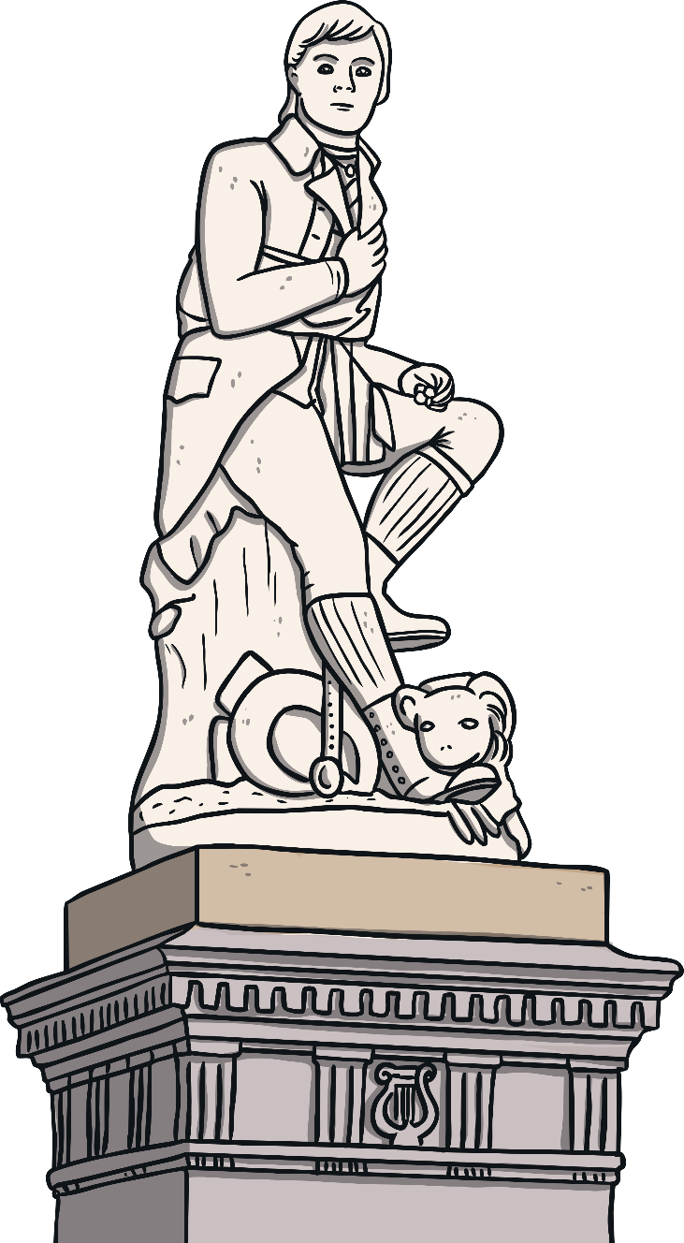
Did You Know?
After Queen Victoria and Christopher Columbus, there are more statues of me around the world than any other non-religious person.
Guess how many there are?
Click to reveal answer
60

Slide 12
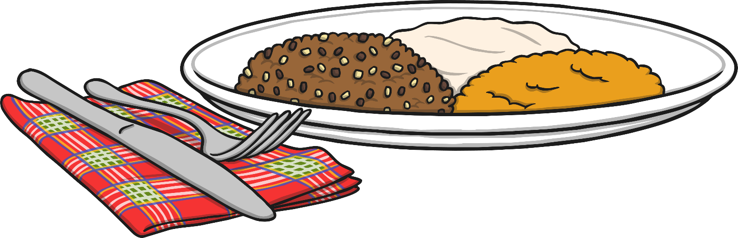
Burns’ Night
The first Burns’ Supper was organised by my friends. They wanted to celebrate my life and read my poems.
Today, every year on what would have been my birthday, people all around the world celebrate Burns’ Night.
They eat haggis, neeps and tatties and recite my poems!

Slide 13
Selkirk Grace
Now it’s your turn to recite one of my famous poems.
It is read at a Burns’ Night before people eat their haggis, neeps and tatties. It is called the Selkirk Grace.
Some hae meat and canna eat,
And some wad eat that want it,
But we hae meat and we can eat,
Sae let the Lord be thankit.

