Slide 2
Learning Objective
To learn how to use grid references and directional language to locate locations on a map.
Success Criteria
I can use grid references to locate places on a map.
I can use directional language to describe somethings position on a map.

Slide 3
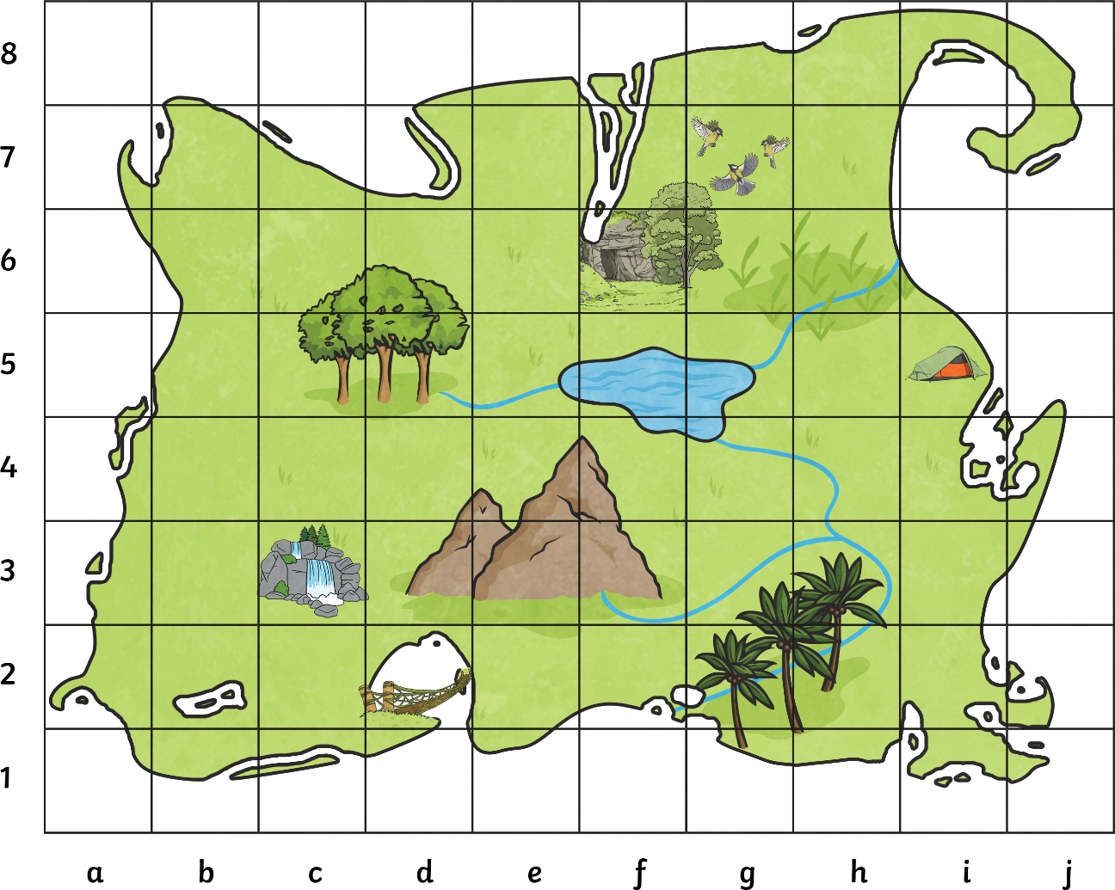
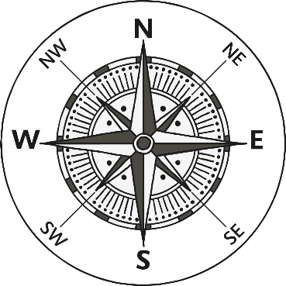
Using a Grid Map
Some maps use grid references to give locations.
The caves are at the grid reference F6. F is the column and 6 is the row.

Slide 4
Using a Grid Map
To find the grid reference for the caves navigate to the letter F, then click the number 6.
You will find the caves where the column and the row cross, giving the grid reference F6

Slide 5
Using a Grid Map
Let’s find some other places on our island map.
Find the waterfall at C3.

Slide 6
Using a Grid Map
Let’s find some other places on our island map.
Find the bridge crossing at D2.

Slide 7
Using a Grid Map
Let’s find some other places on our island map.
The camp site is at I5.

Slide 8
Using a Grid Map
Let’s find some other places on our island map.
There is a bird sanctuary located at G7.

Slide 9
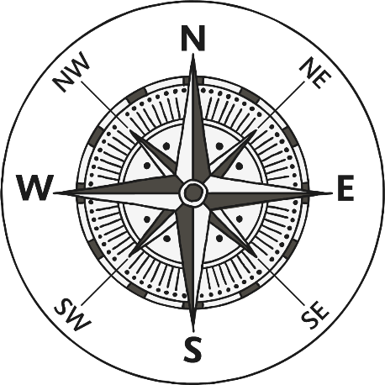
Using a Grid Map
Well done! Look at all the places you found using grid references.
Now lets use directional knowledge to find some other grid references.
What is the grid reference that is directly south west of the waterfall?
B2

Slide 10
Using a Grid Map
What is the grid reference that is on the right hand side of the camp site?
J5

Slide 11
Using a Grid Map
What is the grid reference that is directly below the caves?
F5

Slide 12
Using a Grid Map
G8
What is the grid reference that is directly above the bird sanctuary ?

