Slide 2
Goods and Services
Look at the lists below and see if you can come up with definitions of goods and services.
trainers
picture frames
books
laptops
ovens
chairs
sofas
mugs
Goods
water supply
railway services
hairdressers
education
road building
health
telephone services
Services

Slide 3
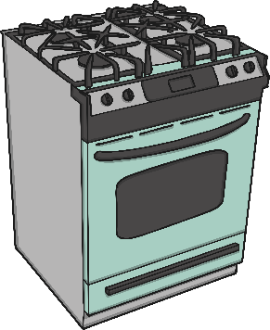
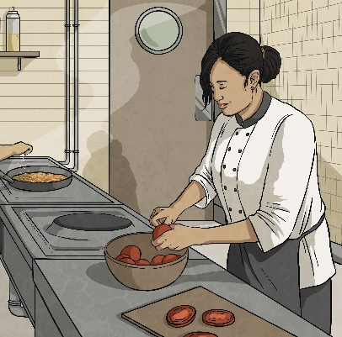
Goods and Services
Goods are items that fulfil human wants or needs, such as clothing and food.
A service is the action of doing work for someone in order to satisfy a need or want.

Slide 4
Essential
Some goods and services are essential
and some are non-essential.
These are often called needs and wants.

Slide 5
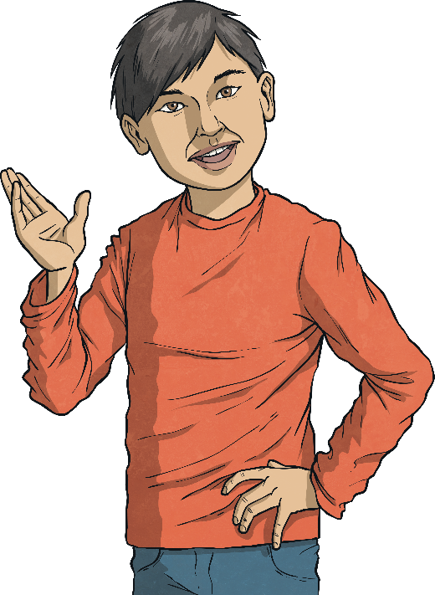
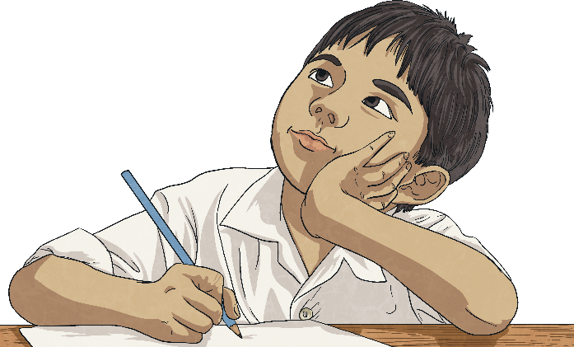
Needs and Wants
Needs are things that are crucial to living.
Wants are things we don’t need to live but that we would like.
Make a list of 5 of your needs and 5 wants.
Will every human have the same wants and needs? What sorts of factors might influence our needs and wants?
Discussion Point

Slide 6
Needs and Wants
These are some examples of needs and wants.
food
water
shelter
warmth
health care
clothes
Needs
jewellery
designer clothes
mobile phones
pieces of art
football
broadband
Wants

Slide 7
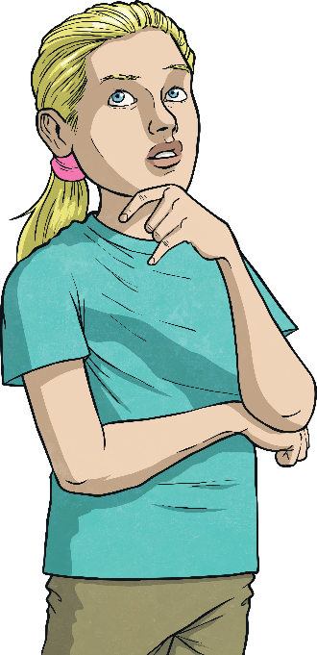
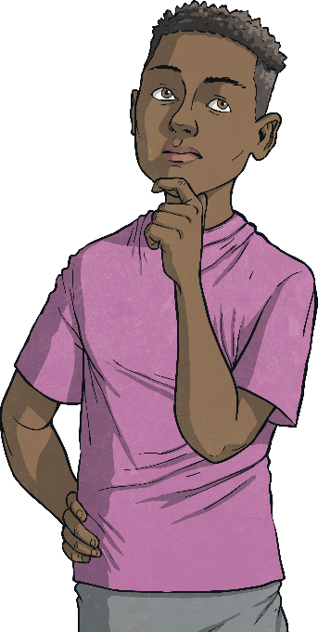
Payment
How many ways can you think of paying for goods and services, things you want and things you need?

Slide 8
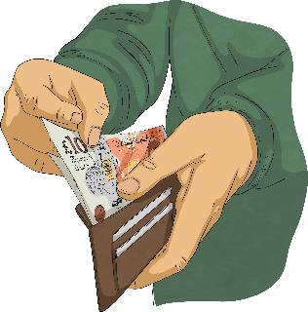
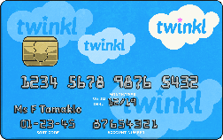
Methods of Payment
Cash - notes and coins. A person has to have the physical money before they can spend it.
Debit Card - a debit card is linked to a bank account where their money is stored.

Slide 9
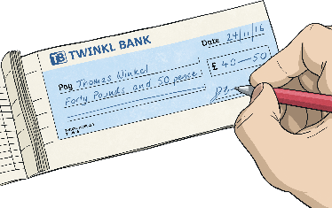
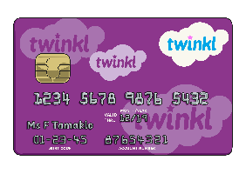
Methods of Payment
Cheque – a written note that gives permission for money to be taken from your bank account.
Credit Card - a credit card works similarly to a debit card, except a credit card is not linked to a bank account. When you purchase something with a credit card, it is a bit like a loan, as you are borrowing money with the intention to pay it back.

Slide 10
Benefits and Risks
Benefits of Cash
You can only spend what you have.
It is easier to know exactly how much money you to spend if you have your money in cash.
Risks of Cash
If you lose it or it is stolen, unless you find it, there is no way to get it back.
Particularly if you are planning on making a large purchase, it is not generally wise to walk around with a lot of money on your person.

Slide 11
Benefits and Risks
The Benefits of Debit Cards
A debit card is linked to your bank account. This means that you can only spend money you already have.
It is safer than carrying cash around, as it is protected by a 4-digit code.
If someone steals your debit card and manages to use it, you can often get the money back because debit cards are protected by fraud prevention schemes.
Debit cards are easier to get than credit cards as the vast majority of banks will give you one as soon as you open a bank account with them.
You are able to take cash out using a debit card.

Slide 12
Benefits and Risks
Risks of Debit Cards
Particularly when shopping online, debit cards do not offer the same level of protection as credit cards.
If you do not have enough money in your account to pay for an item, you might end up in an overdraft and your bank will usually charge you fees until you pay the debt.

Slide 13
Benefits and Risks
Benefits of Cheques
It is safer to send a cheque in the post to someone rather than cash.
You can date a cheque later than when you sign it so that it can’t be used until money is in your bank.
They are free to use.
Risks of Cheques
Cheques take a while to process so the person or organisation being paid doesn’t get the money immediately.
People can create fake cheques.
Most banks will refuse to accept cheques that were dated over 6 months ago.

Slide 14
Benefits and Risks
Benefits of Credit Cards
Credit cards can be helpful to spread out the cost of larger payments.
Any purchases over £100 you make on a credit card are protected.
Risks of Credit Cards
You have to pay interest on what you spend on a credit card
Credit cards have to be used carefully as it is easy for debt to build up.
If you miss a payment on a credit card, you are fined, which adds to the cost of using the card.
There are age restrictions on credit cards. You have to be over 18 to apply for most but some companies insist you are over 21.
Not everyone is able to get a credit card as it depends on your credit history (this is how you have managed any loans in the past).

Slide 15
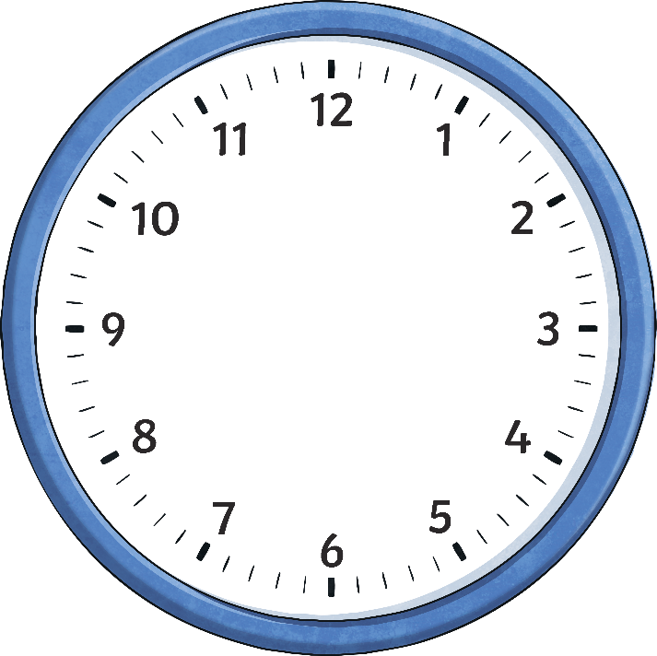
Challenge
One Minute Challenge
You have one minute to tell your partner everything you have learnt about goods and services, needs and wants, the different ways of payment and the benefits and risks that go along with these.
See how many facts you can fit in one minute!
Start timer
Remember to then reset the timer and swap!

