Slide 1
Welcome to Primary 3A with Miss Caldow!

Slide 2
Class Charter
During the first week of school we worked together to create a Class Charter of rules to allow us to work hard, have fun and keep safe in school.
These link with articles from 'The Rights of a Child'.
Have a look at our display next to the window!

Slide 3
Timetable
Our library day is a Monday,
please remember your books every
week!
We have two ICT days. A Tuesday is spent on Active Learn and a Friday is spent working on other ICT skills and e-portfolios.
We have P.E. on a Monday with Miss McConnell and on a Friday with Miss Caldow.

Slide 4
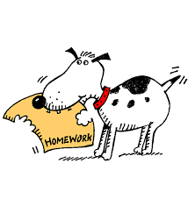
Homework
Every week pupils will be given homework on a Monday and this will be due on a Friday. Pupils will receive points for handing homework in on time.
Weekly homework will usually consist of: spelling, maths and reading. Homework should be signed by an adult.
Please try to keep your homework
in a waterproof folder to keep it
safe!

Slide 5
Communication
If you wish to get in touch with Miss Caldow, the easiest way is to send a note in your child's communication diary.
Communication diaries should be brought every day as notes may also be written for parents.

Slide 6
Water Bottles
Please only give your child water for drinking in class - juice makes a lot of mess if spilled. Thank you.

Slide 7
Toilet
We have a new toilet system in Primary 3.
Children are encouraged to go to the toilet at break times.
Children can use a toilet pass if they really need to in class.
Have a look at our toilet pass rules next to the window for more information.

