Slide 1
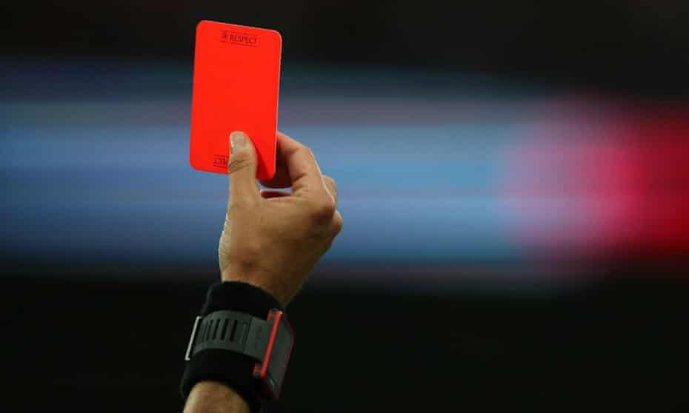
Rights Respecting Schools Show Racism the Red Card

Slide 2
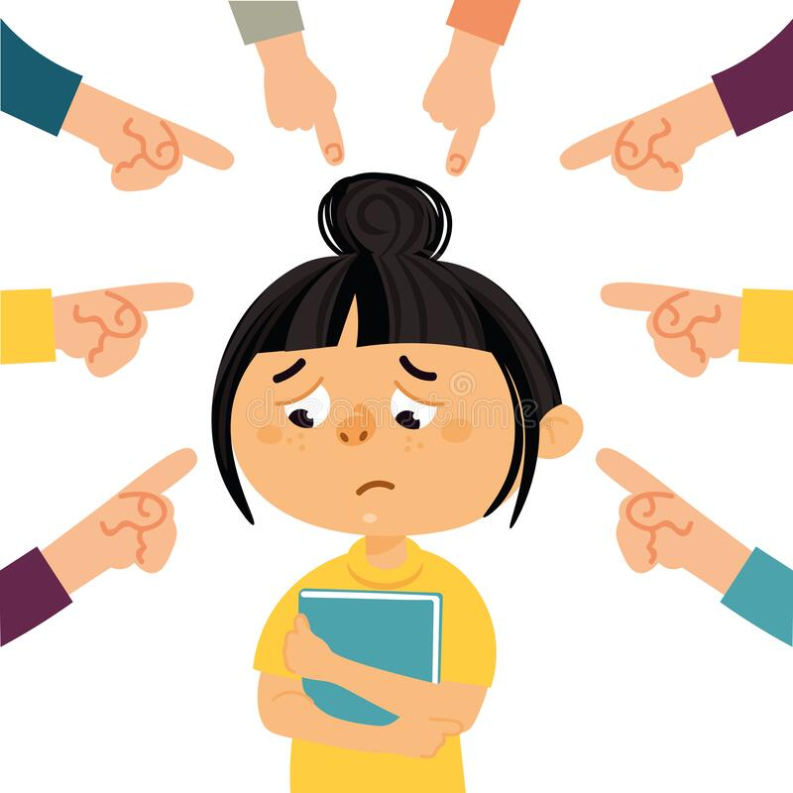
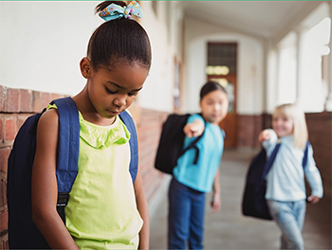
What is Racism?
It’s treating people differently – and unfairly- because of their skin colour, where they come from or their family traditions.
Does it matter what we look like?

Slide 3
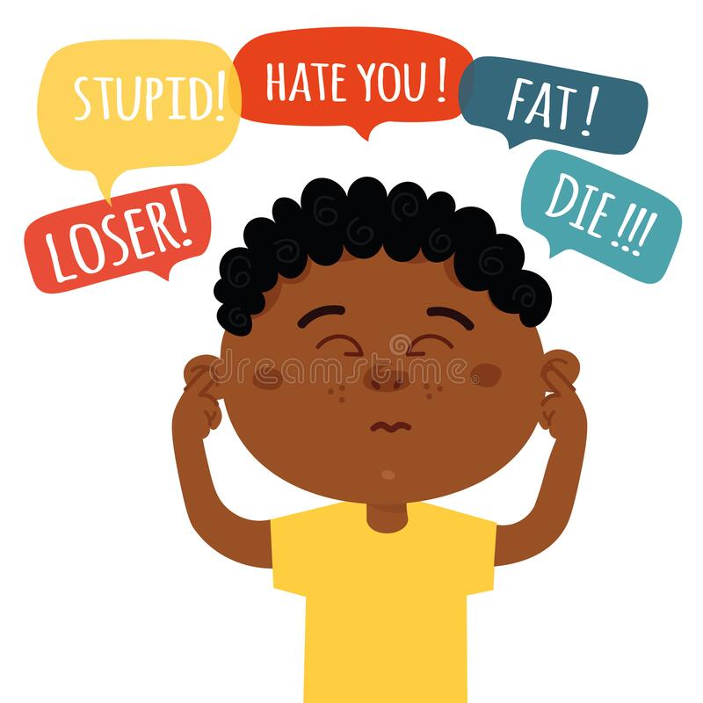
How does Racism feel?
How would you feel if this happened to you?

Slide 4
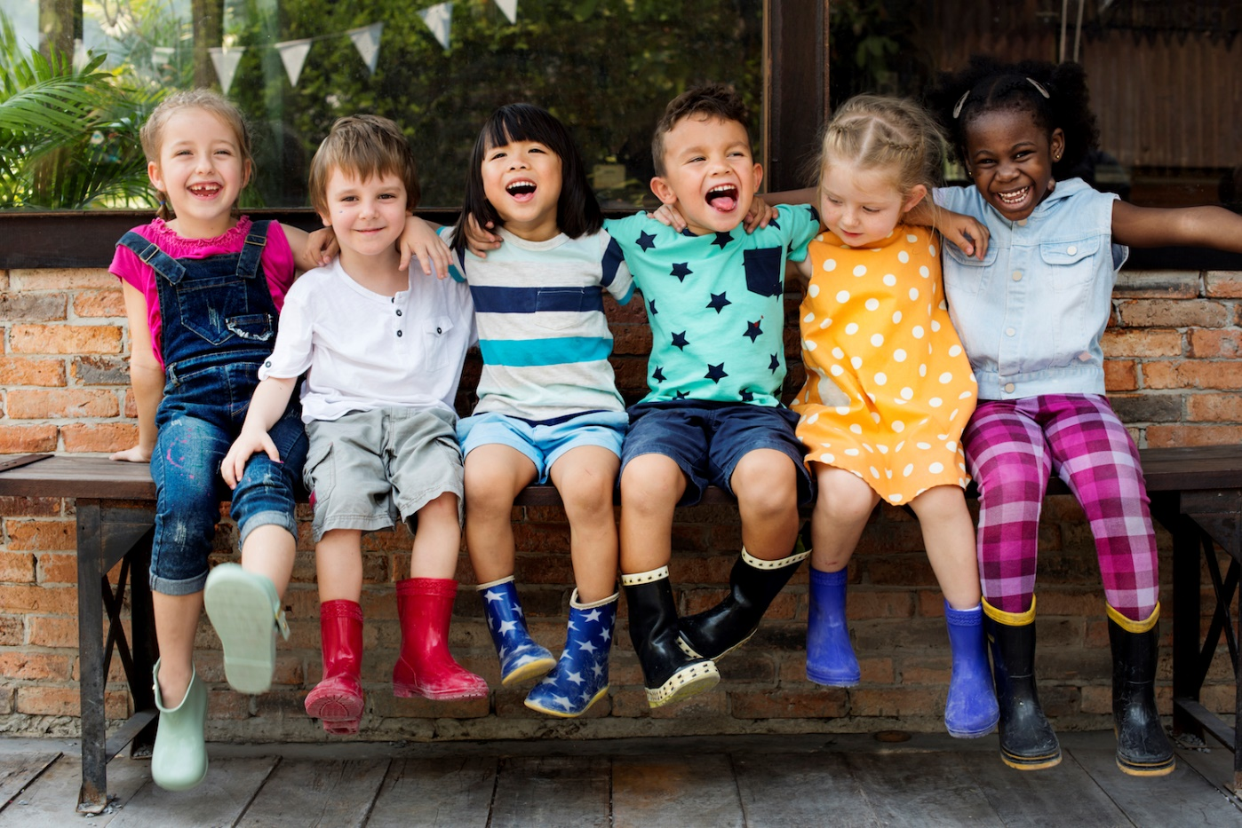
Why do we all look different?
We all look different because we all have different parents.
Some people may dress differently because they have different traditions and their families may come from different places.

Slide 5
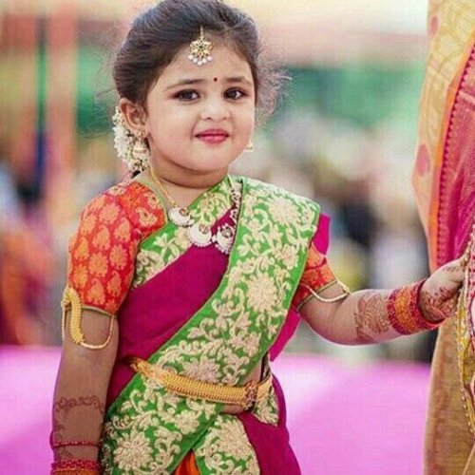
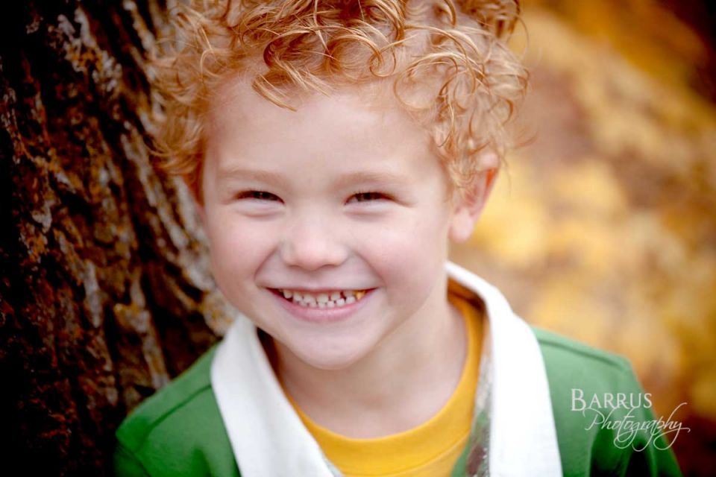
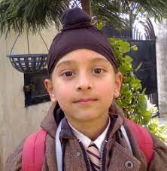
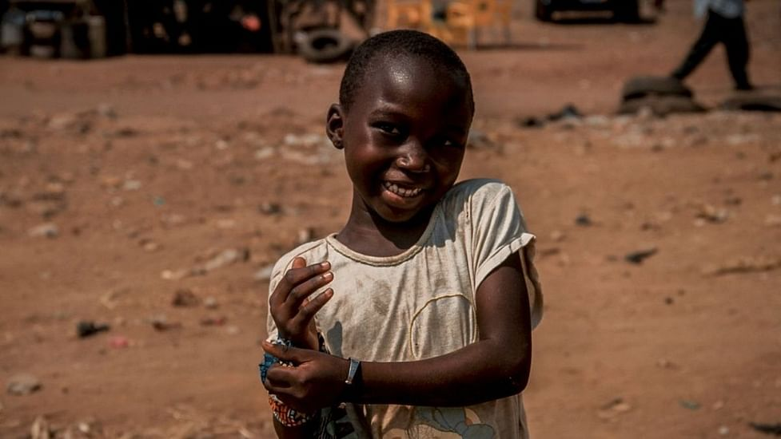
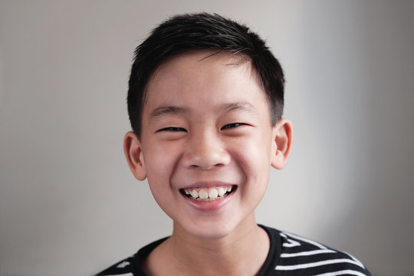

Slide 6
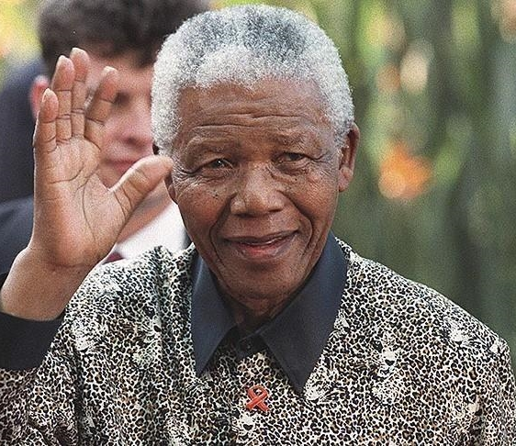
What does “race” mean?
The idea of different races was made up a long time ago in the past to separate people into groups.
In some places, powerful white people used skin colour and race as an excuse to treat others very badly.
Do you know who this man was?

Slide 7
When Nelson was a young man in South Africa he spoke out about the treatment of black people in his country. The government of white leaders felt threatened by what Nelson was saying. He was arrested and put in prison where he remained for 27 years. After his release in 1990 he became President of his country, South Africa. He died in 2013. He will be remember as a man who stood up against racism and remains a world symbol of peace.

Slide 8
Here is Balraj’s story.
Balraj suffered racist abuse from older boys when he was seven. Now, he's using his experience to make a difference, spreading his message and campaigning against all forms of discrimination.

Slide 9
How can we stop racism?
Talk about it with your family or in your class. Have you or someone you know had experience of this?
If someone is racist to you or you see or hear someone being racist – and it’s safe to do so – tell them to stop and tell them it’s wrong.
If you don’t feel safe, tell a parent or trusted adult if you see or hear something that isn’t right.
You, yourself set a good example and show that there is no place for racism.
Be a good friend and show respect for everyone you meet no matter their colour or background.

Slide 10
Show Racism the Red Card Creative Competition 2022

Slide 11
Entries can be from individual learners, pairs, groups or whole class.
Schools have until 1st April to take part in the Creative Competition.
Entries will be judged in different categories – P1-P2, P3-P5, P6-7
Submissions can be in any form – artwork, creative writing, poetry, music, film, posters, t-shirt designs, shoe/football boots design, anything!

Slide 12
Judging for the national competition will take place during April 2022 by a panel of subject experts and surprise guests.
Finalists will be notified at the end of May with the overall category winners being announced at the awards ceremony, planned for Hampden Park, Glasgow later in the term.
All entrants to the competition will receive a certificate from Show Racism the Red Card.

Slide 13
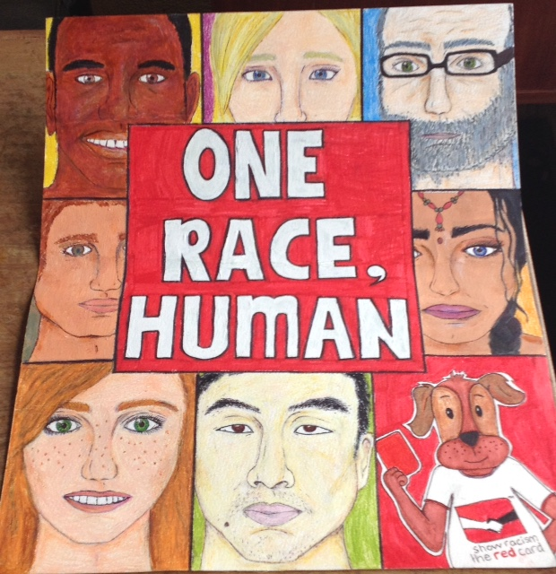

Slide 14
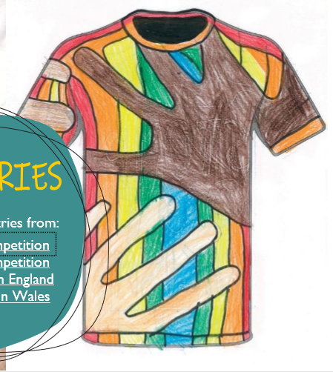
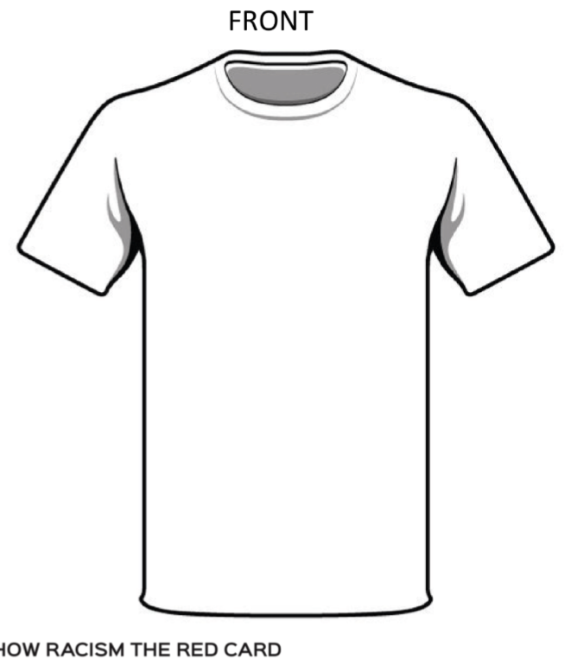

Slide 15
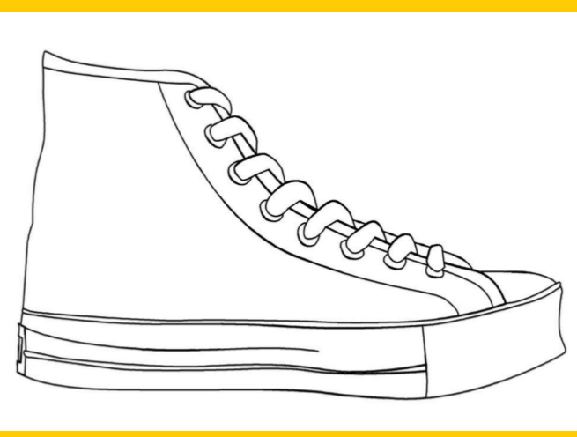
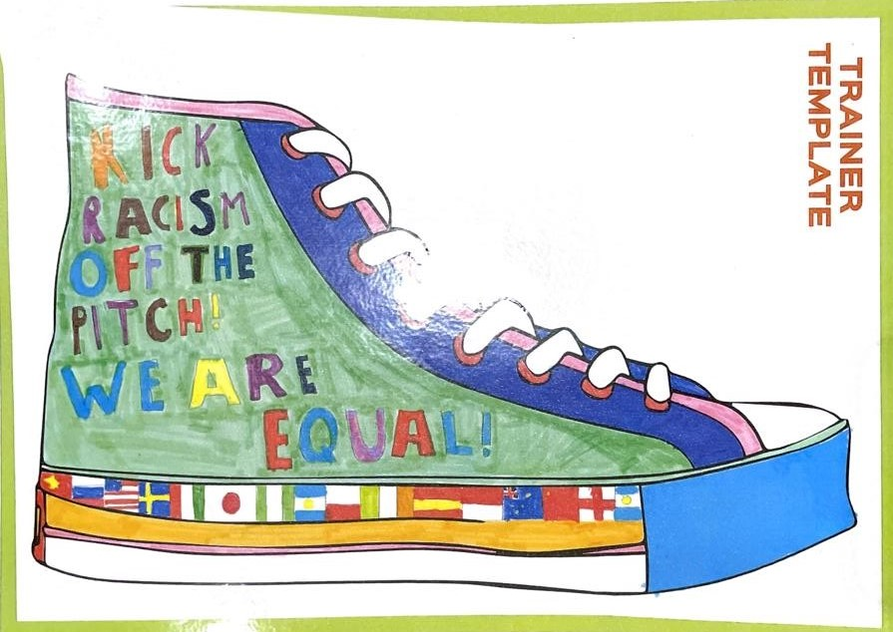
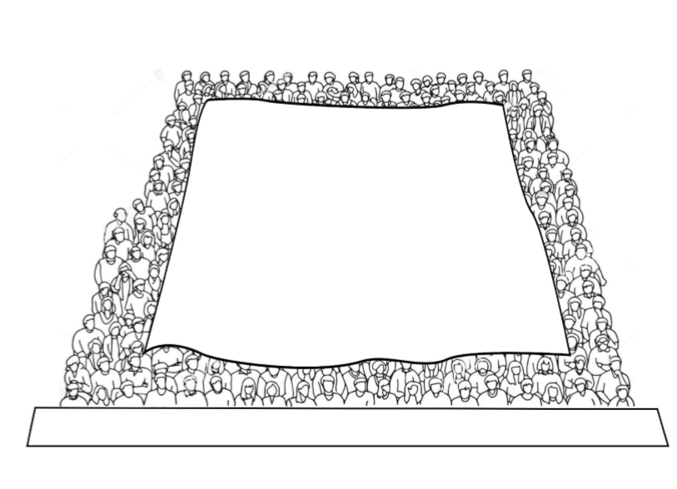

Slide 16
How to enter
Have a think over the weekend of what you think your class could do whether that is individually, in pairs, small groups or as a class.
Speak with your teacher next week about what you could do for this competition.
Think about your talents and the talents of your teacher when you are deciding.
Plan what you are going to do.

Slide 17
The Judging Panel
On the afternoon of Thursday, 24th March, Mrs. Johnston (P6B), myself and a couple of members of the Rights Respecting Schools Committee will come round the classes, look at all the entries that have been put together and chose which ones will go forward and be sent away to the National Competition.
We have a special prize for the top entry from Gargieston Primary.

Slide 18
A special prize for the Gargieston winners.
This is Kris Doolan. When he was a player, Kris played for lots of football teams in Scotland – Auchinleck Talbot, Clyde, Ayr United, Morton, Arbroath and most notably Partick Thistle where he is a legend!!
He is also a dad in our school!! Darcie is in P3A and also in the Rights Respecting Schools group.
Kris has his own Football Academy where he provides fun football coaching for boys and girls of all ages. He loves what we are doing for the competition to Show Racism The Red Card.
Kris has offered a coaching session for the overall Gargieston winner, group winners or class winners who are selected on March 24th

Slide 19
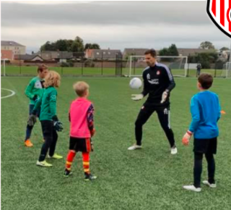
Get Creative
And
Good Luck!!

