Slide 2
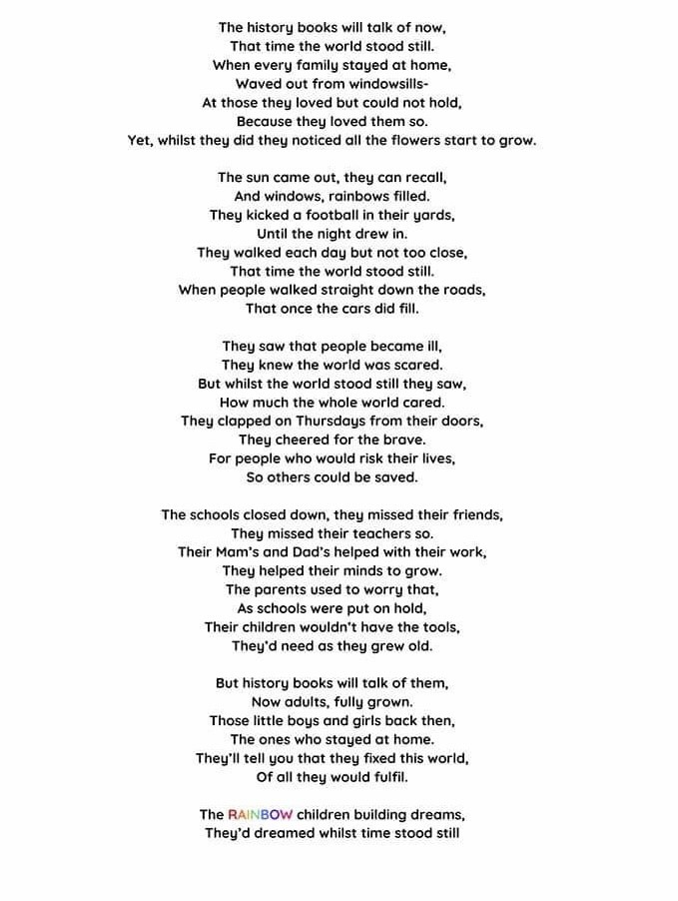

Slide 3
All of our dreams
can come true
If we have the courage
To pursue them
Walt Disney

