Slide 1
Gargie Gallery P1-3

Slide 2
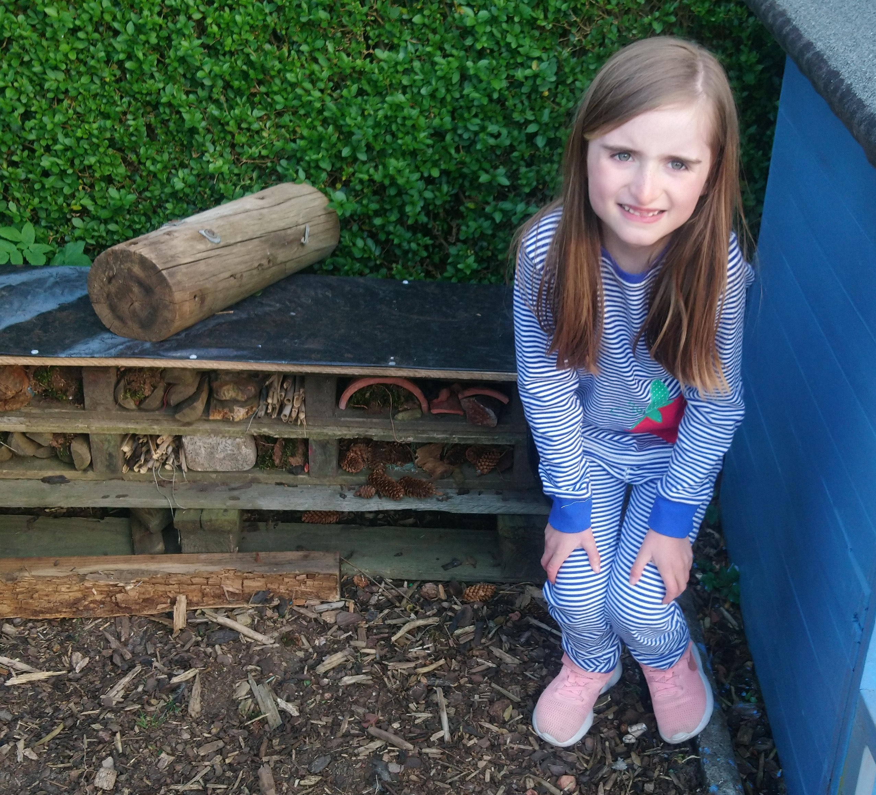
Orla P3B

Slide 3
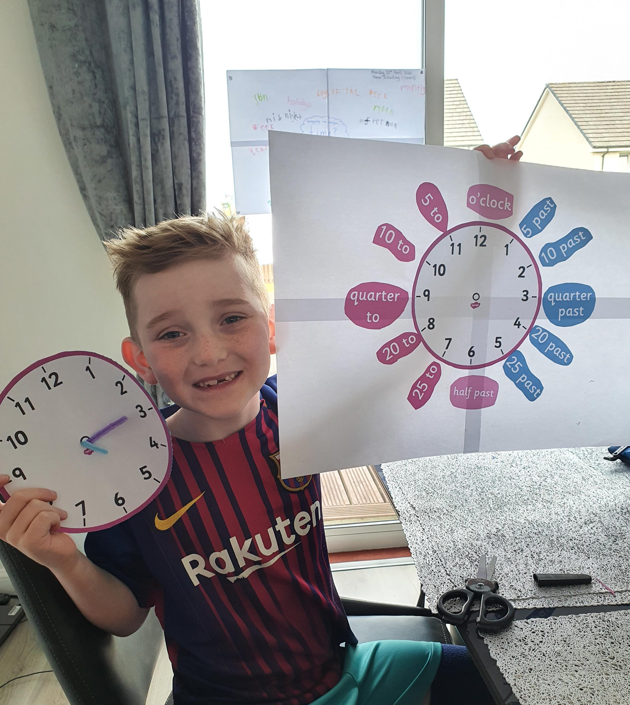
Alfie P2C

Slide 4
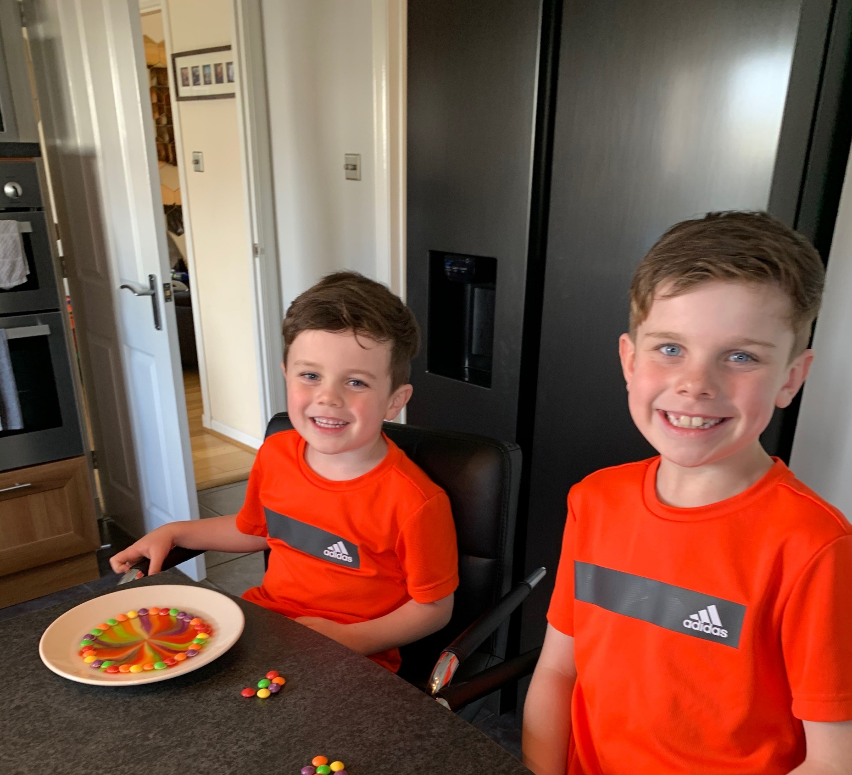
Max P3B

Slide 5
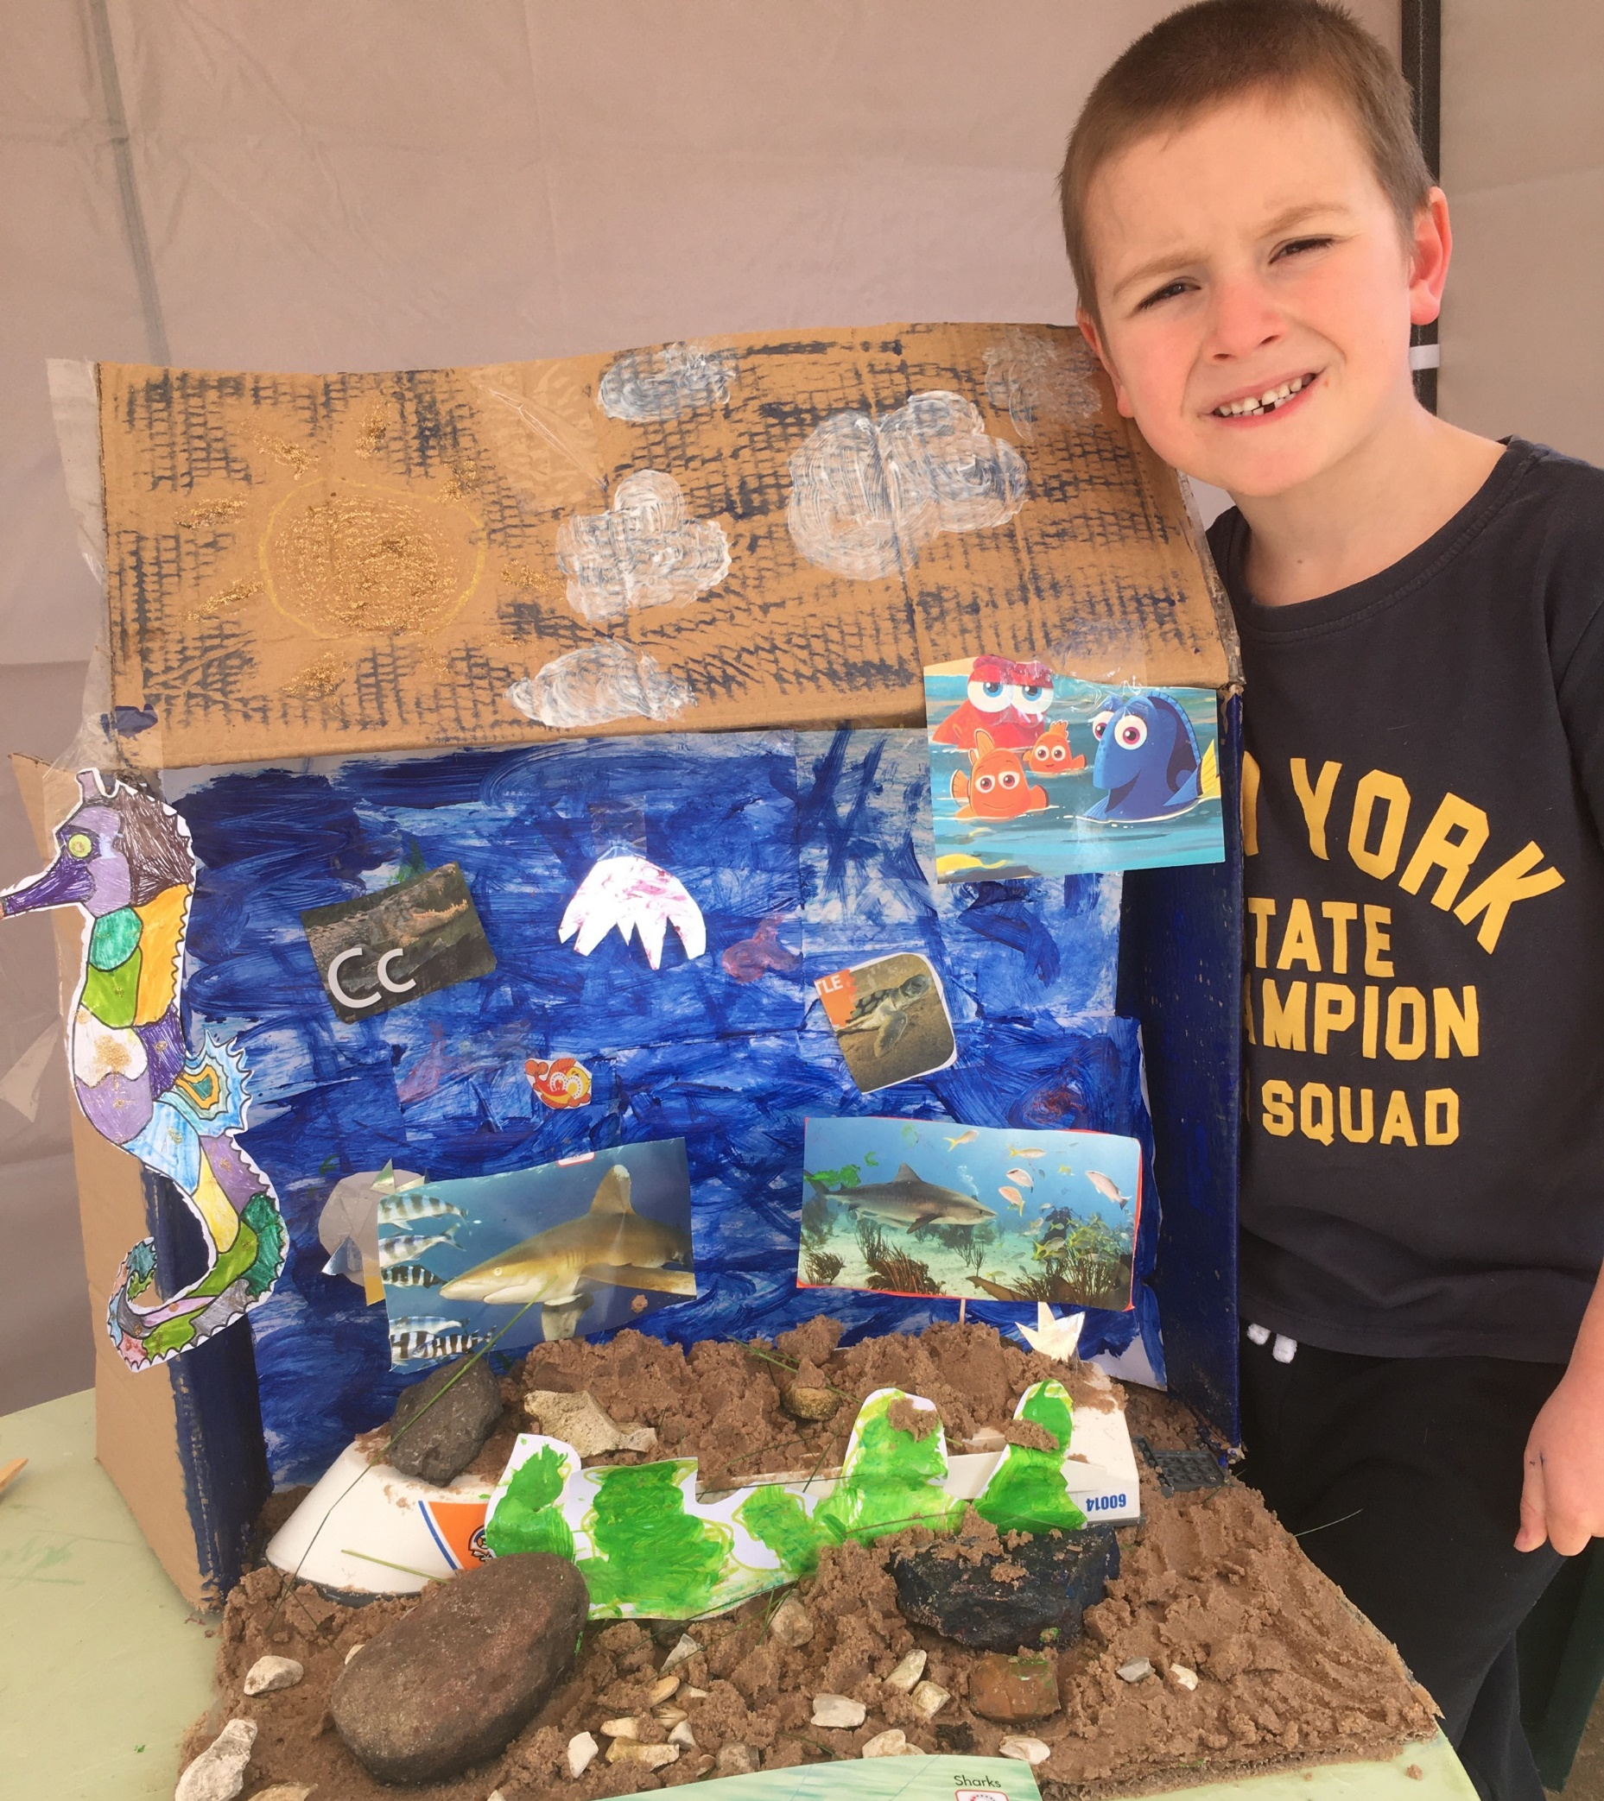
Henry G P2C

Slide 6
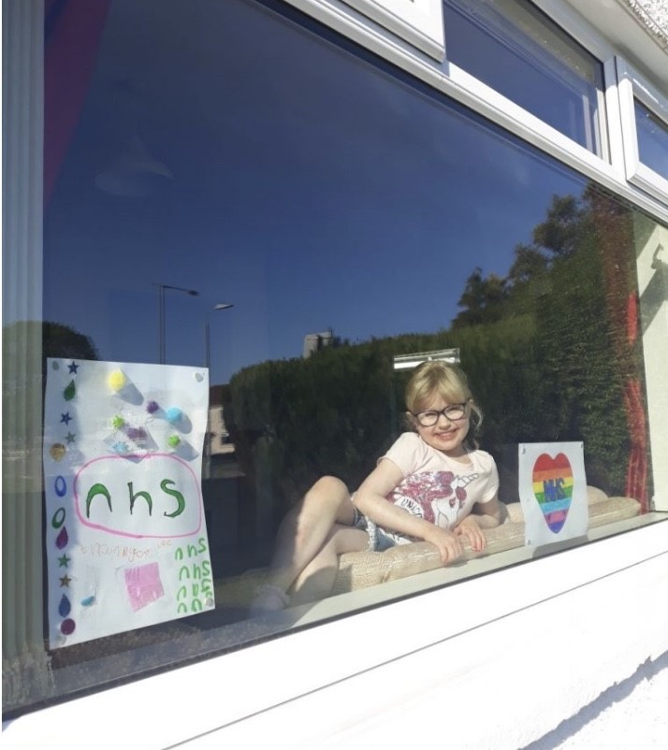
Jasmin P1B

Slide 7
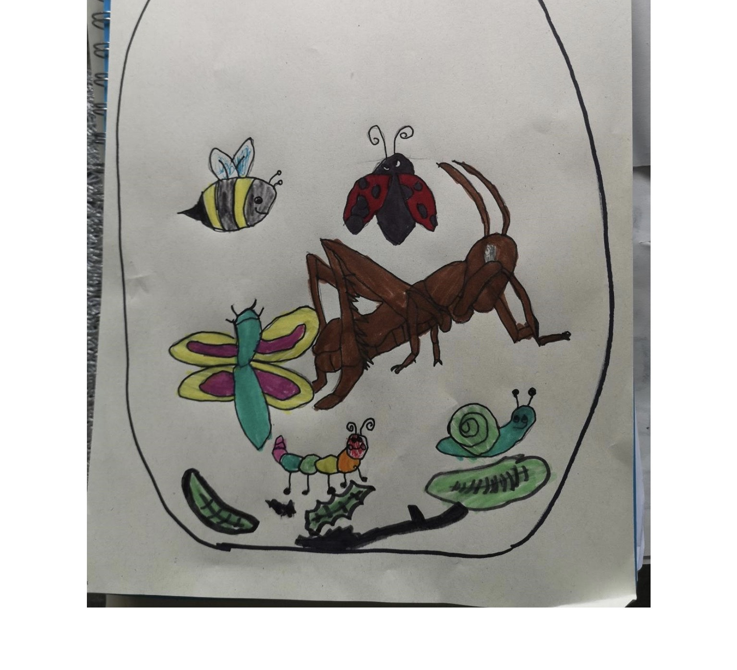
Aeson P3B

Slide 8
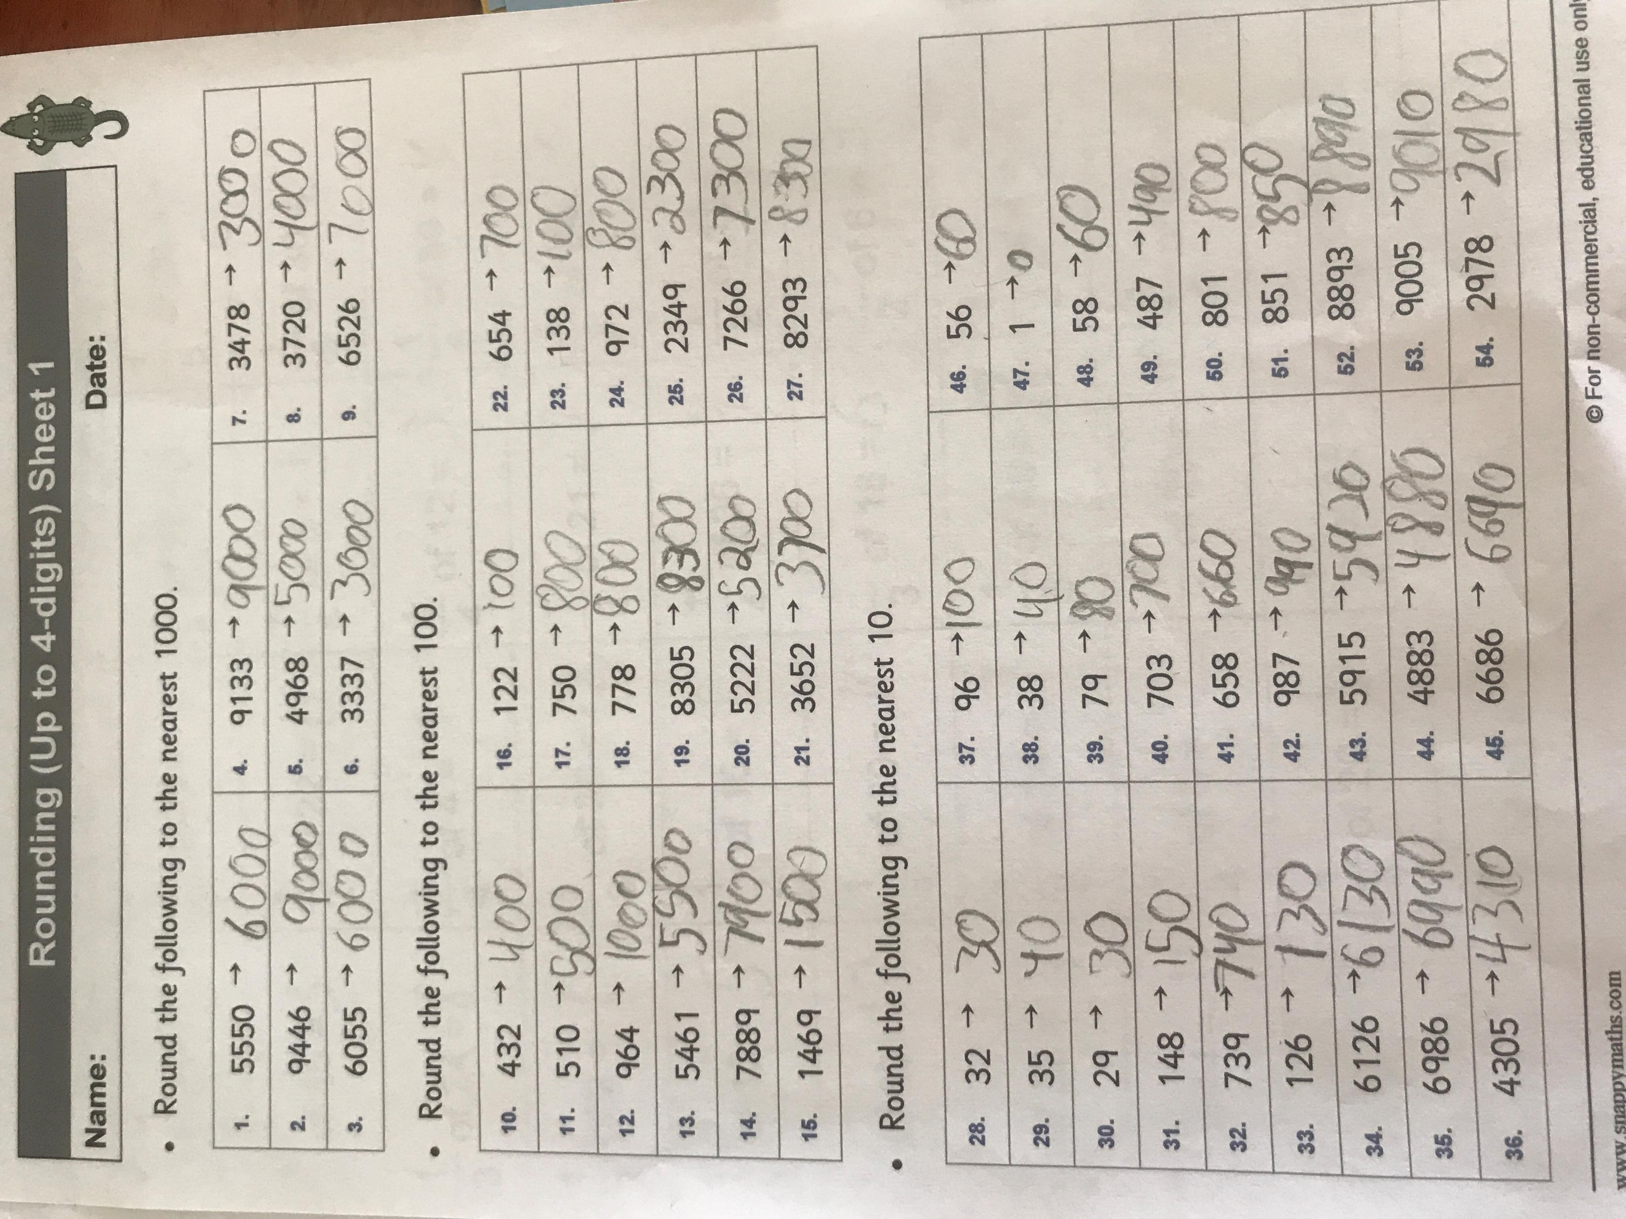
Adil P2B

Slide 9
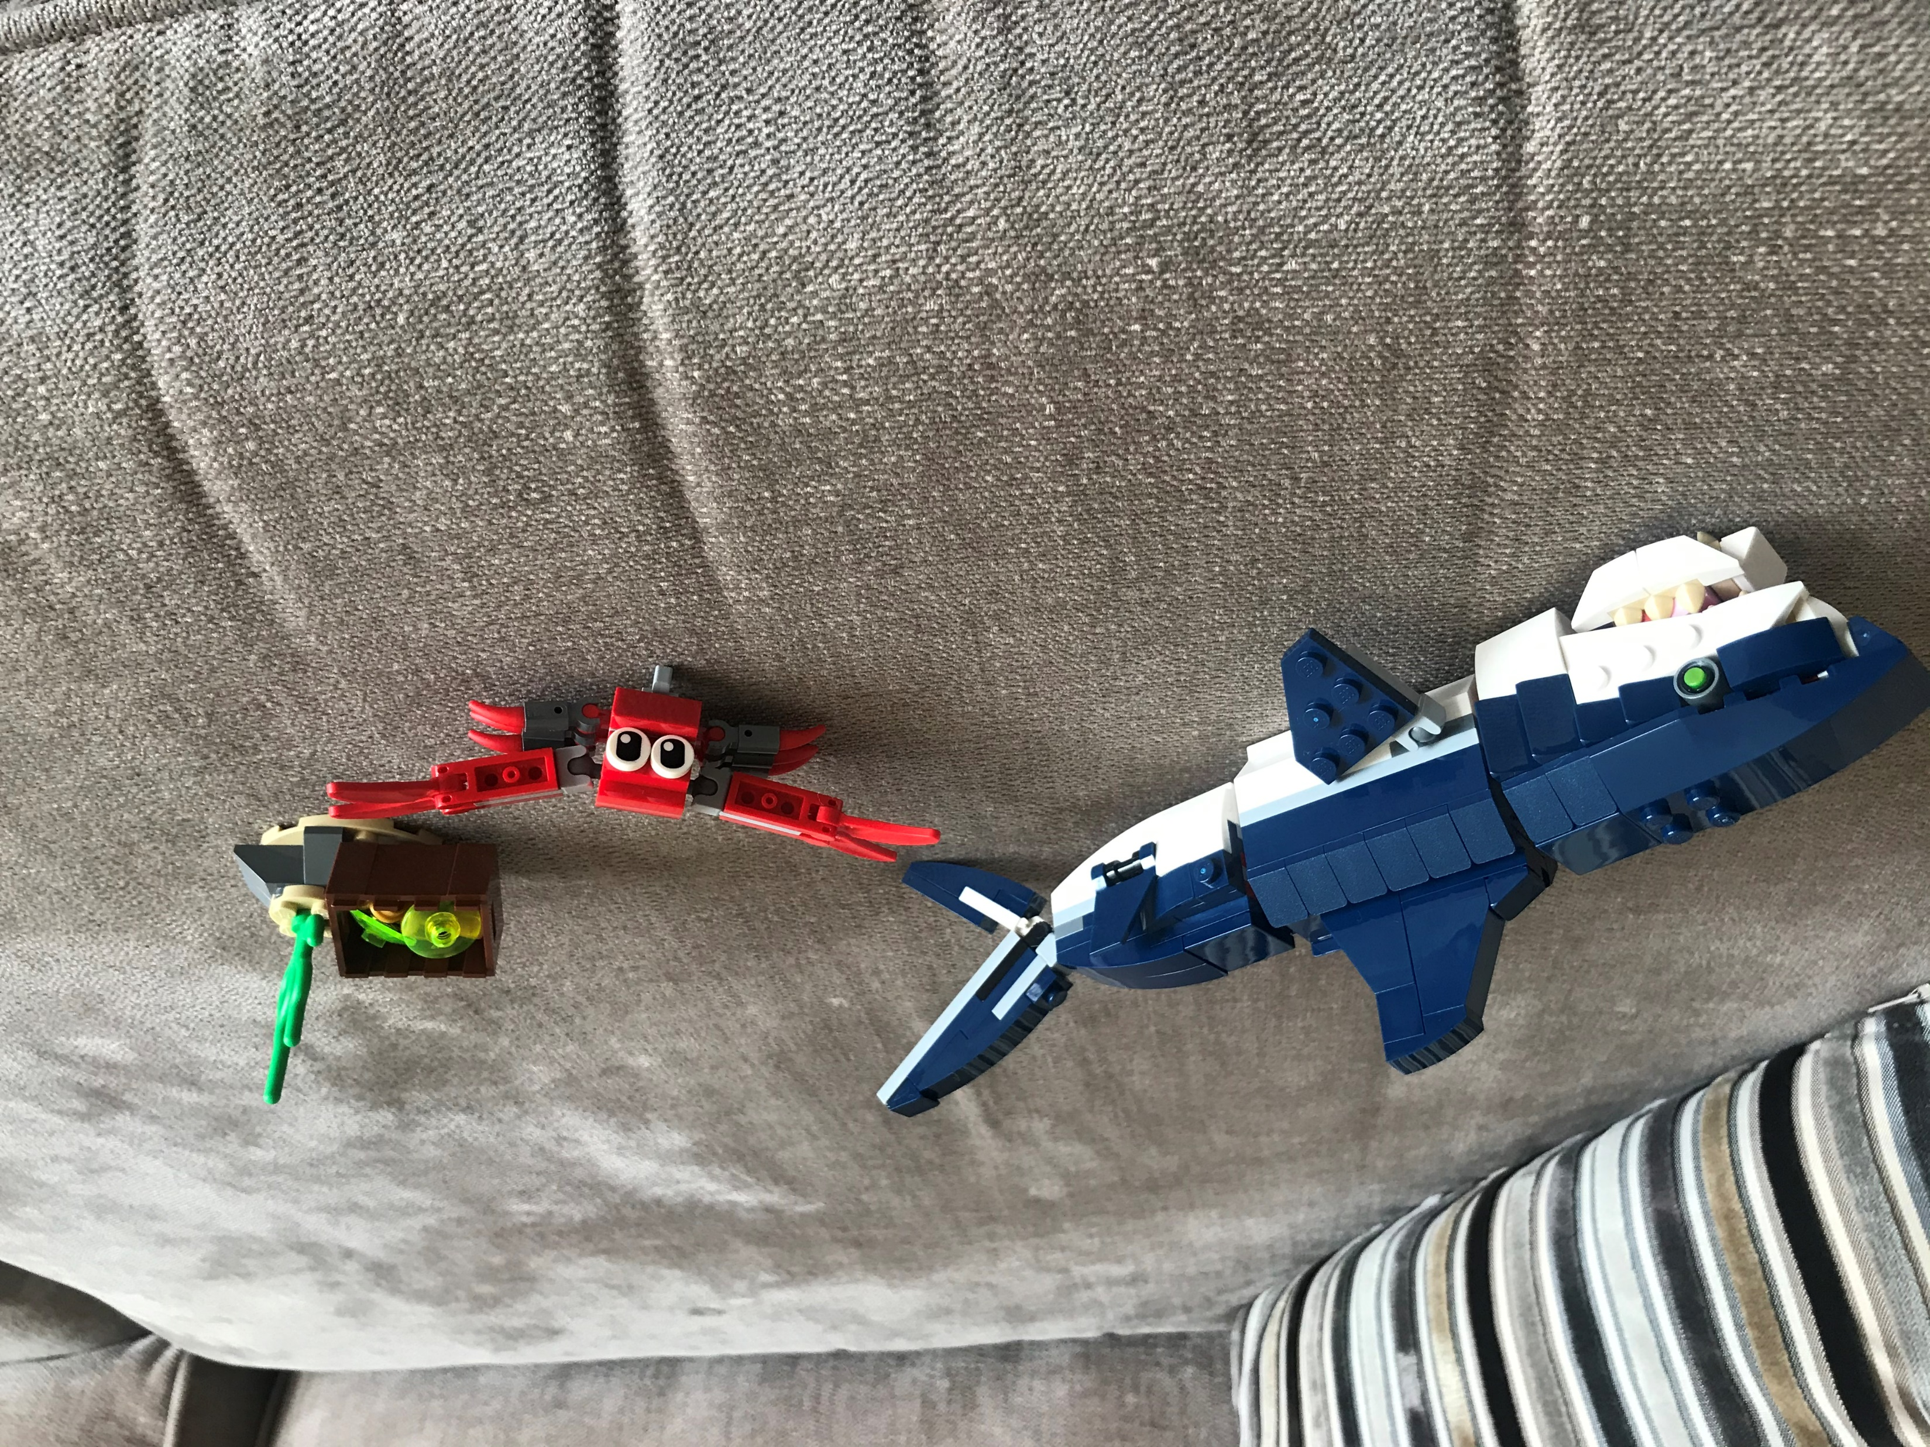
Corey P2C

Slide 10
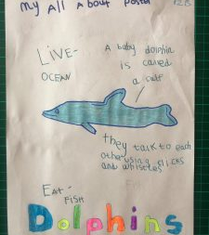
Tom P2B

Slide 11
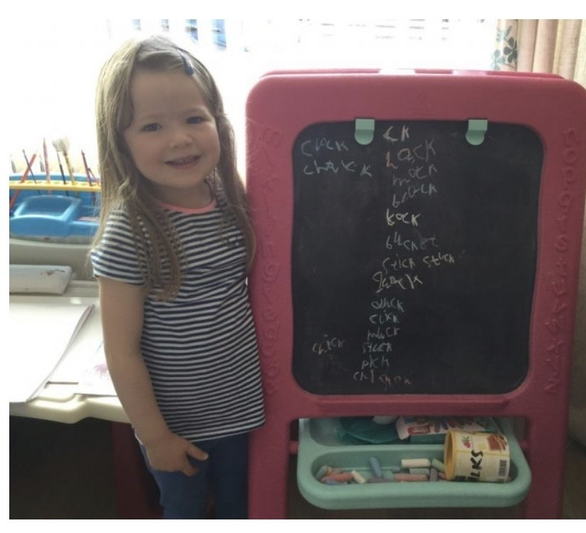
Lucy P1B

Slide 12
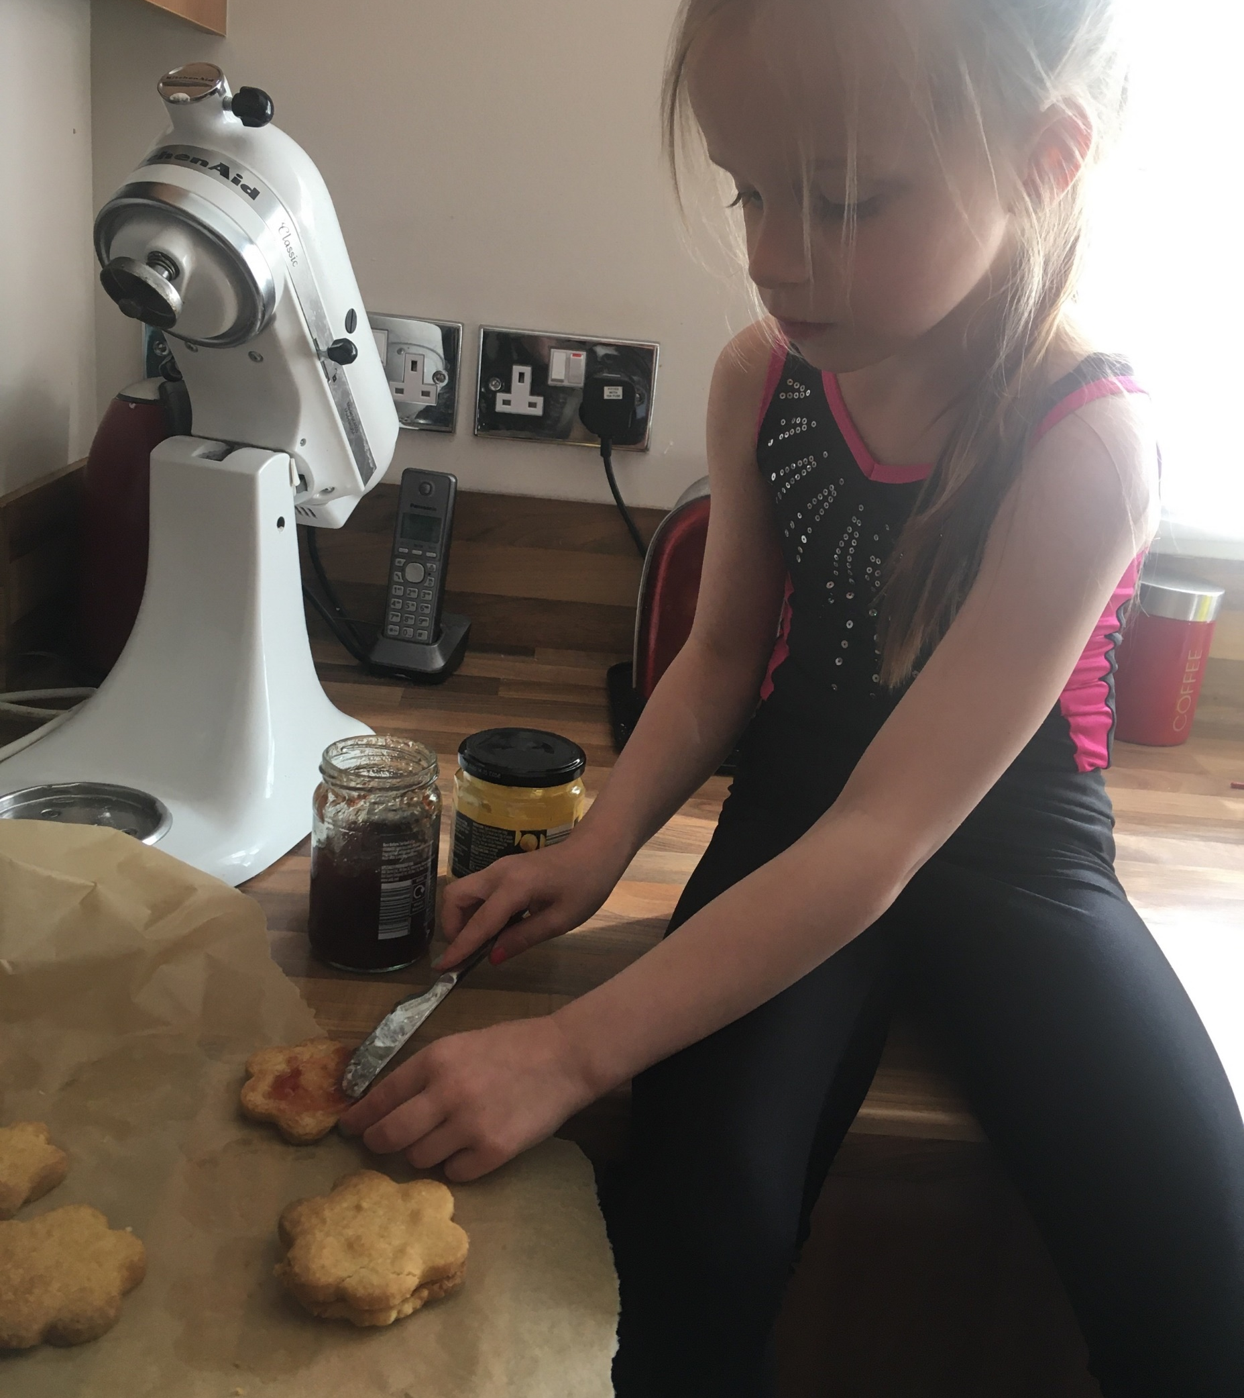
Rachel P2C

Slide 13
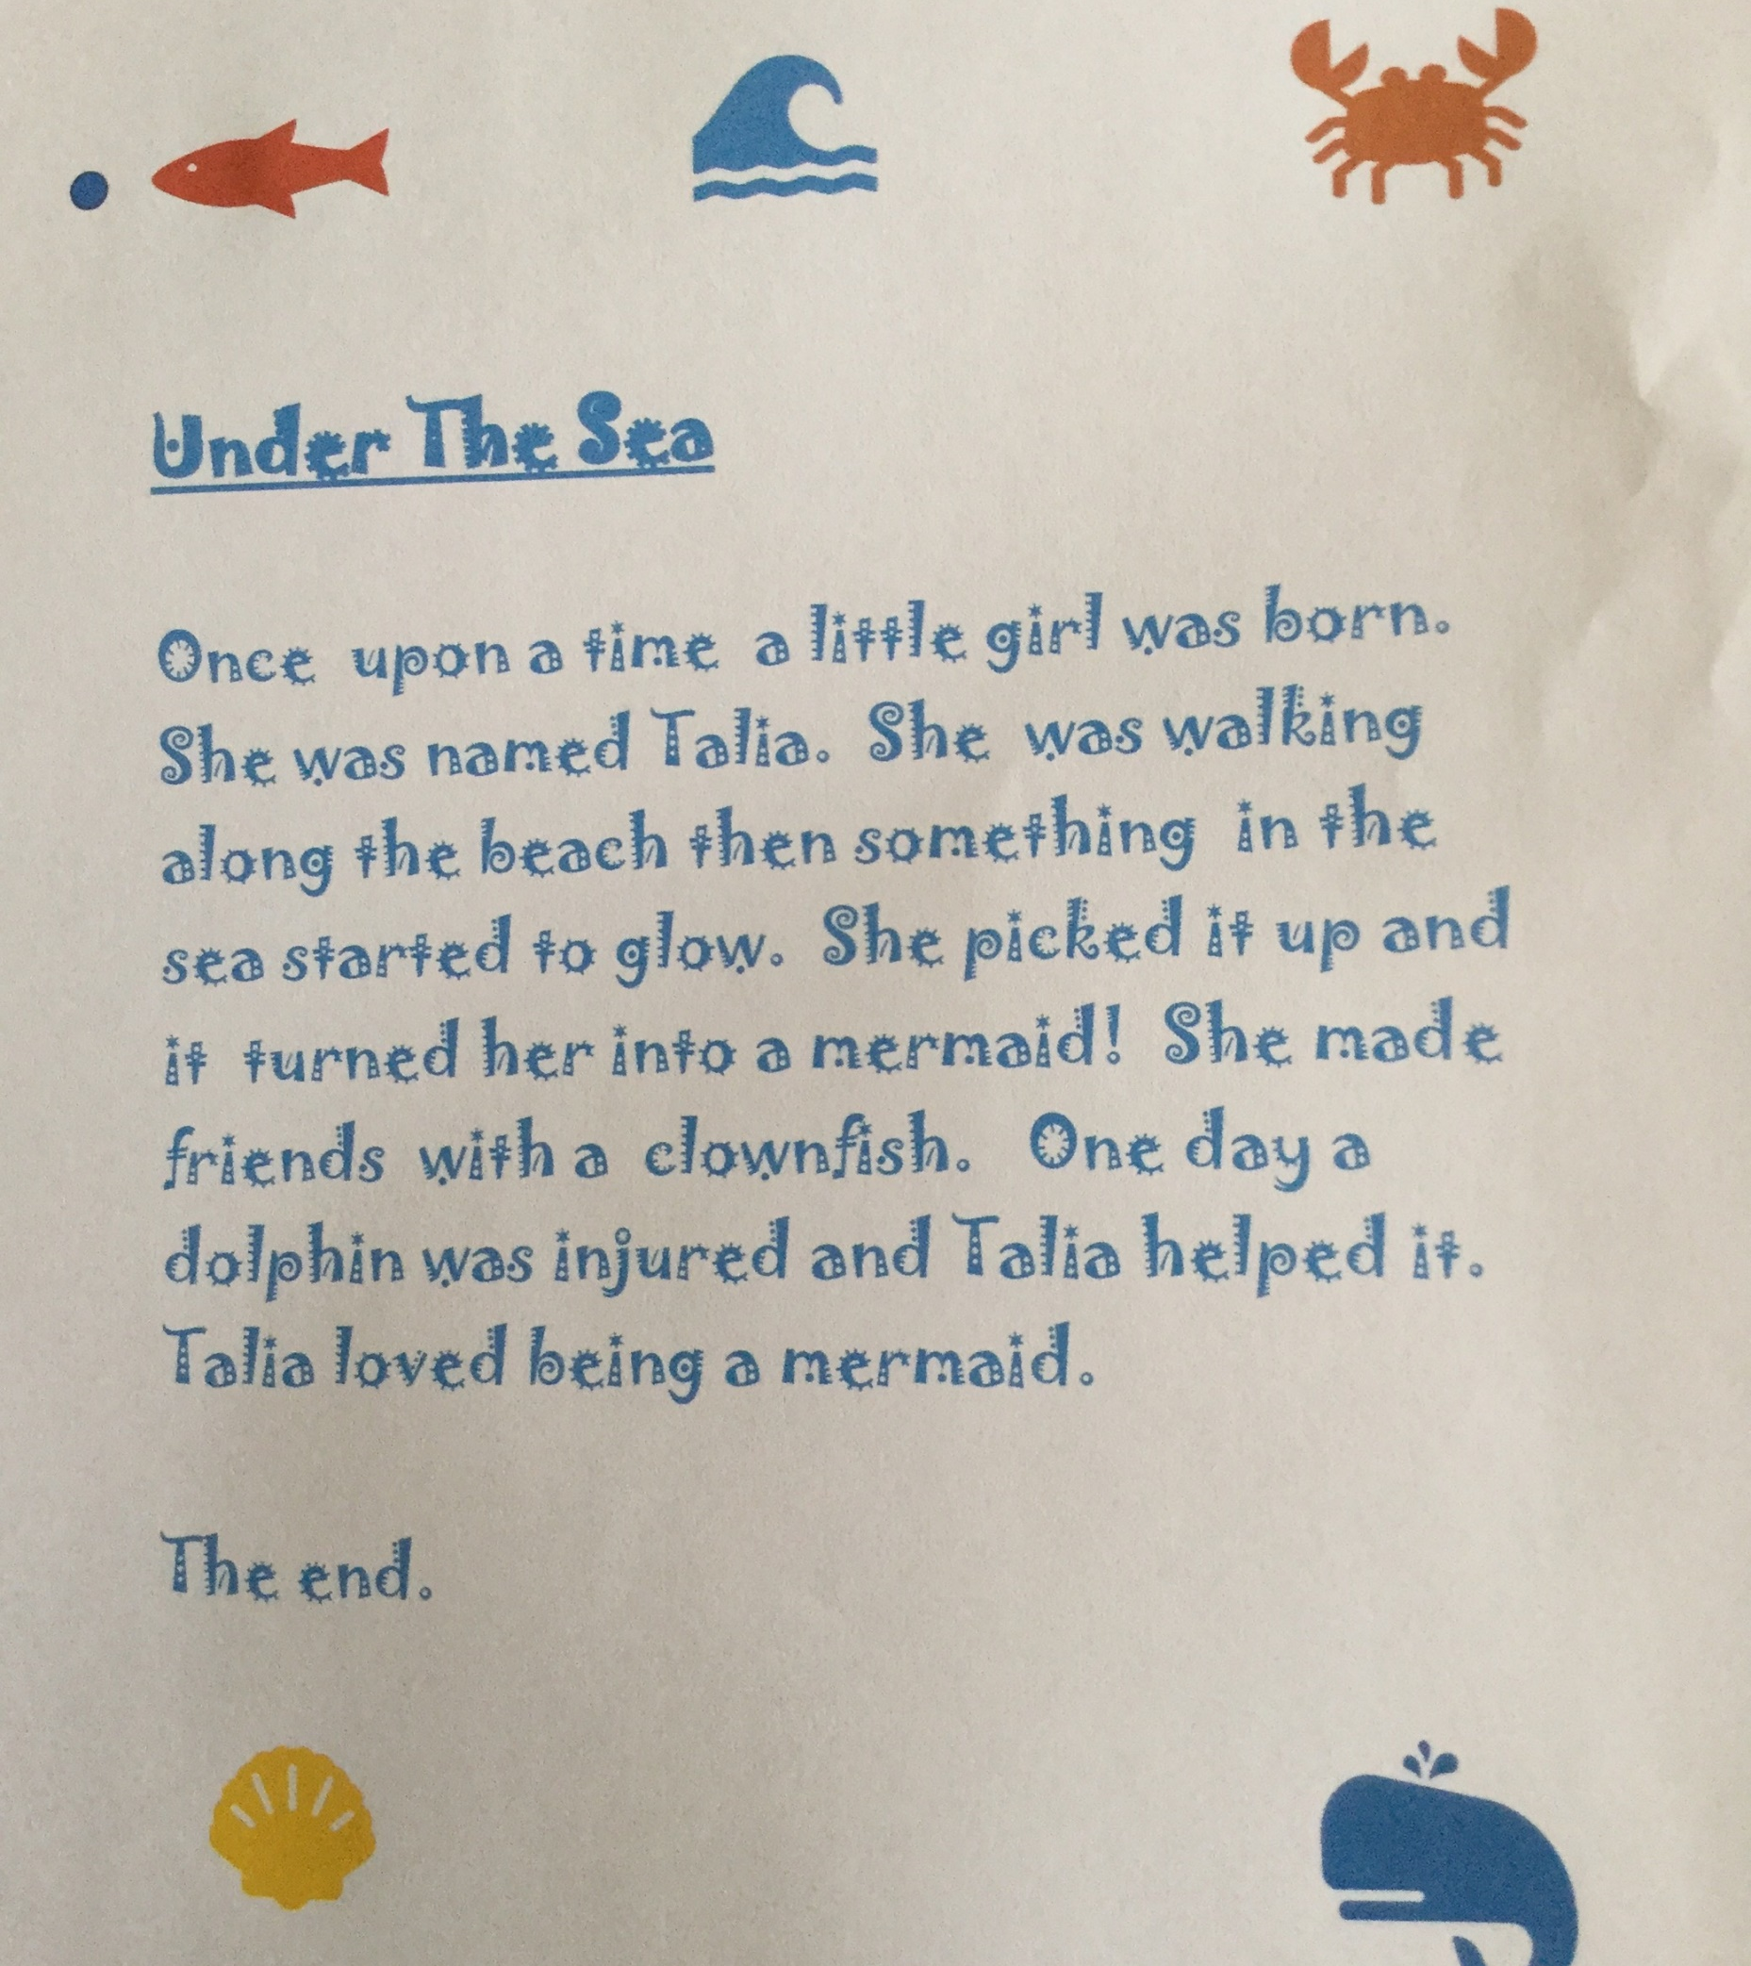
Eilidh P2B

Slide 14
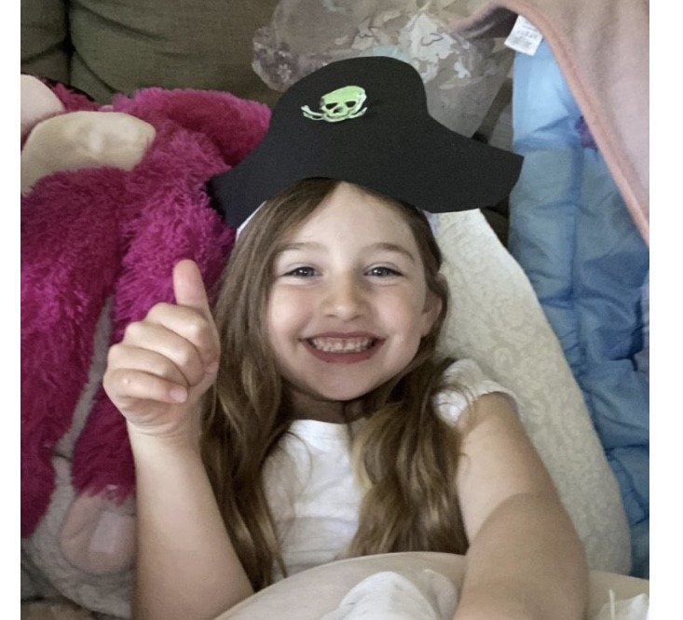
Mila P1B

Slide 15
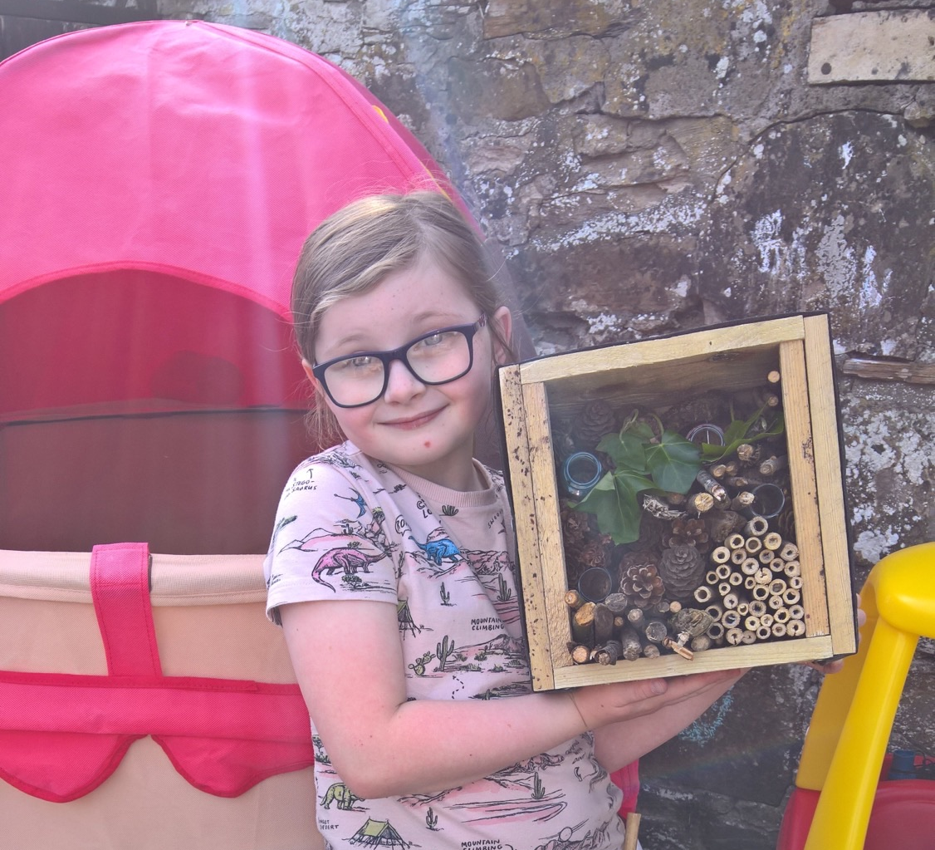
Libby P3B

Slide 16
Annie P2C

Slide 17
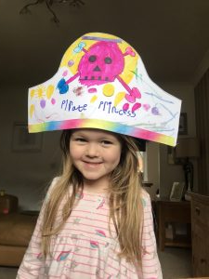
Orla-Rose P1C

Slide 18
Emma P1B

Slide 19
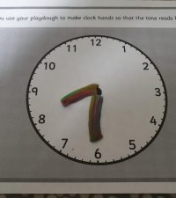
Max P2B

Slide 20
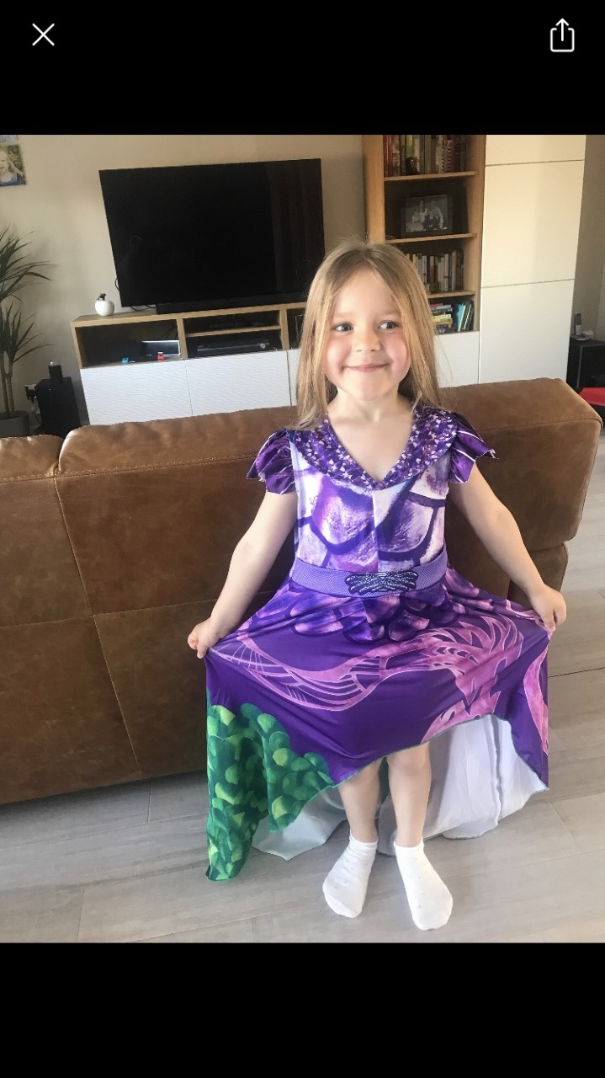
Victoria P1B

Slide 21
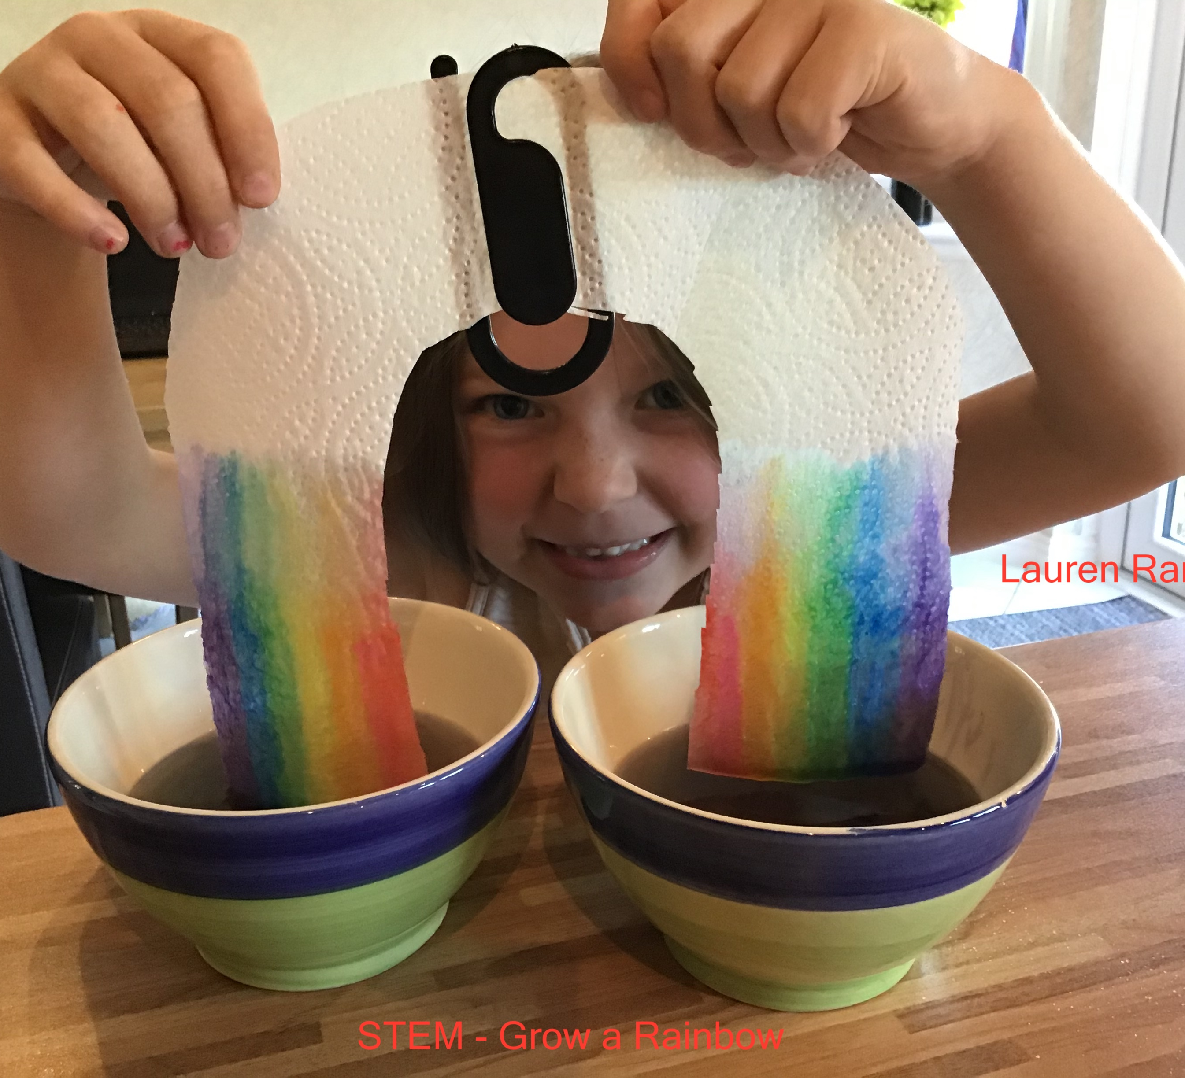
Lauren P3A

Slide 22
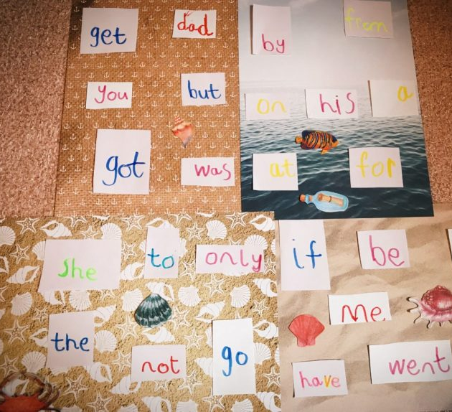
Liliana P1C

Slide 23
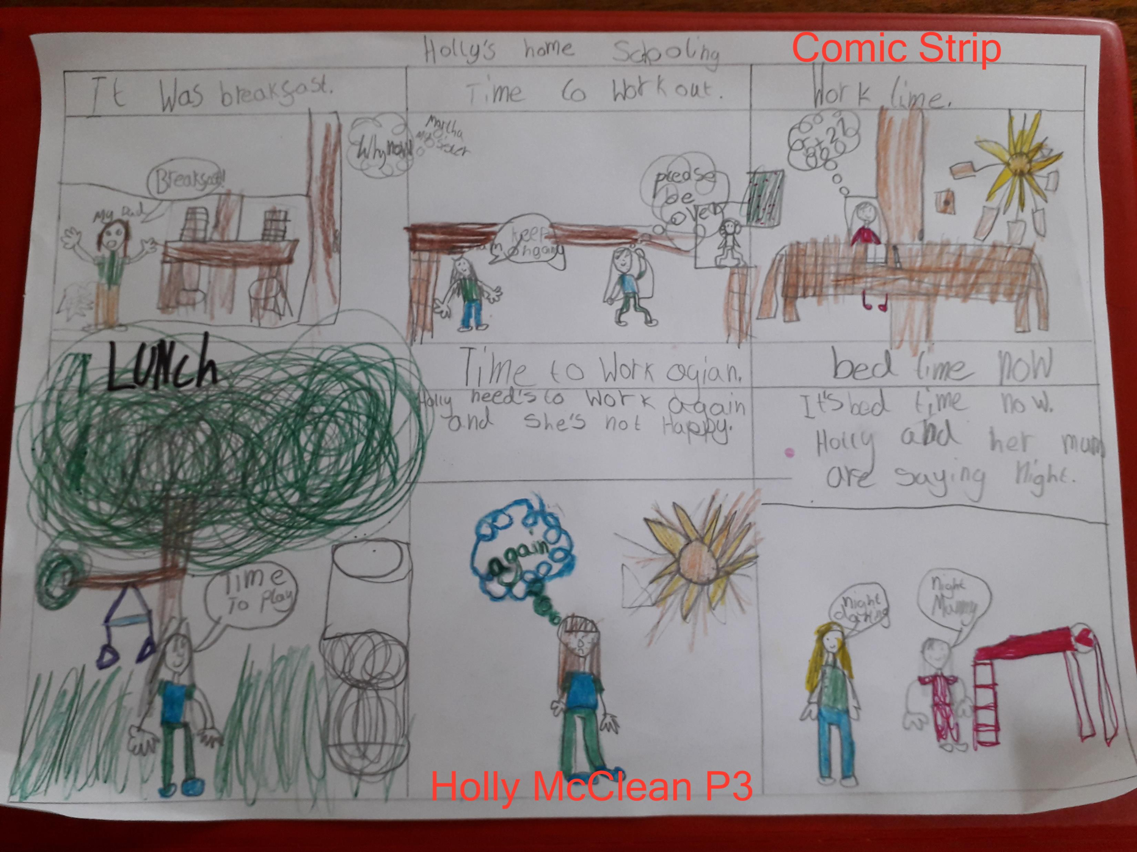
Holly Mc P3A

Slide 24
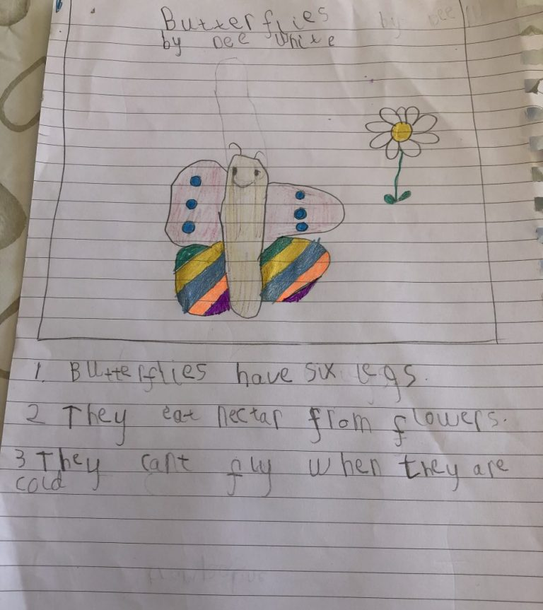
Fearne P1A

Slide 25
Sam P3A

Slide 26
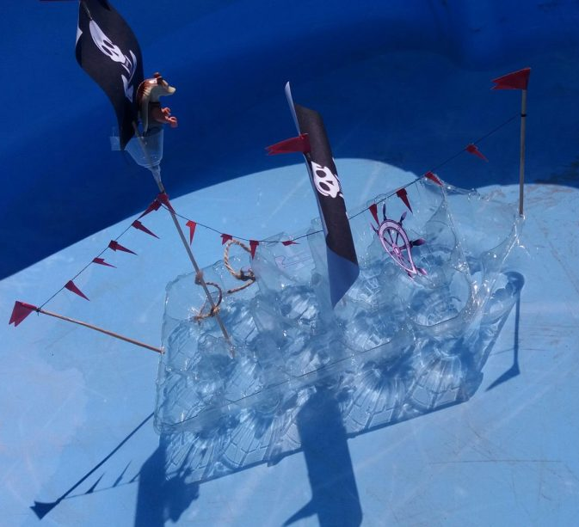
Alexander P1A

Slide 27
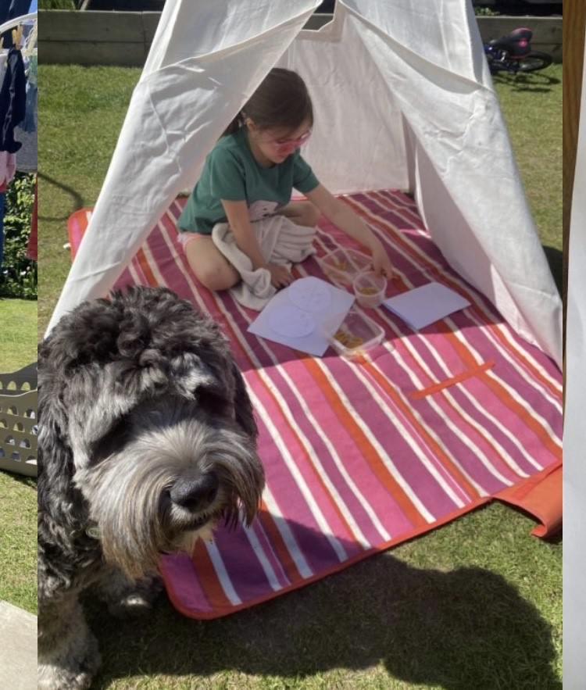
Jess P1B

Slide 28
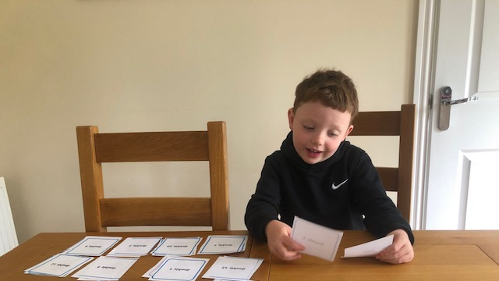
Ben R P1C

Slide 29
Sophia P1A

Slide 30
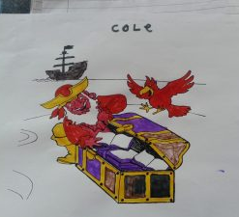
Cole P1C

Slide 31
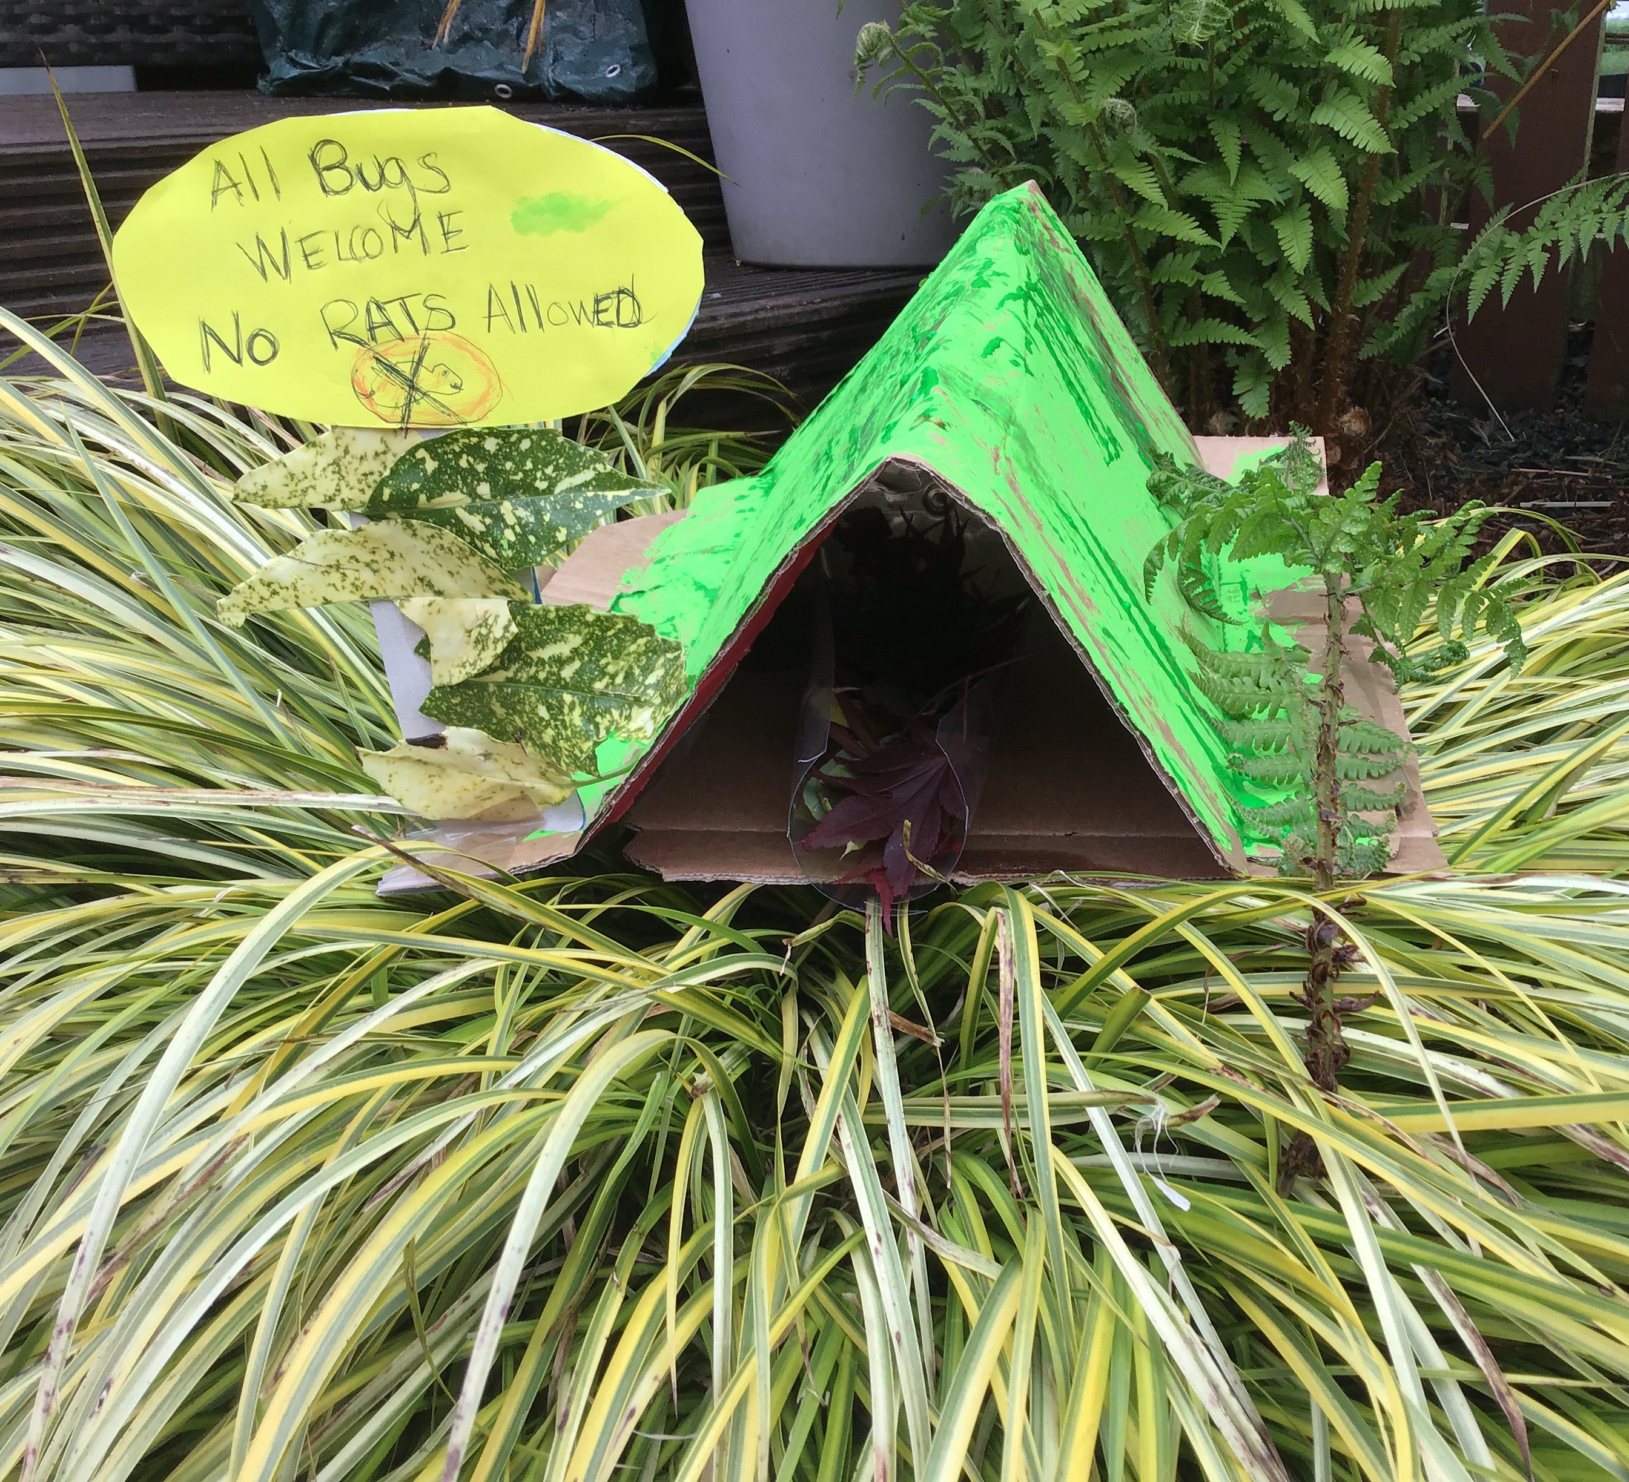
Blair P3B

Slide 32
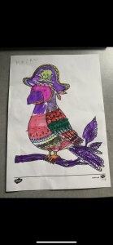
Keira P1C

Slide 33
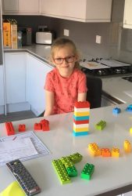
Darcie P1C

Slide 34
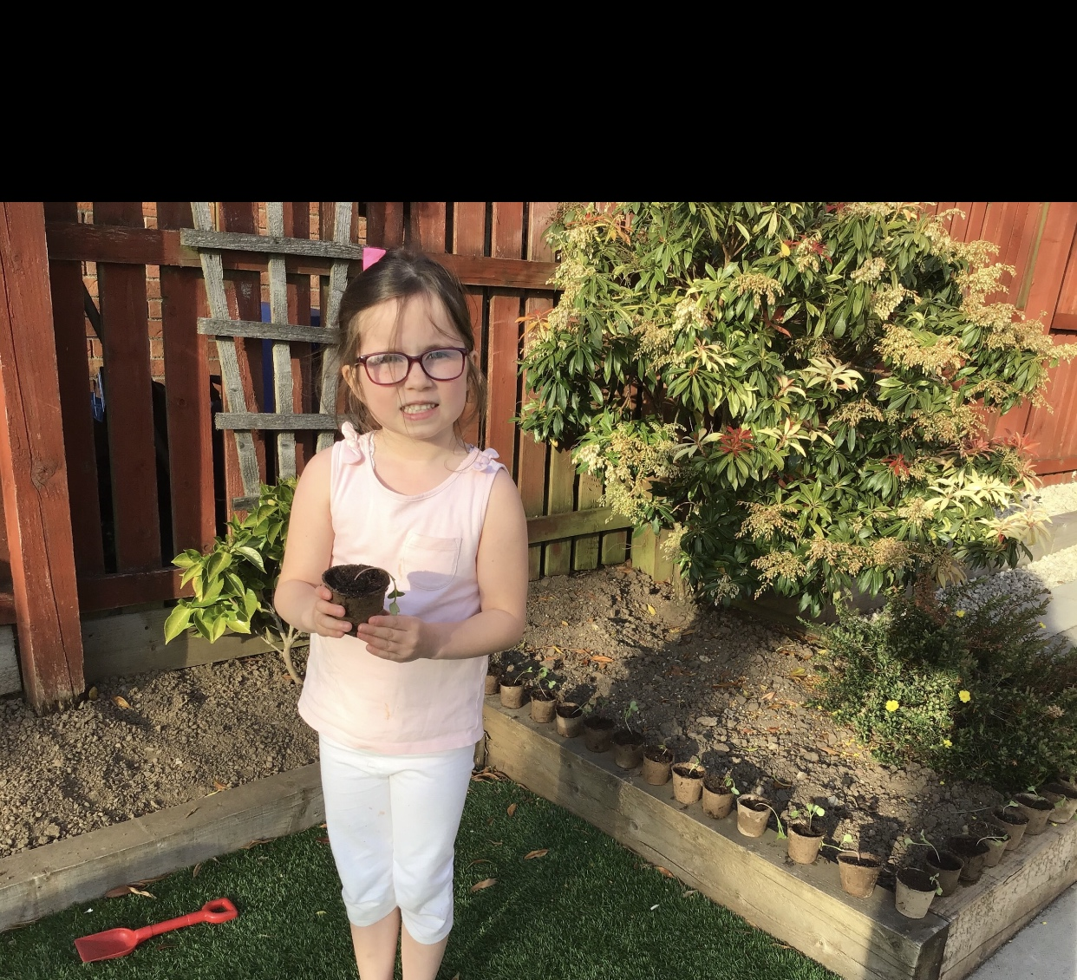
Jasmine P2A

Slide 35
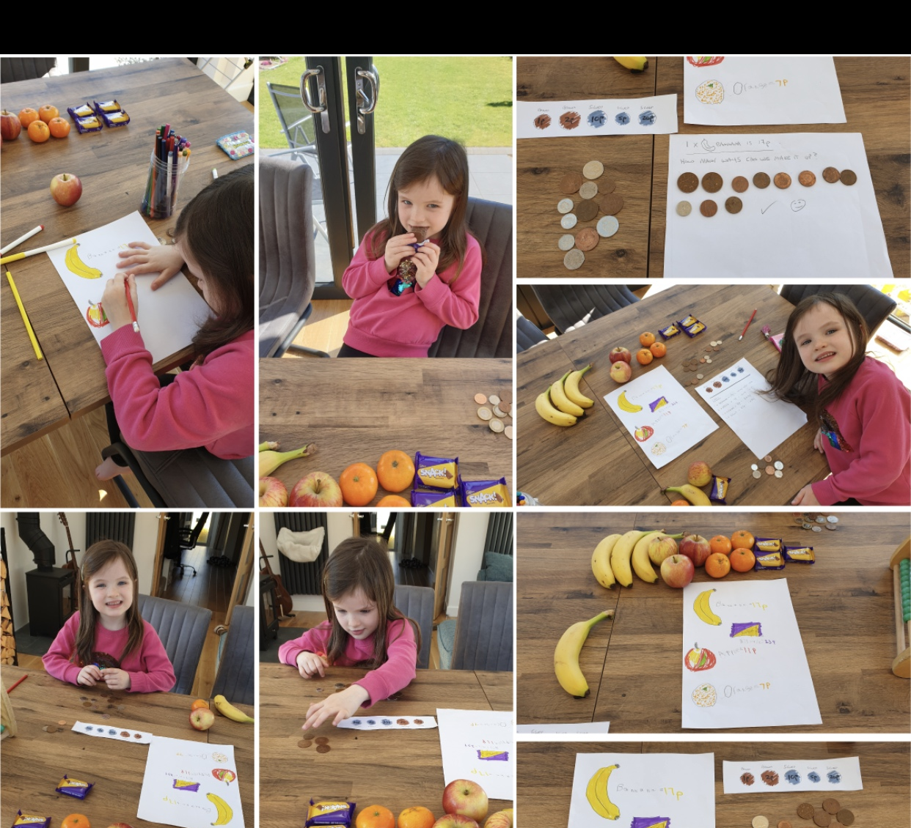
Eilidh P2A

Slide 36
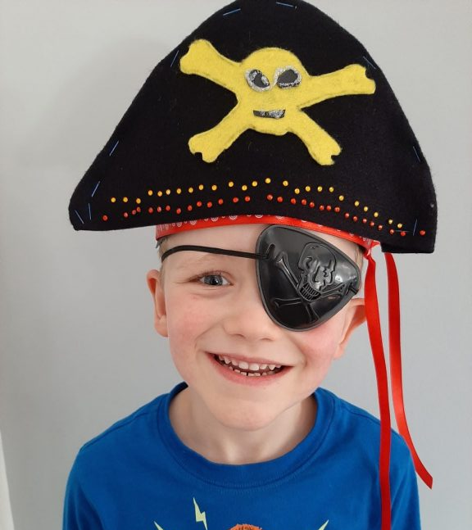
Aaron P1A

Slide 37
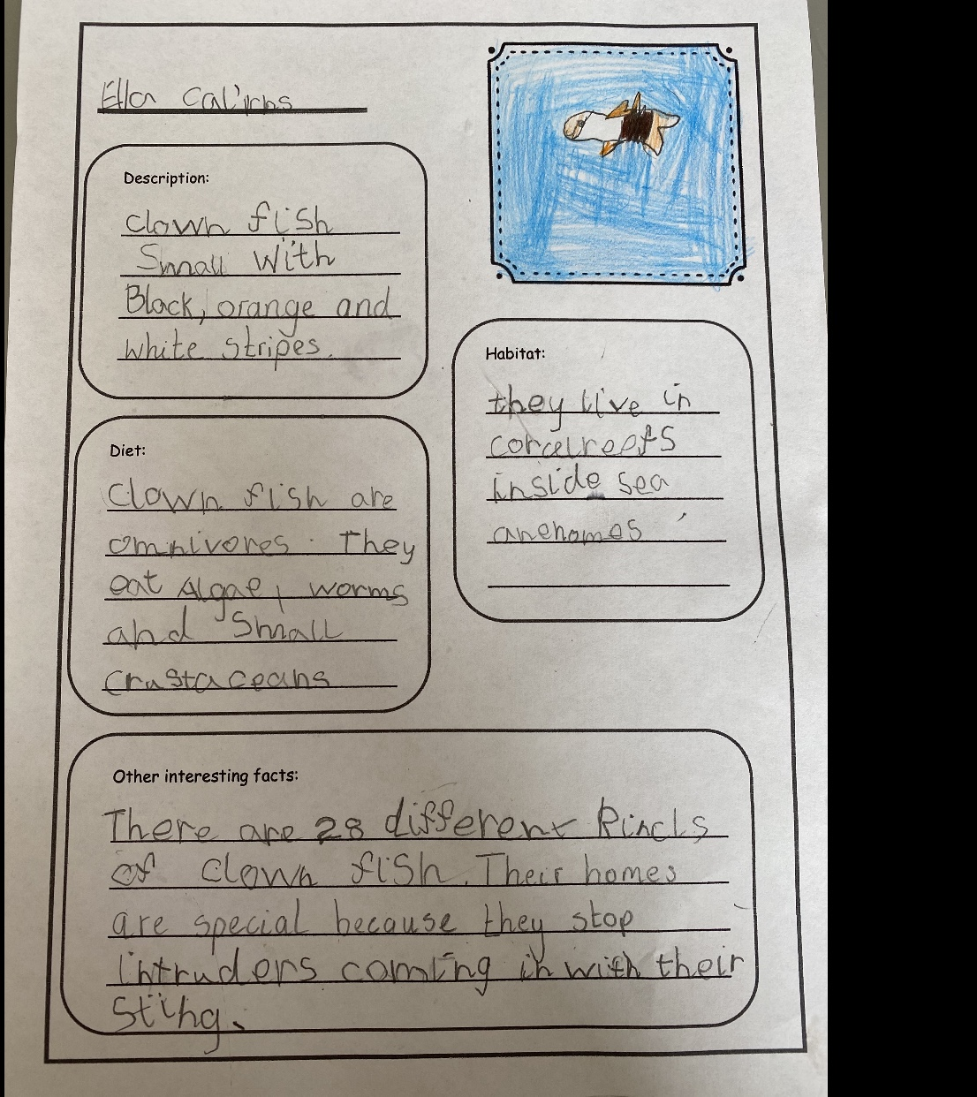
Ella P2A

Slide 38
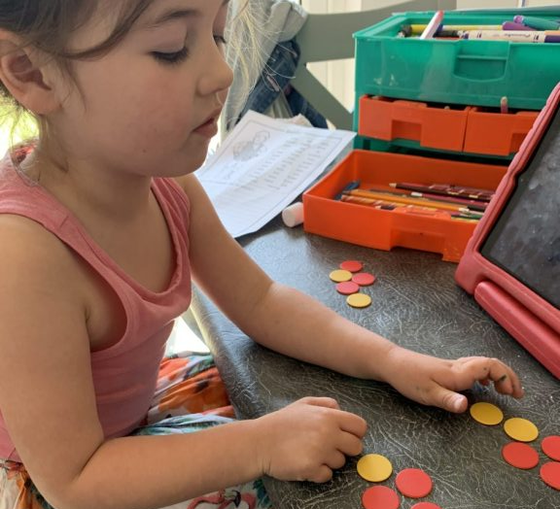
Niamh P1A

Slide 39
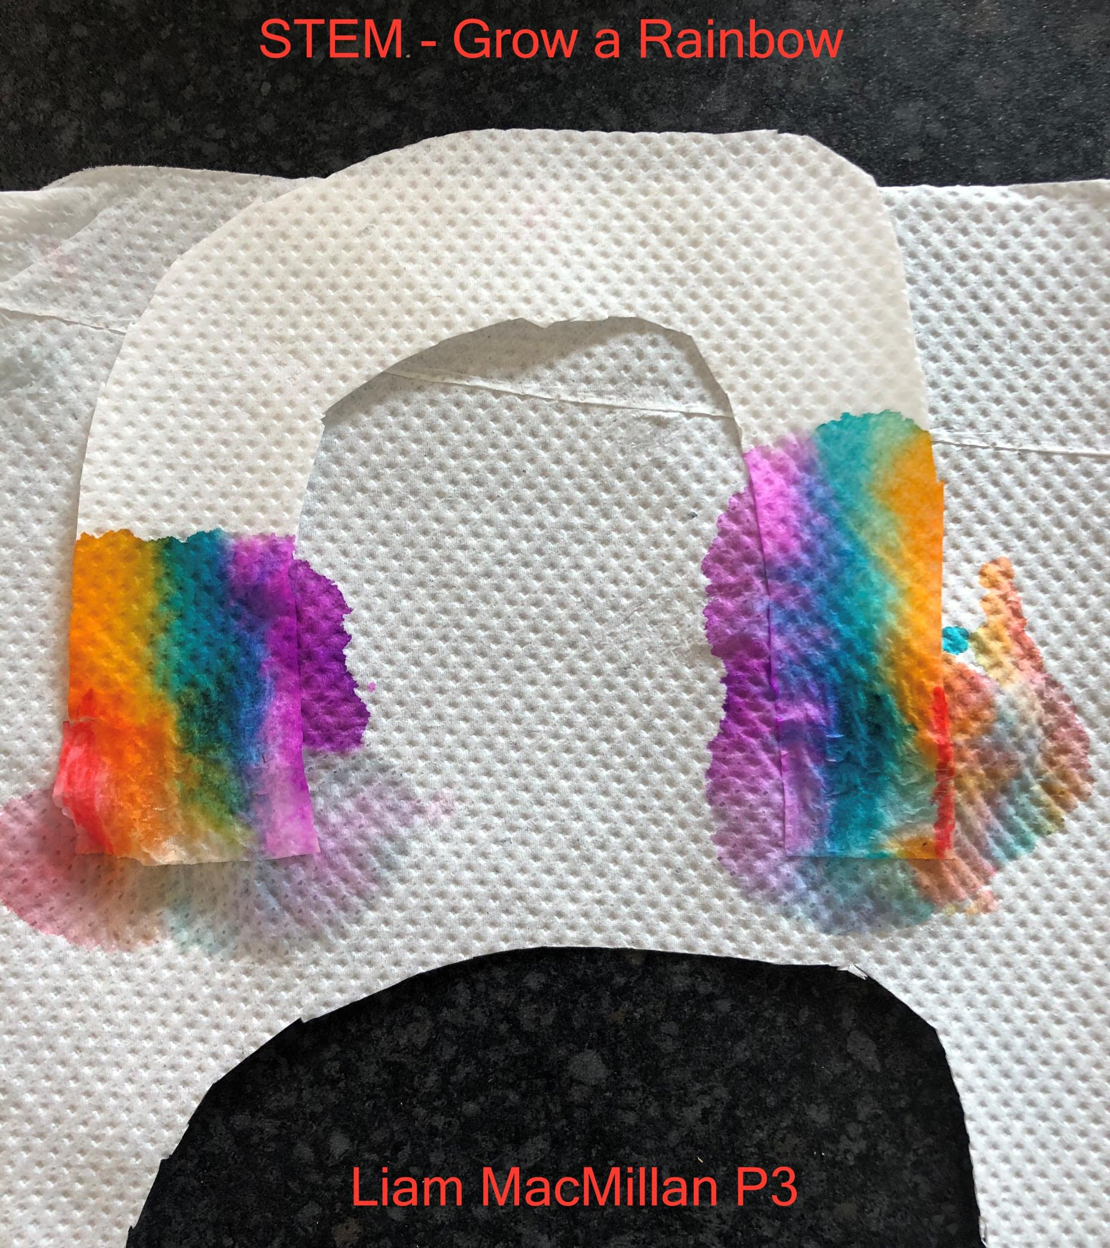
Liam P3A

Slide 40
Lovely to see all the different ways we are learning.

