Slide 1
Gargie Gallery P4-7

Slide 2
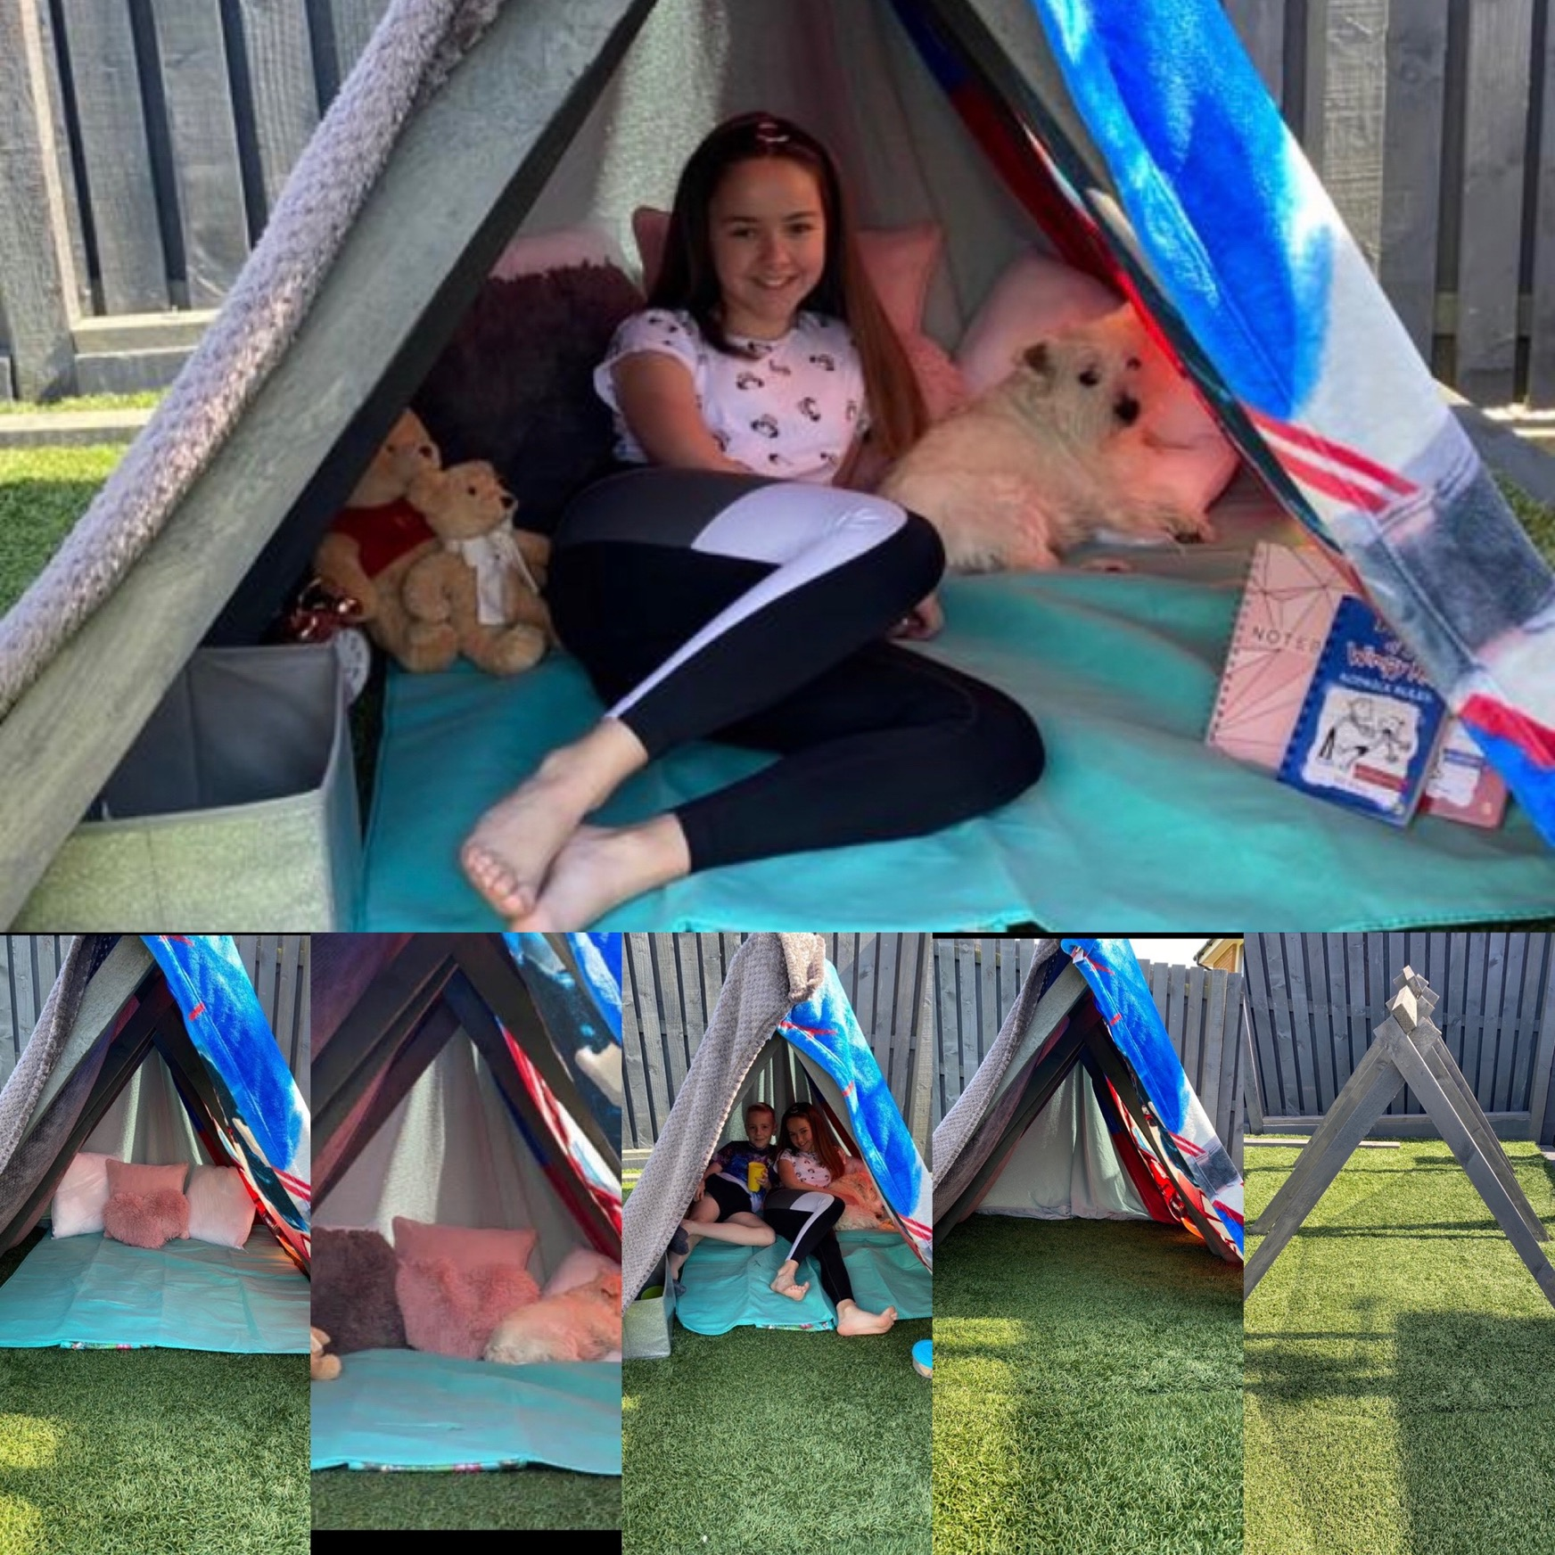
Brooke P7A

Slide 3
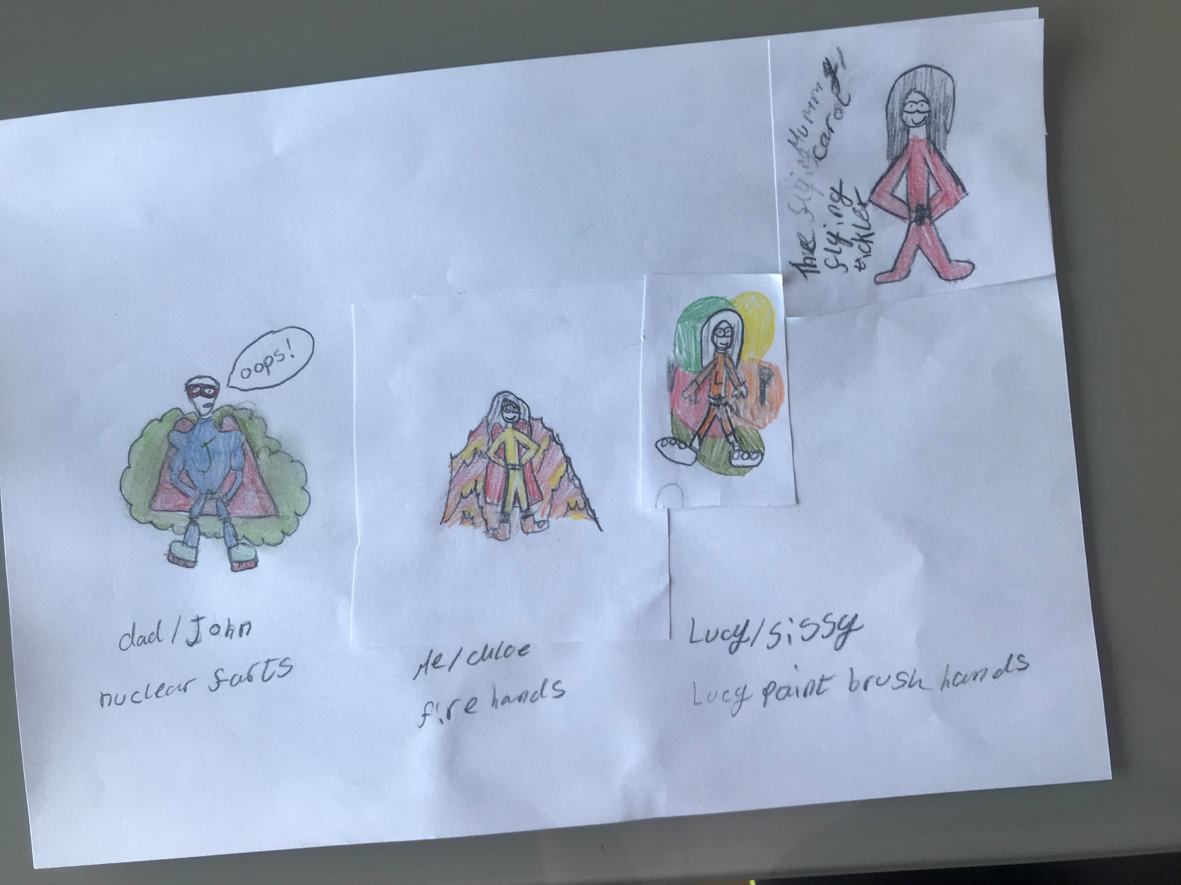
Chloe P6B

Slide 4
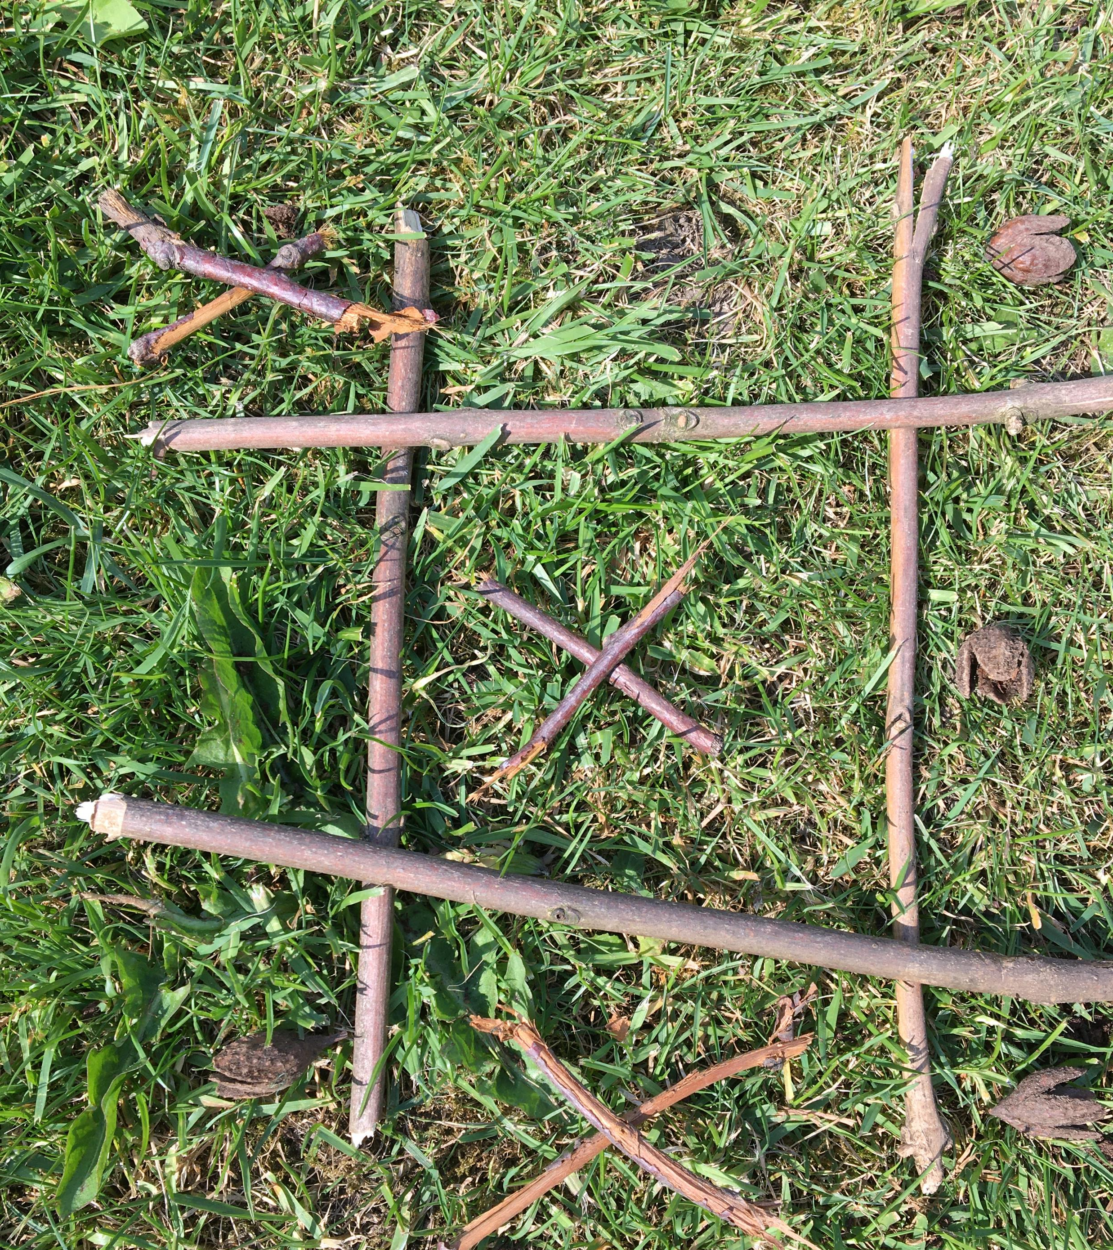
Keir P7A

Slide 5
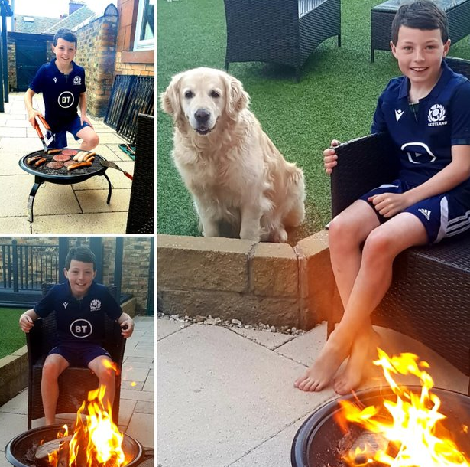
Cameron P7B

Slide 6
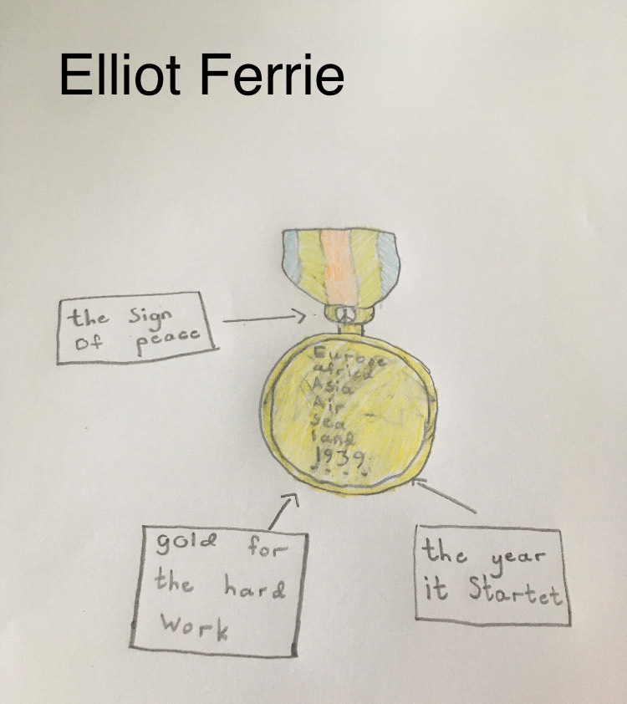
Elliot P5A

Slide 7
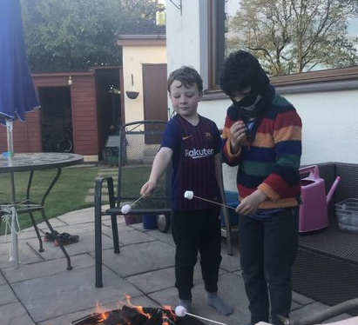
Brodie P7B

Slide 8
John Mc P5A

Slide 9
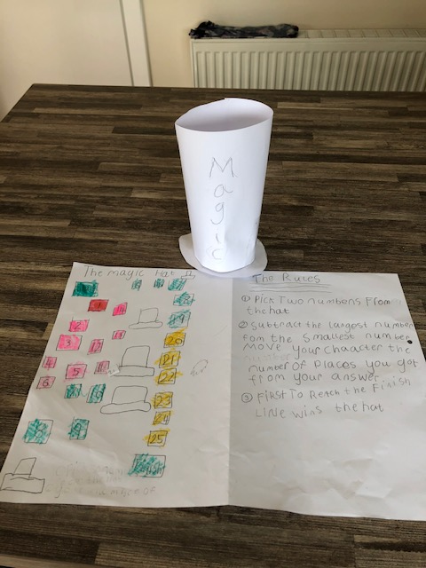
Eilidh P4B

Slide 10
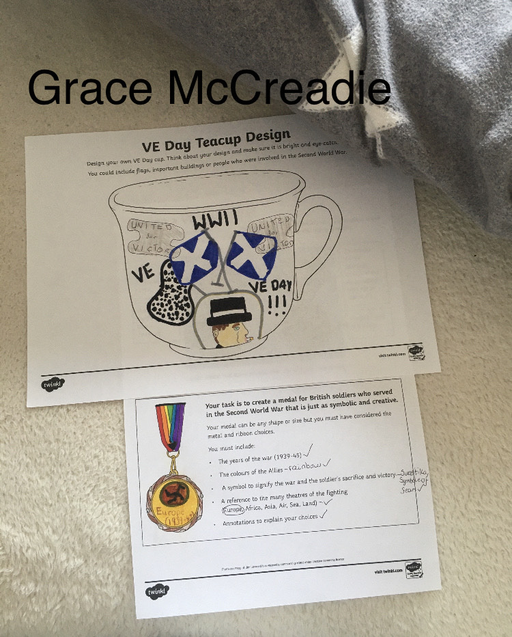
Grace P5A

Slide 11
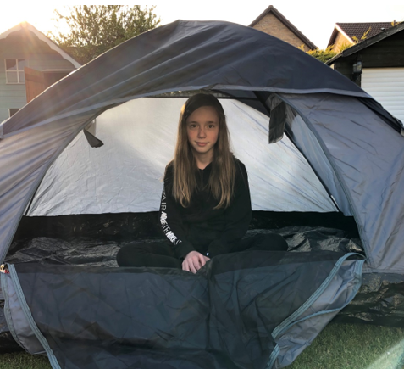
Sophie P7B

Slide 12
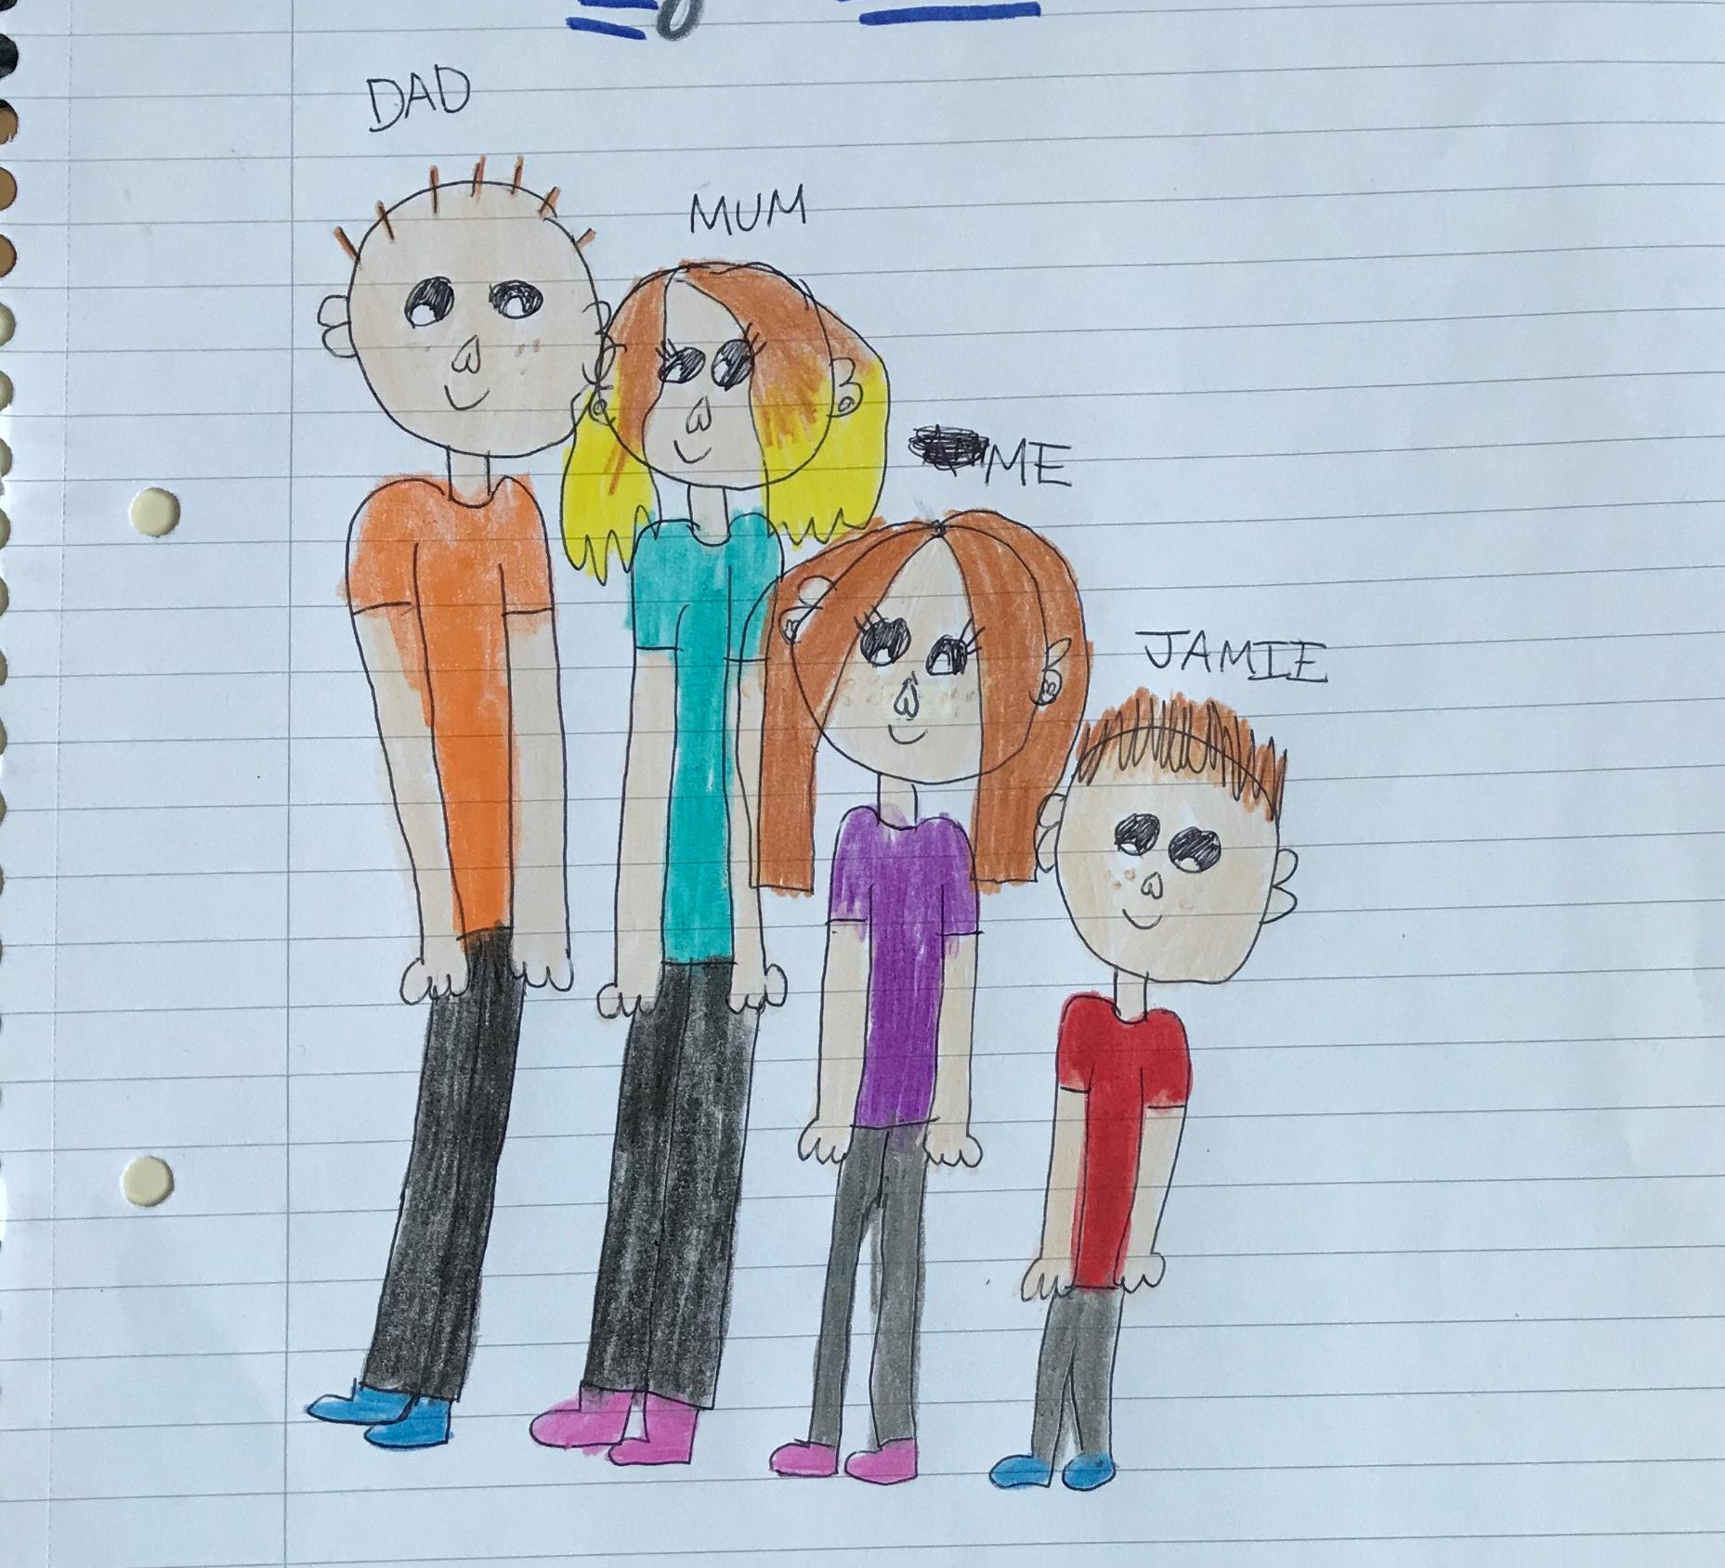
Annalise P6B

Slide 13
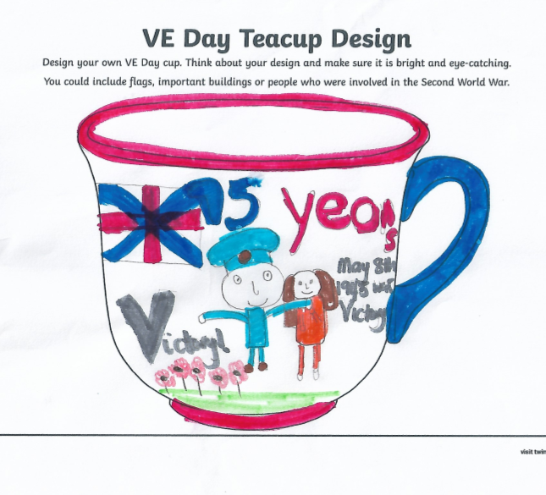
Phoebe P5B

Slide 14
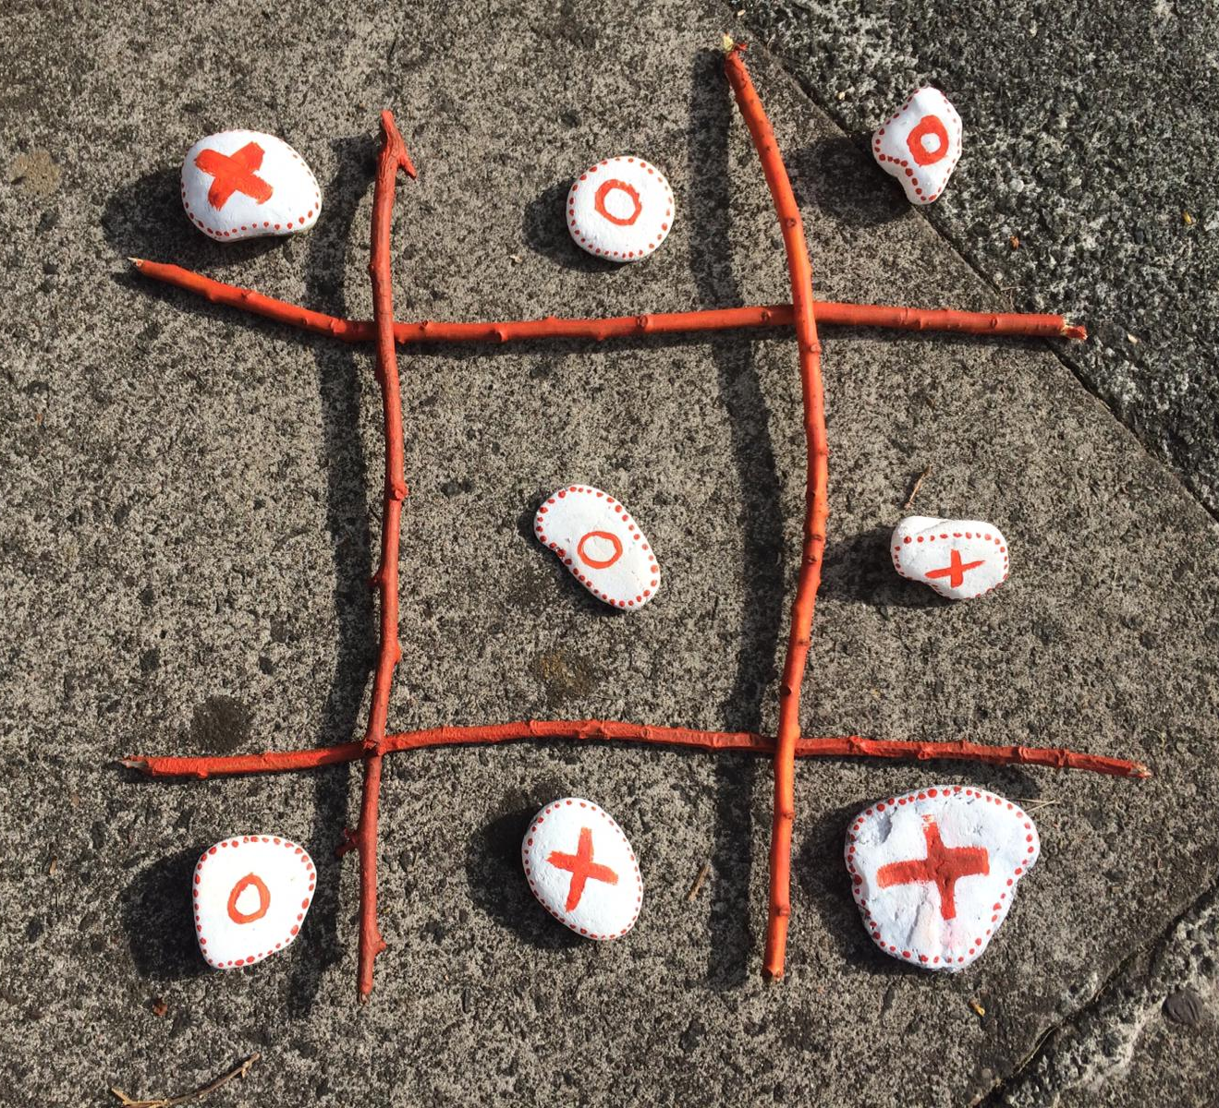
Callum P7A

Slide 15
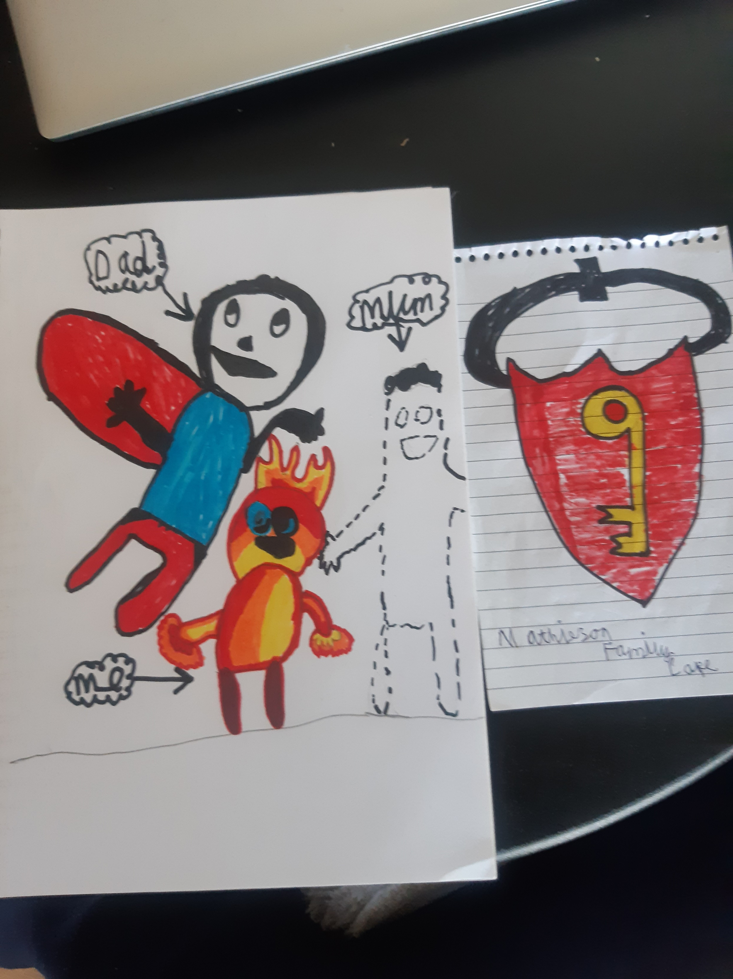
Tristian P6B

Slide 16
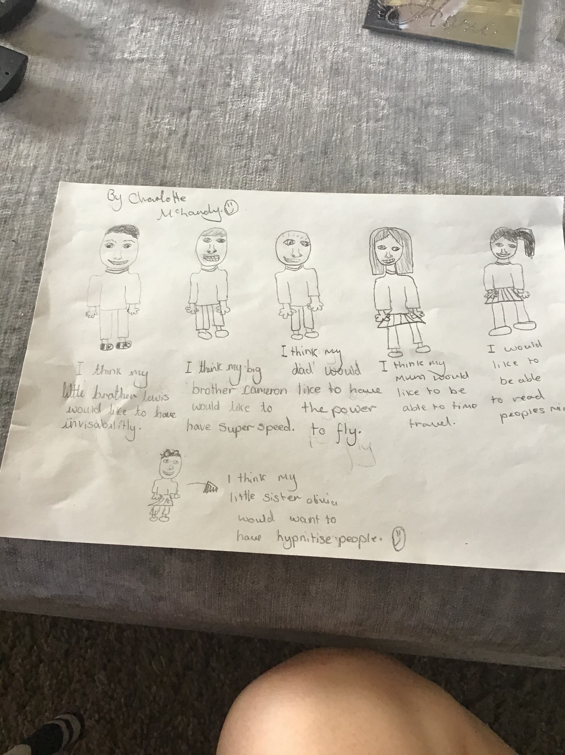
Charlotte P6B

Slide 17
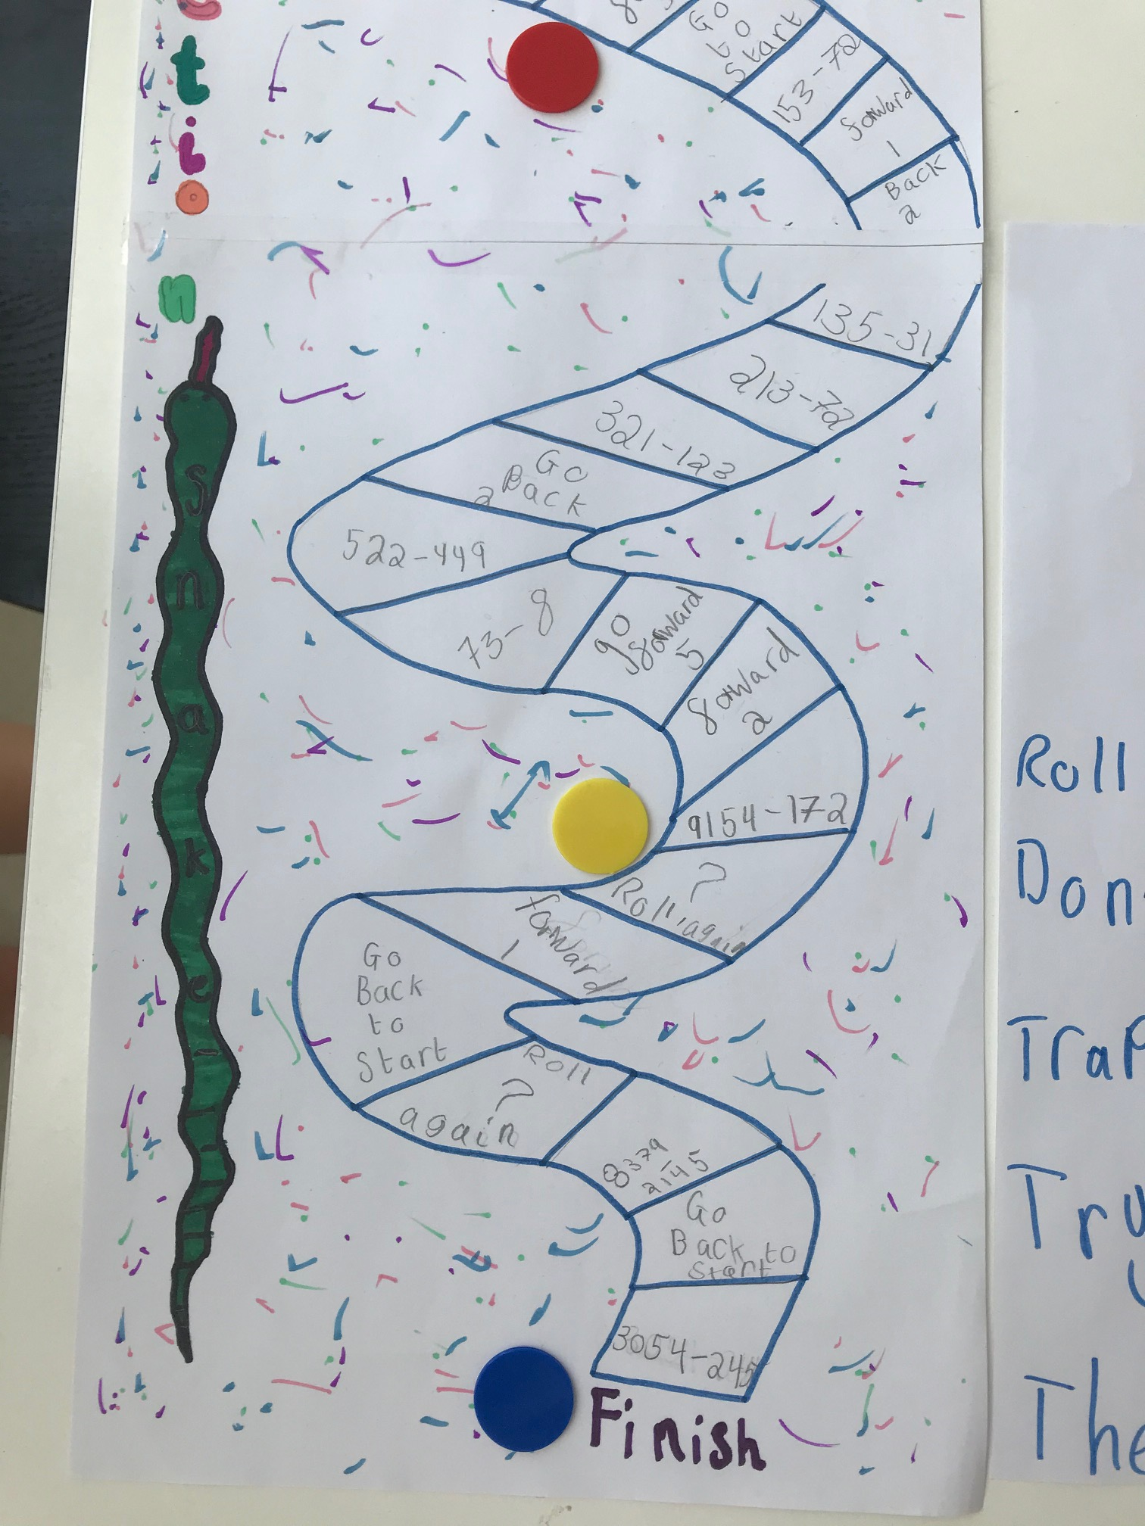
Charlotte P4B

Slide 18
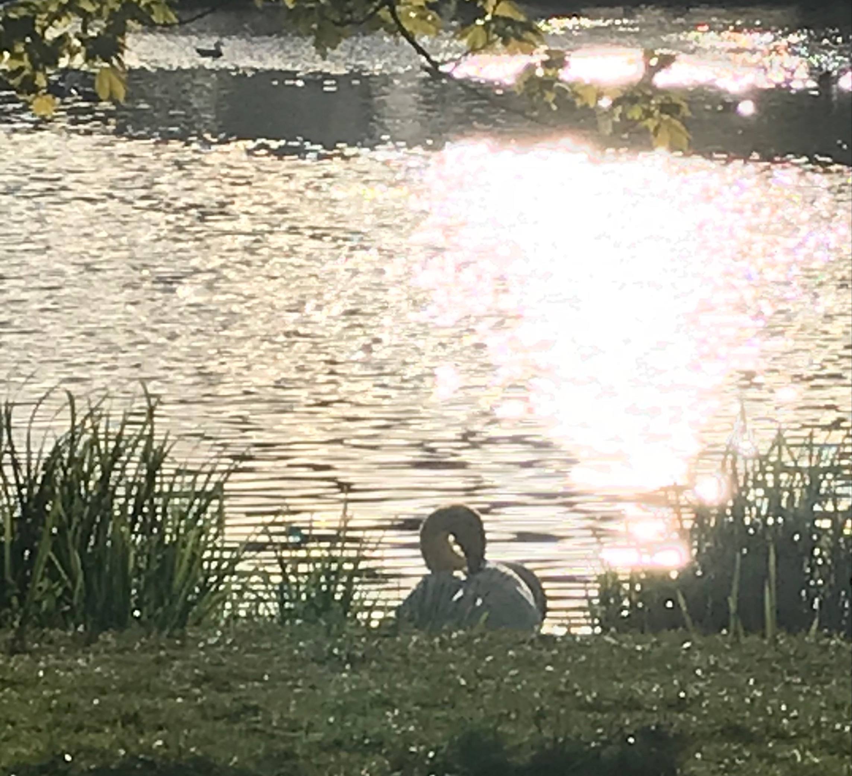
Arran P6A

Slide 19
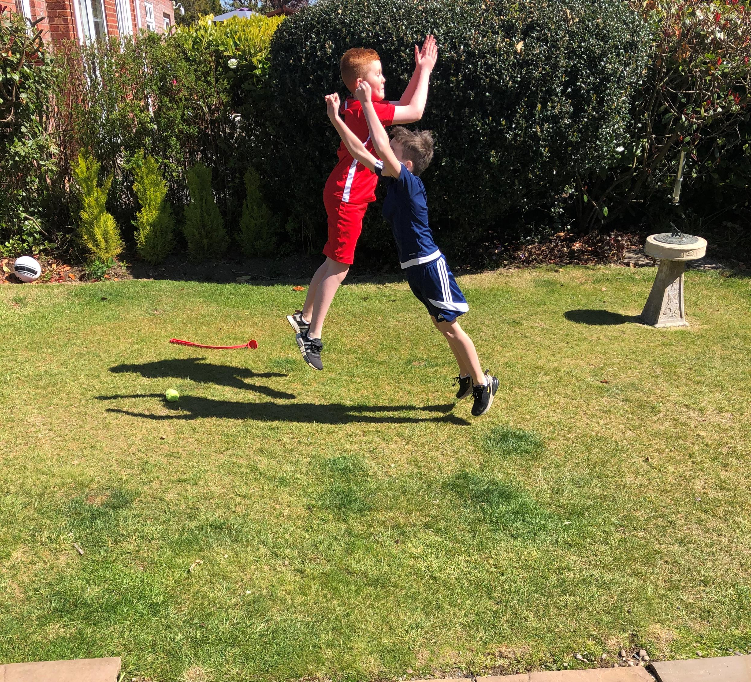
Finlay Mc P4B

Slide 20
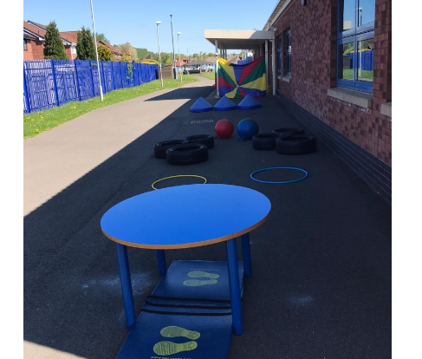
Robbie P4A

Slide 21
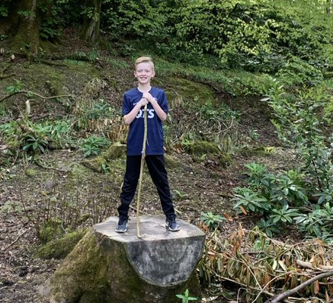
Freddy P7B

Slide 22
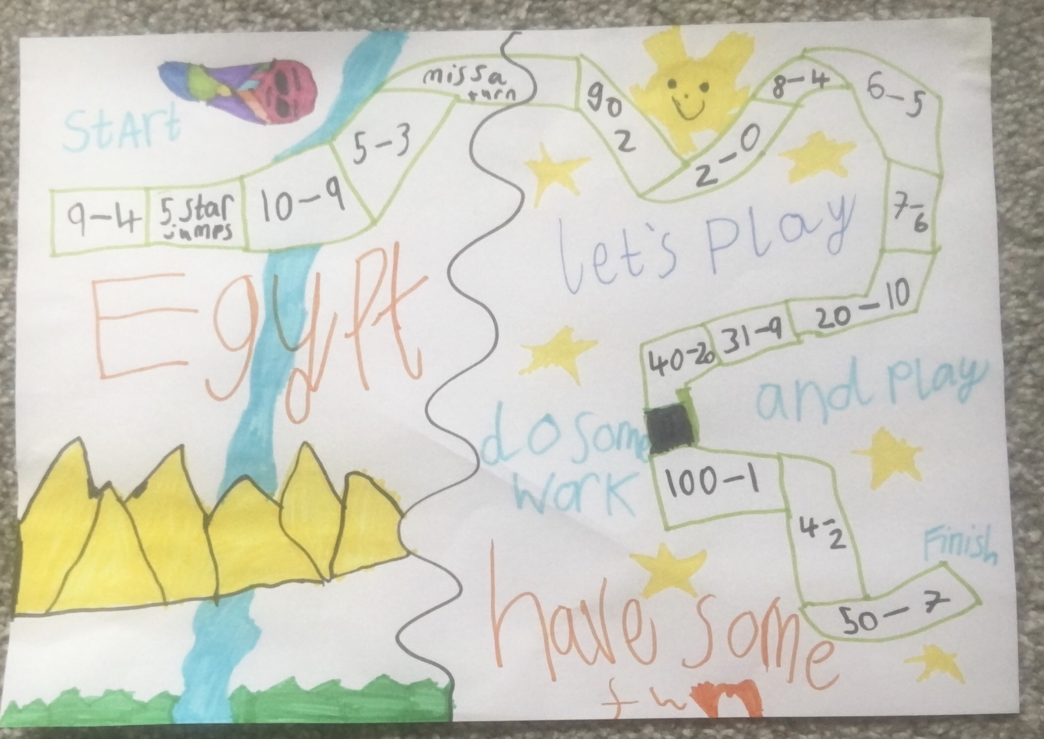
Megan P4B

Slide 23
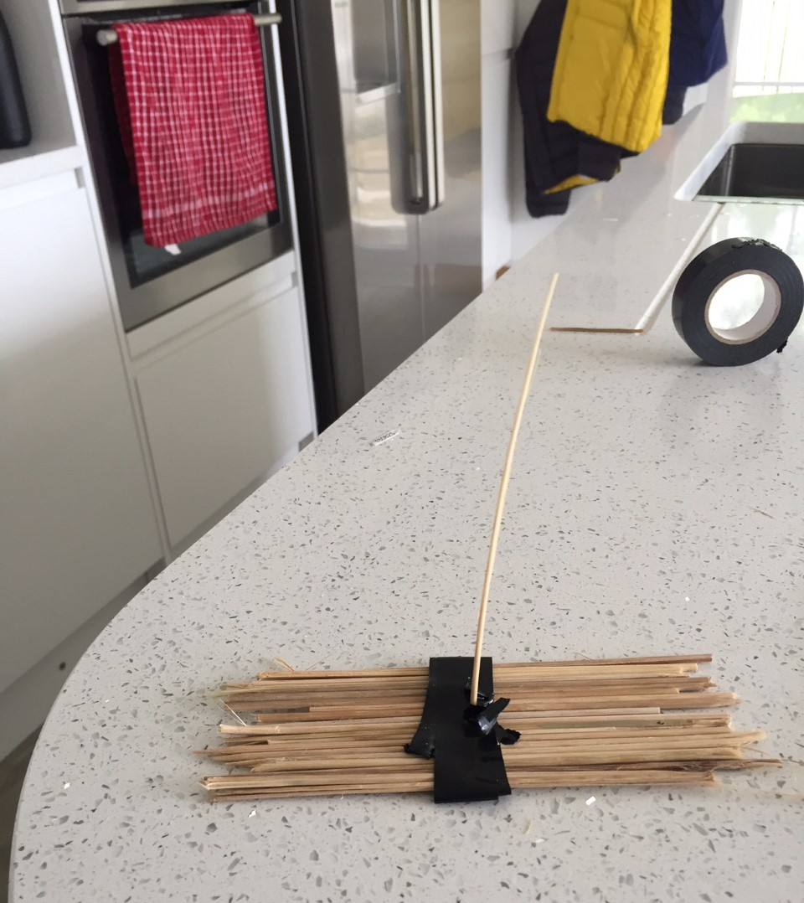
Harry W P7A

Slide 24
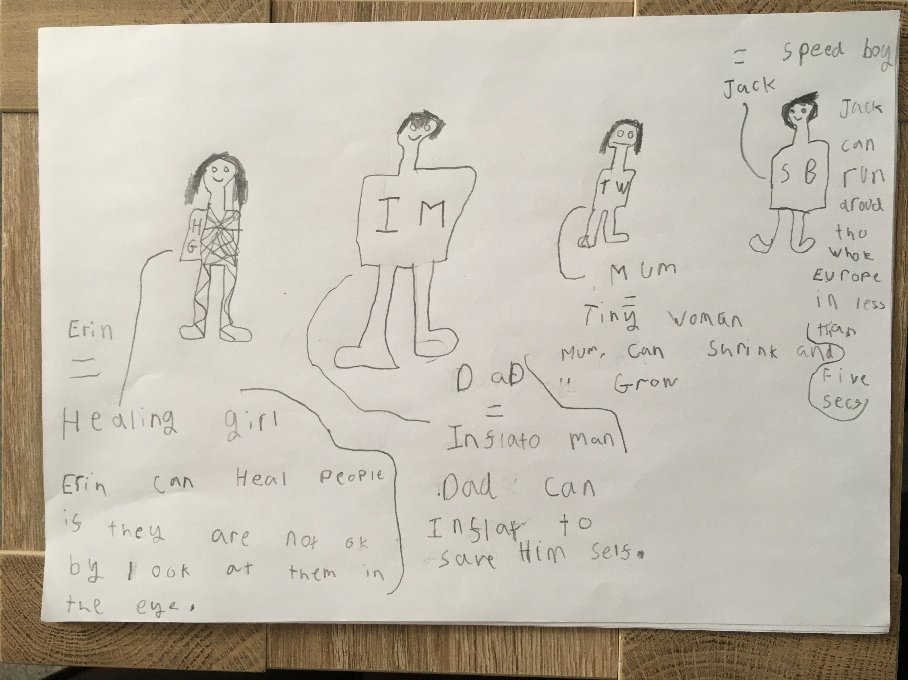
Jack B P6B

Slide 25
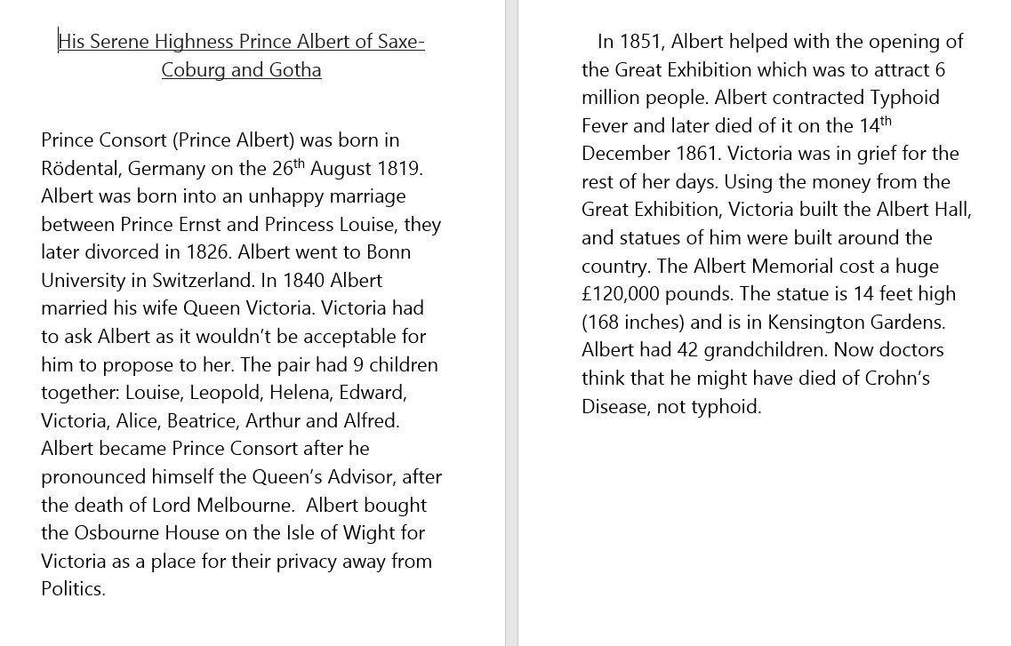
Ella P6A

Slide 26
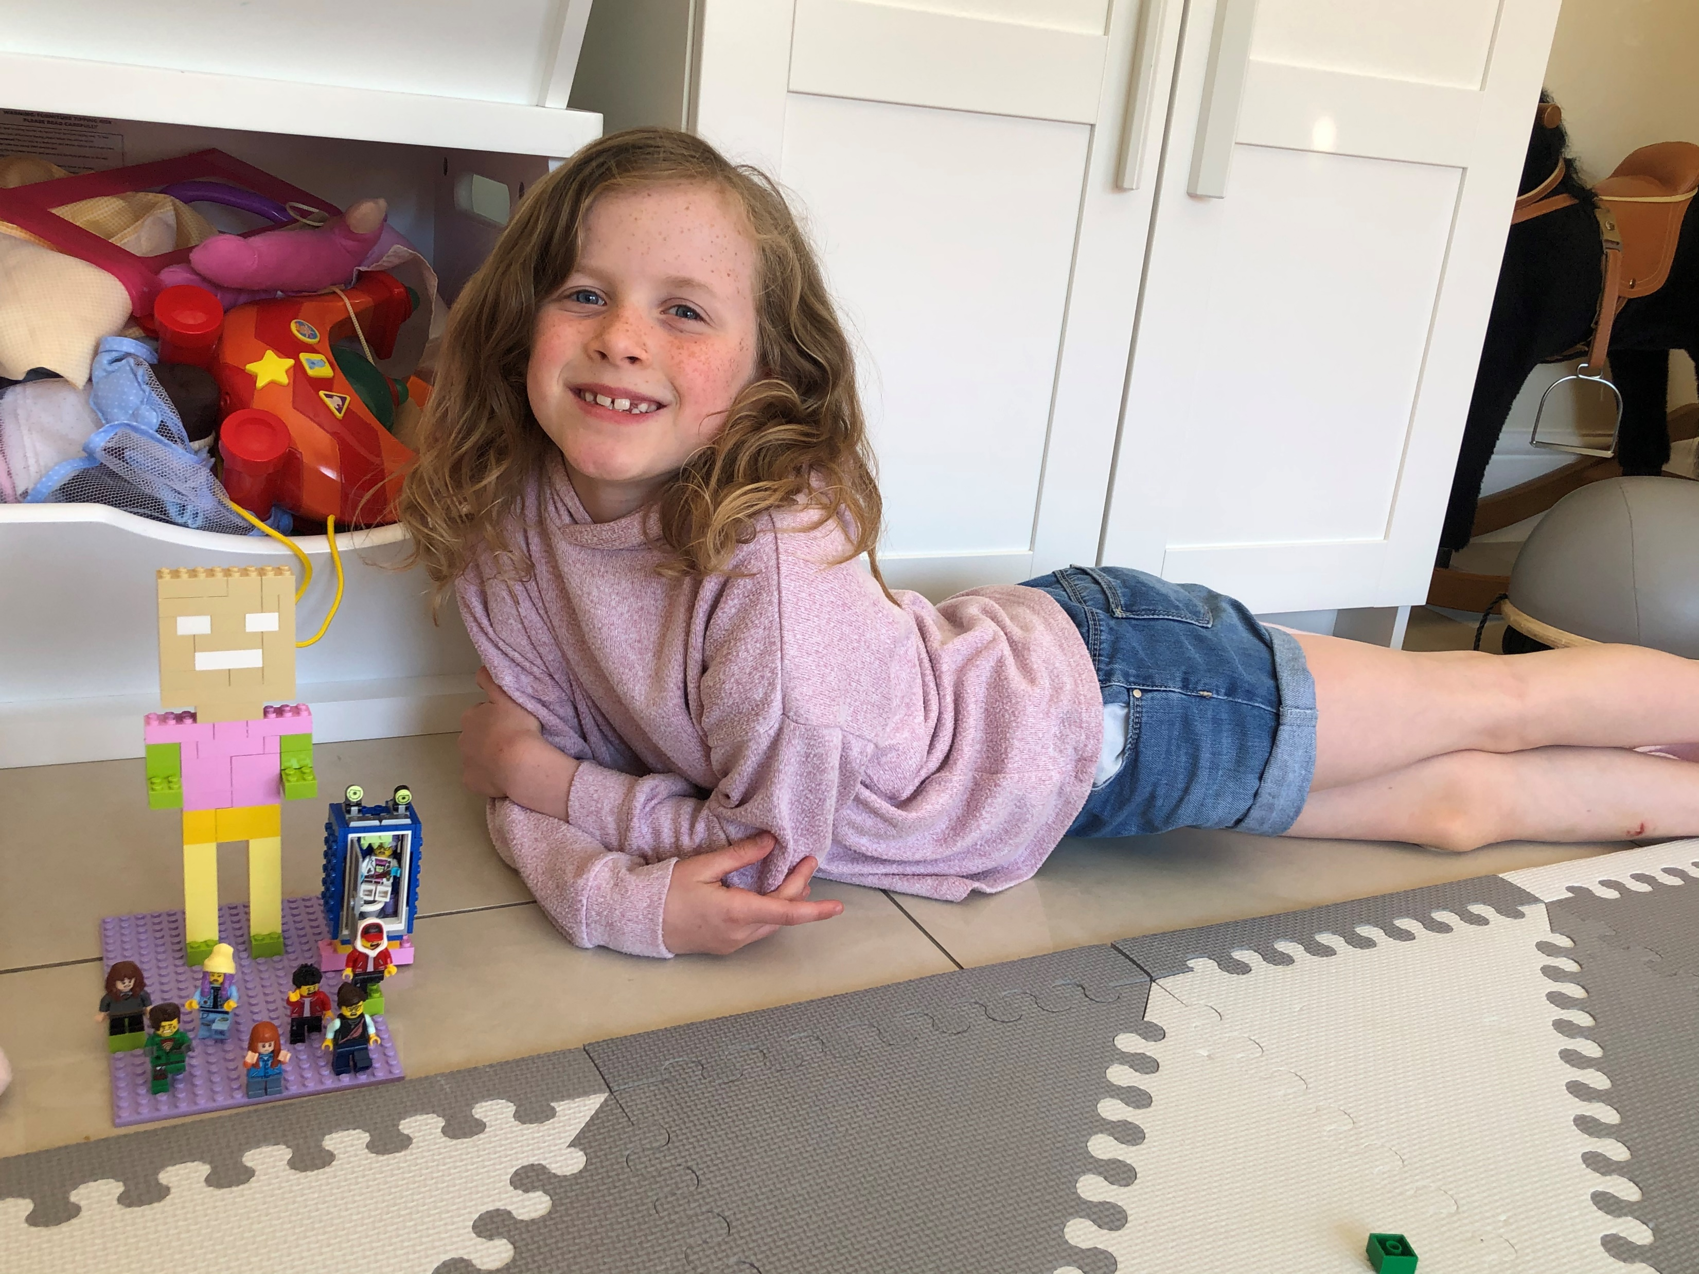
Alexa P4A

Slide 27
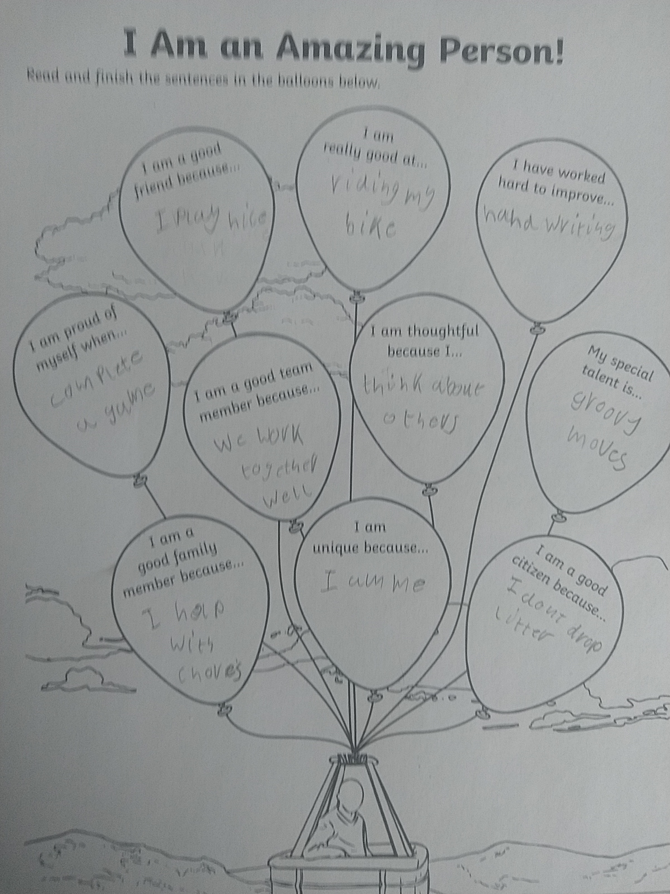
Finlay P5B

Slide 28
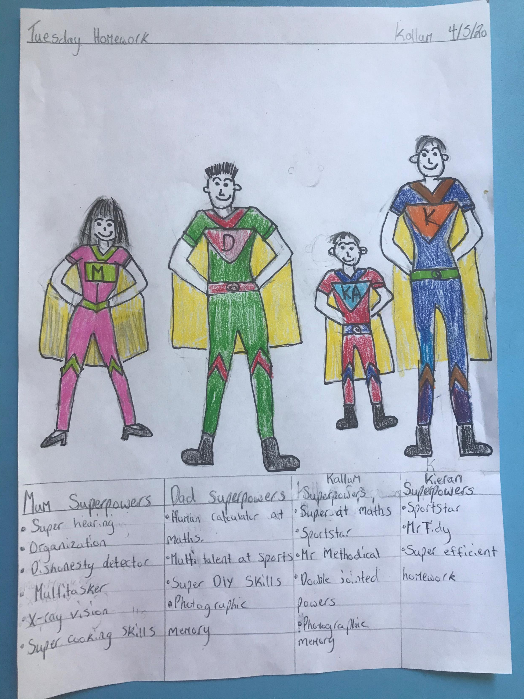
Kallum P6B

Slide 29
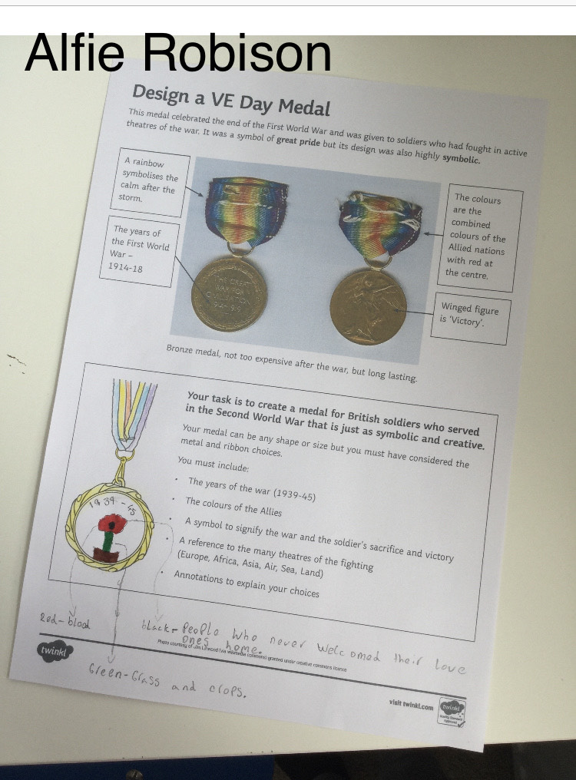
Alfie P5A

Slide 30
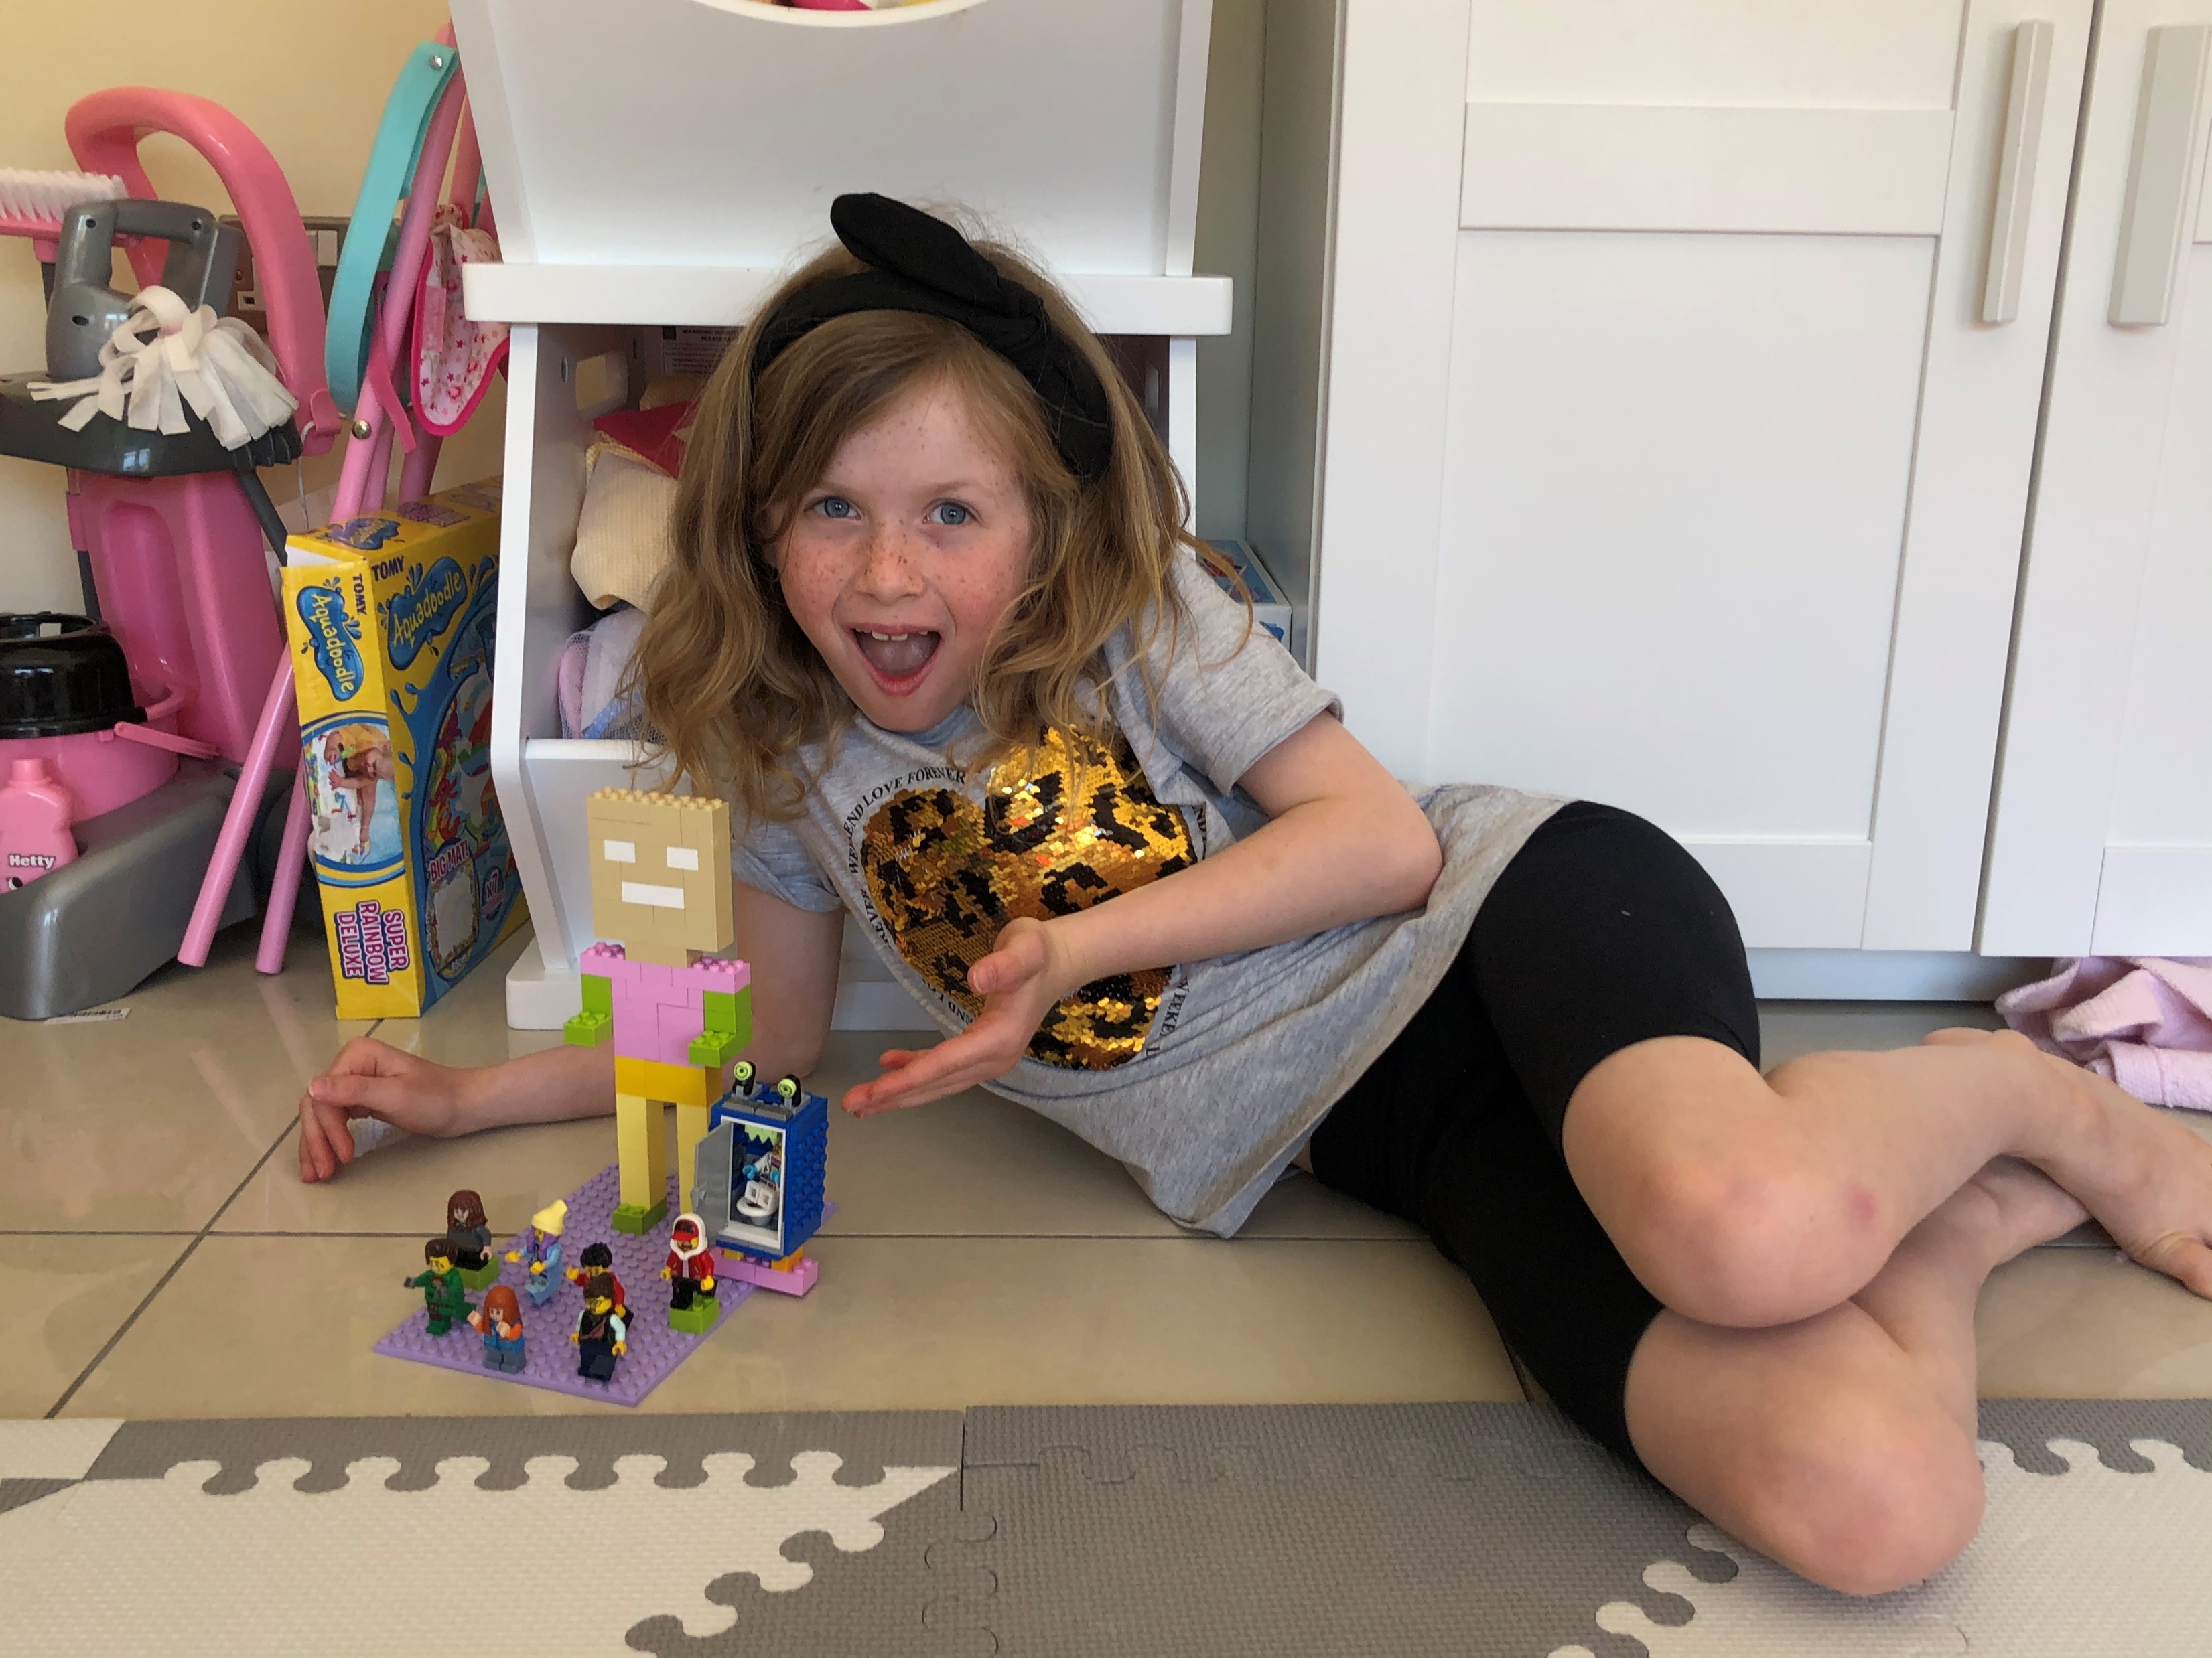
Olivia P4A

Slide 31
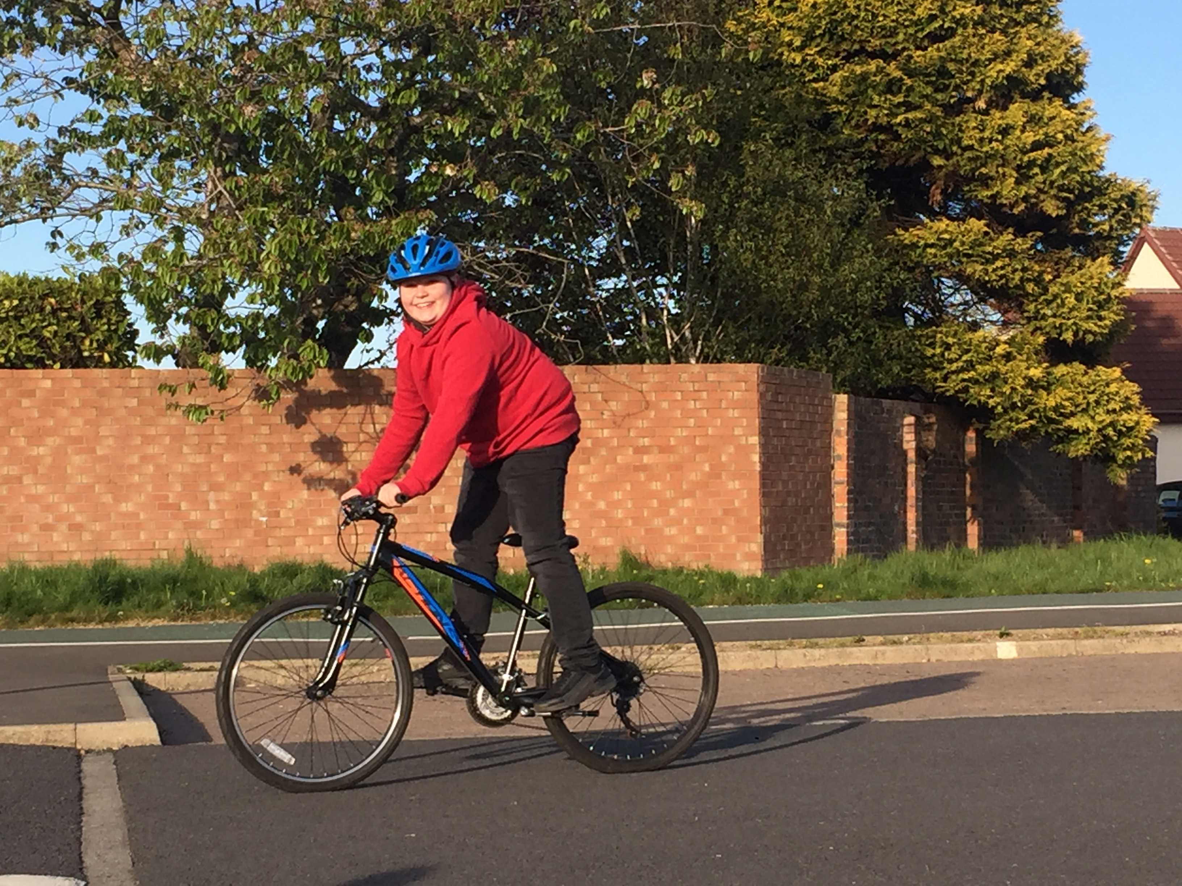
Harry P5B

Slide 32
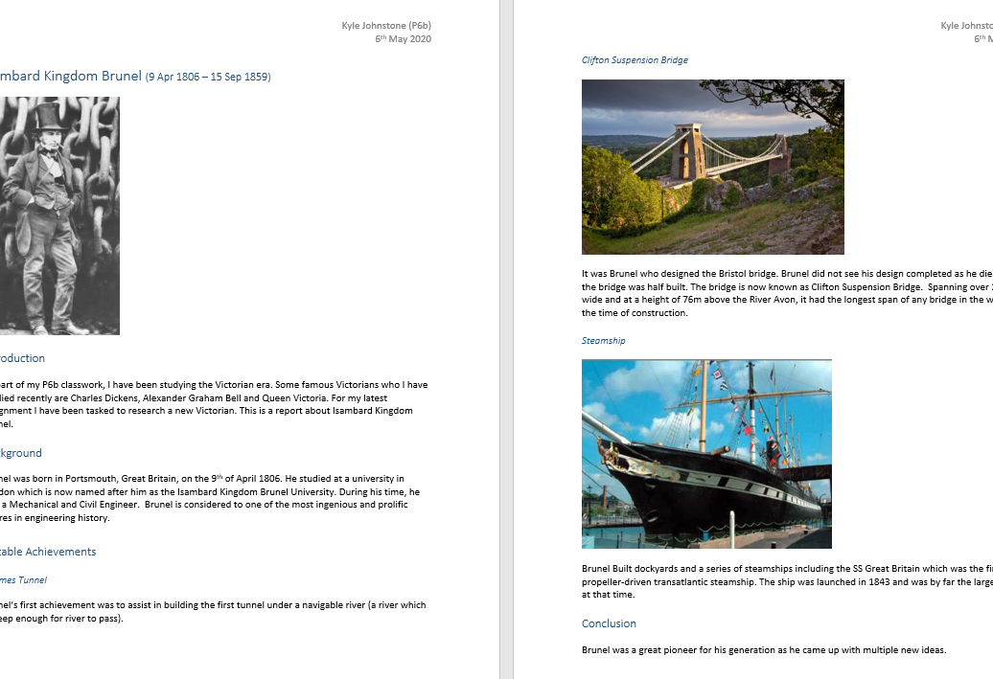
Kyle P6A

Slide 33
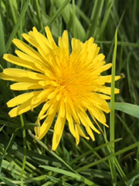
Evan P6A

Slide 34
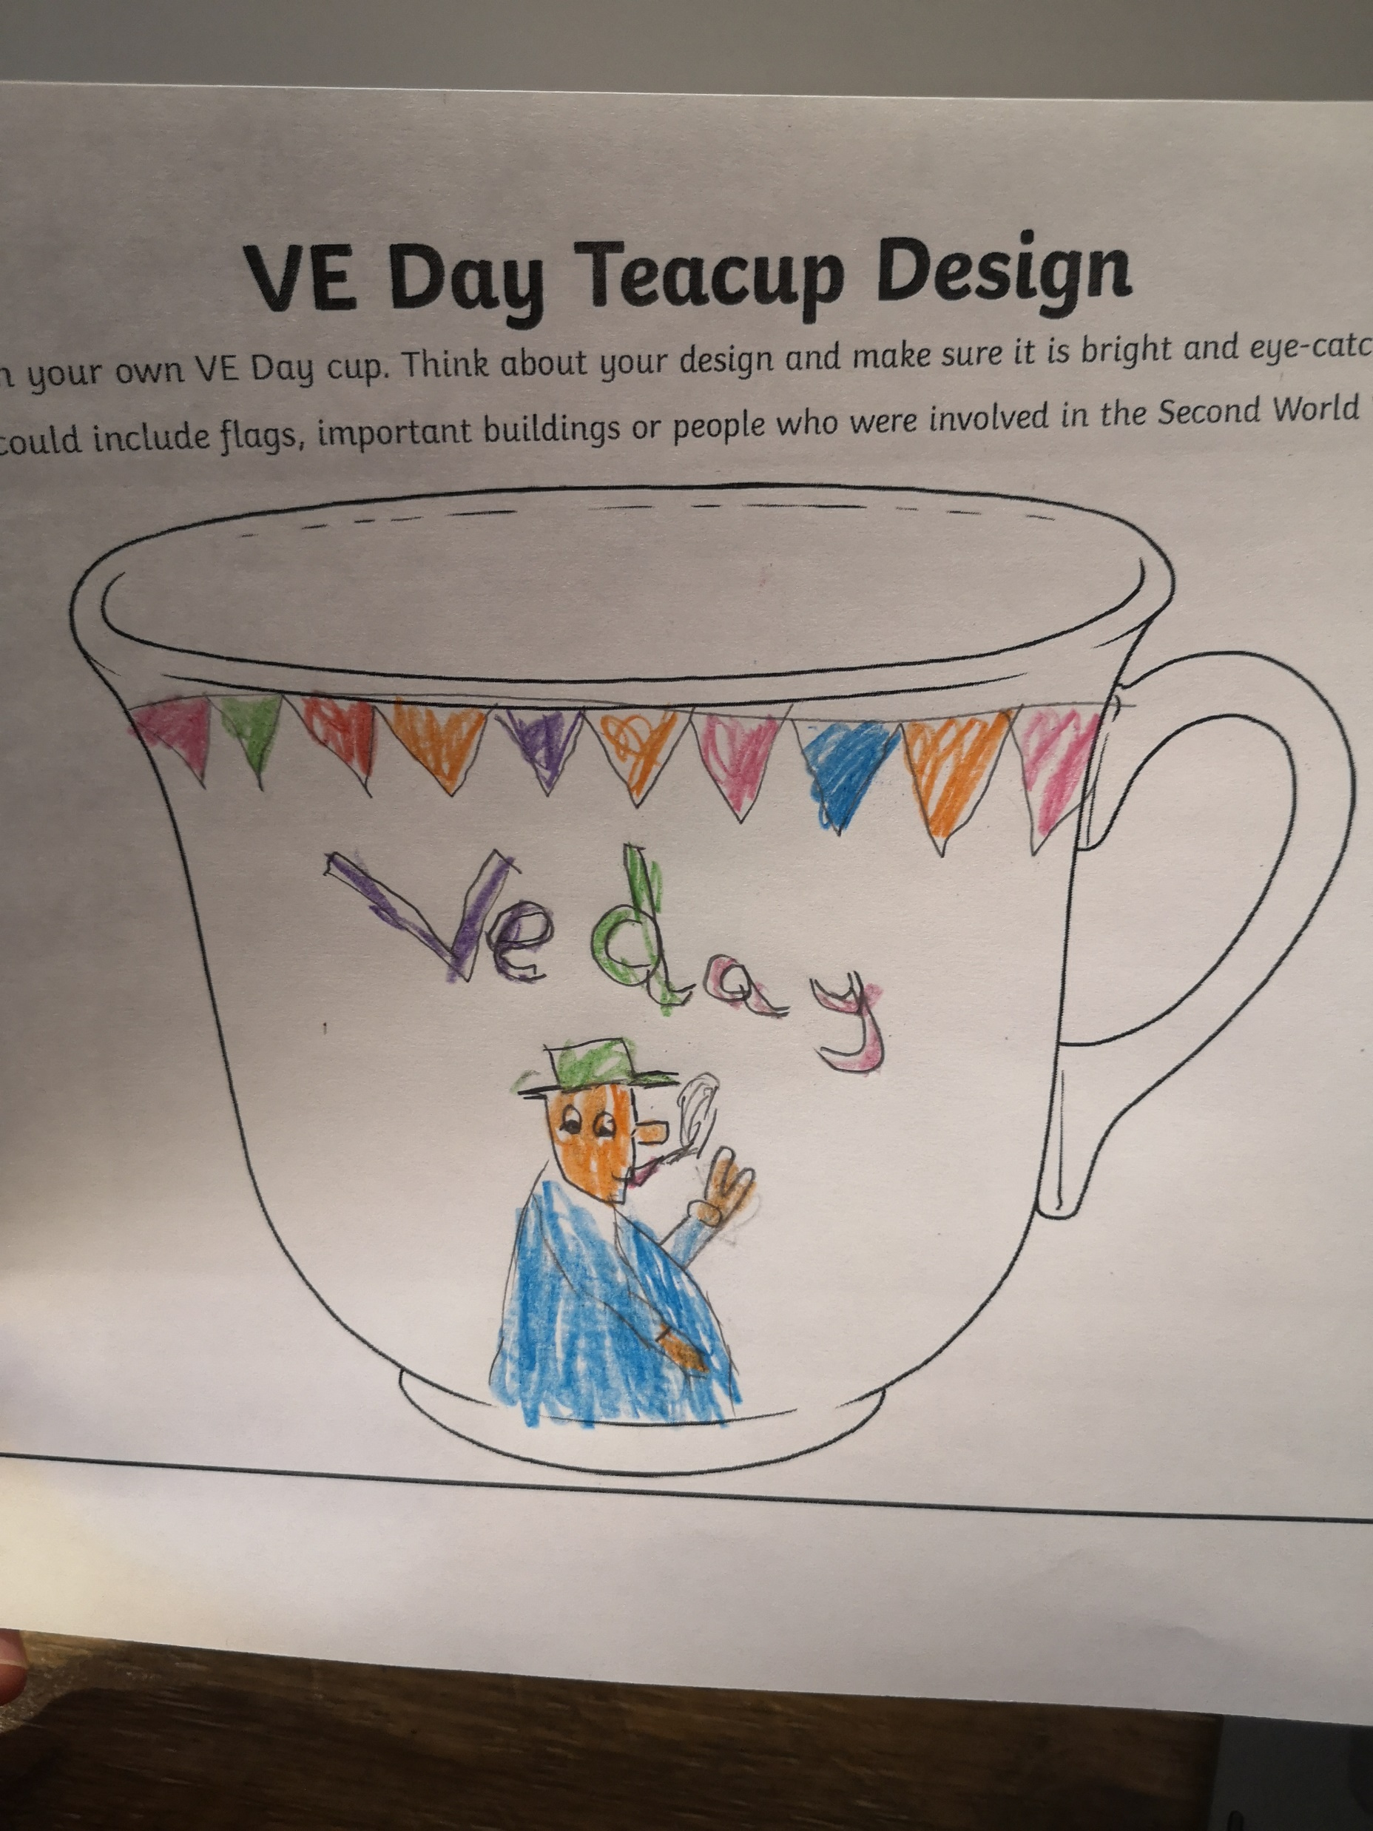
Charlie P5B

Slide 35
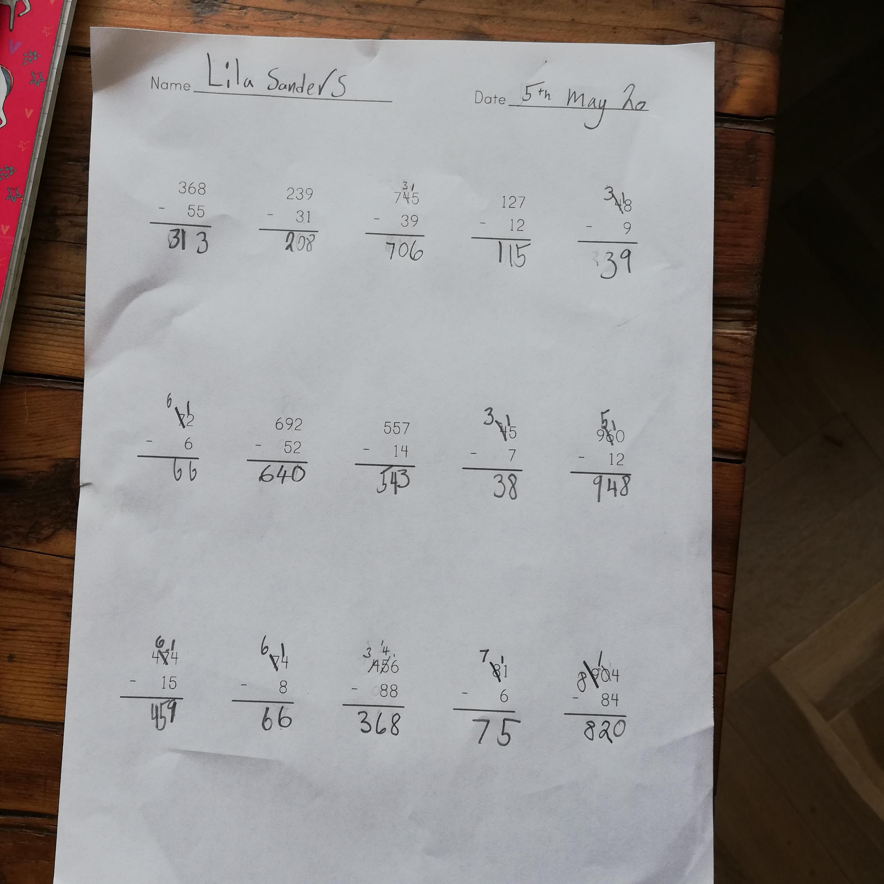
Lila P4A

Slide 36
Logan P5B

Slide 37
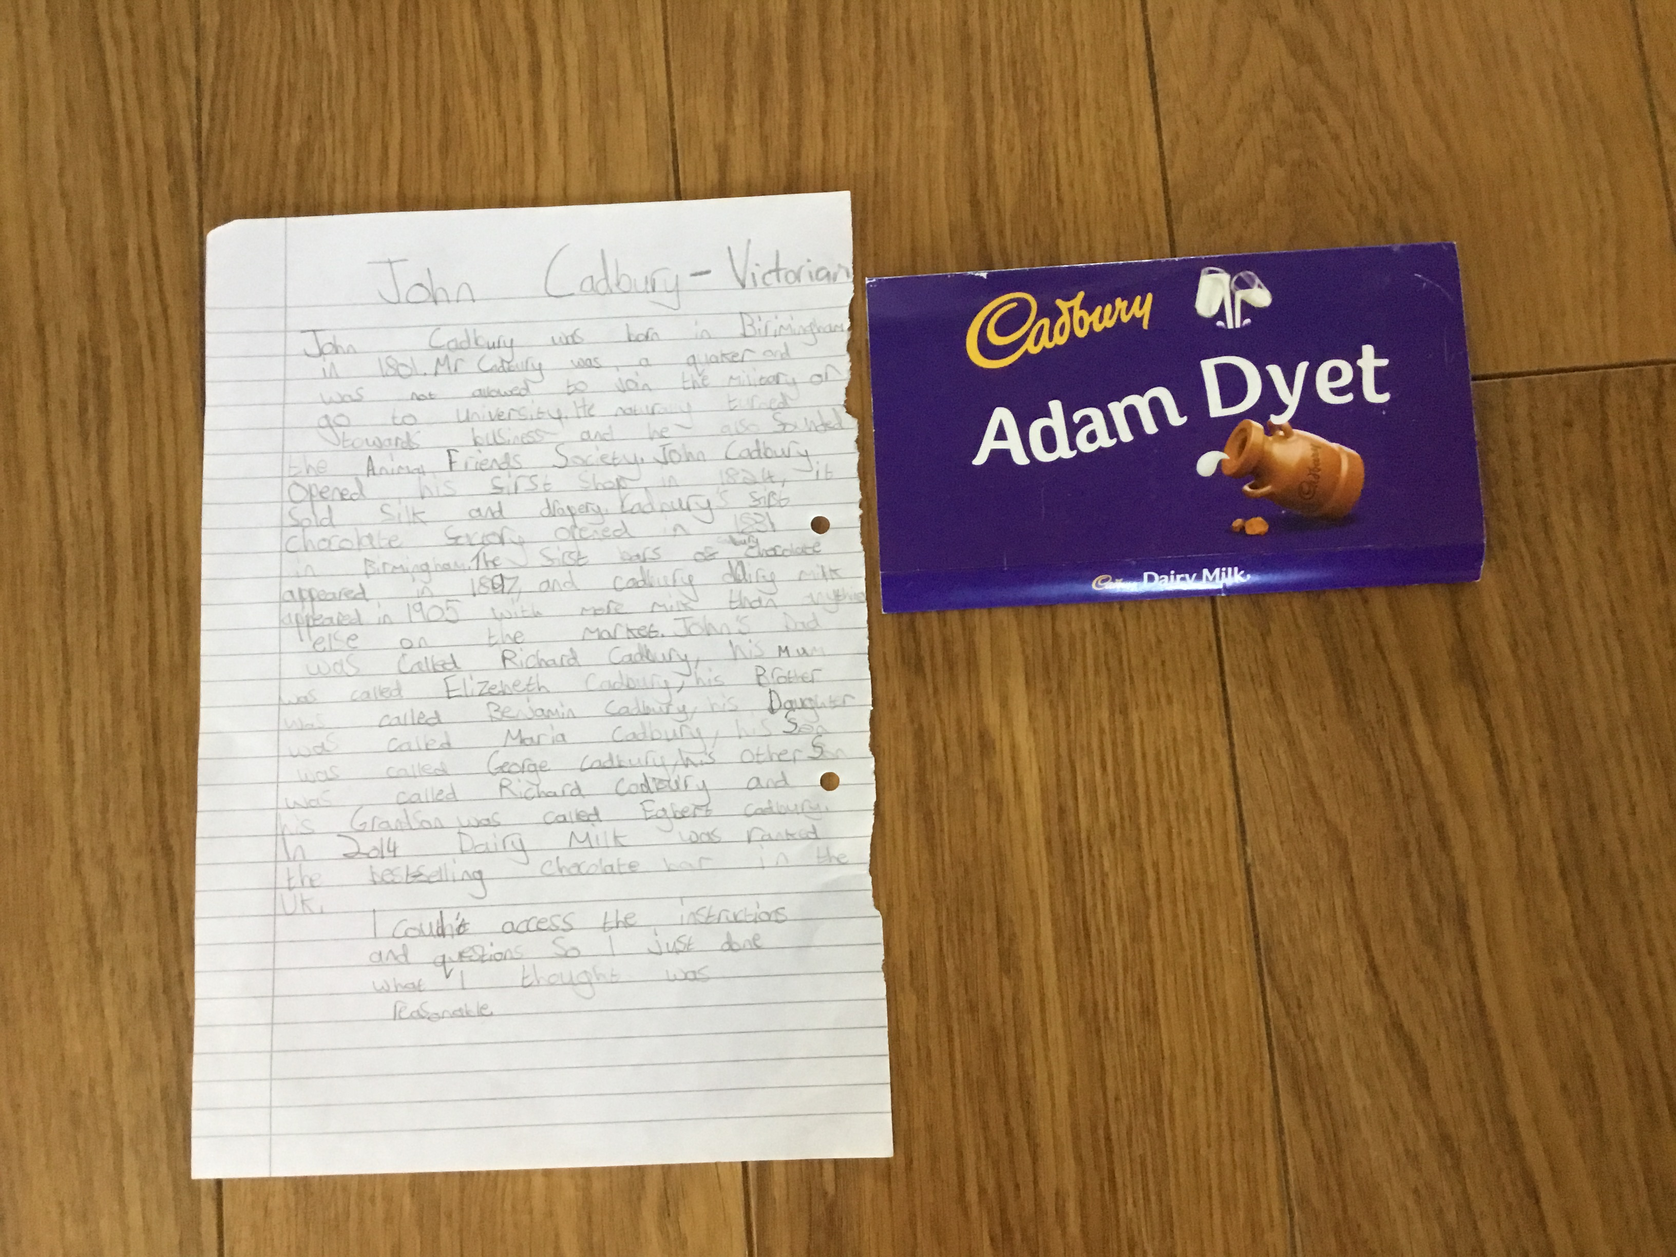
Adam P6A

Slide 38
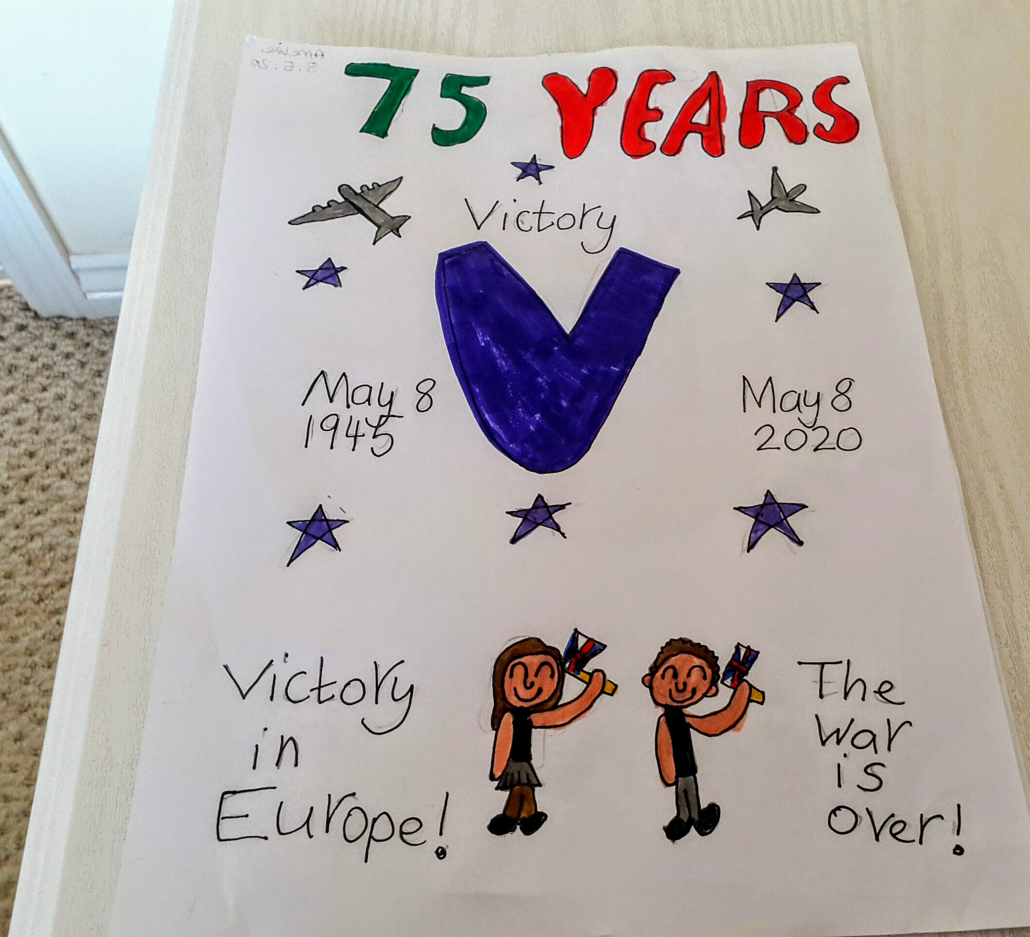
Amelie P4A

Slide 39
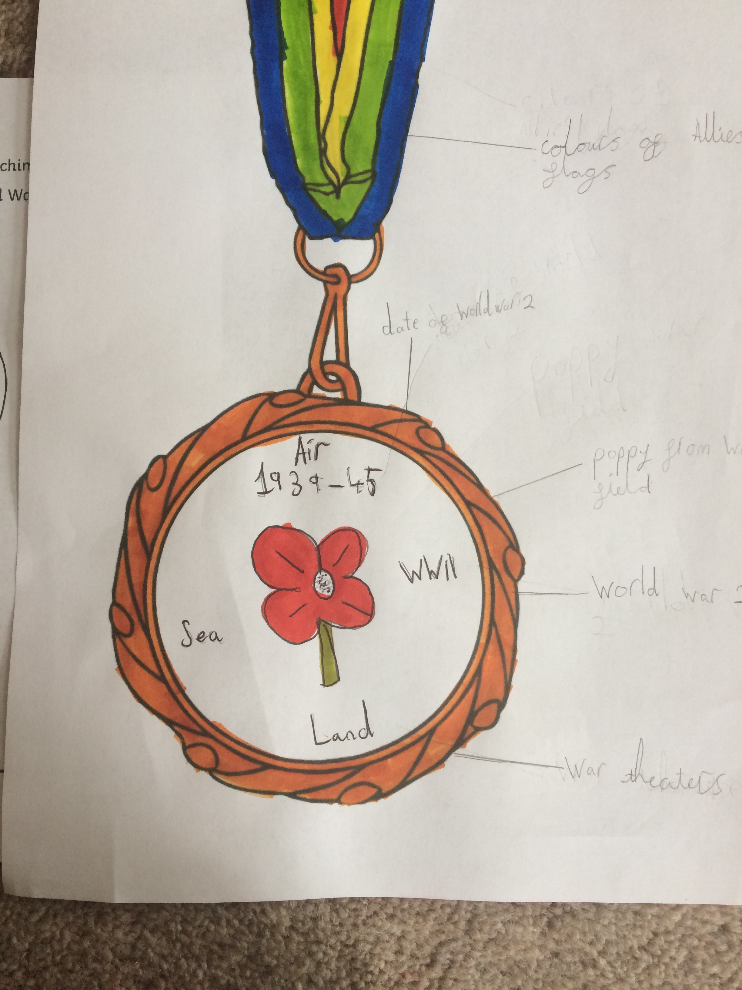
Amy P5B

Slide 40
Lovely to see all the different ways we are learning.

