Slide 1
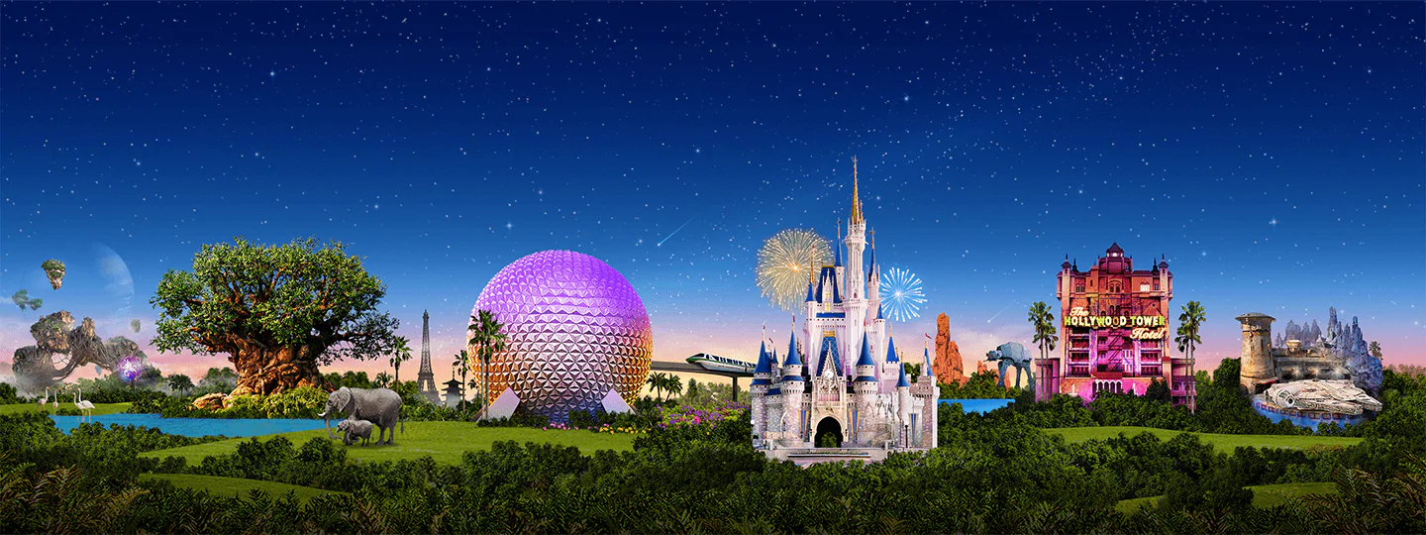
Virtual Disney Trip - Wednesday
Primary 3A’s

Slide 2
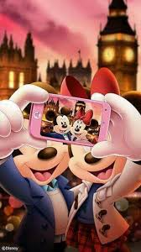
Day 3
Frozen Ever After
Selfies
Lunch time
Under the Sea

Slide 3
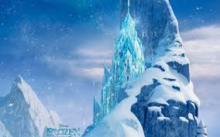
Frozen Ever After
1. Ride on the ‘Frozen Ever After’ Ride.
2. Think of 6 words that rhyme with snow.
3. Use all these words to write a silly story.

Slide 4
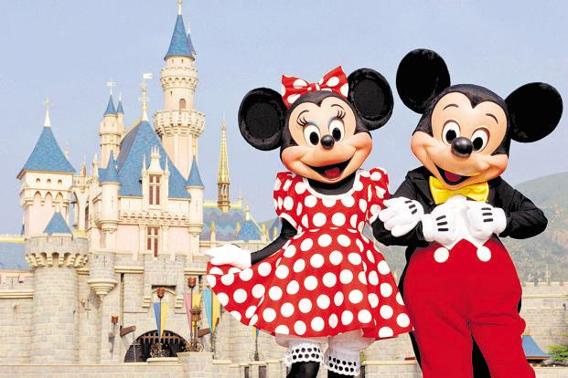
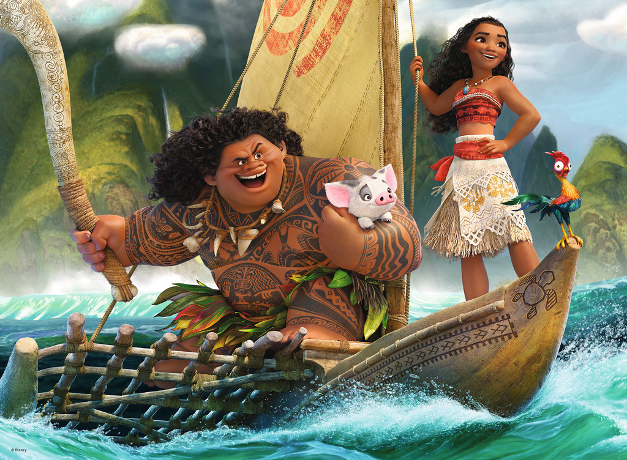
Take a Selfie
Add a photo of your face to the pictures to create your own Disney selfie.

Slide 5
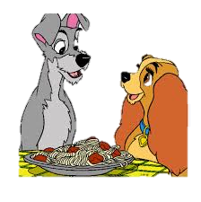
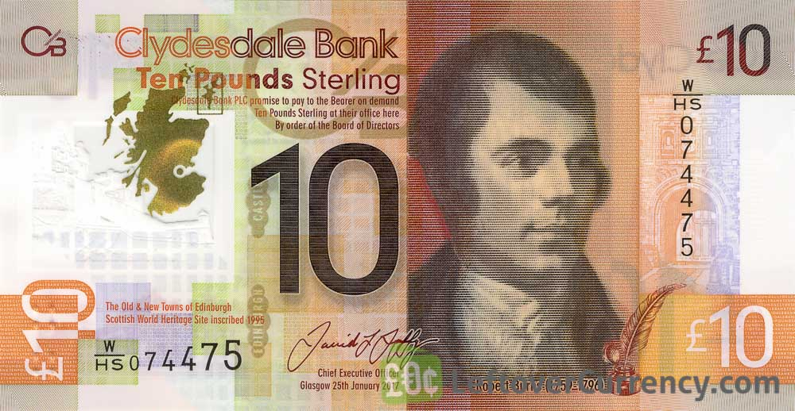
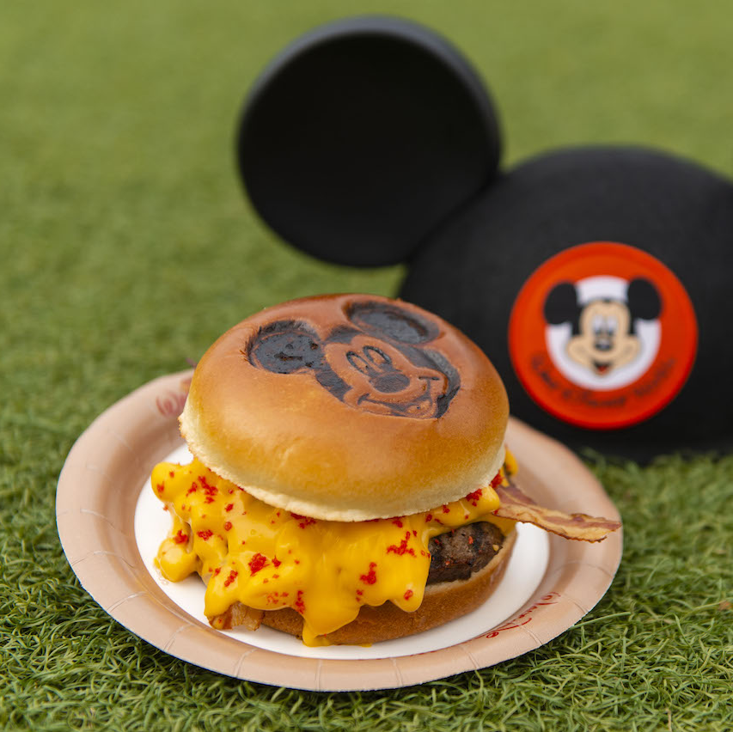
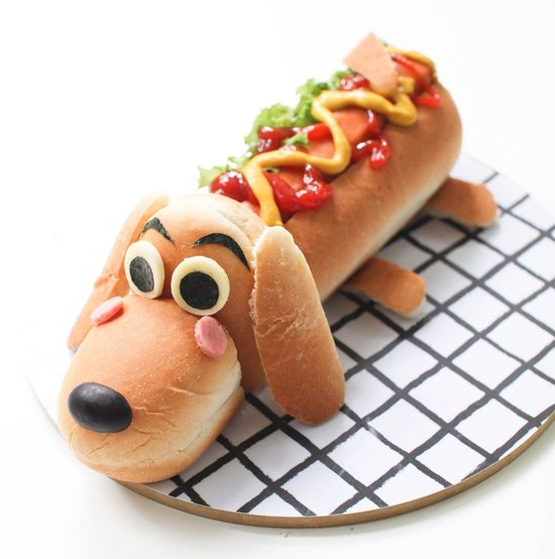
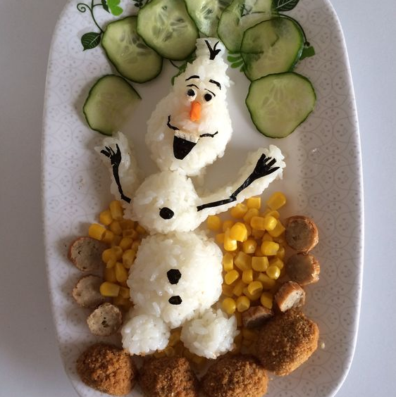
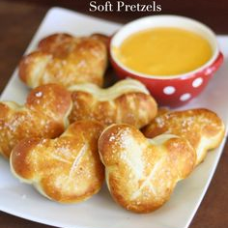
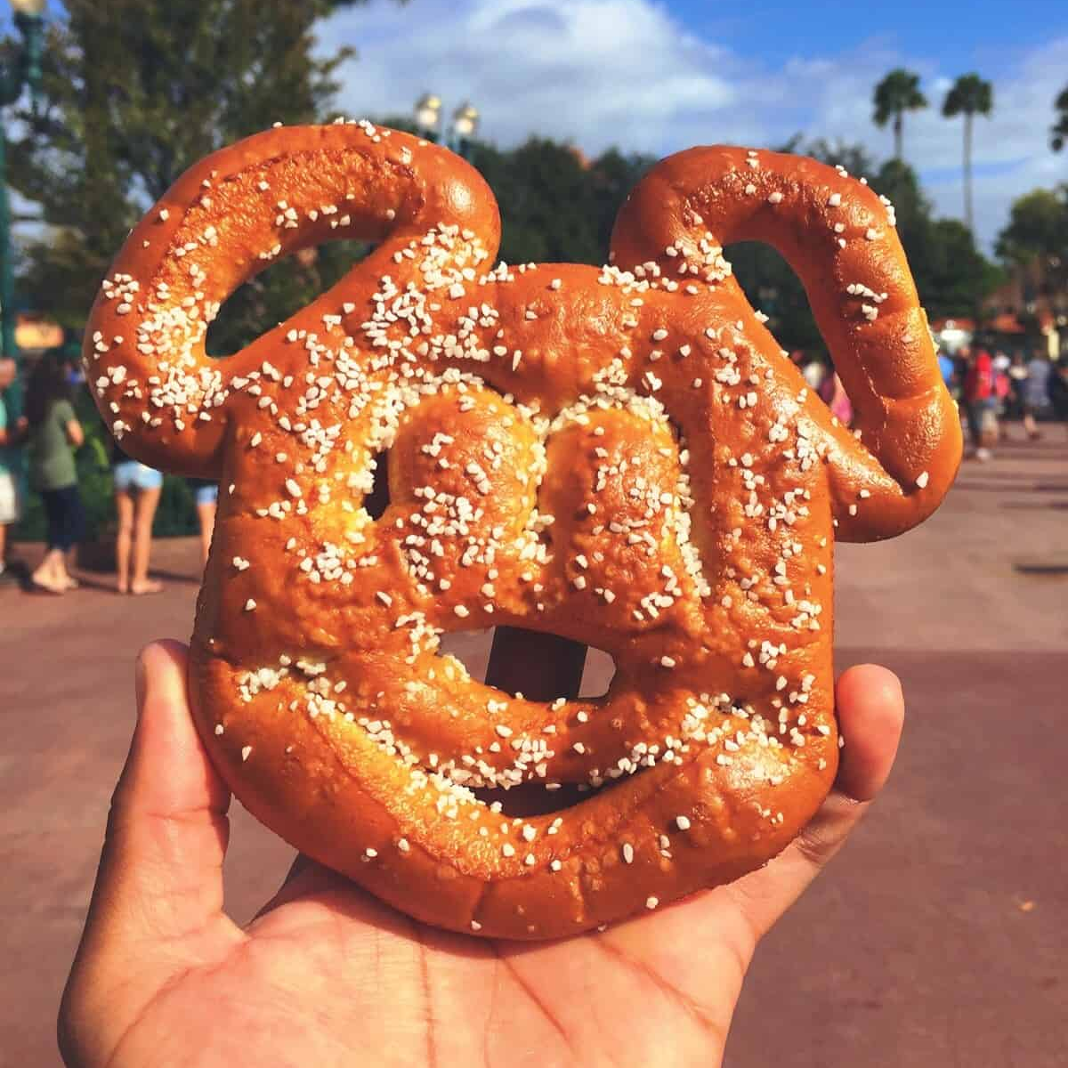
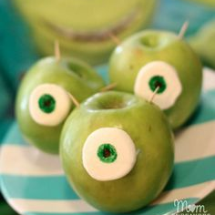
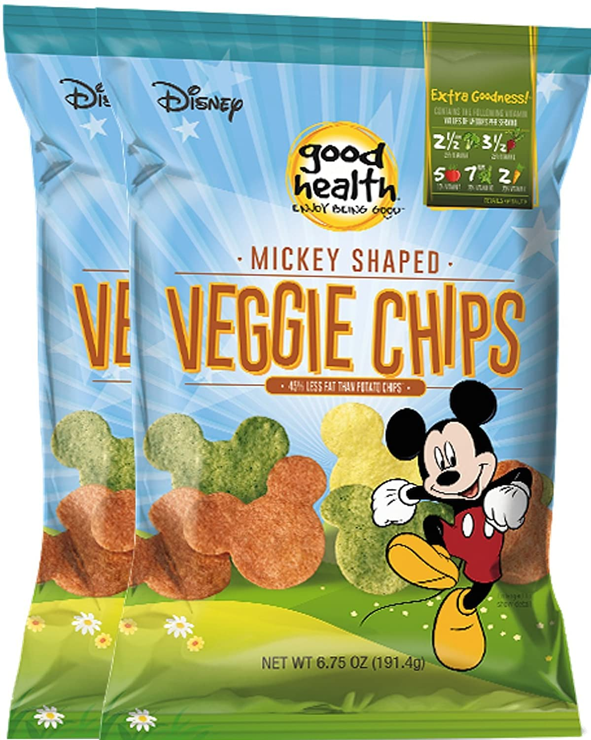
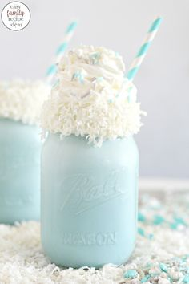
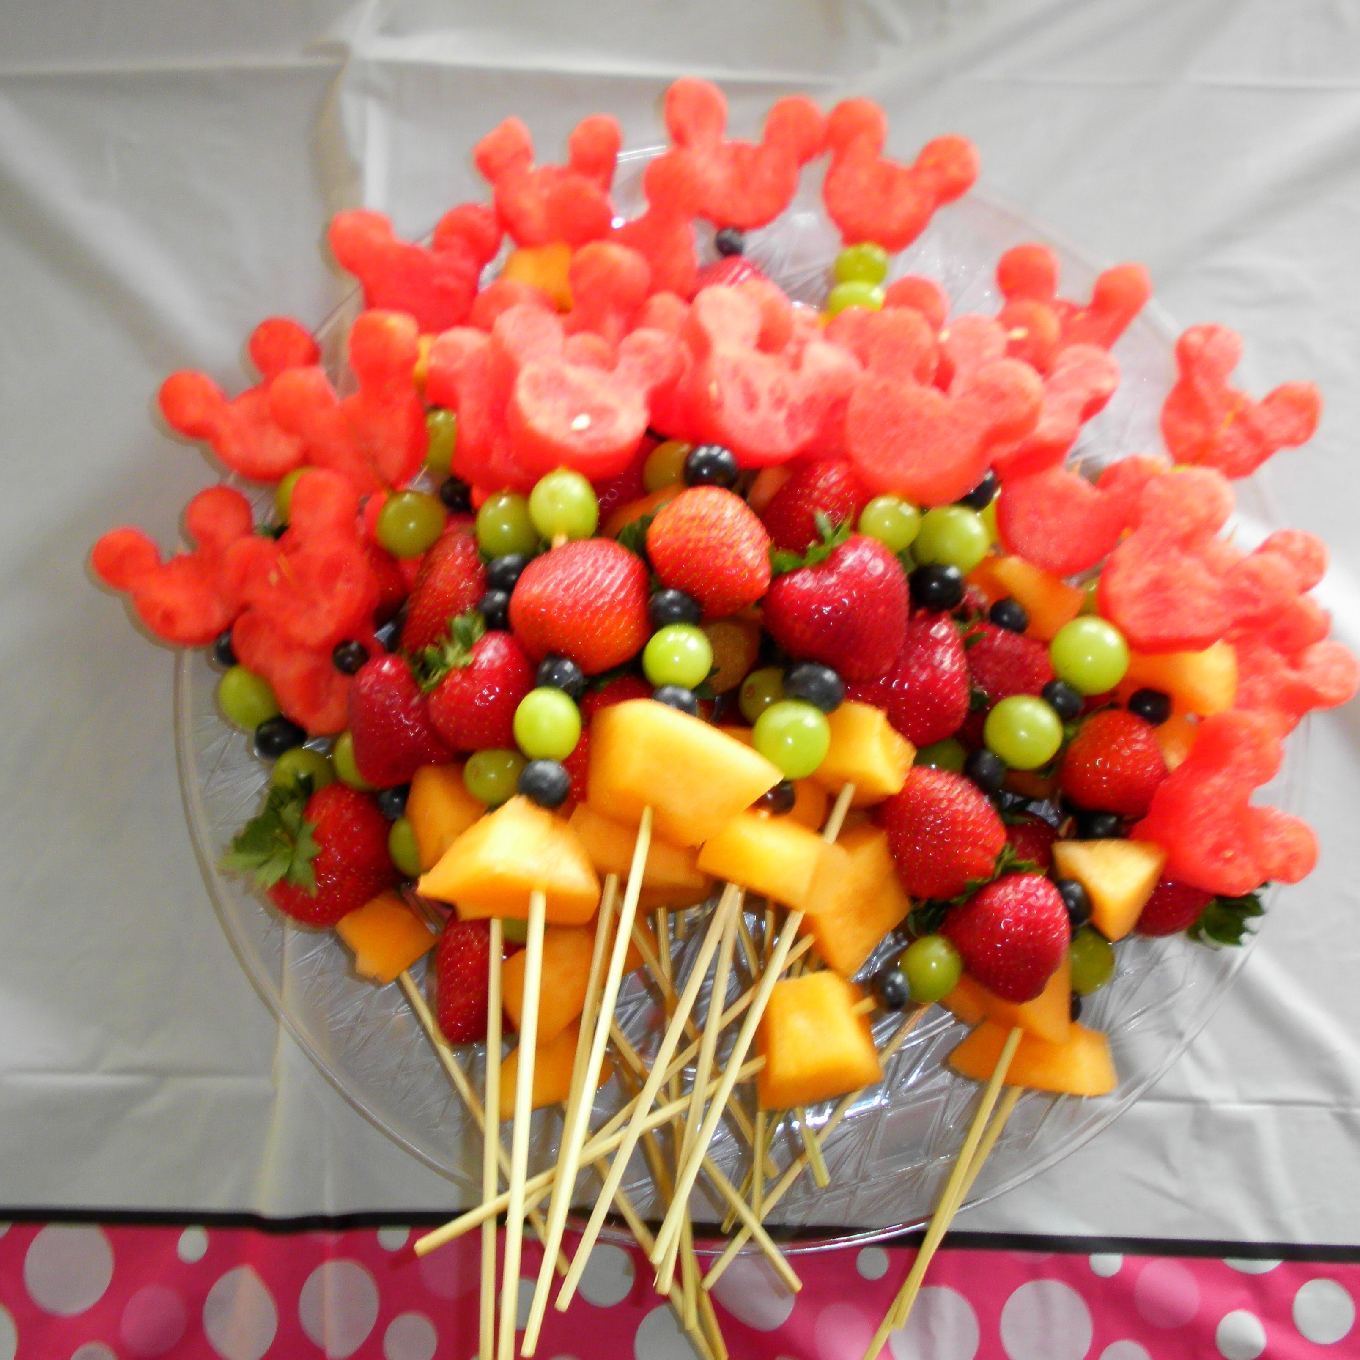
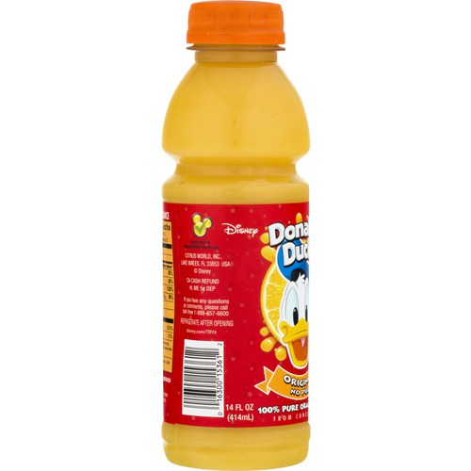
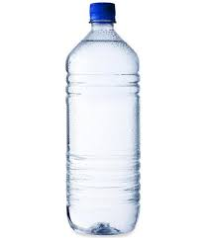
Numeracy: Lunch Time!
You have £10.00 to spend on your lunch.
What will you buy?
Do you have enough money?
How much change will you get?
Cheeseburger £6.00
Pizza
£5.50
Hotdog
£3.50
Chicken & Rice
£7.25
Soup & Bread
£3.50
Pretzel
£2.50
Fruit Kebab
£1.25
Apple
50p
Crisps
70p
Orange Juice
£1.50
Water
£1.00
Frozen Milkshake
£2.50

Slide 6
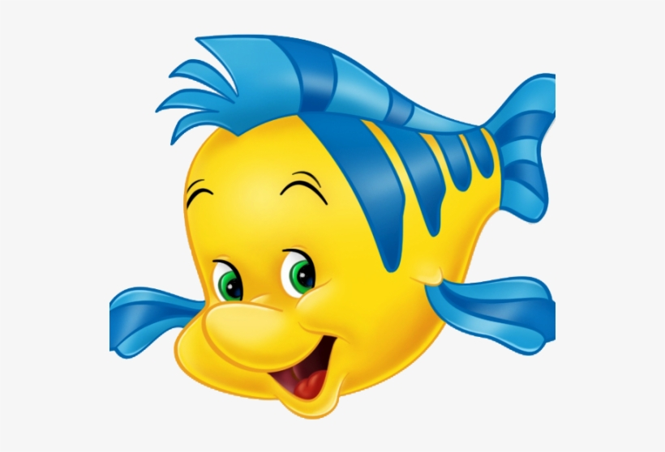
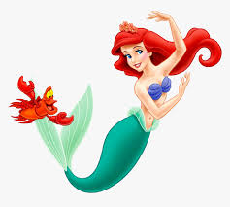
Under the Sea
Listen to:
The Little Mermaid - Under the Sea
Task:
Why does Sebastian think it is better to live under the sea? Give 2 reasons!
Do you agree?
Why or why not?

Slide 7
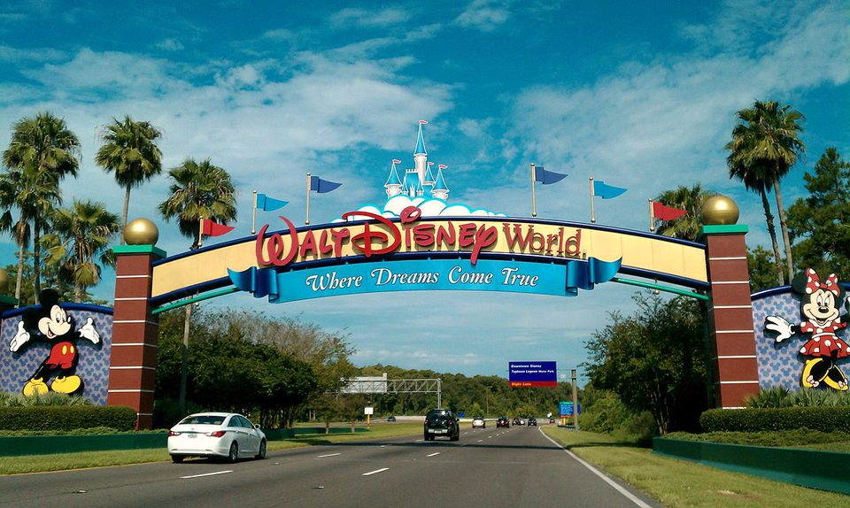
We hope you all enjoyed Day 3 of your trip to Disney World!
Mr Hay & Mrs Kerr
☺

