Slide 1
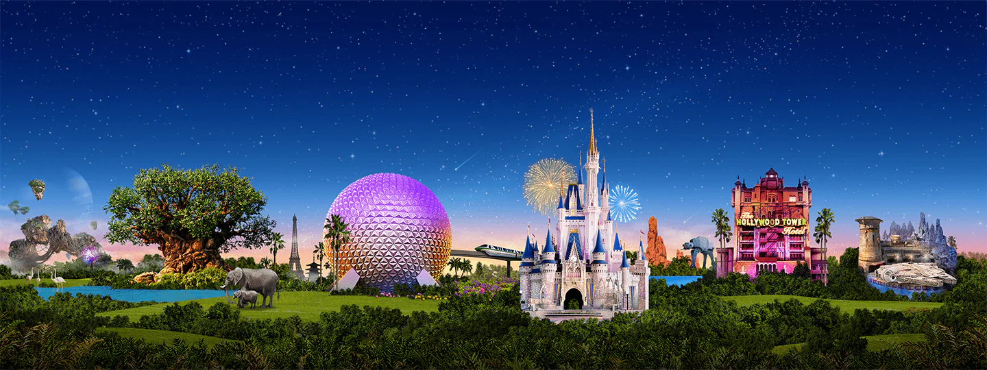
Virtual Disney Trip - Tuesday
Primary 3A’s

Slide 2
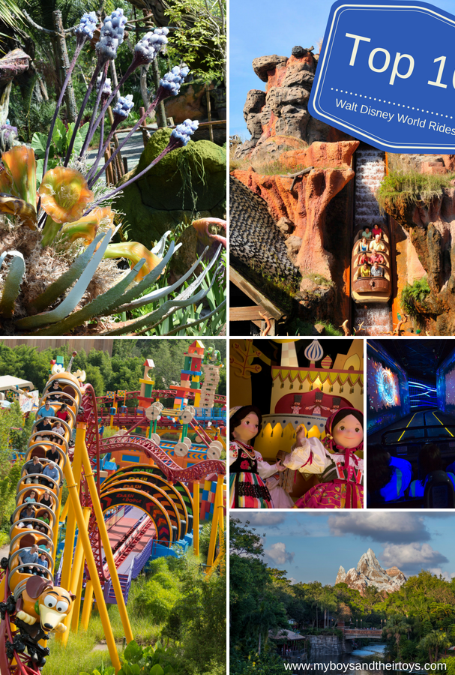
Day 2
It’s time to explore the rides!

Slide 3
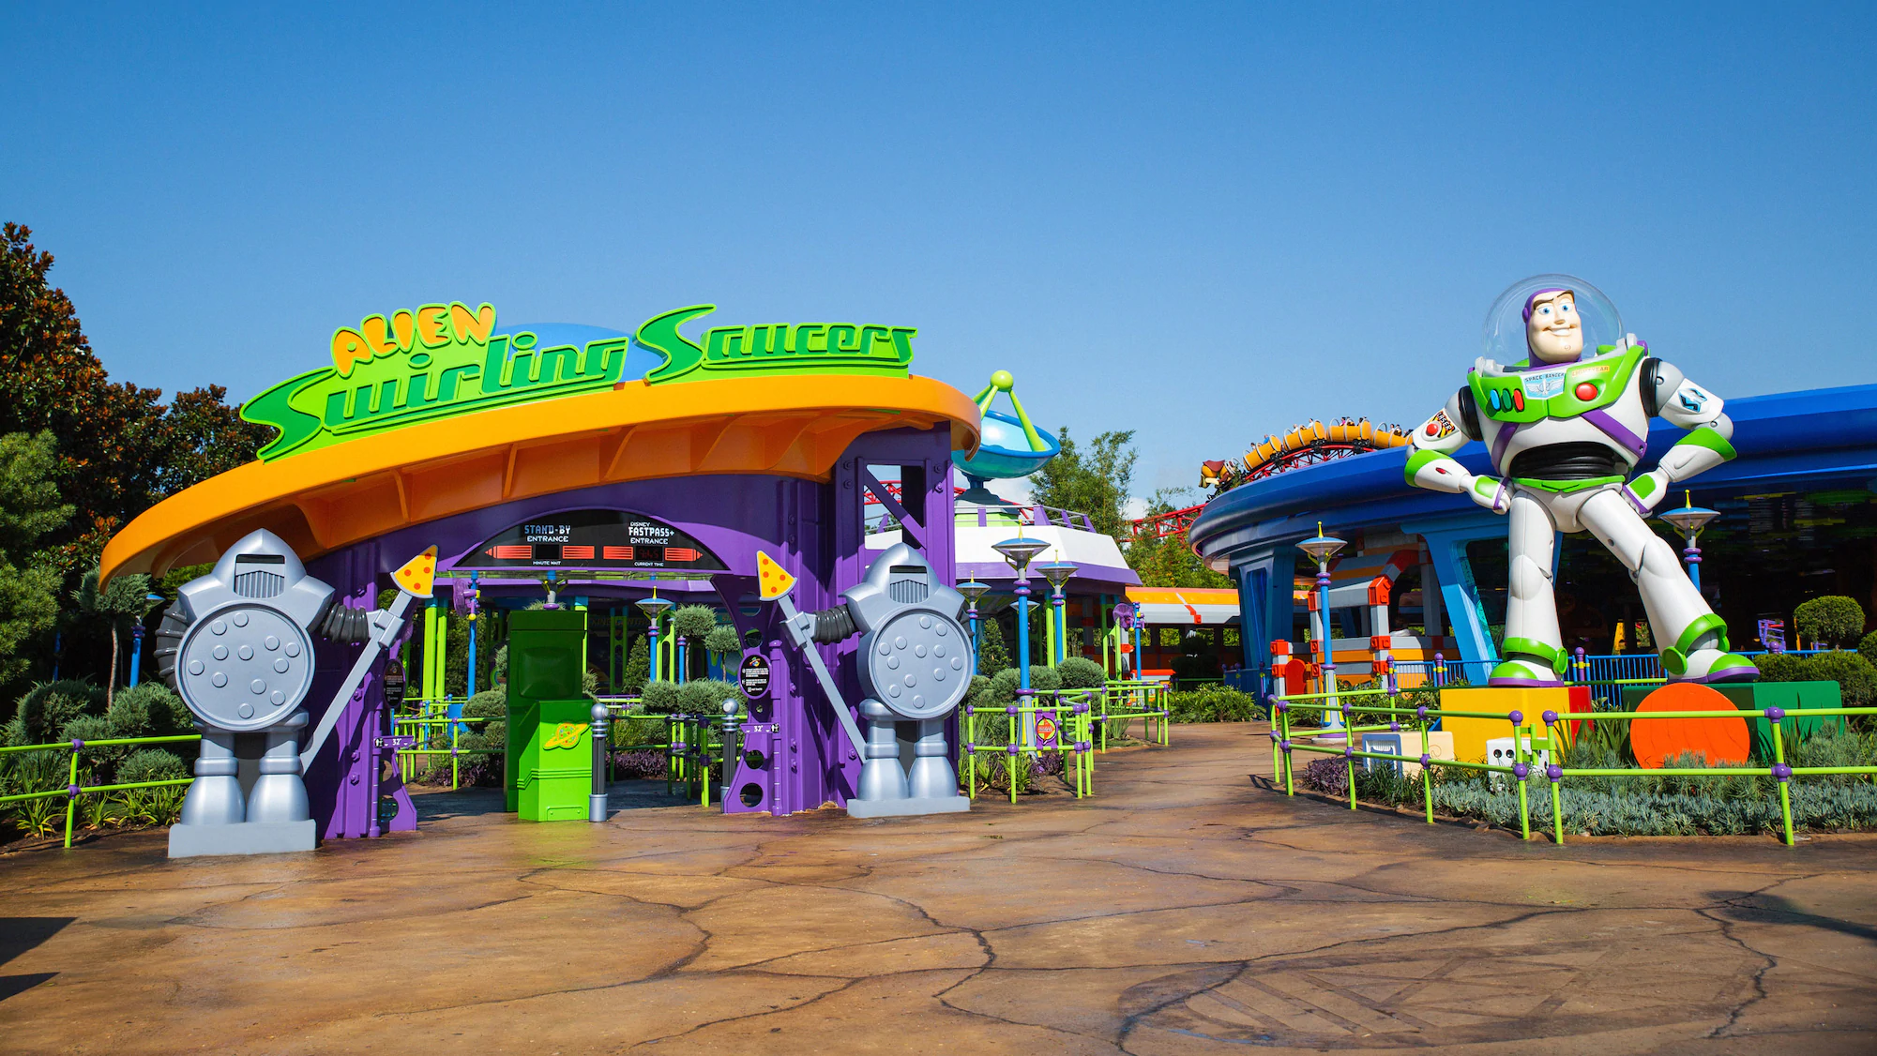
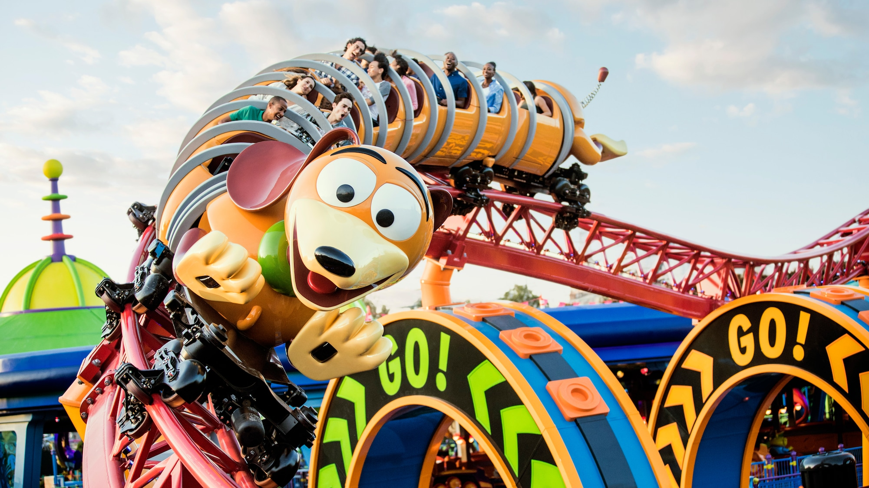
Numeracy: Let’s Ride!
Alien Swirling Saucers: 81cm or taller.
Estimate your height in centimetres (cm).
Measure your height. Are you able to ride?
If yes: By how much?
If not: How much taller would you need to be?
Slinky Dog Dash: 97cm or taller.
Estimate a family member’s height. Are they able to ride?
Measure their height. Are they able to ride?
If yes: By how much?
If not: How much taller would they need to be?
Ready to ride? Click the rides to go!

Slide 4
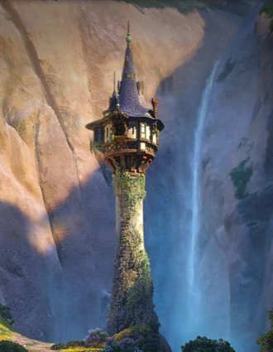
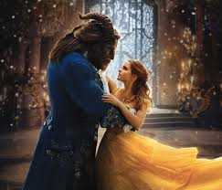
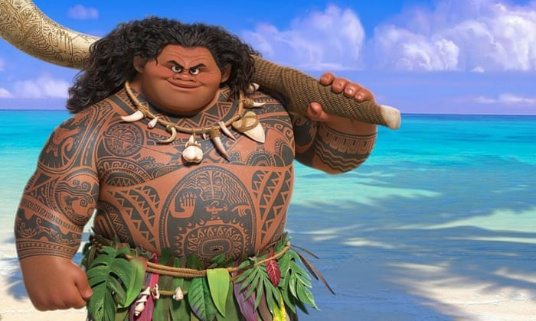
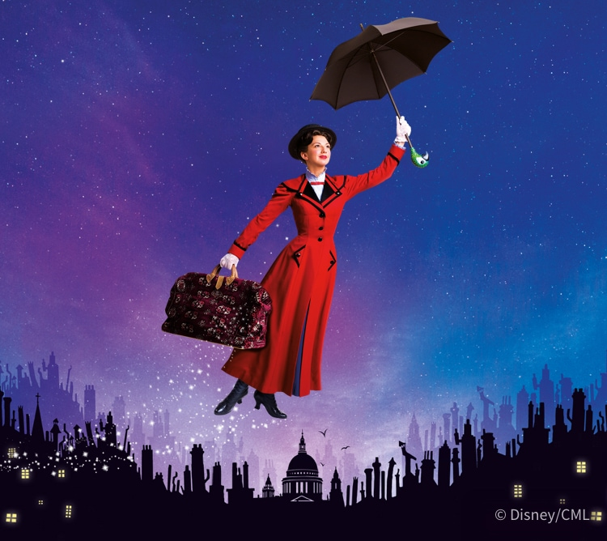
Reading: Match the Pictures
1. The hook is behind his back.
2. The tower stands tall in the mountains.
3. The lady flies high in the sky using her umbrella.
4. The beautiful lady falls in love with the ugly beast. They dance together.

Slide 5
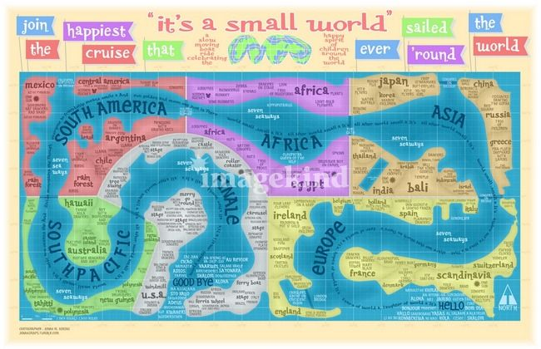
It’s a Small World
3. Compare Scotland to another country.
You may include:
Location
Weather
Food
Flags
Attractions/scenery
Anything else!
You can create a poster or record a video to showcase your information.
1. Set sail on the, ‘It’s a Small World’ Boat Ride to visit countries around the world. (Click the picture to go!)
2. Find out the names of the 7 different continents in the world.

Slide 6
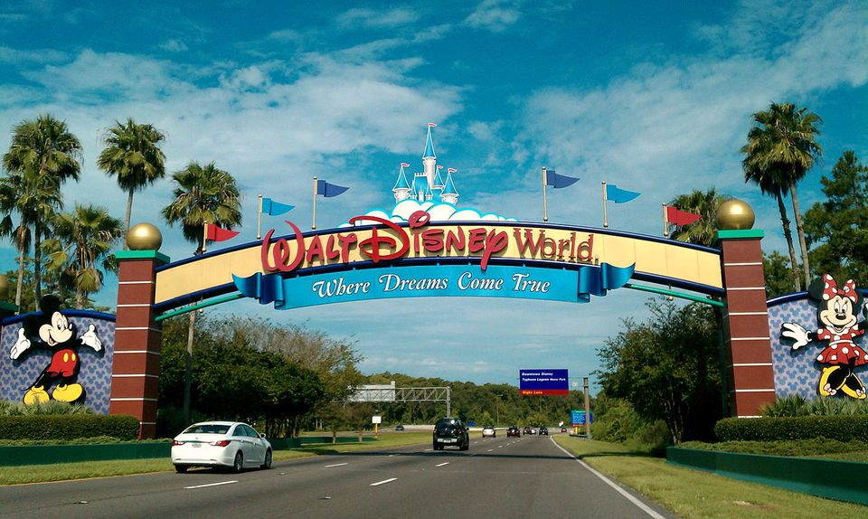
We hope you all enjoyed Day 2 of your trip to Disney World!
Mr Hay & Mrs Kerr
☺

