Slide 1
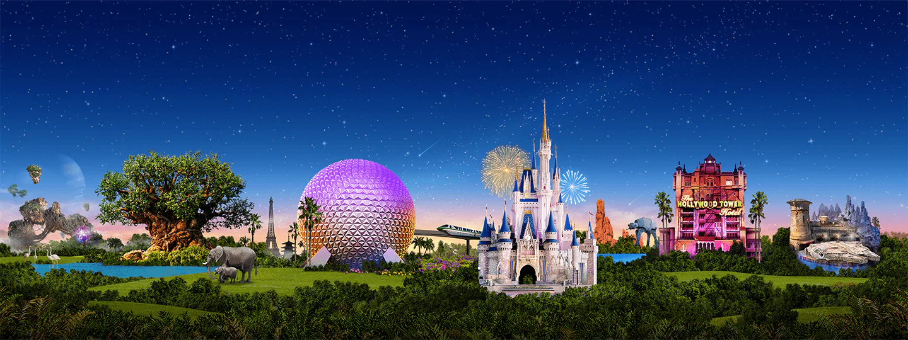
Virtual Disney Trip - Thursday
Primary 3A’s

Slide 2
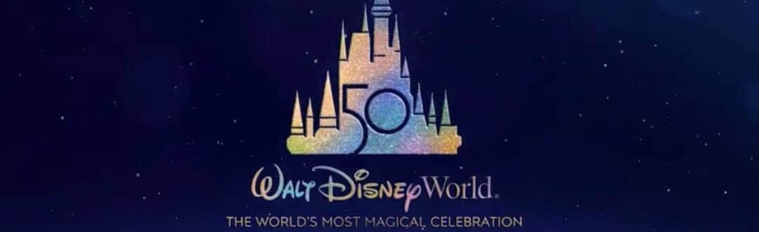
Day 4
Explore the park
Become the Common Word King
Create a new ride

Slide 3
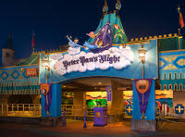
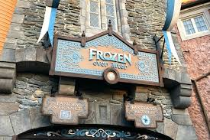
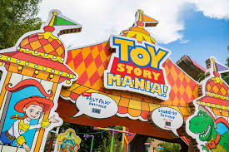
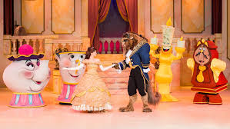
Numeracy: Ride Time!
How long altogether would it take to ride Peter Pan’s Flight & Frozen Ever After?
You have 35 minutes left in the park. Which 2 rides could you go on to make the most of your time left?
How much longer is Toy Story Mania! than Peter Pan’s Flight?
How much shorter is Frozen Ever After than Beauty & the Beast show?
You want to visit all 4 attractions. How long will it take altogether?
Peter Pan’s Flight
Duration: 3 minutes
Frozen Ever After
Duration: 5 minutes
Toy Story Mania!
Duration: 8 minutes
Beauty & the Beast Show
Duration: 30 minutes

Slide 4
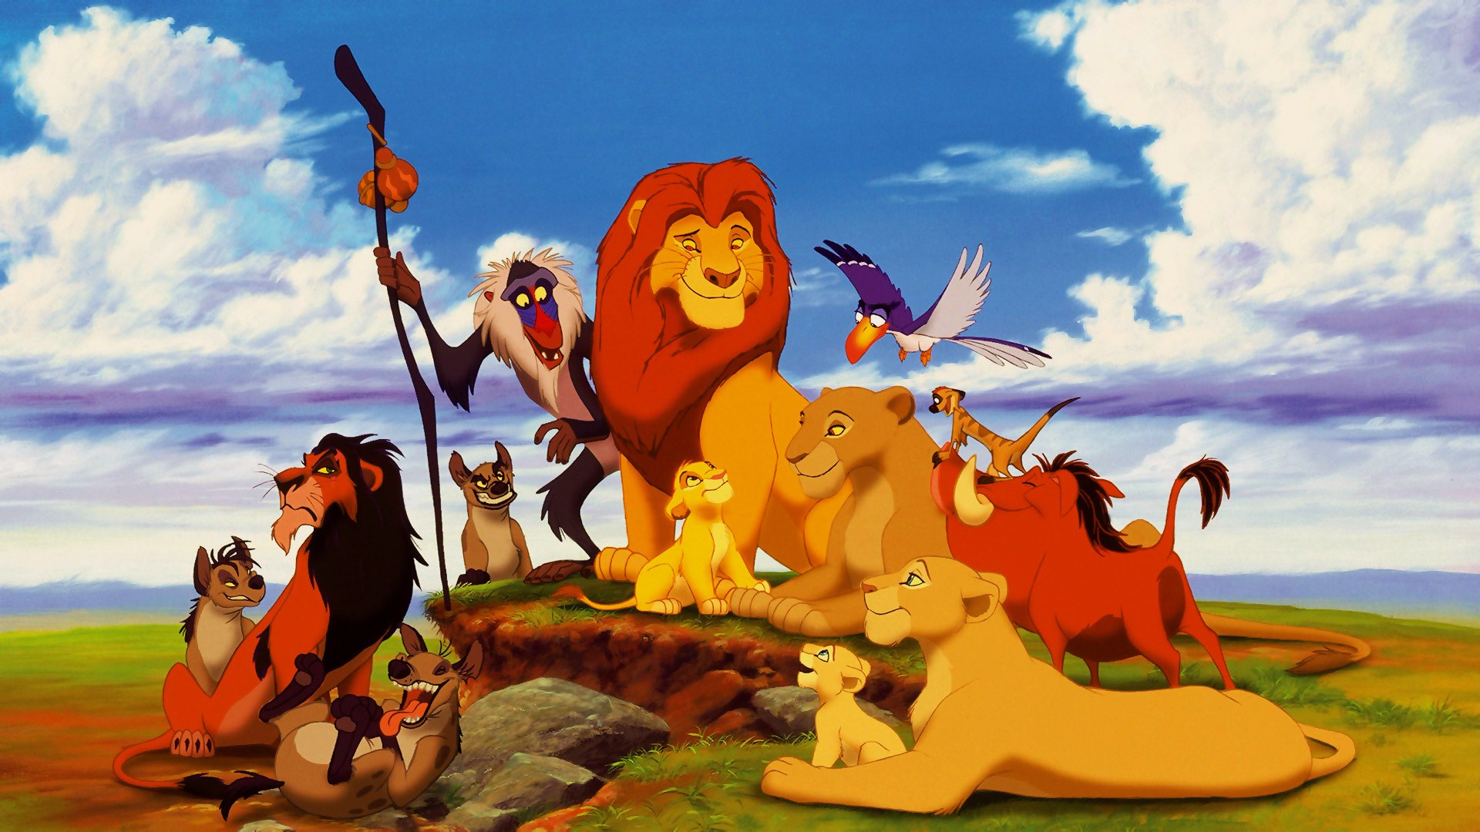
The Common Word King
said
would
Find all 15 of the hidden words to become the Common Word King.
where
here
what
many
the
you
were
does
when
they
of
why
are
come

Slide 5
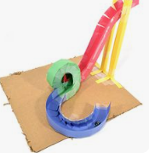
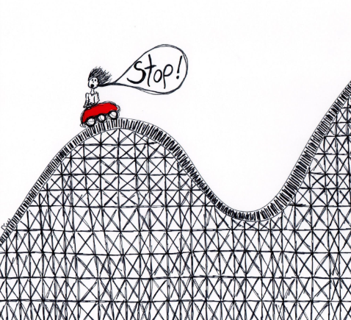
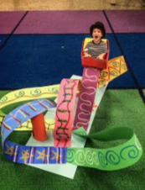
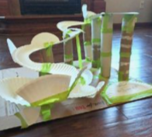
A New Ride: Part 1
The year 2021 is Disneyland’s 50th Anniversary!
We’ve been asked to help design a new ride.
Think about:
What will it be named?
What movie is it based on?
Who will it be for? Young children, teenagers, adults?
What will it look like?
Design your ride! You can draw or build this, you choose.

Slide 6
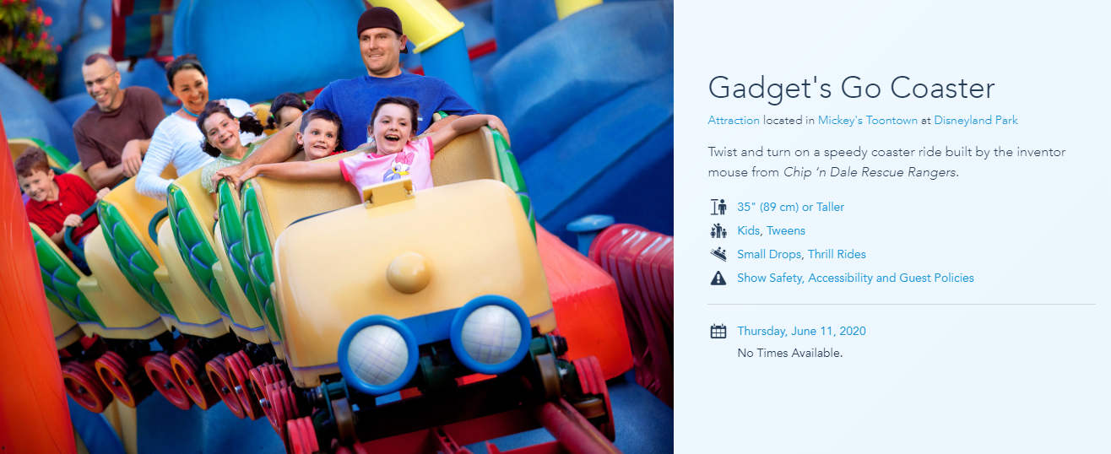
A New Ride: Part 2
Create a poster to advertise your new ride.
Remember to include: Price, height limits and any safety rules.

Slide 7
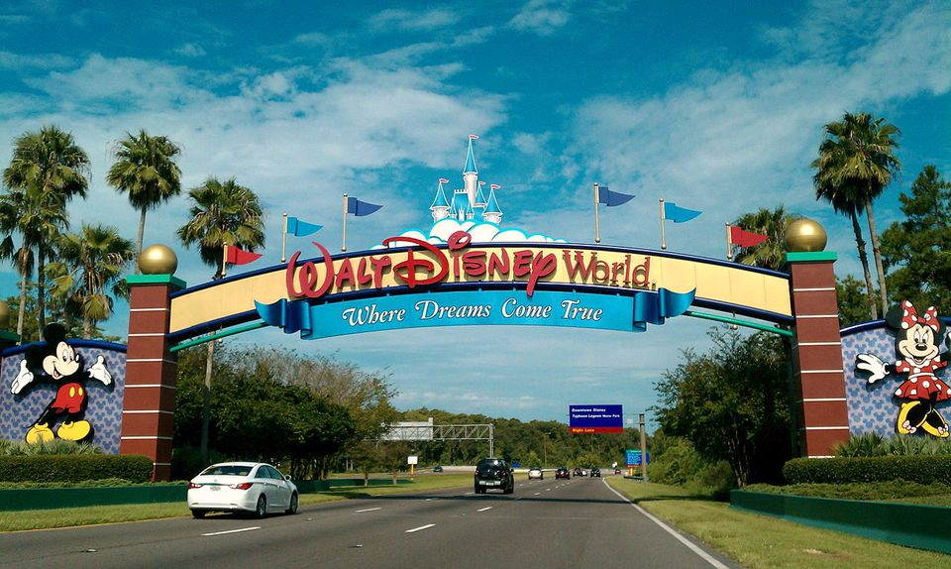
We hope you all enjoyed Day 4 of your trip to Disney World!
Mr Hay & Mrs Kerr
☺

