Slide 1
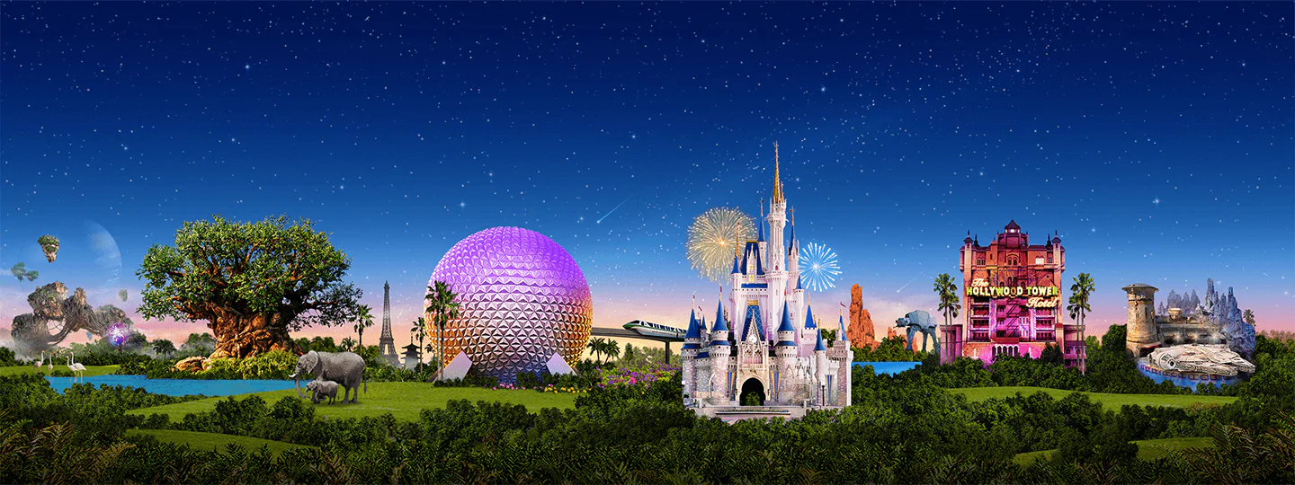
Virtual Disney Trip - Monday
Primary 3A’s

Slide 2
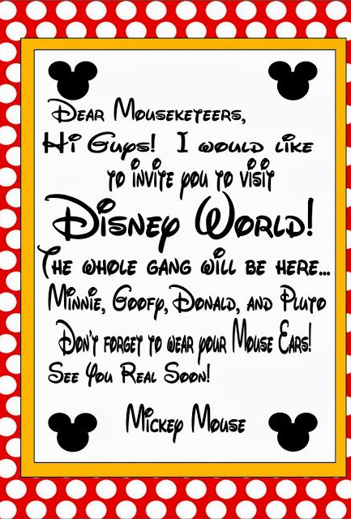
Day 1
Prepare your passport
Plan your timings
Check the weather

Slide 3
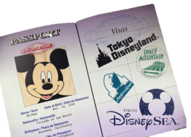
Art
Create a passport that you can use during your trip!
Remember to include:
A front cover
Your name
A picture of yourself
Lots of space for characters names!
Each time you see a character this week in a ride, video or song, make sure to write their name in your passport! How many characters will you meet by the end of the week?

Slide 4
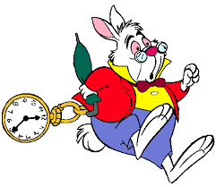
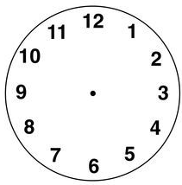
Numeracy: What time?
Draw the hour and minute hands to show the time.
The park opens at quarter past 9.
You visit Mickey’s house at 11 o’clock.
You go on the log flumes at half past 1.
Challenge!
You visit the arcade at 10 past 4.
You eat dinner at 6:15pm.
The park closes at 25 minutes past 8.

Slide 5
Weather Check
Disneyland is in Orlando in America.
Find out what the weather is like in Orlando this week.
Will it be rainy, cloudy or sunny?
What is the temperature?
Task: Create a weather report video to tell us about the weather at Disney World.
What will we need to pack to be prepared?

Slide 6
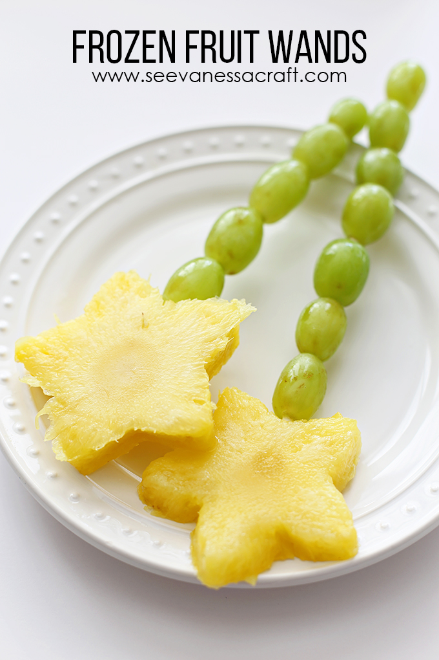
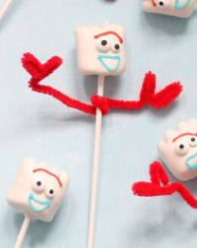
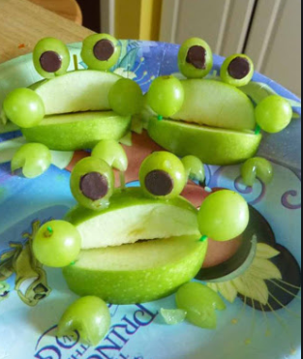
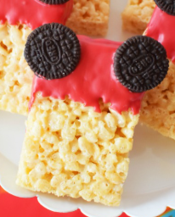
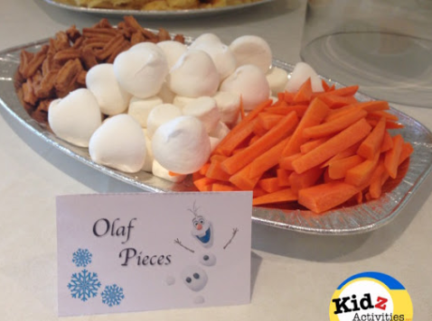
Snack Time
Some simple snack ideas
Can you help to prepare a healthy snack today? Follow a recipe if you can!
Take a photo and show us your home made snacks!

Slide 7
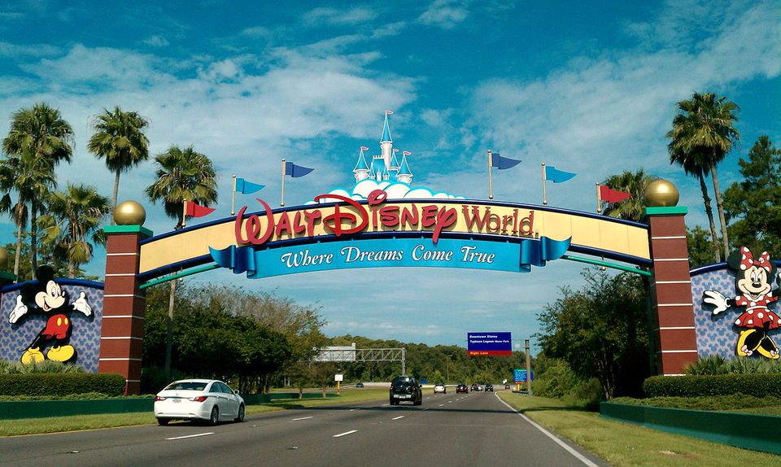
We hope you all enjoyed Day 1 of your trip to Disney World!
Mr Hay & Mrs Kerr
☺

