Slide 1
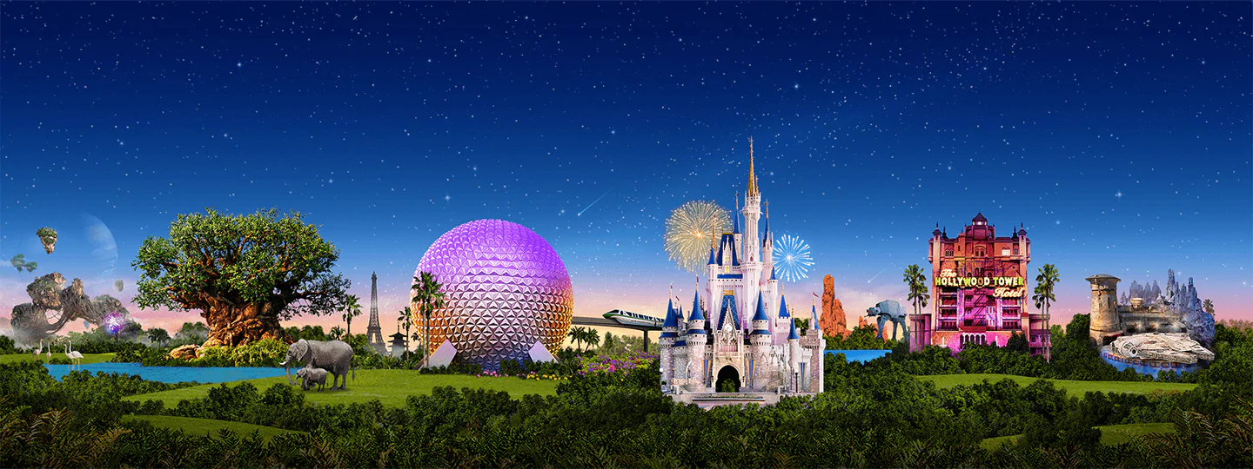
Virtual Disney Trip - Friday
Primary 3A’s

Slide 2
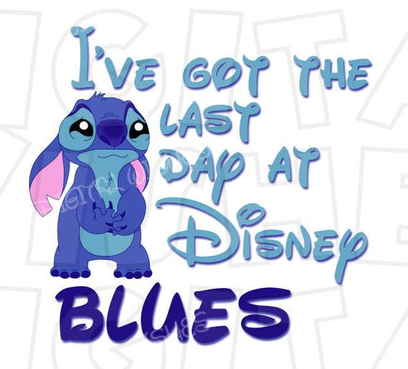
Day 5

Slide 3
Writing: Monsters Inc.
It’s time to enter Monstropolis, the city of Monsters!
Tasks:
Design a monster.
Name your monster.
Describe your monster using 6 adjectives.

Slide 4
HWB: Inside Out
Tell an adult something that makes you feel each of these emotions.
Example: I feel sad when my friends don’t share with me.

Slide 5
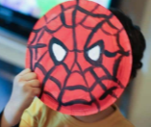
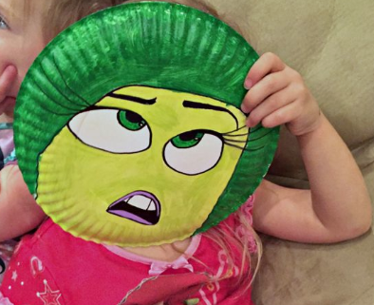
Disney Parade!
Create a mask of your favourite Disney (or any other) character.
Parade Time!
Take part in the parade as your favourite character.

Slide 6
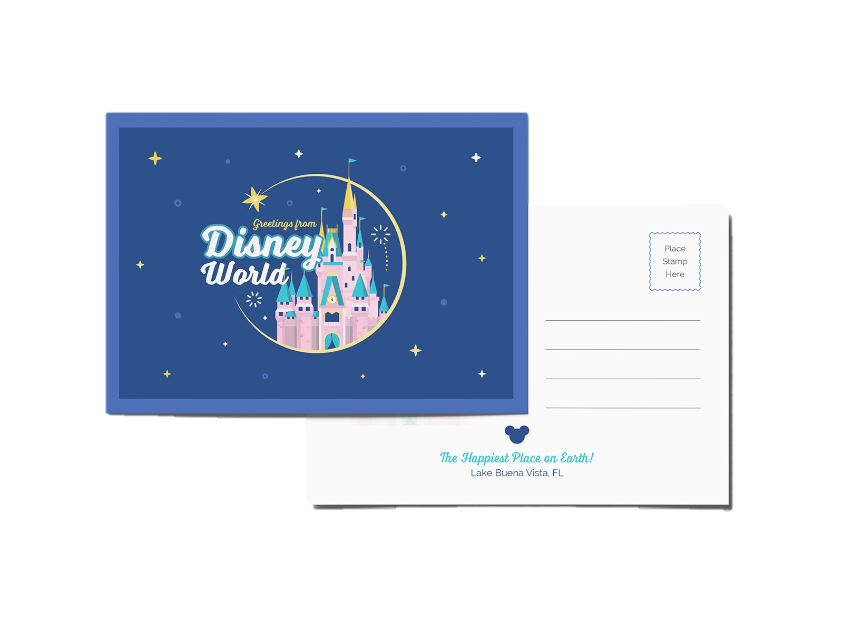
Send a Postcard!
It’s our last day at Disney World. Can you write a postcard to tell your grandparents/friend/sister/auntie about your school trip to Disney?
Draw a detailed picture of your favourite moment on one side, and write a descriptive message on the back. Remember to include the address you are sending it to too!

Slide 7
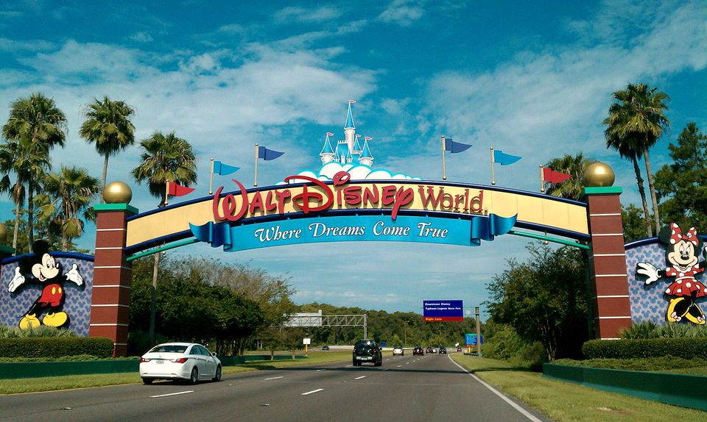
We hope you all enjoyed our virtual trip to Disney World!
Mr Hay & Mrs Kerr
☺

