Slide 1
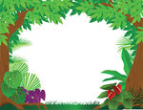
Forest Setting Word Bank
Forest Word Bank
Hearing words
Chirping Singing Birds
Cracking Twigs
Rustling
Swishing Leaves
Snapping Branches
Whistling Wind
Hissing Snakes
Splashing Water
Seeing words
Beautiful Leaves
Green Branches
Dark Vines
Murky Soil
Muddy Water
Feeling words
Rough Rocks
Bumpy Pebbles
Smooth Leaves
Prickly Plants
Smelling Words
Rotting Wood
Fresh Flowers
Fragrant Petals
Tasting words
Juicy Orange
Tangy Lemon
Sharp Mango

