Slide 1
Galson Early Childhood Centre
Eco-Schools Award

Slide 2
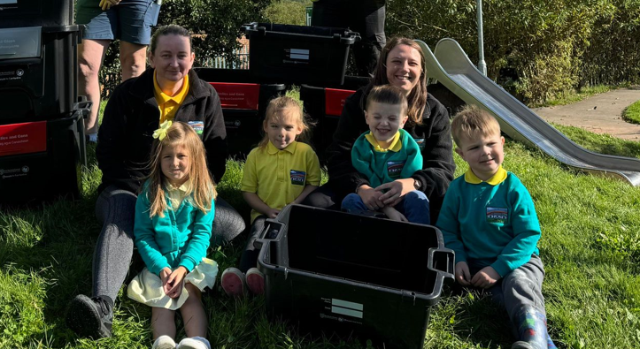
Meet the Eco-Team
We started our eco-journey by working with a small group of children, staff and parents.
Our goal for the first year of the Eco-journey was to establish a small group to review and consider key area’s within our Centre to focus upon and establish an action plan which is both achievable and sustainable.
Our ethos is to start small in year one and build on our achievements into year 2 by broadening into full Centre and wider community engagement.
This is illustrated in our year 1 action plan and subsequent evaluation and development into year 2.

Slide 3
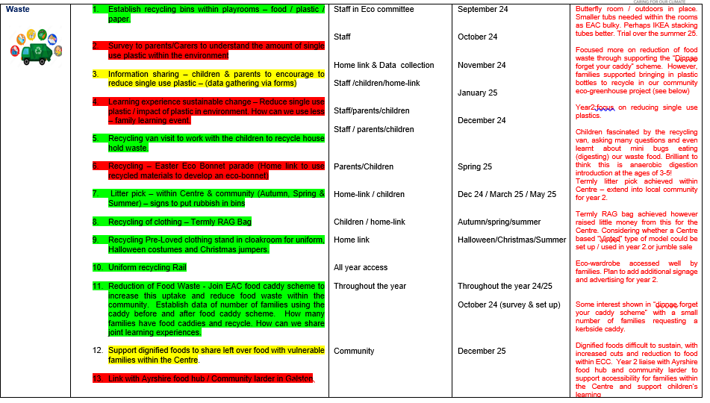
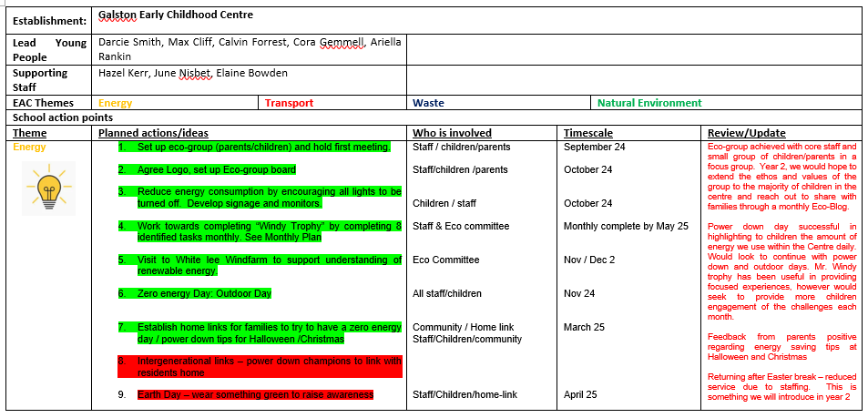
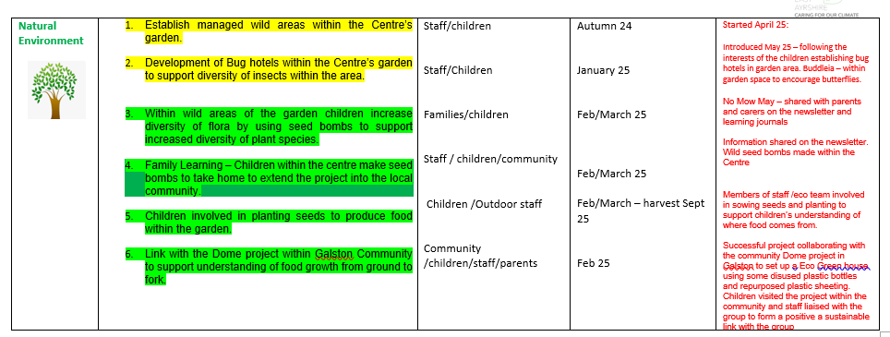
Our Eco Journey
Our Eco team held their first meeting in September to review and identify key areas to develop. As shown in our Action plan below

Slide 4



Eco-Schools - Themes
Theme 1:
Saving Energy
Theme 3: Natural Environment
Theme 2:
Reducing Waste

Slide 5
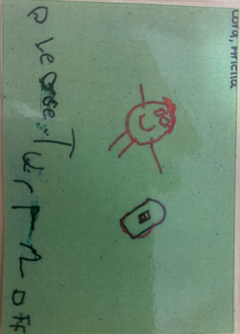
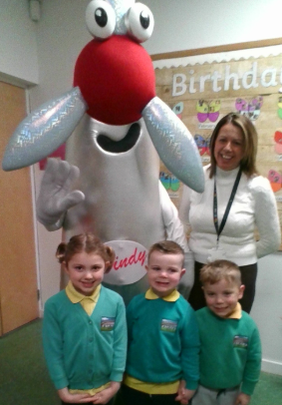
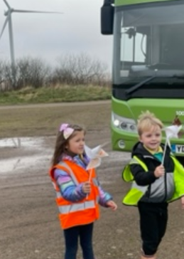
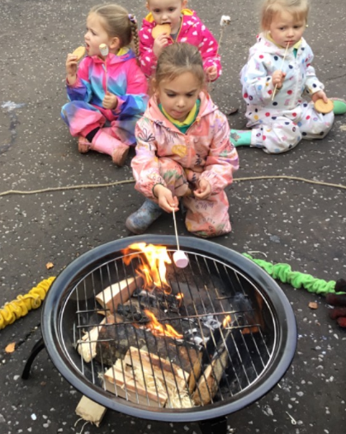
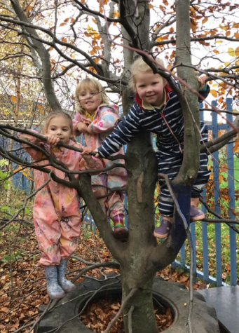
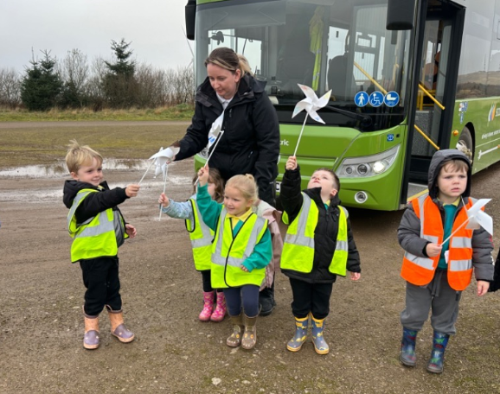
Theme 1: Saving Energy
Powerdown Day
The Eco-Team designed signs to put next to the light switches to remind everyone to turn off the lights when not being used.
We held a power down day, and spent all day outside to make sure no electricity was used in the Centre. We could not work out how much energy we saved as we are linked with the school but we did notice how dark it was in the Centre during our lunch break and used books to find out information rather than technology.
Raise Awareness to reduce energy by:
Taking part in the Powerdown Challenge and welcomed Mr. Windy into the Centre
We had great fun cooking our snack on the fire during our power down day. We listened carefully to instructions and were able to keep ourselves safe
In November the Eco-Committee visited Whitelees windfarm to find out how electricity is made using the wind as a renewable energy resource
We learnt that we need to wrap up warm and move around lots to warm up rather than using more heating.

Slide 6
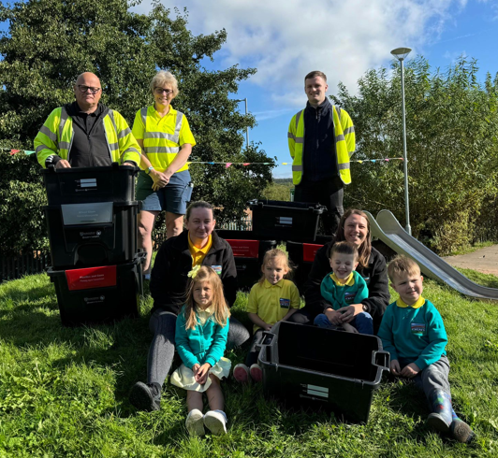
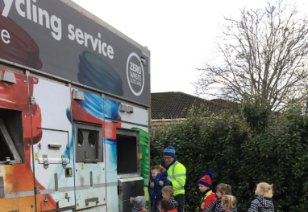
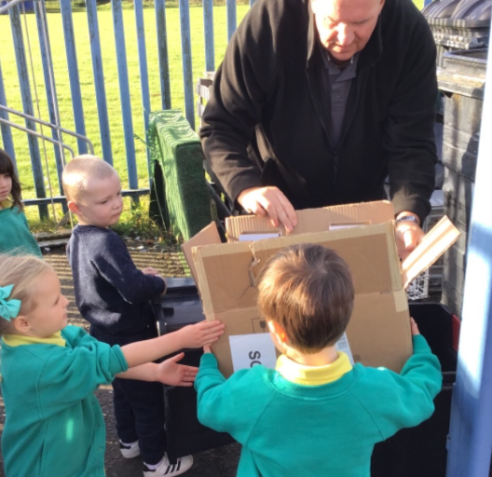
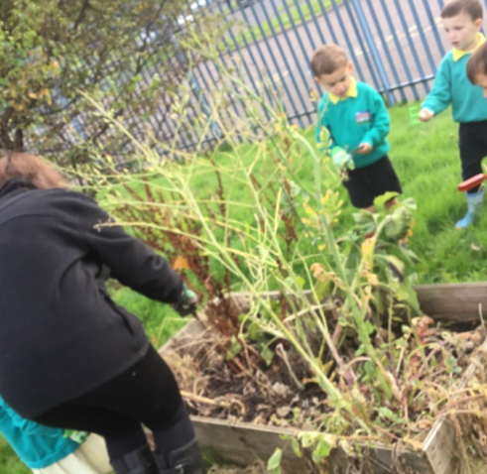
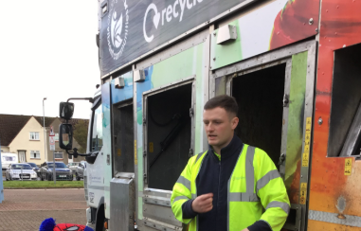
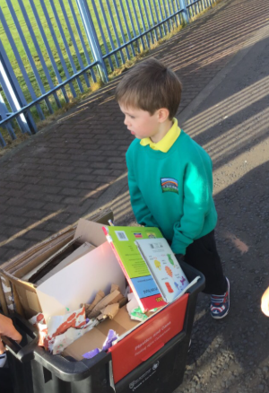
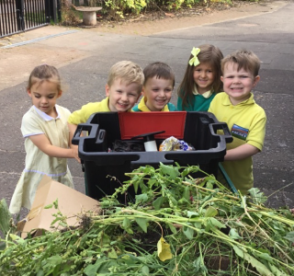
Theme 2: Reducing Waste. Recycling Resources
The Eco-committee arranged for recycling boxes to be in the Rainbow room, butterfly room and outside areas
To help us understand what happens to the things we recycle, we enjoyed a visit from the Romaquip van! We were surprised that it could even recycle coffee pods!
Children from both rooms were responsible for taking the plastic, paper and card recycling to the main recycling bins for the Centre. Mr. Hamilton, the janitor helped us.
We removed the old plants and put this into the container to make compost for next year!
We are working on trying to reduce our waste by using food caddies and setting up our dignified food project,sharing our pre-loved clothing with others on our Eco Rail and raising money for our Centre through termly RAG bag collections

Slide 7

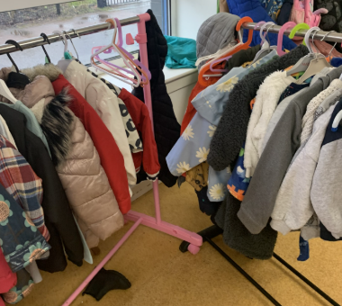
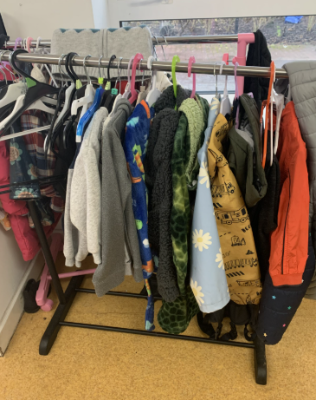

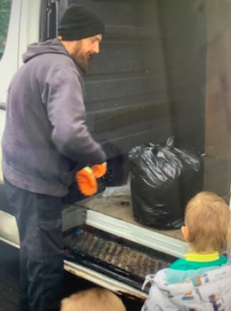
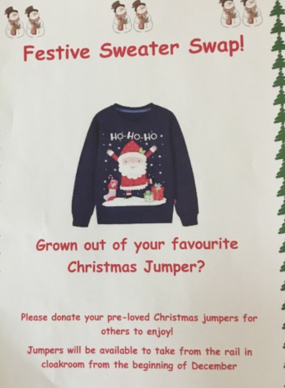
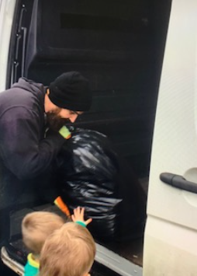
Theme 2: Reducing Waste. Recycling clothing
The Centre arranged for termly RAG bag collections. This supported others to enjoy our pre-loved clothing, raise some money for our Centre and reduced waste. Win, win, win!
Eco-Wardrobe
The Centre offers parents/carers the opportunity to access free pre-loved uniform and clothing from the Eco-rail in the cloakroom.
Seasonal and Festive Clothing swaps
The eco-team recognise how expensive it can be to provide Halloween costumes and festive clothing. A rail was set up in the cloakroom for parents/carers to either swap an old costume /festive jumper for a new one or simply help themselves. Many of the items had only been worn a few times, so this was a very popular addition in supporting to reduce waste through wearing pre-loved clothing.
Picture
Some of the children helped to carry out the bags to the van to be weighed. We collected 149kg of pre-loved clothing. We earned some money and this is being put towards our summer trip and others are enjoying wearing our old clothing

Slide 8
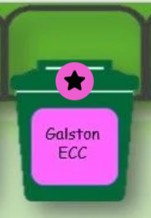
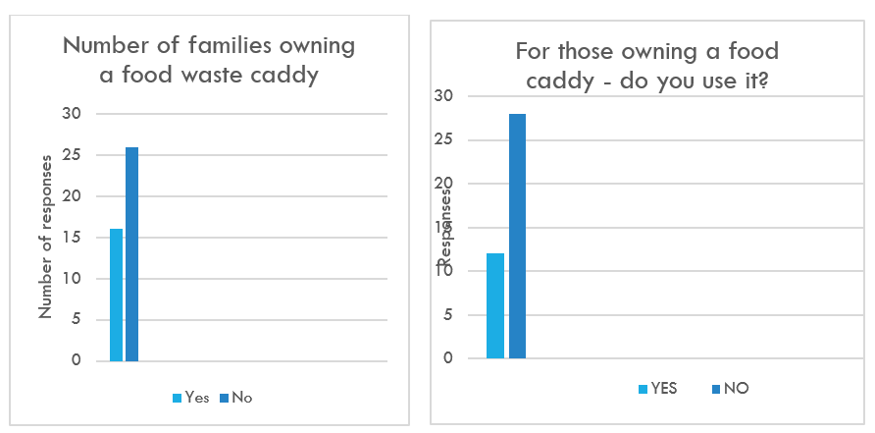
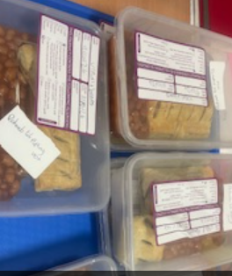
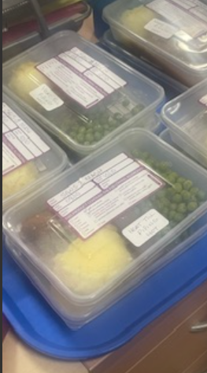
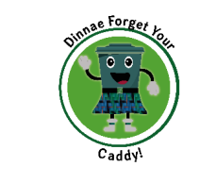
Theme 2: Reducing Waste. Food
The eco-team were keen to find out how many families used their food caddies in reducing the amount of food waste. We surveyed our parents/carers and were very surprised to find out that very few of our families regularly used their food caddy.
Here are our survey results from October 24.
Survey results EAC and ECC survey – May 25
EAC results indicate that families from Galston have only requested 3 new food caddies. This uptake is disappointingly low and further engagement with our families will be included in the second year of our Eco-school journey 25/26.
Dignified food – reducing food waste from the ECC
We recognised that many families were struggling with the cost of living and increase in food prices. We arranged for unused lunches/dinners to be packed and shared with our families most in need of support
To try to encourage more families to use their caddies, we shared information from “Dinnae Forget your Caddy” in our newsletter, emailed all our families to share that their waste food can be used to make energy in East Ayrshire.
During the omniequip visit the children learnt that tiny bugs break down the food to make energy which we can use.
S
Families reported to be grateful for the additional support. However, this has been difficult to sustain given cuts within the Centre long term.

Slide 9
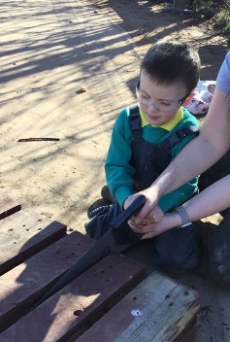
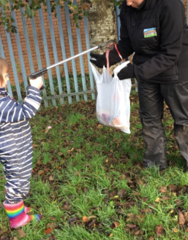
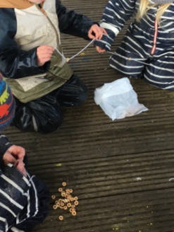

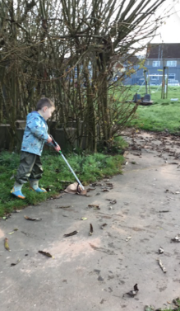
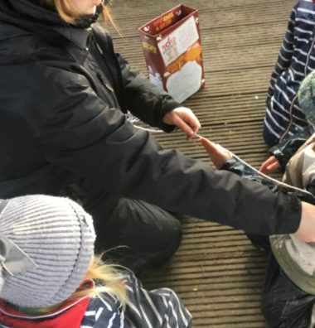
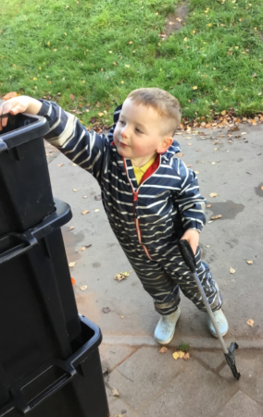
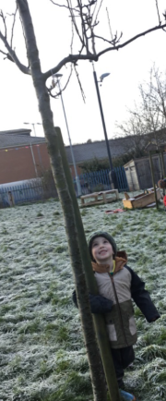
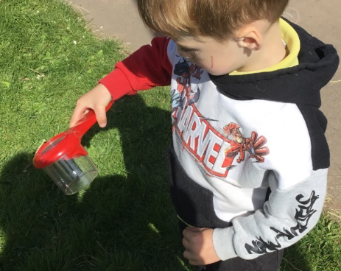
Theme 3: Our Natural Environment
Looking after our Environment
Looking after nature within our environment
The Eco team have involved others in looking after our environment by holding termly litter picks. Being attached to the school we found a lot of crisp packets, and are thinking about ways we can reuse/repurpose this material to reduce waste.
The Eco-team and children were keen to look after the wildlife within our garden area. We have plants to encourage the butterflies and were keen to develop spaces to support other wildlife throughout the year
Establishing Wild areas
Children were involved in recycling pallets to make flower borders to encourage more insects to the garden
Bird Feeders
Supporting Family learning about biodiversity, by encouraging families to take part in No Mow May. Information shared in the May Newsletter. Families encourages to share pictures of their wild areas within their gardens
Bug hotels
Children used magnifying lenses to hunt for mini-beasts in the garden. Children learnt preferred habitats for them, such as under tyres, old wood or stones, in dark damp areas.
We threaded Cheerios onto string and hung them in the trees. We also made lardy seed balls for the birds to feed on during the winter months, when there are fewer berries and food for the birds

Slide 10
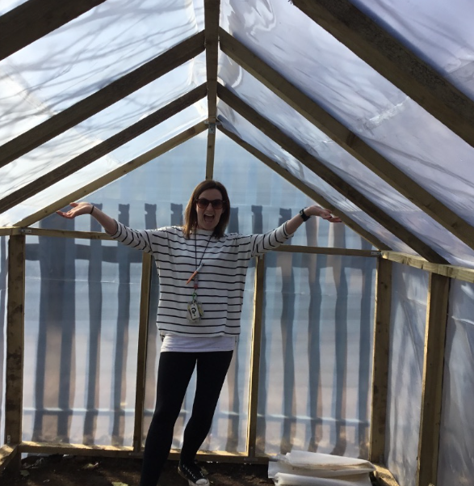
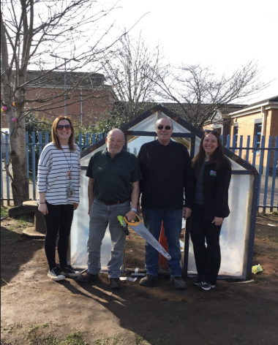
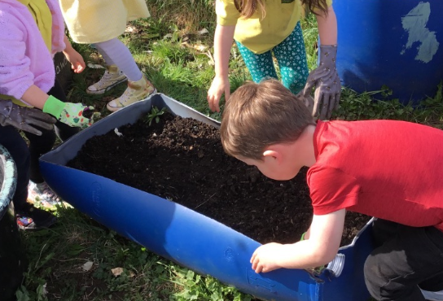
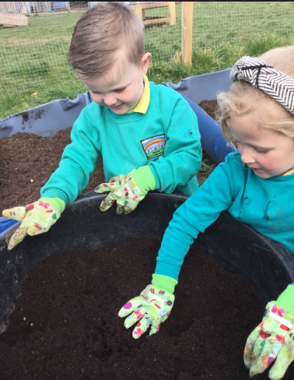
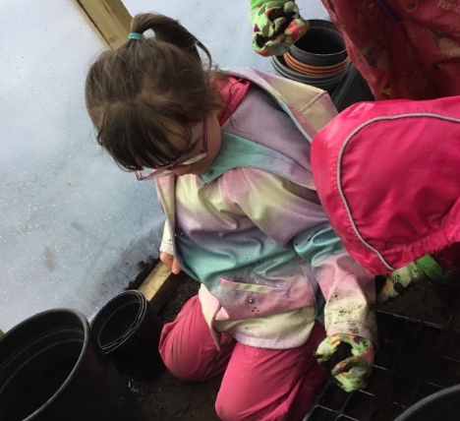
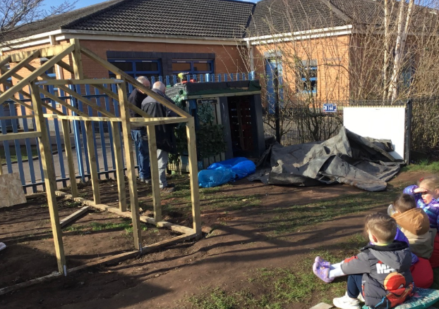
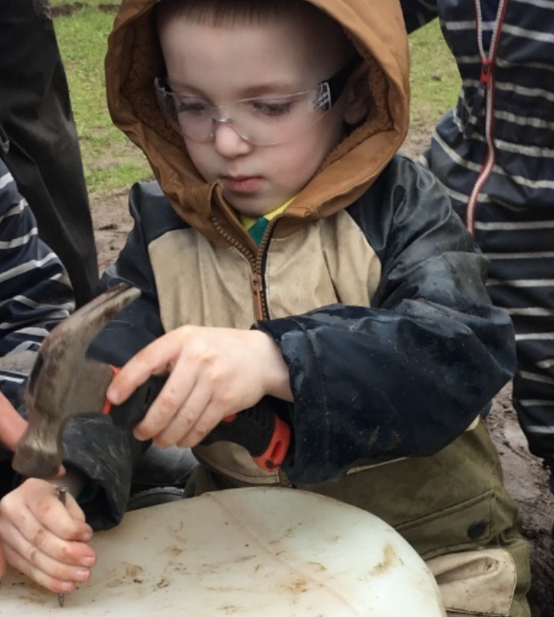
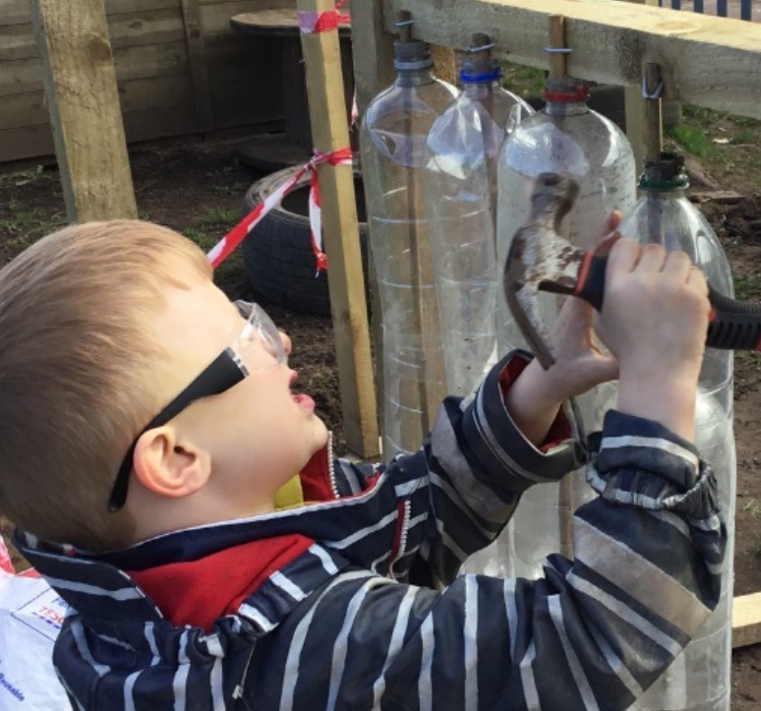
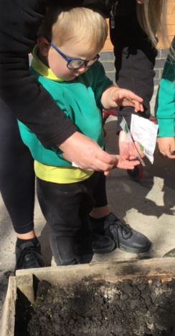
Theme 3: Our Natural Environment
As soon as the greenhouse was finished, compost and pots were kindly donated to the project by volenteers from the Dome. The children quickly became involved in planting new seeds in both the green house and the nursery vegetable patch!
Understanding where our food comes from
The eco-team worked in collaboration with the volunteers from Galson Dome project to build an eco green house. A combination of recycled plastic bottles and plastic have been used to develop the greenhouse which will be used to plant seeds out before putting them into the Nursery Vegetable patch
Children were involved in making the greenhouse, using tools such as hammers and saws. Children were able to show how to keep themselves safe whilst using these tools
Carrots, Sweetcorn, potatoes, cucumber and lettuce amongst other seeds have been planted. We are enjoying looking after them and can’t wait to eat them in the Autumn. We will also look to develop our learning from farm to fork.
The children used tools, including saws and hammers to help make the greenhouse. Children learnt how to use the tools safely

Slide 11
Next steps in our Eco-Journey
Saving Energy
Continue to provide opportunities to reduce energy throughout the Centre, including more zero power days
Share saving energy tips into the wider community and families associated with the Centre
Establish a monthly eco blog to share energy saving tips
Reducing Waste
Use recycling bins which take up less space within the playrooms to encourage them to be used by all rooms consistently
Crisp packets formed a large part of our litter collection. Establish project to use this material to help others.
Continue to support RAG bag, consider alternative digital opportunities to upcycle clothing to raise money, similar to “vinted” or jumble sale
Increase the presence of the eco-wardrobe through additional advertising and opportunities.
To work to encourage the Centre and families to understand the impact of single use plastic on the environment and ways to reduce this.
To continue to work with families to support understanding of the importance of food waste recycling in producing energy, to increase the uptake of food waste caddies and use of within the local area.
Our Natural Environment
To continue to support children to understand where food comes from and to develop their interest in planting seeds to grow food
Increase awareness of farm to fork programme through contacting local farmers and suppliers to support our programme
Establish opportunities for family learning to create soup parcels with instructions to cook at home, and cooking groups within the Centre
Establish family learning opportunities to use and cook with the food that they grow.
Broaden understanding of planting wild flowers within the community to increase food for pollinators.

