Slide 2
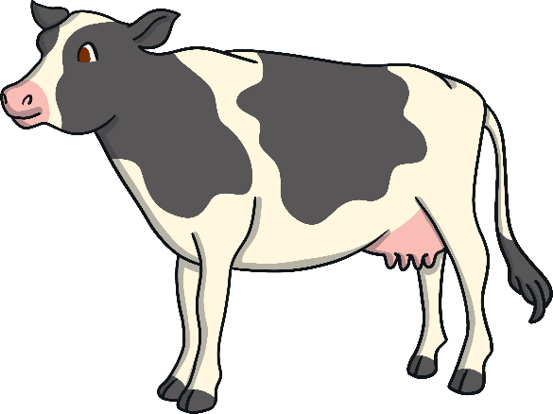
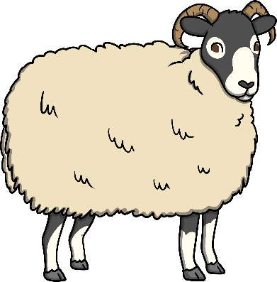
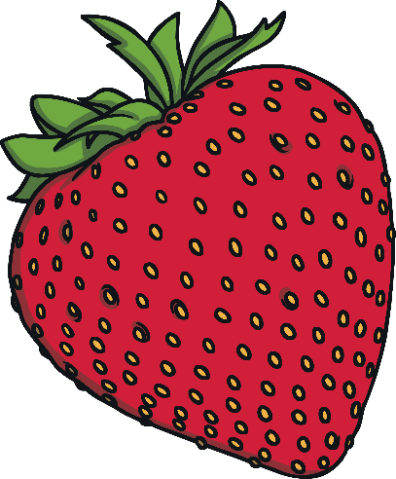
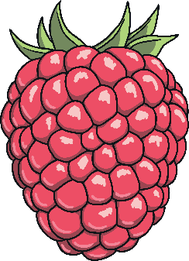
Scottish Produce
Scotch Beef and Scotch Lamb are known for their quality all over the world. Cattle and sheep are reared for meat all over Scotland.
Raspberries and Strawberries are mainly grown in Perthshire and Angus but also grow in Aberdeenshire, Fife, the Highlands, Ayrshire, Arran and the Scottish Borders. Thousands of tonnes of berries are grown every year.

Slide 3
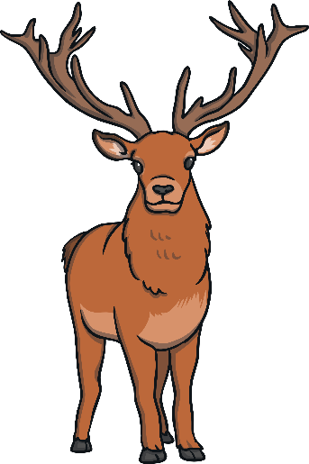
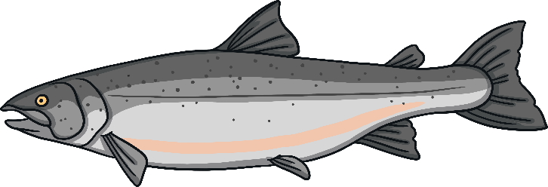
Scottish Produce
Venison comes either from deer that are farmed in Scotland or from those that live on Highland estates. Venison is a very low fat healthy meat.
Salmon can be caught in some of the rivers of Scotland; the Tay, the Dee and the Spey are just some of the rivers famous for salmon fishing. Salmon is also farmed in the Highlands, Outer Hebrides, Orkney, Shetland and Argyll.

Slide 4
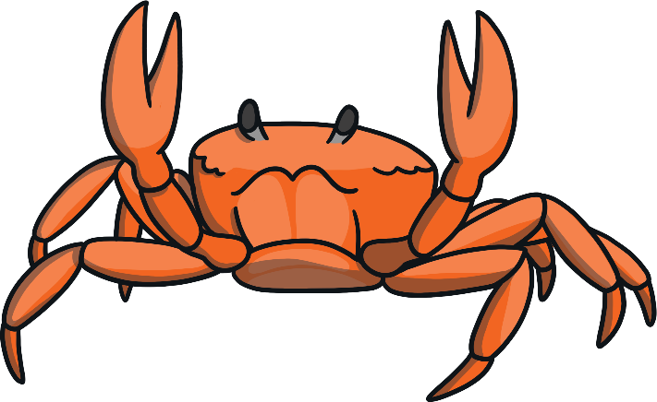
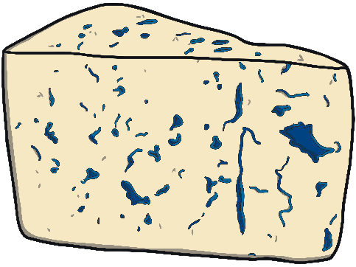
Scottish Produce
Shellfish, like lobster, crab, langoustine, scallops and mussels can be found all around Scotland’s coastline, most commonly around Shetland, Orkney, the Hebrides and the south-east coast. Scottish-caught shellfish are exported alive all around the world.
Cheese production can be found all around Scotland but many cheeses are made around Lockerbie, Stranraer and Campbeltown as well as on the islands of Bute, Arran, Islay, Mull, Gigha and Orkney.

Slide 5
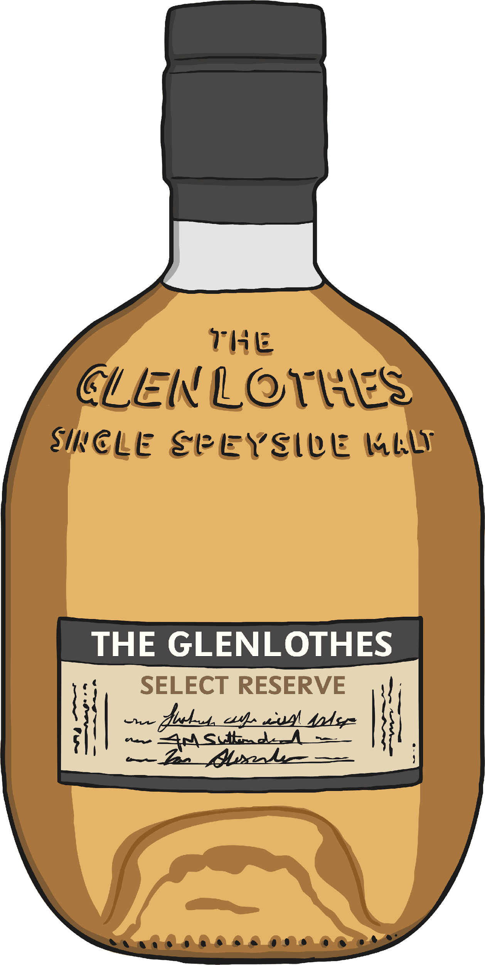
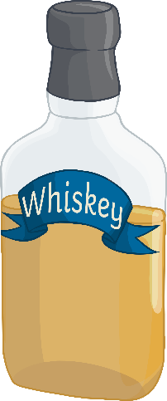
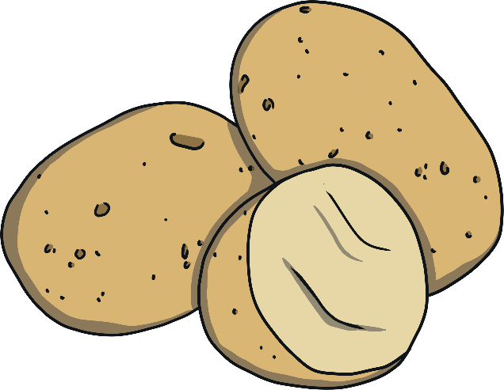
Scottish Produce
Whisky is made in distilleries across Scotland. Whisky is produced in Speyside, the Highlands, the Lowlands, Islay and Campbeltown. Each of these areas has its own special flavours.
Potatoes are one of Scotland’s most important crops and are grown throughout the country. Ayrshire is one area of Scotland that is well known for potato growing.
Can you think of any Scottish produce that might be eaten around the world?

Slide 6
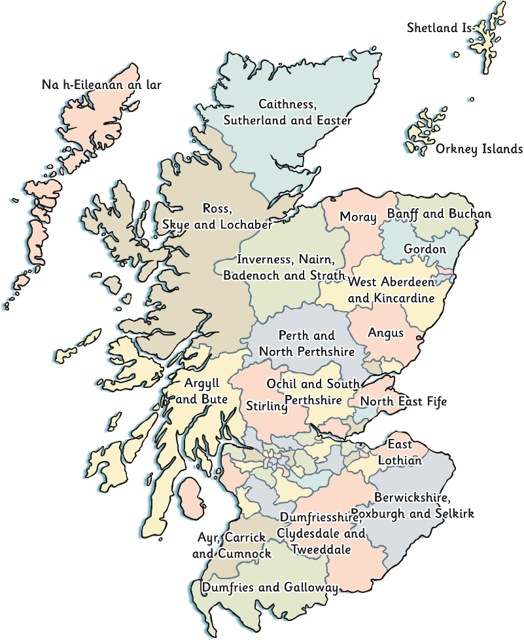
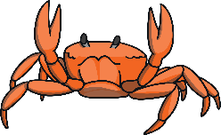
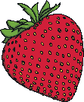
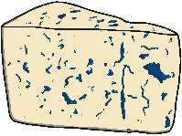
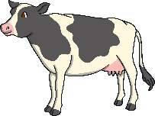
Shellfish
Shetland, Orkney, the Hebrides and the
South East coast
Whisky
Speyside, Highland, Islay, Campbeltown and
Lowlands (South Scotland).
Salmon
Tay, the Dee and the Spey. Orkney and Shetland islands.
Deer
Highlands
Strawberries and Raspberries
Perthshire and Angus.
Cheese
Lockerbie, Stranraer and Campbeltown areas and on the Bute, Arran, Islay, Mull,
Gigha and Orkney islands.
Cows and Sheep
All over Scotland.
Potatoes
Ayrshire

