Slide 1



Fenwick Primary
EAC Clean Green Award

Slide 2
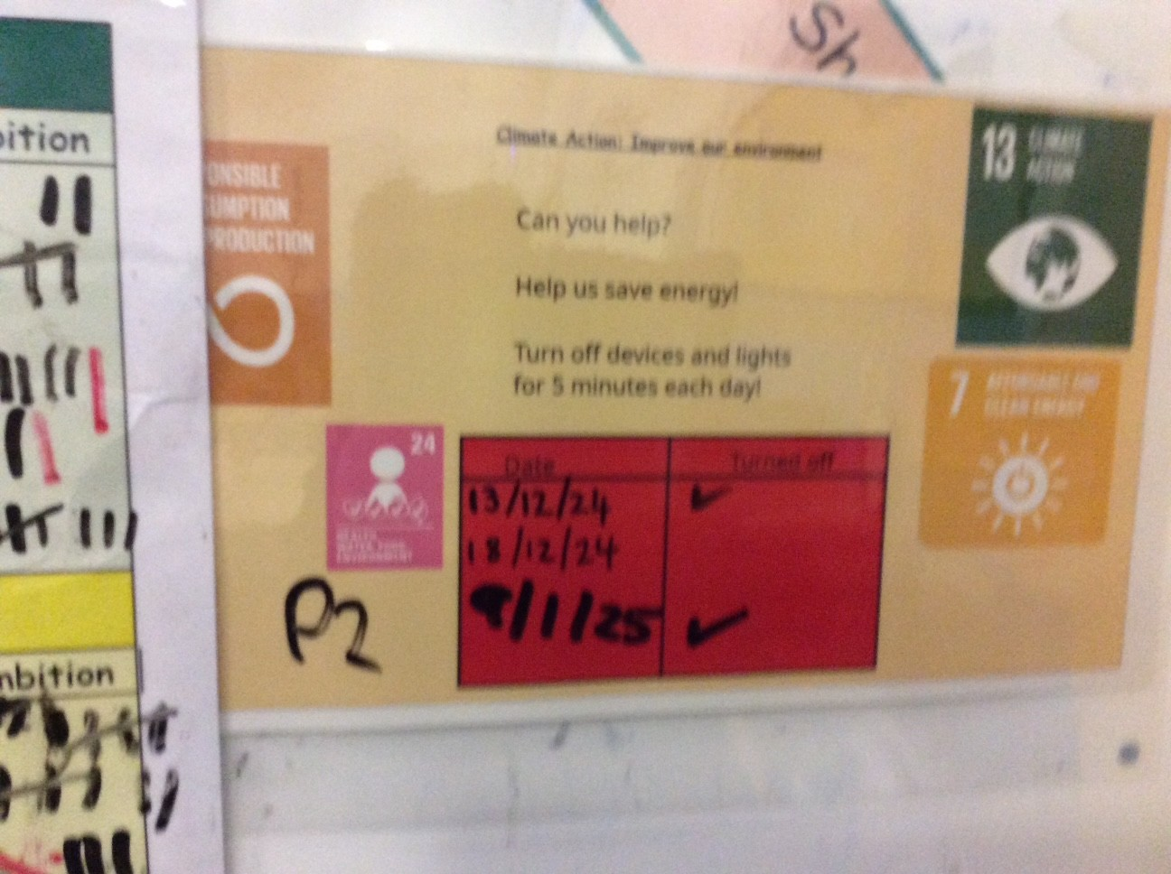
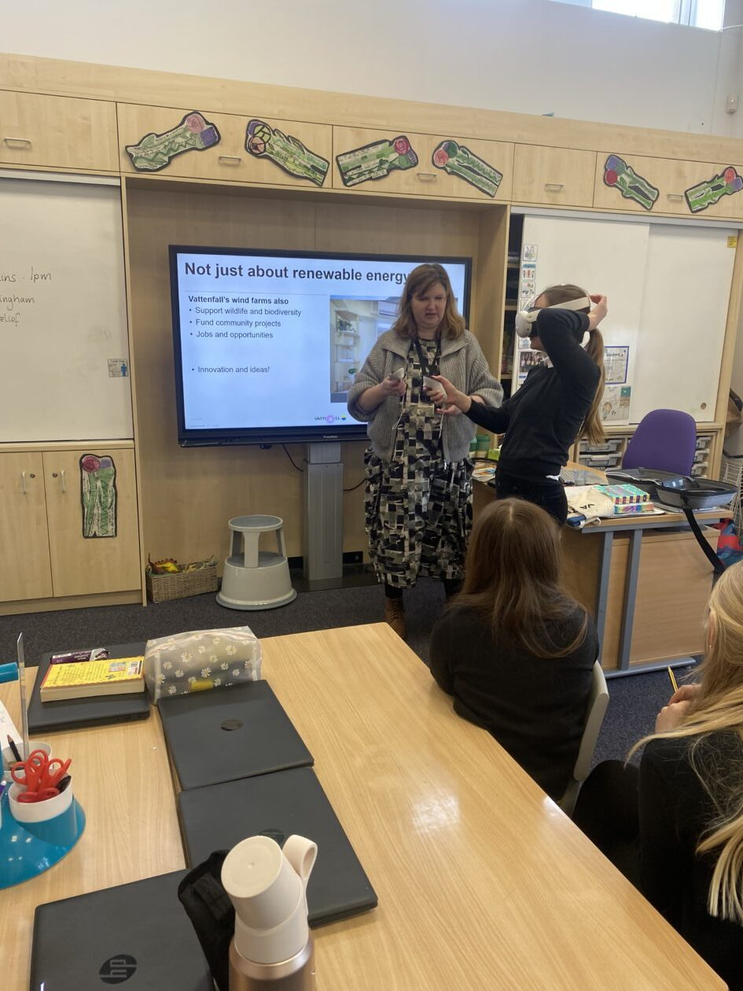
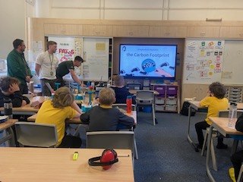
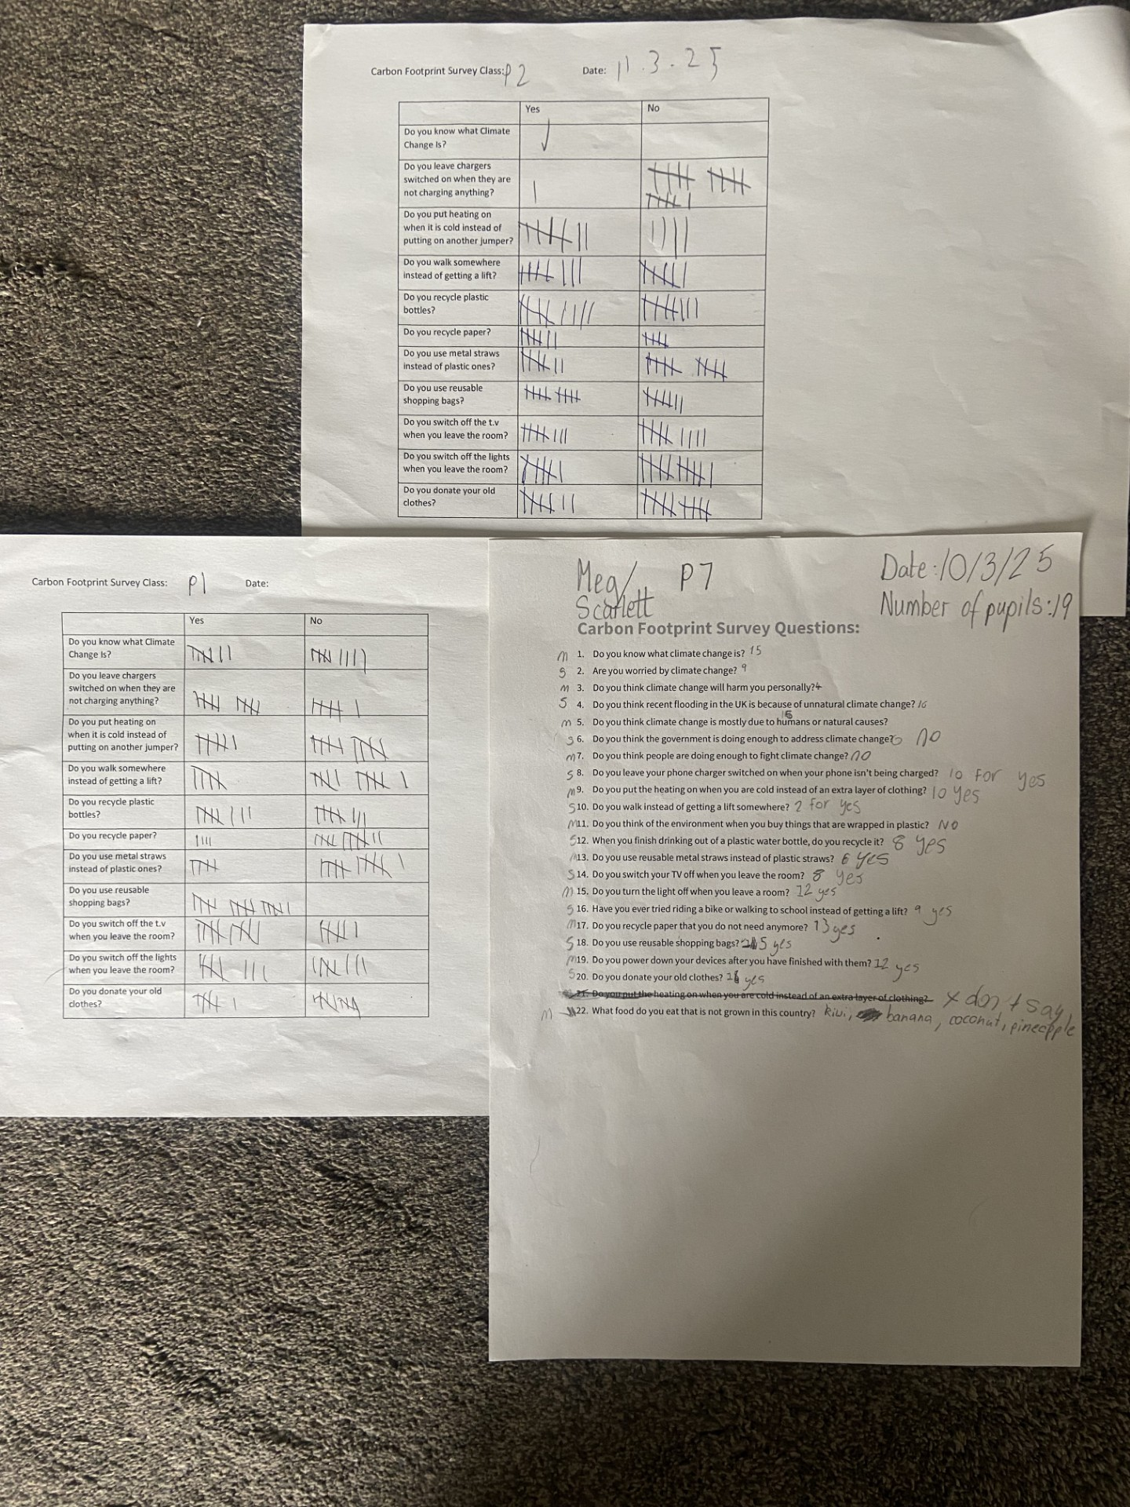
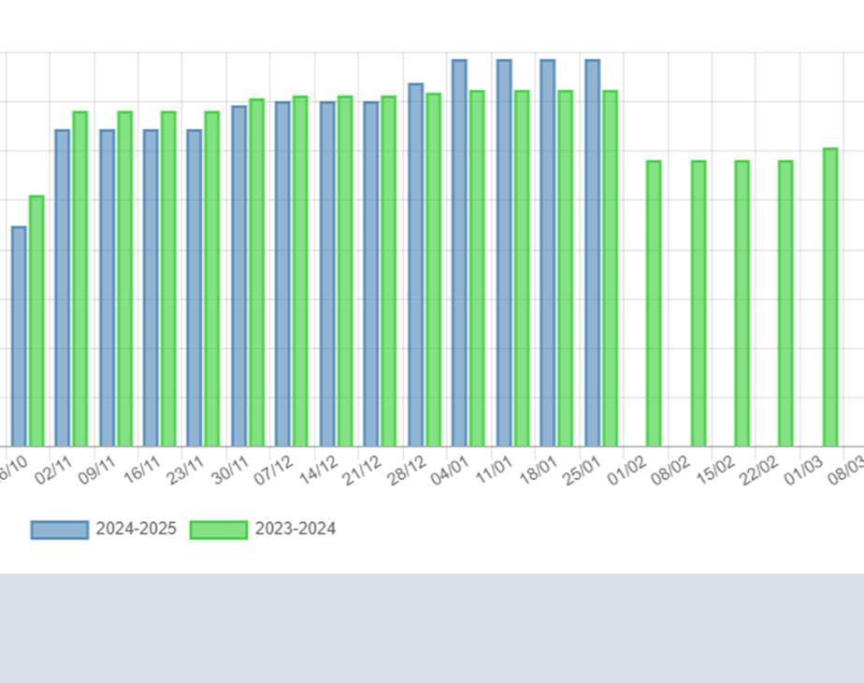
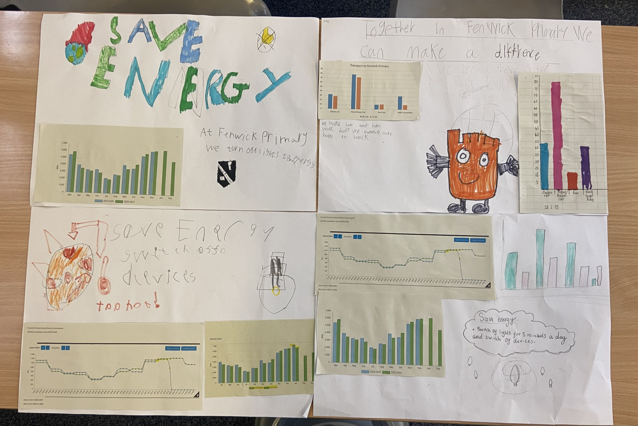
We encouraged switching off lights for 5 minutes a day and we asked EAC for electricity readings so that we could review the impact of this. We completed a carbon footprint survey with classes and took part in Power Down Too and Stat Wars to analyse the data collated. Vattenfall and Scottish Power visited to talk about Climate Change and Renewable Energy.

Slide 3
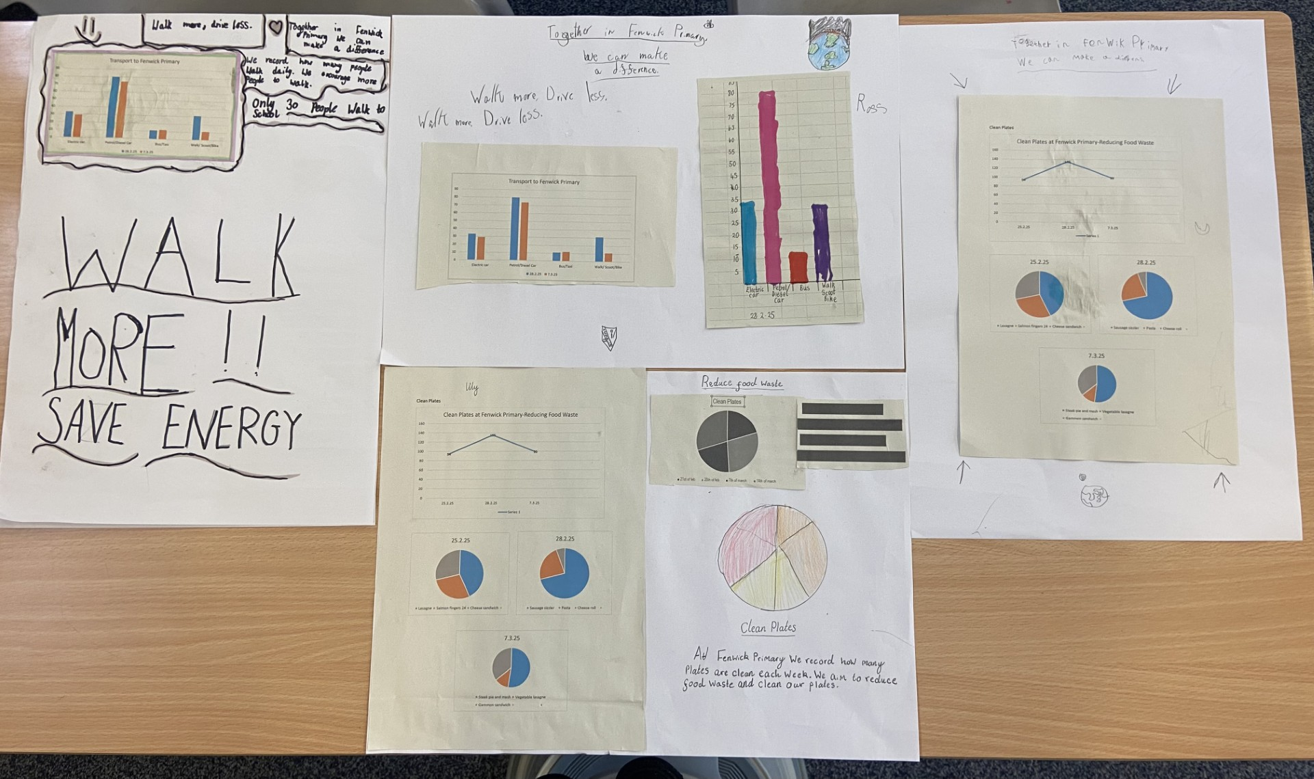
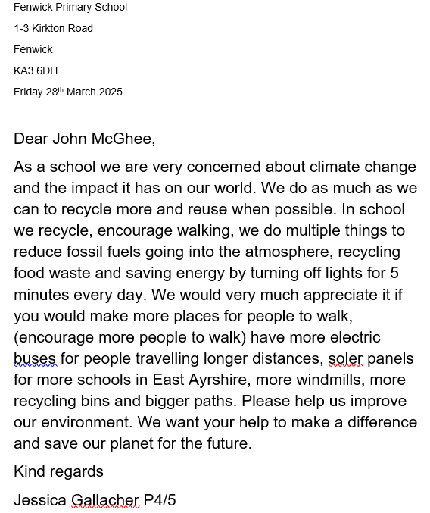
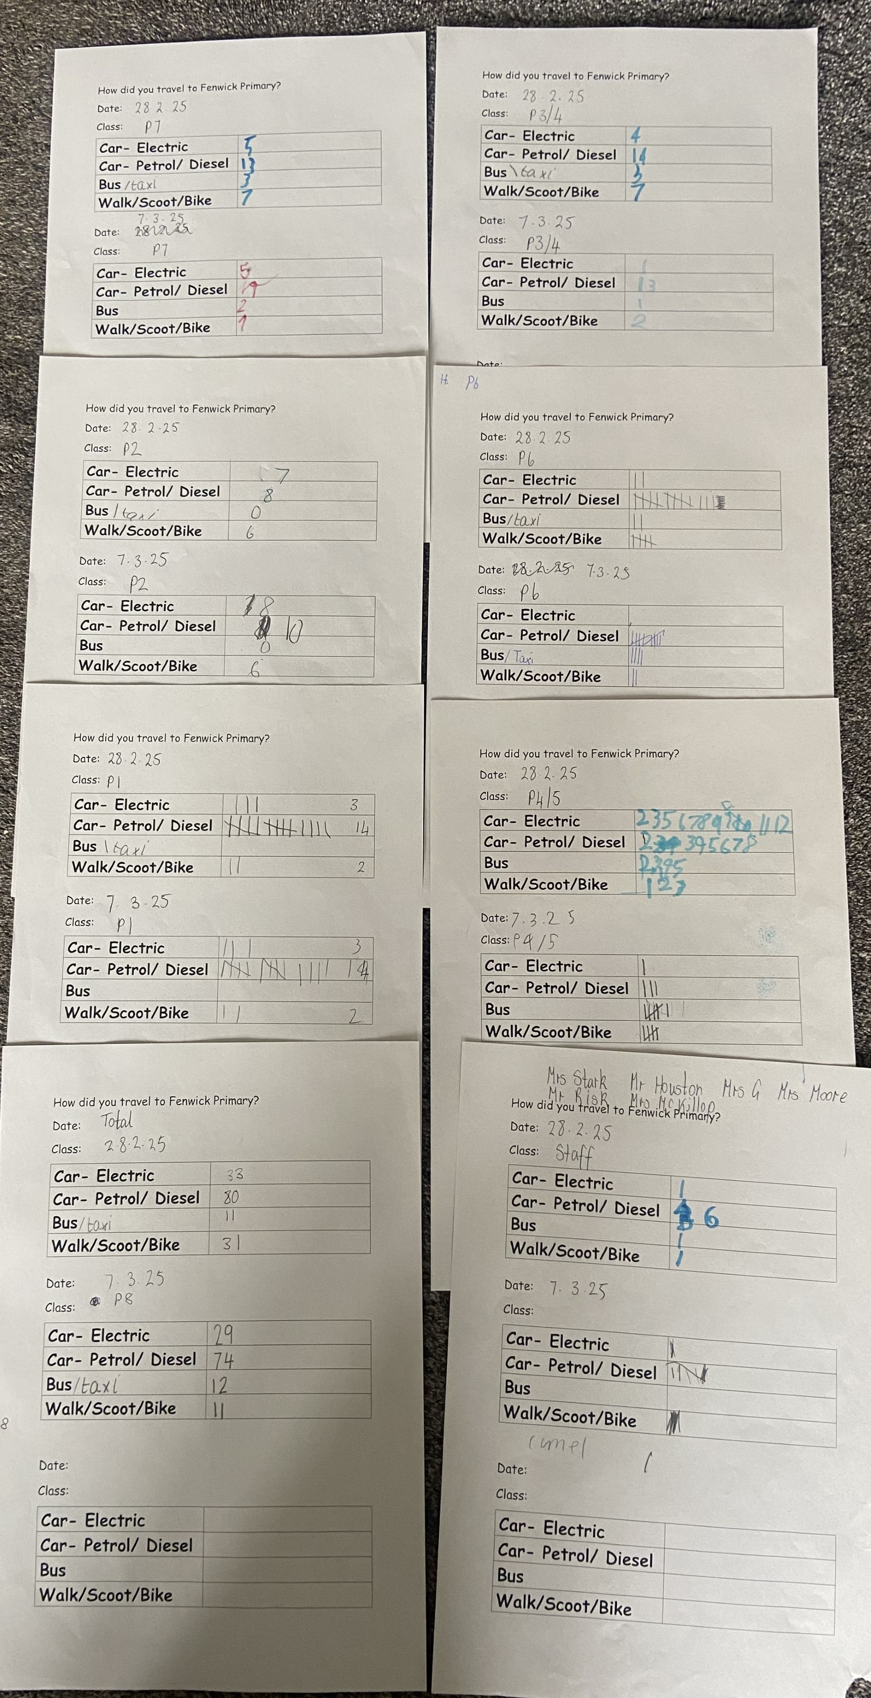
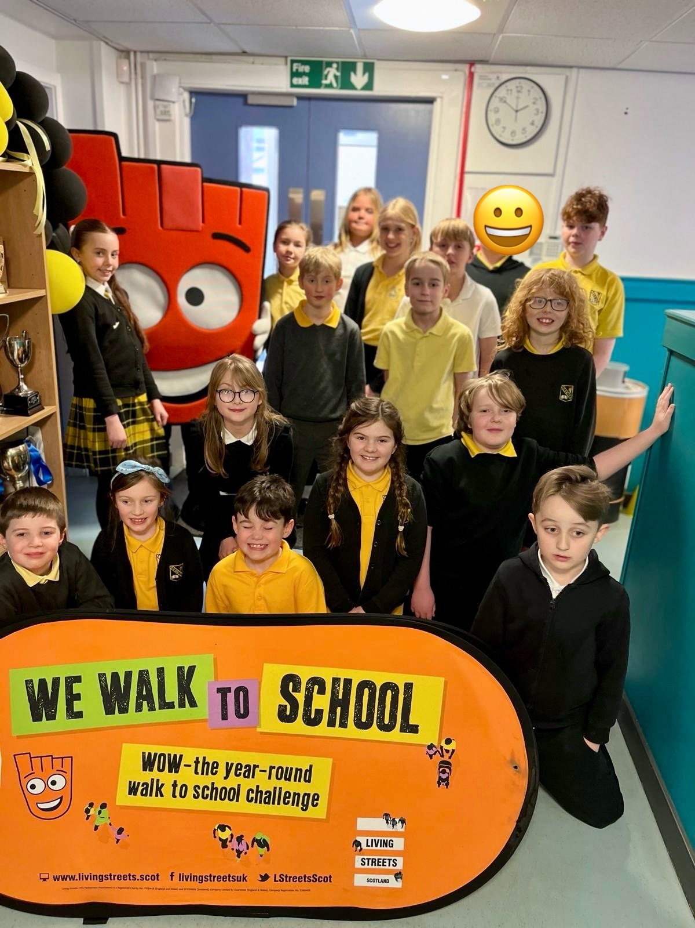

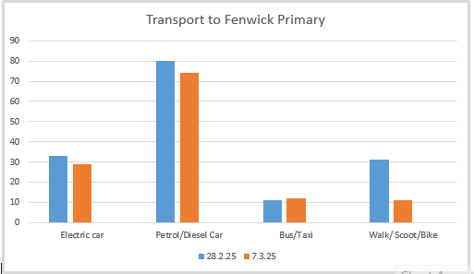
As a school and ECC we participated in Shoot to Saturn, Living Streets Walk to School and Sustran's Big Walk to promote and encourage walking and reducing our carbon footprint. We collected and shared the data. We wrote letters to local councillors to ask for more walking areas and electric buses. We had a visit from Strider the WOW mascot and took part in the design a badge competition.

Slide 4
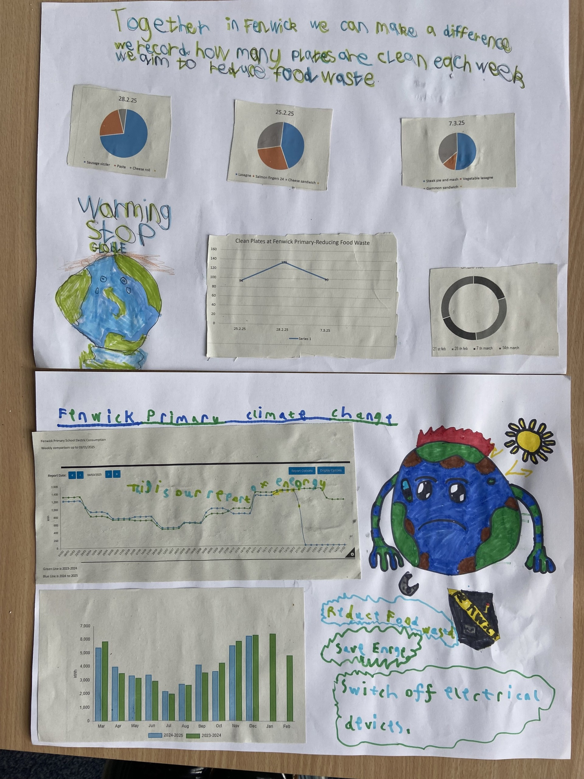
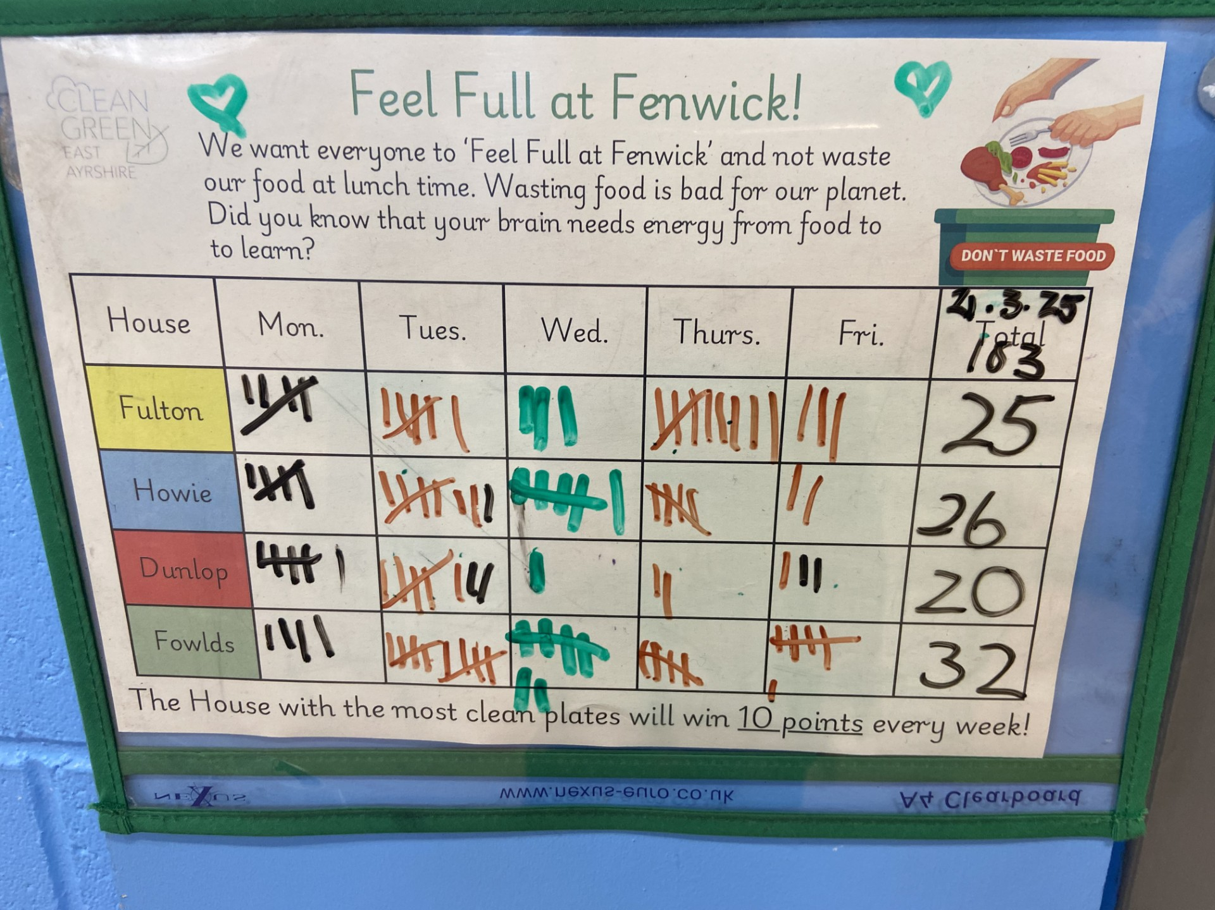
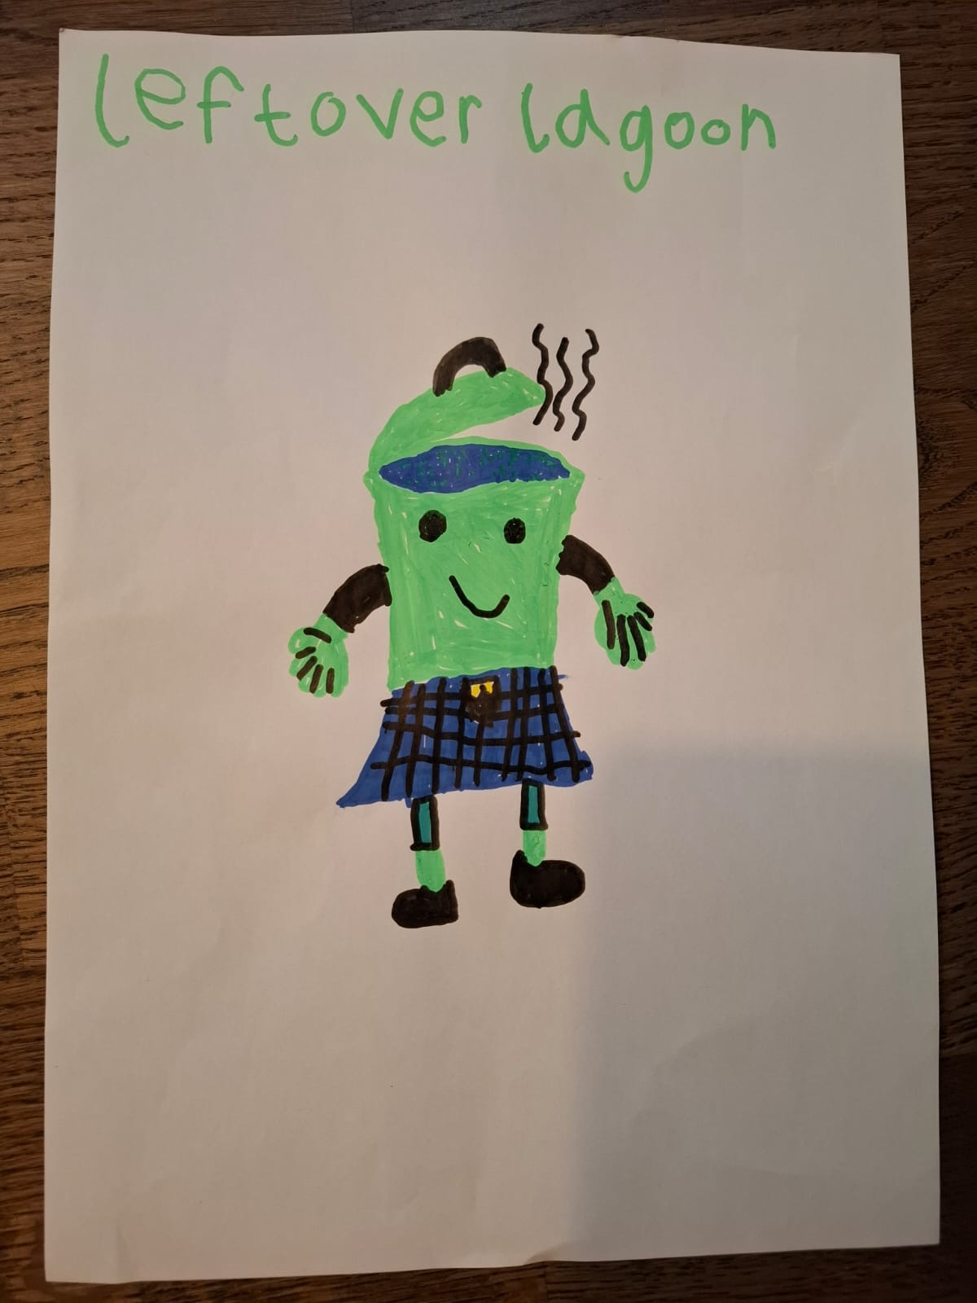
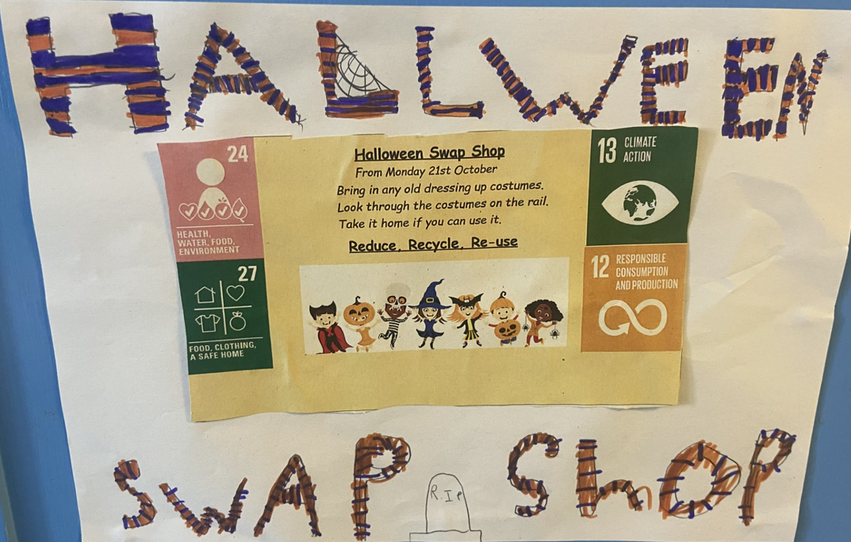
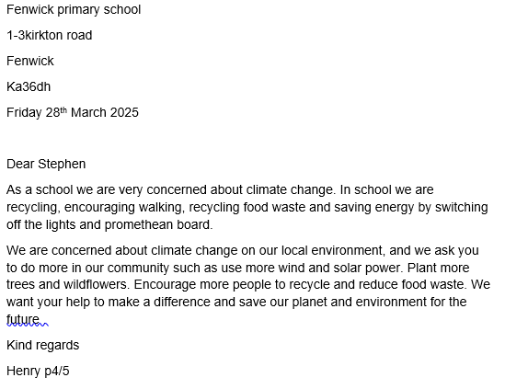
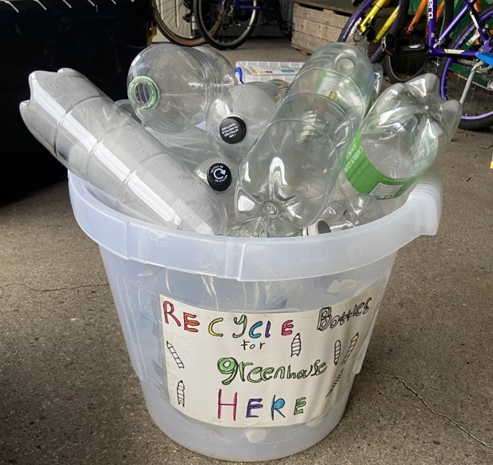
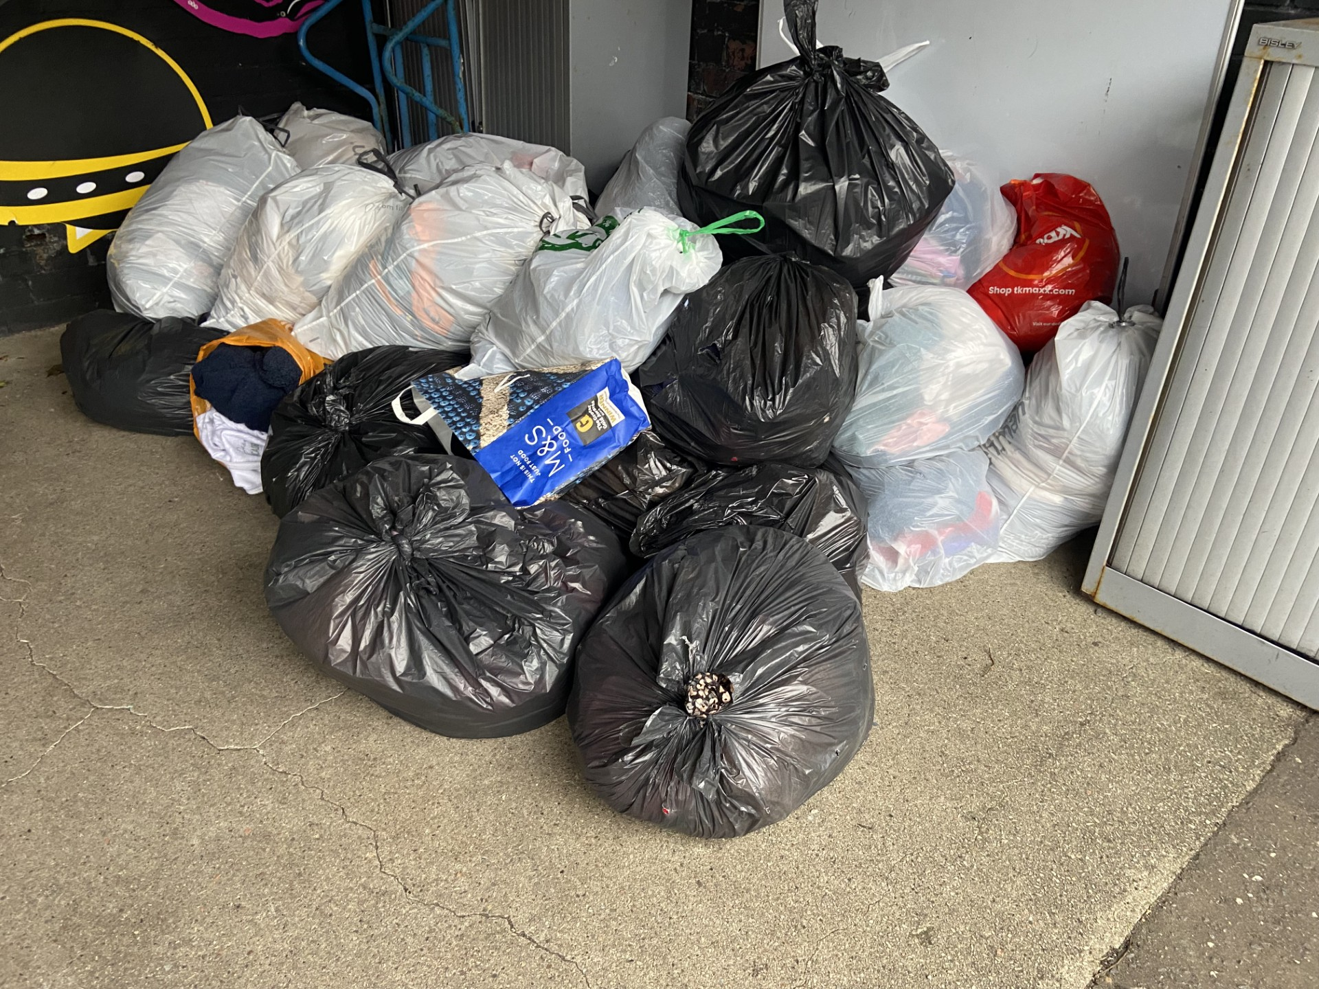
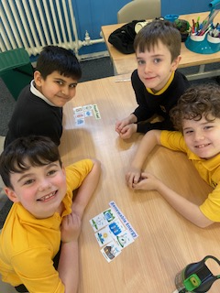

Slide 5
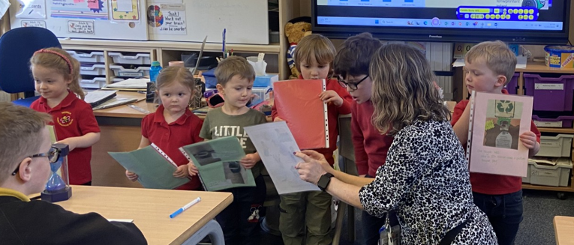
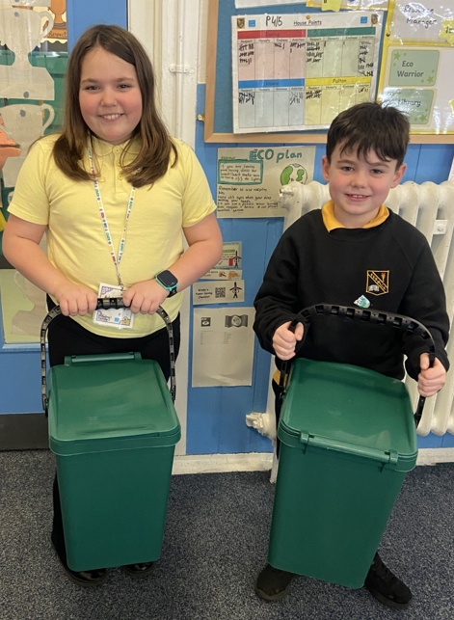
Reducing waste at Fenwick Primary
To reduce waste at Fenwick we recycle paper, plastic and food. We have built a greenhouse from recycled bottles and the ECC came to visit each class to tell us about recycling. We also had visits from the Community Waste Officers to tell us how and what we can recycle. We participated in 'Dinnae forget your caddy' and encouraged families and the local community to become involved. We shared what we are doing in school in the local community magazine. Pupils are encouraged not to waste food at lunchtime through our school 'Clean Plates' display and reward of house points for the most clean plates. Primary 7 House and Vice captains empty recycling bins weekly. We encouraged families to swap old clothes for new at Halloween and Christmas. We participated in the Rag Bag collection. We also have a school uniform rail parents can select from at any time of the year and parents, staff and pupils were all encouraged to swap books on World Book Day but also from libraries set up by Reading Schools Committee that can be used throughout the year.

Slide 6
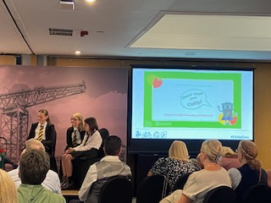
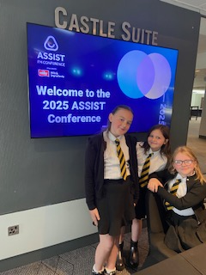
ASSIST conference : Reducing Food Waste
Primary 4/5 created presentations about what we do to reduce Food Waste in Fenwick Primary.
Jessica, Ilaria, Lily presented at the ASSIST conference in Glasgow to 32 local authorities.

Slide 7
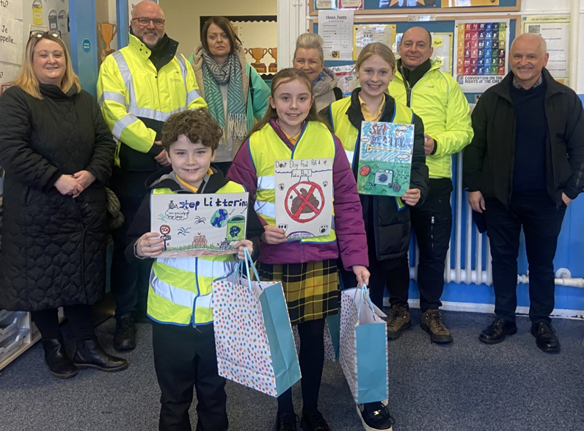
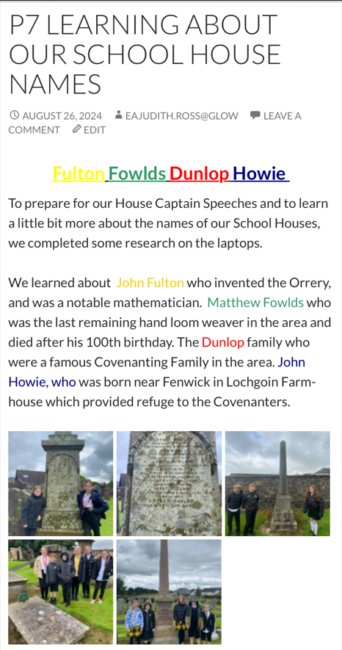
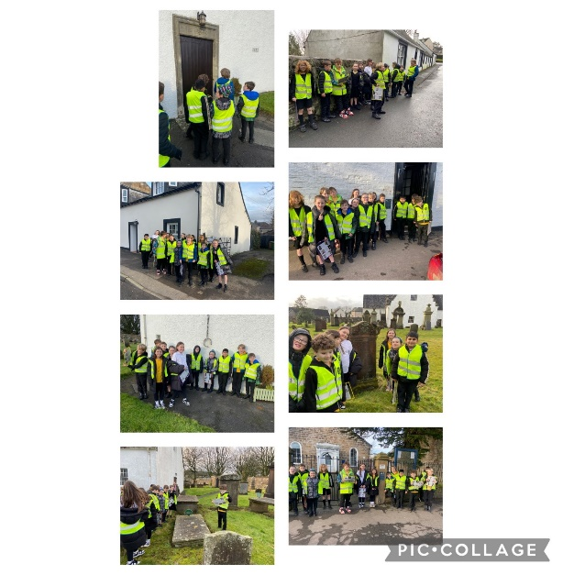
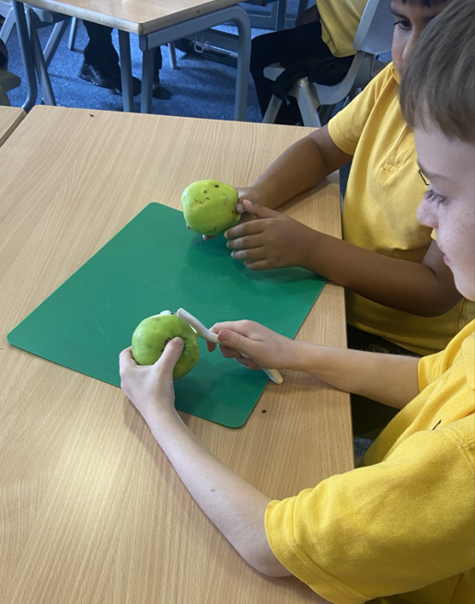
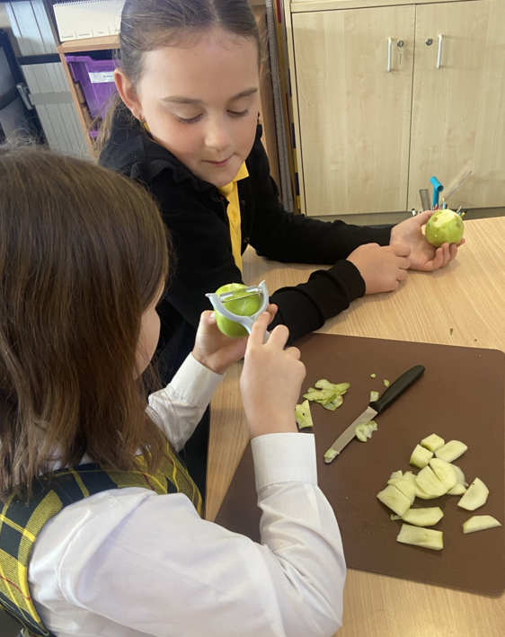
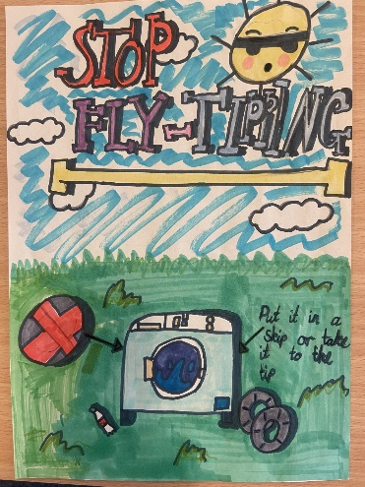
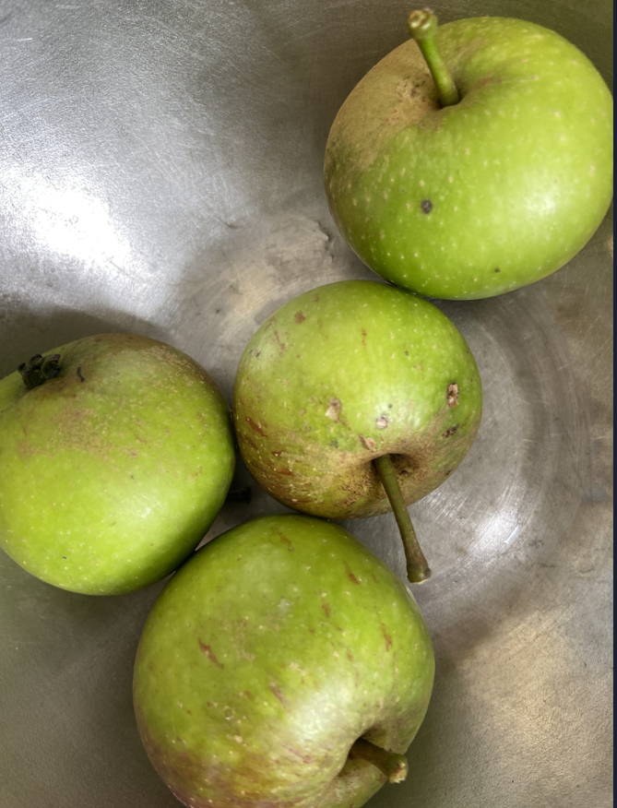
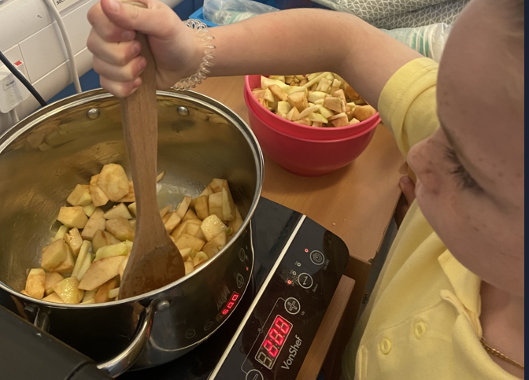
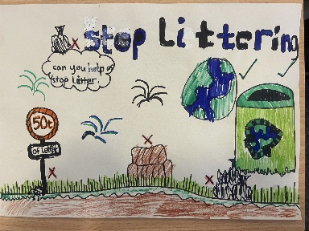
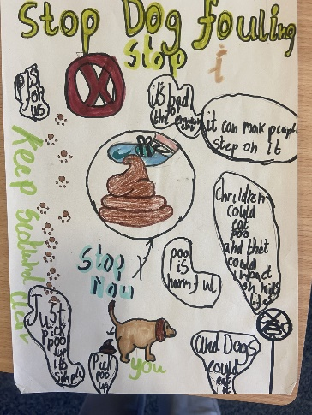
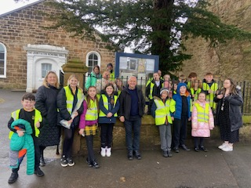
Primary 7 and P4/5 found out about Fenwick’s local heritage. This was shared as part of Fenwick’s celebration of 150 years! The local community was invited into the school to share and learn about the schools history. The Eco committee had a competition to design posters for the community and the Parent Council, Local Councillor, EAC Environmental Officers and Community Council helped the pupils display their posters in the community. P4/5 used apples and carrots from the garden to make some delicious food! We are participating in Nurture Nature EAC initiative to learn about and use our local environment.

Slide 8
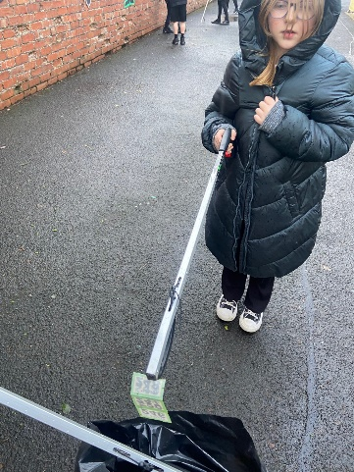
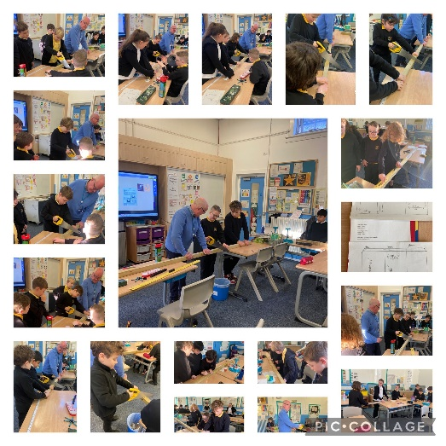
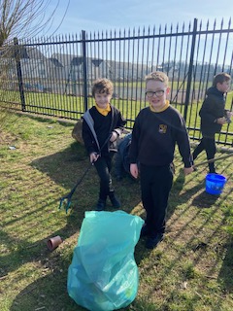
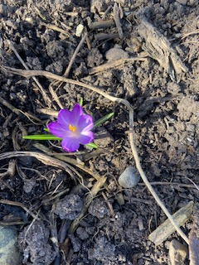
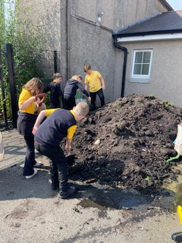
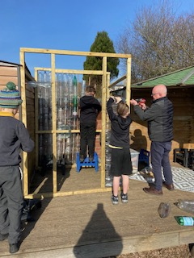
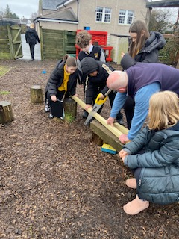
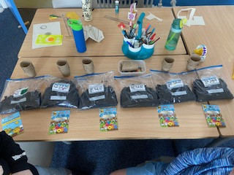
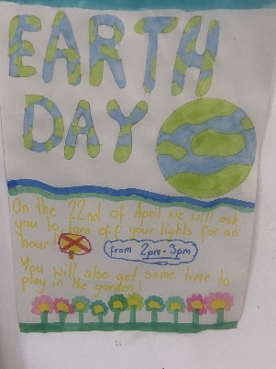
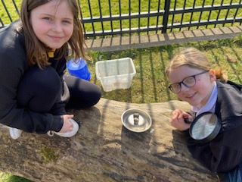
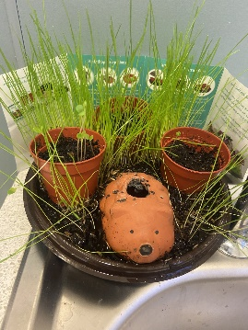
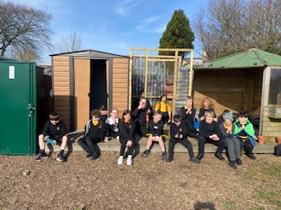
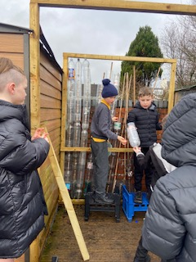
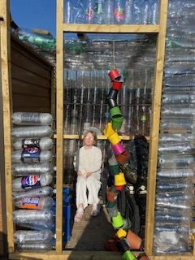
We regularly went litter picking in the school and the community. Parents built 2 new raised beds in the garden which they also helped us fill with compost. We then planted over 100 bulbs in the garden. We worked with a STEM ambassador to build a greenhouse of recycled bottles which were donated from parents and residents at Aidans Brae Residential housing. We gave each class seeds to plant on World Earth Day and switched off power for an hour. We built homes for animals and created a reading space in the garden. The ranger from Dean Castle Country Park came to talk to us about local wildlife.

Slide 9
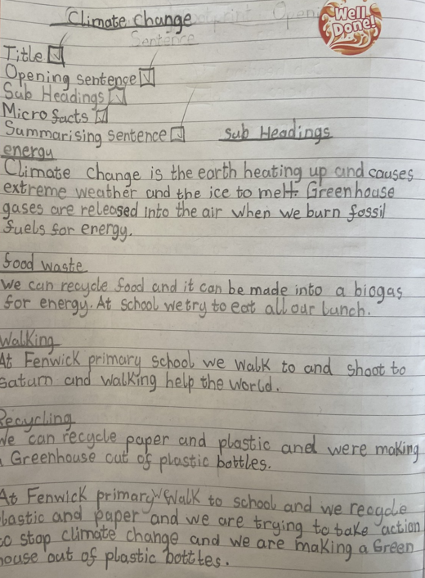
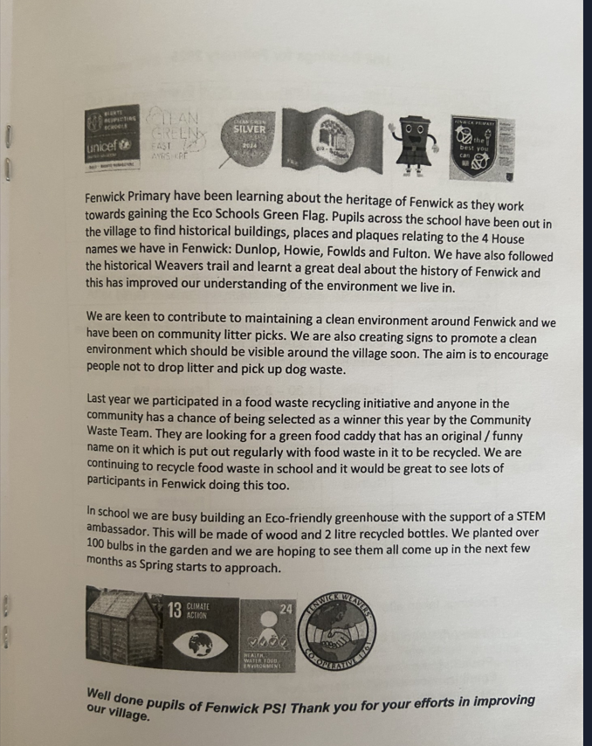





Pupils wrote reports on Climate Change and prepared, presented and evaluated Climate Change lessons that they delivered to classes. We shared regular updates on our Eco Journey with the local community magazine, ‘The Covenanter.’ Pupils also wrote letters to local MP’s.

Slide 10



Climate Manifesto
At Fenwick Primary we are committed making a difference to Climate Change by taking Climate Action

