Slide 1


Gold Action Plan
scottishbooktrust.com

Slide 2




‘Reading Schools’ is about reading for pleasure. What is that?
Reading what you enjoy​
Listening to stories​
Trying different types of stories​
Talking about books with your friends and teachers to find new ones you might like​
Looking at books to find out about new things

Slide 3

Reading Schools Leaders
Create a group ​
Create a group that will work well in your school for pupils and teachers, but also think about inviting other staff and anyone who loves books​
Always include the school librarian if you have one​
Make sure lots of different classes are represented​
Gold schools should ask members of the community to join the group
Choose your own activities ​
Choose the items you would like to focus on from the following slides​
Ask your teacher to send your choices to Reading Schools

Slide 4
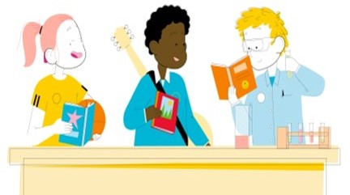
Reading Schools Leaders part two
Progress​
Meet regularly to check on your progress and make new plans​
Take photos and collect quotes from classmates, teachers and parents that show what you are doing for each item​
Your teacher will send all this to Reading Schools
Remember your teacher also needs to fill in their Reading Schools action plan.
Notes:
Framework Key Area 1.2.1
The leadership group must:
Include learners and the school librarian, if the school has one. It can also include teachers, support staff and Senior Management Team
Meet regularly to discuss and implement plans

Slide 5

Useful surveys, posters, badges and signs
Have a look at our websites. You can download printable resources for your school or use them as inspiration to create your own surveys, posters, badges and signs.​
Reading Schools website resources – you can filter our resources section by selecting Type: ‘posters and print outs’ to find certificates, door signs, badges, readers notes, library posters and more.​​

Slide 6

Creating your Action Plan​
The following slides will guide you through creating your plans. ​
You will need to choose actions from each section and make plans​.
Some sections have two slides, core and silver. Instructions on each slide will help you select, depending on whether you have already received your core award.​
For Gold you should be thinking about things you can do in your local community.
(Teachers and Librarians – the framework notes are in the slide notes to help you transfer into the online portal.​)

Slide 7


Being a good role model (Core activity​)
For your core award, you chose at least one of these activities for you and your classmates to do. Can you remember which? You should plan to carry on with these.
If you are going straight to gold award, please select at least one to start doing. You can also add your own ideas.
Wear 'ask me what I'm reading' badges
Talk about books at an assembly
Recommend your favourite books to other pupils – you could use videos, bookmarks, signs, shelf-labels, etc
Make ‘favourite books' lists so teachers know what you like to read
Your teachers will also choose ways to do this themselves​.
Notes:
Framework Key Area 1.2.2
Learners should act as reading role models in one of the below ways, or in another way that suits their setting:
Wearing ‘Ask me what I’m reading’ badges / lanyards
Talking about reading materials they’ve read in assembly / at whole-school occasions
Creating learner-led recommendation lists for display
Making learner-led shelf labels or signs
Putting recommendation notes / bookmarks in reading materials
Making recommendation videos
Making book trailers / vlogs
Making learner-led reading materials lists for staff

Slide 8

Being a good role model (Silver activity​)
For your silver award, you chose at least one of these activities for you and your classmates to do. Can you remember which? You should plan to carry on with these.
If you are going straight to gold award, please select at least one to start doing. You can also add your own ideas.
Take part in a paired or 'buddy' reading project
Lead a reading club ​
Share storytelling videos/activities with reading buddies
Help support those who would like help with reading activities
Notes:
Framework Key Area 1.2.2 (Silver)
Sustain Core activity and:
Learners should support one another in more formal ways in one of the below ways, or in another way that suits their setting:
Taking part in a paired reading project
Acting as reading mentors
Sharing storytelling videos / activities with reading buddies
Leading a reading club

Slide 9
Being a good role model (Gold activity​)
Choose and tick one of these activities to complete or use your own ideas.
Being 'Book Doctors' and prescribing recommendations
A reading flash mob
Writing about books in local newspapers or radio
Making podcasts or videos to share in your community
Making book displays in spaces in your local community
Notes:
Framework Key Area 1.2.2 (Gold)
Sustain Core and Silver activity and:
Learners should act as reading role models through interactions with members of the wider community in one of the below ways, or in another way that suits their setting:
Being Book Doctors and giving out 'prescriptions’
Participating in a reading flash mob
Communicating through community media, e.g., local newspaper, radio etc.
Creating reading podcasts / videos to share with the community via social media
Displaying reading materials they are currently reading / would recommend in their windows

Slide 10

Authors, illustrators, storytellers
Choose and tick one of these activities to complete or use your own ideas.
Watch an Authors Live in class
Arrange an author visit or residency
Arrange online book chat with book creators
Arrange to take part in online book festivals or events
Apply to take part in the Scottish Friendly Children’s Book Tour (in school or online)
Notes:
Framework Key Area 2.3.5
Schools should give all learners the opportunity to engage with authors (writers, illustrators or storytellers) in one of the below ways, or in another way that suits their setting:
Watching Authors Live (Live or On Demand)
Arranging an author visit or residency
Attending / taking part in an online book festival or other book-related event
Hosting / watching online Scottish Friendly Children's Book Tour events
Taking part in an online book chat with an author / illustrator or storyteller

Slide 11

Your school (Core activity)
For your core award, you chose at least one of these activities for you and your classmates to do. Can you remember which? You should plan to carry on with these.
If you are going straight to gold award, please select at least one to start doing. You can also add your own ideas.
Create relaxing reading areas around the school in corridors or library areas
Create classroom book corners or reading areas
Display new book suggestions
Create book-themed displays about the power of reading
Notes:
Framework Key Area 1.3.2
Schools should provide appealing and relaxing reading areas in collaboration with learners, and use displays to promote reading in one of the below ways, or in another way that suits their setting:
Having appealing reading areas throughout the school, e.g. in shared spaces / corridors / within your school library area
Creating classroom book corners / reading areas designed by learners (possibly as part of an enterprise project)
Providing learners with cushions / encouraging them to turn over their chairs and relax when they're reading
Creating themed book displays
Displaying new book suggestions, e.g. 'Hot Books' / 'Bookflix'
Having displays about the power of reading

Slide 12
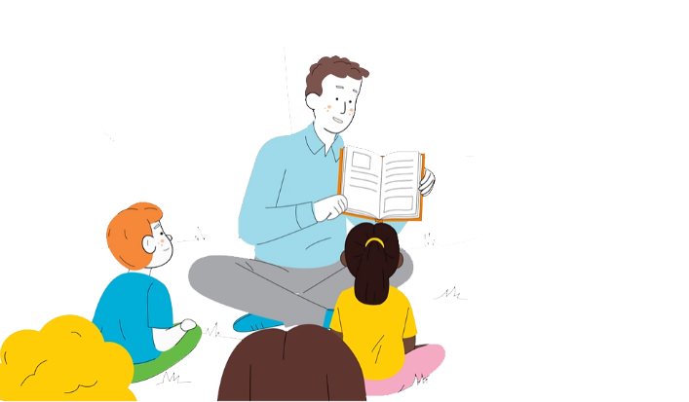
Your school (Silver activity)
For your silver award, you chose at least one of these activities for you and your classmates to do. Can you remember which? You should plan to carry on with these.
If you are going straight to gold award, please select at least one to start doing. You can also add your own ideas.
Hold outdoor reading sessions
Create a playground library
Provide outdoor reading spaces e g. reading benches/chairs.
Include reading time at breakfast clubs or afterschool clubs
Include reading in school events, e.g. Cultural celebrations like Christmas or Eid
Notes:
Framework Key Area 1.3.2 (Silver)
Sustain Core activity and:
Schools should create opportunities for learners to read outside the classroom in one of the below ways, or in another way that suits their setting:
Having reading sessions outdoors
Having reading spaces in the playground, e.g. a reading bench or storytelling chair
Having a playground library
Incorporating reading into breakfast clubs / after-school clubs
Incorporating reading into school events and celebrations

Slide 13

Your school (Gold activity)
Choose and tick one of these one of these activities to complete or use your own
ideas.
Create displays to celebrate reading in community spaces
Start a Book Fairy Trail project
Create a book trail in your city, village or town
Create a community reading area, e.g. bench or garden
Notes:
Framework Key Area 1.3.2 (Gold)
Sustain Core and Silver activity and:
Schools should make reading visible in their community in one of the below ways, or in another way that suits their setting:
Creating displays in community spaces
Introducing a Book Fairies project
Creating book 'pavement quotes' or window signs
Introducing a community Book Trail
Creating a community reading area, e.g., a reading bench or garden

Slide 14

A good book (Core / Silver activity)
For your core award, you made plans for all four of these activities. Can you remember what you did? If you are going straight to gold award you need to make plans for all of them now. You can also add your own ideas.
Talk to your local or school library to see what you could do together
Help choose the books for your school
Change the books regularly in the class and school libraries
Encourage each other to try different types of books
For Silver you need to also make sure all pupils are given the chance to join the local library.
Notes:
Framework Key Area 1.5.1 (Core)
Schools should make sure that learners have access to contemporary and diverse reading materials relevant to their needs, interests and experiences by completing the below four mandatory actions:
Providing learners with access to a school or public library – this could take the form of class / group book boxes or a 'personal shopping experience' using library catalogues
Involving learners in the auditing and selection of books and other reading materials
Regularly updating reading materials to ensure they are contemporary, diverse and relevant to the needs, interests, languages, cultural identity and experiences of learners
Encouraging learners to broaden their reading experience through a wide variety of genres (you could use Bookzilla App on iPads)
For silver, schools should extend access to contemporary reading materials by completing the below mandatory action:
Providing all learners with the opportunity to join the local public library for access to books, other reading materials, eBooks and audiobooks

Slide 15

Everyone read
For your core and silver awards, you chose at least one of these activities for you and your classmates to do. Can you remember which? You should plan to carry on with these.
If you are going straight to gold award, please select at least one to start doing. You can also add your own ideas.
Regular reading time in class and as part of home learning
Regular reading for whole school (e.g. DEAR – Drop Everything and Read)
Your teachers will regularly read aloud in class and for silver and gold accreditation you should also invite special guests to read. Maybe you could ask the local vet to read you a story about animals, or the P.E. teacher to read a story about football. Who will you invite?
Notes:
Framework Key Area 2.2.1
Schools should ensure that all learners have regular time to read texts of their own choosing in one of the below ways, or in another way that suits their setting:
Having regular reading at registration / transition times / other times as appropriate
Holding spontaneous DEAR time (Drop Everything and Read)
Including reading for pleasure time in home learning
Key Area 2.3.1
Core - At primary level schools should complete the below mandatory action:
Class teachers to be routinely reading aloud to their class
Silver - Primary only – we expect schools to be inviting members of the community in to read, e.g., mystery readers, public library staff, sportspeople, local figures, other role models etc.

Slide 16
Talk about books (Core activity)
For your core award, you chose at least one of these activities for you and your classmates to do. Can you remember which? You should plan to carry on with these.
If you are going straight to gold award, please select at least one to start doing. You can also add your own ideas.
Make time in class to talk to your teacher about books and ask for help finding new books
Make time in class to chat with each other about books
Try book speed dating
Try book jenga
Notes:
Framework Key Area 2.3.2
Staff should ensure they know about learners' interests and have regular conversations with them about their personal reading in one of the below ways, or in another way that suits their setting:
Chatting with individual learners during whole-class reading time / other times as appropriate
Supporting individual learners with strategies for choosing reading material they might like during library periods
Providing regular reading recommendations for individual learners in line with their interests
Framework Key Area 2.3.3
Schools should allocate time for all learners to chat about books with each other in one of the below ways, or in another way that suits their setting:
Having a set time for peer discussion following ERIC time / other times as appropriate
Introducing book speed-dating
Playing Book Jenga to spark conversations around books
Pairing up learners to chat about what they are currently reading – this could include famous character duo cards to randomise pairings

Slide 17
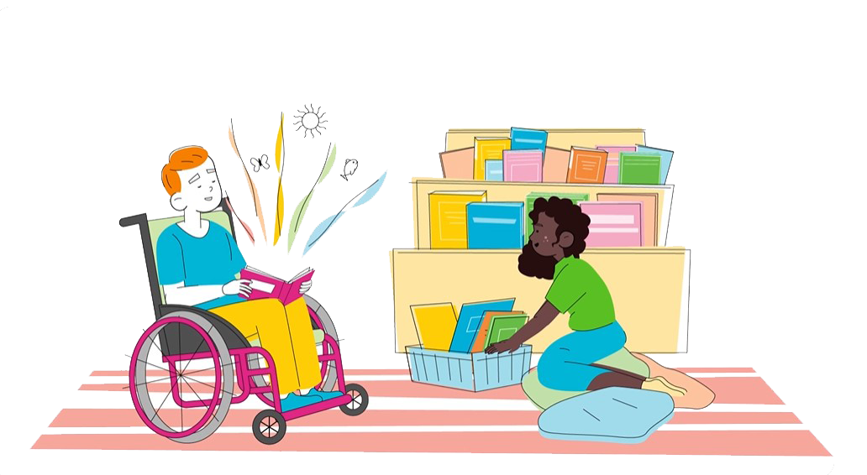
Talk about books (Silver activity)
For your silver award, you chose at least one of these activities for you and your classmates to do. Can you remember which? You should plan to carry on with these.
If you are going straight to gold award, please select at least one to start doing. You can also add your own ideas.
Set up a book club
Hold a regular reading café
In a larger school, organise book clubs about particular topics (e.g. Non-fiction, non-English language, Sci-Fi). You could go online and work with another school
Notes:
Framework Key Area 2.3.3 (Silver)
Sustain Core activity and:
Schools should give learner social networks more formal structures in one of the below ways, or in another way that suits their setting:
Offering interest-based clubs or groups during break times / free lessons / breakfast or after school clubs, e.g. reluctant readers, manga group, ASN, poetry groups, non-fiction, Sci-Fi, EAL etc.
Holding regular reading networking events for learners, e.g., a reading café or reading quiz
Hosting online book club sessions – these could include learners from other schools
Providing book club boxes for learners to take home, including a shared notebook for comments / questions

Slide 18


Books as inspiration (Core /Silver activity)
For your core and silver award, you chose at least one of these activities for
you and your classmates. Can you remember which? You should plan to carry
on with these.
If you are going straight to gold award, please select at least one or add your
own ideas.
Create blogs, vlogs or book trailers
Write book reviews for school newspaper or website
Create a dance / music / creative writing / art / drama piece based on a book or books
Create an enterprise project, e.g. create a cookery book themed around one of your favourite books
Your teachers will also tell you about a bigger project you will do with your classes this year.
Notes:
Framework Key Area 2.3.4
Schools should allow all learners to respond to what they’re reading in a variety of engaging ways that best suit their needs in one of the below ways, or in another way that suits their setting:
Reading journal / drawing
Blog / vlog / book trailer
Social media post
Book review / recommendation for school newspaper / website
Creative writing piece
Use of expressive arts, e.g. drama, music, dance etc.
Enterprise project, e.g. creating a school recipe book based on favourite books

Slide 19

At home (Core activity)
For your core award, you made plans for all three of these activities. Can you remember what you did? You should plan to carry on with these.
If you are going straight to silver award you need to make plans for all of them now. You can also add your own ideas.
Ask about taking books home to read or encourage families to join the local library
Share what fun reading activities are happening in school
Organise a book gifting event in school for Bookbug and Read, Write, Count bags (P1–3)
Notes:
Framework Key Area 2.5.1
Schools should engage with learners’ families to promote reading for pleasure by completing the below three mandatory actions:
Providing access to books to take home / encouraging families to join their local library for access to books, ebooks and audiobooks
Communicating with families about the school’s reading projects and signposting to appropriate resources / setting fun reading challenges
Primary only – making the most of the P1 Bookbug Family Bag and Read, Write Count initiatives by sharing resources and encouraging the use of the bags at home.

Slide 20

At home (Silver activity)
For your silver award, you chose at least one of these activities for you and your classmates. Can you remember which? You should plan to carry on with these.
If you are going straight to gold award, please select at least one. You can also add your own ideas.
Hold special events, e.g. an evening reading by the campfire
Involve your families in your reading celebrations
Invite families to take part in online author events, e.g. Authors Live or virtual book festival
Invite families to the book gifting event in school for Bookbug and Read, Write, Count bags (P1–3)
Notes:
Framework Key Area 2.5.1 (Silver)
Sustain Core activity and:
Schools should offer further opportunities to promote reading for pleasure to families in one of the below ways, or in another way that suits their setting:
Holding special events, e.g. an evening reading by the campfire
Involving families in reading celebrations
Inviting families to attend / take part in online author events, e.g. Authors Live or virtual book festival
Primary only – Inviting families into school for P1 Bookbug Family Bag and Read Write Count gifting events.

Slide 21

National events and celebrations
Which events will your school take part in?​ How can you include reading in these and how can you make this fun for everyone?
Book Week Scotland
World Book Day/Night
National Poetry Day
Other local reading events/prizes/festivals​
Notes:
Framework Key Area 1.3.3
Schools should generate excitement around reading by taking part in one of the below initiatives, or in another that suits their setting:
Book Week Scotland
World Book Day / Night
National Poetry Day
Other prizes

Slide 22

Rewards (Core ​activity)
For your core award, you chose at least one of these activities for you and your classmates to do. Can you remember which? You should plan to carry on with these.
If you are going straight to gold award, please select at least one to start doing. You can also add your own ideas.
Use award certificates
Award small prizes like bookmarks and stickers
Award house points
Award a Reader or Reading Class of the Week/Month etc.
Notes:
Framework Key Area 3.2.1
Schools should reward the progress of individual learners in one of the below ways, or in another way that suits their setting:
Presenting certificates
Awarding small prizes such as bookmarks, stickers etc.
Awarding points through the school's individual rewards system
Having class / school awards to recognise effort, eg. 'reader of the week' or 'reader who has made the most recommendations' etc.

Slide 23

Rewards (Silver ​activity)
For your silver award, you chose at least one of these activities for you and your classmates to do. Can you remember which? You should plan to carry on with these.
If you are going straight to gold award, please select at least one to start doing. You can also add your own ideas.
Hold a prize-giving assembly
Organise a reading party
Hold a Book Bistro (restaurant) or other reading event
Give books as gifts, e.g. for Christmas​ or birthdays ​
Notes:
Framework Key Area 3.2.1 (Silver)
Sustain Core activity and:
Schools should celebrate reading in wider groups or as a whole-school in one of the below ways, or in another way that suits their setting:
Holding a prize-giving assembly
Having a reading party
Inviting learners to a Book Bistro / other reading event
Gifting books, e.g. for Christmas or birthdays

Slide 24
Rewards (Gold activity)
Choose and tick one of these one of these activities to complete or
use your own ideas.
Invite members of the community to join in your celebrations
Organise a reading party in a community space
Notes:
Framework Key Area 3.2.1 (Gold)
Sustain Core and Silver activity and:
Schools should widen celebrations to include the community in one of the below ways, or in another way that suits their setting:
Inviting members of the community to take part in celebrations in school
Holding an event in a community venue
Holding a joint event with a partner
Celebrating learner achievements in community spaces, e.g., Social media / local paper etc.

Slide 25
Community (Gold activity)
Choose and tick one of these one of these activities to complete or
use your own ideas.
Work with your library or bookshop to create a booky project or event for your community
Work with a local business to encourage customers to read, e.g. 'read while you wait' at the hairdressers or take away
Work with a local charity to bring reading to others, e.g. a local care home
Notes:
Framework Key Area 2.7.1
Schools should build sustainable partnerships within their community, sharing expertise in one of the below ways, or in another way that suits their setting:
Working with the local public library on a joint project, e.g., a community reading club
Partnering with a local bookshop on a joint project, e.g., community reading picnics
Working with a local business to encourage customers to read, e.g., a ‘read while you wait’ initiative at the hairdressers
Partnering with a college / university on a joint project, e.g., a reading outdoors campaign
Working with a third sector organisation on a joint project, e.g., a reading pen-pal initiative with a local care home

Slide 26

What happens next?
Now you have your plan, you can get to work on some of your ideas.​
​
Start by asking around to find out how everyone feels about reading at the moment. You can use these surveys or create your own. You can repeat these later to see how much things have changed! ​
​
Your teacher will send us your plan and we'll let you know what we'd like you to send us to work toward your Reading Schools Silver award. ​
​
Remember to take photos and get quotes from staff and pupils about what you are doing, but most of all, have fun!

Slide 27


Thank you
scottishbooktrust.com
Scottish Book Trust is a national charity changing lives through reading and writing. Registered company SC184248 | Scottish charity SC027669

