Slide 1






Welcome
to P5/6
With
Miss Cunningham

Slide 2



Our School Values
Be the Best You Can Be
Respect
Honesty
Ambition
Kindness

Slide 4


Who helps in our playground and at breaks/lunch hall?
Mrs Moore
Mrs G
Mr Houston
Mrs McKillop
Mr Risk
Teachers
Dinner ladies
Wellbeing Bees
Buddies
House and Vice Captains
Everyone…

Slide 5



School Lunches
You can order lunches online or children can order their lunch in class in the morning.
School Lunches Website

Slide 6
Lunch Rota (September – November)

Slide 7

PE Days
Primary 5/6 PE days are:
Monday and Wednesday
Children should bring their PE kit on these days and a bottle of water.

Slide 8


Music Lessons
Chanter – Tuesday (Mr. Armstrong)
Brass – Friday (Mr. Wylie)

Slide 9

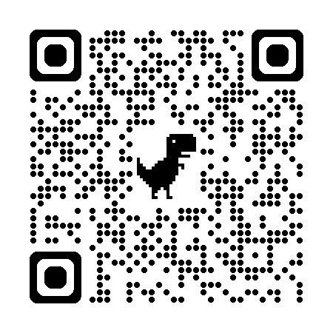

Class Blog
Keep up to date with our learning across the curriculum and achievements by looking at our class blog.

Slide 10

Pupil Committee Groups
Sports Committee – Miss Cunningham and Mrs Ross
Rights Respecting Schools Committee – Miss Caldwell
Digital Schools Committee – Mrs Conetta and Mrs Eccleston

Slide 11
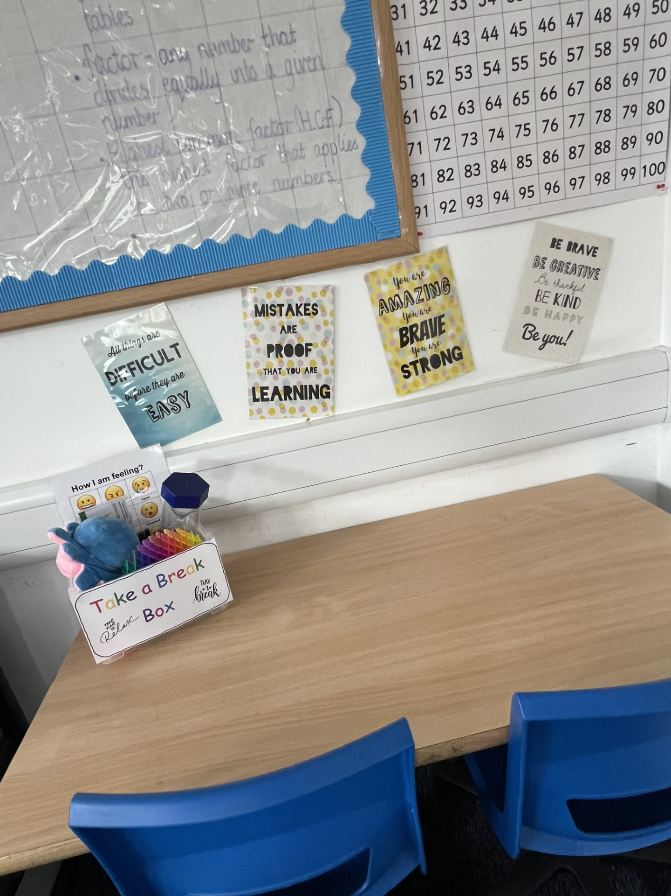
Toys
Please can children keep toys at home. This is to save any toys getting broken or lost.
The classroom has lots of fidget toys within our Calm Corner that children can access.

Slide 12

Movies/Documentaries
As part of our learning, we may watch movies/documentaries rated U and PG which link to what is being taught in class.
During wet break and lunch, the children can watch a short film/episode rated U and PG.
If you wish for your child to not take part in these experiences, please contact the school office.

Slide 13
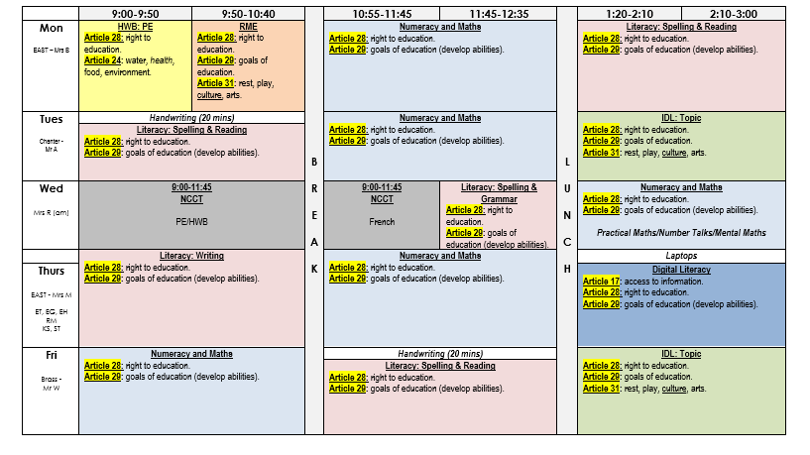
Timetable

Slide 14
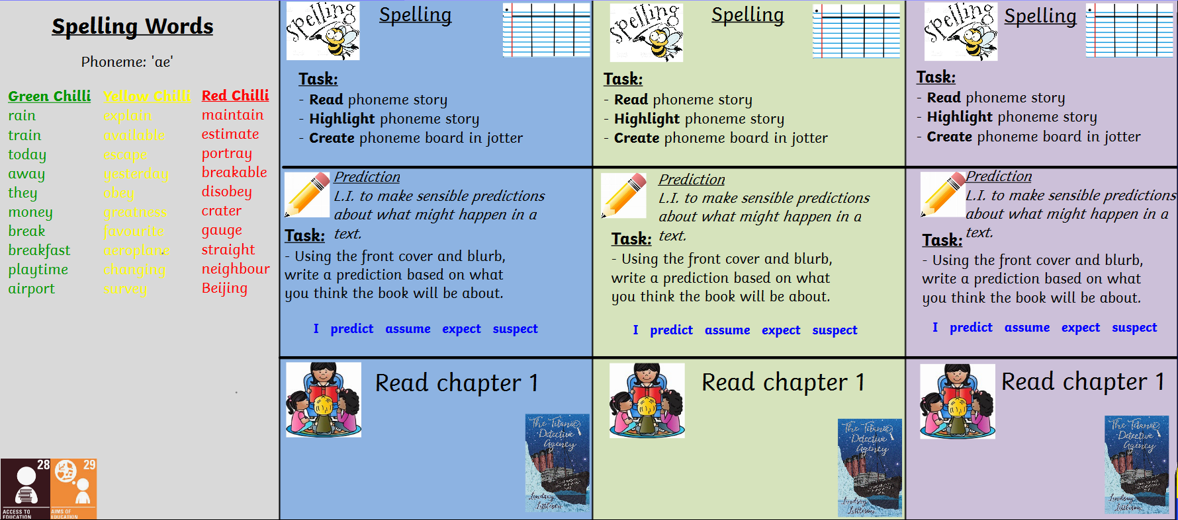
Literacy

Slide 15
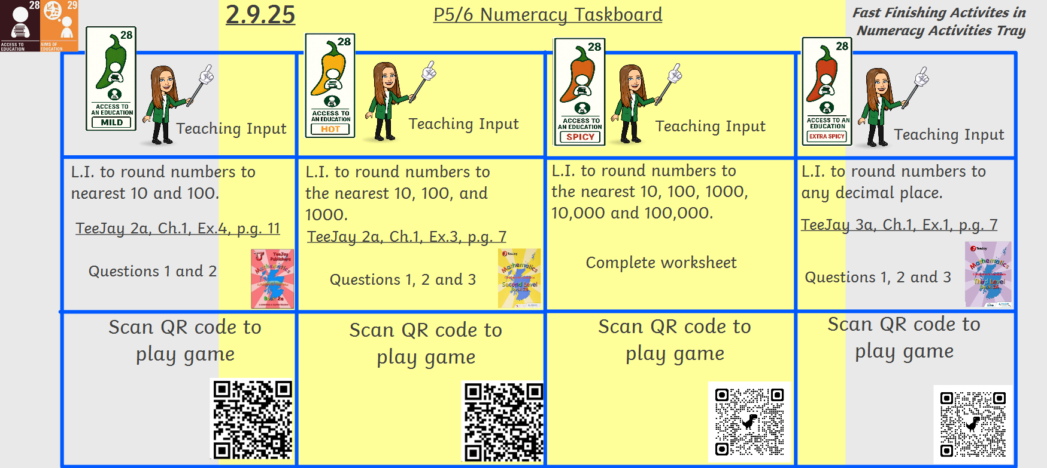
Numeracy

Slide 16
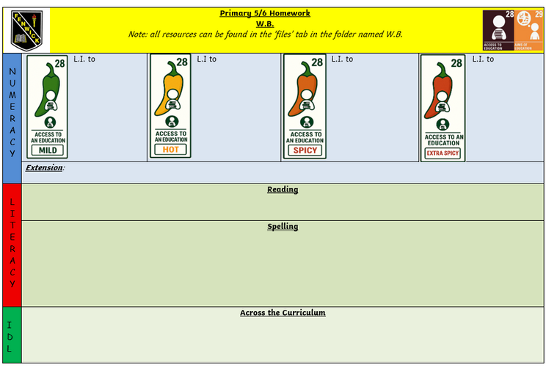
Homework
Homework will run in a 5-week block and will focus on aspects of literacy, numeracy, across the curriculum, and UNCRC tasks.
Homework will run on an online and written week rotation, and all homework communication will be posted on the class TEAMS page and class blog.
Written homework will post using this template and links to online games and videoclips may be attached.
C:\Users\fenwprcunninghame\Desktop\Fenwick PS - Homework & LAH Policy.pdf

Slide 17
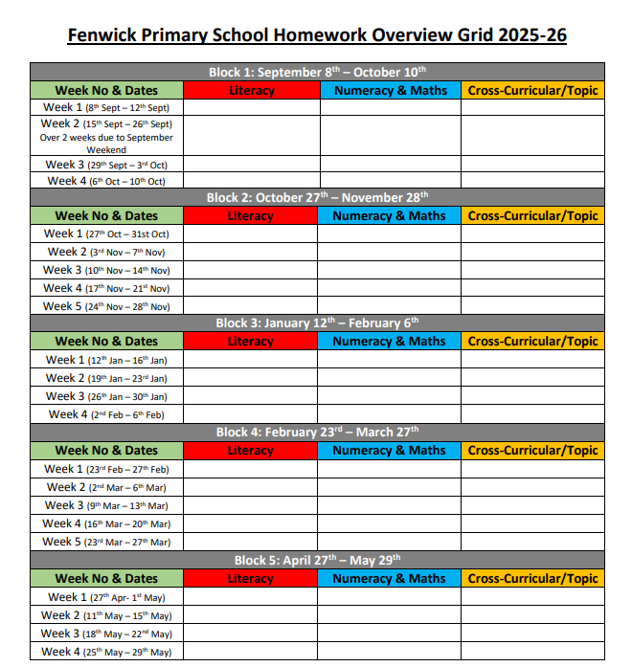
Homework Overview

Slide 18







School Accreditations

Slide 19
School Celebrations
  Halloween
  Children in Need
  Christmas
  Burns Day
  World Book Day
  Easter

Slide 20
Does anyone have any questions?

