Slide 1







WELCOME PRESENTATION
Meet the Teacher Information Session
9th September 2026
Kindness Ambition Respect Honesty

Slide 2
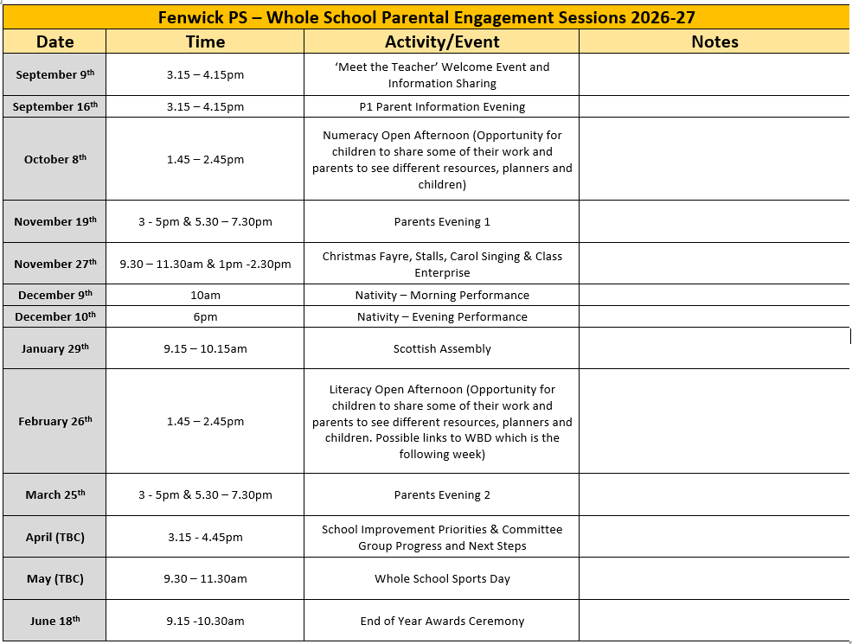

Slide 3

Who helps in our playground and at Breaks/lunch hall?
Mrs Moore
Mrs G
Mr Houston
Mr Risk
Mrs Linford
Teachers
Dinner ladies
Wellbeing Bees
Buddies
House and Vice Captains
Everyone…

Slide 4
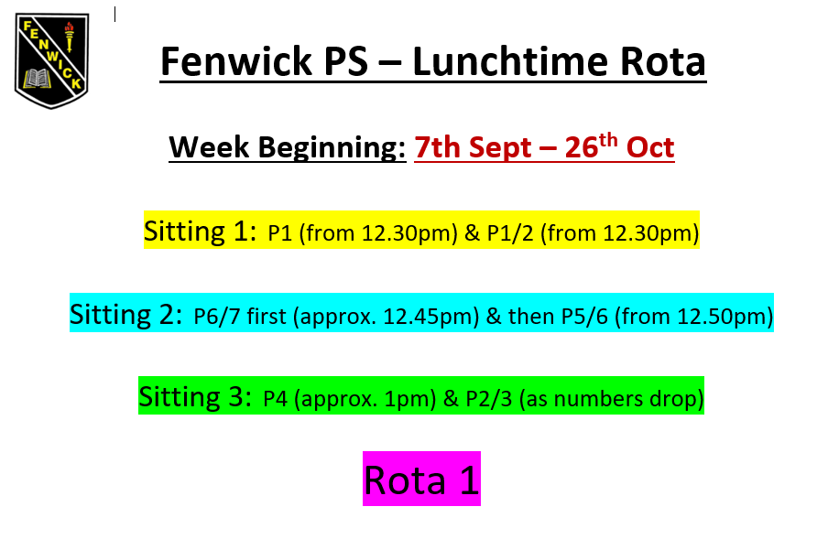
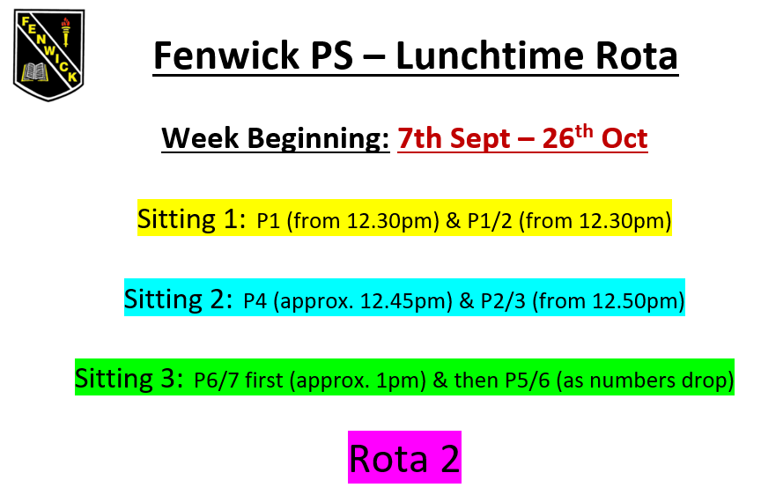
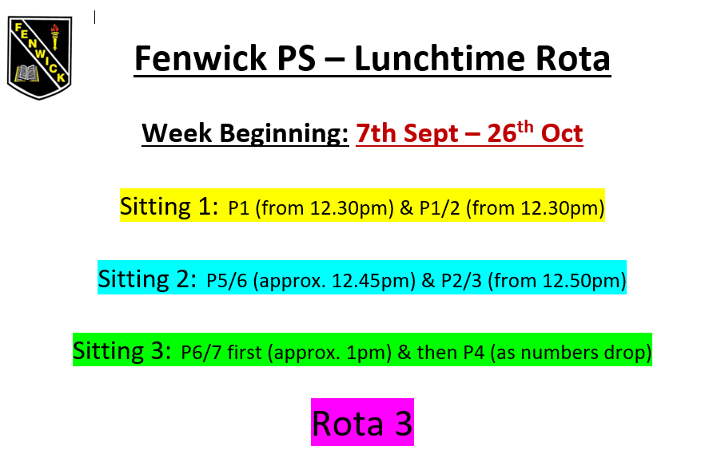

Slide 5
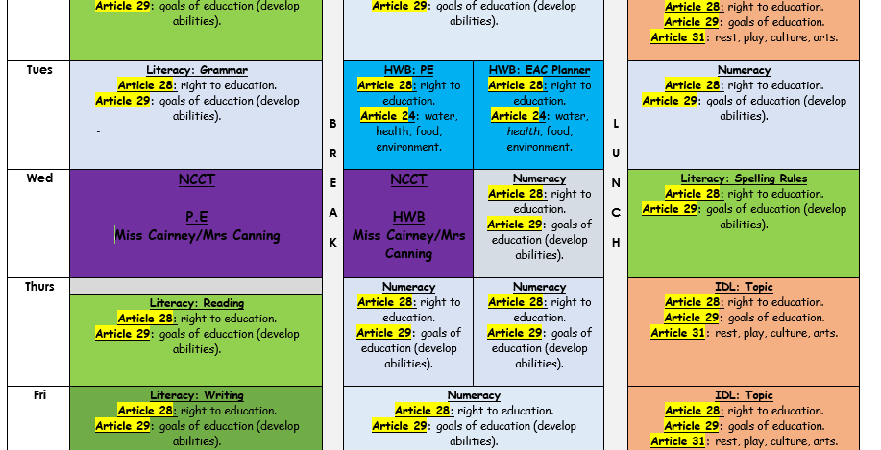

Slide 6
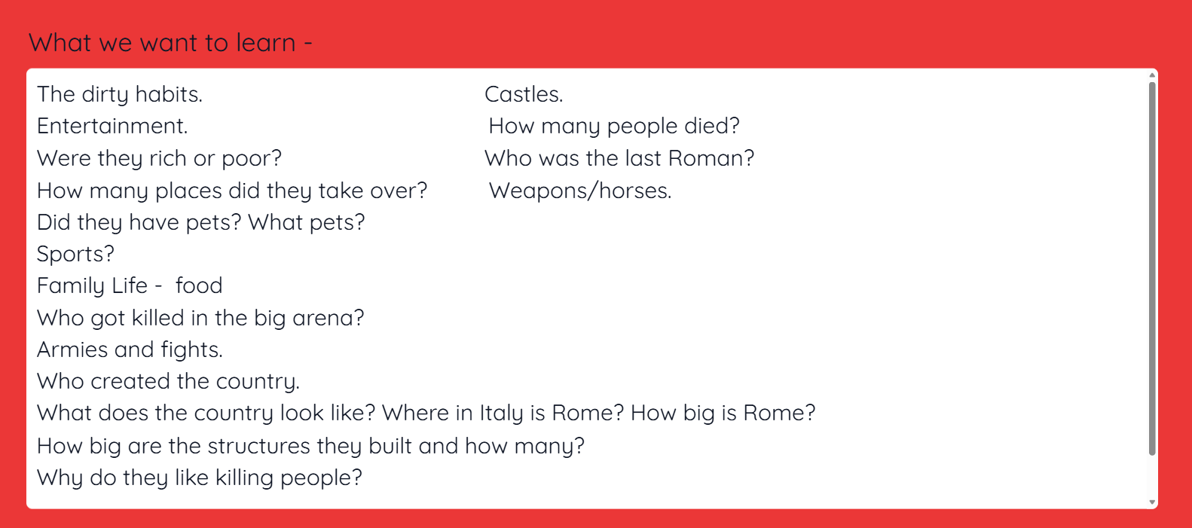

Slide 7

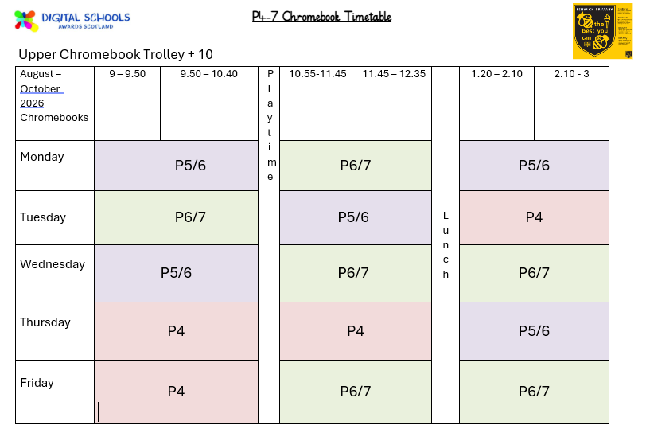

Slide 8
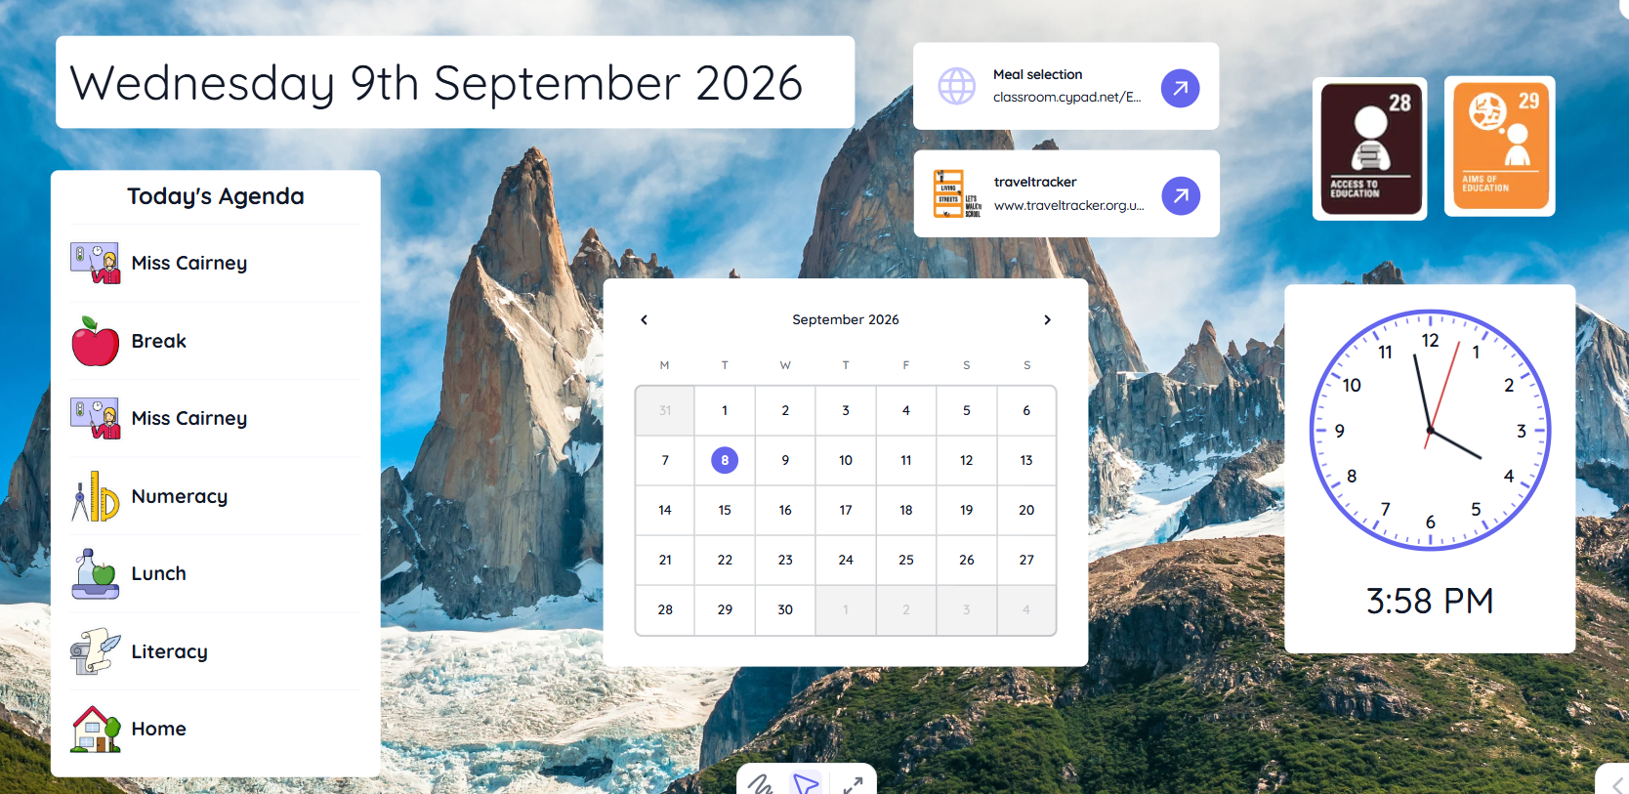

Slide 9
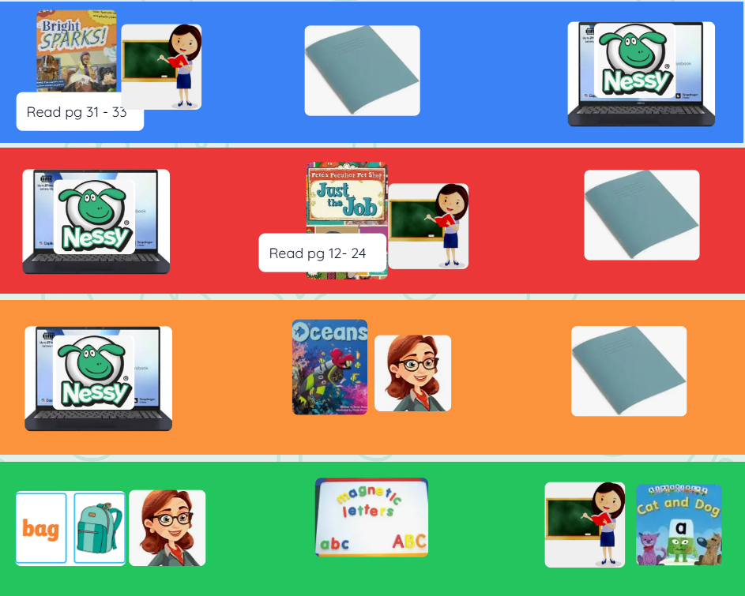

Slide 10


Slide 11

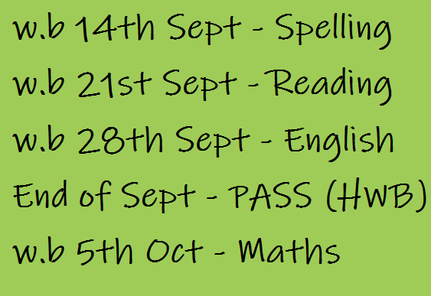

Slide 12
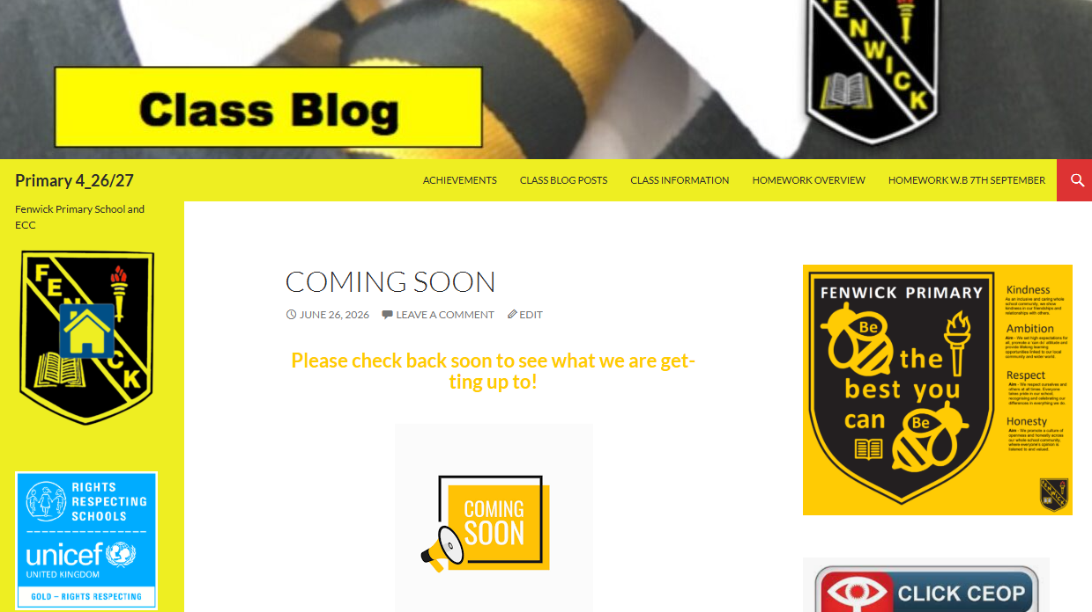

Slide 13

What a Class Charter Is
A class charter is a collaboratively created agreement outlining shared values, expectations, and behaviours that support a positive, inclusive learning environment. It is most effective when co‑created with students and regularly reviewed.

Slide 14
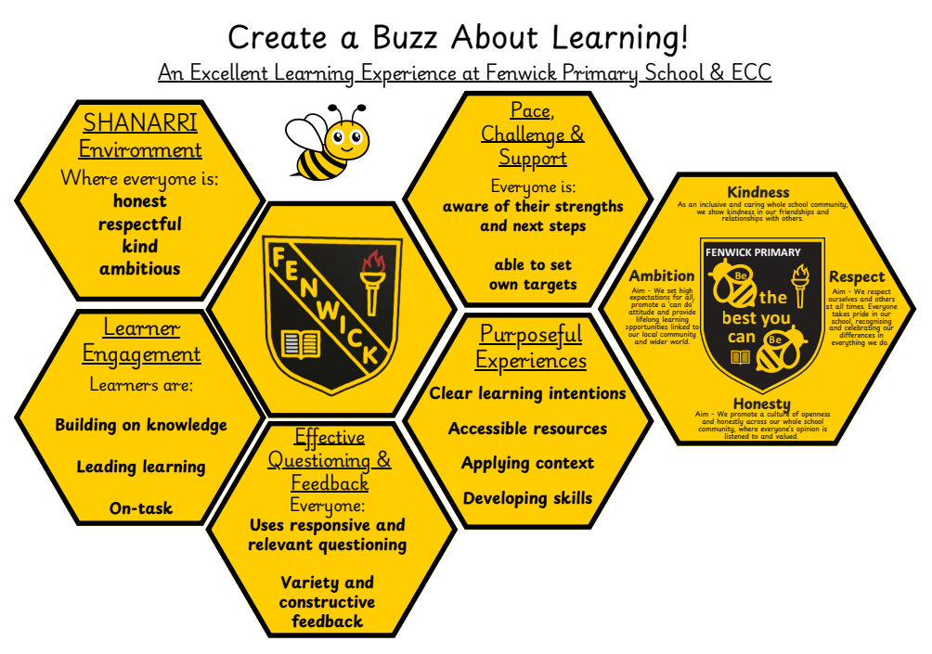
Notes:
Our whole school excellent lesson graphic reflects the consistent approaches we want to see in all classes. This also includes our values which we want the children to live everyday. However, the children have taken this further by personalising it to their own classes and their individual learning styles. This tells us how they see their learning and what we can do to help them reach their potential.

Slide 15
Our Homework Overview for 2026-27
For the moment, homework will continue as before and will be provided in a set block of time.
The following slide shows how this was done last session.
Unfortunately, there were many times in the year where limited amounts of homework were returned.
Hence, we will be undertaking a survey towards the end of this term to determine the best way ahead for our school.
Further information will follow…

Slide 16
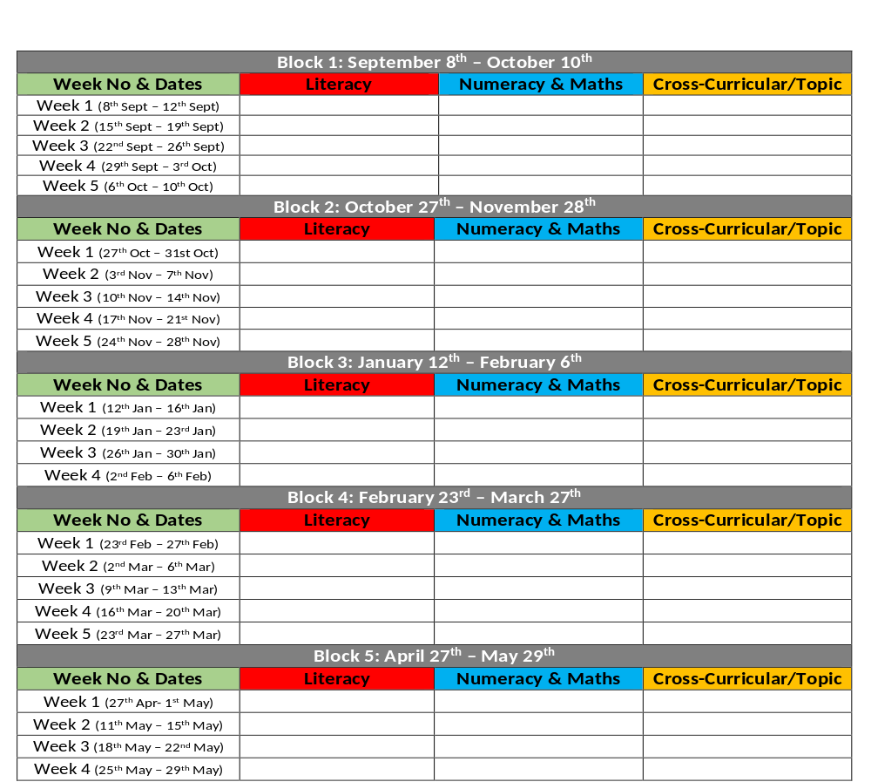

Example of Homework Overview 2025-26

