Slide 1








WELCOME PRESENTATION
Meet the Teacher Information Session
3rd September 2025 – Miss Stevenson: P1
Kindness Ambition Respect Honesty

Slide 2

Who helps in our playground and at Breaks/lunch hall?
Mrs Moore
Mrs G
Mr Houston
Mrs McKillop
Mr Risk
Teachers
Dinner ladies
Wellbeing Bees
Buddies
House and Vice Captains
Everyone…

Slide 3
Our Lunch Rota from September…

Slide 5
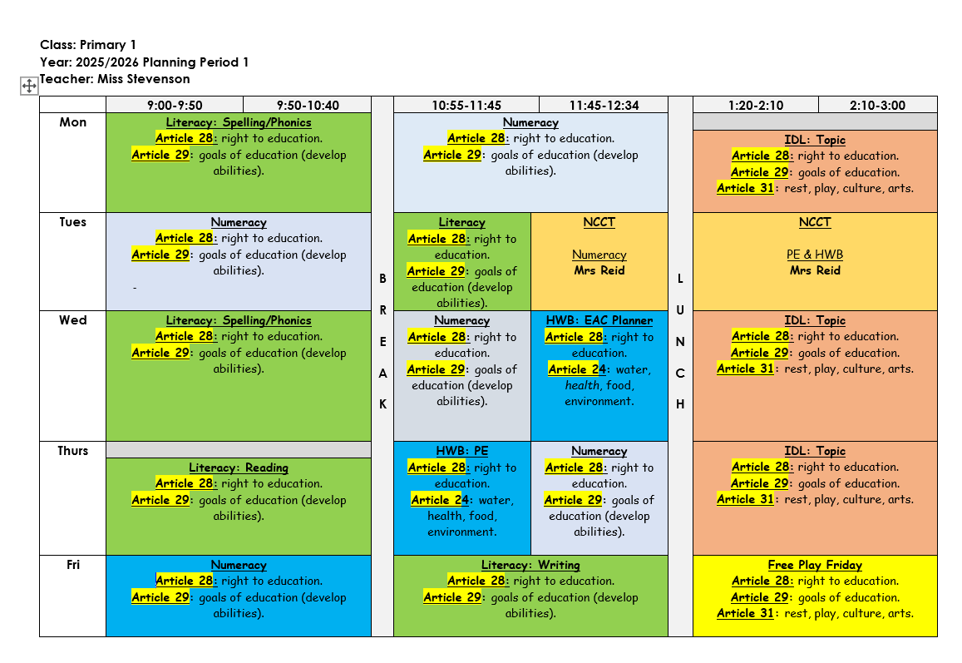

Slide 6
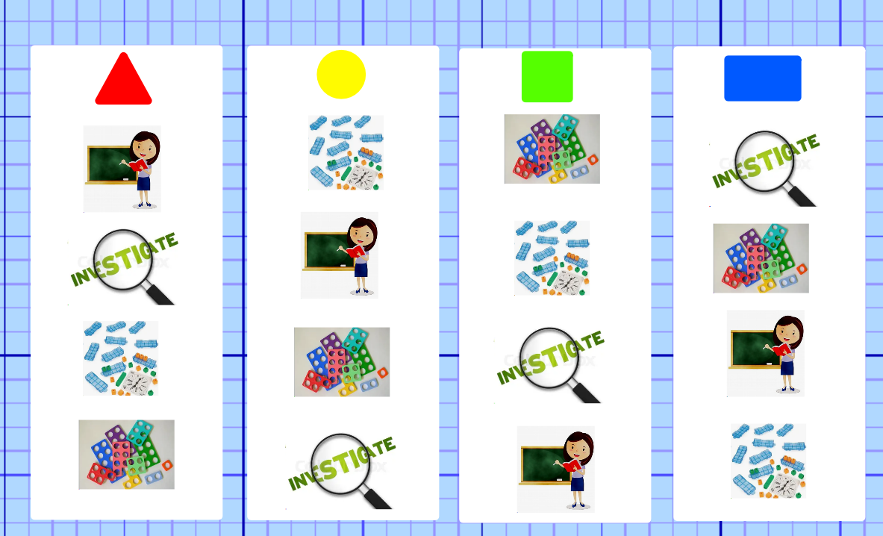

Slide 7
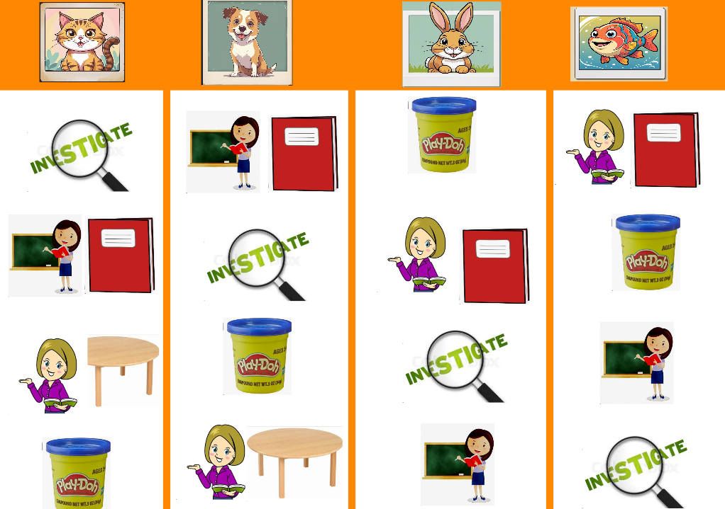

Slide 8
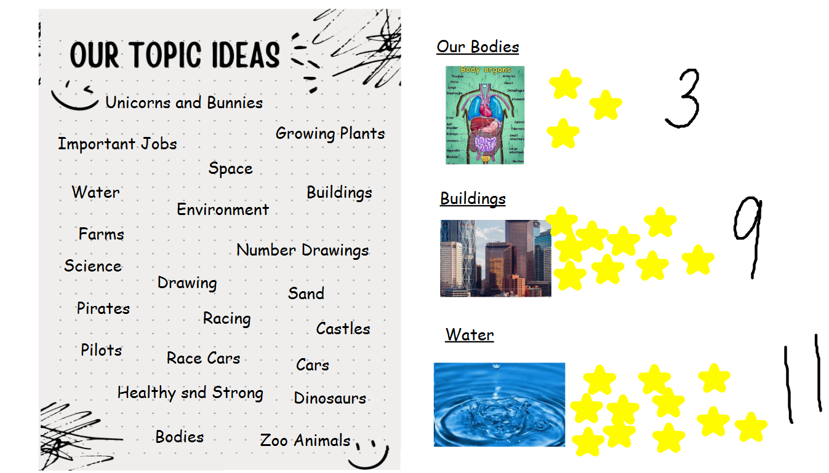

Slide 9
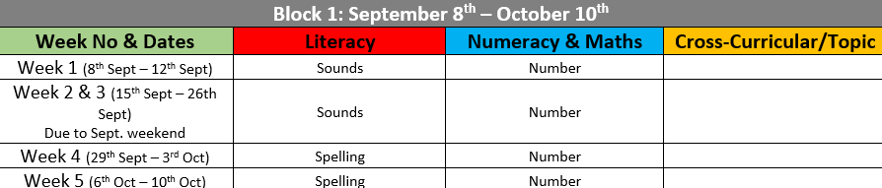
Our Homework Overview for 2025-26

Slide 10
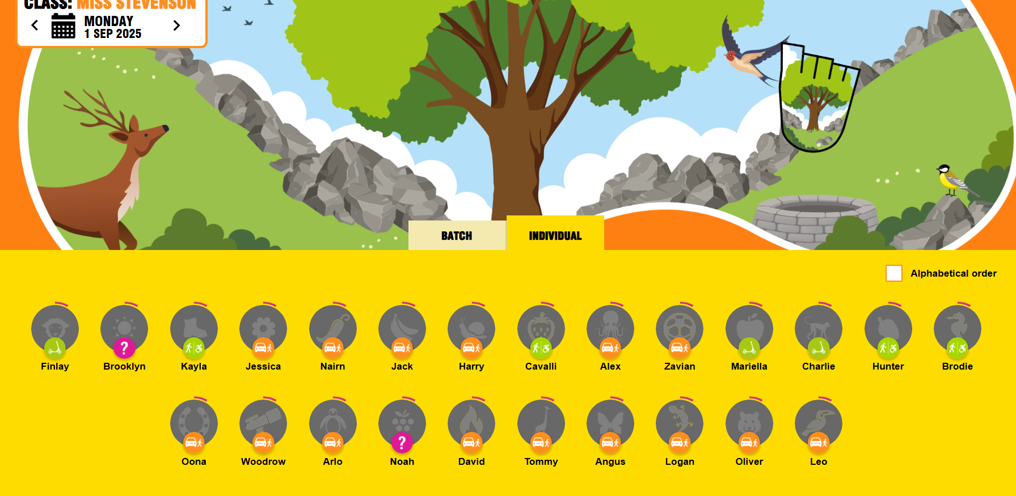

Slide 11






Class Charter – under construction.

