Slide 1
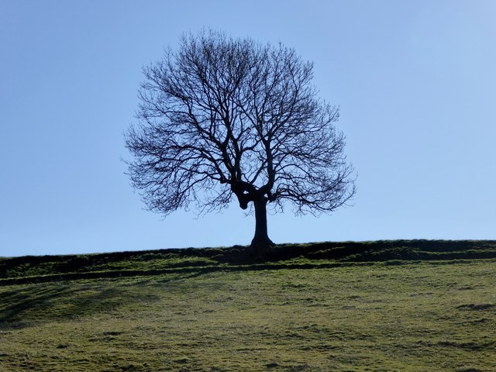
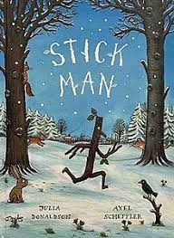
Listen to the story of Stickman by Julia Donaldson
https://watchkin.com/d5fc59f081
Talk about your favourite part of the story. What was your favourite part?
Why is it your favourite part?
What happened?
Write asentence about it.
Draw a picture to match your sentence.
Look at Stickman’s facial expressions throughout the story. How is he feeling?
Why does he feel that way?
Can you make some of these facial expressions?
Outdoor Art
Use materials, eg sticks and leaves to make your own stick people and animals. You could add some stones or googly eyes. Send us a photo of your Stick Family.
Stickman Yoga
https://watchkin.com/fcb13c08de
This Photo by Unknown Author is licensed under CC BY-SA

Slide 2
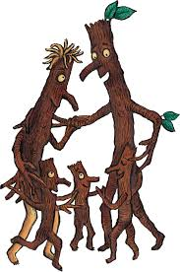
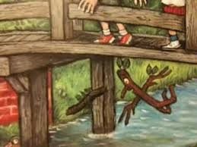
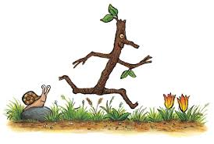
Maths
Collect different a stick and use it to measure things around your house.eg How many stick lengths is your table, TV, frdige ?
How many stick lengths are you? Another family member? Look for other things to measure using your stick. Find another size of stick and measure again.
Rhyming Words
Find all the rhyming words in the book.
eg tree and three
Science
The Stick Man floats out to sea. Think about why things float. Can you test different materials to see if they float?
Art
Draw a picture of one of Stick Man’s adventures.

