Slide 1
Health & Wellbeing
P1
Last week we thought about the uncomfortable feeling worried and what we could do when we feel worried.
Worrying can make us feel uncomfortable in our bodies. We are going to learn how to make our feeling change to calm, which is a comfortable feeling
Task 1
Hot chocolate breathing is a great way to calm down. Learn how to do this with Henrietta. You could even practice with some real hot chocolate.
Task 2
Twiggle and his friends are feeling calm in this story, ask someone to read it with you Twiggle feels CALM
(View in slideshow to open links)

Slide 2
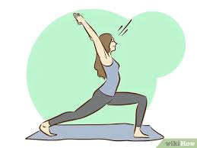
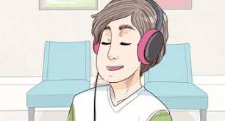
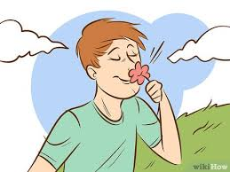
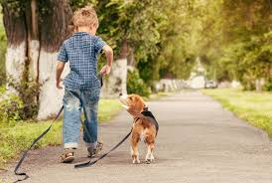
Time to get creative!
Calm is a feeling where we are still, we don’t move much, our muscles are relaxed, our heart is beating slowly and we are comfortable.
What makes you feel calm? Can you draw a picture?

