Slide 1
Paddington Bear
Primary 1
Onthank Primary

Slide 2
Paddington Bear is Onthank Primary’s Rights Respecting School Mascot.
Please listen to the story about Paddington Bear being found by Mr & Mrs Brown at a railway station in London.

Slide 3
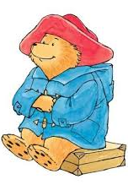
Listen to the story of Paddington being found.
https://www.youtube.com/watch?app=desktop&v=BNZ3i9utHl4

Slide 4
Follow up Chilli Challenge
Mild
Hot
Flamin’ hot
Choose 1 ,2 or try all 3

Slide 5
Mild
In your best writing, write
Please look after this bear. Thank you.

Slide 6
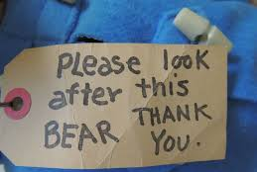
hot
Now write it inside a label -like this

Slide 7
flamin’ hot
Try rainbow writing – like this
Please look after this bear. Thank you.

Slide 8
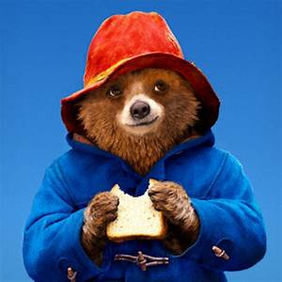
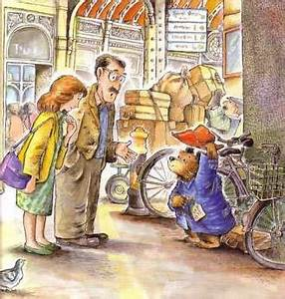
What is your favourite bear’s name?
Mr & Mrs Brown called him Paddington after the Railway Station.

Slide 9
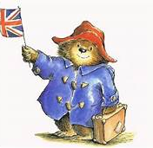
Watch the video and try to draw Paddington.
https://www.youtube.com/watch?app=desktop&v=MSDEzM9tQnU
Please show us your drawings.

Slide 10
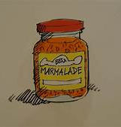
Paddington loves marmalade.
Plan a meal for Paddington after his long journey.

Slide 11
Love is ……. Our Onthank
We miss you all and look forward to seeing you soon.
Team P1

