Slide 1
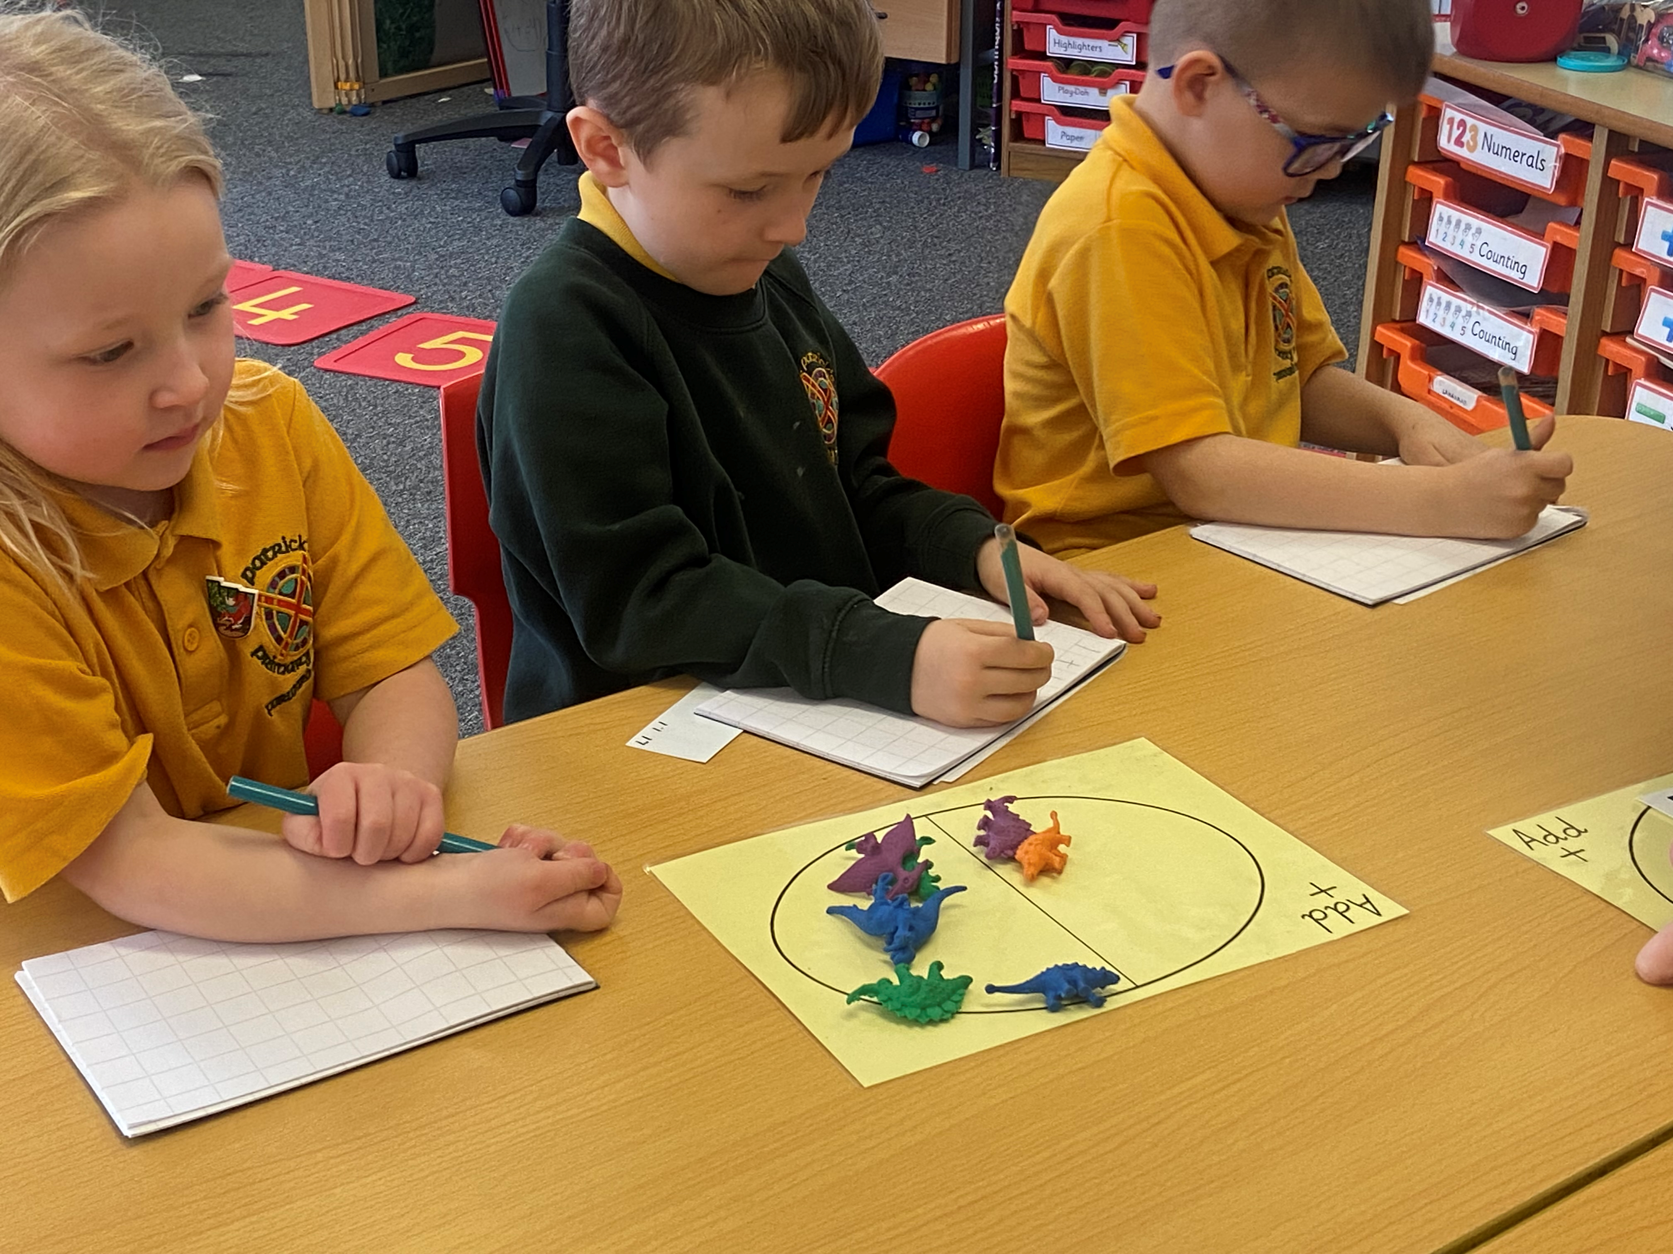

St Patrick’s ps pef impact april ‘23 – april ’24

Slide 2

School Context
St Patrick’s Primary School is the designated Roman Catholic Primary School for Auchinleck and Cumnock and our catchment area extends to Catrine, Coylton, Drongan, Logan, Mauchline, Muirkirk, New Cumnock, Ochiltree and Sorn. We are a co-educational establishment with a current roll of 130. Approximately 30% of our children rely on local authority transport for travel to and from school. During session 2022/23 we enrolled 10 pupils across P4 – P7 this was a 15% increase in roll for P4 – P7. In this current session the role has increased by 7% from P3 – P7 with 3 pupils waiting for space which will become available in August 24.
We are part of the St. Joseph’s Education Group and P7 Pupils transfer to St. Joseph’s Academy and Robert Burns Academy. In August 2024 70% of leavers have registered for St. Joseph’s and 30% at Robert Burns Academy. The projection is this will remain similar for 2025. Our P1 children join us from Local Authority Early Childhood Centres and Partner Providers from across our catchment area. This makes it challenging to make projections on future enrolments.
Session | No of P1 enrolments
2021/22 | 13
2022/23 | 17
2023/24 | 17
2024/25 | 19
We have parish links with Our Lady and St. Patrick’s, Auchinleck, St. John the Evangelist, Cumnock and St. Thomas the Apostle, Muirkirk. It is an important aspect of our school that our pupils feel a sense of community which is strengthened by our links to our parishes and the support of our school chaplain and our community partners. Our School Values reflect our commitment to our Faith.

Slide 3
62% of pupils reside within SIMD1 & 2 (Q1)
3.1% reside in SIMD 9 & 10 (Q5)
32% of the school roll are identified as having an additional support need.
16.1% of pupils are claiming FMR.
The attendance rate across the school for session 2022/23 was 92%. This remains the same from Aug 23 – April ‘24.
20% of pupils currently have attendance under 90%. This is a 10% decrease from session 2022/23.

Slide 4
Pupil Equity Fund: Aims and Impact 2020/21
Classroom Assistant We employed an additional Classroom Assistant for 10 hours per week in order to support education recovery following lockdown. | This additional staffing allowed individual and small groups to access more targeted support in the early stages. This also allowed us to support children at lunchtimes.
To provide the resources to support the increase in outdoor learning. | In collaboaration with the ‘Lost’ team the school purchased outdoor seating and a tent was erected in the wildlife garden. We continued our partnership with The Knowe Garden Centre and ACDI with tree planting, plant science classes and vegetable planting.
Additional management time for development tasks. | Due to the Lockdown in January 2021 much of this work was delayed. We were able to pick up some of the tasks in the final term but this will be continued into 2021-22 session.
Purchase of additional iPads | The school now has 30 iPads which are divided between the three main areas of the school. The pupils are now benefitting from easier access to online materials and those accessing individualised programmes, such as Cogmed, can do this within the classroom.
Purchase of Webcams and digital document cameras | This has been an essential purchase for the school. Teachers have made full use of the visualisers to engage with pupils in live lessons throughout the second lockdown period.
Purchase of Scholastic Materials and training to support implementation of Stephen Graham writing. | £1800 was spent on resources to support the implementation of Stephen Graham Writing: PM Writing – Emergent, 1, 2, 3 and 4 £671 was spent on Scholastic online training for all teachers.

Slide 5
Pupil Equity Fund: Aims and Impact – 2021/22
Staffing Continuation of PT post , 0.1FTE teaching staff, 5 hrs CA weekly, 27.5 CA term 4 AIMS: to provide additional leadership time to support the implementation of new writing approaches across the school, to provide stability to P2 class for final 2 terms, to provide targeted interventions for identified learners | Due the continued challenges of staff absence related to Covid-19 isolation periods and non Covid related absence additional staffing was mainly used to cover staff absence. In term 4, the additional CA was able to target identified learners with interventions. These interventions will continue onto the following year and robust data on impact collated. The P2 class benefited from one full time teacher for term 3 & term 4.
Digital technologies 3 x laptops, Set of Spheros, Class sets of Earl for P1 – P3, Encrypted pen drive, Tripod stand, Headphones ,Blue Tooth Speakers AIMS: to enhance the learning and teaching of computing science, ensuring that all learners have access to quality and relevant equipment. | All classes benefited from increased access to technology and in particular to aspects of computer science involving problem solving and coding. Due to the timescale involved in receiving the laptops these have not yet been utilised to their full potential.
Numeracy Resources Range of numeracy manipulatives for all stages, Leckie Texts books Sum dog subscription AIMS : improvements in numeracy attainment | All classes have access to a range of manipulatives and resources for high quality learning and teaching in numeracy. The attainment data for the session does not reflect that this has improved attainment in ACEL data. However, tracking data has shown an increase in cohort tracking between TP2 and the end of session.
Literacy resources Reading Books – early level 9wordless and decodable texts) First level – orange, turquoise, purple texts Writing resources AIMS : improvements in reading and Writing attainment | Increased access to resources to support learning and teaching. New decodable texts have been aligned to the EA Active literacy progression. Although there has been increase in the ACEL data, this is not reflected by an increase on cohort tracking.
Play pedagogy resources Class Furniture, small world resources, AIMS : improved approaches to learning at early level that aligns with current SG policy. | Early Level classrooms are better equipped to support a play based pedagogical approach.
Outdoor Learning Resources Outdoor speaker, Welly stand, Outdoor storage and loose parts PE equipment AIMS : increased opportunities for outdoor learning, increased participation in purposeful play at social times. | Due to the delivery time involved these resources have not yet been utilised to their full potential.
Inclusive Practice Resources for ‘boost boxes’ AIMS : to ensure every learner has access to resources that support their access to the curriculum and support them to achieve within the classroom environment | All learners across the school have access to a range of resources to support access to the curriculum. These resources are carefully selected to be age and stage appropriate. Pupils focus groups have indicated that that they are leading to improved confidence amongst pupils. There is evidence that this is not consistent across the school.

Slide 6
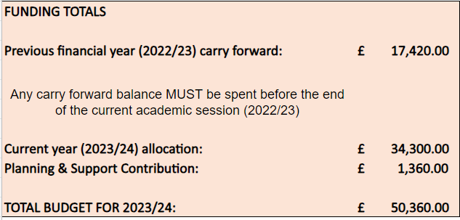
Pef allocation
Carry forward as a result of
previous year’s planned
spend being unable to be
fulfilled due to procurement
Issues and planning for the
Spend up to June 2023.
Carry forward included
staffing costs
April 22 – Aug 24

Slide 7

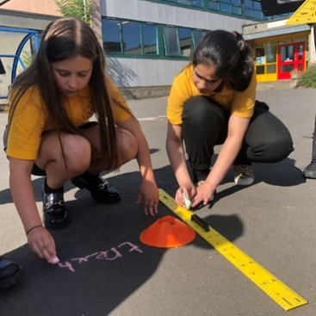
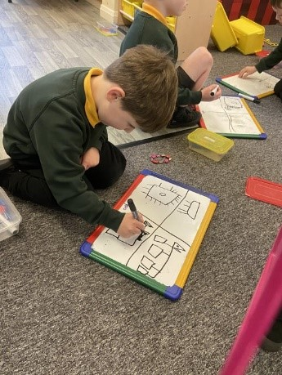
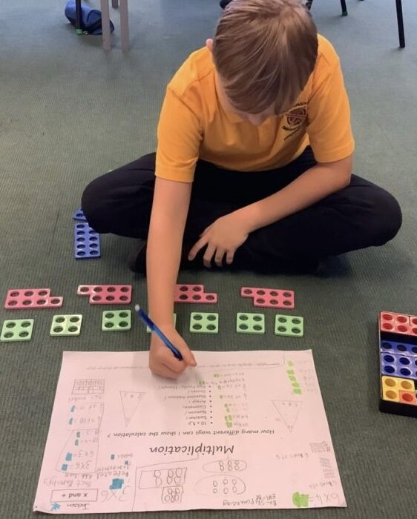
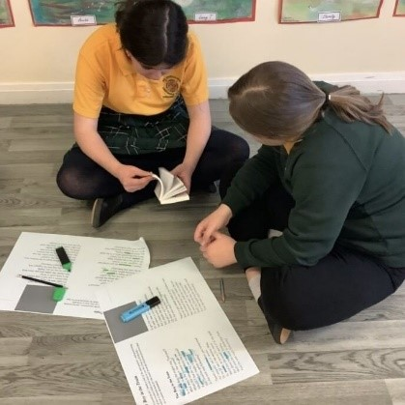
Planned pef spend Overview
Staffing
Reading texts
Digital subscriptions
Hardware to support 1to1 devices
Breakfast club
Subsidise residential
Reduce costs associated with school day
Targeted interventions

Slide 8
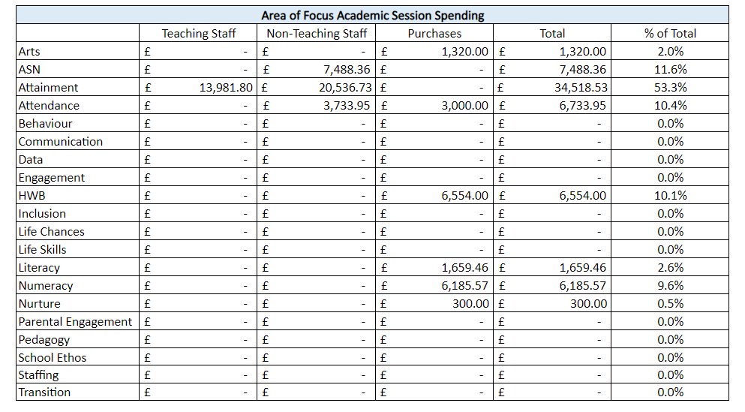

Slide 9
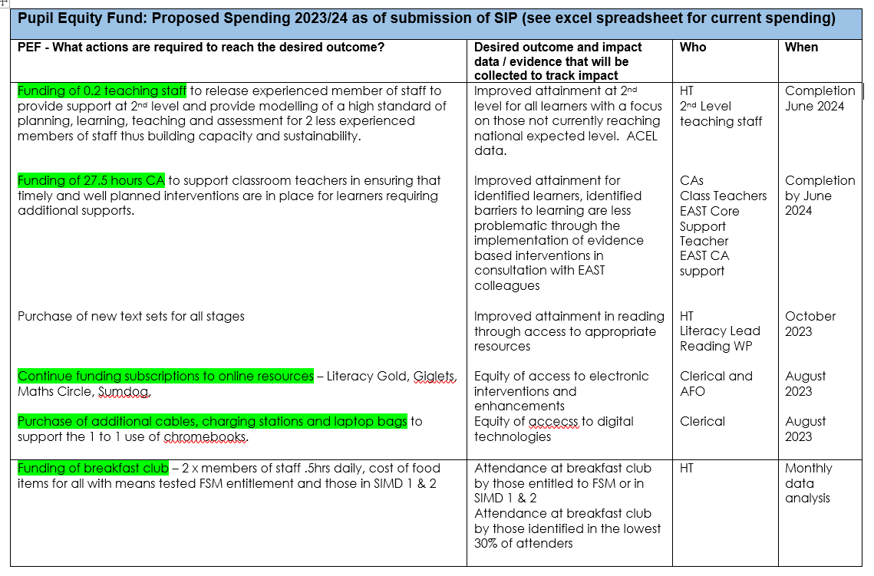

Slide 10
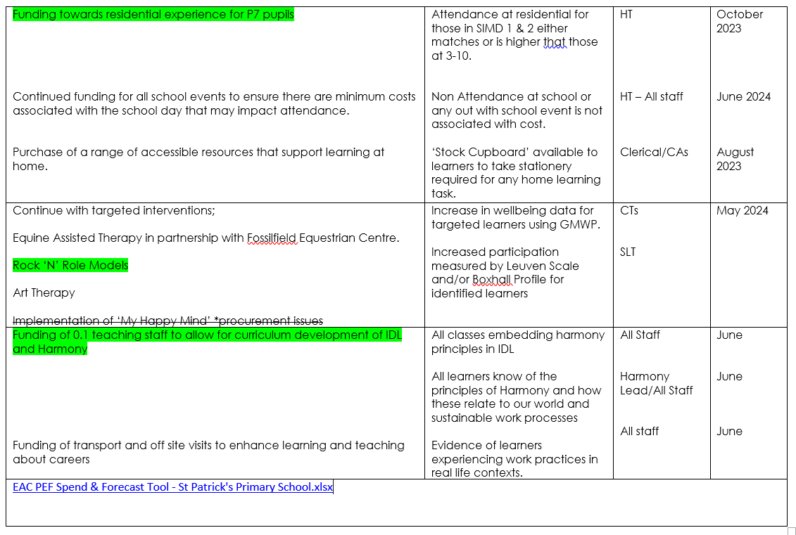

Slide 11
Actual spend
Overspend: additional staffing costs due to pay increases, additional staffing costs for CA initially charging to section 23.

Slide 12
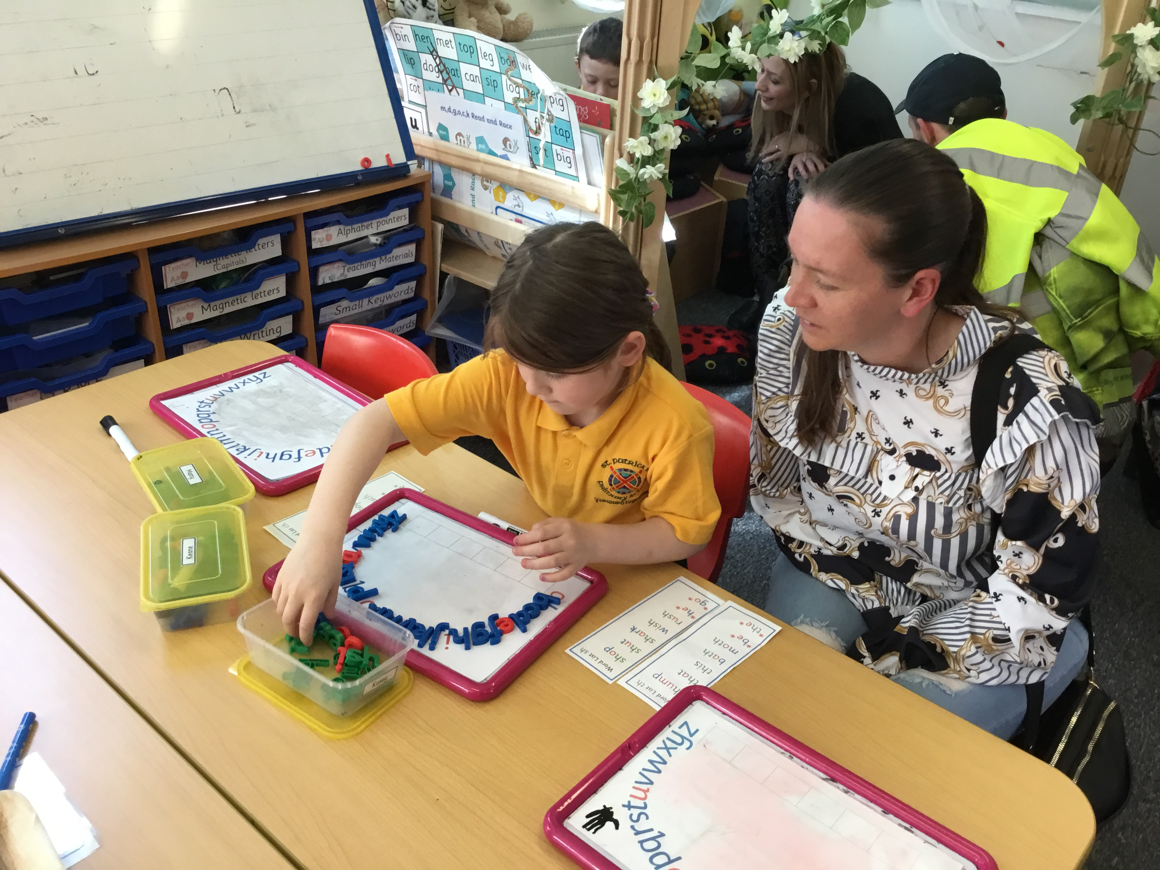
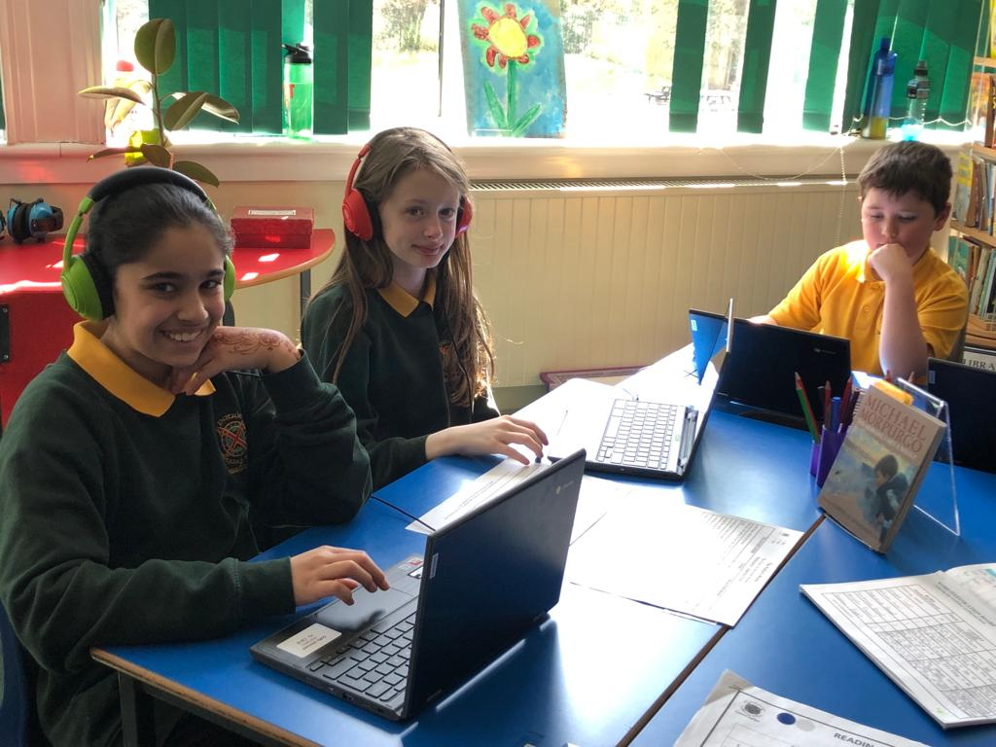
IMPACT – Literacy
Pupil | Stage | SMID | March 23 | April 24 | Differential | March 23 | April 24 | Differential
 |  |  | Reading |  |  | Spelling
JC | P7 | 1 | 9y 2m | 11y 1m | +1y 11m | 8y 1m | 10y 2m | +2y 1m
BS | P7 | 2 | 7y 10m | 8y 5m | +7m | 6y | 6y 7m | +7m
AS | P7 | 6 | 7y 6m | 9y | +1y 6m | 6y 4m | 6y 7m | +3m
BB | P7 | 8 | 8y 3m | 10y 9m | +2y 6m | 6y 7m | 7y 1m | +6
IF | P7 | 1 | 8y 10m | 10y 4m | +1y 6m | 8y 2m | 8y 2m | =
LL | P7 | 9 | 8y 10m | 10y | +1 y 2m | 7y 2m | 8y 2m | +1y
LS | P7 | 1 | 8y 9m | 10y 3m | +1y 6m | 7y 4m | 7y 2m | -2m
MMc | P7 | 1 | 11y 1m | 12 y 7m | +1y 6m | 7y 9m | 9y | + 1y 3m
NB | P7 | 6 | 8y 9m | 10 y 9m | +2y | 9y | 9y | =
AB | P6 | 2 | 9y 2m | 11y 5m | +2y 3m | 8y 4m | 8y 8m | +4m
BMc | P6 | 2 | 8y 8m | 10y 4m | +1y 8m | 7y 7m | 8y 2m | +7m
CB | P6 | 6 | 10y 10m | 12y 5m | +1y 7m | 7y 8m | 8y 9m | +1y 1m
DS | P6 | 6 | 8y 3m | 10y 11m | +2y 8m | 7y 6m | 8y 1m | +7m
LW | P6 | 2 | 8y 8m | 8y 3m | -5m | 6y 7m | 7y | +5m
LMc | P6 | 3 | 7y 7m | 8y 10m | +1y 3m | 6y 7m | 7y | +5m
ML | P6 | 1 | 9y 2m | 11y | +1y 10m | 9y | 9y 8m | +8m
NB | P6 | 10 | 7y 7m | 9y 8m | +2y 1m | 6y 4m | 7y 9m | +1y 5m
SM | P6 | 6 | 8y 1m | 10y 6m | +2y 5m | 6y 2m | 9y 3m | +3y 1m
AL | P5 | 3 | 6y 11m | 9y | +2y 1m | 6y 1m | 8y 3m | +2y 2m
CS | P5 | 6 | 6y 4m | 10y | +3y 8m | 7y 7m | 9y 3m | +1y 8m
JT | P5 | 2 | 8y 3m | 9y 1m | +10m | 6y 4m | 8y 1m | +1y 8m
KK | P5 | 1 | 7y 4m | 8m | +8m | 6y 6m | 7y 4m | +10m
ST | P5 | 1 | 7y 9m | 8y 10m | +1y 1m | 6y 4m | 7y 8m | +1y 4m
AVERAGE |  |  |  |  | +1y 7 months | AVERAGE |  | +11m

Slide 13
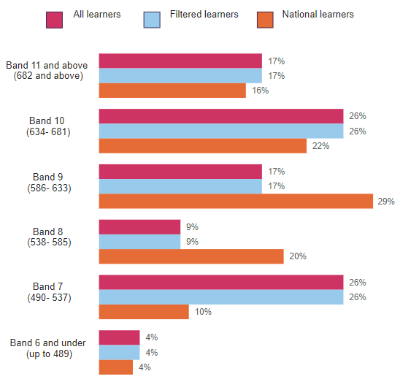
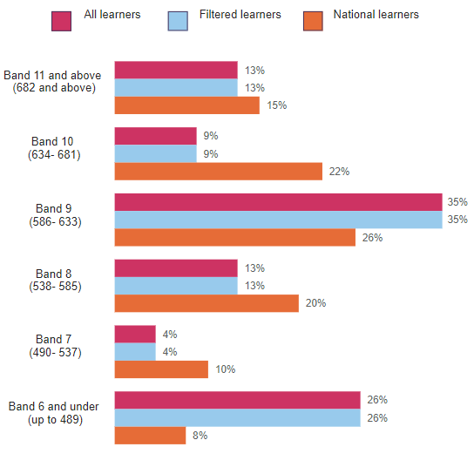
Reading
Writing

Slide 14
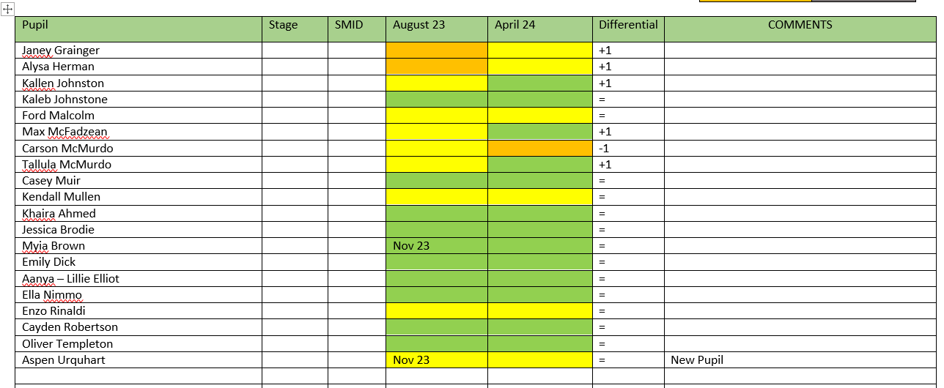
IMPACT – Numeracy
P3 – 36% of pupils show improvement towards expected level
P4 – 25% of pupils show improvement towards expected level

Slide 15
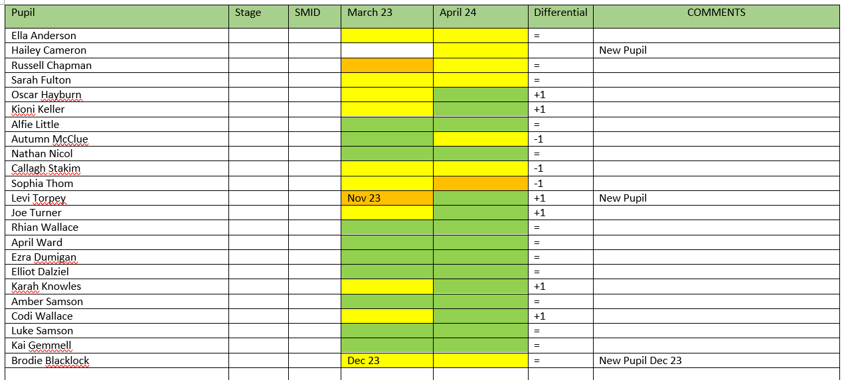
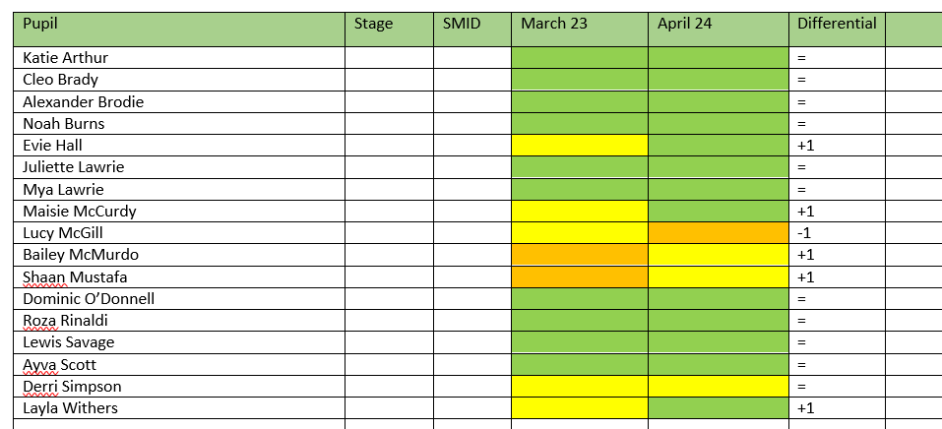
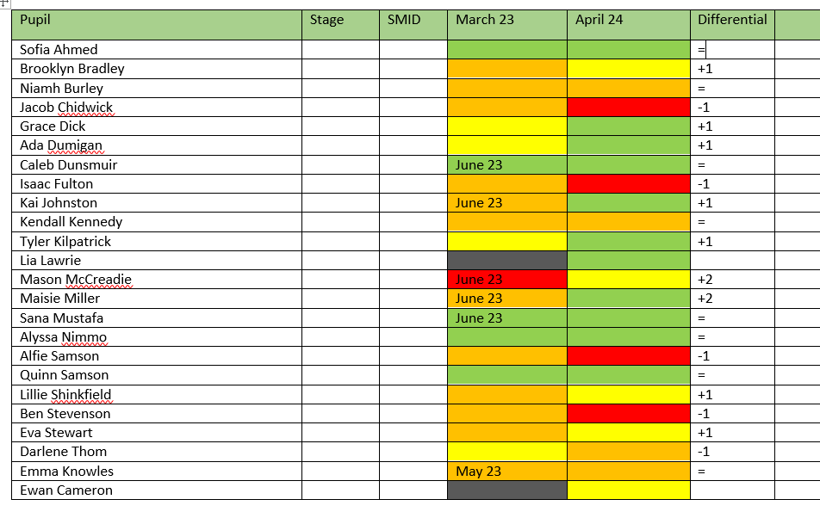
IMPACT – Numeracy
P5 – 27% of pupils show improvement towards expected level
P6 – 29% of pupils show improvement towards expected level
P7 – 43% of pupils show improvement towards expected level

Slide 16
Impact - wellbeing
Case-Study-Art-Therapy.pdf
Case-Study-Fossilfield.pdf
impact data resillience.docx
Impact of Rock N Role Models intervention.docx.pdf

Slide 17
Future focus
April – June 2024
August 2024 – March 2025
Gather robust data for acel June 23
Measure impact on attainment for all learners, focus on q1
Analyse writing
Snsa p1, p4
Explore other funding options
Explore transport option
Already secured £1000 for breakfast club
Explore opportunities to work with other schools in the locality as opposed to EG
Utilse community volunteers
Loss of local facilities
New texts through commision

Slide 18
Pef challenges
Increase in number of pupils - funding remains same
Impact of new pupils on anticipated use of staffing
Staff absence
Reduced core allocation of support staff
Increased costs of goods and services
Widespread education group – shared resourcing not always beneficial

Slide 19
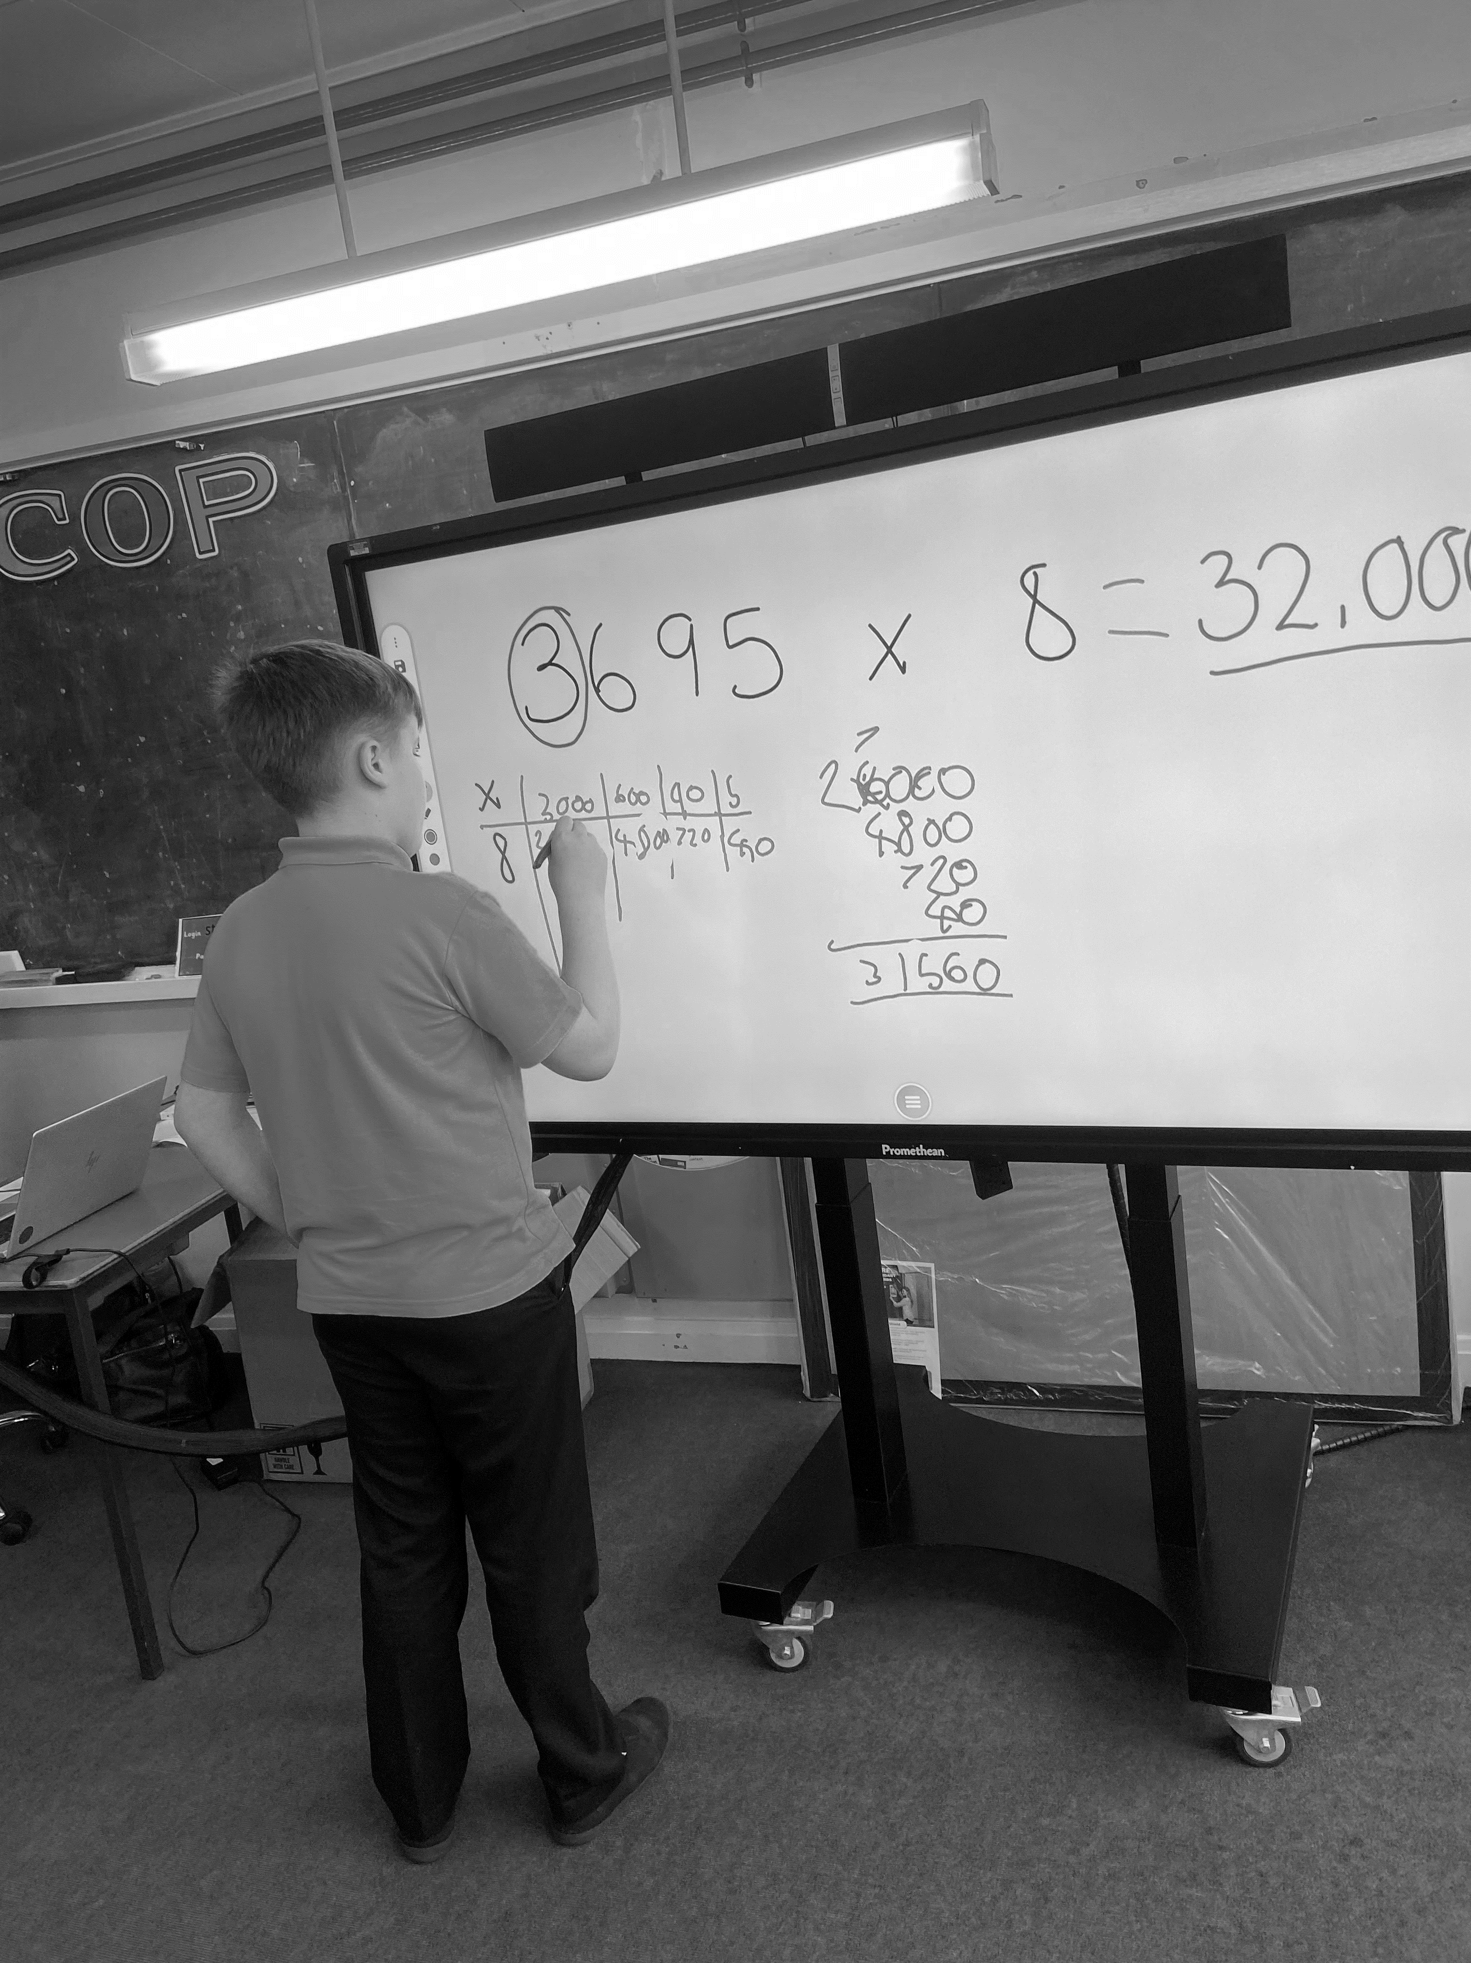
Thank You

