Slide 1

Pupil Equity Fund
Impact meeting
08/02/24

Slide 2
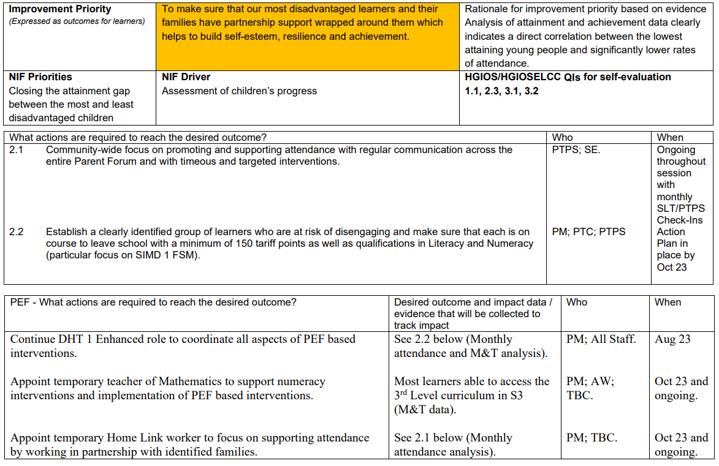
Doon Academy Establishment Improvement Plan 2023/24

Slide 3
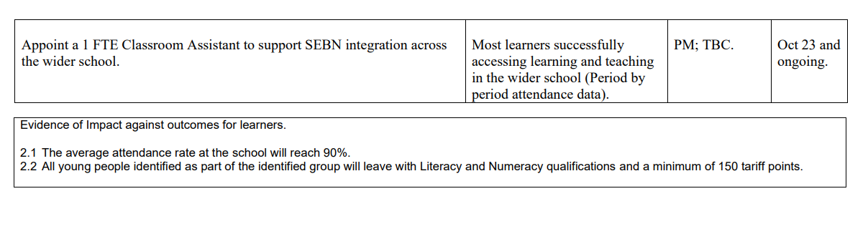

Slide 4
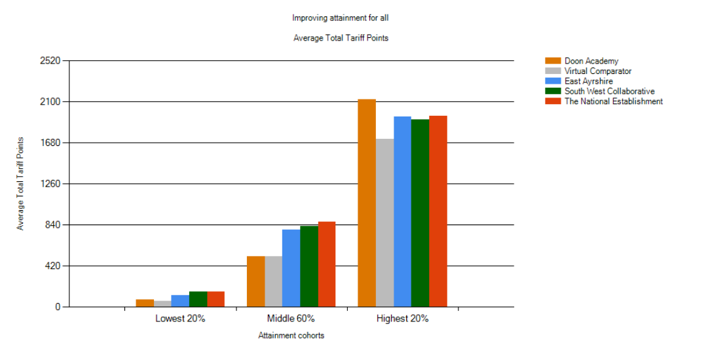
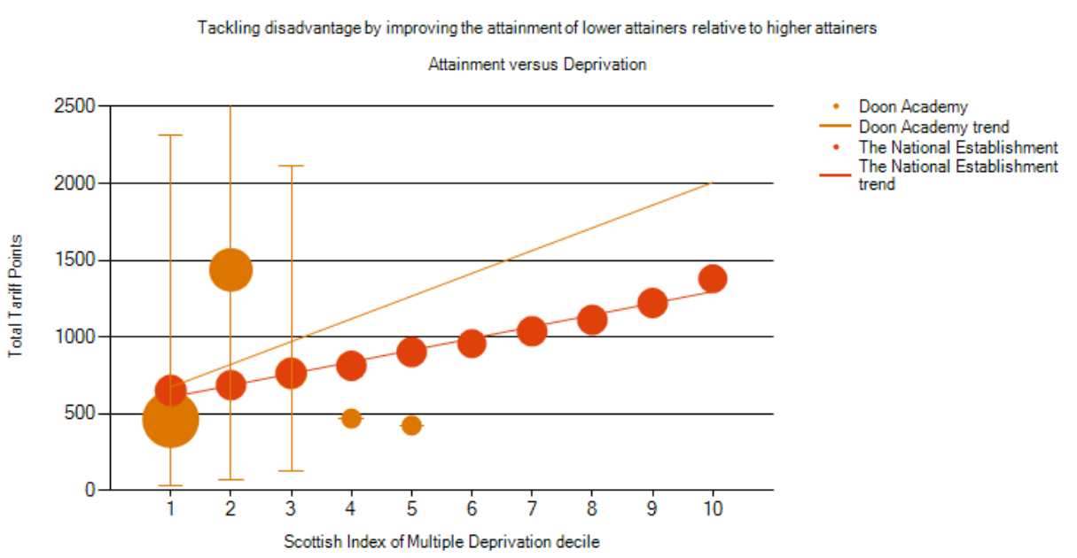
Our rationale
Based on HMIE feedback we have tightened up our 'actions to be achieved' and identified 2 areas of priority within SIP.
Our Lowest 20% is slightly above VC but below EAC/SWC & Nat Est.
Our Middle 60% is an area to be improved (1 tariff point below our VC). Some pupils in targeted group could potentially contribute to this cohort.
Average tariff points for SIMD 1 is slightly lower VC and lower than Nat Est. (Most pupils in targeted intervention group are from this SIMD)
Attendance continues to be an area for improvement (current figure for this session is 84.49%)
We felt it was important to commit to an aspirational tariff goal for our learners.

Slide 5
SIP Actions : Where are we now? 2.1
Community-wide focus promoting and supporting attendance with regular communication across the entire Parent Forum and with timeous and targeted interventions.
Progress:
'Attacking attendance' Team set up to ensure a timeous and joined up approach between SLT/PS
Interim member of staff to monitor period by period attendance and make prompt contact with home to maximise attendance.
Audit of current attendance statistics. Comparisons carried out with another centre and with wider authority.
Whole school attendance currently 84.49%
Middle leadership focus meeting on national attendance issues, professional dialogue on the potential causes of these issues and how we can mitigate.
New attendance initiative due to be launched with pupils/ parents.
How do we know?
This session's average attendance to date is higher than average attendance from last 2 years.
Whole school attendance currently 84.48%
By end of session average attendance will be at 90% or above.
Challenges:
Parental engagement – Most recent parents evening attendance was 27% (S4), 33% S5 & 48% S6)
Wider national challenges in relation attendance.
Support required:
Home link worker to be appointed.

Slide 6
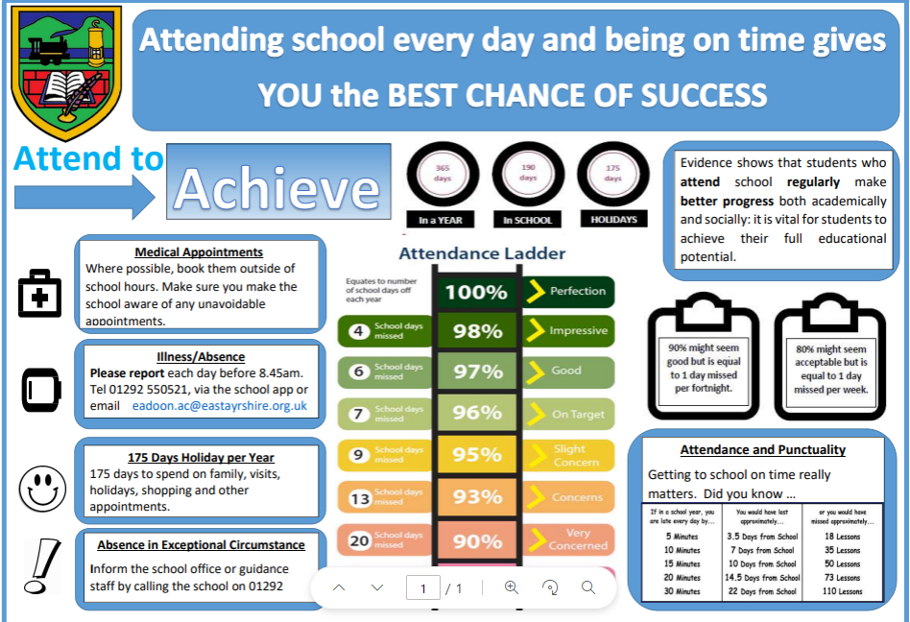
This is due to be shared with pupils in assemblies and embedded into whole school approaches. It will also be communicated with parents/ carers through the school app.

Slide 7
SIP Actions : Where are we now? 2.2 Establish a clearly identified group of learners who are at risk of disengaging and make sure that each is on course to leave school with a minimum of 150 tariff points as well as qualifications in Literacy and Numeracy (particular focus on SIMD 1 FSM)
Progress:
Group of 20 pupils identified as being at risk of disengaging (Aug 23).
10 of these pupils are at risk of not achieving target - further interventions currently being identified.
PT consultation on proposed process to monitor pupils identified.
Targeted pupils tracking information collated to identify areas of concerns across the school. This will be used to inform interventions.
How do we know:
Decision to focus on S4 as pilot group and to maximise tariff points @S4.
Utilising 'considerations for using PEF' guidance.
Guidance teachers provided list to pupils who were at the highest risk of disengagement based on this criteria.
Further consideration of pupils who did not necessarily fall into this category but were at risk of disengagement.
Insight data indicates this cohort as being a group who could be pushed further to maximise attainment.
Challenges:
Attendance – it is anticipated that attendance interventions will mitigate this challenge.
Support required:
PTs/ departments to monitor pupils identified and liaise with SLT on progress and supports being put in place within department.
Classroom teachers/ PTs keeping accurate tracking and progress reports on pupils identified to build a detailed overview of individual pupil progress so that interventions can be put in place if necessary.

Slide 8
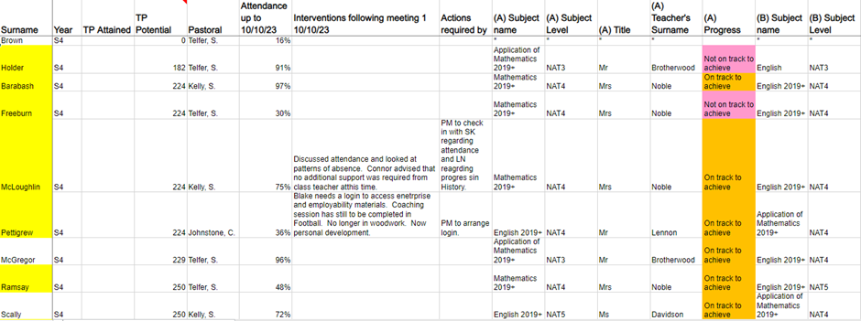
Excerpt from Targeted Attainment Group monitoring spreadsheet. 11/23

Slide 9

Looking forwards…
We need to continue to be 'a small school that thinks big' for our young people to achieve these aspirational targets.
Clear and concise objectives established.
Measurable and specific targets identified following robust consultation within the school.
Use of data needs to continue to be our priority to inform our actions throughout the session and adapt to changes if necessary.
Continue to be innovative when it comes to parental engagement. (eg. Changes to prize giving)
Be collaborative in our approach, looking outwards to see what is working for learners in comparable settings.

