Slide 1

Kilmarnock Academy: Pupil Equity Fund
Aspire Together; Achieve Together
#KACares

Slide 2

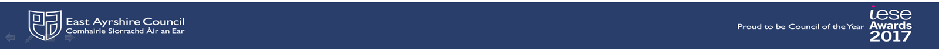
KA PEF ALLOCATION
PEF ALLOCATION 22.23 (INCLUDING CARRY FORWARD): £212, 667.24

Slide 3

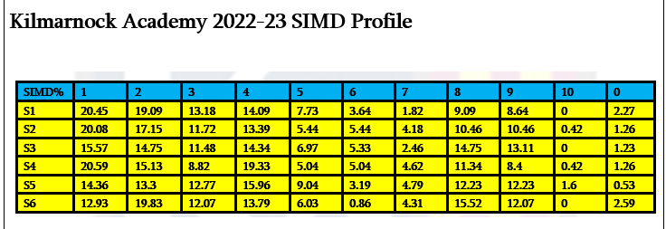
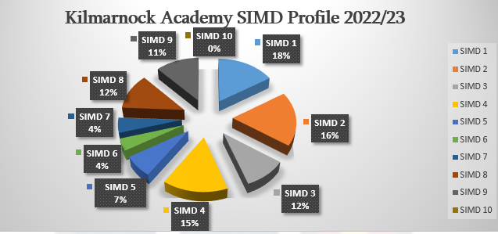
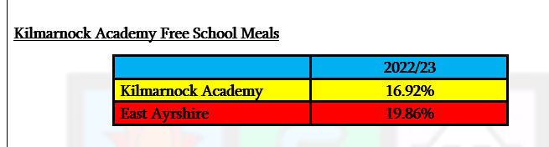
Contextual Analysis: 2022-2023

Slide 4
PEF TARGETED COHORT ANALYSIS
Identification of KA’s PEF Targeted Cohort. This includes:
SIMD 1-3 (local data highlights that those living in SIMD 3 are also at risk of poverty)
CEYP
FSM
Ethnic Minorities
Young Carers
Pupils living in single parent families
Pupils with 3+ siblings (where known)
PEF TARGETED COHORT SHARED WITH ALL STAFF AND IS A FOCUS FOR ALL PUPIL EVALUATION OF PEF INTERVENTIONS

Slide 5
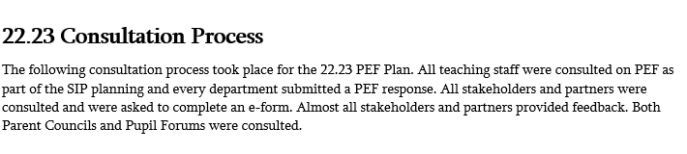
CONSULTATION: GATHERING VIEWS
23.24 Consultation Process
Same consultation as above but with the introduction of Pupil Participatory Budgeting and formation of Cost of The School Day Group. £5000 of PEF Budget allocated to pupils who came up with four ideas for spend. All pupils had the opportunity to vote on their preferred option.
There was an expansion of PEF consultation with Parents/Careers through introduction of e-form at Parents’ Evenings

Slide 6
Identified Interventions: 22.23 PEF Plan
Improved Outcomes for Young People
Raising Attainment and Closing the Gap
Literacy and Numeracy Intervention
Improving Pedagogy and Skills
Building Positive Relationships
Improve Wellbeing
Increase Parental Engagement

Slide 7
#KACares: Cost of the School Day
Each KA PEF Plan sets aside a budget to address the Cost of the School Day:
“There is a clear link been family income and educational attainment (Cooper and Stewart, 2013). Specific impacts of income on education outcomes include parents’ ability to pay for resources (e.g. childcare, educational resources (e.g. computers, internet access), transport costs and extra-curricular activities) (White, 2018). Participating in out of-school activities has been evidenced to be associated with positive educational outcomes and children from lowincome households are markedly less likely to take part in organised out-of-school activities (Chanfreau et al., 2016).”- Poverty Related Attainment Gap- A Review of Evidence
In KA 34% of pupils in SIMD 1-2, 21% of young people are in receipt of FSM

Slide 8
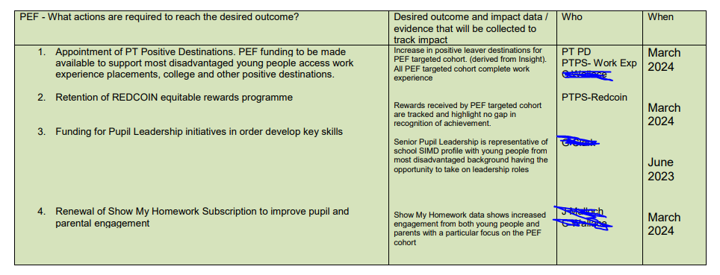
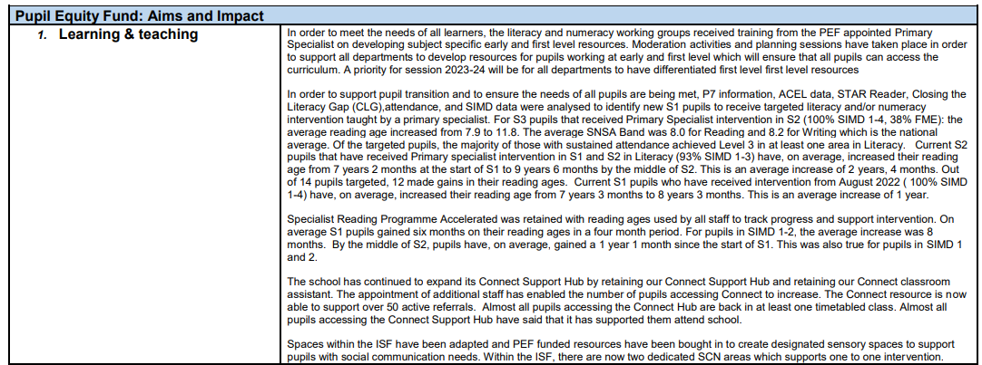
KA PEF PLAN AND SCHOOL IMPROVEMENT
23.24 PEF NOW HAS OWN SECTION IN SIP
PEF EVALUATION IN THE 22.23 S&Q

Slide 9
22.23: EVALUATION OF IMPACT
Evaluation of PEF 22.23 (1).docx
Notes:
Discuss the different ways we support young people and their families and what the challenges will be this year with the cost of living crisis

Slide 10

CLOSING THE GAP: IMPROVE ATTAINMENT FOR MOST DISADVANTAGED LEARNERS
Notes:
Discuss the different ways we support young people and their families and what the challenges will be this year with the cost of living crisis

Slide 11
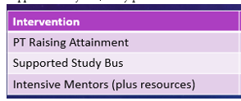
RA: Interventions and Intended Impact
Intended Impact:
Increase number of pupils achieving 3+ SCQF Level 6 Awards with no attainment gap between the most and least deprived pupils
Increase number of pupils achieving 3+ A passes at SCQF Level 6 in S5 with no attainment gap between the most and least deprived pupils
Increase number of pupils achieving 5+ SCQF Level 5 in S4 with no attainment gap between the most and least deprived pupils
Increase number of pupils achieving 3+ A passes at SCQF Level 5 in S4 with no attainment gap between the most and least deprived pupils
Increase number of total tariff points of top 20% in S4
Increase number of total tariff points of top 20% in S5
Improved attainment in BGE through a whole school understanding and approach to assessing benchmarks
Improved attendance and engagement at supported study

Slide 12
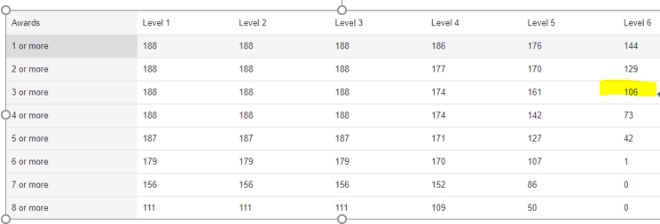
a) Insight 2023: S5 COHORT 3+ @L6
5 @ L6 Increased by 3
39% of Most Deprived 20% achieving 3+ @ L6 v 57% S5 cohort.
VC: 36% of Most Deprived 20% achieving 3+ @ L6

Slide 13
b) Insight 2023: Number of Pupils achieving 3+A at Higher- S5 Cohort
No of Higher A Passes | 2022 KA | 2022 KA Quintile 1 | 2022 VC | 2023 KA | 2023 KA Quintile 1 | 2023 VC
1 | 34.97% | 29.41% | 34.43% | 22.98% | 25.93% | 33.56%
2 | 22.40% | 23.53% | 20.66% | 20.21% | 18.52% | 21.38%
3 | 12.57% | 13.24% | 14.32% | 14.36% | 11.11% | 13.72%
4 | 6.01% | 8.82% | 9.13% | 11.17% | 7.41% | 8.83%
5 | 2.73% | 2.94% | 5.08% | 4.79% | 1.85% | 4.31%
Increase at 3+ A at L6 for S5 Cohort.

Slide 14
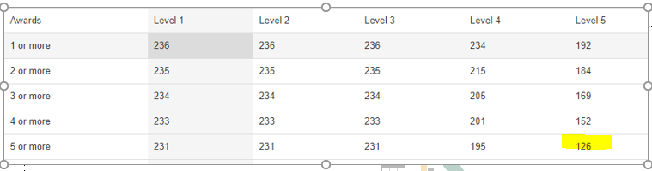
c) Insight 2023: S4 COHORT 5+ @L5
5 @ L5 increased by 10
38% Most Deprived 20% achieving 5 @ L5 v 53% S4 cohort
VC: 37% of Most Deprived 20% achieving 5@L5

Slide 15
d) Insight 2023: Number of Pupils achieving 3+A at National 5- S4 Cohort
No of Nat 5 A Passes | 2022 KA | 2022 KA Quintile 1 | 2022 VC | 2023 KA | 2023 KA Quintile 1 | 2023 VC
1 | 58.49% | 53.62% | 56.98% | 53.59% | 37.65% | 51.77%
2 | 39.62% | 34.78% | 38.54% | 33.76% | 23.53% | 34.64%
3 | 25.94% | 20.29% | 27.50% | 21.52% | 14.12% | 24.81%
4 | 17.45% | 13.04% | 20.33% | 14.77% | 10.59% | 18.14%
5 | 16.04% | 13.04% | 14.95% | 10.97% | 10.59% | 13.50%
Target not met- will be a focus due to increasing gap.

Slide 16
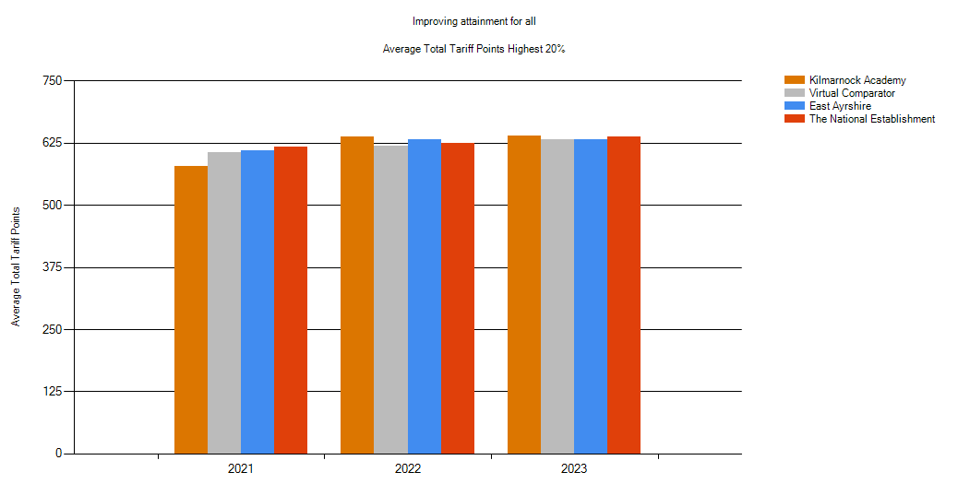
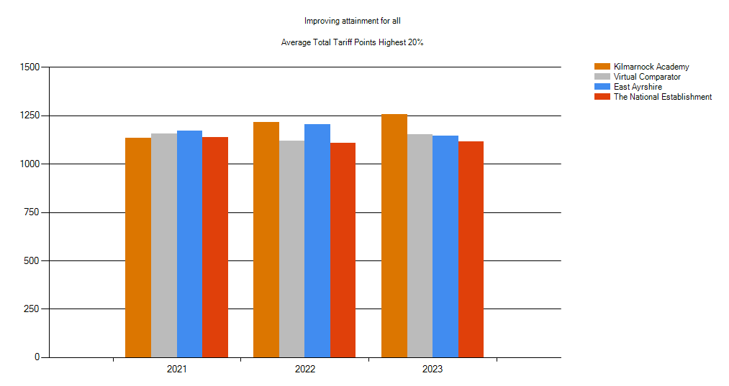
e) Insight 2023: S4 Top 20%
Increase in total tariff points in top 20% for S4
Increase in total tariff points in top 20% for most deprived 20% in S4

Slide 17
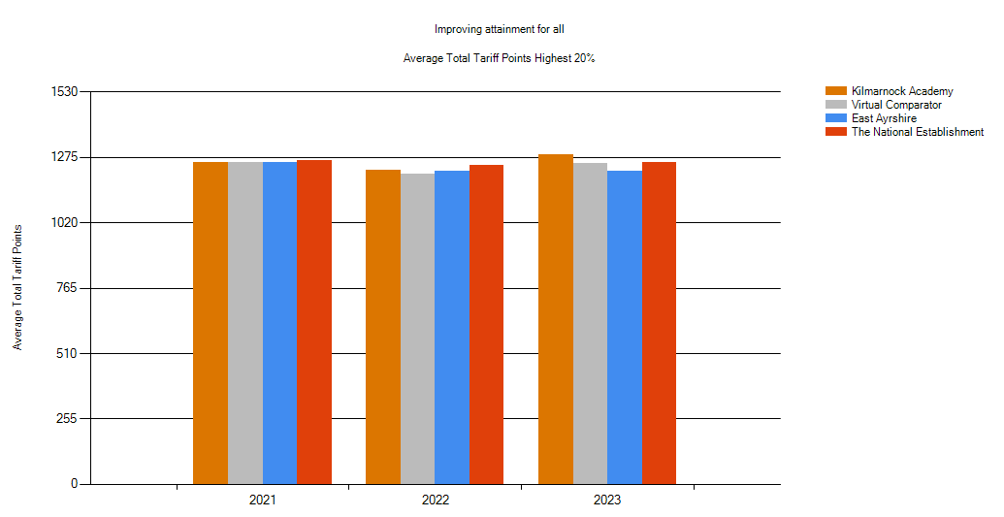
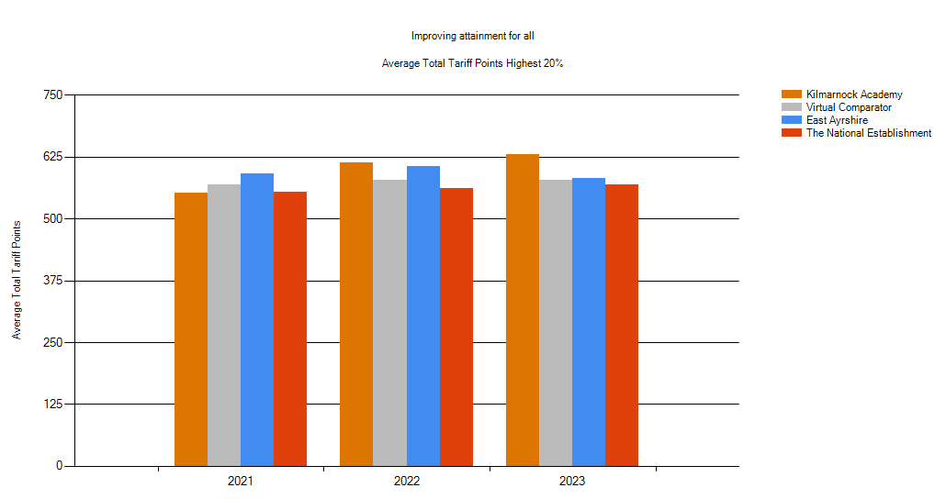
f) Insight 2023: S5 Top 20%
Increase in total Tariff Points for Top 20% in S5
Increase in total Tariff Points for Top 20% in Most Deprived Top 20% in S5

Slide 18
Capturing Attainment and Closing the Gap

Slide 19
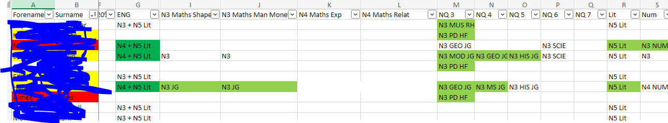
How do we Capture Attainment?
Identification of pupils at risk of under achievement from S1- shared with all staff and tracked through out the year
PEF Funded Connect Support Hub to support pupils gain these qualification

Slide 20
Intended Impact
100% of leavers achieving at least 5 N3 Qualifications
100% of leavers achieving Level 4 Literacy and Numeracy (2021-93.81%)
Increase number of leavers achieving Level 5 Literacy and Numeracy (2021- 75.77%)
To be above Virtual, East Ayrshire, SWEIC, and National measures for all attainment cohorts
To continue to be above National Establishment total tariff points for pupils in SIMD 1-3

Slide 21
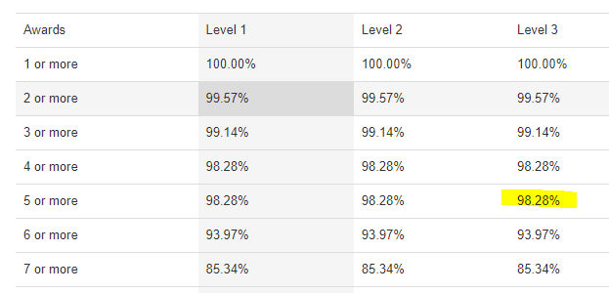
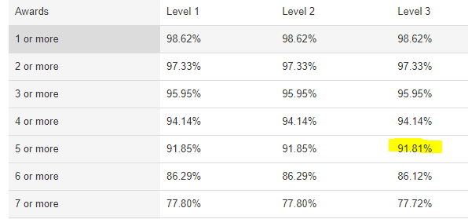
a) Insight Feb 2023: Leavers achieving 5+L3 NQs
KA
VC

Slide 22
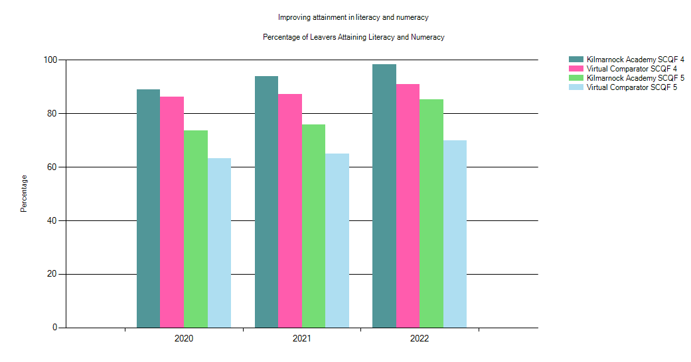
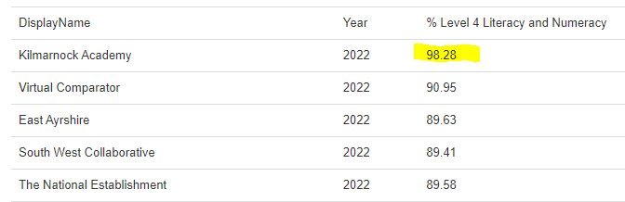
b) Insight Feb 2023: Leavers Achieving L4 Literacy and Numeracy
100% Pupils achieved L4 Literacy
98.28% achieved L4 Numeracy

Slide 23
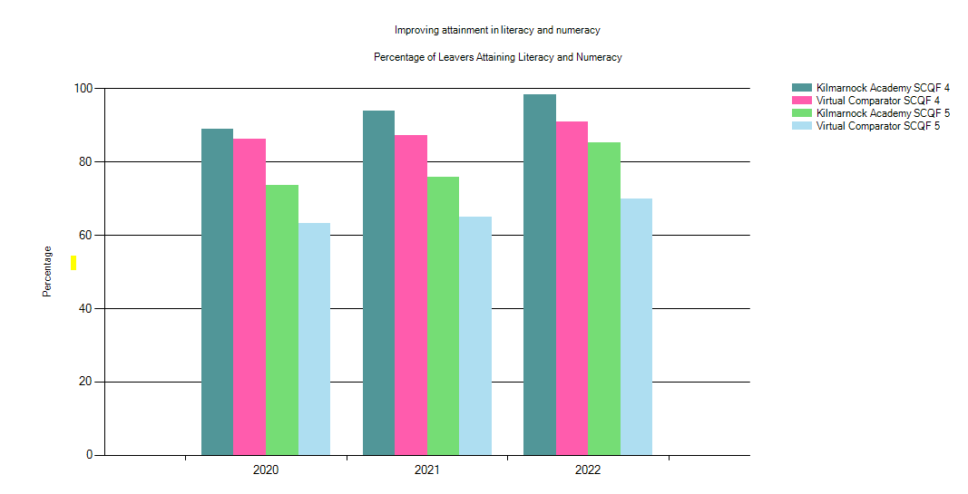
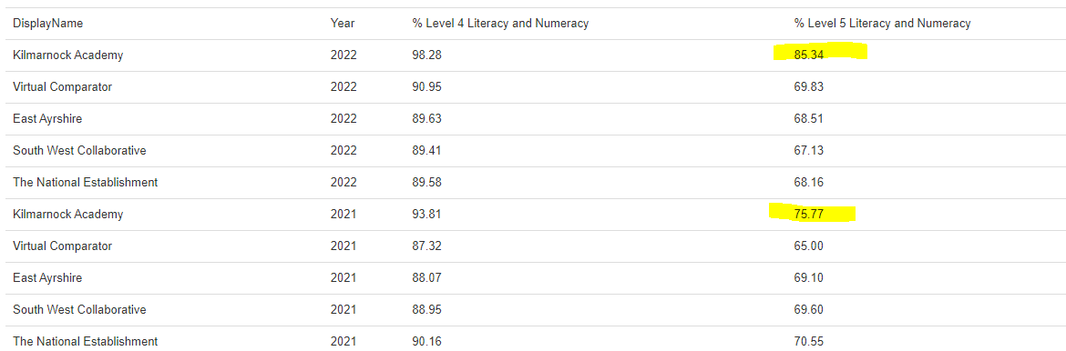
c) Insight Feb 2023: Leavers Achieving L5 Literacy and Numeracy
96.12% Pupils Achieved L5 Literacy
85.78% Achieved L5 Numeracy

Slide 24
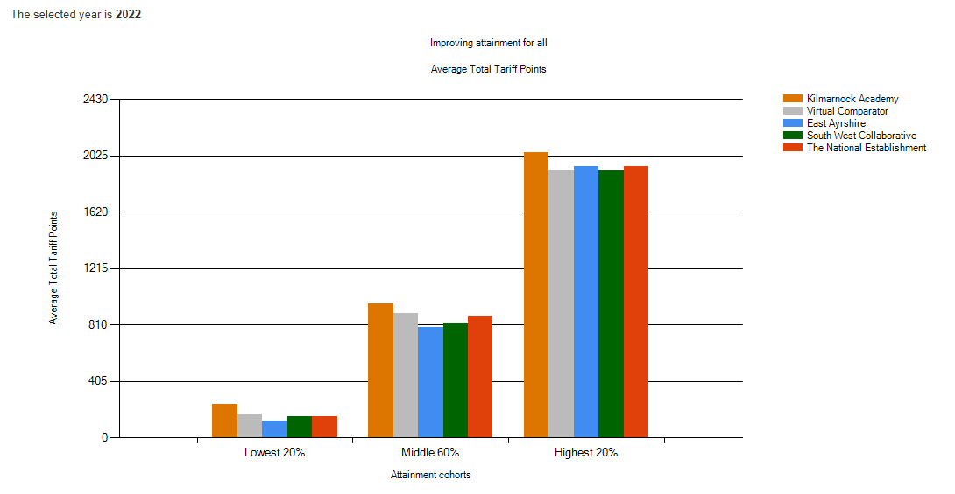
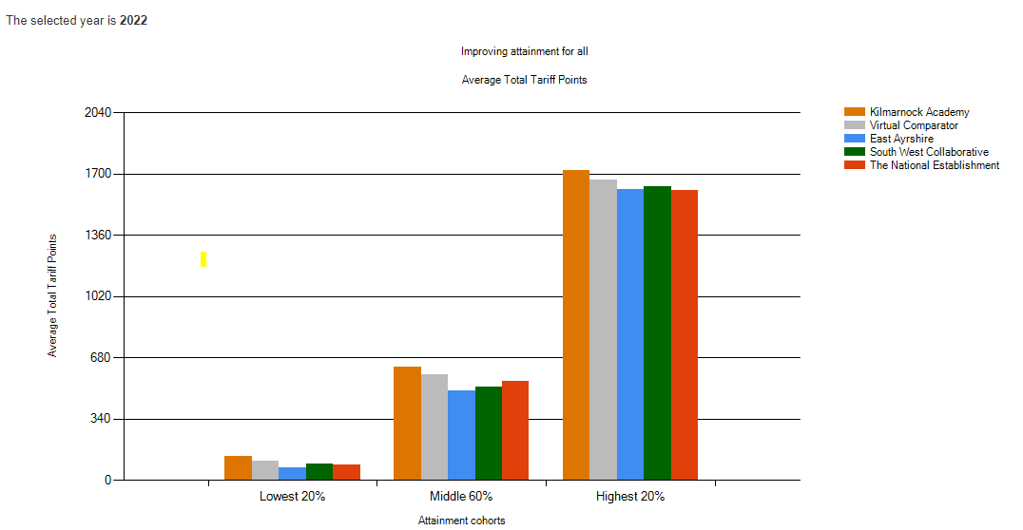
d) Insight Feb 2023: Leavers’ Improving Attainment for All
Most deprived 20%

Slide 25
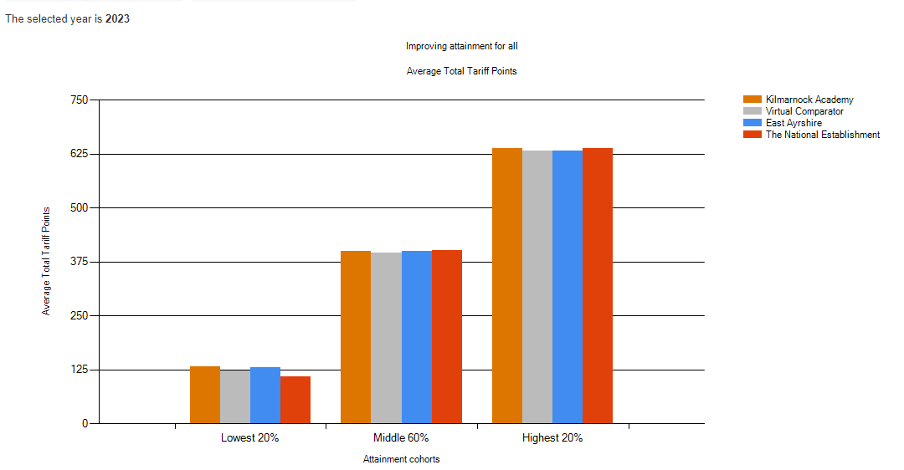
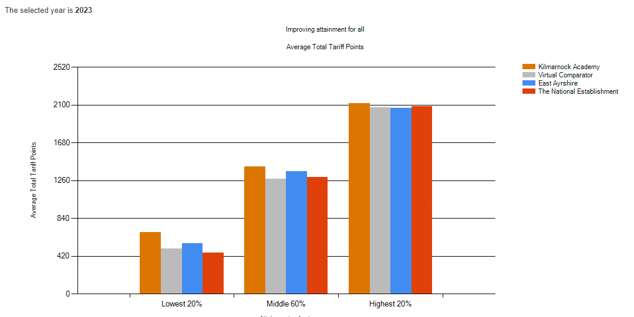
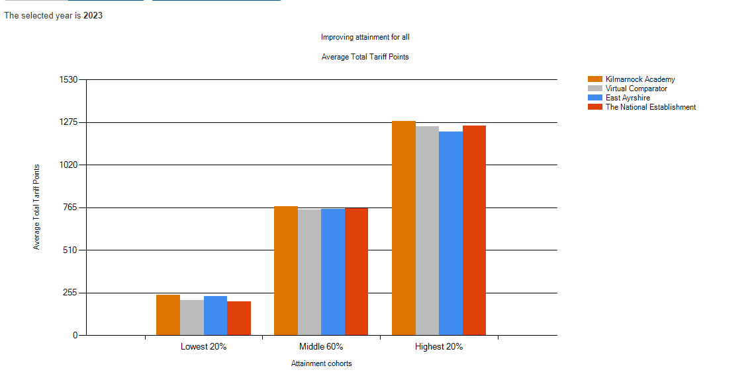
d) Insight September 2023
S4
S6
Pupils in Lowest 20%, Middle 60% and Top 20% outperforming VC, East Ayrshire and National
S5

Slide 26
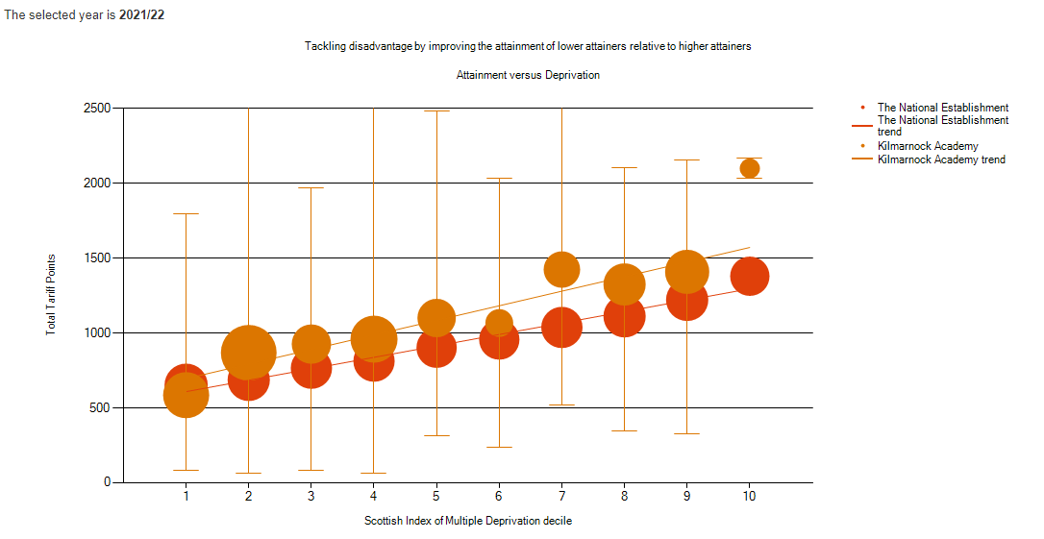
d) Insight Feb 2023: Attainment v Deprivation

Slide 27
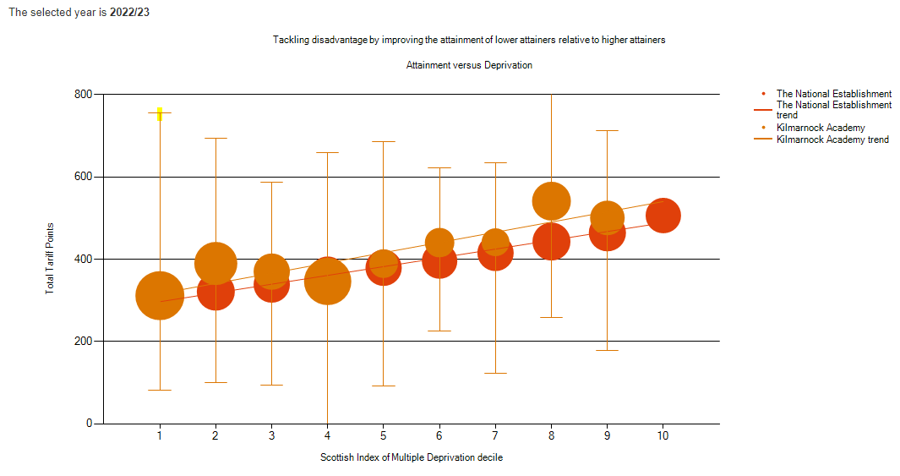
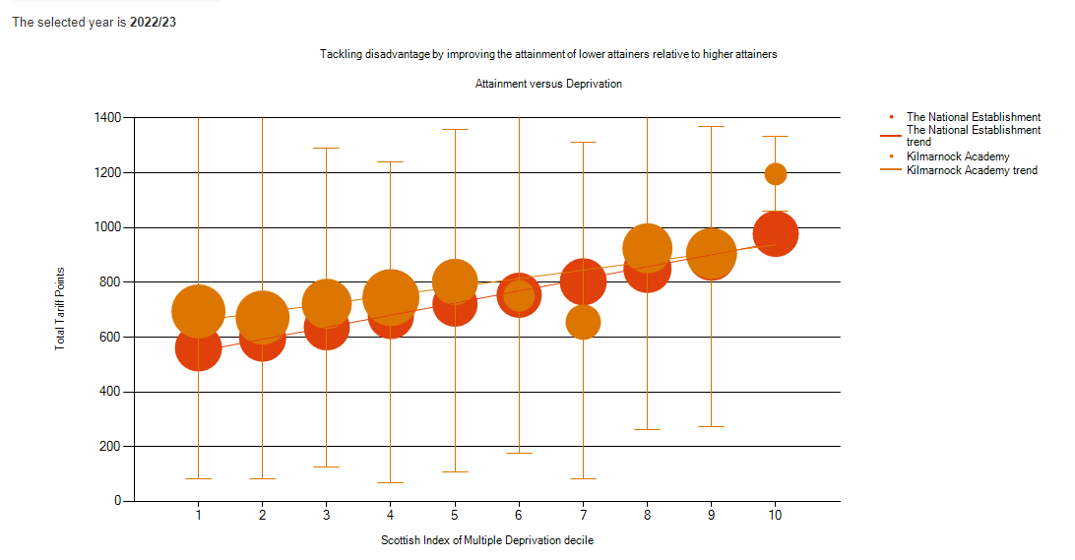
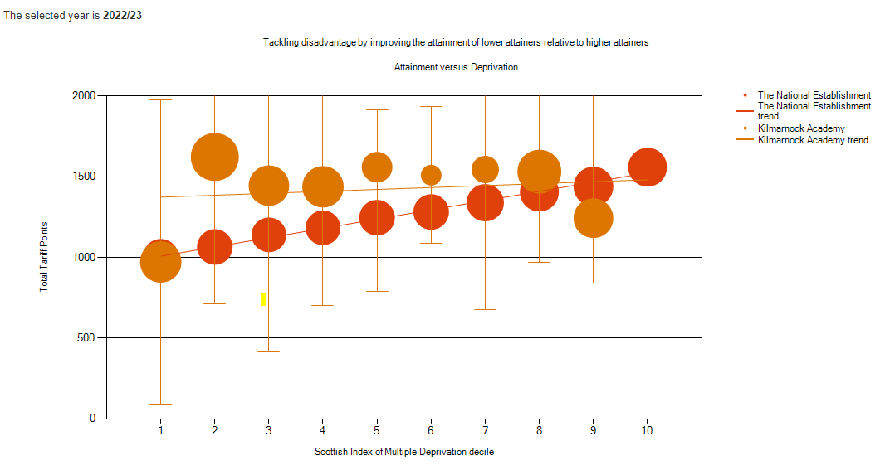
d) Insight Sept 2023: Attainment v Deprivation
S4
S5
S6

Slide 28

CLOSING THE GAP: RAISING ATTAINMENT IN LITERACY AND NUMERACY
Notes:
Discuss the different ways we support young people and their families and what the challenges will be this year with the cost of living crisis

Slide 29

Literacy and Numeracy Intervention
Intended Impact
Make 4-5% gains for S3 Level 3 ACEL data in Reading, Writing, and Talking and Listening
Make 2% gains for S3 Level 4 ACEL data in Reading Writing, and Talking and Listening
Improve reading ages, writing, and numeracy levels for targeted groups so that by the end of S3 all pupils have achieved Level 2
Year on year increases in Reading Ages for targeted groups
Notes:
Discuss the different ways we support young people and their families and what the challenges will be this year with the cost of living crisis

Slide 30
Who was targeted for Intervention?
P7 ACEL and Transition data were scrutinised to identify targeted groups. Attendance and SIMD data of this list was analysed to identify pupils with high attendance and low SIMD who would benefit from Primary Specialist. Improvements were tracked through BGE tracking and monitoring and reading ages (using Accelerated Reader).
Additional sets created in S1 and S2 English and Maths. Pupils received input from Primary Specialist at least 3 times a week.
Notes:
Discuss the different ways we support young people and their families and what the challenges will be this year with the cost of living crisis

Slide 31
How is Accelerated Reader used to identify pupils for intervention?
Every S1 Pupil in August takes a STAR Reader Test- this is used to help identify pupil who may require Literacy intervention
STAR Reader Tests are taken termly for all S1 and S2 Pupils and Reading Ages are shared with all staff so that they can best meet the needs of learners
STAR Reader Tests are used to track the progress of Literacy intervention
Notes:
Discuss the different ways we support young people and their families and what the challenges will be this year with the cost of living crisis

Slide 32
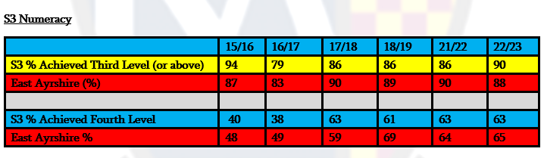
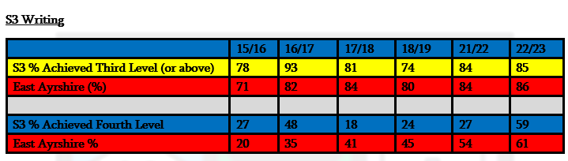
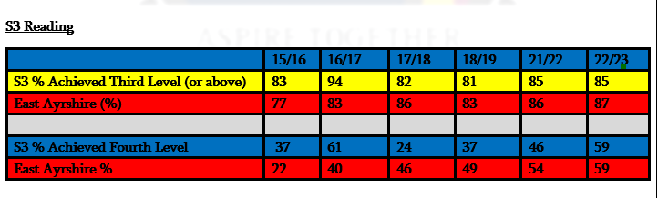
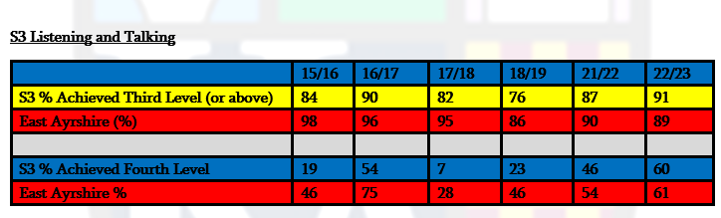
a + b) 2023 ACEL Data
32% increase in L4 W
11% increase in L4 Reading

Slide 33
Performance of Targeted Groups
For S3 pupils that received Primary Specialist intervention in S2 (100% SIMD 1-4, 38% FME): the average reading age increased from 7.9 to 11.8. The average SNSA Band was 8.0 for Reading and 8.2 for Writing which is the national average. Of the targeted pupils, the majority of those with sustained attendance achieved Level 3 in at least one area in Literacy.
Current S1 pupils who have received intervention from August 2022 ( 100% SIMD 1-4): The average reading age increased from 7.3 to 8.3. This is an average increase of 1 year.
Current S2 pupils that have received Primary specialist intervention in S1 and S2 in Literacy (93% SIMD 1-3): The average reading age increased from 7.2 at the start of S1 to 9.6 in the middle of S2. This is an average increase of 2 years, 4 months. Out of 14 pupils targeted, 12 made gains in their reading ages.
On average S1 pupils gained six months on their reading ages in a four month period. For pupils in SIMD 1-2, the average increase was 8 months. By the middle of S2, pupils have, on average, gained a 1 year 1 month since the start of S1. This was also true for pupils in SIMD 1 and 2

Slide 34

IMPROVING PEDAGOGY AND SKILLS
Notes:
Discuss the different ways we support young people and their families and what the challenges will be this year with the cost of living crisis

Slide 35
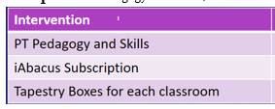
Intended Impact:
School is rated excellent in for QI 2.3- Learning, Teaching and Assessment
Pupil feedback consistently highlights excellent teaching and learning
All staff feel confident in delivering high quality teaching and learning including the use of digital technologies
Notes:
Discuss the different ways we support young people and their families and what the challenges will be this year with the cost of living crisis

Slide 36
Impact 22.23
School’s self-evaluation rating is very good for session 22.23
100% of pupil feedback agreed or strongly agreed that they were given the opportunity to lead learning.
92% of pupil feedback agreed or strongly agreed that they enjoyed learning at school because their teacher uses engaging teaching strategies
93% of pupil feedback said that they were given the opportunity to influence what and how I learn through activities such as creating learning intentions and success criteria and through learner conversations.
99% of pupil feedback said that that the feedback they receive on their work helps them improve their learning
All staff trained in the MetaSkills 4 framework to allow a consistent understanding and approach across all subjects. A Baseline survey has been completed which will allow progress through priority to be measured and enable a more focused approach moving forward.
Learning observations evidence that tapestry techniques are being used to support learning and teaching, however, a wider variety of approaches could be trialled and used more consistently across the school. This should be a focus for next term
All Learning Facilitators have received refresher training in Tapestry
All staff have completed online Promethean Training with departmental representatives receiving more advanced training
All classroom have tapestry boxes and use of tapestry techniques is part of every departmental observation strategy
Almost all joint leaders are now fully conversant in the use of iAbacus to support self evaluation. Built into the Quality Assurance calendar this session are opportunities to evaluate progress through the Quality Indicators allowing for an improved cycle of action planning and evaluation.
Notes:
Discuss the different ways we support young people and their families and what the challenges will be this year with the cost of living crisis

Slide 37

BUILDING POSITIVE RELATIONSHIPS
Notes:
Discuss the different ways we support young people and their families and what the challenges will be this year with the cost of living crisis

Slide 38
PT POSITIVE RELATIONSHIPS
INTENDED IMPACT:
Visible Consistencies used by all staff will make pupils feel safe at the school
Reduction in the number of behaviour referrals
Improved relationships in school
Notes:
Discuss the different ways we support young people and their families and what the challenges will be this year with the cost of living crisis

Slide 39
Impact
a) 98% of pupil feedback from learning observations agreed or strongly agreed that visible consistencies were used by staff and this helped them feel safe.
b) Decrease in the number of referrals from Term 1 to Term 2, due mainly to the increased focus on particular year groups and accelerating next steps by PTs/DHTs
c)76% decrease in the number of restorative conversations related to bullying
c)Statistics show an increase in the number of restorative conversations compared to 2021/22 session and increased requests from individual pupils. Aspire restorative conversations have been well received by the majority of pupils, helping create strong positive relationships with a variety of pupils and in year groups

Slide 40

IMPROVING WELLBEING
Notes:
Discuss the different ways we support young people and their families and what the challenges will be this year with the cost of living crisis

Slide 41
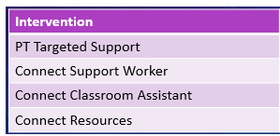
Expansion of Connect Support Hub
Intended Impact:
To support a flexible and integrated curriculum for pupils who attend the Inclusion Hub/ Connect Hub, there will be additional staffing allocated which will enable pupils who are on a flexible timetable to be taught by a subject specialist.
Increased number of pupils who are able to access the Connect Resource
Increased number of pupils accessing timetabled classes
Improved pupil wellbeing of those pupils accessing Connect
Improved pupil attendance from those accessing Connect

Slide 42

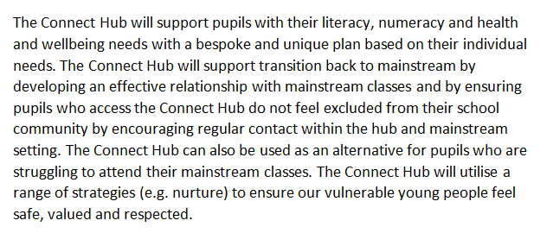
What is the Connect Support Hub?

Slide 43
Impact 22.23
Appointment of PT Targeted Support in Oct 2023 has led to the creation of small groups in order to improve transition
The appointment of additional staff has enabled the number of pupils accessing Connect to increase. The Connect resource is now able to support over 50 active referrals.
Almost all pupils accessing the Connect Hub are back in at least one timetabled class
Almost all pupils accessing the Connect Support Hub have said that it has supported them attend school.
Almost all pupils who have accessed the support hub have had improved attendance (but this is not always sustained) as they transition back to timetabled classes.

Slide 44

INCREASE PARENTAL ENGAGEMNENT
Notes:
Discuss the different ways we support young people and their families and what the challenges will be this year with the cost of living crisis

Slide 45
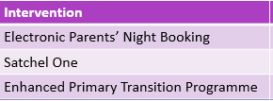
Intended Impact:
Increase in attendance at Parents’ Evenings with no attendance gap between SIMD 1-3 and SIMD 4-10
Almost all parents signed up to Satchel One and regularly engaging with app
Attendance of all targeted parents/carers at Enhanced Primary Transition Programme. Feedback from parents/carers will be positive and pupils will have over 80% attendance in S1.

Slide 46
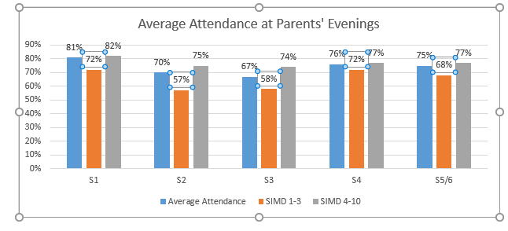
a+b) Attendance at Parents’ Evenings and Satchel One Uptake
805 Parents Signed Up

Slide 47
c) Enhanced Primary Transition
25 Families involved in Enhanced Transition Programme with the 88% of families attending majority of the sessions.
Almost all young people stating they felt more confident about starting Kilmarnock Academy.
The majority of parents involved stating they would wish to participate in further parental engagement programmes
The average S1 attendance for those in the programme was 80.84%. 11/25 pupils have Out of 25 families- 18 attended S1 Parents’ Evening (72%).

Slide 48
Cost of the School Day: Addressing Equity and Tackling Poverty

Slide 49
Addressing the Cost of Living Crisis
In line with the Scottish Government’s Poverty Plan, the school launched KA Cares which seeks to address the cost of living crisis. 120 parents responded to The Cost of the School Day survey which identified potential barriers to learning. In response to feedback, the school created a Cost of the School Day page on the school blog which collated all relevant information relating to access to financial support.
In order to reduce barriers to learning relating to poverty (and to promote sustainability), the school ran a summer pop up shop for school uniform and a campus wide KA Cares event working in partnership with Vibrant Communities and the Financial Inclusion Team. The event provided winter clothing and financial support to families to help with the cost of living crisis.
Pupil Feedback highlights that the majority of young people feels that the school provides appropriate resources in relation to the school day.

Slide 50
#KACares
#KACares – PEF Funded initiatives that address equity and wellbeing within the school.
#KACampusCares- Joint Campus initiatives to support the school community. This has included the Winter Clothing Drives and S1 Backpack Initiative
#KACommunityCares- Working with partners and the wider community to support young people; their families; and the wider community.

Slide 51
New Priorities: 23.24
Improved Outcomes for Young People
Participatory Budgeting
Pupil Leadership
Support for Pupils with SCN
Develop Wider Achievement
Improve Attendance
Increase Family Engagement
KA 23.24 Improvement Plan

Slide 52
Moving Forward: Actions for 23.24
More interrogation of the impact on intervention on the PEF Targeted Cohort – all quantitative and qualitative data must consider this
Increase Parental Consultation by including PEF in Parental Feedback forms issued at Parents’ Evenings
Utilise Support of Financial Inclusion Officer and Child Poverty Action Scotland

