Slide 1


Dalmellington PS and ECC
PB Funding 2023-2024
Notes:
To start off today, I'd like to hand over to some of the Pupil Council who would like to tell you a bit about our PB journey.

Slide 2
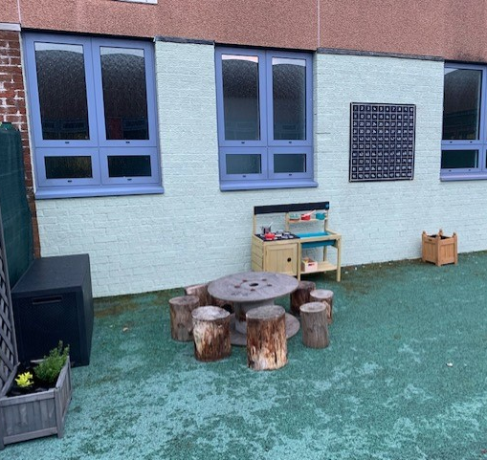
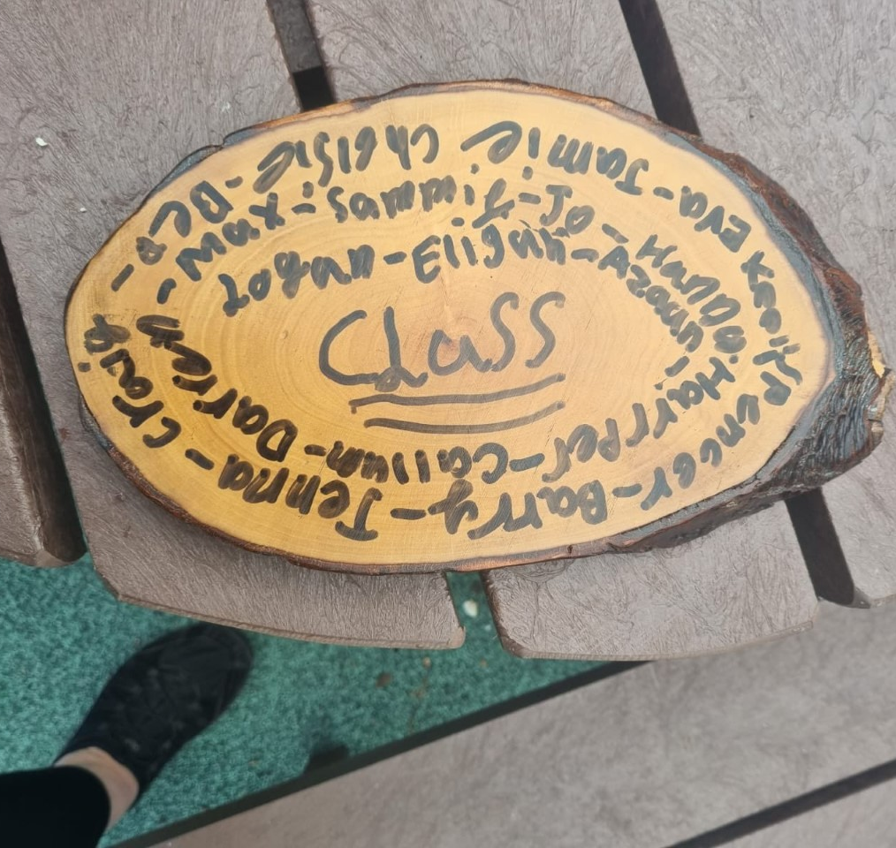
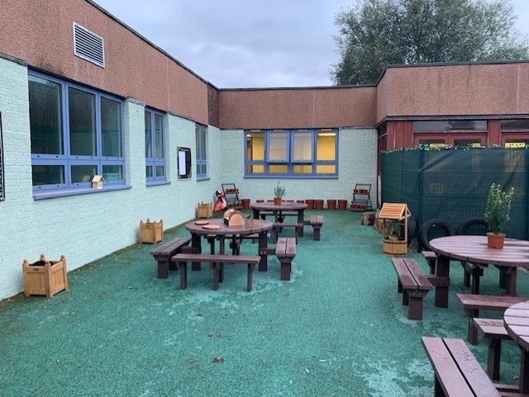
Impact of previous PB initiatives
Outdoor Classroom – Doon View
Inter-disciplinary learning project led by P5/6
Focus on literacy and numeracy outdoor resources
Parental Engagement
Notes:
We have been fortunate as a school to benefit from funds that have come in to our local community. This was especially welcome as this happened as we were trying to get back to some sort of normality. The Outdoor Classroom project was one of the projects voted for by our pupils. The development of our Outdoor Classroom was led by the P5/6 class. We focused on ensuring there were resources for outdoor learning; outdoor literacy and numeracy activities. Our parents were really keen to get involved and a highlight of this project was the afternoon the parents came along to work with the P5/6 class to build all the planters and get the area ready for the children to use. We ran a competition to name the area and the winner was 'Doon View'

Slide 3
Nomination process
Links to financial education
Classes were asked to give costs for the projects they were nominating
Data handling during the voting process
Notes:
During the nomination process, the children were encouraged to cost out the projects they were nominating, helping us develop financial education at the appropriate level for each class. There will be some data handling work to develop from the voting process we've just gone through.

Slide 4
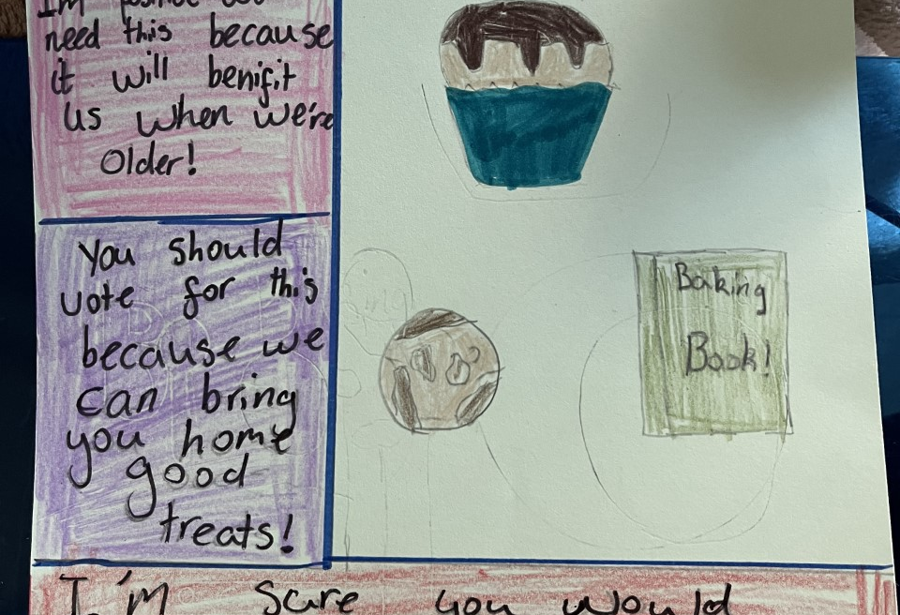
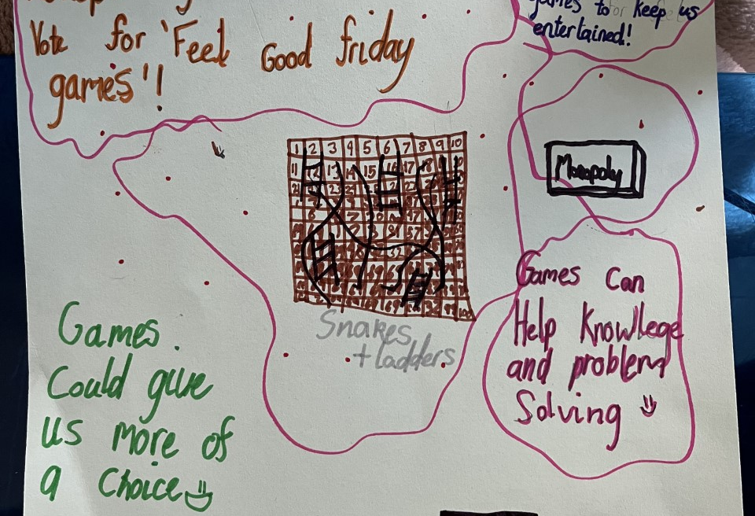
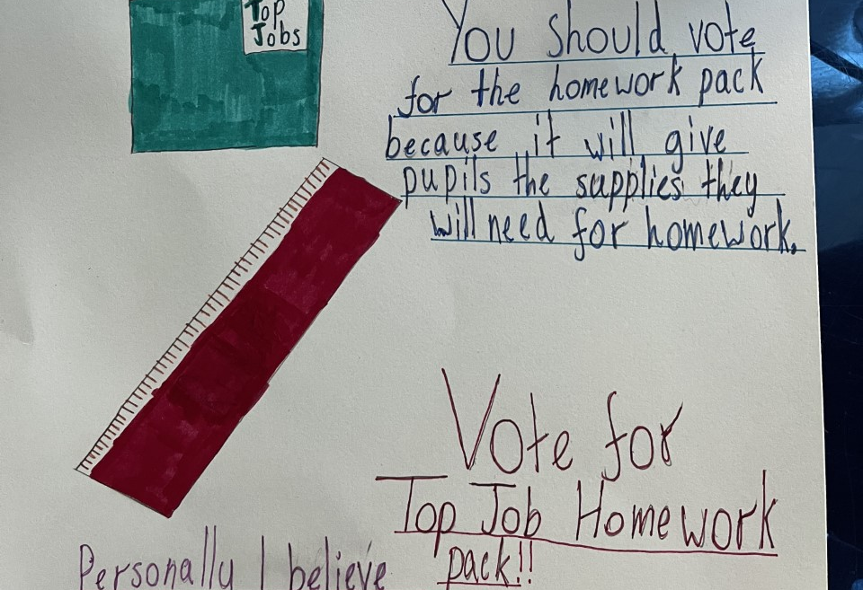
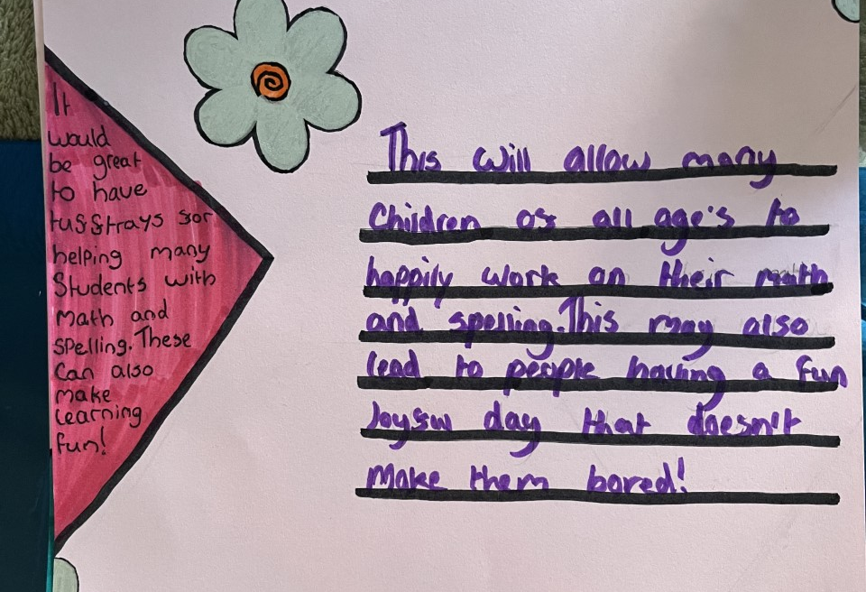
Voting Process – developing the literacy curriculum
Notes:
There was lots of literacy involved in the nomination and voting process. From the class and group discussions to having a real life context for persuasive writing. There was was lots of debate happening.

Slide 5
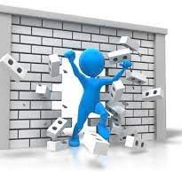
Difficulties
The literacy and numeracy tasks developed from the PB process
Wish list of nice things to have v. interventions which can have a direct impact on raising attainment
Notes:
The development of these areas of literacy and numeracy seemed to happen as a result to the PB process rather than be planned in a progressive way. This is something that we need to be aware of as we move into the planning and carrying out of the project so that we can measure the impact of planned interventions.
It was also difficult to explain the purpose of PEF funds in a way that children and parents understood. There was a tendency to suggest lots of nice things – extras almost. I've learned that it will be up to us to work with the stakeholders to design the winning projects in a way that they can deliver the extras while having the focus on raising attainment and narrowing the poverty related attainment gap.
It will take working the voting, planning, implementing and evaluating cycle to develop a greater understanding amongst our stakeholders.

Slide 6
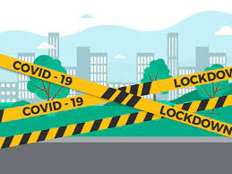

Pupil Nominated Homework Packs
Notes:
To try to help pupils understand the potential uses of PEF, I shared the Cost of the School Day toolkit. We discussed some of the initiatives there and they could see that we already do some of these things. This led to a discussion about homework. Homework being returned since returning from lockdown has been a bit erratic. The pupils were aware of this perhaps through discussions they had had with their teachers and this was where the idea for homework packs came from. This was something we'd done successfully during lockdown where resource packs were located in the local shop for families to collect resources from home learning. From the children's experiences this had been a good thing. Unsurprisingly parents didn't vote overwhemingly for this project but the children and teachers did. In moving on from lockdown, we have perhaps moved away from a source of support that children would like. Using PEF funds in this way will allow us to measure the impact of having these resources more accessible for families. Dexter's Learning Squad – our Inclusive Schools group will be leading this project.

Slide 7

Parent Nominated 'Baking Classes for All'
Most popular project with pupils, staff and parents
Literacy
Numeracy
Parental Engagement
Developing relationships within our Community
Skills for life, Learning and Work
Intergenerational work
Notes:
When this project was first selected, I was concerned how can we design this in such a way to have a focus on raising attainment and closing the poverty related attainment gap. Through discussion with the pupil council, we have designed a project outline to ensure we are developing the 4 contexts for learning in the curriculum. The next step will be to work with the staff team to ensure progression in the learning and ensure the learning activities are age and stage appropriate. Our pupil groups will also have a voice in this process too.

Slide 8
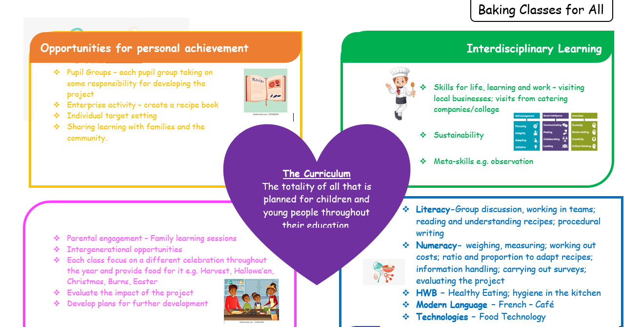
Notes:
This is the overview the we created together.

Slide 9

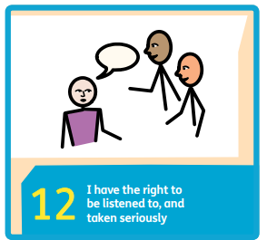
Dalmellington PS and ECC – Why PB Funding?
In the words of Dalmellington PS and ECC Pupil Council.....
The whole school can spend it – Kayla
We get to have more experiences – Callen
Pupils gets to vote on what they want – Emily
It gives people the same resources to use
Notes:
Of the 4 main pillars of the UNCRC, this process will help us develop 3 of them and it definitley allows meaningful pupil and parental voice to happen but I think my Pupil Council sum it up perfectly.

