Slide 1


INSPIRE AND TRANSFORM
St Joseph’s Academy, Kilmarnock
St Joseph’s Academy
PEF Presentation
21/4/23

Slide 2
INSPIRE AND TRANSFORM
St Joseph’s Academy, Kilmarnock
Contents
1. PEF Funded Inclusion Base
Purpose & Rationale
Logistics/Referrals
Example Timetable
Example Tracking
Insight Data
Summary
2. PEF Funded Attendance Assistant
Purpose & Rationale
Procedure
Example Data
Summary

Slide 3
INSPIRE AND TRANSFORM
St Joseph’s Academy, Kilmarnock
Inclusion Base
Rationale
Our Insight analysis of lower 20% in 2019 showed well below VC (81)and LA (104).
Lowest attainers = Lowest attenders = Strong correlation with SIMD Quintile 1
In consultation with Pastoral staff, many had significant barriers to attendance (poverty, mental health, family support/expectations, historic patterns of low attendance).
6.5 IE&I P1.
An initial short term solution from March 2019 to get S4 low/non-attenders into an alternative environment to complete outstanding units and to try to complete courses and secure destinations was successful.
It became a long term strategic plan from 2019/20 onwards. Analysis of attendance data from those targeted in 2019 showed drop off from S3 into S4. Therefore the initial target group became those identified as lowest attenders in S3.

Slide 4
Included, Engaged & Involved Part 1
INSPIRE AND TRANSFORM
St Joseph’s Academy, Kilmarnock
6.5
Longer term absence – school related issues:-
• Struggling with learning or specific lessons
• Conflict with, or fear of, a teacher or teachers
• Conflict with, or fear of, another child or young person
• Bullying
• Issues relating to social media
• Social and emotional needs and concerns relating to mental health
• Anxiety about school
• Unhappy with course choices after
Longer term absence – home and wider community issues:-
• Challenging family circumstances, including domestic abuse
• Coping with adversity and trauma
• Worries about parents, siblings or people close to them
• Experience of care
• Experience of abuse or neglect
• Anxiety/mental health issues
• Substance or alcohol misuse
It is essential to identify any underlying causes of absence and to take action to resolve these.
A child or young person may suffer from extreme anxiety and mental health issues which make it very difficult for them to attend school. Schools should consider developing a whole school approach to reducing stigma and provide support for mental health. In some circumstances other agencies and supports may be required, e.g. school counsellors or educational psychologists

Slide 5
INSPIRE AND TRANSFORM
St Joseph’s Academy, Kilmarnock
Inclusion Base
Purpose
Our PEF funded Inclusion Base is an alternative working environment staffed by 1.6 Inclusion Workers.
The aim is to create a calm, quiet working environment for very low or non attenders. Staff can provide intense support to young people who find it difficult to be in a class environment.
We allow a maximum of 10 pupils in at any one time.
Subjects can be accessed up to N4*.
Pupils work on bespoke timetables and learning plans at a suitable pace and challenge.
Ideally, pupils use this as a ‘bridge’ back to regular attendance, or an intervention to prevent further decline in attendance.
Improve attainment (primarily lower 20%) as lowest attenders are most often lowest attainers
Maintain engagement with school for attainment/achievement, but also for wellbeing, access to services and destinations. Staff are trained in ACES, TIP, Nurture, DFS, Autism Awareness. We provide breakfast and healthy snacks.
On Tuesday and Thursday afternoons, Inclusion Base staff run our ‘Outreach’ service. Where pupils who are non-attenders and haven’t engaged in all other intervention are visited. The purpose is for families and the young person to build a relationship with the staff they will work with in the base. As a last resort, they drop work off and pick it up to try to build confidence in completing work, re-engage pupils and bank qualifications (usually N2,N3 units and courses).

Slide 6
INSPIRE AND TRANSFORM
St Joseph’s Academy, Kilmarnock
Outline of Inclusion Base
Logistics
1) Referrals go to DHT using bespoke RfA. DHT completes this and sends back to Pastoral/Year Head and to Inclusion Base staff. They use this as a starting point to plan package of work.
2) Inclusion Base staff approach class teachers for appropriate work and prepare a package of work. They also have back of work to hand (workbooks, booklets, online resources).
At fortnightly meetings (Standing item on Pastoral DMs), all cases are discussed and can be adapted/adjusted accordingly. Inclusion staff keep accurate records of work completed in the base, and on Outreach visits.
Recently, on Outreach, we have been using SL33 as a meeting place to complete work. We initially booked venues, however this was proving too costly.

Slide 7
INSPIRE AND TRANSFORM
St Joseph’s Academy, Kilmarnock
Example of Schedule/Timetable

Slide 8
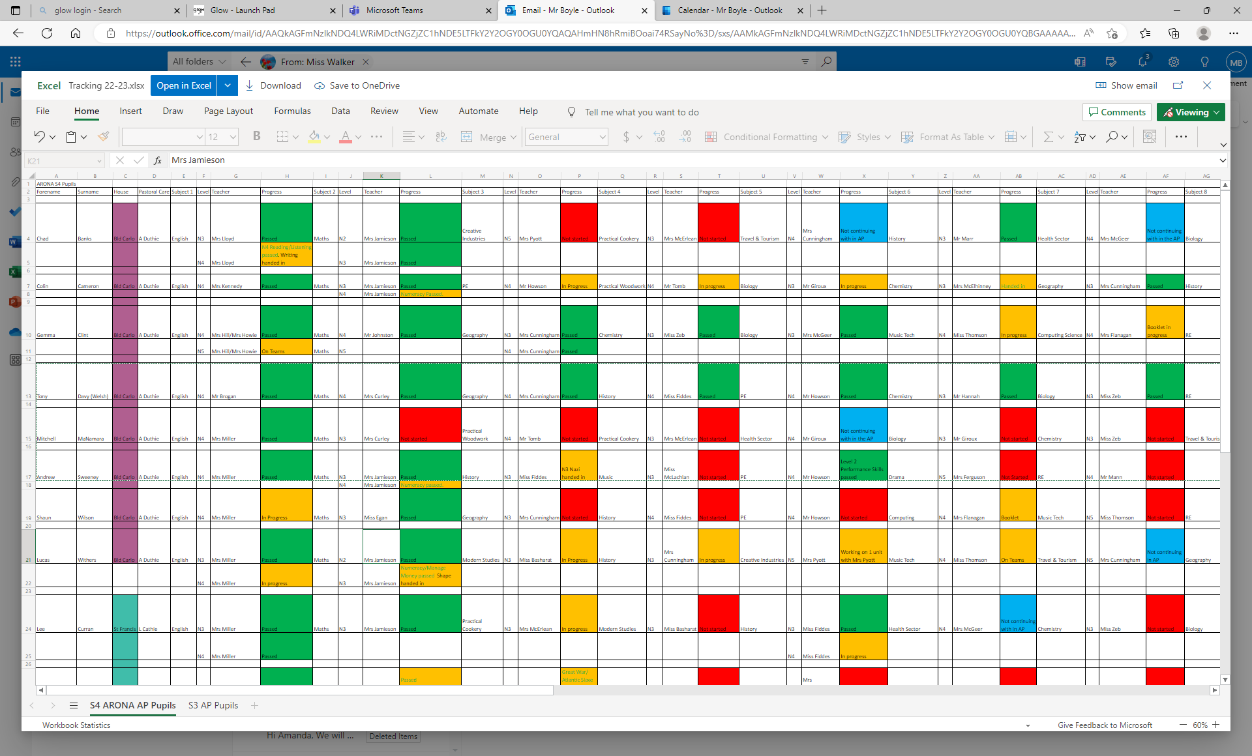
INSPIRE AND TRANSFORM
St Joseph’s Academy, Kilmarnock
Example Attainment Tracking Spreadsheet
Completed courses are tracked
(R – Not started, A – In progress, G – Completed, B – Not continuing in base)

Slide 9
INSPIRE AND TRANSFORM
St Joseph’s Academy, Kilmarnock
Example of Tracking - Outreach
Outreach Tracking Sheet. Updated on Teams after every visit. Team for each house group. Pastoral teacher copies and pastes action/information into Pastoral Notes.
St Theresa House
Pupil Name |  | Class | Parent/Carer | Address |  | Date Contacted | Comments | Date Contacted | Comments | Date Contacted | Comments | Date Contacted | Comments
DB |  | 2T2 |  |  | 07526127795 (new 24/8/22 07738810784 (new 20/1/23 JW) New email - Karendunsmore91@gmail.com | 1/3/23 HV (JW/CM) | Spoke with Mum. She said she'd try to get Declan to attend tomorrow. We asked if any of the previous work we have left had been completed but it hadn't. We left some other work too. | 9/3/23 HV(JW/CM) | Spoke with mum, clarified email. dunsmorekaren91@gmail.com Left work for Declan. She said Declan may attend if S Cassidy is attending. | 16/3/23 HV (JW/CM) | Mum answered the door but said she couldn't talk, she was on the phone about her bank card. We left work for Declan, no work given back.
KB |  | 1T1 |  |  | 07526127795 (new 24/8/22 07738810784 (new 20/1/23 JW) New email - Karendunsmore91@gmail.com | 1/3/23 HV (JW/CM) | Spoke with Mum. She said Kailtyn should've been in last week, but couldn't get her to go. She said she would try to get her in tomorrow. | 13/3/23 Phone call from Mum (JW) | Mum called to ask why Kaitlyn and Sophie have to be in separate rooms during school day. Notified her that Mr Boyle would email her regarding the matter. | 16/3/23 HV (JW/CM) | Mum answered the door but said she couldn't talk, she was on the phone about her bank card. Hope to see Kaitlyn on Monday.
DB |  | 4T1 |  |  | 7771868436 | 9/3/23 HV ( JW/CM) | Mum not pleased, "wasn't expecting us." Said "we need to communicate better with colleagues as she had spoken to M Marshall yesterday and a taxi has already been arranged for Daniel for Monday." We said we'd check in with M Marshall | 14/3/23 email to mum (CM) | Sent email requesting best time to visit.

Slide 10
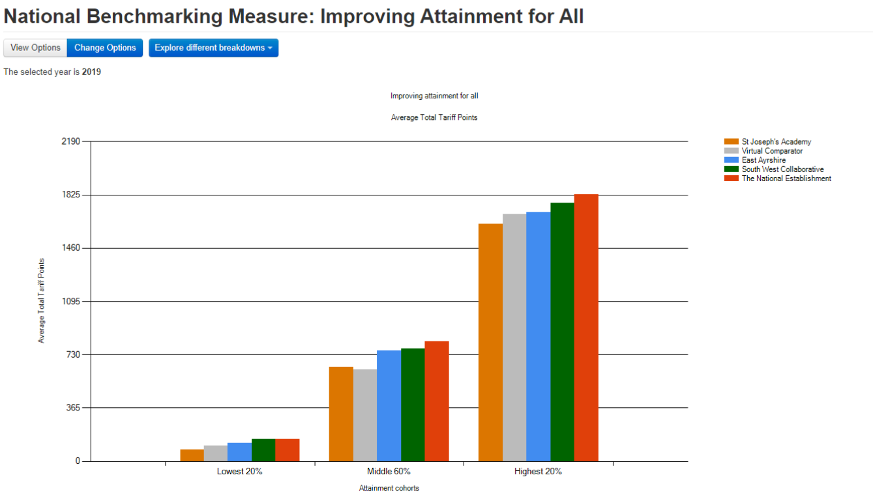
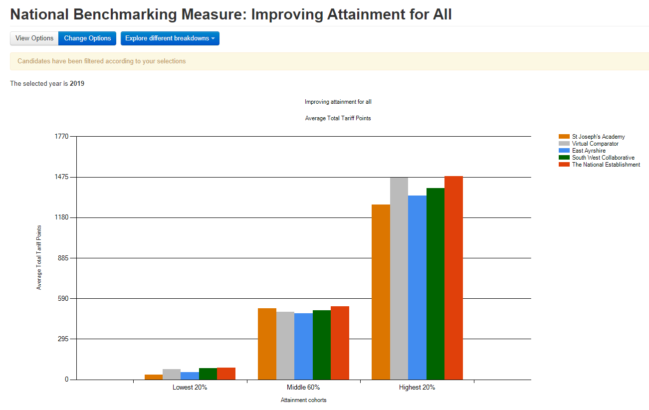
Data
INSPIRE AND TRANSFORM
St Joseph’s Academy, Kilmarnock
All
2019 – SJA 81 v VC 104
Quintile 1
2019 – SJA 34 v VC 74

Slide 11
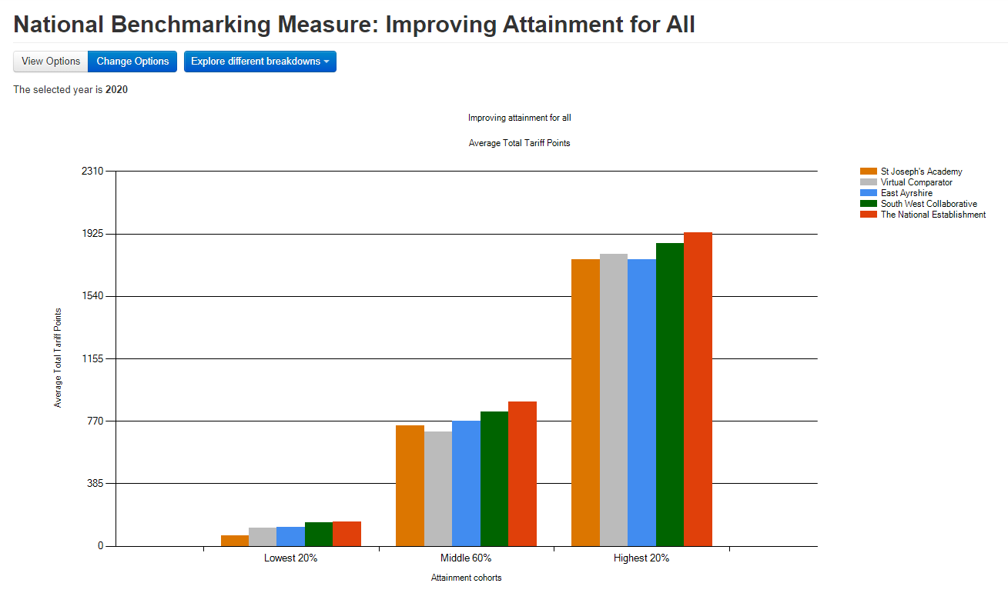
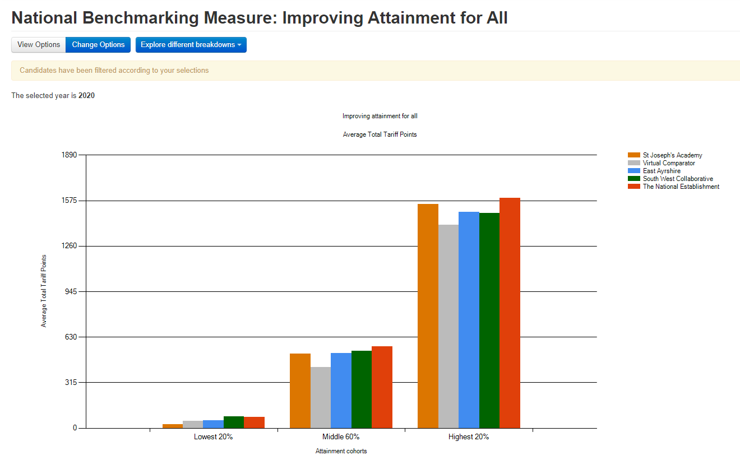
Data
INSPIRE AND TRANSFORM
St Joseph’s Academy, Kilmarnock
All
2020 – SJA 63 v VC 110
Quintile 1
2020 – SJA 25 v VC 50

Slide 12
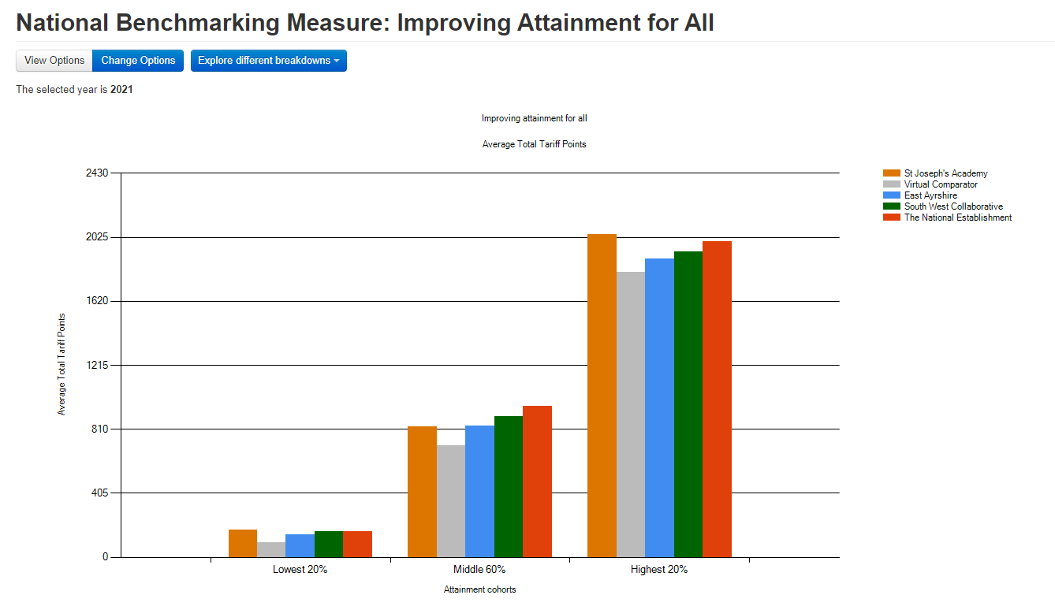

Data
INSPIRE AND TRANSFORM
St Joseph’s Academy, Kilmarnock
All
2021 – SJA 173 v VC 92
Quintile 1
2021 – SJA 148 v VC 65

Slide 13
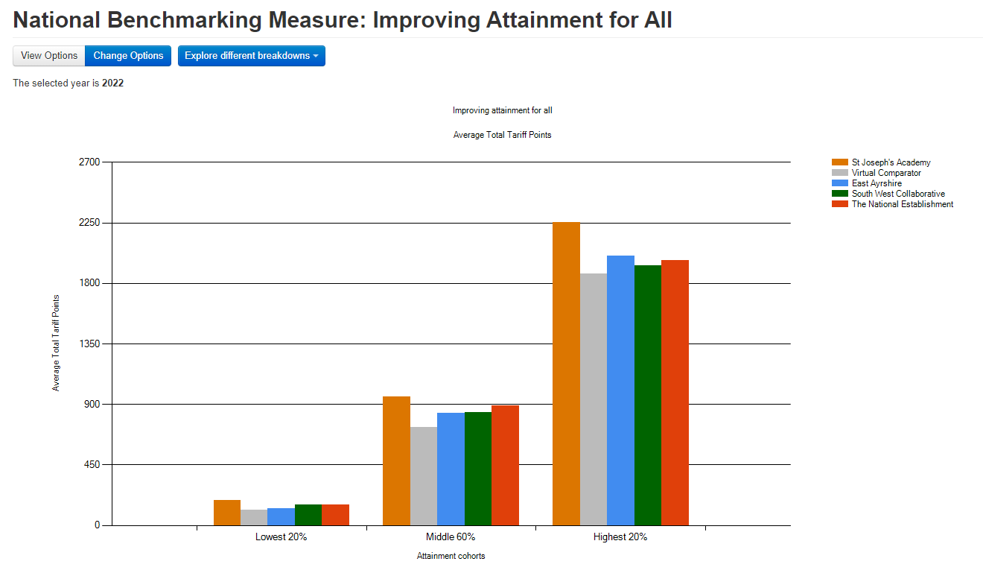
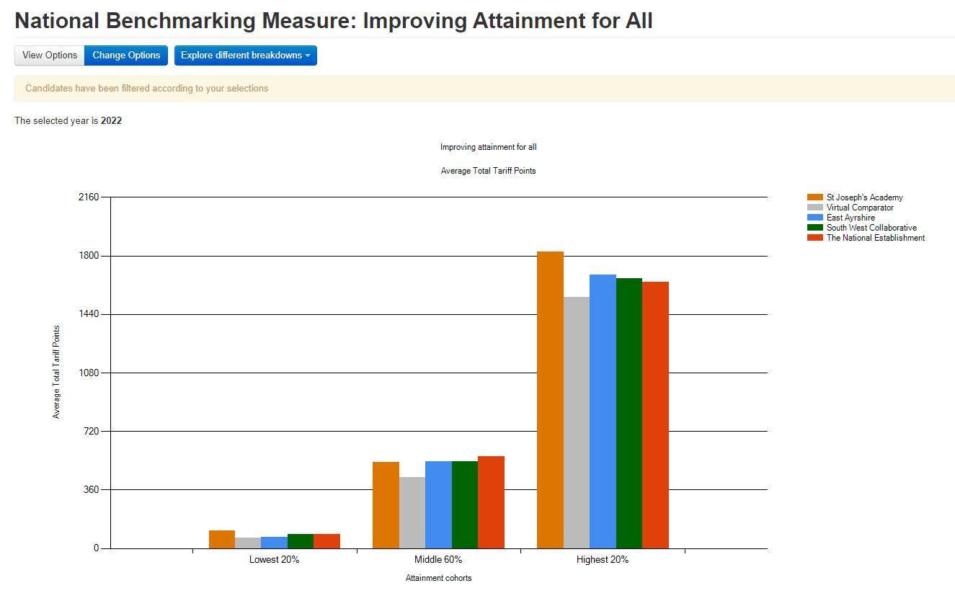
Data
INSPIRE AND TRANSFORM
St Joseph’s Academy, Kilmarnock
All
2022 – SJA 184 v VC 114
Quintile 1
2022 – SJA 109 v VC 66

Slide 14
Inclusion Base Summary Success Very successful initiative. Data supports this. Parent and pupil feedback is very positive and shows a need for this type of facility, as do number of referrals. Difficulties Managing timetables so as to maintain quiet environment. Often pupils with no/very low attendance can display/present challenging behaviour, therefore creating a timetable which prevents disruptive dynamics is key. Not all pupils are appropriate for referral to Inclusion Base, where we then need to look at alternative interventions. Future Where PEF allows, keep the staffing and space to allow the Inclusion Base to run in its current form. If space did not allow, this would present major issues. Likewise with the future of PEF funding to allow staffing.
INSPIRE AND TRANSFORM
St Joseph’s Academy, Kilmarnock

Slide 15
PEF Attendance Assistant Rationale Attendance analysis showed that we were consistently below the EA average. Usually between 1- 2% below. Limited detailed data means analysis was difficult in order to ascertain reasons. We felt that a member of staff with responsibility for attendance could not only manage day to day attendance, but also produce accurate data to allow us to track patterns of attendance. Also, in discussions with Pastoral Staff, tracking attendance took up a significant amount of their time and we felt an attendance assistant would free Pastoral Staff up to dedicate more time to their strategic remit areas. We had shared responsibility between office staff and Pastoral to manage attendance. Office staff took absence calls and updated seemis, Pastoral acted on TBCs and truancy and indicated who was to receive attendance letters. Often TBCs were not followed up due to time constraints/other priorities, therefore remained TBC. This is not a long term code. Having TBCs then renders the data inaccurate and does also not explain the reason for absence. Also, who entered a code (or didn’t) could be difficult to trace and manage. Furthermore, period by period incomplete registers can be an issue if not acted upon, as they default to ‘Present’. Sending home attendance letters, or discussing attendance in TACs which included TBC showed that we as a school did not actually know the reason their child was absent and indicated that the system lacked robustness. Also, truancy was not picked up live, it was often after school or the next day (or never) that it became apparent, meanwhile the child’s whereabouts is unknown.
INSPIRE AND TRANSFORM
St Joseph’s Academy, Kilmarnock

Slide 16
PEF Attendance Assistant Purpose - Mange day to day attendance (take absence line, send group calls, code pupils appropriately) - Chase up incomplete registers period by period by phoning staff - Act on anomalies as they appear period by period. If this ends up being truancy, call parents straight away. - Investigate all TBCs so as to assign accurate code - Generated and send attendance letters - Generate data for analysis. Lowest attenders by house group week to week. This is emailed to Pastoral staff on a Friday, lowest to highest. - Generate termly spreadsheets showing attendance by year group and attendance by SIMD
INSPIRE AND TRANSFORM
St Joseph’s Academy, Kilmarnock

Slide 17
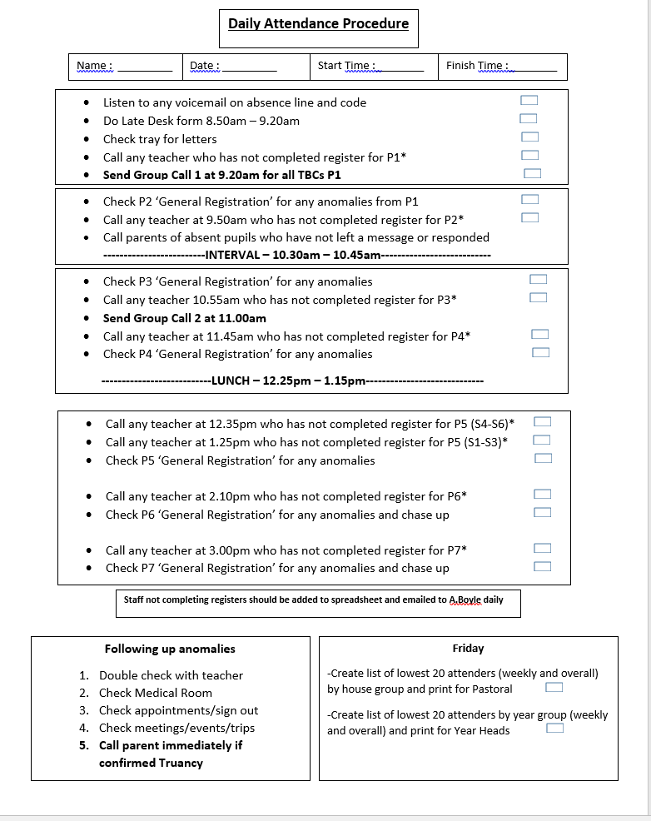
PEF Attendance Assistant
INSPIRE AND TRANSFORM
St Joseph’s Academy, Kilmarnock

Slide 18
INSPIRE AND TRANSFORM
St Joseph’s Academy, Kilmarnock
Example Weekly Attendance Data
St Joseph's Academy |  |  |  |  | Weekly Attendance Monitoring
 | S1 |  | S2 |  | S3 |  | S4 |  | S5 |  | S6 |  | (blank) |  | Total Count | Total Av %
House | Count | Av % | Count | Av % | Count | Av % | Count | Av % | Count | Av % | Count | Av % | Count | Av %
St Andrew | 57 | 95.31 | 30 | 85.12 | 55 | 88.60 | 50 | 84.86 | 25 | 94.18 | 29 | 95.20 |  |  | 246 | 90.32
St Columba | 28 | 95.41 | 52 | 89.90 | 48 | 88.19 | 26 | 87.29 | 47 | 84.38 | 15 | 89.33 |  |  | 216 | 88.68
St Margaret | 49 | 96.47 | 45 | 95.36 | 27 | 93.98 | 55 | 89.42 | 29 | 84.04 | 35 | 89.59 |  |  | 240 | 91.86
(blank)
Grand Total | 134 | 95.75 | 127 | 90.71 | 130 | 89.57 | 131 | 87.25 | 101 | 86.71 | 79 | 91.60 |  |  | 702 | 90.34
This data can be viewed as individual weeks and can also be accumulative.

Slide 19
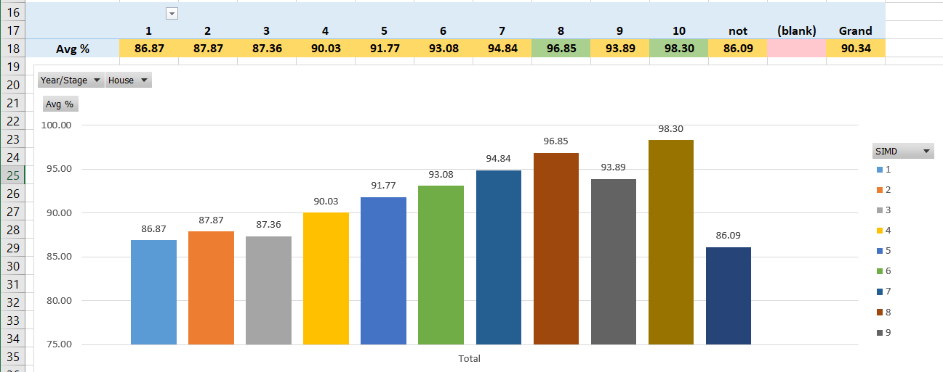
INSPIRE AND TRANSFORM
St Joseph’s Academy, Kilmarnock
Example Termly Attendance Data (By SIMD)

Slide 20
INSPIRE AND TRANSFORM
St Joseph’s Academy, Kilmarnock
Example Termly Attendance Data
Row Labels | Count
1 | 115
2 | 170
3 | 72
4 | 67
5 | 74
6 | 24
7 | 37
8 | 51
9 | 68
10 | 20
not found | 4
(blank)
Grand Total | 702

Slide 21
INSPIRE AND TRANSFORM
St Joseph’s Academy, Kilmarnock
Example Termly Attendance Data

Slide 22
Attendance Assistance Summary Success Data shows that overall, attendance has not increased significantly. We have had spells where we have been above EA average but it has not been sustained. (Potential reason for this is lowest attenders statistically are form SIMD1&2, we have 40% of pupils from SIMD1&2, therefore significant impact on overall stat). However, our systems and coding accuracy have vastly improved, which is a success. Our confidence in individual attendance reporting (particularly in TACs, hearings etc) has improved. The clarity in roles and time for Pastoral staff to fulfil other parts of role means we have progressed in other strategic areas. Also, importantly, we are more successful in identifying and acting on truancy. Difficulties Having one person solely responsible, means if that person is off sick, we have to have a contingency, which is not as robust or efficient and means we cannot generate the statistical data. Future Where PEF funding allows, we would look to keep this post, using the same/similar format and procedure. Use the statistical breakdown to plan further interventions (ie SIMD 1 & 2), to improve % is a future target.
INSPIRE AND TRANSFORM
St Joseph’s Academy, Kilmarnock

