Slide 1



PEF Refresh
Notes:
Cat
Good morning and a warm welcome to this PEF refresh session.
Intro everyone.

Slide 2

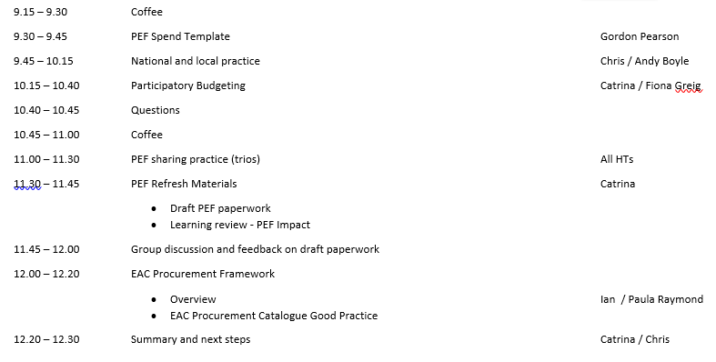
Programme
PEF Blog
East Ayrshire PEF blog | Just another blogs.glowscotland.org.uk – East Ayrshire site
Notes:
You should have a copy of the programme for this morning but after we had run the printing we meet and changed things around a bit so I have added a few copies of the new programme onto your tables.
I have also set up a Blog to share the papers, a PB video, PP and examples of practice from SLC. You have the link and QR code on the screen here and on your programme.

Slide 3
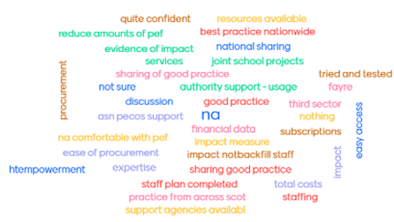
Session Aims
Update on PEF spend
Participatory Budgeting
National and Local practice
Enhancing quality assurance
Reflect on PEF plans
Reflect on use of Procurement Framework
Notes:
Cat
Back on 4th October at the HTs meeting at London Road I asked what content you would like us to provided today and I hope that we have provided that for you. As yet I have not organised a procurement fair but this will be my next priority after today.

Slide 4
PEF Spend Template
Forecasting tool
Auto populates staffing costs
Pay rising in January has been factored in
Forecasting information is pulled into your PEF spending plan
Drop downs for type of purchase and area of focus - Overview
Feedback sheet
Do you want to leave the drop downs for type of purchase and area targeted?
Notes:
Cat / Gordon
When I have been out visiting schools it was clear that the staffing changes constantly wither its starting for new staff or staff are pulled away to cover other core staff so I have worked with Gordon Person and Finance to add a staffing forecasting tool into our PEF Spend Template. The forecasting tool calculates your staff for you and pulls the information into your PEF Spend template. I thought it would allow you to keep in touch with your expenditure much more easily. Gordon is going to demo the new PEF Spend Template.
You have a feedback sheet to give us your comments about the new PEF Spend Template. Gordon has added drop downs for type of resources and area of impact and the forecasting tool provides an overview on tab 1. This information make it easier for you to share with your stakeholders what you are spending your PEF on and what area you are targeting with the funding. However, if you don’t feel you need this information let us know and we can remove the columns.
Play clip
The information you add in staff and resources spending automatically gets pulled into your PEF spending plan to give you and finance an overview of your spend.

Slide 5

National context
Pupil Equity Funding (PEF) is additional funding allocated directly to schools and targeted at closing the poverty-related attainment gap.
• £520m from 2022-2026 invested at school level
• Overall PEF investment in 2021/22 was £130.76 million with a record £59.70 million carried forward. This equates to 69% investment / 31% carry forward
• Aware nationally that headteachers have faced significant challenges in terms of recruitment and due to restrictions in schools during 2021-22 session

Slide 6
Key messages
• Interventions and approaches should be considered within the context of the school improvement planning cycle and must be targeted towards closing the poverty-related attainment gap
• Headteachers have flexibility when deciding which children and young people can benefit from the funding
• The use of school and learning community data is strongly encouraged to identify the gap that you are trying to address
• Unspent funds can be carried forward to the new financial year. The expectation is that, other than in exceptional circumstances, it should be spent within that same academic year

Slide 7
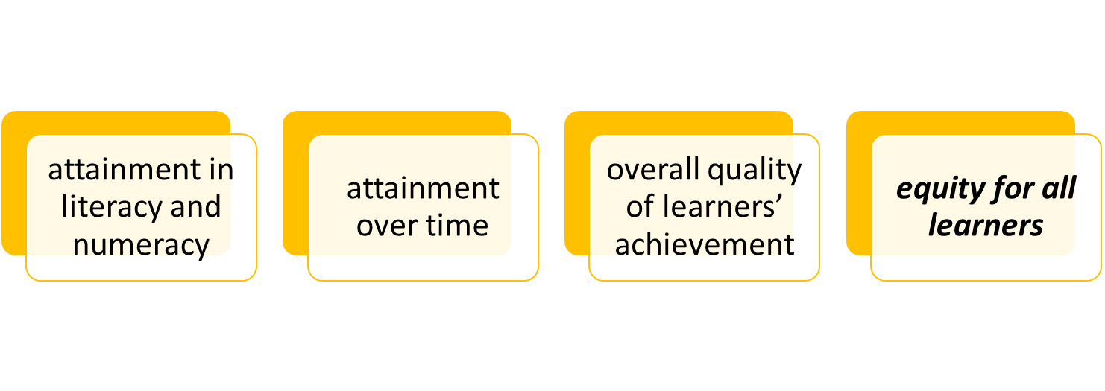
Looking outwards – PEF, Equity and HMI
HTs keen to learn from practice from outwith East Ayrshire
Summary of key themes emerging from HMI inspection reports in relation to PEF and equity across the West RIC between September 2022 and February 2023
During this period 24 school reports have been published – 20 primary and four secondary.
The majority of evidence comes from Q.I 3.2:
Notes:
.

Slide 8
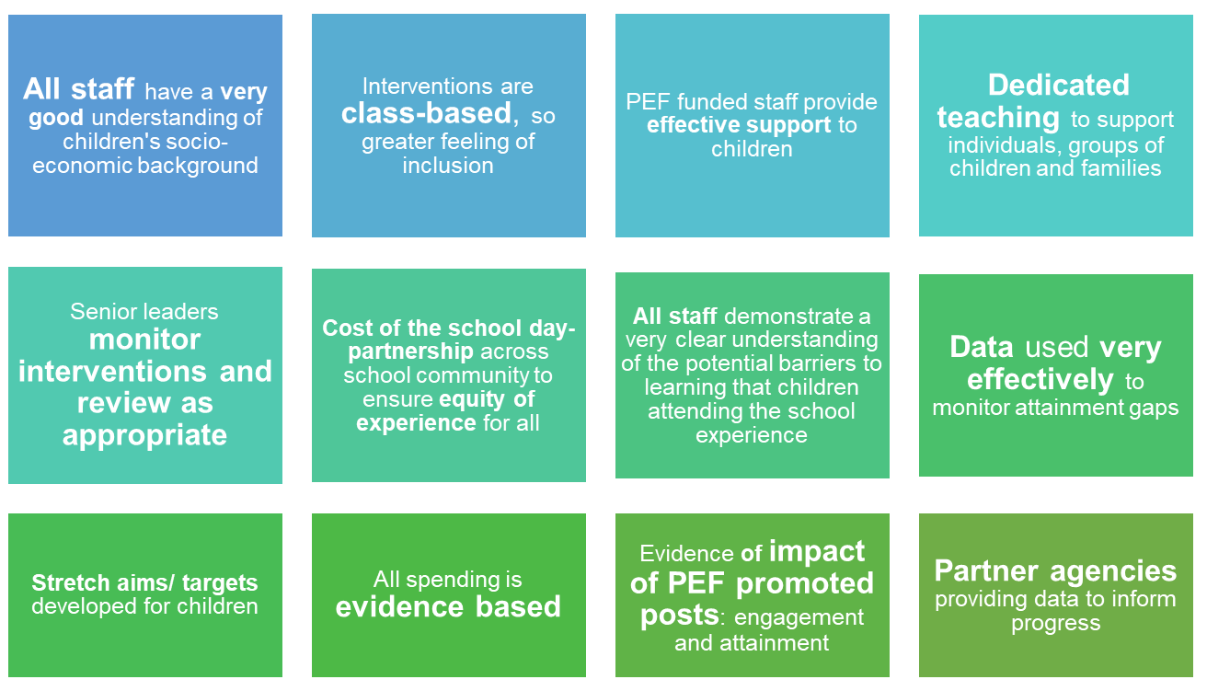
'Very Good' - emerging themes

Slide 9
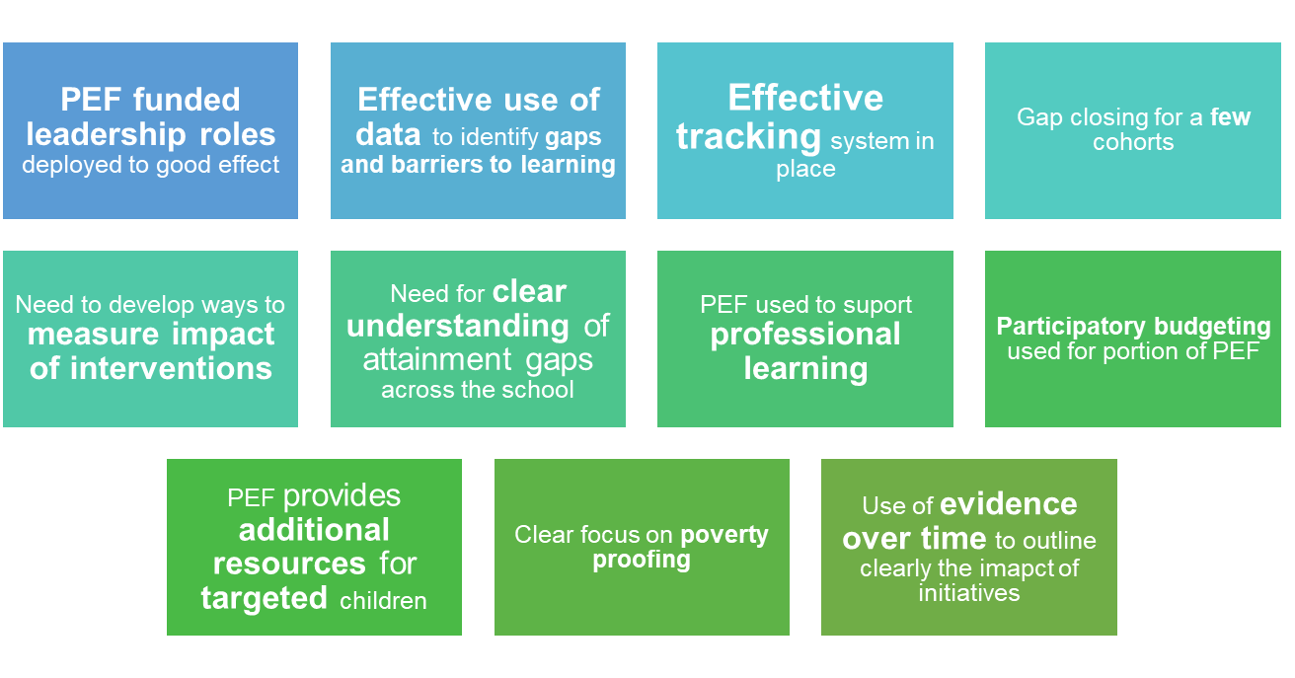
'Good' - emerging themes

Slide 10
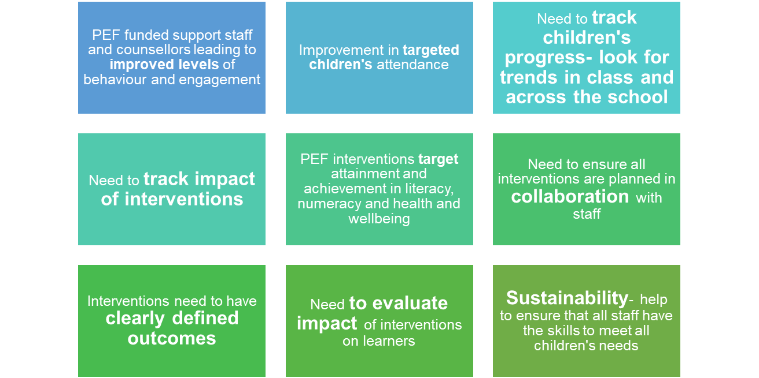
'Satisfactory' - emerging themes

Slide 11
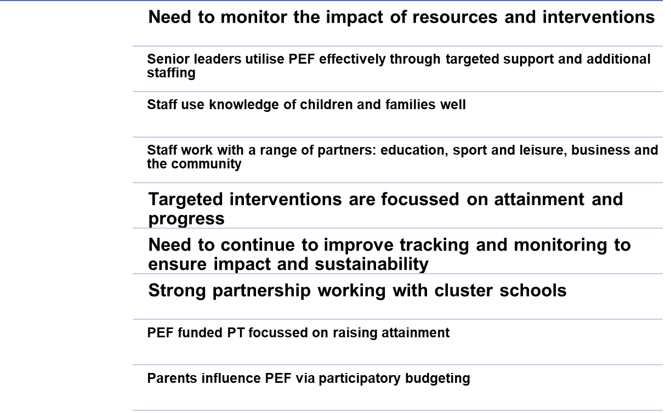
QI 1.3 Leadership of Change

Slide 12
Further support
PEF clinic
Friday 5th and Friday 12th May
30 minute online meeting to discuss anything related to your PEF plan
Sign up sheet at door
Identifying your gap
Identifying your targeted cohort
Outcomes and measures
Evaluating impact

Slide 13



PEF Spend Update
Sharing Local Practice
Total - £5,369,570 (including carry forward)
Spend period 11 (End Feb 23) - £471935.77 (9%)
Important Reading | East Ayrshire PEF bolg (glowscotland.org.uk)
ttps://forms.office.com/e/cZCrwKj5JU
St Joseph's Academy
Notes:
Cat
PEF spend – as you know the guidance PEF funding should be spent in the financial year it is issued. With this in mind back in October we proposed that this financial year we spend as much of our PEF in the financial year with an aim of moving completely to financial year spend by 24/25.
Now going to look at PEF practice in EA – in our pack you will find a sheet which outlines the GLOW returns from the 15 schools who completed the survey which ask each HT to tell us about an aspect of their PEF which is having an impact on poverty. If you haven’t complete the GLOW form I have added the QR code on this slide and you can take the time today to complete it and I will update the document.
I am so glad that Andy agreed to come today to tell us about some of the very successful projects at St Joseph’s and although it is a secondary school I think that everyone can learn from what he has to tell us.

Slide 14
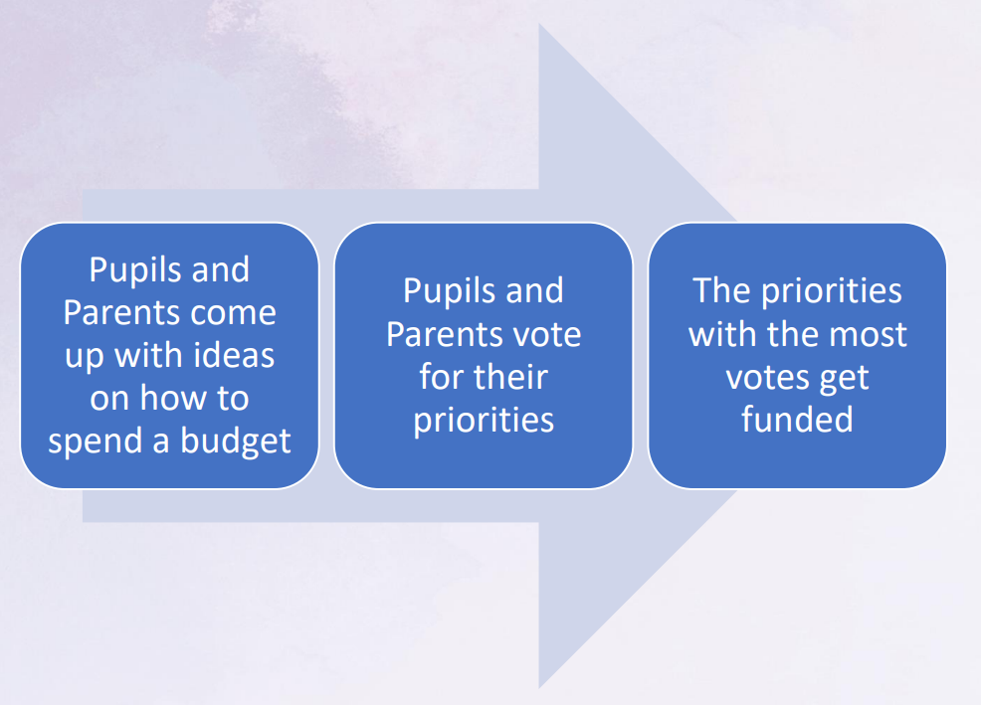


Collaboration - Participatory Budgeting
Pupil and parent voice
PEF - “meaningfully involve children, young people and their parents” (p5)
Article 12 of the UNCRC
Education Scotland Paper (2018) entitled “Learner Participation in Educational Settings”
PEF – LIOF – p29/30
https://blogs.glowscotland.org.uk/ea/eastayrshirepefbolg/participatory-budgeting/
Notes:
Cat
Fiona Greig is also going to share some local practice with regards Participatory budgeting but before she does, I know that a number of you are keen to look at this for this financial year so I though I would give you a very quick view of SLC PB programme.
For examples of PB if you look at the PEF- LIOF document p29/30
We were hoping that someone for SLC would be be able to come along today to tell us about their experience but they couldn’t make it but they very kindly shared all their materials with us.
To save trees we have not printed the SLC PB materials but you can find them all on the blog. Link and QR code here and on your programme. On the blog you will find the full HTs presentation, a video and examples of practice from 4 schools – (2 x Primary and 2 x Secondary) – an outline of their project and an impact report.

Slide 15
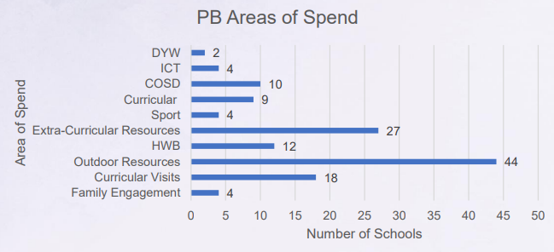

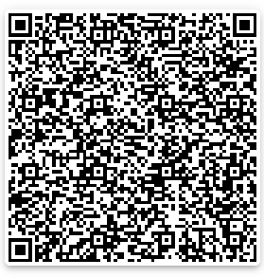
SLC PB 2021-2022
Minimum 5%
Stakeholders groups – 2,084 young people and 1,145 parents/carer trained
27,972 young people, 9,689 parents/carers and 3,806 staff voted
Video of SLC 21-22 PB Journey
Examples of good practice - GLOW
Notes:
Cat
To explain more about how schools have run PEF PB projects I will run through some of the slides from the SLC HT presentation which is on the Blog.
In 2021/22 SLC asked schools to spend at least 5% of their PEF on PB but 19% of schools allocated more than this and in 2022 – 2023 – many more schools increased the % allocated to PB.
As you can see from the figures on the slide it allowed a significant number of parents and pupils to have their voice heard and a number of them under went training to run the projects in their own school.

Slide 16
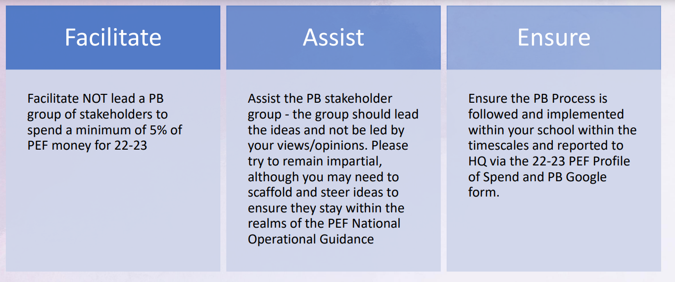
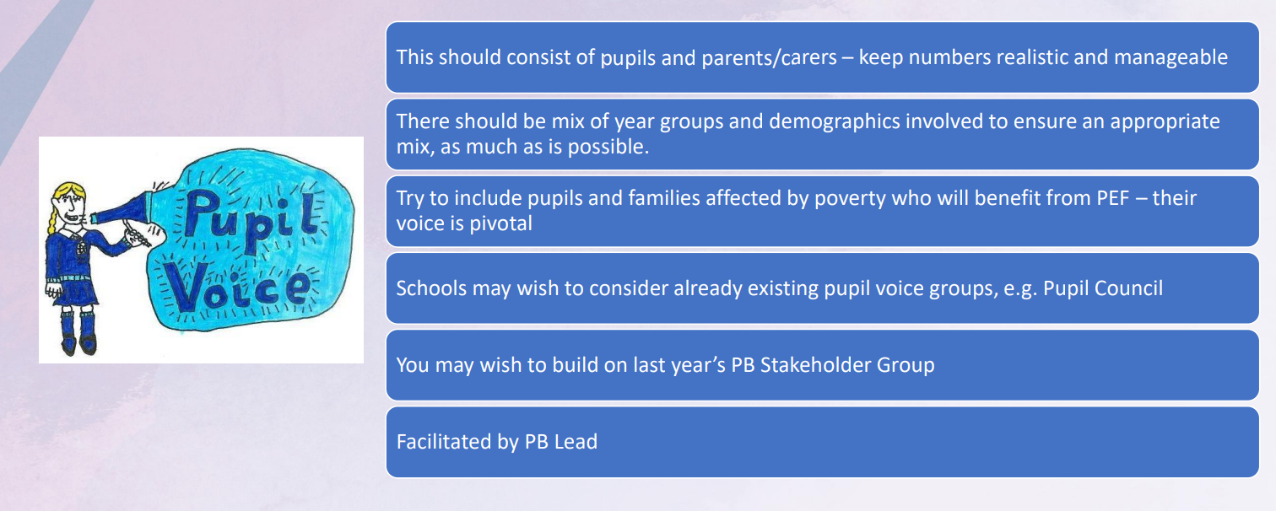
PB Lead
PB
Stakeholder
Group
Notes:
Cat
SLC approach was for each school to identify a lead member of staff who took on the role outlined on the slide and they set up a PB stakeholder group with volunteer parents and pupils. We could work with our HLW staff to ensure that families that are affected by poverty are represented.

Slide 17
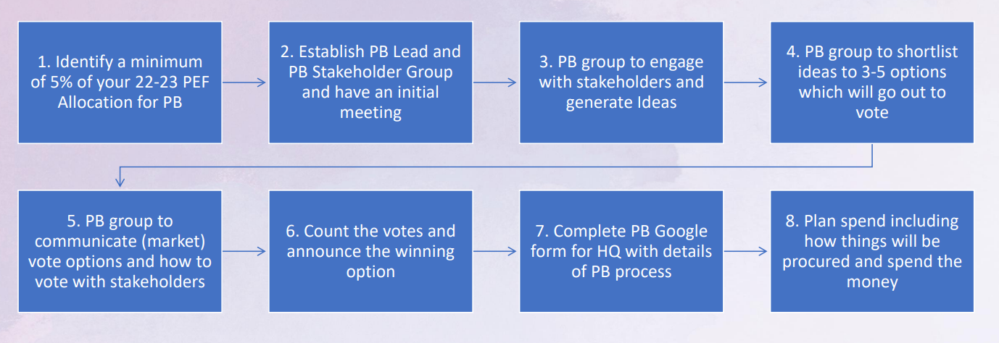

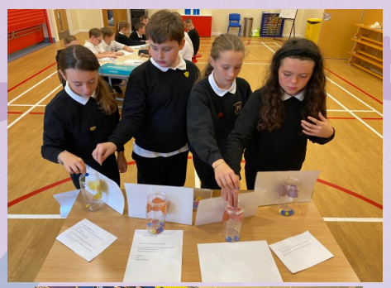
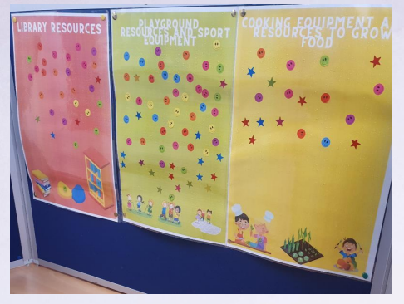


The PB process
CoSD
HT Check
Dalmellington Primary
Notes:
Cat
3- to ensure its targeting poverty – schools based it on COSD principles – training on PEF funding principles and PB – training which the PB lead can deliver to their group. Use pupil councils, school app or website.
4 – group run the ideas past HT first
5 – staff / pupils / parents –
Publicity - school app, assemblies, school website
Vote – examples from SLC – all 4 can be used for staff / pupils / parents – at parents night
7 – For the schools doing PB this year we will create a GLOW form so we can collate what was done and share with other schools
8. PB steering group than work together to Plan how they will action the winning option forward – as with all PEF actions – What / Who /When / how they will measure impact
9. Make their purchase and they run their project collecting impact data as they go.

Slide 18

Coffee

Slide 19
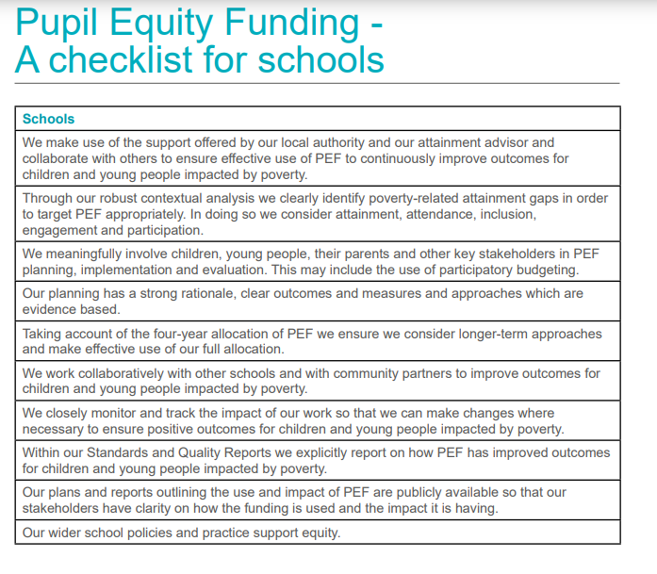
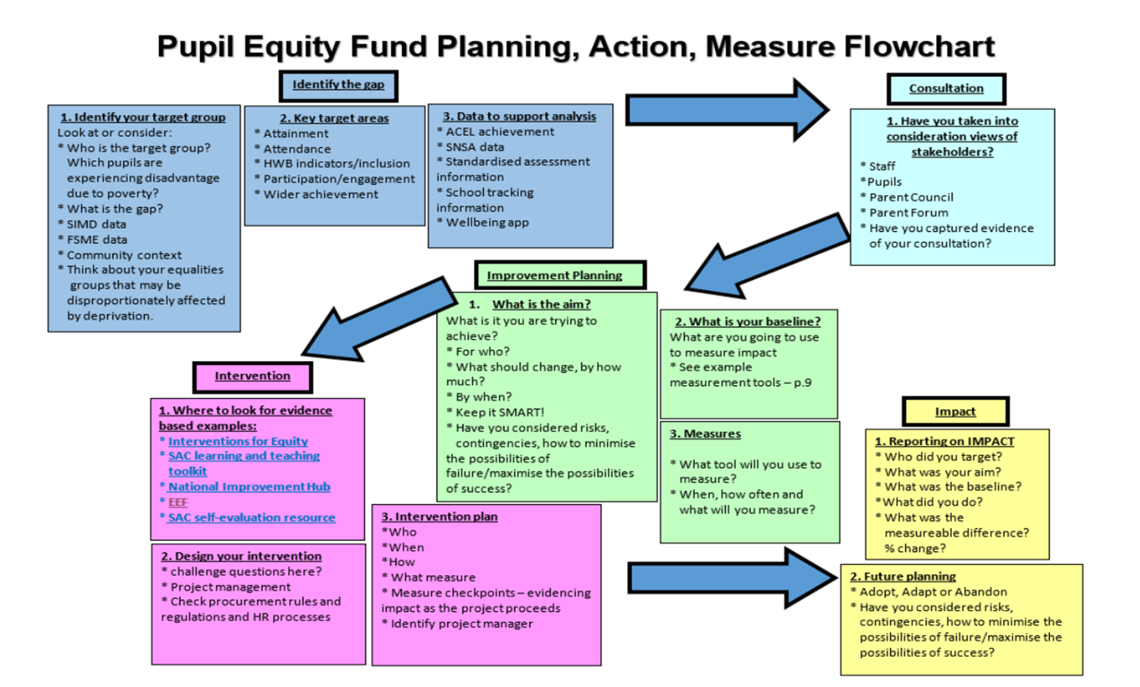
PEF sharing practice (trios)
Practice - https://forms.office.com/e/cZCrwKj5JU
Inspection reports (PEF)
Notes:
Chris

Slide 20
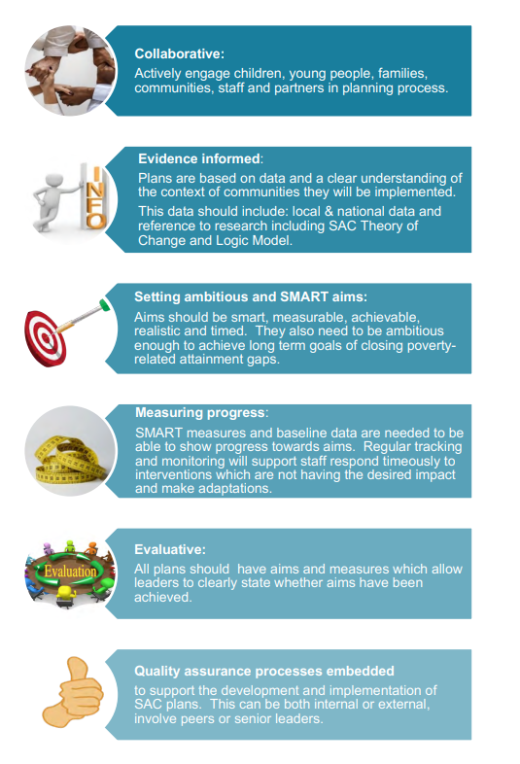
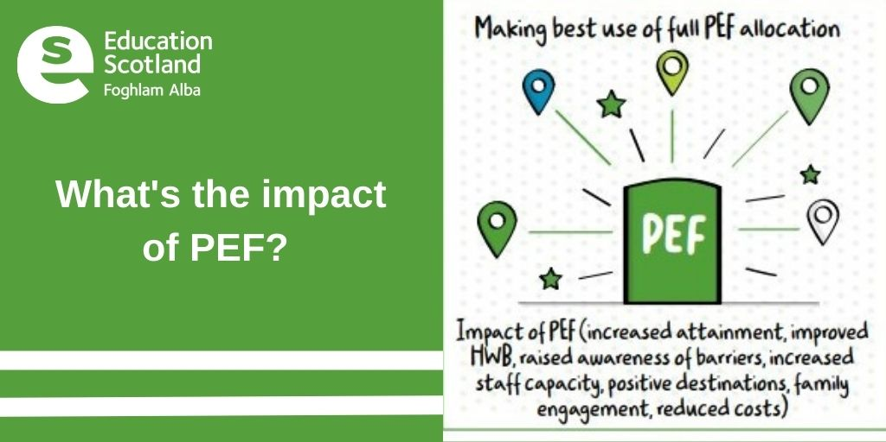
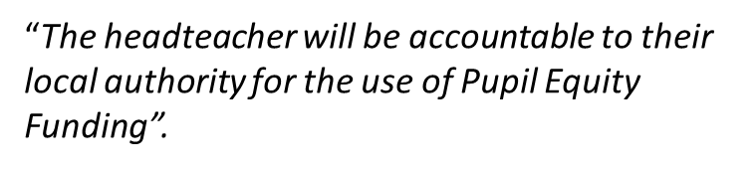
Authority shift
EA PEF - £3,809,120 per year
Notes:
Cat
PEF started in Academic session 2017/2018 so after 6th years I can understand you might be thinking why should the authority be shifting its focus on PEF. Well the answer is pretty easy there is a big focus on the impact of PEF nationally and the government has an ask of LA to support school with their PEF and to quality assure the provision. As an authority we received a substantial amount of money via PEF, £3. 8 million, so there is increasing scrutiny and accountability from the Government on spend and impact it is having on pupils affected by poverty.
As an authority we want to assist you to make the most of your PEF funding to really impact on the C& YP impacted by poverty. We want to know how we can help to resolve any barriers and address any training needs you and your staff to assist you to maximise the impact.

Slide 21
Planning - SiP
This must provide clarity to stakeholders on how Pupil Equity Funding is being used and its expected impact.
Outline clear outcomes to be achieved and how progress towards these, and the impact on closing the poverty-related attainment gap, will be measured
Actions | Desired outcome and impact data that will be collected to track impact | Who | When
A group of 12 learners (8 from SIMD 1&2), will participate in a 12 week programme with outdoor education lead. Learners will work together to remodel outdoor area within school. | By June 2024 we aim to increase the attendance of the targeted cohort from 70% or below to 85% or better - Fortnightly attendance check By June 2024, we also aim to enhance the targeted cohorts wellbeing and sense of belonging to the school. Pre and post intervention comparison of GMWP data (focus on health and safety and affiliation. | Outdoor Team PEF HLW Senior link - DHT | October - December
Explicit-
outcomes
/ measures
As per SiP
Clarity how
its being used
Notes:
When it comes to planning your PEF – the PEF guidance states that HTs must provide clarity to stakeholders on how Pupil Equity Funding is being used, its expected impact and how progress will be measured.
It also states that the operation of the Pupil Equity Funding should be included within existing planning procedures e.g. through School Improvement Plans and Standards and Quality reports.
We want to ensure we are in line with the guidance but minimise burocracy and workload. So we want to report PEF plans in the SiP and S&Q reports. However, when we look at excising reports we are not complying with the guidance and it is very difficult to see what PEF is being spent on and the impact it is having on pupils affected by poverty.
Derek and Graham going to be looking for volunteer HTs to review our SiP and S&Q paperwork. A few months ago we proposed some changes to the paperwork to help you clearly report the impact of your PEF plans and forwarded them to Derek for the group to consider. I know that some of you will be working on this now but Graham wasn’t able to give me a date for when this work will be carried out. However, we will take you through the changes we are proposing for PEF and you have a feedback sheet to provided your opinions on what we are proposing.
To ensure we clearly show clearly what the PEF is being used for and our desired outcome and the measures that we are putting in place we suggest that we add the table on the screen to the SiP. The table can be added at the end of each improvement priority, so the PEF outcomes are still along side relevant school targets or you may want to add the table at the end of your SiP and have all your PEF spend in the one table. Either approach would help us to clearly show our PEF spend and measures.

Slide 22

PEF Spend 23/24
PEF spend arrangements (23/24)
Resources by end of the financial year
Staffing can be committed till end of academic year
No carry forward after academic year
Spending Issues
PEF Clinic – 5th / 12th May - sign up sheet
AFOs
Standardise provision
PEF meeting
Steering Group meetings – sign up sheet
Procurement
HR
Notes:
However, the government has changed the arrangements for us submitting our PEF spend and at the moment they are suggesting they will request our spend x 2 per year – financial year end and September to all for staffing till the end of the academic year. SO – we are now suggesting that we aim to have all resources purchased with the financial year but that you can commit staff till the end of the academic year. Summer salaries should be taken from your new PEF spend.
Also in October we asked you what were your biggest barriers to your PEF spend. Chris is offering to run two PEF clinic on the 5th May and the 12th May – to sign up please see the A3 sheet on the wall by the door.
We going to meet with your AFO’s once a term so that we can hear about any issues they are having and try to get them addressed.
We also wanted to ask if you would like us to like to re-establish the HTs steering group that meet with procurement and extend an invite to HR to also attend the meeting so that we can talk to them directly about any issues you have. We could initially look to meet twice a term and adjust as required.
I have sat a sign up sheet on your table so if you would like to join the steering group and bring your peers concerns to HR & procurement then please put your name on the sheet. If we have no names we will know that you don’t think it is needed.

Slide 23
Reporting - S&Q
The headteacher will be accountable to their local authority for the use of Pupil Equity Funding
Explicitly report on the impact on outcomes for learners impacted by poverty
Pupil Equity Funding: (not applicable for standalone ECCs) Level of PEF funding: How has this been allocated this session? Evidence of impact so far:
PEF Evaluation
Approach / Intervention | Impact: Report on how you have improved outcomes for learners impacted by poverty. | Outline the data that supports your findings.
Outdoor Ed programme | Most of the targeted cohort’s attendance improved during this period of time. In addition the majority of learners showed that their wellbeing had improved when completing the follow up tracker through GMWP. | Attendance at school 70% of the targeted cohort’s attendance improved to 85% or above. Of the remaining 30% of learners, 20% improved their attendance by 7% or more with 10% of learners attendance remaining in line or below pre-intervention baselines. Enhanced Wellbeing – GMWP (HWB - Health and Safety / Included - Affiliation) The majority of learners rated their wellbeing higher in both aspects when compared to initial tracking in August.
Notes:
When it comes to the S&Q report the guidance states that we need to explicitly report on the impact on poverty but again when you look at the excising we reports we could look to increasing our use of evaluative language and provided more data to evidence the impact of the spend. To help us do this we suggest replacing the present 3 questions with the table shown here. The table will help to ensure that we report on the impact on poverty and that we provided specific data to evidence impact.

Slide 24

Learning Visit – PEF Impact
Schedule
Visit paperwork
Notes:
There is an ask of authorities that they quality assure the PEF spending arrangements of their schools and ensure that we are getting the value for money for the target pupils. A number of authorities have started PEF Impact Visits but don’t worry we are looking at adding a PEF element to our present Quality Assurance visits and would only carryout a PEF visit if required or requested by a school. I have given you copies of the draft schedule and paperwork for the PEF aspect of the learning visits and I am keen to get your views on these.
Jemma Donnelly asked me recently for a way to report her PEF spend and I sent her the PEF Impact Visit paperwork and she has kindly offered to share her preliminary findings with you and her report is on the blog. Jemma Donnelly said that she found working through really helpful.
Make it clear that this paperwork would only be completed in learning visit were there was a PEF element to the visit and the PEF aspect of the visit will not start till sometime after the summer holidays.

Slide 25

Procurement Framework
Are there any services not on the framework that you would like to be there?
Overview – Ian
Local practice – Paula Raymond
Support paper work
Attainment Challenge Procurement Framework Guidance Document
Service Specification paperwork

Slide 26

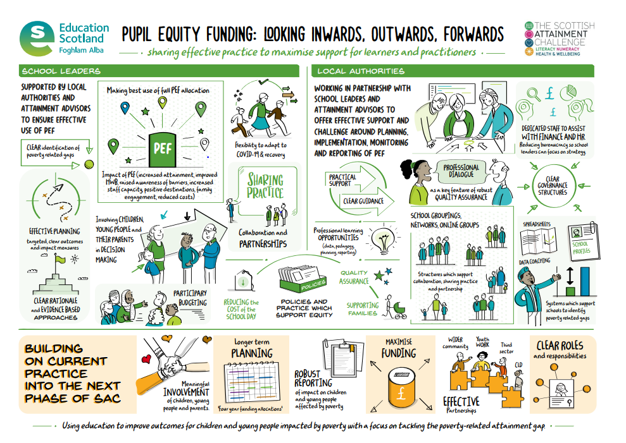
Questions
Notes:
Thank you so much for giving me the time to talk to you about my PEF findings and remember we are here to help if we can.
Thank all the speakers – SLC, Fiona Greig, Andy Boyle, Ian and Paula Raymond
Does anyone have any questions?

