Slide 1
Kilmaurs ECC
Obstacle course and end of term party!

Slide 2
The children enjoyed the activities over the last week of nursery. We had a party where we had water balloons and played lots of party games. Each cohort had fun on an outdoor obstacle course, using their balancing skills to avoid the shark infested water.

Slide 3
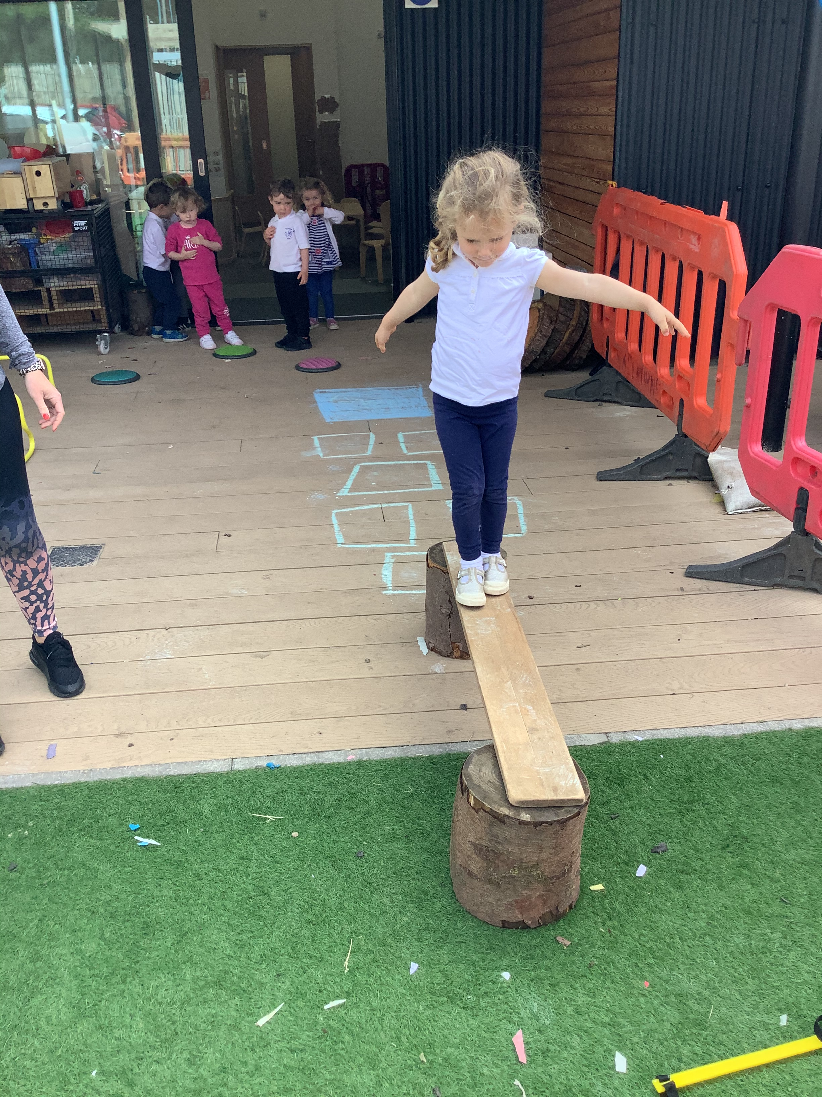
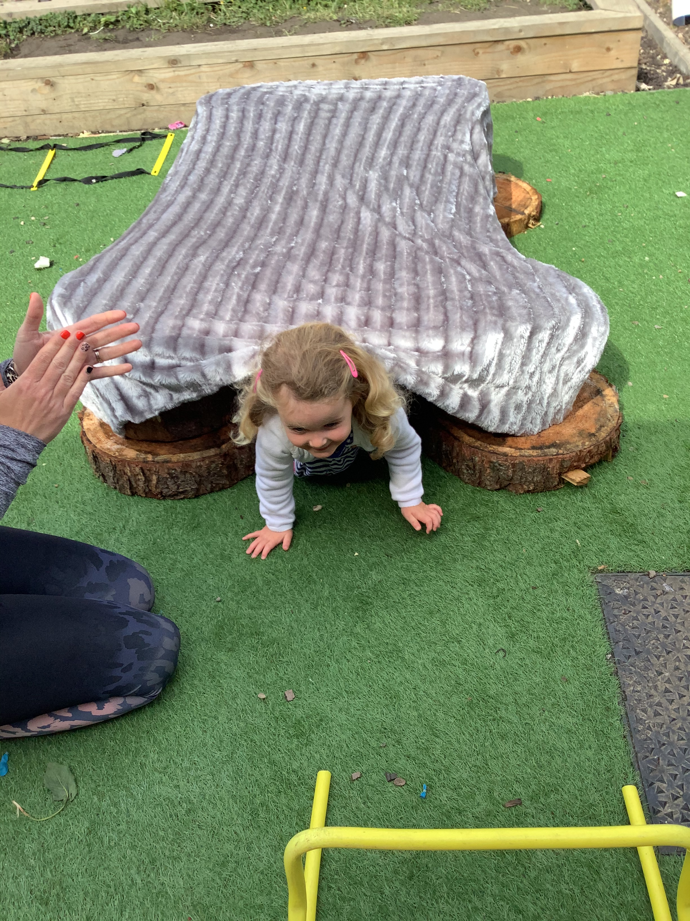
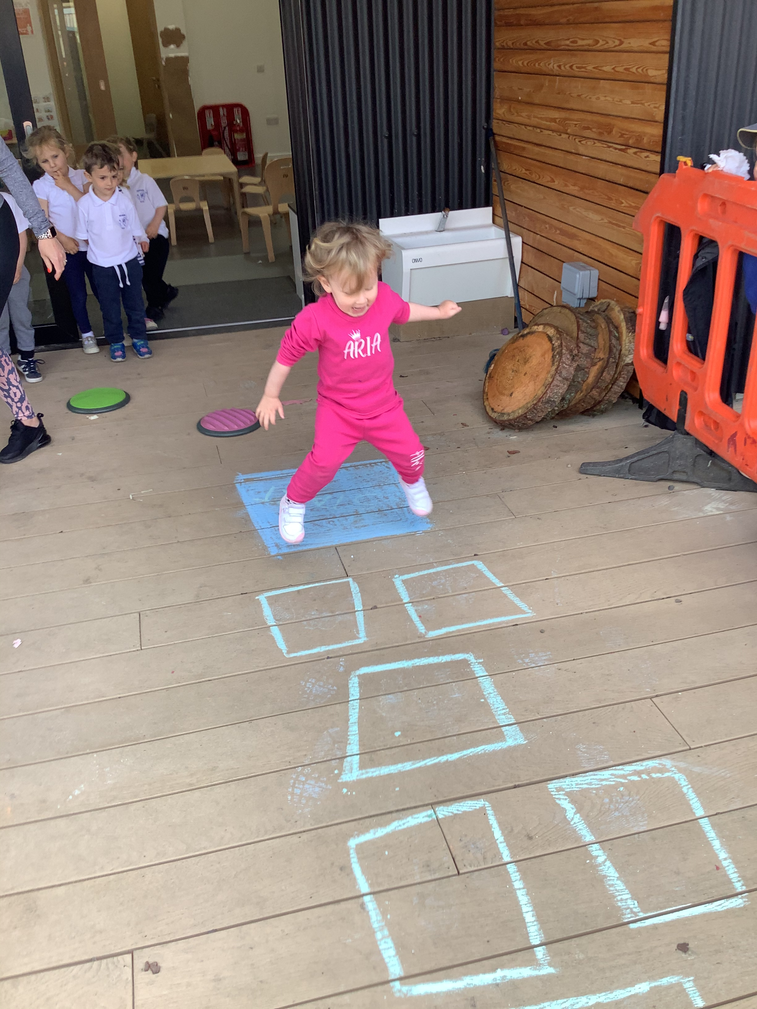

Slide 4
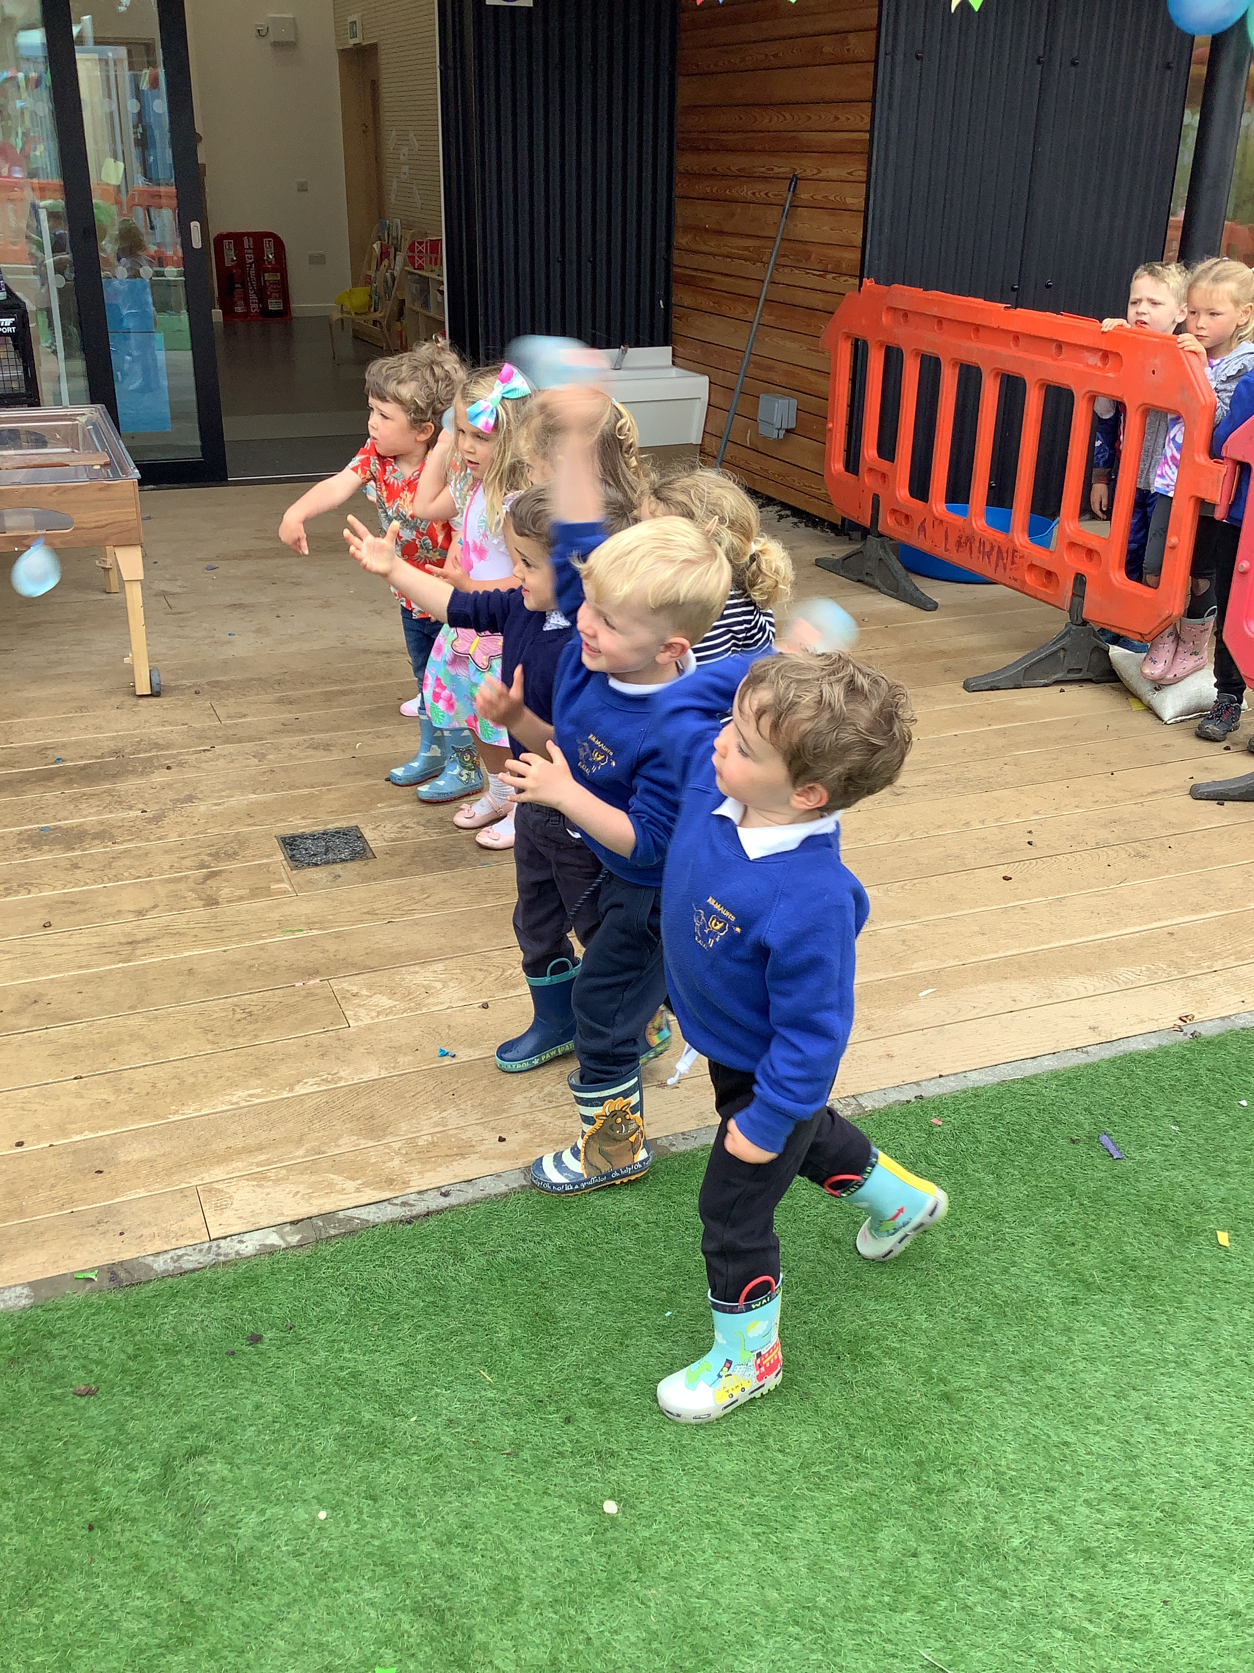
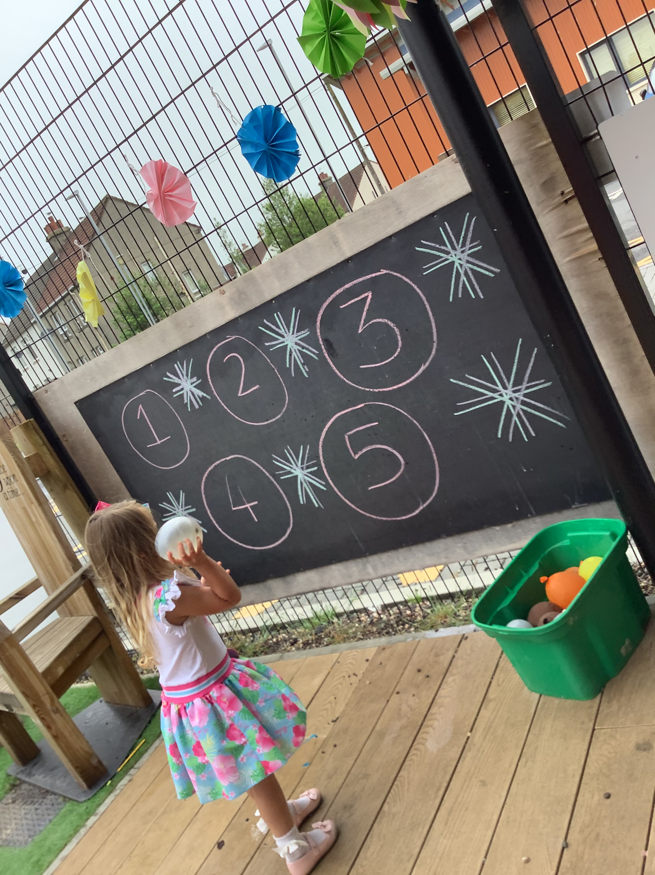
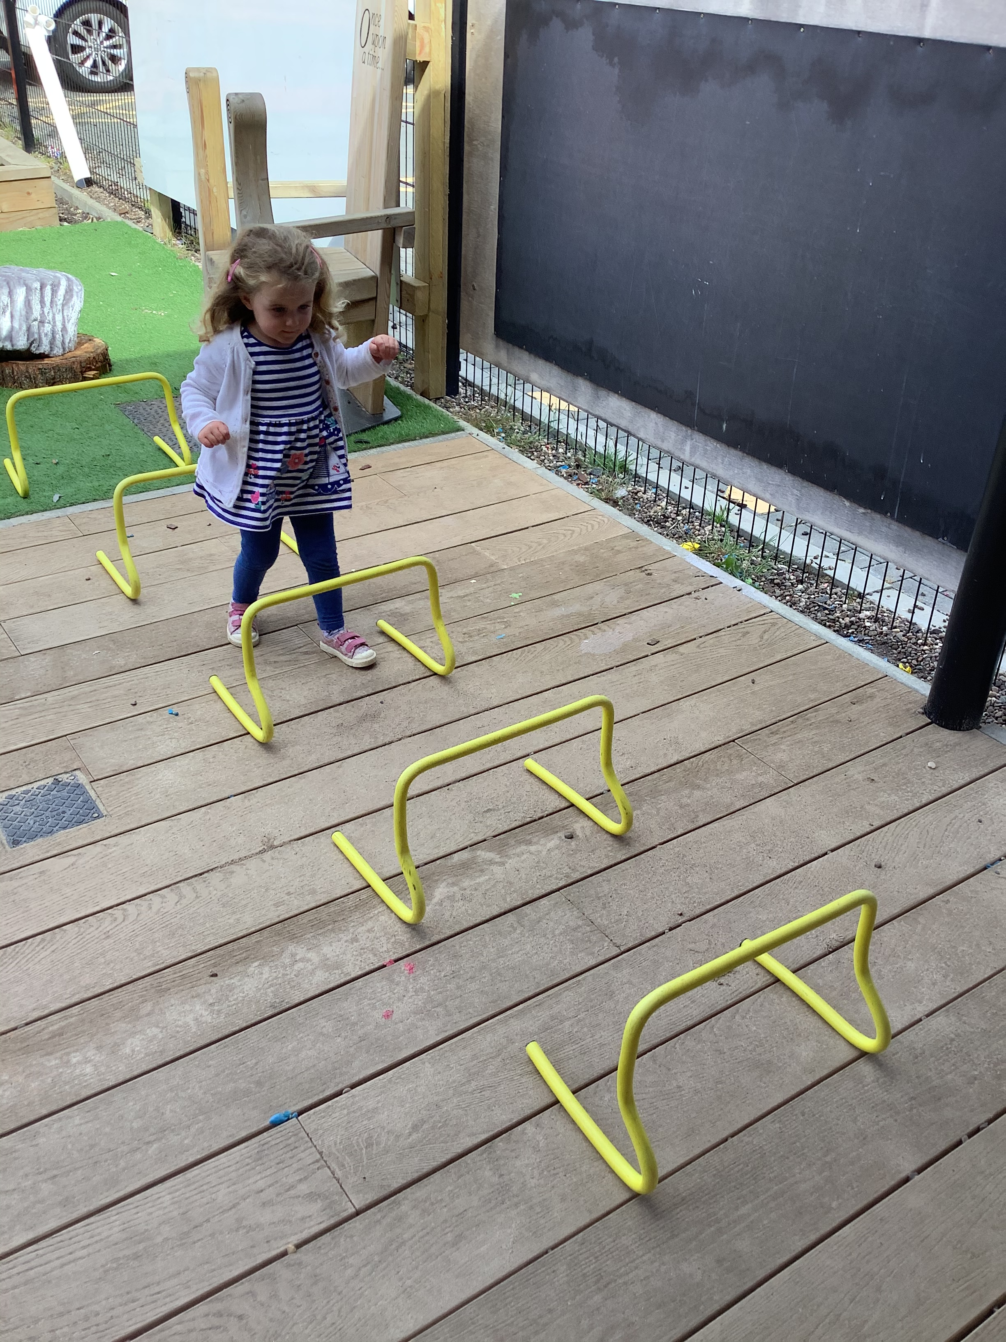

Slide 5
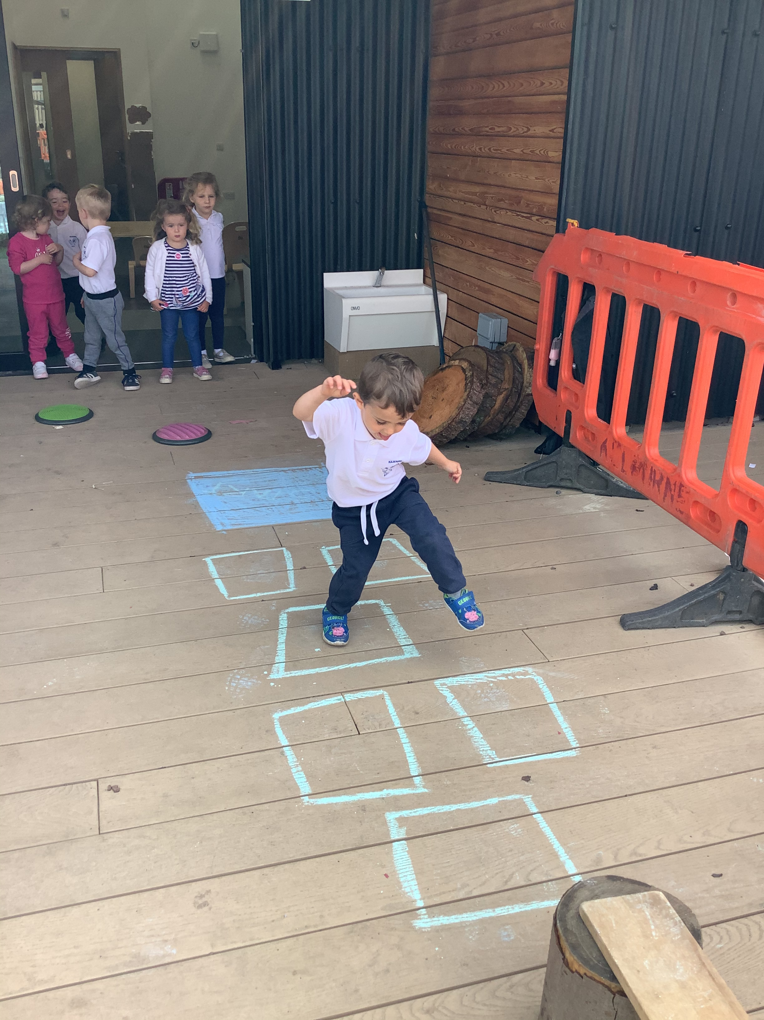
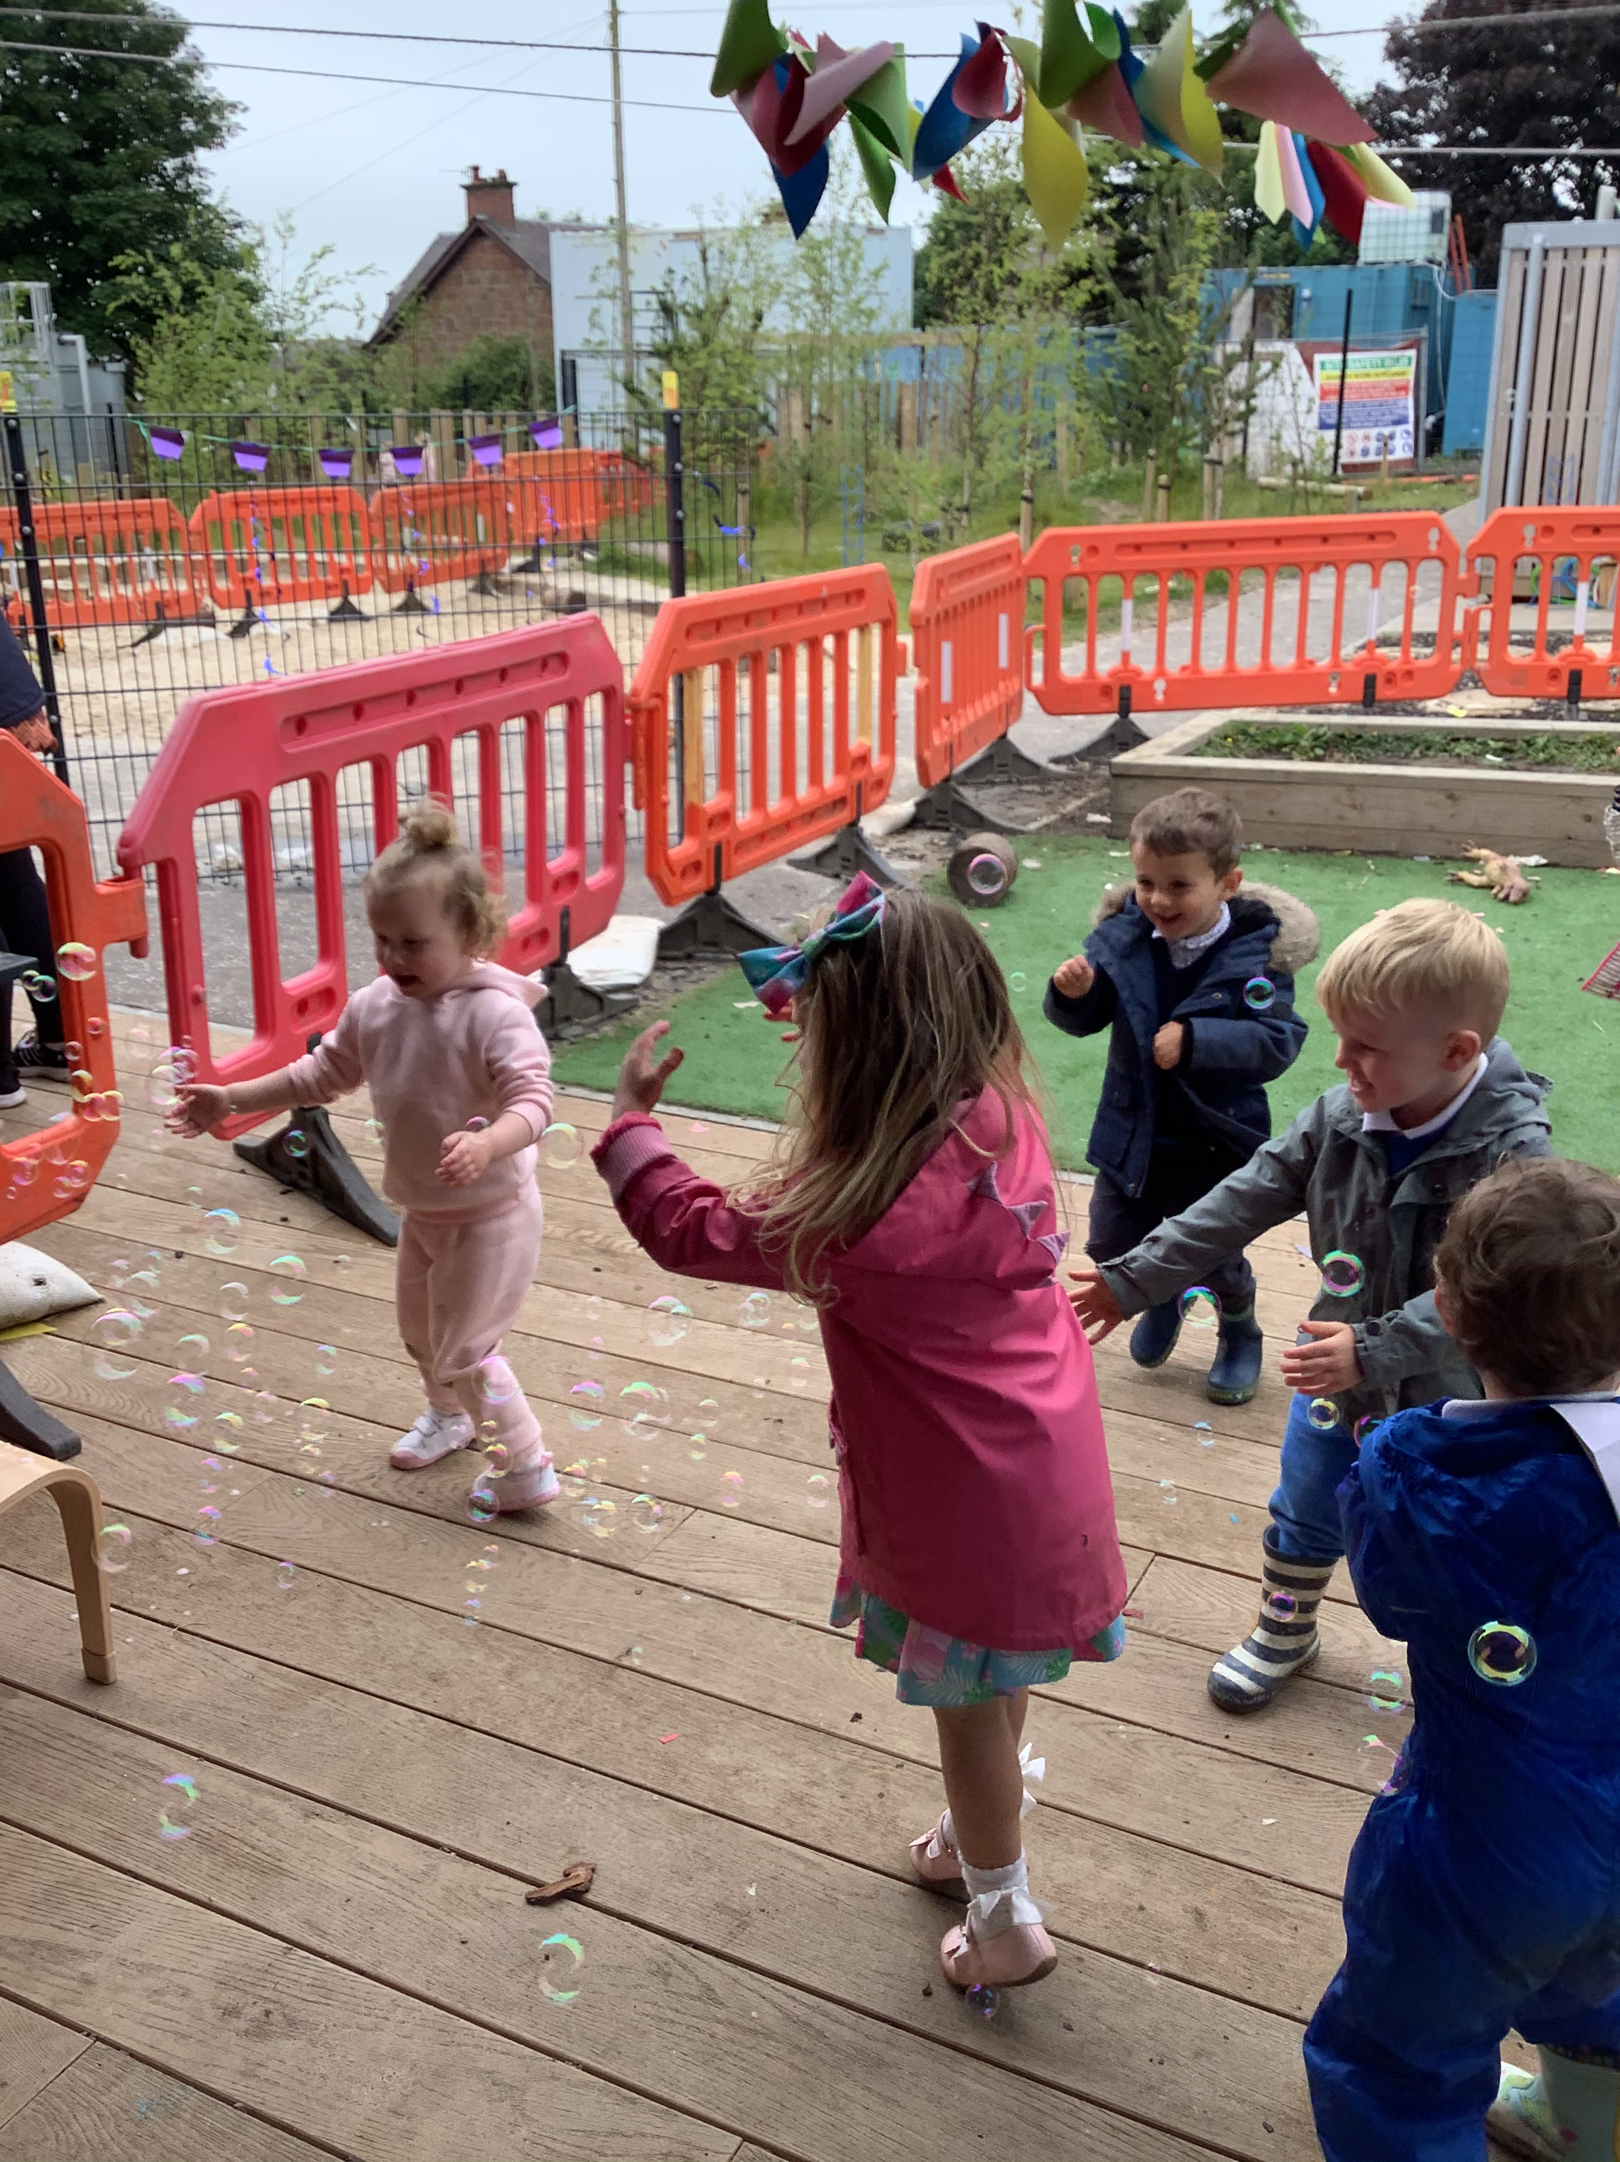

Slide 6
Thank you

