Slide 1
Grange Academy Bulletin
9th September 2019

Slide 2
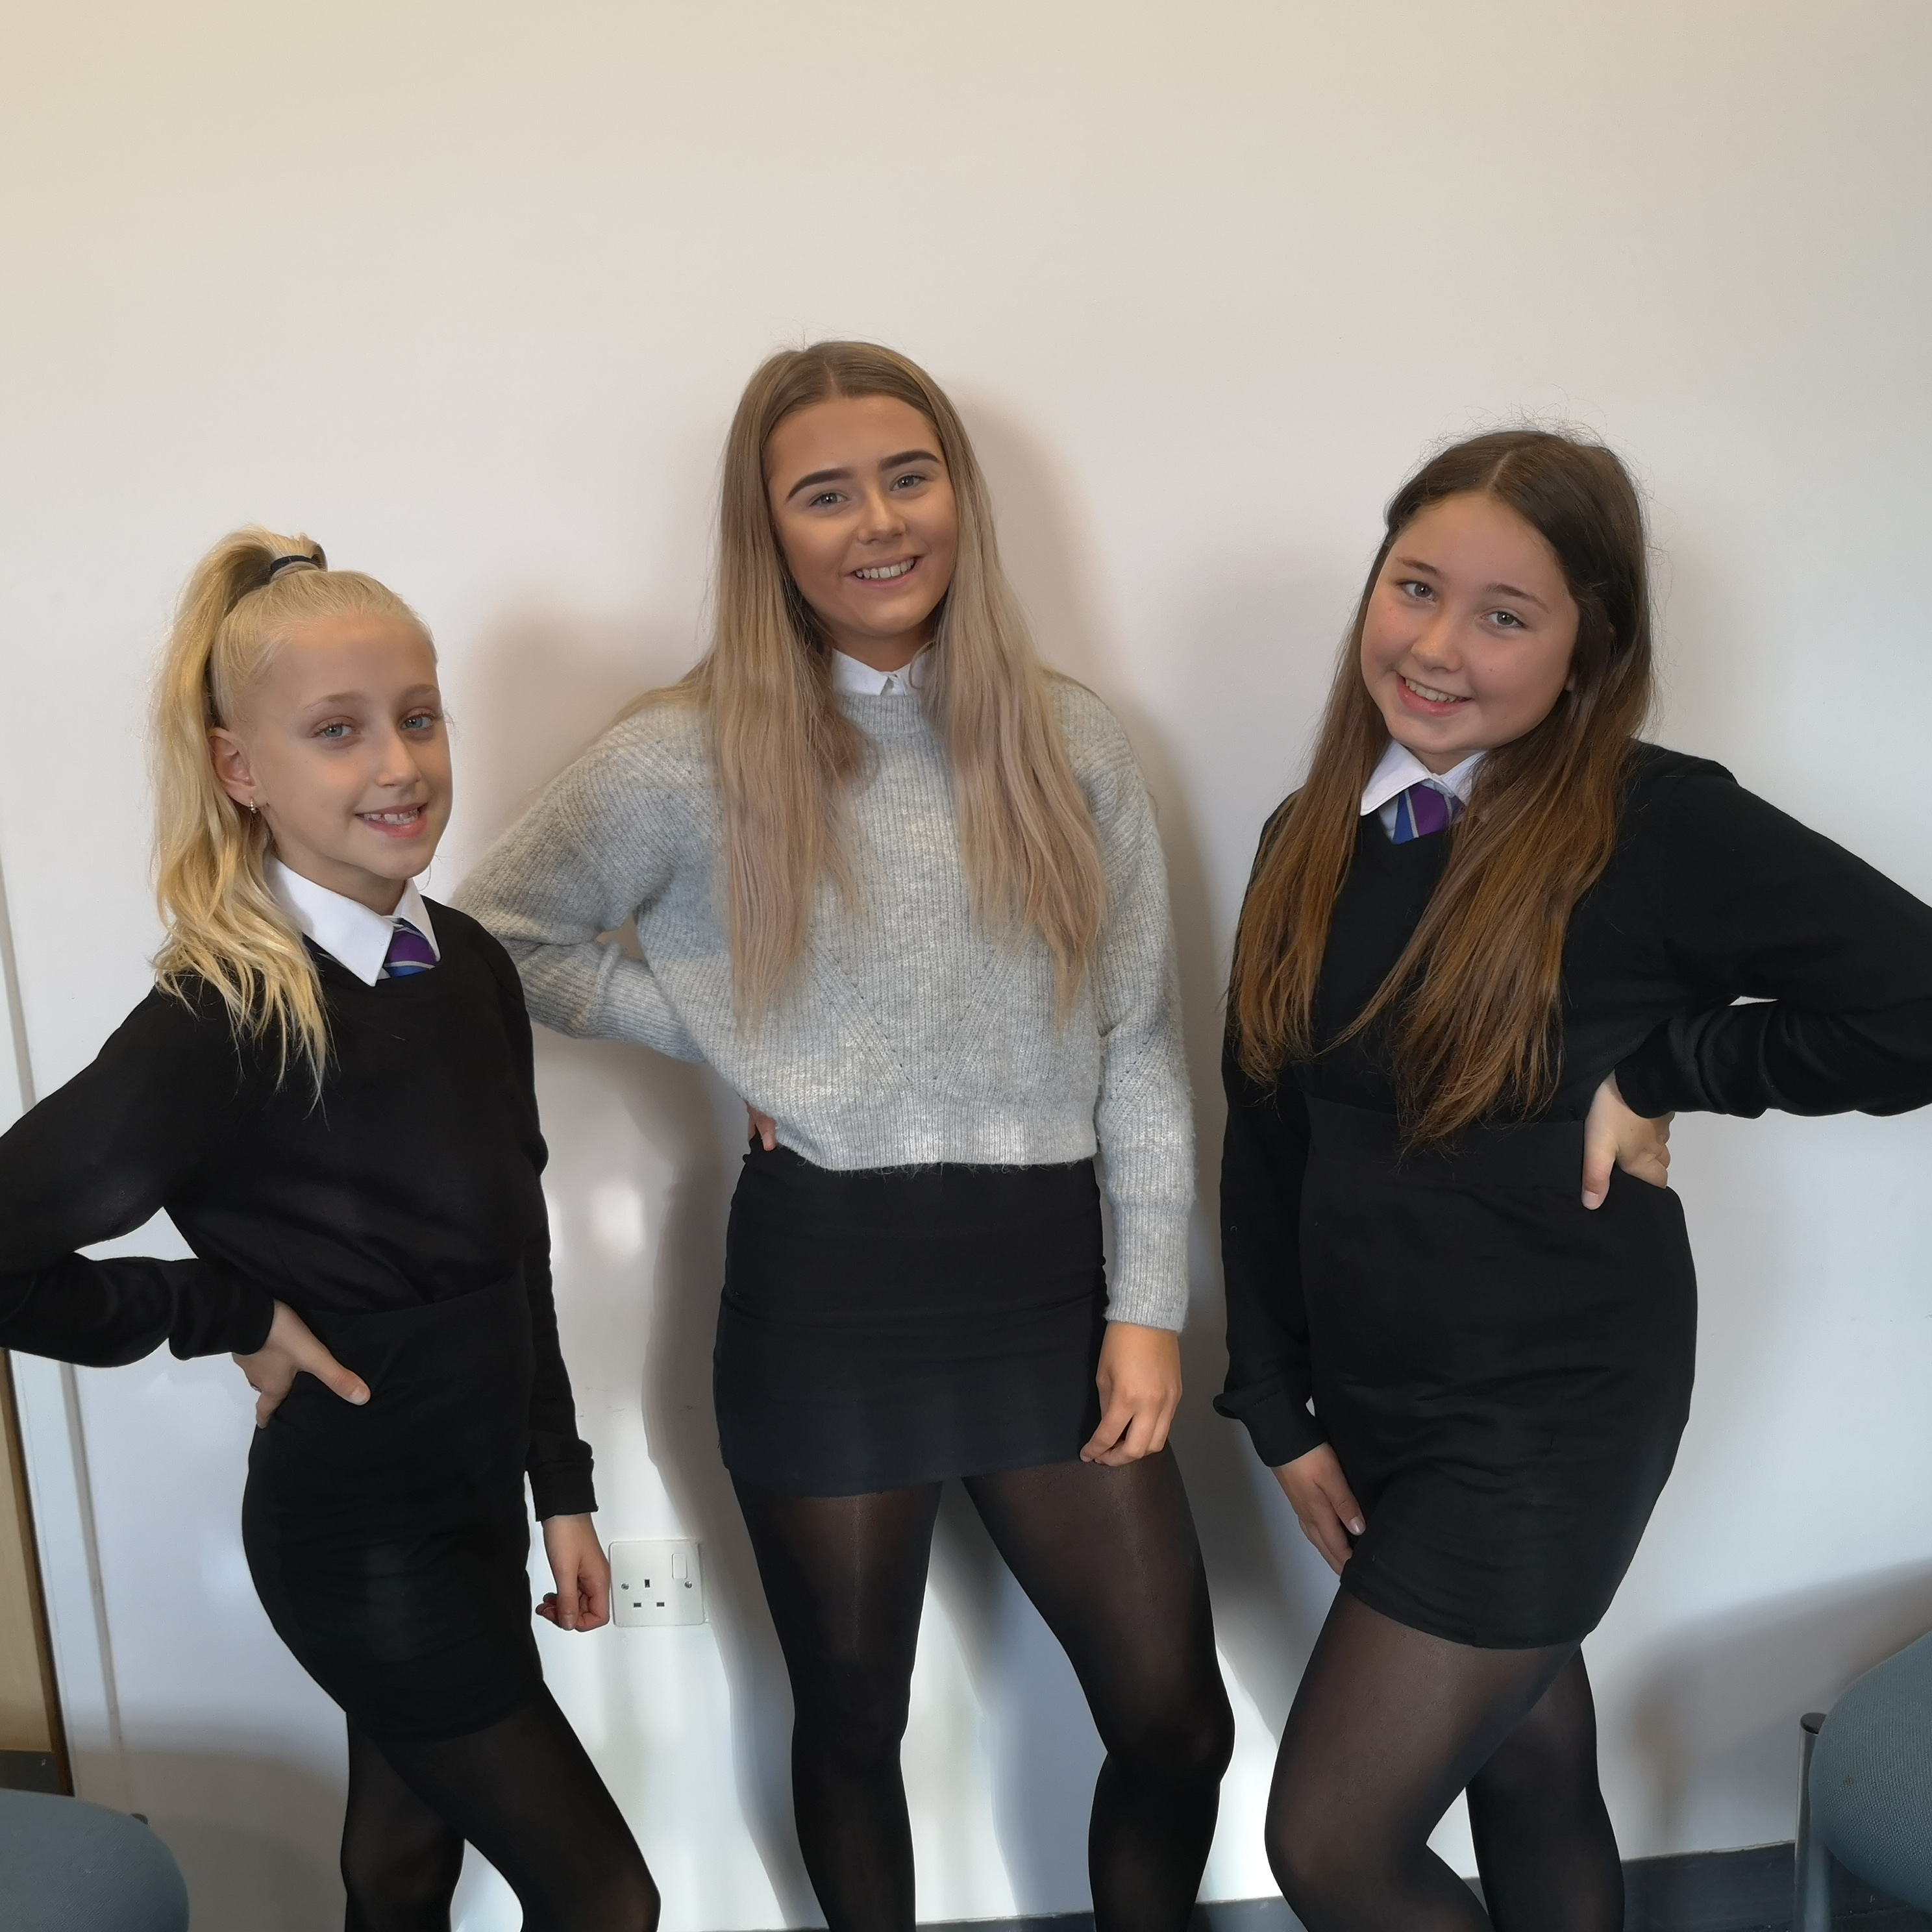
Jorja, Callie, Hannah, Emily
We are proud of our Team Scotland dancers. They are representing their country at the International Cheer Union Worlds 2020 Competition in Florida. They will be competing against teams from all over the world.
Hannah and Emily compete in cheerleading. Jorja and Callie compete in hip hop.

Slide 3
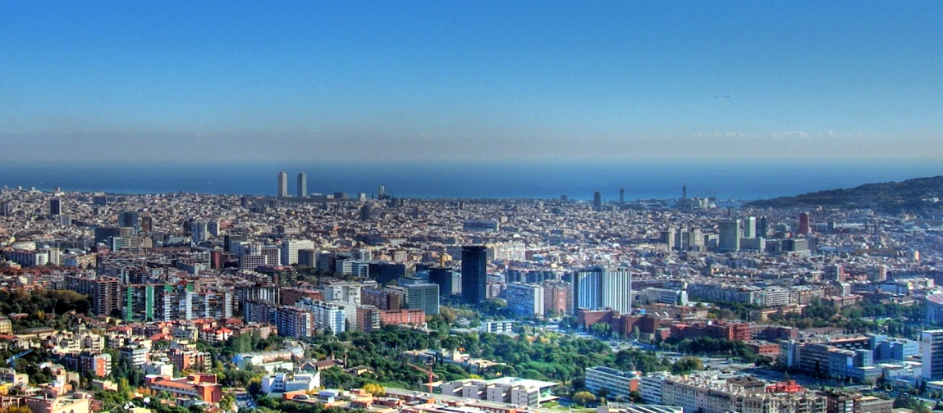
Barcelona
All pupils who signed up for the Barcelona trip are asked to attend a short meeting with Miss Murtagh in Modern Languages today at break please.
(Monday 9th September)

Slide 4
Work Experience With Police Scotland
If you are in S4 and are considering a career with Police Scotland, please apply for their work experience programme.
It starts on the 7th October and runs for a week. It will be certificated by Dynamic Youth.
Over the course of the week you will experience: the Force Training and Recruitment Centre at Jackton, Air Support Unit, Firearms Dept, Mounted Unit, Dog Unit, Public Order Unit, a football stadium tour and live court trials. You will also work on practical policing like statement-taking and giving evidence in court.
To apply, see your Guidance teacher or Miss MacKinnon for a form. All forms must be returned to Miss MacKinnon by 16th September. Successful candidates will be selected by PC McKenna.

Slide 5
Prom Committee
Are you an S5/S6 leaver? Do you have ideas for Prom 2020? (Think: venue, theme, decorations etc.)
Come along to the Games Hall (P.E Department) on Wednesday break time for more info!
If you want to be involved (in any way) with the organisation of Prom or contribute to the decisions that will influence YOUR event - make sure you're there!
Thank you!

Slide 6
Senior Awards Ceremony
Congratulations to everyone who has been nominated for an award. It is important that you or your parent/carer contacts the main school office to let us know if you are attending the ceremony and how many guests you will be bringing.
Please also ensure that you remember to attend the rehearsal – it will take place in the assembly hall on Thursday 12th period 4.

Slide 7
Higher Leadership Classes
On Monday 16th, there is a meeting of all pupils who are taking Higher Leadership.
Everyone from Mrs Cardow’s, Miss Smith’s, Mrs Crawford’s, Miss MacKinnon’s and Mrs Brotherston’s classes must attend.
It will take place in the library period 3.
This is a chance to hear from the Celebrate Kilmarnock team about opportunities you could take up for your Unit 2 projects.

Slide 8

Junior Choir
Junior Choir for S1/2 pupils is on Tuesday at lunchtime, starting at 1.30pm. Room FO42 .
All welcome.

Slide 9

Drum Club
Drum Club for S1/2 pupils is on Tuesday at lunchtime, starting at 1.30pm.
All welcome.

Slide 10
Have a great week, Grange.
Work hard.
Be kind.

