Slide 1
Achievement
In
SPORT AND FITNESS

Slide 2
Rugby

Slide 4
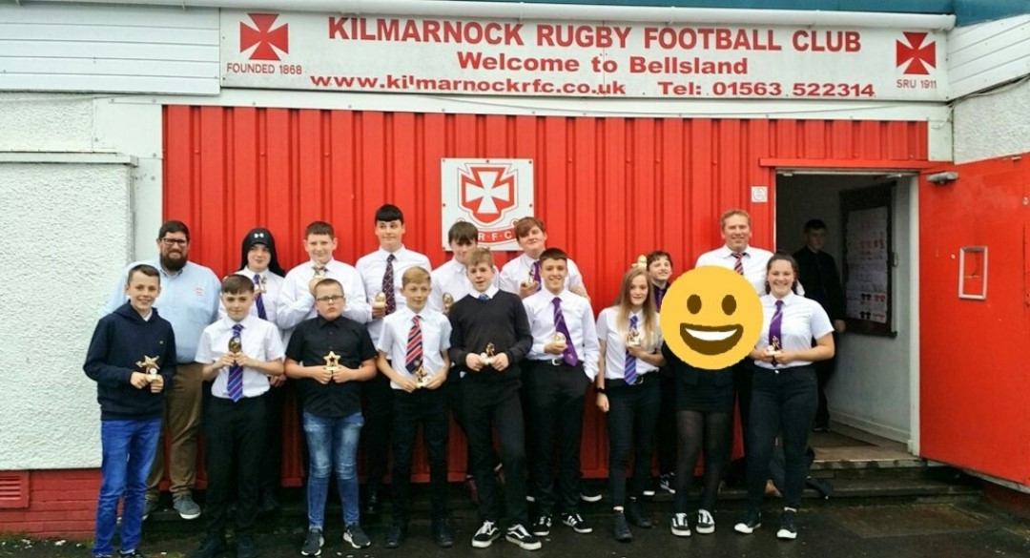
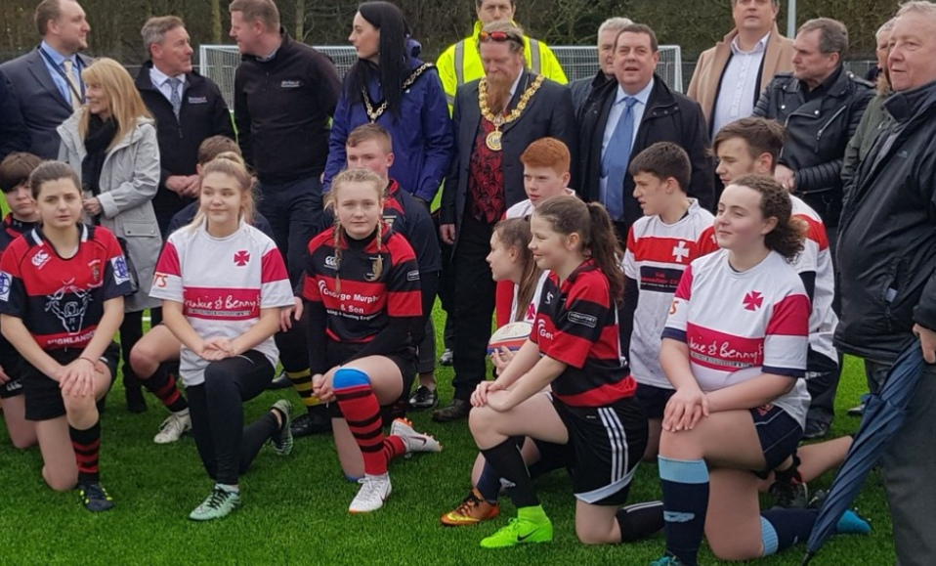

Slide 5
Killie v Austria!

Slide 6
Golf

Slide 7
Lessons from a Pro!

Slide 8
Swimming

Slide 9
Daniel at the Nationals!

Slide 10
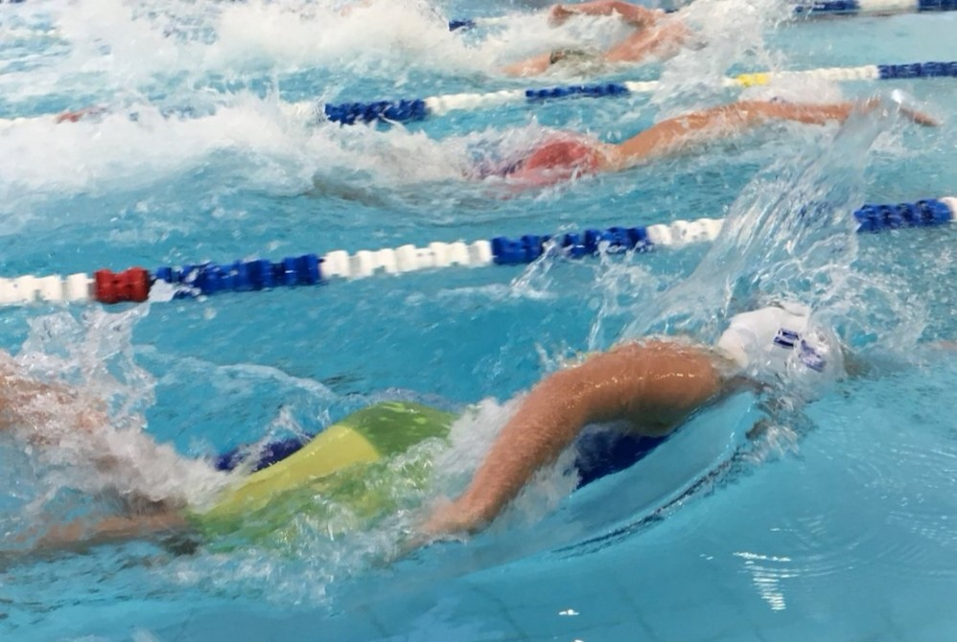
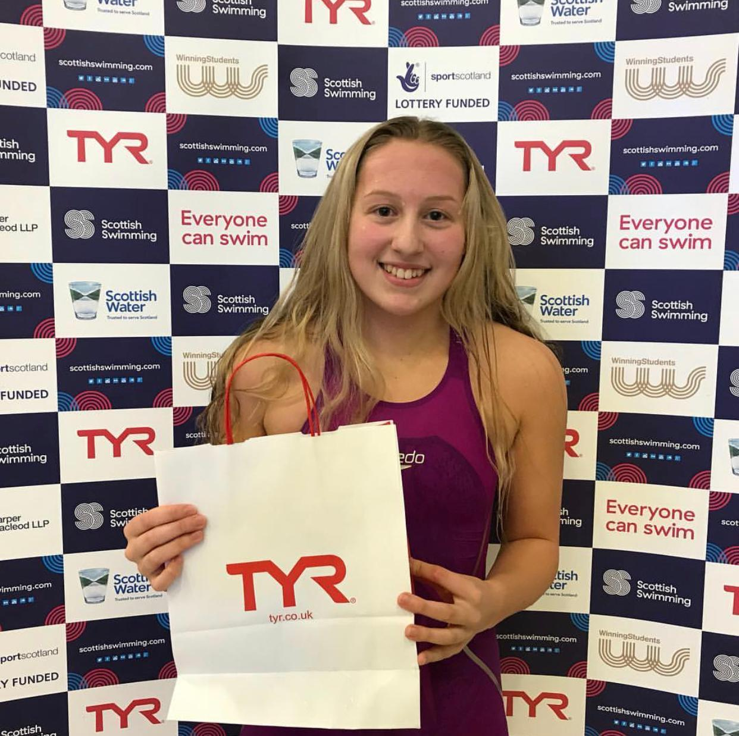
Eve at the Scottish Championships!

Slide 11
Kickboxing

Slide 12
Ben: Crowned World champion in Athens!

Slide 13
Badminton

Slide 14
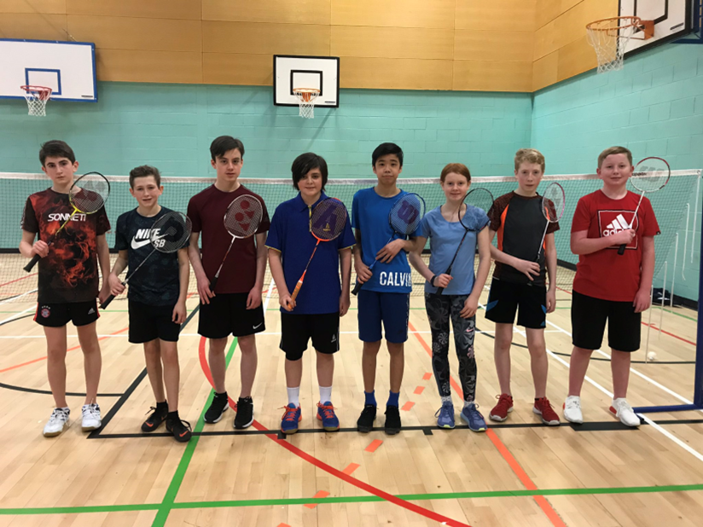
Ayrshire Championships

Slide 15
Evan: in the National Team!

Slide 16
Bowling

Slide 17
Mason: Scottish Champion!

Slide 18
Football

Slide 19
Ayrshire U16s Schools FA Cup Winners

Slide 20
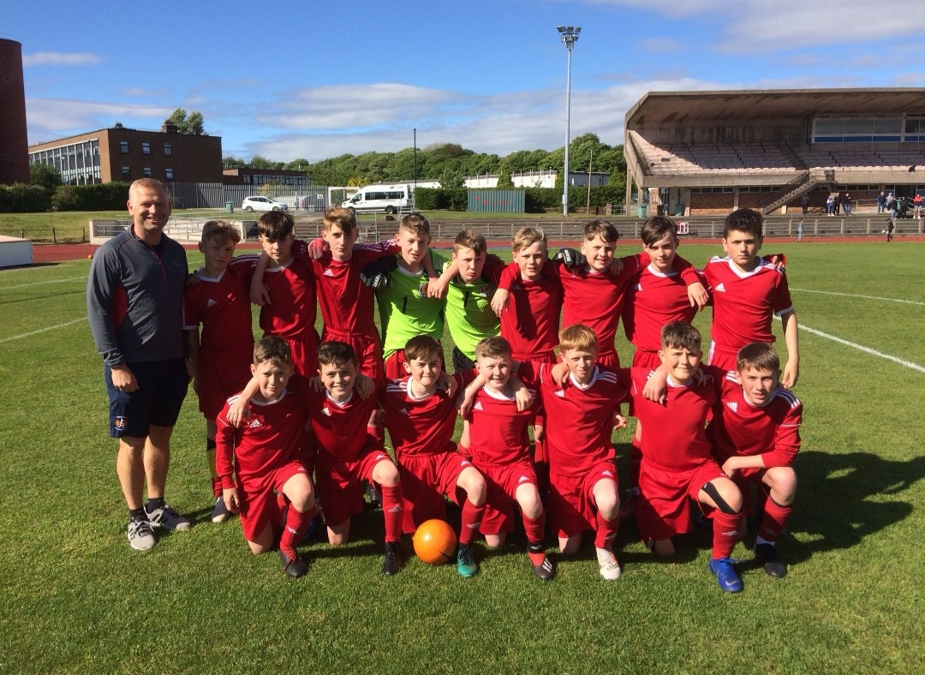
U13s Ayrshire Cup Winners!

Slide 21
U14s Scottish Cup Finalists!

Slide 22
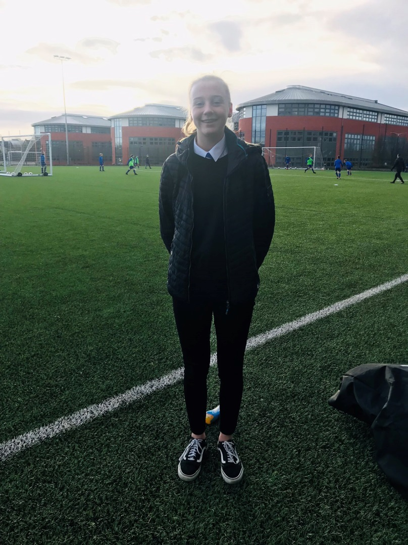
Hannah: U16s Scotland Squad!

Slide 23
East Ayrshire Champions, 2019!

Slide 24
Scottish Concept 7s Winners

Slide 25
S4 SFA Performance Graduation at Hampden

Slide 26
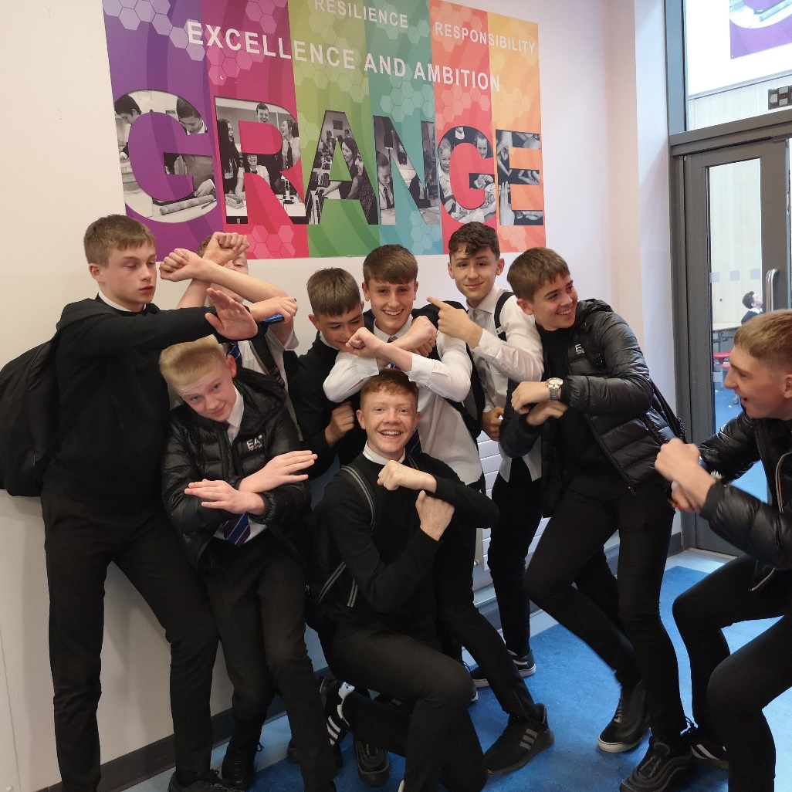
Andrew and George: Bob McWilliam Award

Slide 27
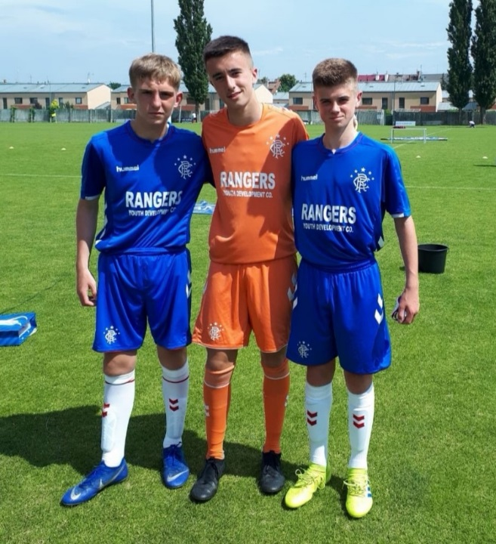
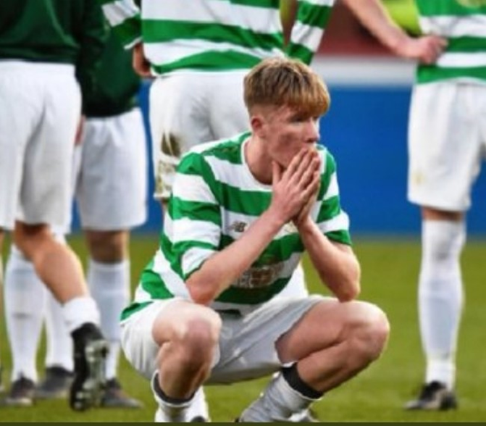
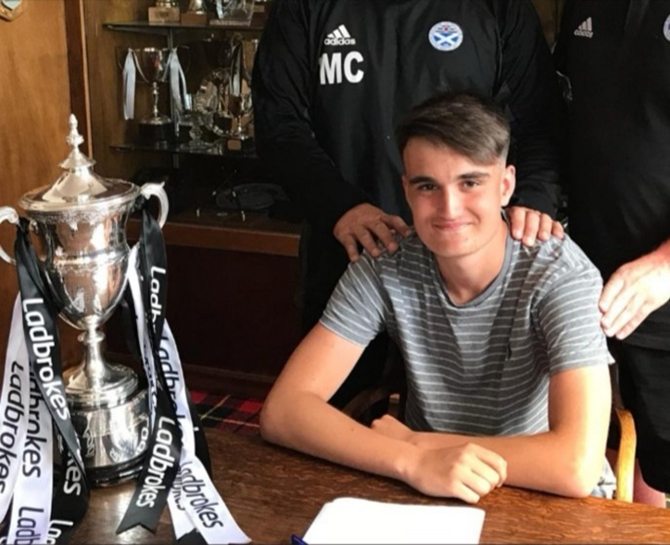
Played in the Czech Republic, Spain, Abu Dhabi!

Slide 28
Orienteering

Slide 29
Jonathan: Ayrshire Champion

Slide 30
Dance

Slide 31
Dancefest 2019

Slide 32
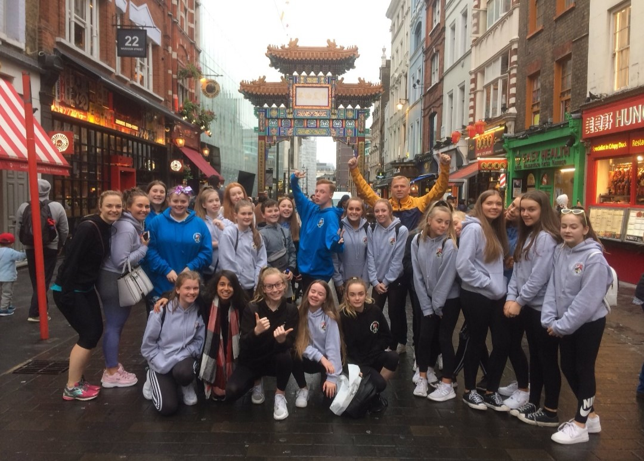
Pineapple Dance Studios, London

Slide 33
Beth: Danced with Louie Spence!

Slide 34
Athletics

Slide 35
Grange Athletics Champions, 2019!

Slide 36
East Ayrshire Athletics Champions, 2019!

Slide 37
Ayrshire Athletics Champions, 2019!

Slide 38
Brayden: West District Javelin Champion

Slide 39
Ice Hockey

Slide 40
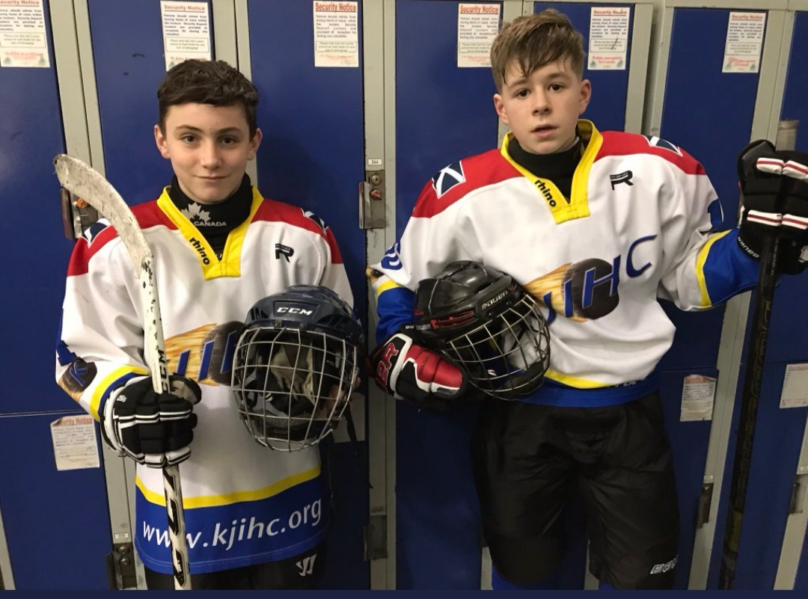
Ollie and Conner: Representing Scotland!

Slide 41
Boxing

Slide 42
Destany: British Gold Champion!

Slide 43
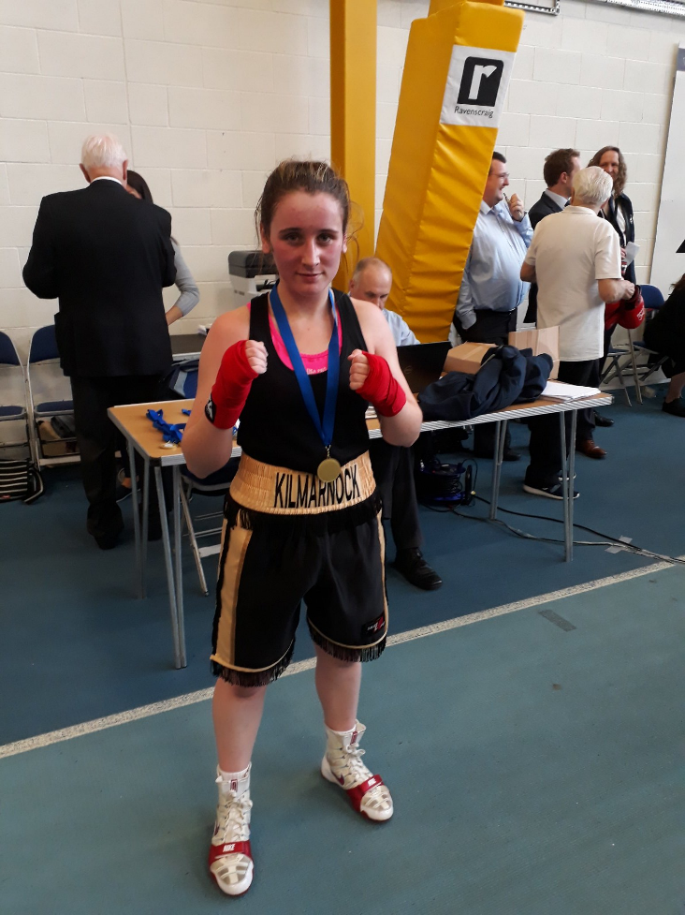
Kilmarnock's 1st female Scottish champion!

Slide 44
Cricket

Slide 45
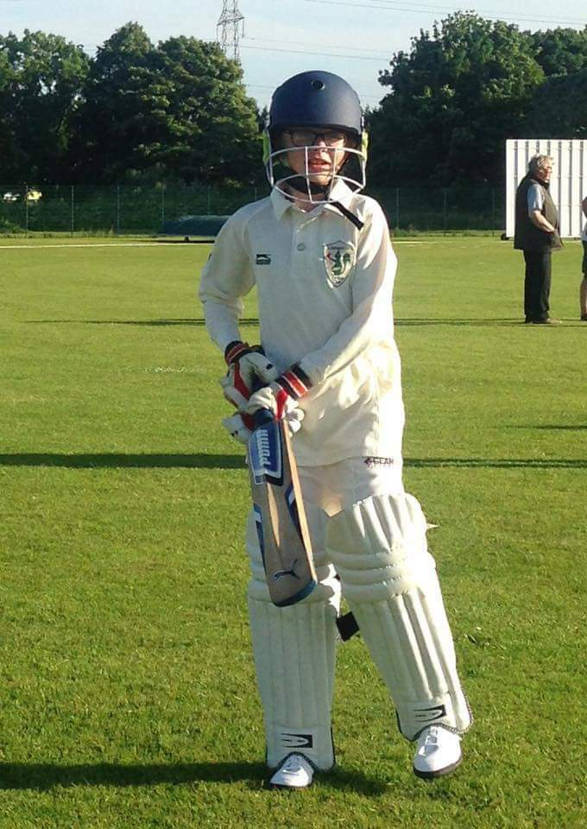
Carmen: 1st Female Captain of KCC Jrs!

Slide 46
Handball

Slide 48
Hiking

Slide 49
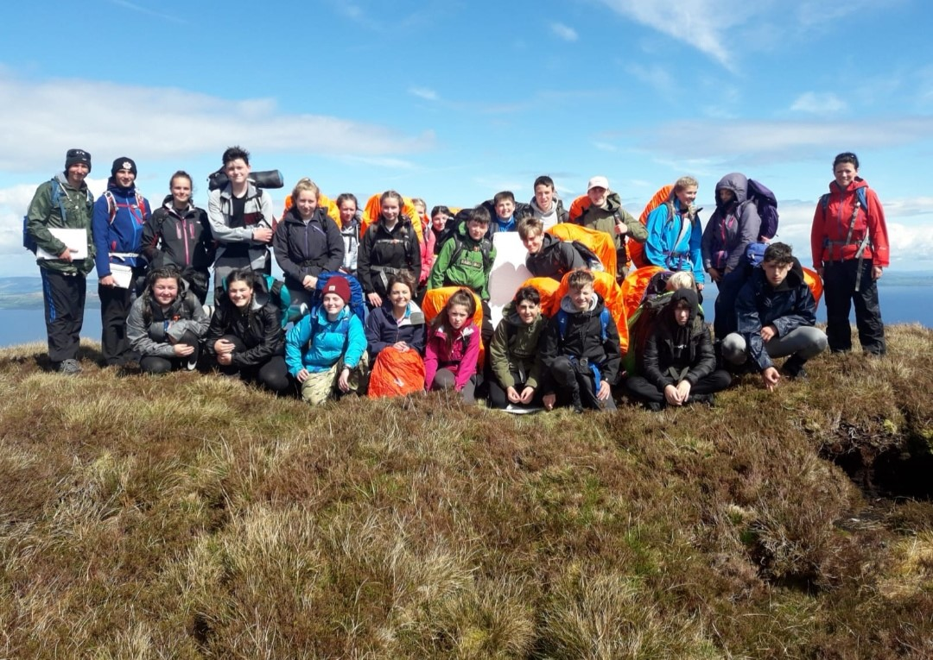

Slide 50
Figure Skating

Slide 51
Libby competed in Australia!

Slide 52
Coaching

Slide 53
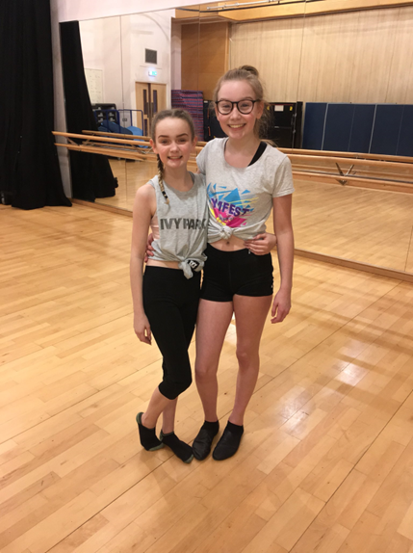
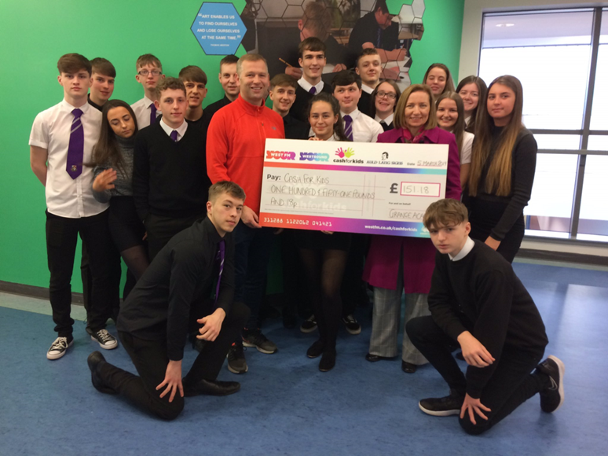
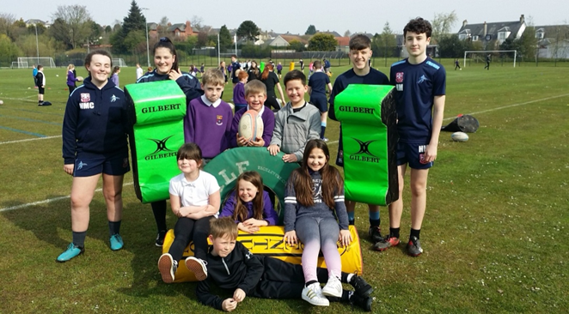
Pupils learning to coach

Slide 54
Rafting

Slide 56
Volleyball

Slide 58
Wakeboarding

Slide 59
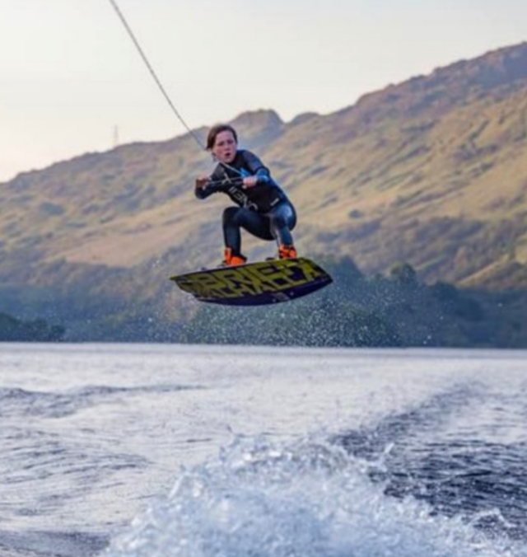
Harvey: ranked 2nd in Scotland! (U14s)

Slide 60
Sailing

Slide 61
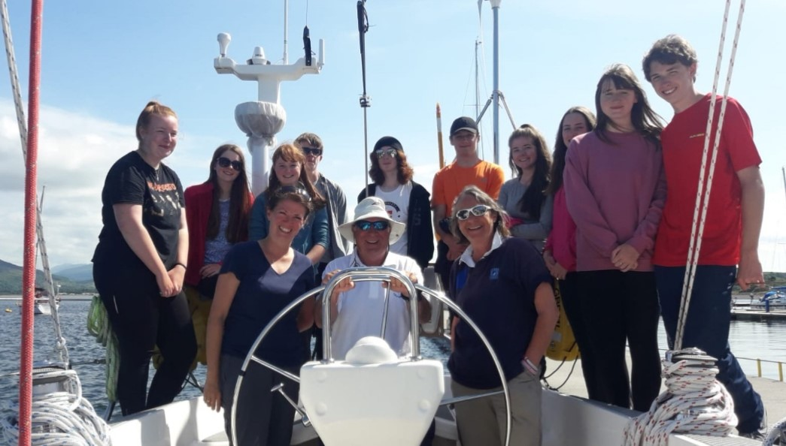

Slide 62
Mud Run

Slide 63
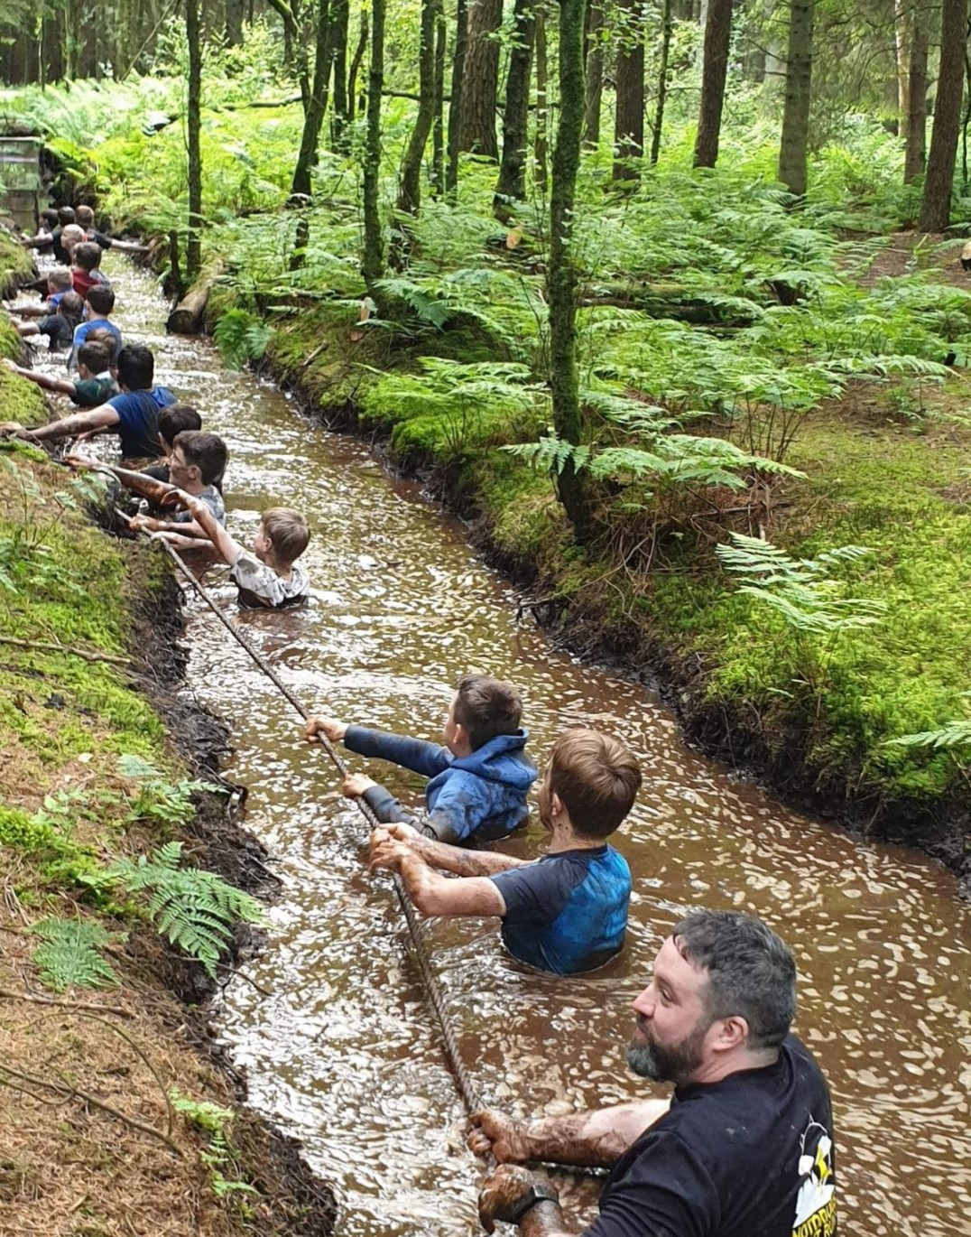
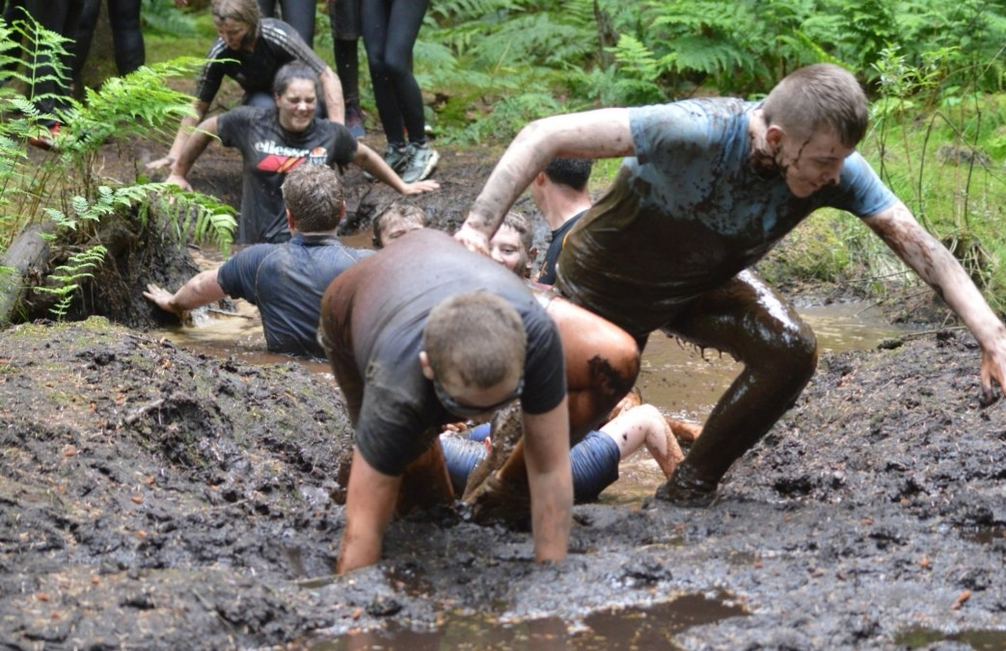

Slide 64
Well done, everyone!

Slide 65
Well done, everyone!

Slide 66
Well done, everyone!

Slide 67
#TheGrangeWay

Slide 68
#TheGrangeWay

