Slide 1


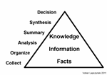






4 Steps to Success
1
2
3
4

Slide 2






4 Steps to Success
4 Steps to Success is a simple and effective process for our students to follow throughout their time at Grange Academy. The 4 steps allow our young people to take responsibility for their learning, as well as providing them with the necessary tools to reach their full potential in each class. We encourage our Grange community to use the 4 steps from S1-S6 to become the person they are capable of being.

Slide 3


Slide 4




My Learning Style
VISUAL LEARNING
SEE IT
AUDITORY LEARNING
HEAR IT
KINESTHETIC LEARNING
DO IT

Slide 5
1. What do you remember most after meeting new people?
A. their face, clothes etc.
B. what they said and how they said it
C. something they did
2. If you have to give directions to get somewhere, what do you do?
A. draw a map and describe important landmarks
B. tell them bit by bit (go left, then turn right)
C. rely on hand gestures to show them
3. In your free time which do you prefer?
A. watch TV or a film
B. listen to music or talk with friends / family
C. sport / outdoor activities

Slide 6
4. When you think of your earliest memories what are they mostly of?
A. things you saw
B. things people said
C. things you did or felt
5. When you are trying to concentrate, what distracts you most?
A. an untidy room, things on the wall etc.
B. talking and other noises
C. other people moving around
6. How do you try to remember things like phone numbers?
A. write them down
B. say them out loud a couple of times
C. use them over and over again

Slide 7

Mostly A
You’re a great watcher!
You prefer working with pictures, diagrams and mind-maps.
You prefer to read the instructions before doing a task.
You probably prefer to make a ‘to do’ list or other plan before getting on with a task.
Sometimes you might bogged down in too much note-making and planning.
You could use phrases like ‘show me’ and ‘let’s have a look at it’ to understand better.

Slide 8

Mostly B
You’re a great listener!
You prefer to be told the instructions rather than read them.
You will often work best after listening to instructions.
You may often say or even sing something to yourself to remember it.
Sometimes you might find it hard turning things you’ve talked about into writing.
You could use phrases like ‘tell me’ and ‘let’s talk it through’ to understand better.

Slide 9

Mostly C
You’re a great doer!
You work best when touching, holding, moving, making, shaping etc.
You tend to find new tasks easier by trying them out and learning as you go.
You may find it easier to just get writing and check it over as you go - rather than planning it out first.
Sometimes you might find it hard to organise your ideas and keep a clear head.
You could use phrases like ‘let me try it out’ to understand better.

Slide 10
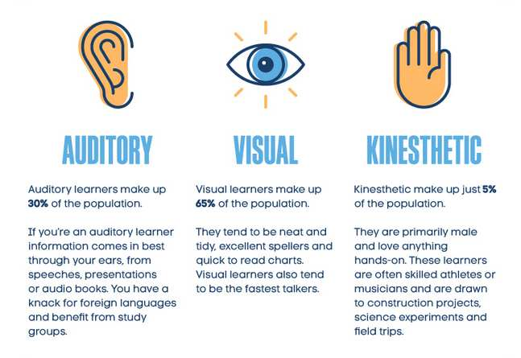

Slide 11




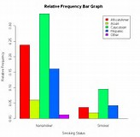


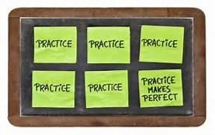
Learning Styles
Papers
Listening to recordings
Visual
Auditory
Prototyping
Graphs
Kinesthetic

Slide 12

Step 1: Understand it
Remember there is always support on offer at Grange Academy, but it is your responsibility to ask for support to ensure you understand the work before moving on. Don’t be embarrassed to ask for help and don’t think of supported study as an inconvenience. Take the opportunity to boost your confidence and make the most of the resources available to you.

Slide 13
How can I help?
Engage your child in regular discussion regarding what they learn each day. Articulating new concepts can aid with understanding.
Look at class notes and discuss new ideas with your child. You may ﬁnd that a one – to – one discussion will help with their understanding of a new concept.

Slide 14

Step 2: Condense it
Condensing information is a fun and effective way of learning and memorising key information. Like a jigsaw puzzle, it’s important to look at the whole picture first, but you must focus on small pieces at a time. Condensing your notes will enable you to work smartly. Those of you in S4, S5 and S6 will find that condensing your class notes will help you to prepare for your Prelims and final exams.

Slide 15

How can I help?
Encourage your child to create a calm and comfortable environment before they condense their notes. Relaxation is key to studying smartly!
Set a goal with your child and praise their progress on a regular basis. This should help to create a positive mind-set.
Encourage your child to stick to their study timetable and monitor their progress. You can create a free study timetable at www.getrevising.co.uk/planner or www.sqa.org.uk
Encourage your child to condense their notes using a range of methods. I’ll talk you through some of these on the following slide.

Slide 16

Step 2: Condense it
Highlighting information
Highlighting key information is a useful tool for condensing notes, but often your page ends up covered in coloured ink and it can be difficult to decipher what the key information is.
Top tip: Select 3 colours and use only these 3 colours for highlighting. Use each colour to highlight the theme, main ideas and then the detail.
Hurricanes are one of the most powerful forces on earth. They are the combination of swirling wind, clouds and rain. The extraordinary power of these storms damages more property than all other kinds of storms. Trees are uprooted and roofs are ripped off the tops of buildings. Power poles crash to the ground causing power failure.

Slide 17


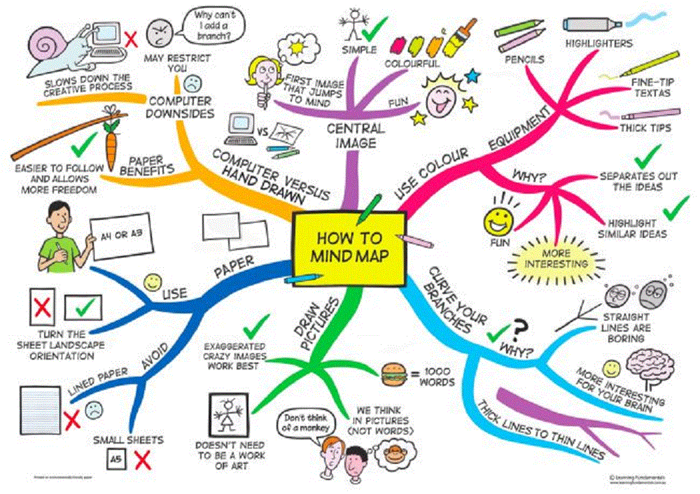
Step 2: Condense it
Mind maps
Mind maps are a useful way to present information visually, usually with a central idea placed in the middle and associated ideas arranged around it. You can include images and written text to display your condensed notes.
Top tip: Adding colour and images to your mind map will help you to memorise key information and will mean that your finished piece is more eye catching when displayed on your wall or classroom.

Slide 18


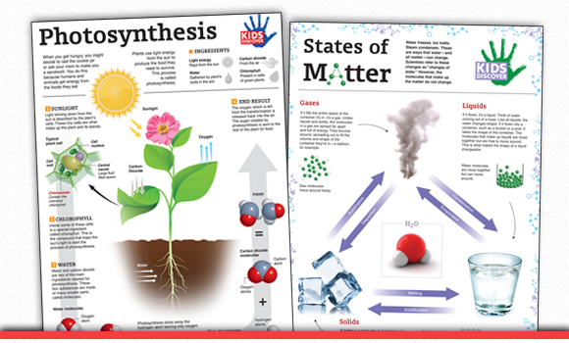
Step 2: Condense it
Posters
Creating posters might seem childish but it can be a really effective way to condense your notes. Posters provide you with the freedom to be creative and can enable you to focus on small units of work at a time.
Top tip: Create a poster after each unit of work and display them around the classroom or your bedroom. It’s easier to retain information when you look at it everyday.

Slide 19


Step 2: Condense it
Recorded notes
Do you remember the lyrics to your favourite song? Well, that’s because music often provides escape for a wandering mind. Our brains react to patterns and repetition of sounds. Recording your notes on your phone can be just as effective as writing them down.
Top tip: Recording your notes in the form of a song or rap can improve your retention. If Jay Z can do it, so can you!
Recording on an iPhone
Open the Voice Memos app. You can find this on one of your Home screens. It may be in a folder labelled "Extras." You can also hold the Home button to launch Siri and say "Record a voice memo" to start the app.
Tap the Record button to begin recording. This will immediately begin recording using your iPhone's microphone.
Tap the Record button again to pause the recording. You can pause and restart your recording as many times as you'd like.
Tap "Done" after stopping a recording to save it. You'll be prompted to give the recording a name. Type a name and tap "Save" to save it to your list of recordings.

Slide 20

Step 3: Memorise it
It’s a well known fact that memory has an important role to play in the development of our learning. We need to remember key information in order to develop essential skills and a good memory enables us to build on our prior learning. You can’t complete homework if you don’t remember the information you have been taught and exam situations can be very stressful if you haven’t memorised how to structure each answer. You will be delighted to hear that there are various memory techniques which can aid your learning. Use these throughout your time at Grange Academy and find the best technique for you.

Slide 21

How can I help?
Encourage your child to complete past papers on a regular basis.
Test your child on their knowledge on a regular basis.
Monitor homework via Show my Homework and ensure that your child meets the deadline.
Encourage your child to try different memory techniques. I’ll talk you through some of these on the next few slides.

Slide 22
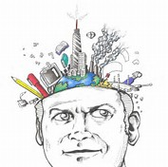

Step 3: Memorise it
Image chains
This is a simple and imaginative way to remember lists or words. You simple take each item on the list and link them together using a story. You could create a story using text or images.
Top tip: This will work particularly well in subjects where you are expected to remember subject specific terminology. Wacky stories are easier to remember.
Task
Spend 2 minutes looking at the words listed below, then take the slide away and try to write down the words you can remember.
The Queen alarm shop chips chip sunflower button hat monster munch yellow dress little boy hammer dog cheese roll keys 1666

Slide 23

Step 3: Memorise it
Using the image chain
Now let’s put our image chain theory to the test. I have created a wacky story using all 20 words and I’d like you to read through the story several times. Repeat it in your head and out loud before removing the slide.
Discussion
How many words did you remember?
Did you find it difficult to remember more than 10?
The Queen worked in a chip shop called Monster Munch. The Queen was required to wear a hat with a sunflower on it and a dress with a yellow button at the bottom. One day a little boy arrived with his dog called Hammer and ordered a roll and chips and cheese. The alarm went off as he finished his order so the Queen had to grab her keys and enter the code 1666.

Slide 24










Step 3: Memorise it
I couldn’t forget those visual learners! Here’s another example of how this works.
MONSTER MUNCH
Hurry up Hammer
Phillip!
1666

Slide 25


Step 3: Memorise it
The Enigma System
Become a spy by creating your own code system, where every number translates to a letter. Then unleash your imagination to create words and phrases to help you memorise the numbers.
Top tip: This works really well if you need to memorise dates or formulae.
Example
1 2 3 4 5 6
A B C D E F
The great fire of London happened in 1666. Using the code 1666 translate to AFFF. You could remember this as A Flaming Ferocious Fire!
Try it!
Create your own Enigma system. Your numbers and dates don’t need to appear in order, so your code can be as original as you like!

Slide 26

Step 4: Review it
Revision probably conjures up many negative images in your head and that’s why I want you to rethink how you study. You should focus on reviewing your work throughout the year, rather than revising your work just on the build up to the exam. When we learn something new links are formed between the neurons in the brain, and when you use a memory technique, it makes the connections even stronger. But over time those connections will start to fade if you don’t use them from time to time. Consistent reviewing will help you to strengthen those connections. Let’s agree to think of our study as the process of reviewing and not revision.

Slide 27

How can I help?
Read feedback with your child and discuss steps they can take to improve.
Use show my homework and encourage your child to check it on a regular basis.
Access past papers via the SQA website and make use of the marking schemes at home. This is your opportunity to look at the coursework closely.
Encourage your child to attend supported study.

Slide 28
Step 4: Review it
Using past papers
Completing past papers is another way you can review your work and progress throughout the year. S4-S6 can access past papers and marking schemes on the SQA website. You can also access mini assessments and quizzes on BBC Bitesize. Have a look at the links below and discuss how you could use the sites to your advantage.
www.sqa.org.uk
www.bbc.co.uk/education

Slide 29


Step 4: Review it
Creating a study plan
Don’t wait until the last minute to create a study plan. Create a weekly or monthly plan with allocated time to review each subject, as well as, rest and relaxation or sports and hobbies. You don’t need to be in S4-S6 to follow a study plan!
Top tip: Stick your plan to your fridge and encourage people at home to make you accountable for your plans.
If you’re feeling creative, you can create a timetable using coloured pens and pencils. Alternatively, you can create a free study plan by following the link.

Slide 30
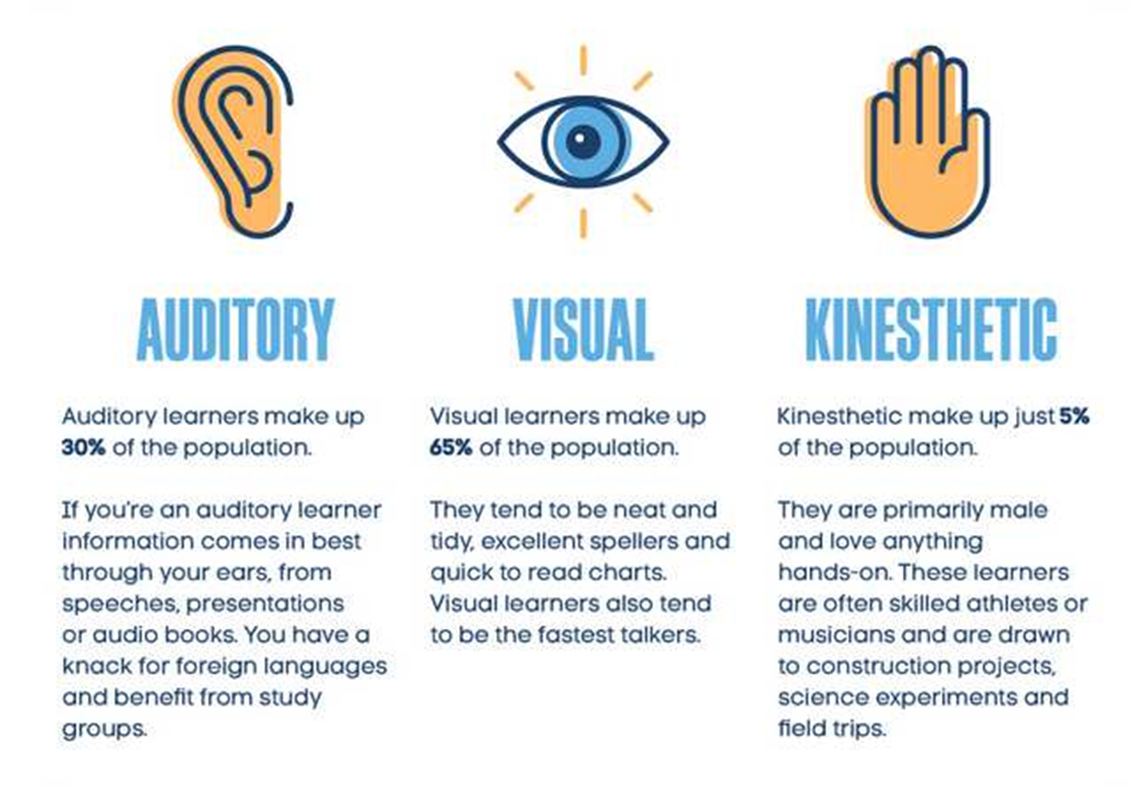
Useful advice
Work with your child to establish their learning style and discuss how can study effectively.

Slide 31
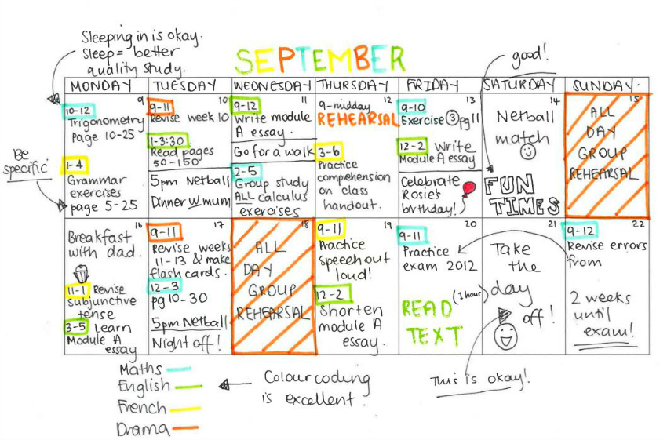
Useful advice
Create a study plan with your child. This can be changed on a weekly or monthly basis.

Slide 32

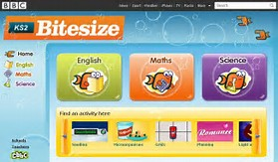

Useful advice
Take a look at the resources available to you and save them in your favourites folder.
www.showmyhomework.co.uk/login
www.sqa.org.uk
www.bbc.co.uk/education

