Slide 1
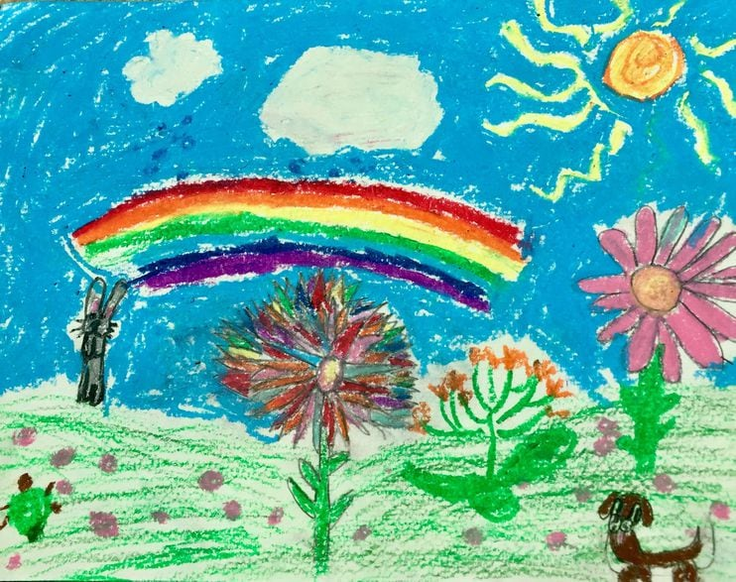
The Weather Massage

Slide 2
The massage is done on the back, over clothes, and the person giving the massage always asks permission to the person receiving the massage: “Can I give you a massage?” At the end the giver always tells the receiver: “Thank you for allowing me to give you a massage”

Slide 3
Spoken Words (story)
“Once upon a time there was a big, yellow sun that warmed the whole earth. | With one hand on the shoulder, take the other hand and make a circle on the back.
And from the middle of the sun, sunrays reach out and touch all parts of the world. | Make sunrays to the sides.
But look! Clouds appear and cover the sun. | Make small circles with finger pads.
Movements

Slide 4
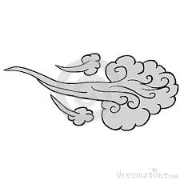
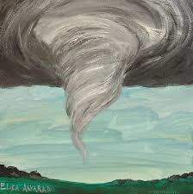
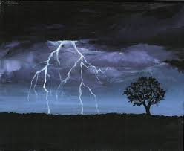
Then the wind comes and it blows harder... and harder... and harder | Move hands from side to side...harder and harder.
...until the wind turns into a tornado and a hurricane! | Begin at shoulders and make tornado-like strokes with finger pads.
Then comes lightning... | Make lightning with fingertips.

Slide 5
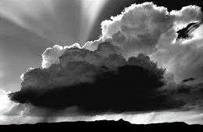
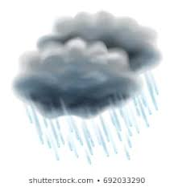
...and thunder. | Clap the back with hands.
It begins to rain...and it rains harder...and harder. | From the shoulders, stroke down with finger pads...faster and faster.
The rain turns into hail. | Play with fingertips on back.

Slide 6
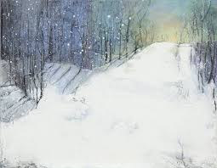
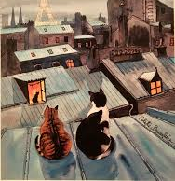
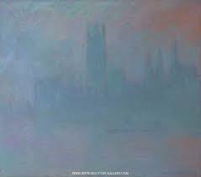
And then it begins to snow, and everything is white and beautiful. | Press lightly with fingers slowly over back.
And the only thing you see is the cat climbing up onto the roof of the house...and another cat...and a third cat. | Climb up back toward neck by first using palm of hand, then rolling the hand upward, first up one side, then the middle of the back, then the other side.
The cats sit on the roof and watch as the fog appears and everything becomes still... and quiet. | Resting hands on shoulders

Slide 7
Until the sun comes out, burns away the fog, and warms up the earth once again.” | Begin at centre of back and slowly make a circle, getting bigger and bigger.
After the massage, the person giving the massage always thanks the person receiving the massage;
“Thank you for letting me give you a massage”
http://misascotland.org.uk/

