Slide 1
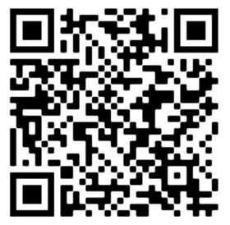
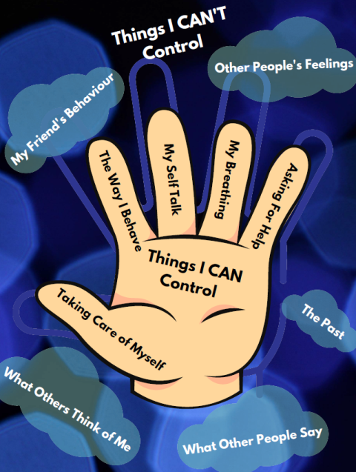
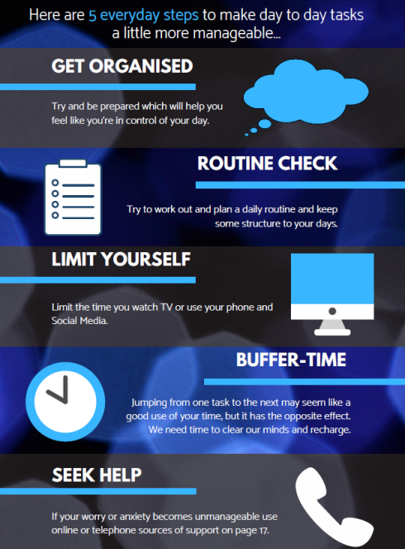
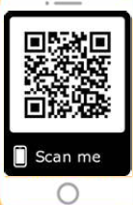
A GUIDE
YOUNG PEOPLE
for
A creative self help guide to staying healthy and happy
https://www.nhsaaa.net/media/9654/a-guide-for-yp-mh-wellbeing-6-mb.pdf
Printed copies of the booklet available from HIRS Tel. 01292 885927
10 ways to improve your mental health and wellbeing
www.nhsaaa.net/better-health

