Slide 1
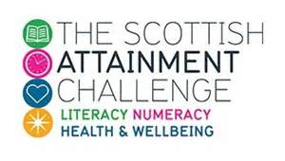
Phonological Awareness for Parents & Carers
Scottish Attainment Challenge
Speech & Language Therapy
in East Ayrshire

Slide 2
Voice Clips
Wherever you see this symbol…
… double-click or hover over and press play to hear more information

Slide 3
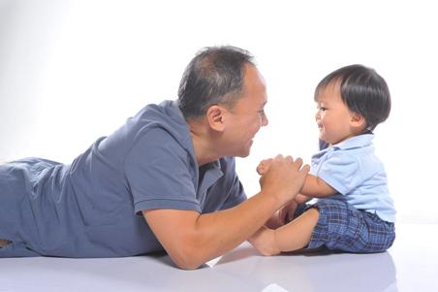
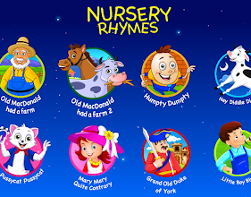
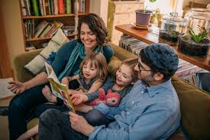
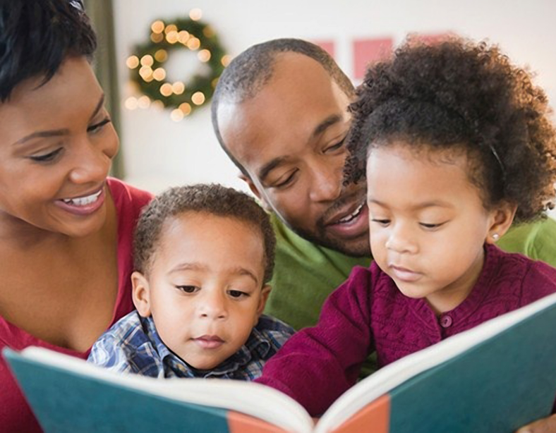
How does Phonological Awareness develop?

Slide 4
Why is Phonological Awareness important for my child?

Slide 5
Why is Phonological Awareness important for my child?
Phonological Awareness
Phonological awareness is the first building block when beginning to read
It is one of the 5 components children need to support their growth in reading skills
Children need to be taught to hear sounds in words and that words are made up of the smallest parts of sound, or phonemes
Phonics
Fluency
Vocabulary
Comprehension Strategies

Slide 6
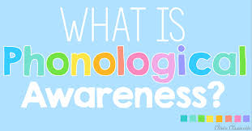
Phonological Awareness
At a Glance
Phonological awareness is the ability to recognise and work with sounds in spoken language
Phonological awareness is the foundation for learning to read
Some children pick it up naturally but others need to be taught

Slide 7
What is Phonological Awareness?
In most children, an awareness of the phonological structure of speech generally develops gradually over the pre-school year
Books based on rhyming and alliteration are fantastic for developing phonological awareness for babies, toddler and pre-schoolers
By late pre-school, if taught, many children can hear all the different phonemes (sounds) in words
Phonological awareness is required before a wee one can begin matching letters to sounds (phonics)

Slide 8
Phonological Awareness
To summarise:
When a child has good phonological awareness skills, they know that sounds are the building blocks of words

Slide 9
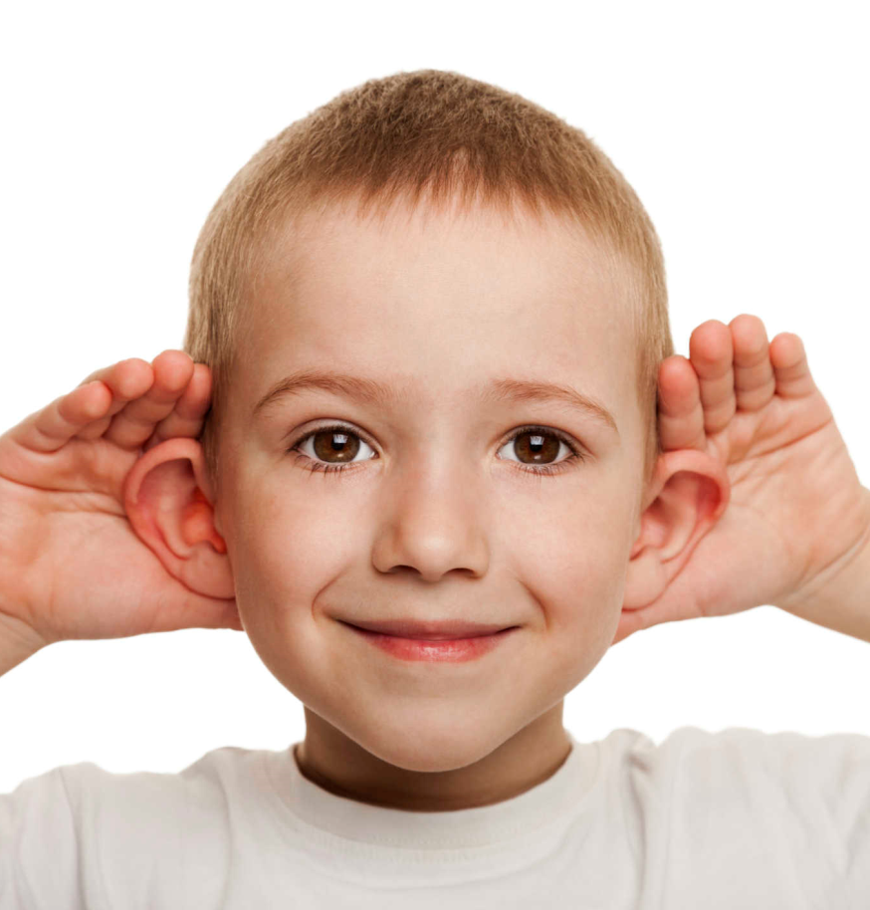
Children with secure
phonological awareness can:
identify and make oral rhymes
clap out the number of syllables in a word
recognise words with the same initial sounds & same final sounds
Segment and blend phonemes to break & make words
Notes:
Basic listening skills and "word awareness" are critical precursors to phonological awareness.
Phonological awareness is an important determiner of the success in learning to read and spell. Effective readers have strong phonological awareness, whereas poor readers are weak in this area. The levels of phonological skill in preschool children strongly predict how well and how quickly children will develop reading skills.
The relationship between phonological awareness and reading acquisition is complex, there is strong evidence to suggest that difficulty with manipulation of verbal sounds inhibits the ability to read.
In addition, interventions aimed at improving phonological awareness lead to significantly improved reading skills, proving that phonological awareness can be taught.

Slide 10
Ages of Phonological Awareness development
being able to spot rhyme
4 +
being able to divide words into syllables
identify alliteration (words that start with
the same sound)
identify the beginning sound of a word
identify the last sound in the word
3 years
6 months
﻿
Notes:
Talk through slide
.

Slide 11
Ages of Phonological Awareness development
5 +
being able to put a word together when it has been broken down into sounds: blending
6 +
manipulating sounds
what word do I make now?
being able to break down a word into the individual sounds: segmenting
e.g. if I had a ‘rat’ and swapped the ‘r’ sound for a ‘h’
﻿
Notes:
Talk through slide. As with all children there will be differences in how they progress through the stages.
.

Slide 12
Quick check for Phonological Awareness
Here are six skills that indicate that your child has developed phonological awareness:
Your child is able to rhyme. If you say the word bat, your child can respond with words that rhyme like hat, sat, mat, or cat
Your child understands word boundaries. If you say the sentence Don’t let the cat out, your child is able to separate the sentence into five individual words
Your child can clap syllables. If you say dog, your child knows to clap once. If you say umbrella, your child knows to clap three times

Slide 13
Quick check for Phonological Awareness
Your child can blend sounds to make a word. If you say the sounds sh…eep, your child can respond and say the word sheep
Your child can identify the beginning sound in a word. If you ask your child to say the first sound in pig, your child is able to respond with the sound /p/
Your child can identify the ending sound in a word. If you ask your child to say the last sound in the word jam, your child is able to respond with the sound /m/

Slide 14
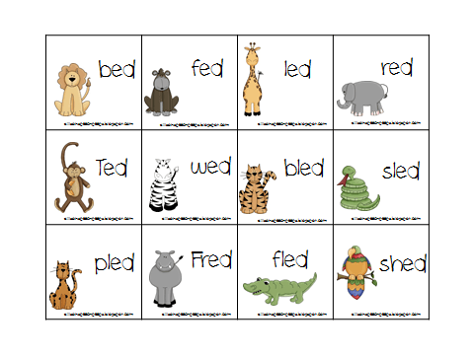
Don’t worry if your wee one hasn’t developed these skills quite yet! There are lots of fun ways to support them
Tasks and activities targeting phonological awareness lead to significantly improved reading skills

Slide 15
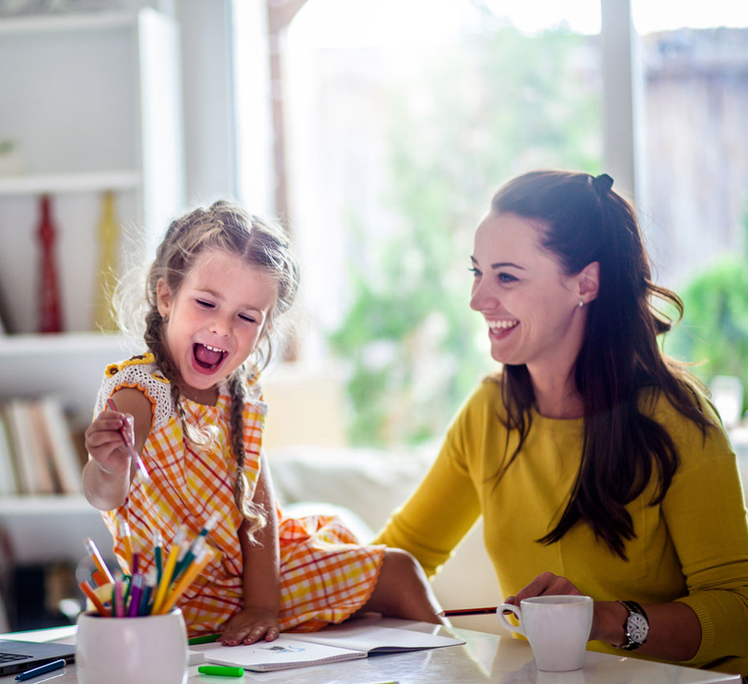
How can I help my wee one with their Phonological Awareness at home?
If your child hasn’t yet acquired the skills on the checklist above, you can help her develop them through informal activities such as listening to great books and playing oral language games
Here are a few ideas for you!

Slide 16
Read lots of great rhyming picture books!
Head to your local library
Ask the librarian for some rhyming book suggestions
Snuggle up and read them together
Point out and talk about the rhyming words
e.g. “Listen… frog & log… they sound the same… they rhyme”

Slide 17
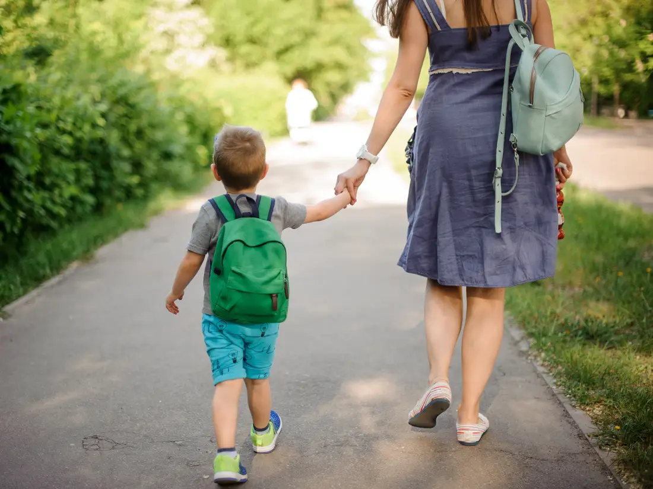
Practise listening to & talking about sounds
“I spy” using sounds instead of letters
e.g. something that begins with the sound /f/ - phone, fish
Go on a sound walk:
What sounds can we hear?
How many things can you find that begin with...?

Slide 18
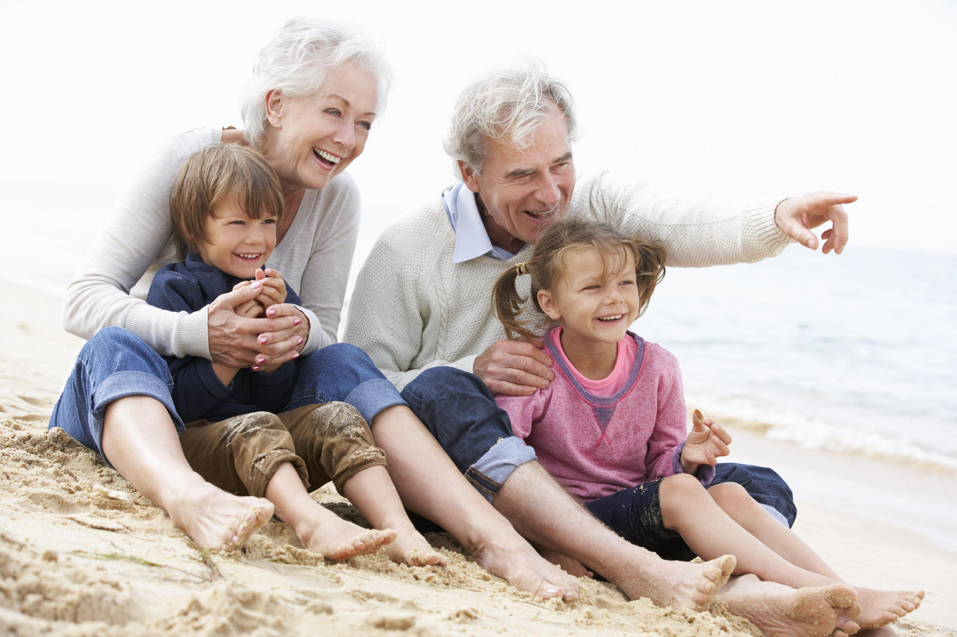
Practise listening to & talking about sounds
Use different situations at home and out and about, to point out objects and pictures which end with the same specific sound
e.g. “book & cook have the same sound at the end, /k/. Can you hear it?”
Books: point out and emphasise the beginning & ending sounds in words when you are reading books together

Slide 19
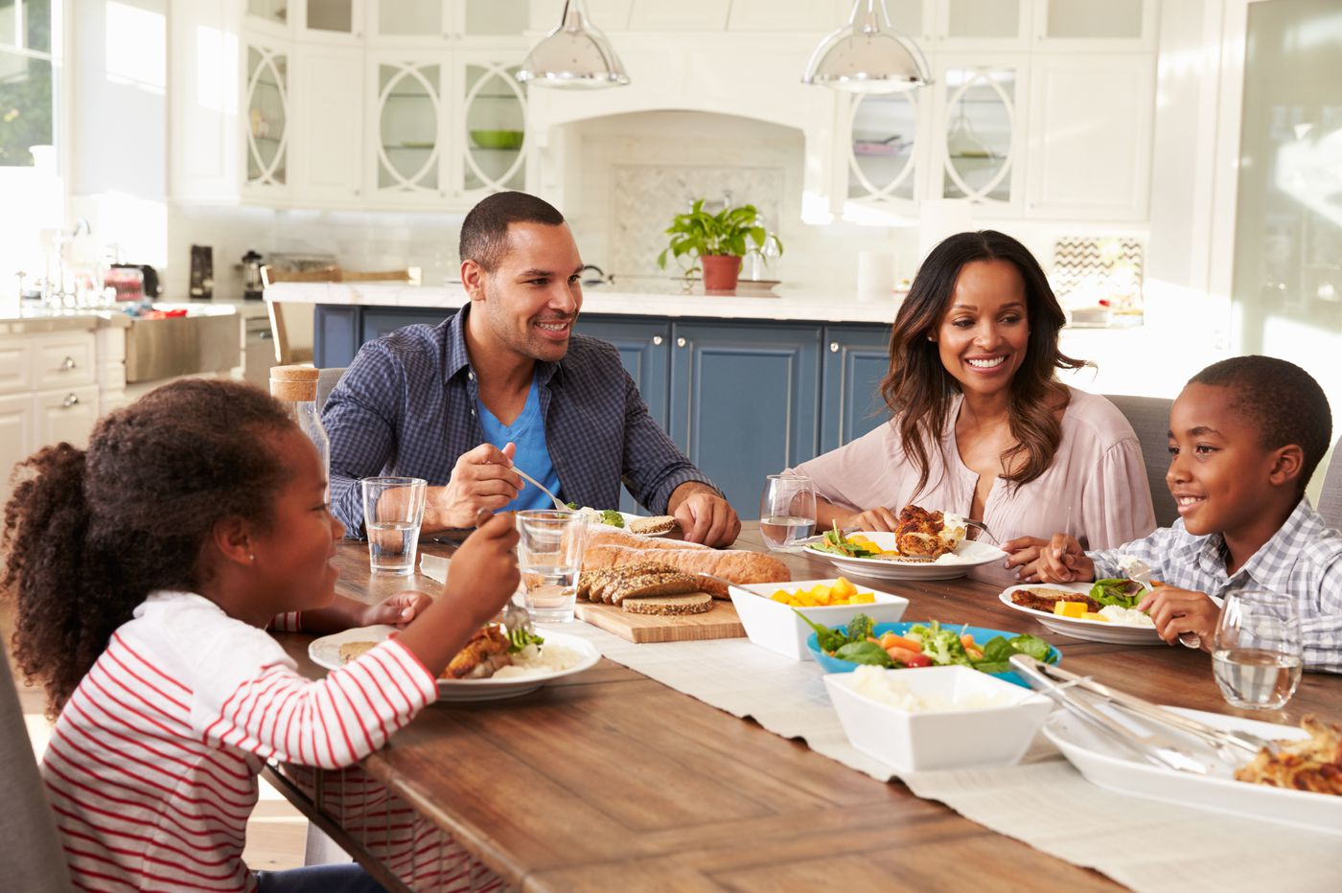
Syllables
Turn mealtime into practice time
At mealtime, use the food on your plate as inspiration for a syllable counting game
One at a time, each family member announces what he is eating. As you say what you’re eating, playfully break up the words into chunks
e.g. “I’m eating an a-pple!” “Would you like some spa-ghet-ti?” “Please pass the sal-ad.“

Slide 20
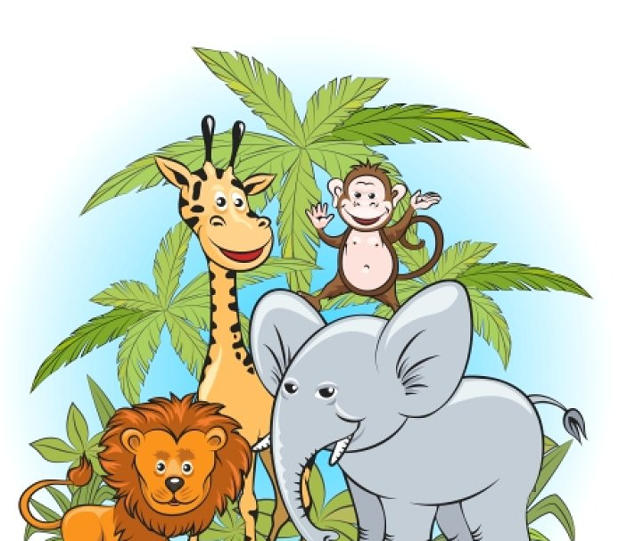
Syllables
Play “going to the zoo.”
Take turns calling out animal names and, if possible, the sounds they make. Then everyone can jump, beat, or clap to the syllables
e.g. “I went to the zoo, and I saw a kan-ga-roo.” “I went to the zoo, and I saw a ze-bra!” “I went to the zoo, and I saw a tur-key, and the tur-key said, gob-ble-gob-ble!”

Slide 21
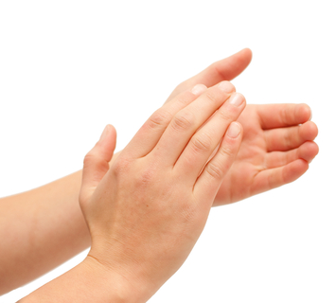
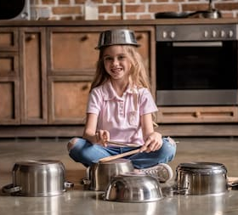
Syllables
Sing simple songs or nursery rhymes that your child knows
e.g. “Mary Had a Little Lamb.” Clap out each beat in the song like this: “Mar – y – had – a – lit – tle – lamb – its – fleece – was – white – as – snow.”
Or you could try beating out the rhythm on a homemade drum (box and spoon, or a saucepan and chopsticks)
Call it music class, and work on it a little each day

Slide 22
Syllables
Play a robot game with your child
Your child gives you a word, and you say it in your best robotic voice, separating the syllables
Then switch roles—you give your child a word to try
Have a contest to see who can sound the most like a robot!

Slide 23
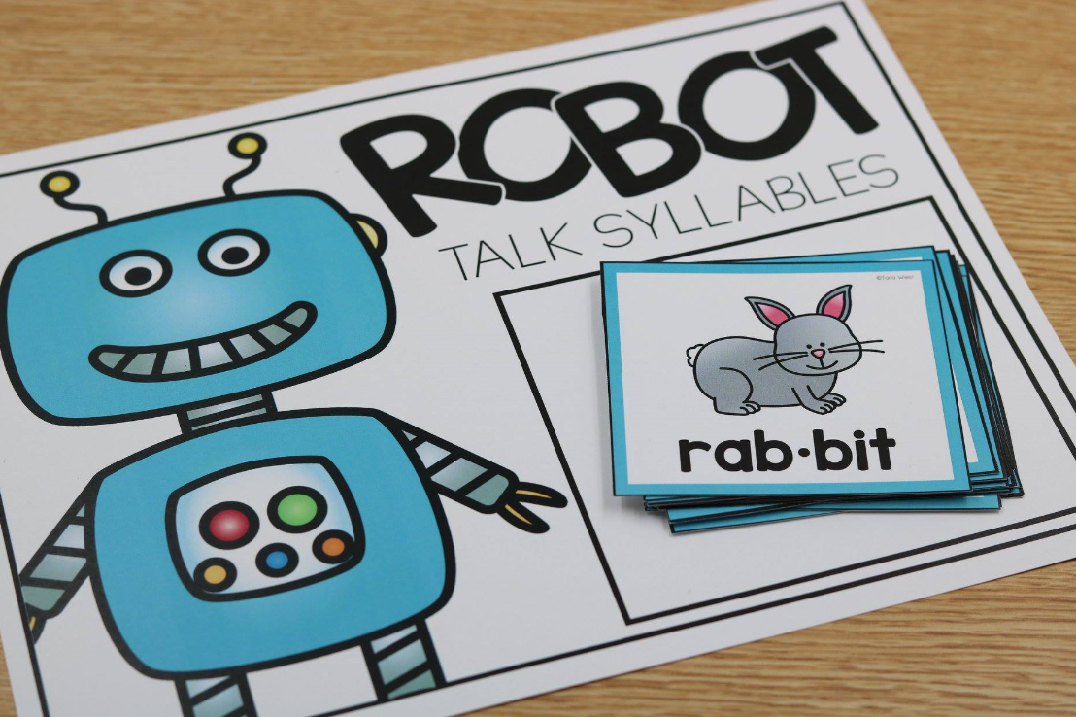
Syllables

Slide 24
Phonological Awareness Activities
Videos, information
and activities
https://highlandliteracy.com/
emerging-literacy/phonological-awareness/
Notes:
Example of activities

Slide 25
Phonological Awareness Activities
Downloadable file
http://www.essexlocaloffer.org.uk/file/
ultimate-guide-phonological-awareness/

Slide 26
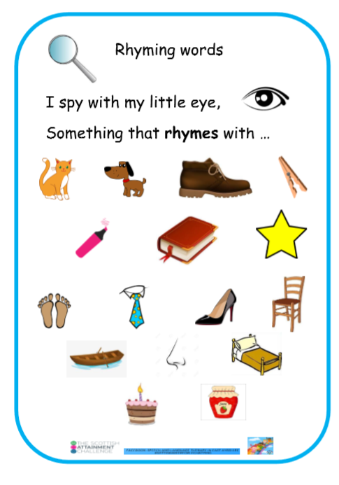

Slide 27
Have fun!
The most important thing is to make
phonological awareness development fun!
Enjoy having special ‘talking times’ with your wee ones
Call us on the helpline for advice,
or contact your wee one’s nursery/school ☺

Slide 28
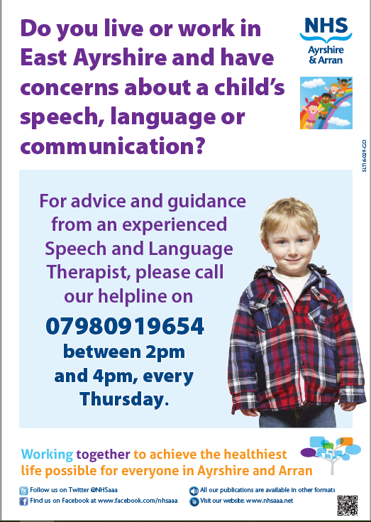
Speech & Language Therapy Helpline 07980919654

